Slide 1
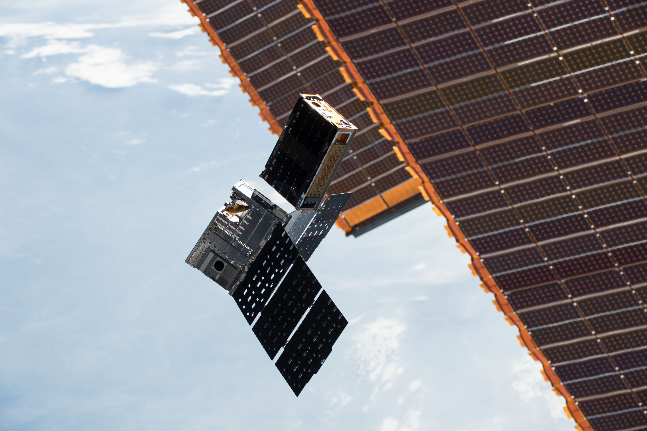
Improving Temporal Sampling of Microwave Sounders using SmallSats/CubeSats: Perspectives from Experience Gained from the TEMPEST-D NASA Earth Venture Technology Mission
Steven C. Reising¹, V. Chandrasekar¹, Christian D. Kummerow¹,
Shannon T. Brown², Todd C. Gaier², Wesley Berg¹,
Sharmila Padmanabhan², C. Radhakrishnan¹, Matthew Pallas³,
Doug Laczkowski³, and Nancy Gaytan³
¹Colorado State University, Fort Collins, CO
²NASA Caltech/Jet Propulsion Laboratory, Pasadena, CA
³Blue Canyon Technologies, Boulder, CO
Many thanks to NASA Wallops for providing ground communications!

Slide 2
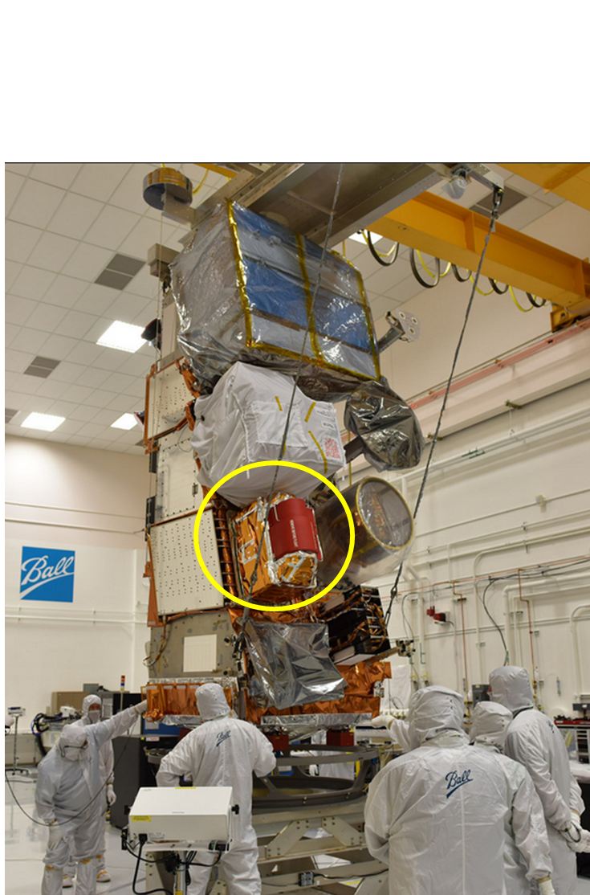
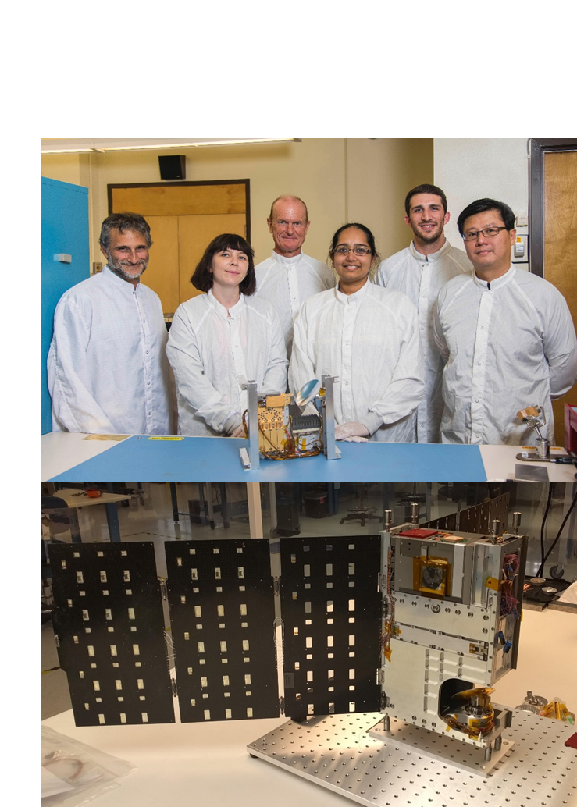
3.8 kg, 6.0 W,
$
75 kg, 100 W,

Slide 3
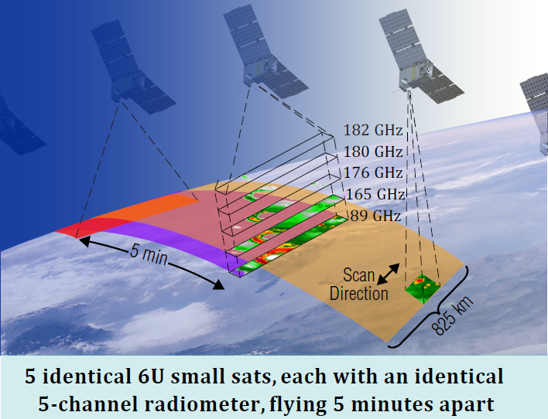
Temporal Experiment for Storms and
Tropical Systems (TEMPEST)
TEMPEST addresses 2017 National Academies Earth Science Decadal Survey: Why do convective storms, heavy precipitation, and clouds occur exactly when and where they do? (Most Important Science Question W-4)
Proposed to NASA Earth Venture Instrument-2 in 2013 as a constellation of 5 identical 6U CubeSats to provide temporally-resolved observations of rapidly-evolving storms every ~5 minutes
Selected as NASA Earth Venture Technology Demonstration mission to deploy a single 6U CubeSat with multi-channel millimeter-wave radiometer; started in August 2015.
TEMPEST-D technology demonstration mission delivered 6U CubeSat in under 2 years; deployed into orbit in July 2018.
Demonstrated first global Earth observations from a multi-frequency microwave radiometer on a CubeSat.
TEMPEST-D planned for 3-month mission; greatly exceeded expectations by providing atmospheric data for nearly 3 years.
TEMPEST-H8 on ISS for 3 years starting on Jan. 8, 2022.
Success of TEMPEST-D and RainCube essential in selection of INCUS as Earth Venture Mission-3, to be launched in 2026.

Slide 4
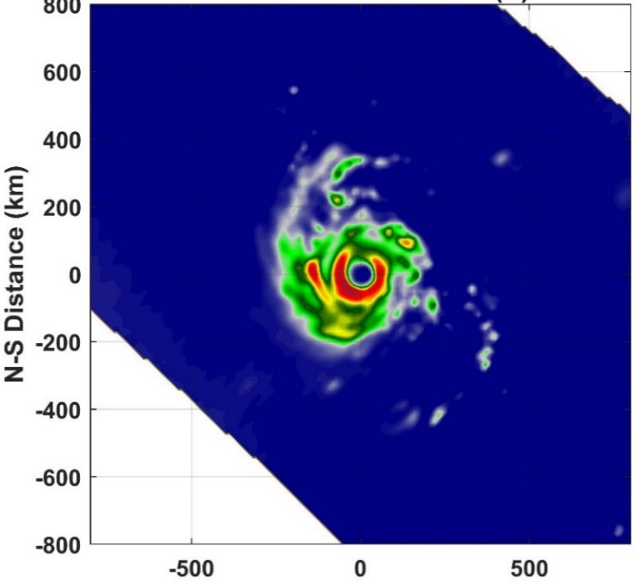
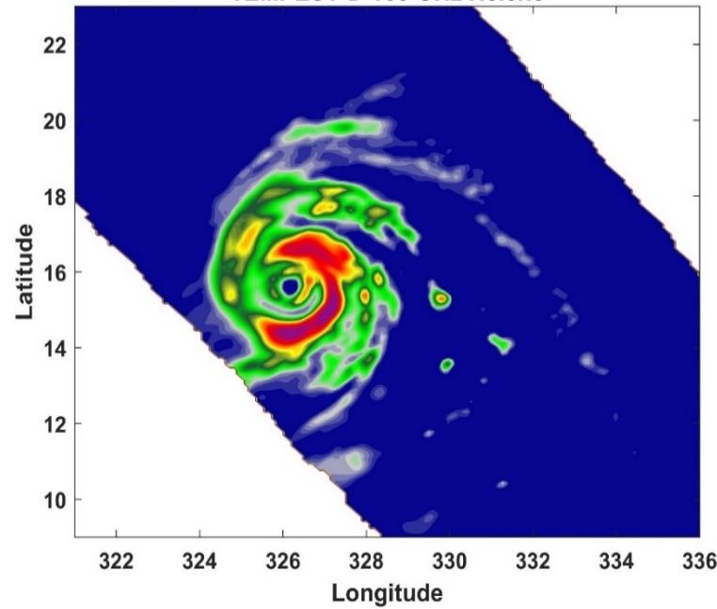
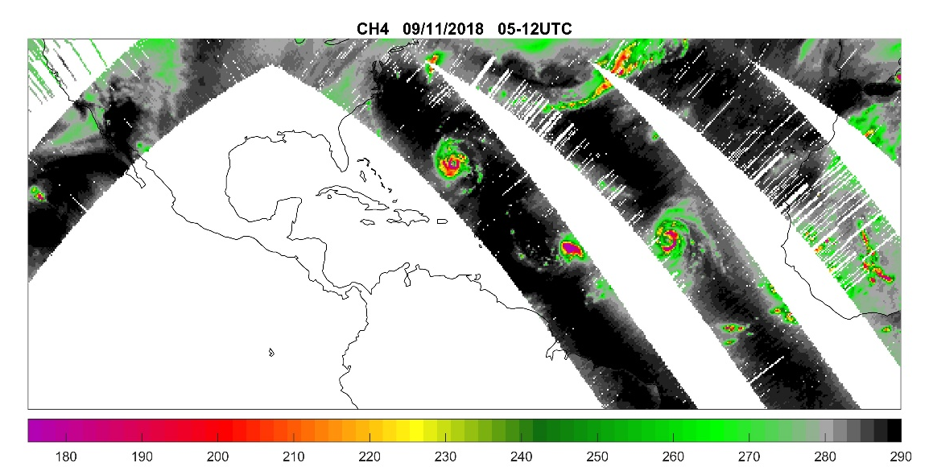
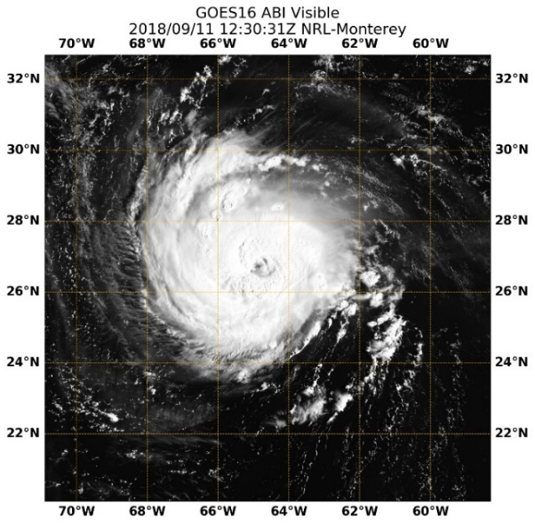
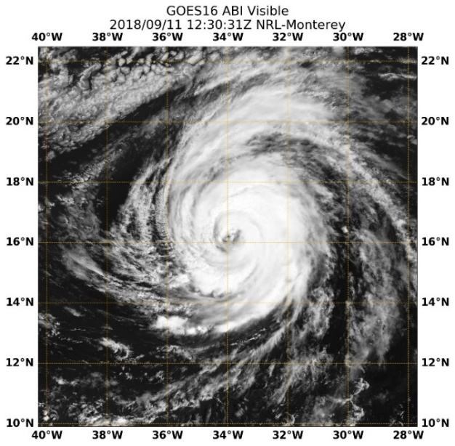
TEMPEST-D Mission: Hurricane Observations during First Full Orbits of Data: Sept. 11, 2018
Hurricane Florence
Hurricane Helene
164 GHz mm-wave Brightness Temperature (K)
Sept. 11, 2018 11:50 UTC
Sept. 11, 2018 10:21 UTC
Florence
Helene

Slide 5
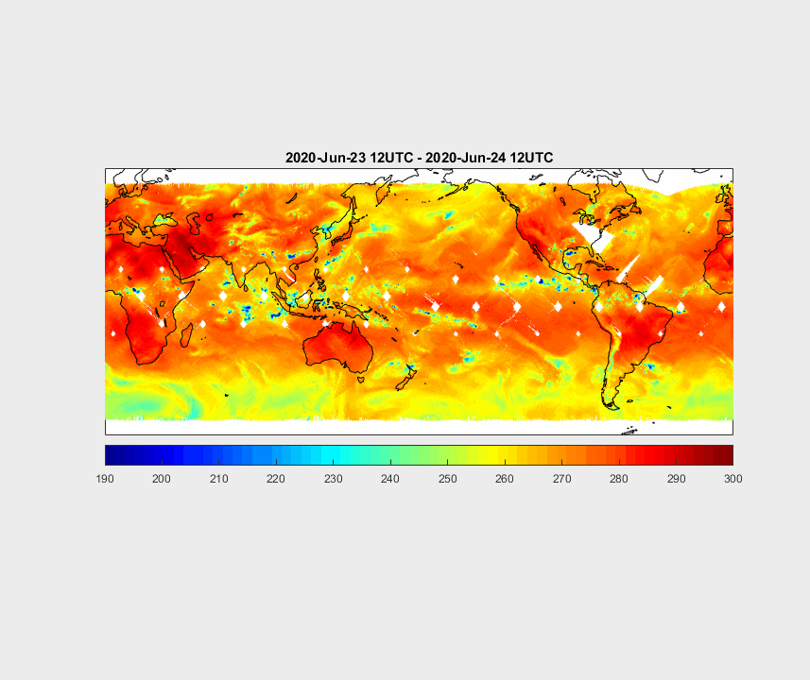
TEMPEST-D Venture Tech Mission: Global Atmospheric Observations at 174 GHz from June 23 to July 3, 2020
et al. IEEE AP-S Symposium & USNC-URSI Meeting, Denver, Colorado July 11, 2022

Slide 6
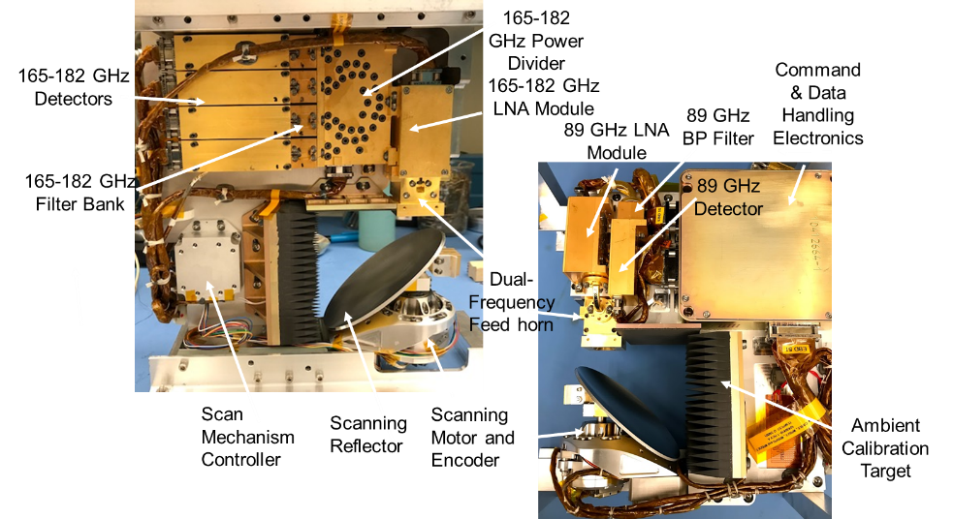
TEMPEST-D Multi-Frequency Millimeter-wave Radiometer

Slide 7
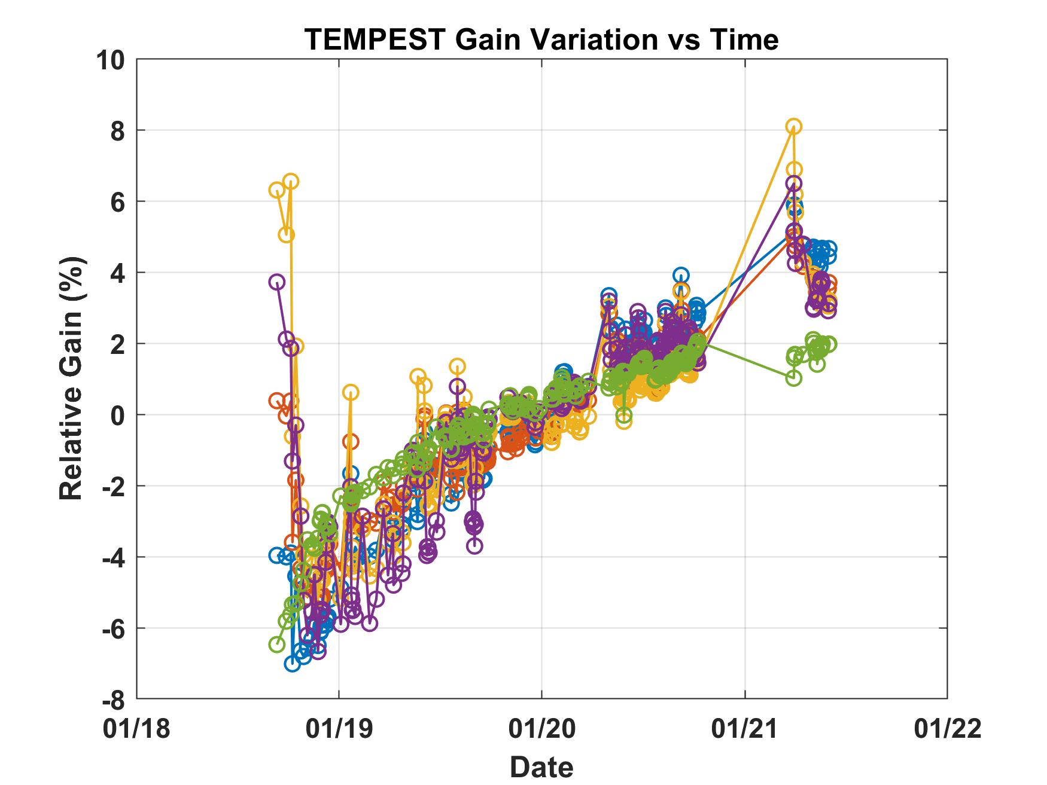
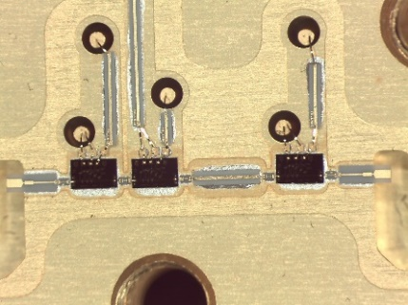
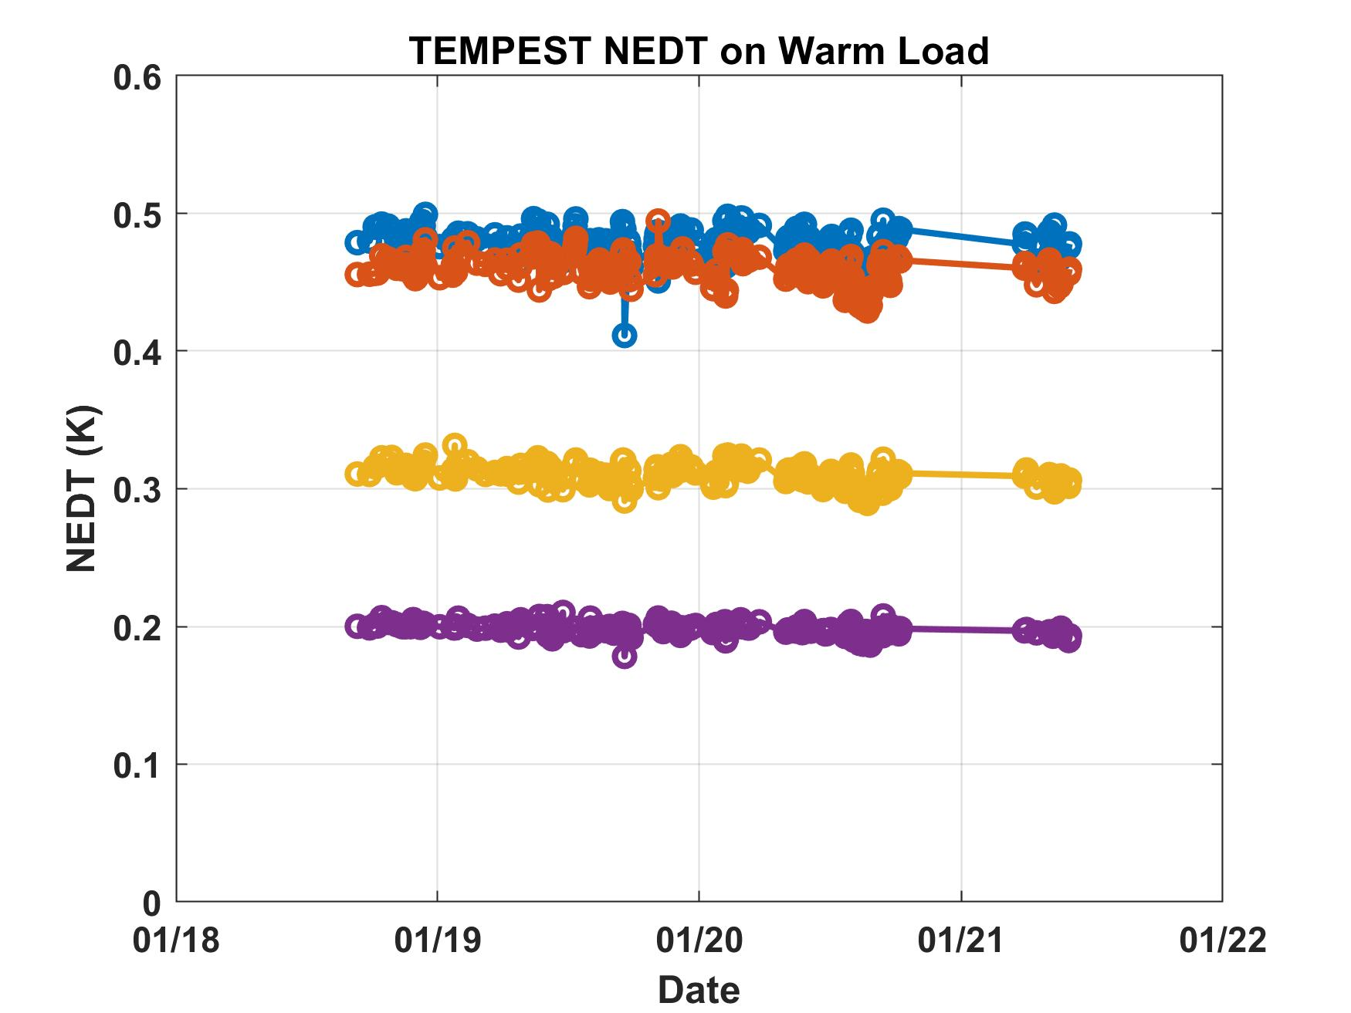
TEMPEST-D Microwave Radiometer Performance
Long mission duration enabled validation of new InP HEMT amplifier technology
Long-term in-space trending reduces risk for use in future operational sensors
Noise and gain were stable over entire mission, even after extended power down
TEMPEST-D demonstrates improved receiver performance over current-generation NOAA operational sensors
178 GHz
@ T_{A} = 300K 18-ms integration time and ATMS Bandwidths | TEMPEST-D¹ | NPP ATMS²
87 GHz | 0.13 K | 0.29 K
164 GHz | 0.25 K | 0.46 K
174 GHz | 0.2 K | 0.38 K
178 GHz | 0.25 K | 0.54 K
181 GHz | 0.7 K | 0.73 K
174 GHz
164 GHz
87 GHz
¹ Equivalent NEDT for ATMS bandwidth/integration time; ² Kim et al., 2014

Slide 8
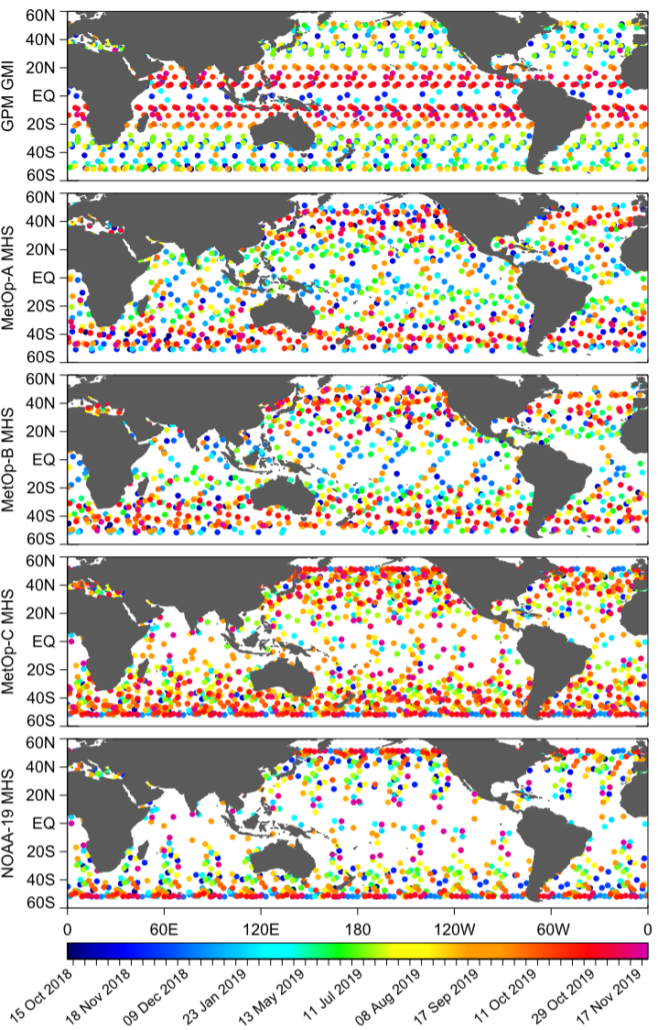
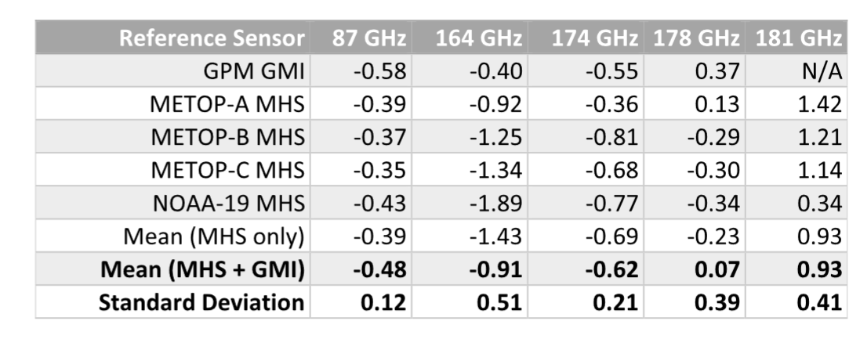
TEMPEST-D Validation: Reference Sensor Coincident Overpasses
TEMPEST-D observations from Oct 2018 – Nov 2019 are matched with simultaneous observations from multiple satellite reference sensors.
Double difference method uses model to translate other sensor’s frequency response and polarization characteristics to those of TEMPEST
Absolution calibration differences of <1 K demonstrate that TEMPEST calibration performance is equivalent to the more costly and larger operational sensors
W. Berg, S. T. Brown, et al., "Calibration and validation of the TEMPEST-D CubeSat radiometer," IEEE TGRS, vol. 59, no. 6, pp. 4904-4914, Jun. 2021, doi:10.1109/TGRS.2020.3018999..

Slide 9
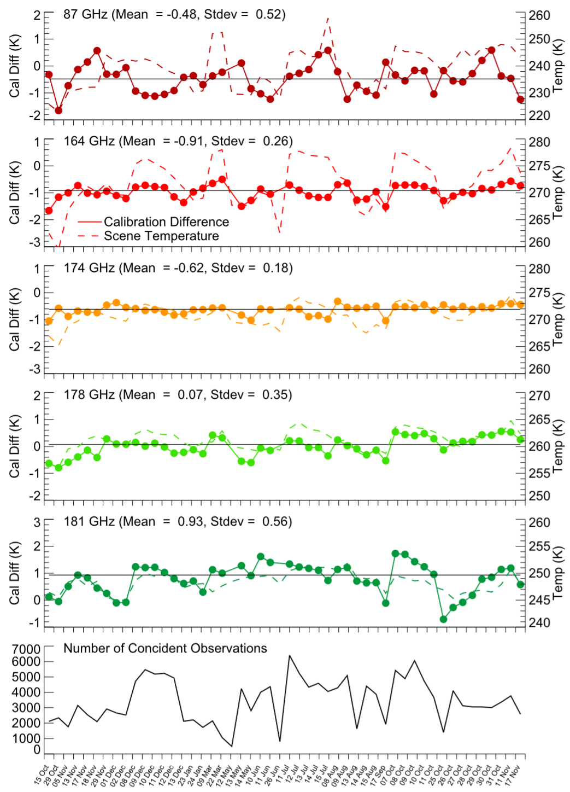
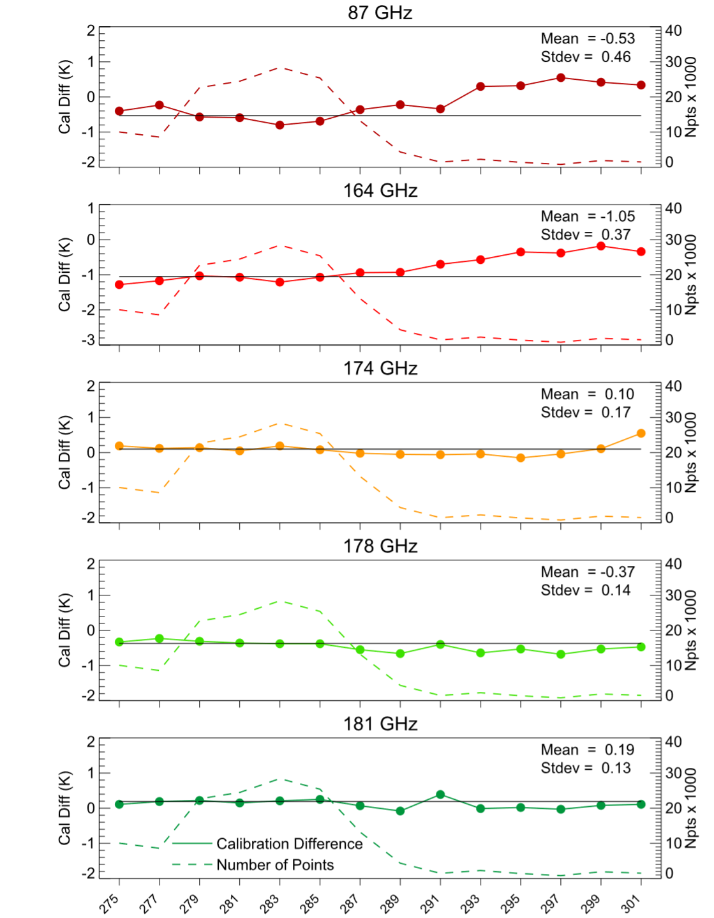
TEMPEST-D Validation: Calibration Accuracy and Precision
Calibration observed to be stable over time...
and instrument temperature.

Slide 10
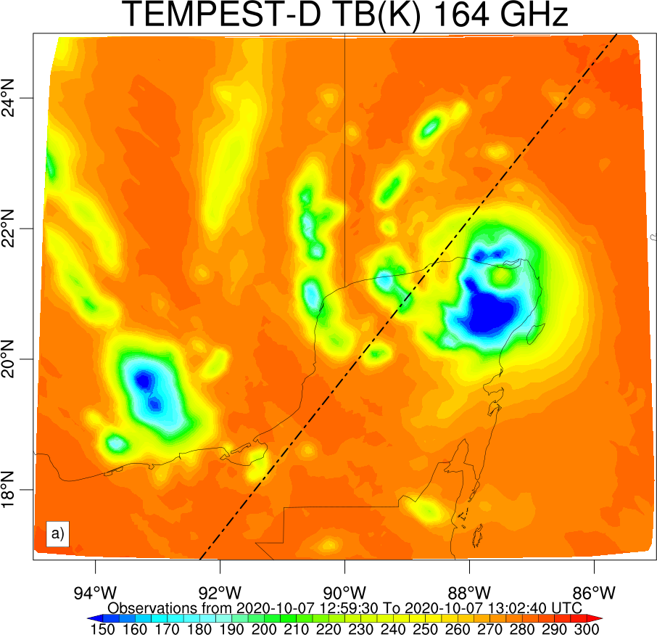
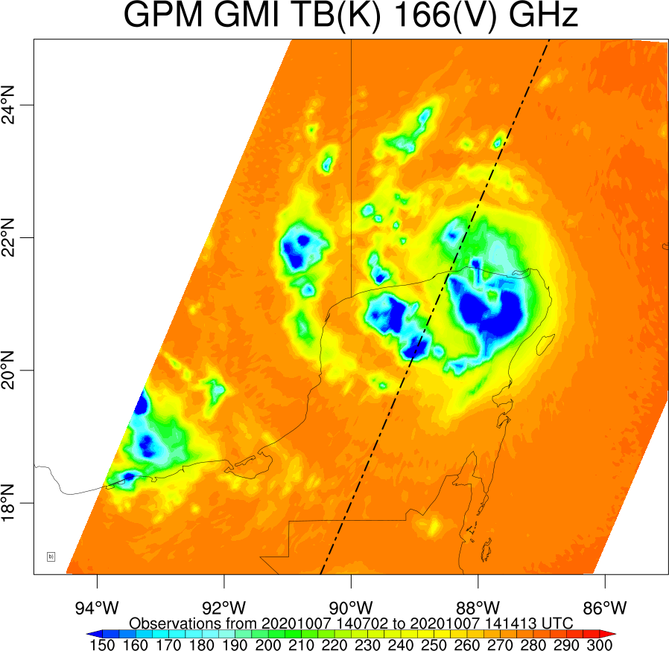
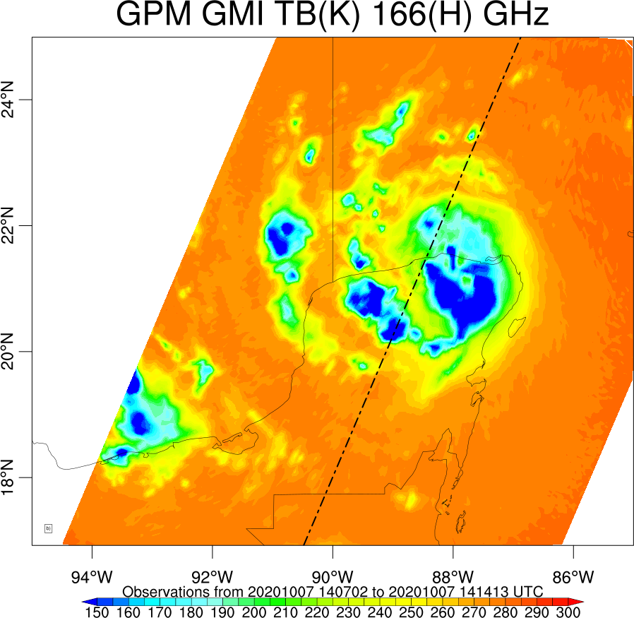
TEMPEST-D and GPM-GMI Observations of Hurricane Delta on October 7, 2020
TEMPEST-D leads GPM-GMI by 1 hour and 10 minutes

Slide 11
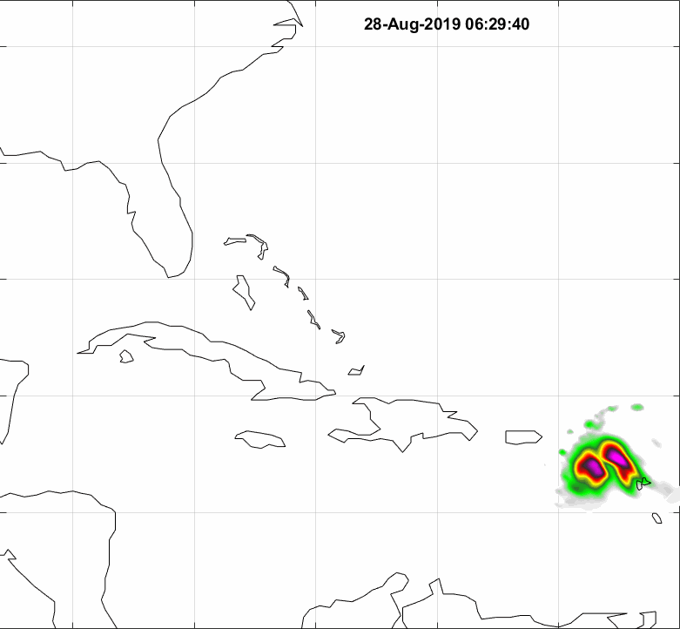
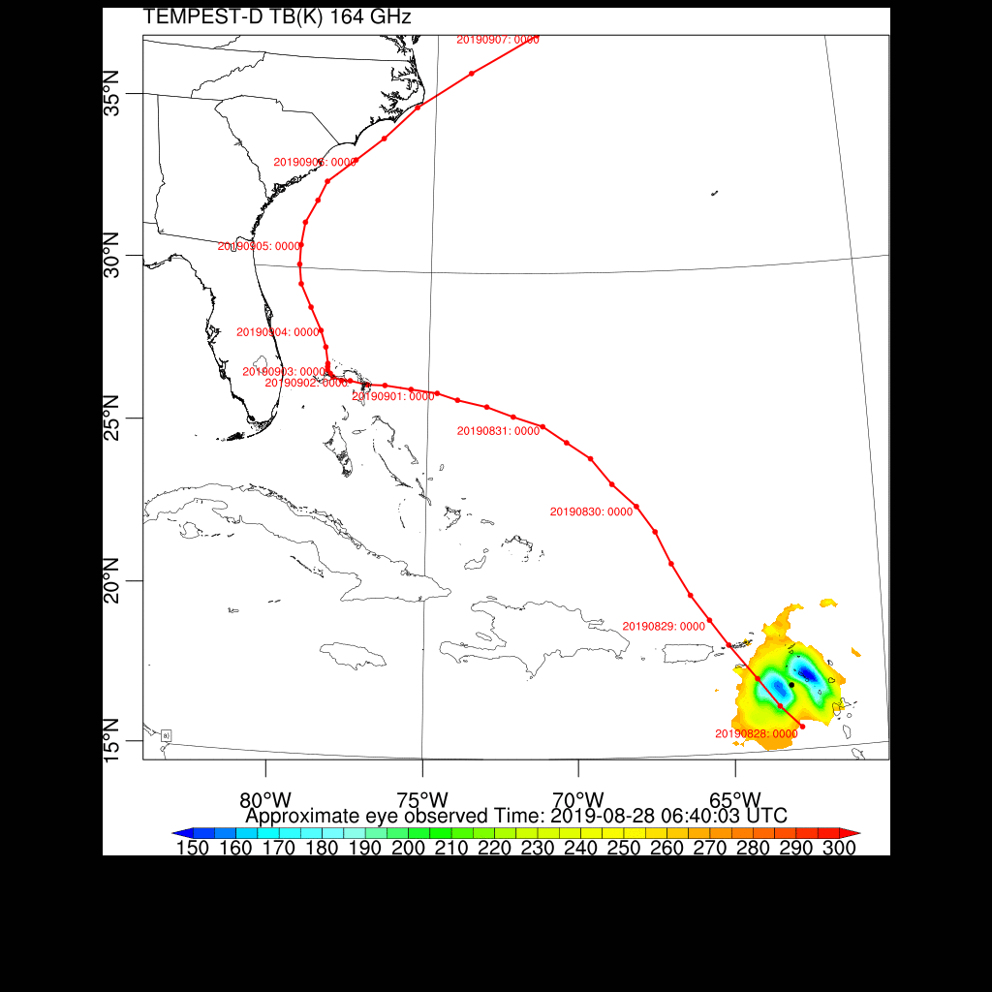
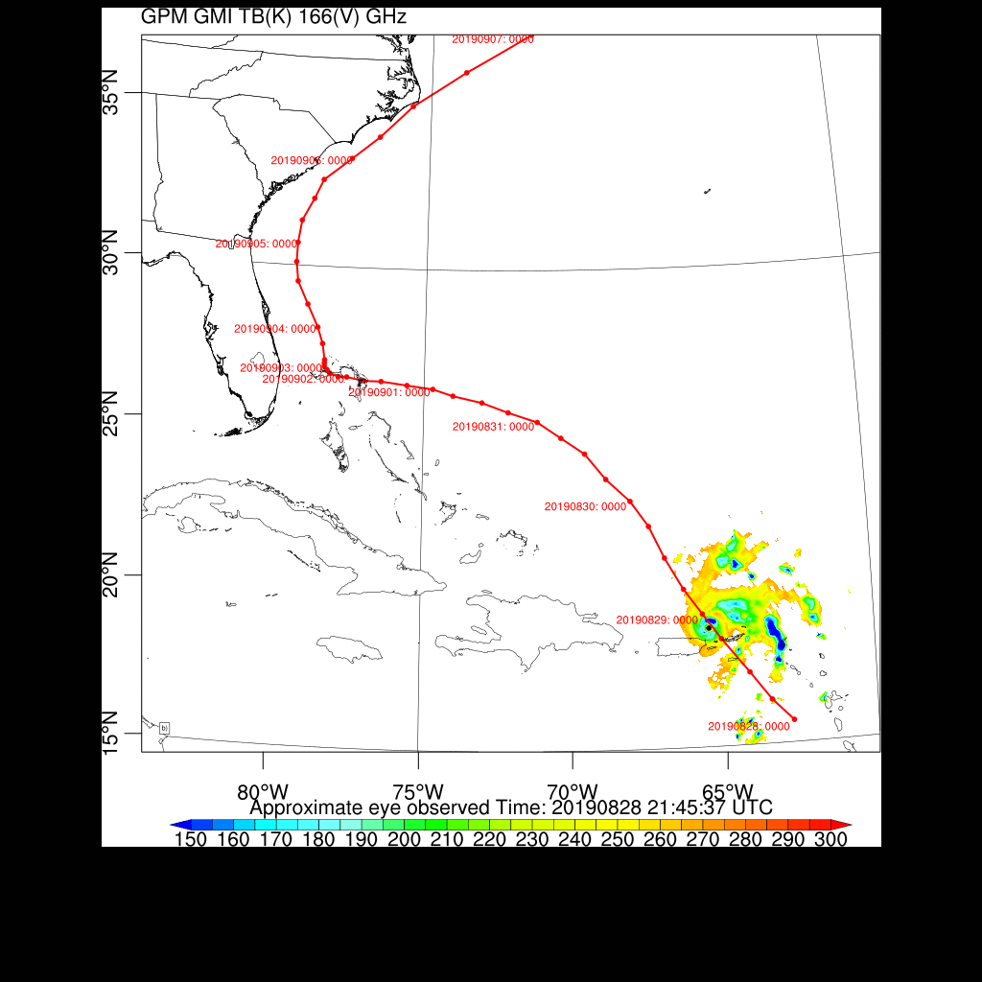
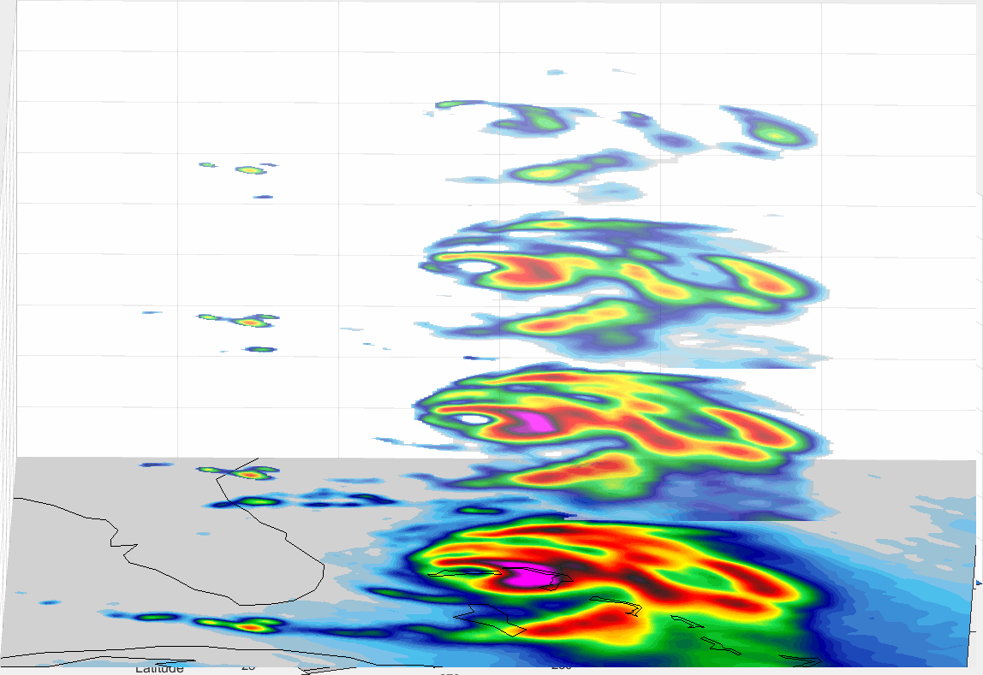
TEMPEST-D and GPM-GMI Estimated Tracks for Hurricane Dorian, along with NOAA Best Track
Calibrated TEMPEST-D data are publicly available!
https://tempest.colostate.edu/data
TEMPEST-D data have been downloaded by 57 user groups in 13 countries on 5 continents.
Hurricane Dorian
10-day track
NOAA best track
NOAA best track
TEMPEST-D Dorian track
GPM-GMI Dorian track

Slide 12
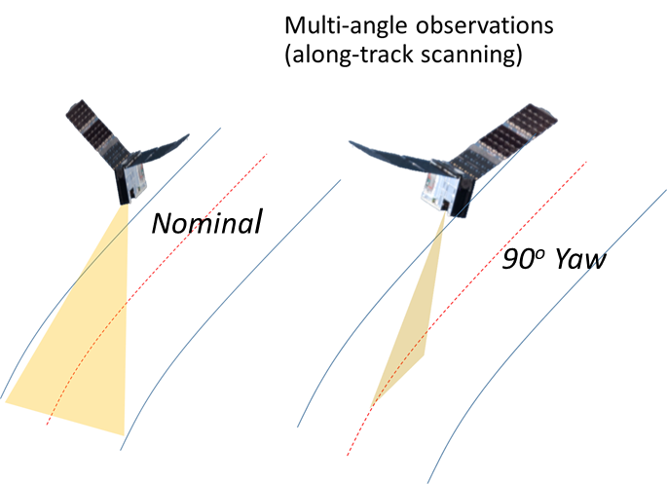
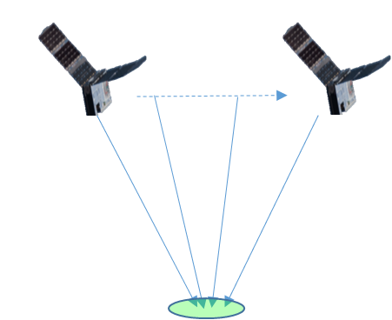
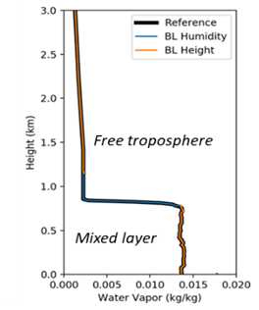
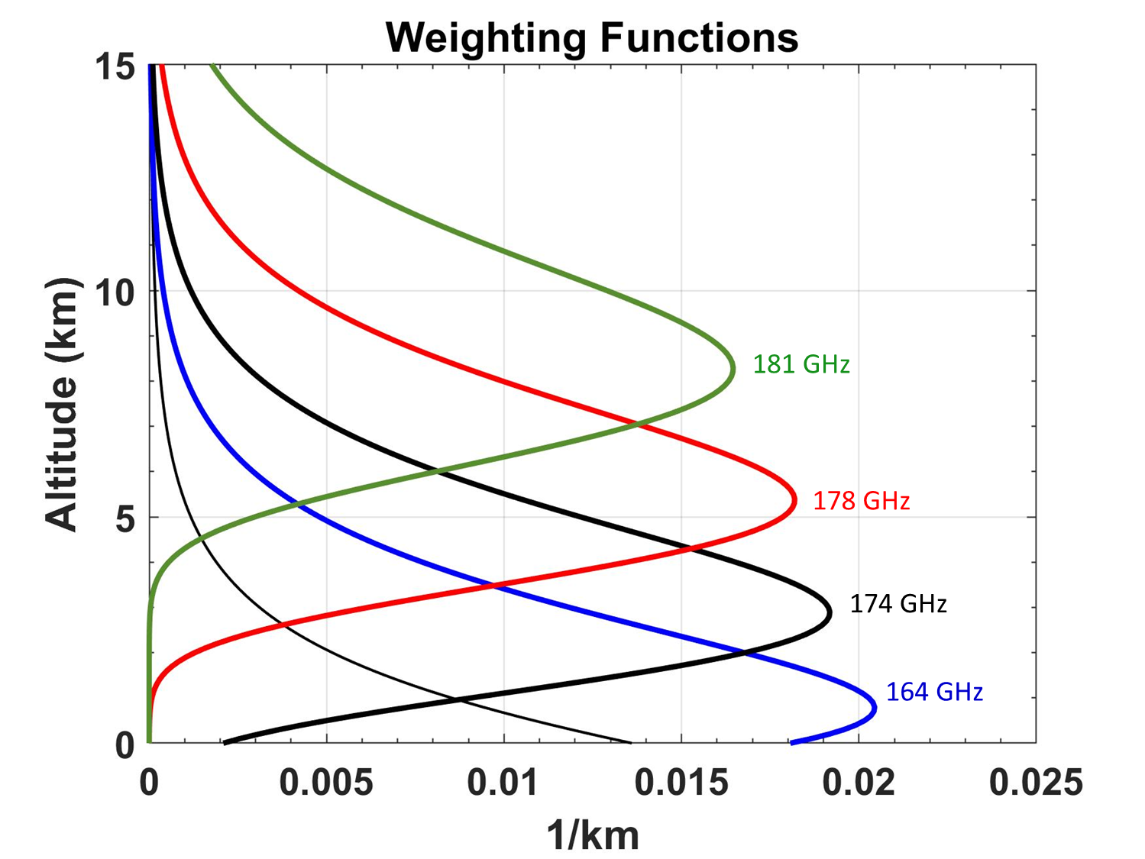
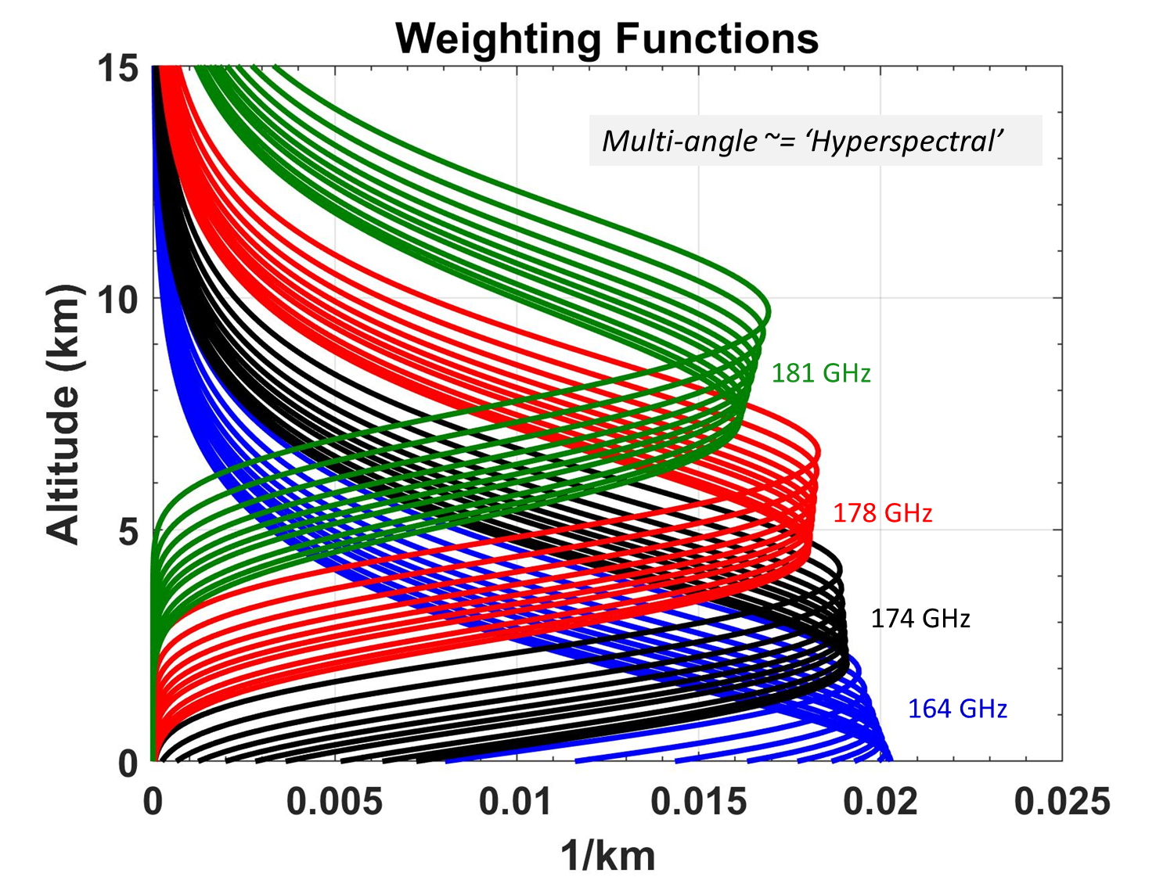
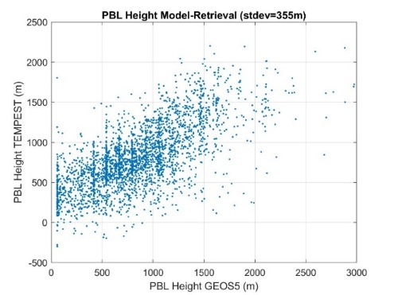
Unique Observations Demonstrated by TEMPEST-D
Multi-angle sounding improves vertical sampling through troposphere, analogous to a “hyperspectral” sounder
A promising application is improving measurement capability in planetary boundary layer (PBL)
Also enables uncertainty quantification for time resolved measurement concepts
Unique multi-angle observations accomplished by flying TEMPEST-D yawed by 90º
TEMPEST-D allows testing these new concepts with satellite data for the first time
90º yaw
PBL height
Nominal
355 m PBL height uncertainty
65º
0º

Slide 13
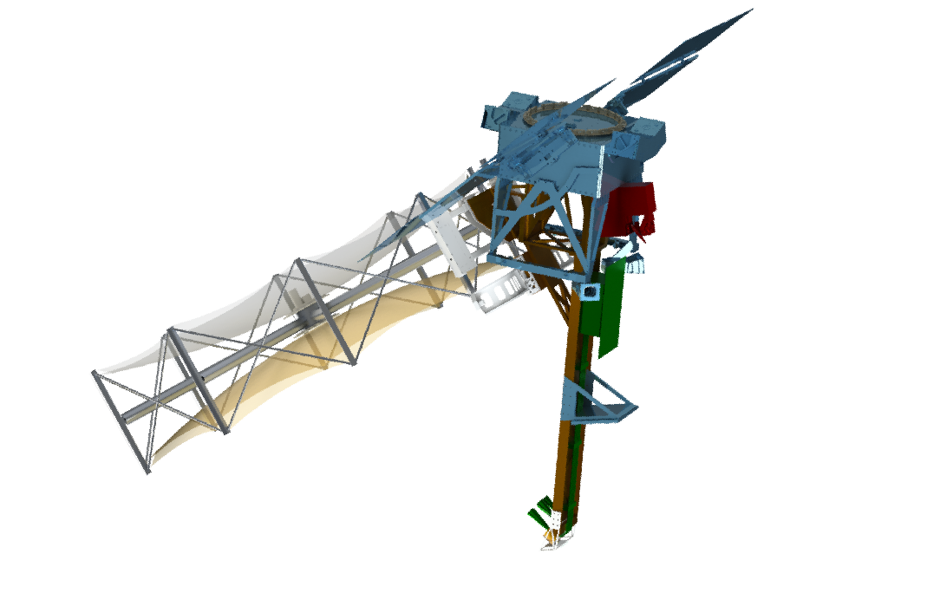
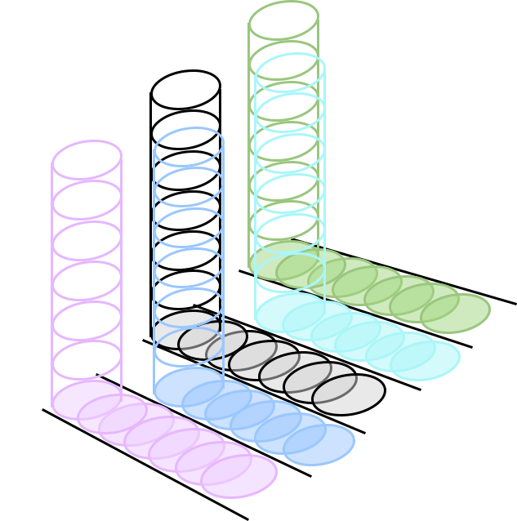


INCUS Investigation of Convective Updrafts
Blue Canyon Technologies X-SAT Venus commercial bus
NASA Earth Venture Mission (EVM-3): Collaborative partnership among CSU, JPL, BCT and Science Team members
JPL cross-track scanning microwave radiometer (middle spacecraft only) (TEMPEST-D heritage)
$∆t$=30secs
$∆t$=90secs
JPL Ka-band radar with 5 beams (RainCube heritage)
Tendeg deployable Ka-band antenna
PI: Susan van den Heever, CSU
Deputy PI: Ziad Haddad, JPL
Project Scientist: Simone Tanelli, JPL
Mission Management & Participating Organizations
CSU: PI Org, Science Data Processing
JPL: Instruments & Mission Management
Tendeg: Deployable Antennas
BCT: Spacecraft, Mission Ops
CCNY, GSFC, MSFC, NOAA, SBU, TAMU: Science Co-Is
Flight Direction
The INCUS Baseline Mission:
Flies 3 SmallSats carrying RainCube-like radars with cross-track scanning capabilities and a TEMPEST-D-like radiometer
Applies a novel time-differencing ($∆t)$approach
Provides the first ever tropics-wide measurements of convective mass flux
17

Slide 14
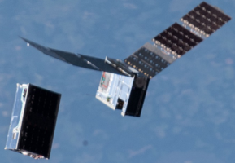
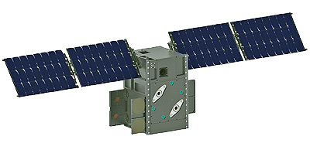
TEMPEST-based Sounder: Spatial Resolution for Moisture and Temperature Sounding
TEMPEST-D
BCT-built Ascent
12U CubeSat (AFRL)
CubeRRT
12U CubeSat:
TEMPEST-D radiometer instrument heritage
Temperature and moisture sounding from a single 12U CubeSat
Double size of TEMPEST-D antenna to improve spatial resolution at 830 km altitude
6U CubeSat:
TEMPEST-D radiometer & CubeSat heritage at TRL 9
Moisture sounding or temperature sounding from a single 6U CubeSat
NOAA Target Spatial Res.: 25 km | Moisture sounding near 183 GHz from 6U CubeSat | Temperature sounding near 118 GHz from 6U CubeSat | Moisture sounding near 183 GHz from 12U CubeSat | Temperature sounding near 118 GHz from 12U CubeSat
Spatial resolution (km) from 500 km alt. | 16 | 24 | 8 | 12
Spatial resolution (km) from 830 km alt. | 26 | 40 | 13 | 20

Slide 15
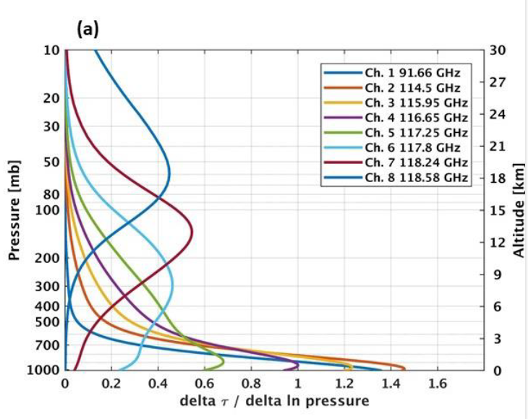
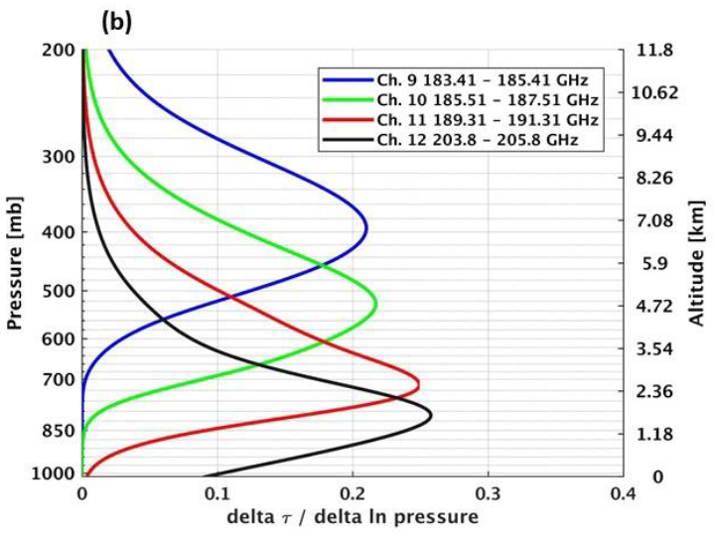
TEMPEST Channel Specifications
TEMPEST-based Microwave Sounder:
Channel Frequency and Bandwidth
TROPICS Weighting Functions
Channel No. | Center Freq. (GHz) | Bandwidth (MHz) | NEDT (K) | Integration Time (ms)
1 | 87.1 | 3200 | 0.20 | 5
2 | 164.1 | 3900 | 0.35 | 5
3 | 173.8 | 2232 | 0.55 | 5
4 | 178.4 | 1848 | 0.55 | 5
5 | 180.8 | 1989 | 0.75 | 5
6 | 114.5 | 1000 | 0.55 | 8.3
7 | 116.0 | 800 | 0.60 | 8.3
8 | 116.7 | 600 | 0.70 | 8.3
9 | 117.3 | 600 | 0.70 | 8.3
10 | 117.8 | 500 | 0.75 | 8.3
11 | 118.2 | 380 | 0.85 | 8.3
12 | 118.6 | 300 | 1.00 | 8.3
Channels 1-5 are the channel specs of the TEMPEST-D on-orbit radiometer. Channels 6-12 are temperature sounding channels of the TROPICS radiometer channels 2-8 for 114-118 GHz.

Slide 16
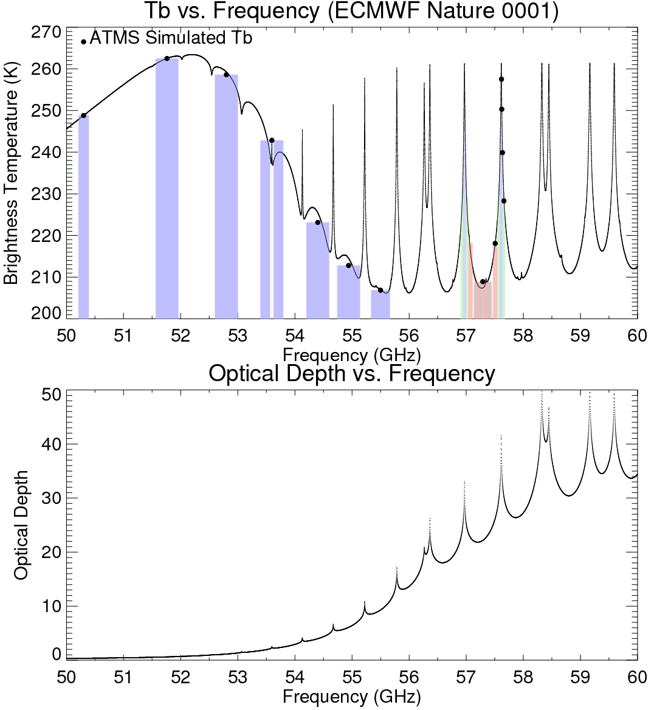
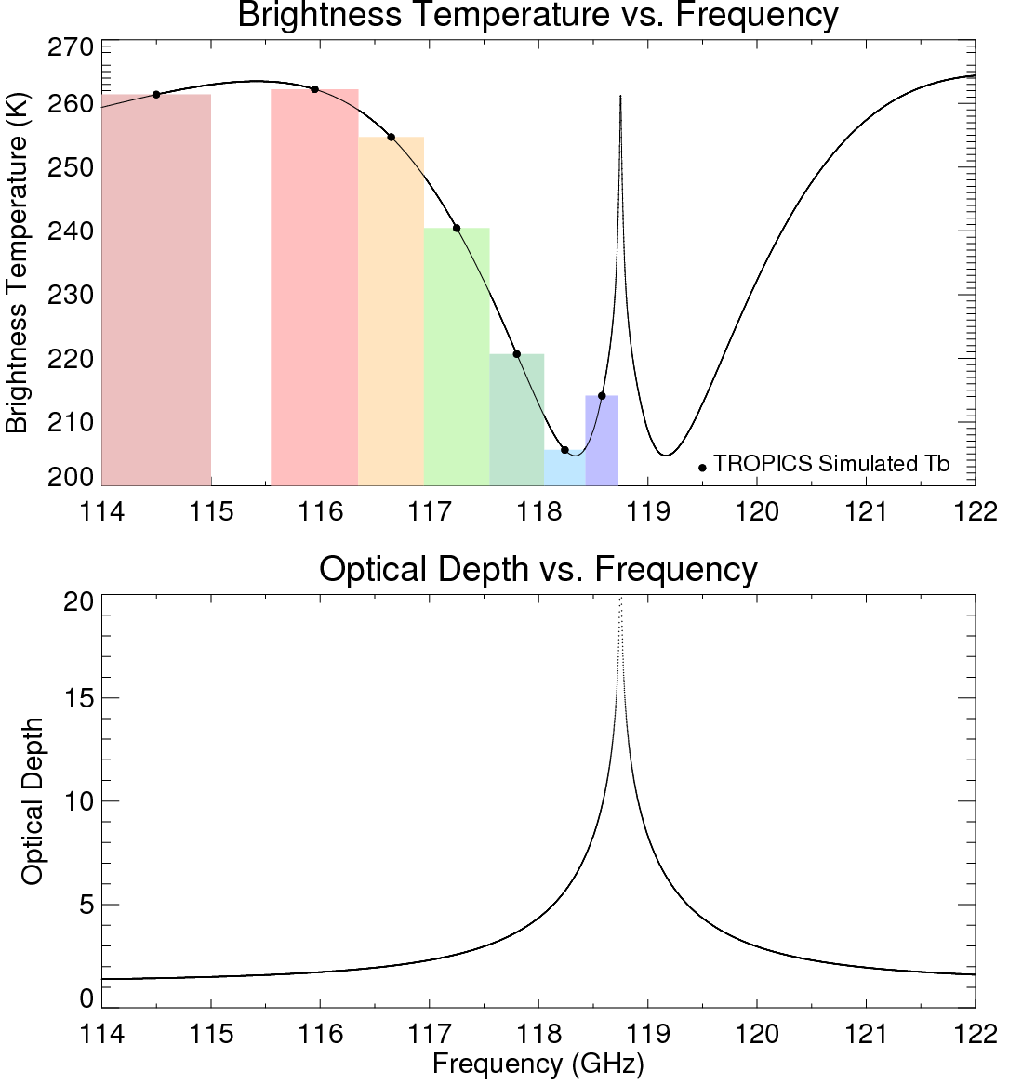
TEMPEST-based Microwave Sounder:
Temperature Sounding, 50-60 vs. 118 GHz

Slide 17
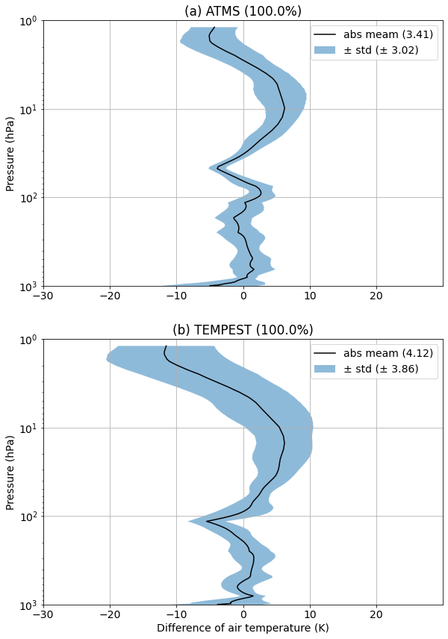
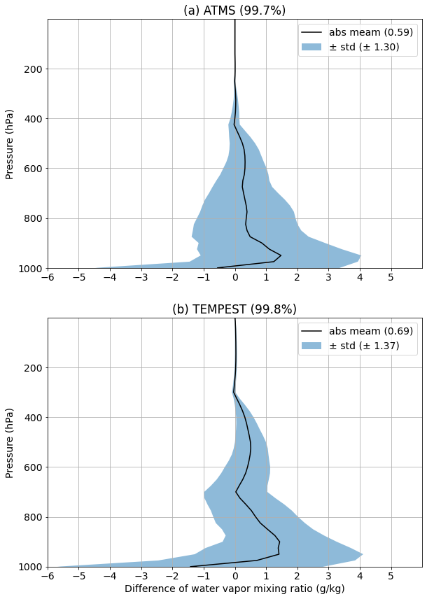
TEMPEST vs. ATMS Profile Retrievals from Simulated Brightness Temperatures
We have assessed microwave sounder capability with respect to that of ATMS.
Temperature
Water Vapor
Even though retrieval has not been optimized, retrieval differences provide meaningful insights into impact of channel differences.
Plots show difference (retrieved minus truth) of temperature (left) and water vapor mixing ratio (right) versus pressure for ATMS (top) and TEMPEST (bottom). Black lines are mean difference values, and blue areas represent ±1 standard deviation.
Differences in upper atmospheric temperature retrievals are due to lack of a strong absorption band near 118 GHz vs. ATMS bands in the 50-60 GHz range.
While TEMPEST has fewer channels near the 183 GHz water vapor line than ATMS does, lower NEDT helps to compensate for this, resulting in only slightly lower retrieval performance.

Slide 18
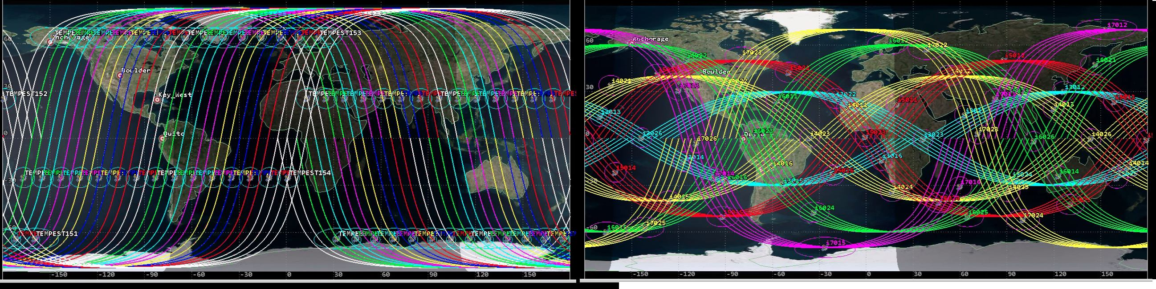
TEMPEST CubeSat Constellations to Supplement Current Polar Orbiters in LEO
Simulated ground tracks of (a) TEMPEST Polar constellation and (b) TEMPEST Multi-Inclination Constellation (MIC) over a single orbital period (i.e., approximately 95 min)
Each simulated TEMPEST constellation has a total of 60 satellites. The TEMPEST MIC constellation has 10 groups of satellites in inclination angles of 30º, 40º, 50º, 60º and 70º.
Y. V. Goncharenko, W. Berg, S. C. Reising et al., "Design and Analysis of CubeSat Microwave Radiometer Constellations to Observe Temporal Variability of the Atmosphere," IEEE JSTARS, vol. 14, pp. 11728-11736, Nov. 2021, doi: 10.1109/JSTARS.2021.3128069

Slide 19
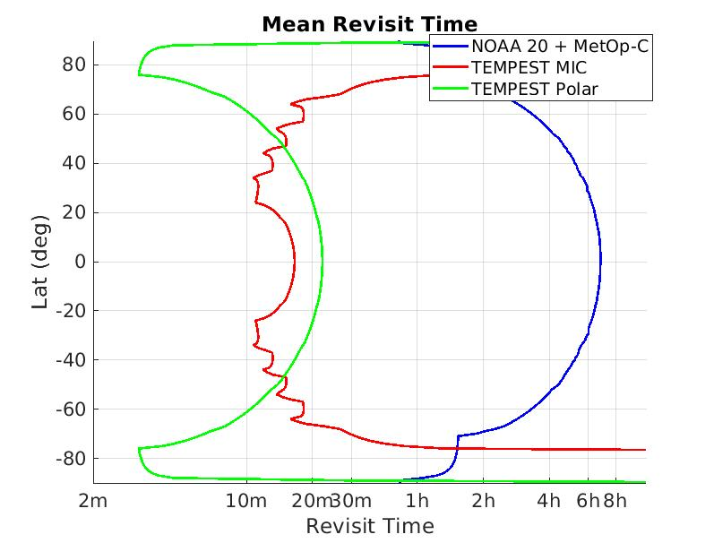
Mean Revisit Time of TEMPEST 60-Satellite Constellations to Supplement Polar Orbiters
Mean revisit time for NOAA-20/MetOp-C polar orbiters (blue), TEMPEST MIC (red) and TEMPEST Polar (green) constellations. On the horizontal axis labels, “m” indicates revisit time in minutes, and “h” in hours.

Slide 20
Temporal Sampling of Water Vapor Mixing Ratio
Top: Temporal sampling of water vapor mixing ratio at 700 mb pressure altitude at Corpus Christi, TX.
Bottom: Corresponding temporal representativeness error for the three constellation configurations studied.

Slide 21
Temporal Sampling of Atmospheric Temperature
Top: Temporal sampling of atmospheric temperature at 700 mb pressure altitude at Corpus Christi, TX.
Bottom: Corresponding temporal representativeness error for the three constellation configurations studied.

Slide 22
Conclusions
TEMPEST-D CubeSat Microwave Sounder has successfully demonstrated global microwave sounding measurements over its nearly 3-year mission
Quantitative comparisons with GPM/GMI and MHS sensors on NOAA and MetOp satellites have demonstrated that TEMPEST-D accuracy and precision are comparable to those of much larger operational satellites.
TEMPEST-D radiometers are highly stable over a nearly 3-year mission, and there is no evidence of calibration errors with on-orbit instrument temperature.
Validation and trending results show that TEMPEST-D is a well-calibrated and highly stable radiometer with very low noise, equivalent to that of much larger operational instruments.
Deployment of a TEMPEST-based 60-satellite constellation to supplement polar-orbiting satellites could improve revisit time of moisture and temperature sounding of NOAA and MetOp satellites from ~4-6 hours to ~10-20 minutes at latitudes below ~60º.

