Slide 1
Future Observational Needs for NWP
November 9, 2020
Jim Yoe
National Centers for Environmental Prediction

Slide 2
Overview
NOAA’s Current Operational Model Suite
NOAA’s Future Modeling Suite
Unified Forecast System (UFS)
Community Development
Implications for Observational Needs
Questions and Discussion
2

Slide 3
NOAA’s Operational Numerical Model Guidance Suite - Current
Climate Forecast
System (CFSv2)
Regional Hurricane HMONv3,
HWRFv13
Global Waves (GWMv3)
WaveWatch III
Nearshore Waters
SURGE: SLOSH
ESTOFS: ADCIRC
NWPS1.3:
SWAN
Great Lakes v3.4
WaveWatchIII
Ecosystem
EwE
3D-Var DA (CDAS)
4D-EnVar DA
GFS, MOM4, GODAS, GLDAS/Noah Land, KISS Sea Ice
Ocean (RTOFSv2)
HYCOM, CICE4
Regional Bays
Great Lakes (POM)
N Gulf of Mexico (FVCOM)
Columbia R. (SELFE)
Chesapeake (ROMS)
Tampa (ROMS)
Delaware (ROMS)
3D-Var DA
Global Forecast System (GFSv15)
4D-En-Var
DA (GDAS)
Regional NAMv4
w/NAM-nests
NMMB, Noah land model, includes Fire Wx
FV3 Dynamics
Noah Land model
3D-Hybrid-VAR DA
Dispersion
HYSPLITv7
Global Ensemble Forecast System (GEFSv12)
Short-Range Ensemble Forecast (SREFv7) 26 members
31 GFS Members coupled to Waves (GWES) and Aerosols
High Res Ensemble Forecast (HREFv3)
Air Quality
WRF-ARW & NMMB
13 members each
CMAQv5
North American Ensemble Forecast System (NAEFS)
WRF-ARW, NMMB, FV3 CAM
High Res Window v7
Rapid Refresh RAPv5
3D-VAR
DA
GEFS, Canadian Global Model Ensembles
WRF-ARW & NMMB
WRF ARW
North American Land Surface Data Assimilation System
Regional Climate Data Assimil. Syst.
National Water Model
Space Weather
Space
Weather
High-Res RR (HRRRv4)
WRF ARW
Ens DA (HRRDAS)
3D-Var DA
GSM WAM
ENLIL
Noah Land Surface Model
Eta-32/NARR
Noah-MP
3
Notes:
3

Slide 4
Key Features of the UFS
Shared codes to enable academic & industry researchers help NOAA accelerate the transition of research innovations into operations.
UFS code developed by a broad community and is openly available to the public, with documentation and support for users
Link to EPIC and JEDI
Enables NOAA to simplify its production suite of forecasting models from many independent systems, each of which has to be improved and maintained separately, to a single seamless modeling system with fewer, more comprehensive applications.
UFS applications, which each provide guidance for a particular forecast, span local to global domains and predictive time scales from sub-hourly analyses to seasonal predictions (next slide)

Slide 5
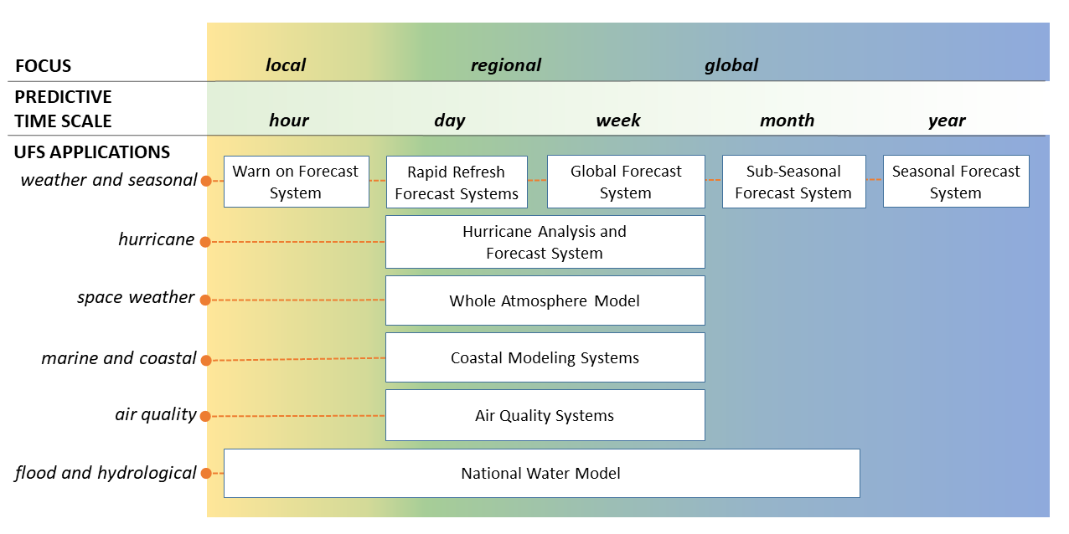
NPS Transitioning to UFS Applications
5

Slide 6
Implications for Observations for NWP models
Coupled models and DA - expanded observations
Vertical sounding – T and moisture
Surface properties (L/O/C) – T, type, wind, fluxes
Wind (vertically resolved sufficient to include shear)
Aerosols and chemical species
Quantitative precipitation
Ocean Color
Needs more uniform across scales by 2035
For both variables and attributes
Specific attributes being provided by SMEs
TIPIO’s NOSIA survey update
XORWG
6

Slide 7
Questions and Discussion
7

Slide 8
Thank you
Additional questions can be addressed to brian.gross@noaa.gov

Slide 9
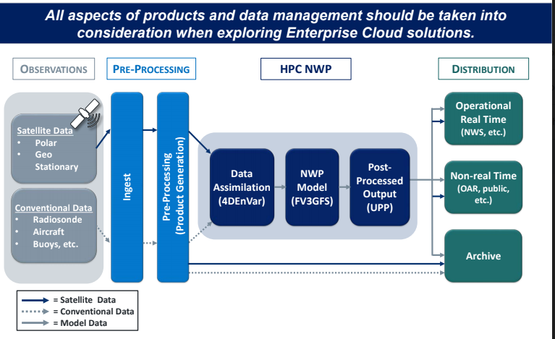
Architectural View of NWP Processing with NOAA Data Lake Pilot Support
First Deployment - Model Initial Conditions & Reanalysis
NOAA Data Lake Support to NWP
Early 2021 Deployment- Near Real-Time Observations
Future 2021 and 2022 Deployments - Opoprtunity to include Archive & Retrospective Data

Slide 10
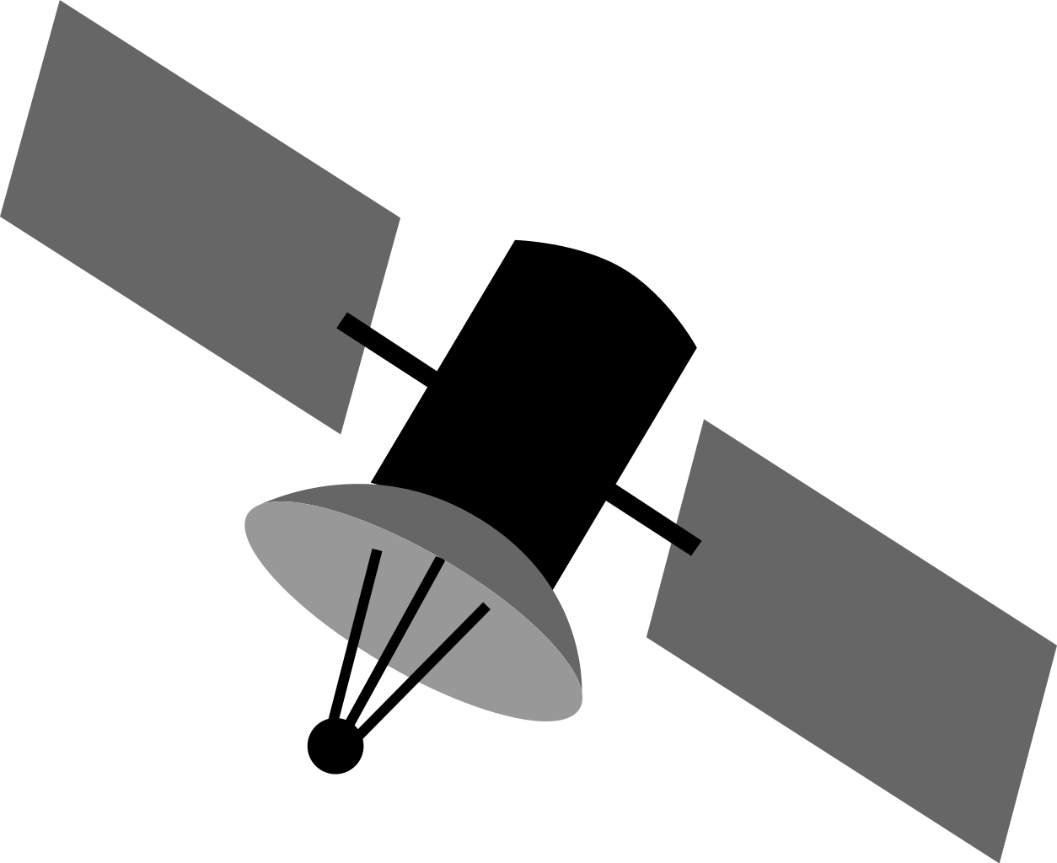
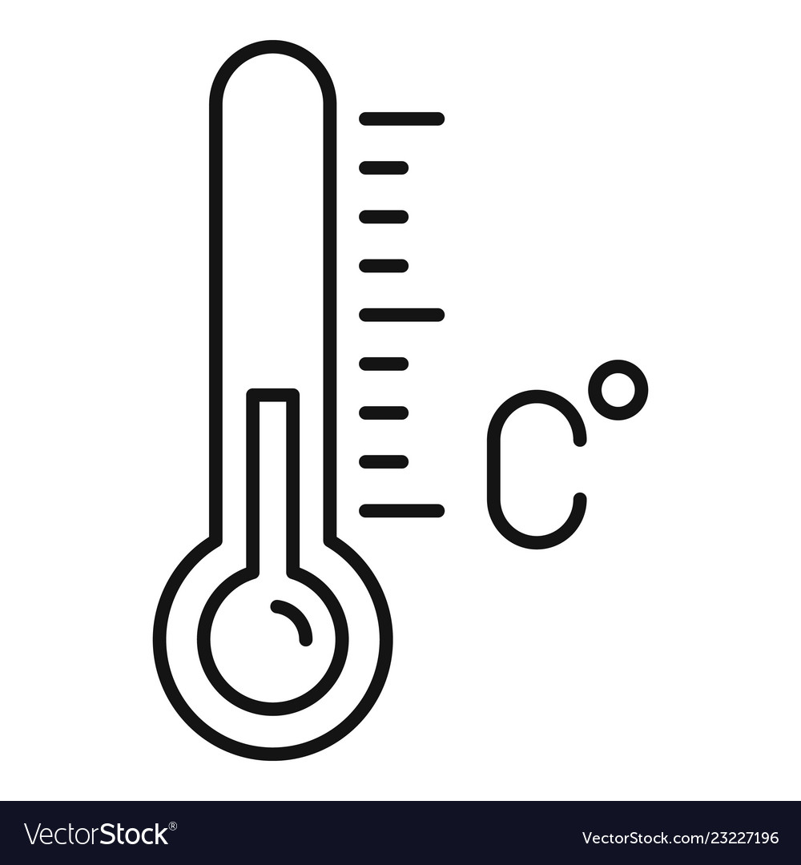
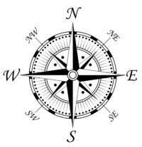
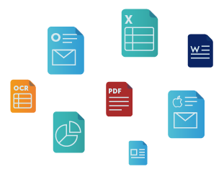
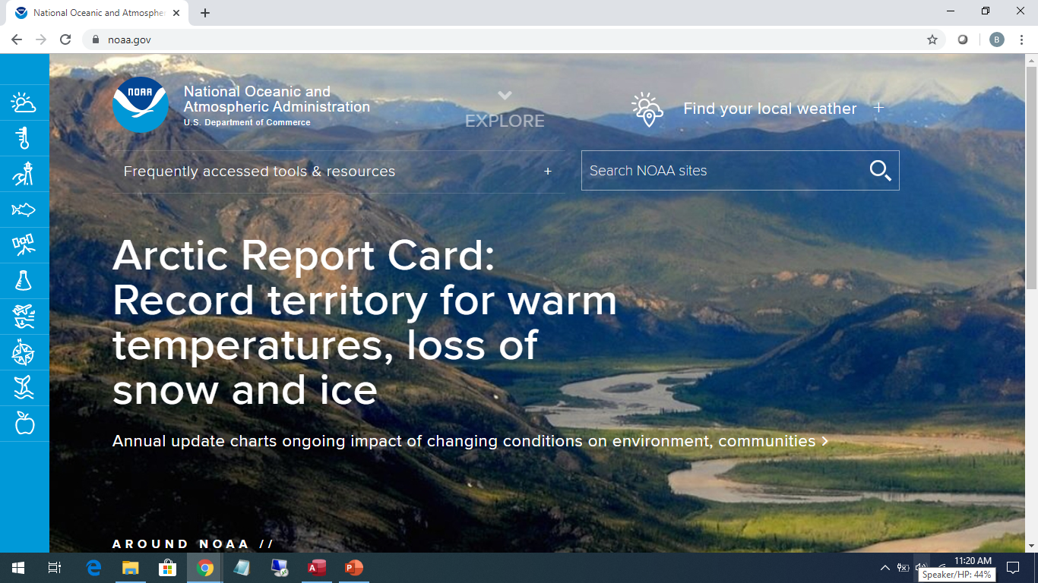
NOAA Cloud / BDP / EPIC / Data Lake Integration Vision
Big Data Program (BDP)
Environment
1. Data Capture (Real Time)
Observation Data
Other External Data
Policy
Structured & Unstructured Data
CSP or NOAA Network
Multi-Vendor Cloud
Policy Enforcement Point
Public Data Lake
2. Data Ingest & Transformation
Storage
Metadata
3a. Operational Modeling
4. Model/Product Sharing
Transformation
real-time data & models
Data Broker
(One Way Push)
Public
Data
Data Integration Service
models/products
Data Integration Service
Operational Systems
(on-prem)
NOAA Data Lake
Enforcement
3b. R&D Modeling
EPIC &
HPC (R&D)
Metadata
Storage
HPC (Ops.)
EPIC &
HPC (R&D)
Transformation
Point
Collaboration
Public Users
Other
Clouds
Dev, Test &
Sandbox Environments
Policy Enforcement Point
Analytics
AI / ML
Public
5. Model/Product Usage (Predictions, Forecasts, Trends, etc.)
VPC
Research /
Academia
Dedicated
Connection
Policy Enforcement Point
NOAA Users
Business /
Partners
Legend:
Data Scientists, PMs, etc.
Primary to model development/use
Secondary to model development/use
text
Model development/use value chain
1

