Slide 1
Assessment of 3D-winds technologies, capabilities, and impacts
Mike Hardesty, Kevin Garrett, Lidia Cucurull, Kayo Ide, and David Santek

Slide 2
Aeolus NWP impact on TCs
QOSAP/AOML
PI: Lidia Cucurull
Team: Karina Apodaca (FV3GFS), Iliana Genkova (EMC, FV3GFS), Peter Marinescu (HWRF), Lisa Bucci (Validation)

Slide 3
Improved assimilation of Aeolus HLOS in FV3GFS
Estimated of an accurate probability model for Aeolus observations, this is needed for adopting VarQC for the Aeolus DWL observation operator in GSI
Completed a 1-month statistical assessment experiment of the HLOS assimilation in FV3GFS
Obtained innovation statistics and PDF moments for the Mie cloudy and Rayleigh clear observation regimes for VarQC tuning
Assessment of innovation statistics indicate departures from the pure Gaussian form indicating Aeolus assimilation may benefit from advanced QC by assigning adaptive weights to observation outliers

Slide 4
Current work on VarQC for Aeolus
Histograms of innovations and analysis residuals are used to obtain statistical moments of Aeolus PDF’s
Innovation statistics for August 2019 Mie cloudy channel
Significant departures from the
pure Gaussian form can be seen, VarQC can account for non-Gaussian effects
By adding adaptive weights observations at the tails of the PDF might still influence the analysis, they rejecting them
FM-B period Mie Cloudy O-B PDF
Gaussian fit

Slide 5
Current work on VarQC for Aeolus
FM-B period Rayleigh Clear O-B PDF
Innovation statistics for August 2019 Rayleigh clear channel
Positive Kurtosis and skewness indicating observed Aeolus winds are larger than the background
By assessing skewness in the
the innovations we hope to
give less weight to observations that are far from their model equivalent
Gaussian fit

Slide 6
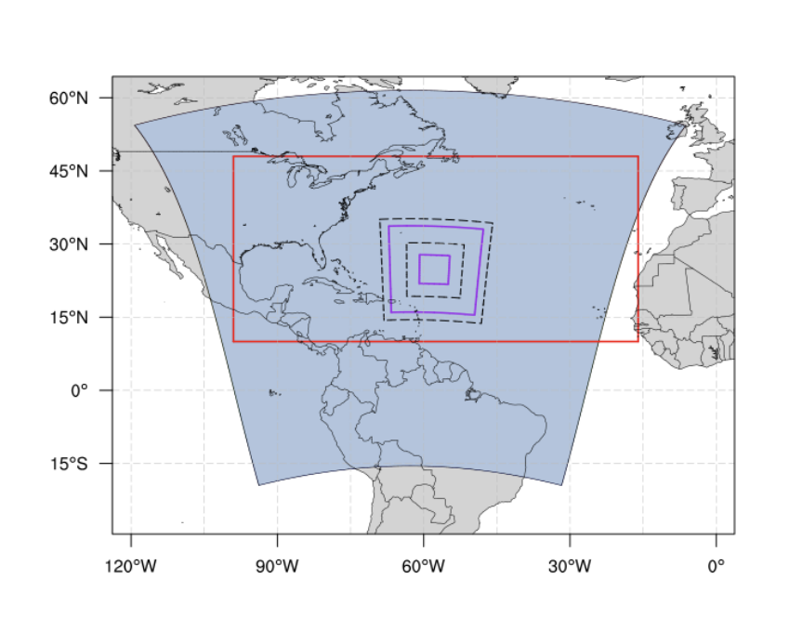
ADM-Aeolus Impacts on HWRF Tropical Cyclone Forecasts
Hurricane Weather Research and Forecasting (HWRF) Model
Regional, operational TC prediction
3 nested grids (2 moving nests)
13km, 4km, 1.5km horizontal grid spacing
Assimilation on inner two grids
HWRF Simulation Experiments
CTL (operational mode with conventional and satellite data assimilation)
CTL + Aeolus (No Bias Correction)
Additional Experiments
CTL + Aeolus: With Bias Correction
CTL + Aeolus: With GFS initial conditions that incorporate Aeolus DA
CTL: With GFS initial conditions that incorporate Aeolus

Slide 7
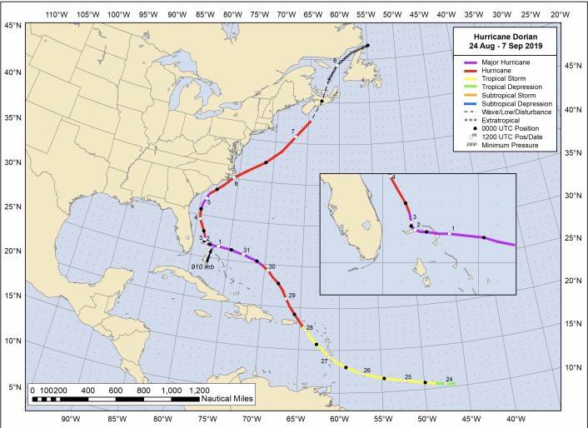
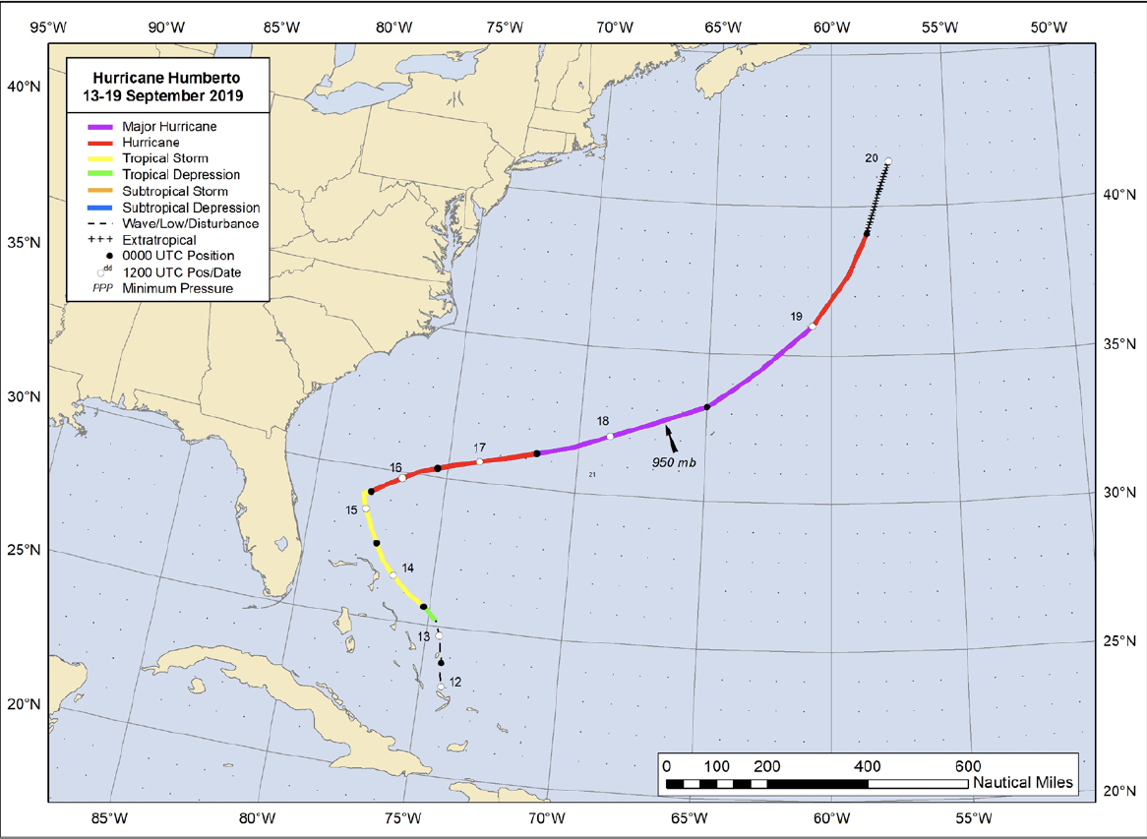
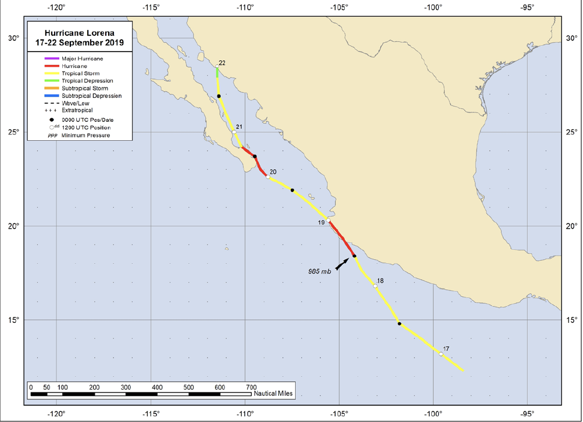
Tropical Cyclone Cases
Dorian
Focus on FMB period (August - September 2019)
Period after laser replacement with lower biases (B Laser)
Initial TC cases with poor track and/or intensity forecasts:
Hurricane Dorian (Atlantic)
Hurricane Humberto (Atlantic)
Hurricane Lorena (E. Pacific)
Other potential storms for additional cases:
2019: Lorenzo, Ivo, Kiko, Mario
Humberto
Lorena

Slide 8
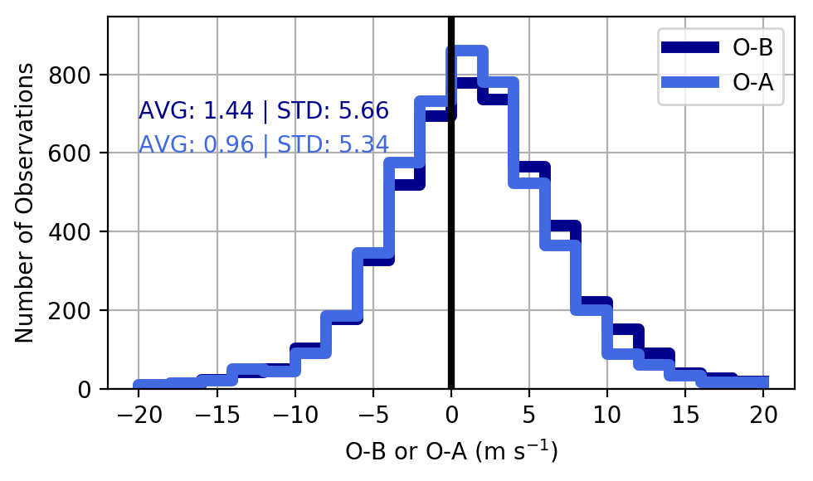
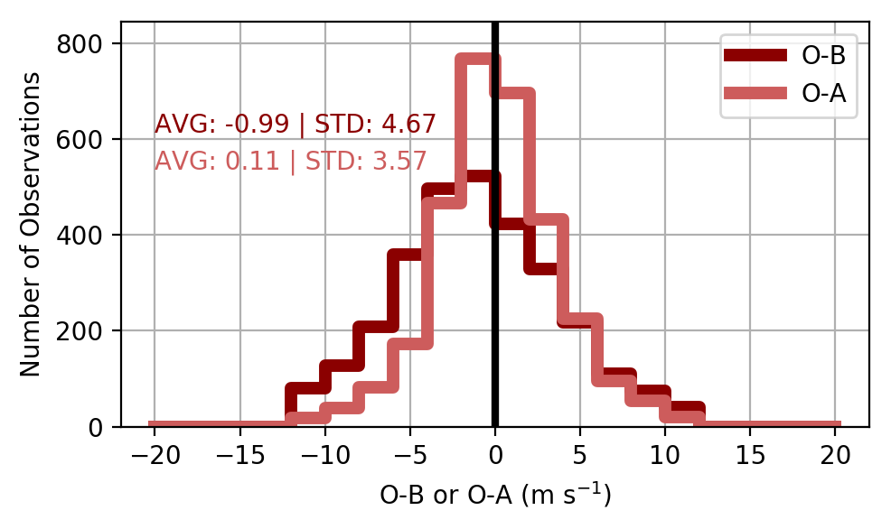
Assimilating Aeolus Observations into HWRF
Altering the initial model state towards the observations
Narrowing of O-A distribution with means closer to 0
Rayleigh Clear Observations*
Mie Cloudy Observations*
*Data shown from Hurricane Lorena (09/17/19 - 09/22/19)

Slide 9
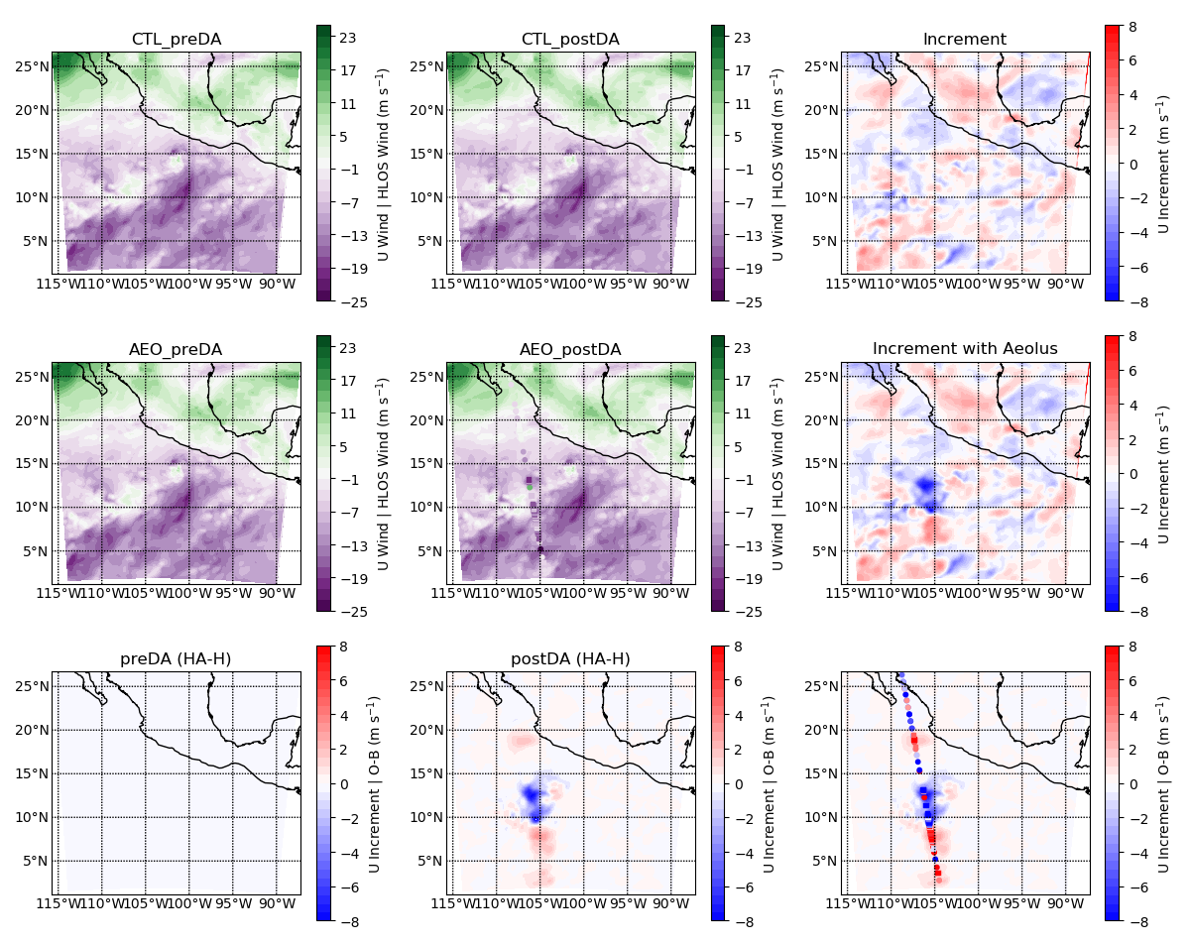
Assimilating Aeolus Observations into HWRF 300 hPa U Winds Hurricane Lorena 09/18/2019 00Z
Background
Analysis
Increment
CTL (No Aeolus)
CTL + Aeolus
Aeolus HLOS winds
Difference in Increments
Aeolus O-Bs
Next Steps: Assessing how these initial model state changes alter tropical cyclone forecasts, including track, intensity and structure
Significant changes in initial model state due to Aeolus wind assimilation

Slide 10
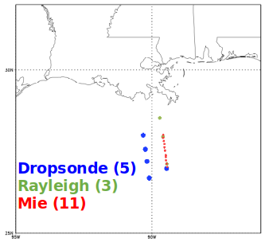
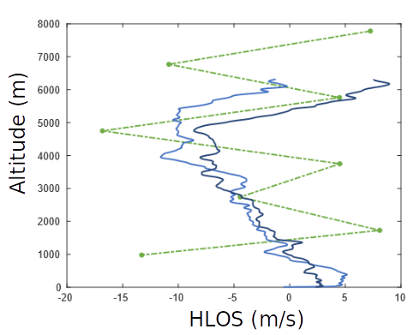
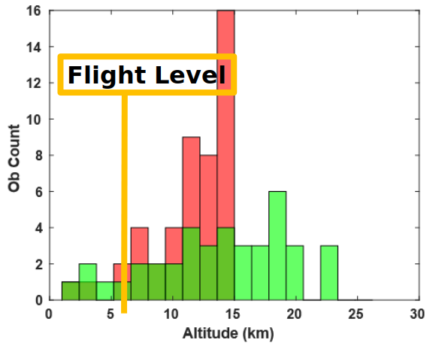
NOAA P-3 Aeolus Validation
Rayleigh comparison in Barry
Goal: Release dropsondes while passing under Aeolus in a tropical cyclone environment for comparison and validation.
Performed in two tropical cyclones (2019)
Tropical Storm Barry
Hurricane Humberto
Dropsonde and Aeolus observations collocated within 100 km / 1 hr was insufficient
Due to the flight altitude of the P-3 (typically flown ~3-6 km) and the majority of Aeolus data collected higher in the atmosphere
Vertical distribution of Aeolus observations in Barry

Slide 11
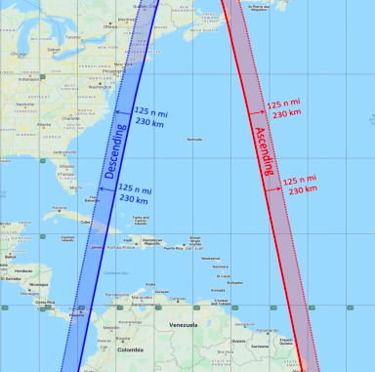
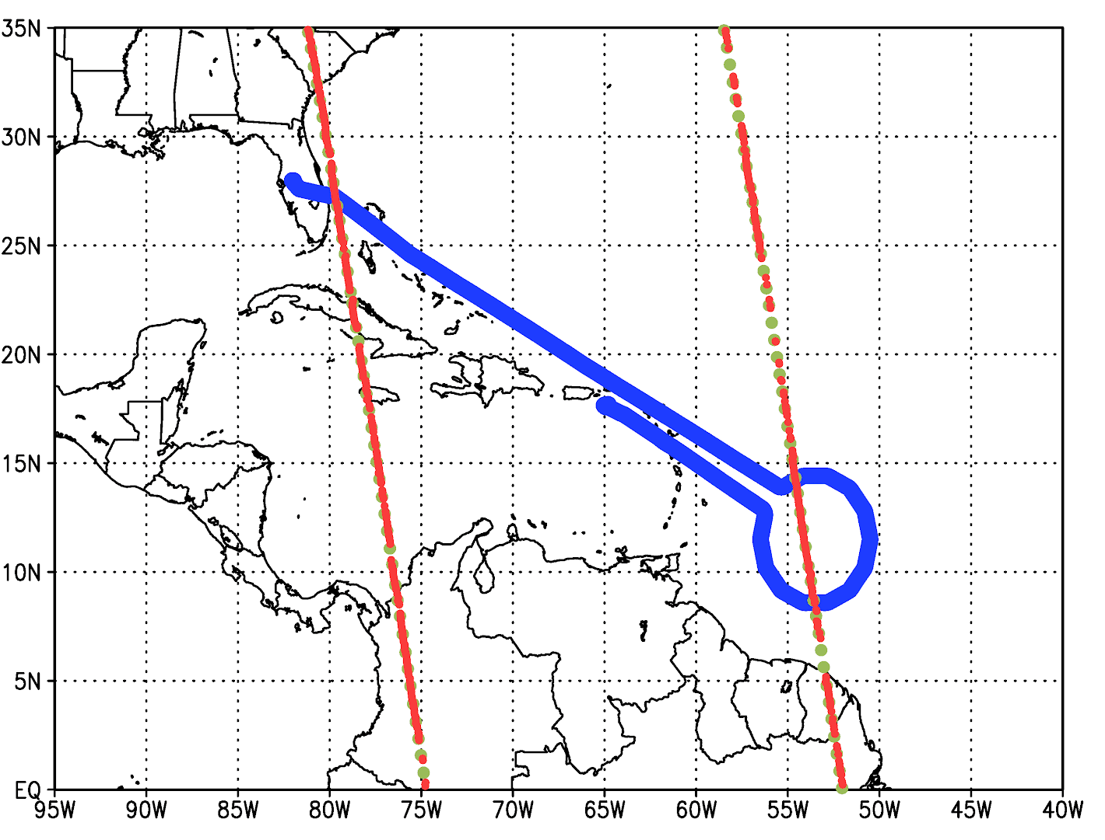
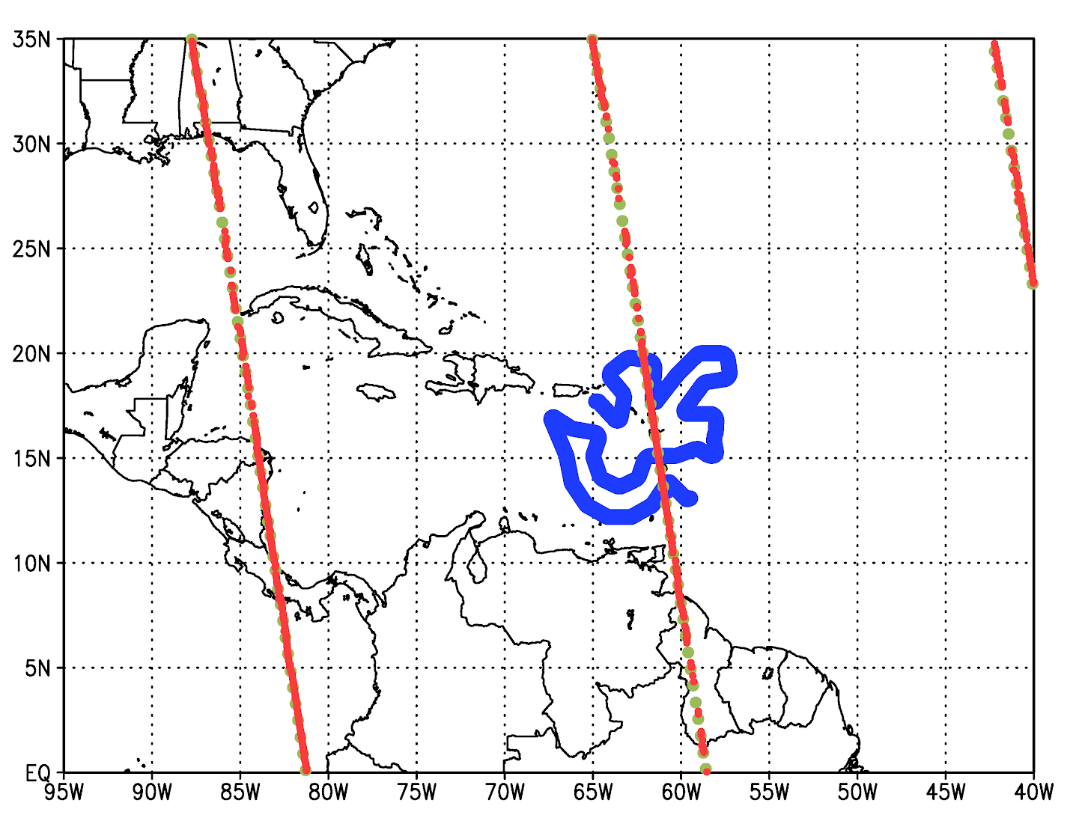
NOAA G-IV Aeolus Validation and Ongoing Research
Goal: Release dropsondes from the G-IV while passing under Aeolus in a tropical cyclone environment for comparison and validation. Currently planned for Tropical Depression 20
Collocate 2019 G-IV dropsondes with Aeolus
Hurricane Dorian
Collocate 2019 P-3 tail Doppler Radar winds
Hurricane Humberto
Figure from the 2020 NOAA Hurricane Field Program Plan: Sample Aeolus ascending (red) and descending (blue) satellite passes. The solid lines denote the nadir points directly below the satellite. The dashed curves denote the desired aircraft underflight locations.
Examples: Aeolus overpasses with G-IV Dorian flight tracks

Slide 12
Ongoing and planned 3D-winds OSSEs
QOSAP/AOML
PI: Lidia Cucurull
Team: Sean Casey, Andres Vidal, Mike Mueller, Paulo Paz , Agnes Lim (CIMMS)

Slide 13
Global Wind observation Value
OSSE System (QOSAP and OSAAP)
ECO1280 Nature Run
Consolidated Observing Systems Simulator (COSS)
Error-added observations
FV3GFS global system
Ongoing (OPPA)
AMVs
Active sensor (Aeolus type)
Planned (OSAAP)
Global AMVs from sounders
Wind lidar based on UV laser and associates scattering (high altitude winds)
Wind lidar based on IR laser and associated scattering (lower altitude winds)
Others?

