Slide 1

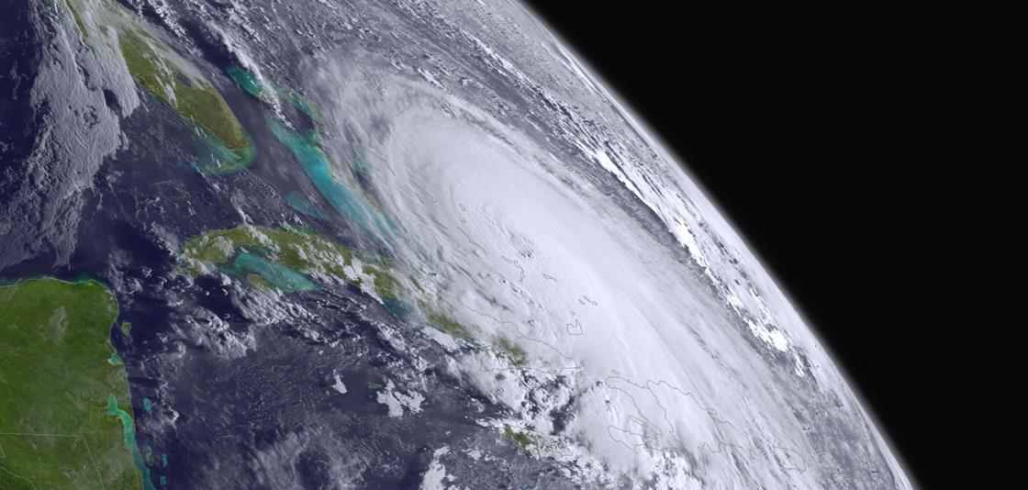
Exploitation of Shortwave IR sounder observations in NOAA Global NWP
Kevin Garrett
NOAA/NESDIS Center for Satellite Applications and Research
Erin Jones, Kayo Ide (University of Maryland/CISESS)
Yingtao Ma (Colorado State University/CIRA)
Chris Barnet (STC)
Funded under NESDIS/OPPA Technology Maturation Program (TMP)
Satellite and Information Service
31 AUG 2020

Slide 2
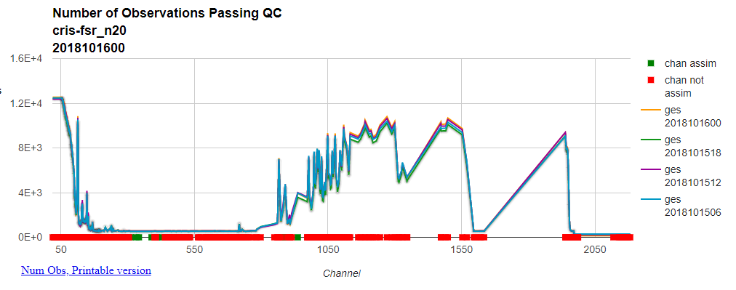
Project Motivation and Objectives
Cubesat technology supports an alternative/cost effective/agile constellation of shortwave/midwave IR (SW/MWIR) sensors to provide temperature and water vapor profile information to numerical weather prediction (NWP).
A SWIR constellation could compliment LWIR sounders and add robustness to the global observation system
Shortwave IR data (4 µm CO₂ band), however, is not operationally assimilated in NWP models (LWIR only)
Overarching Objective:
To help shape future satellite global observing system architecture, assess if a SWIR-only solution can achieve or exceed positive impact provided by LWIR radiances in medium-range, global NWP.
Additional objectives:
  Extend NOAA global NWP to assimilation SWIR data (CrIS/IASI/AIRS)
  Improved radiance forward operator for SWIR (CRTM)
  Compare impact of SWIR vs LWIR assimilation on FV3GFS forecasts
  Transition SWIR/LWIR assimilation to NCEP operations (pending impact results)
NCEP radiance monitoring plot showing assimilation of LW IR observations but only monitoring of SW IR observations in the FV3GFS.

Slide 3
Current SWIR status in NOAA NWP
This project focuses on the NOAA global FV3GFS (using the Gridpoint Statistical Interpolation – GSI 4DEnVar assimilation)
GSI has capability to ingest 3 CrIS datasets: 399 NSR, 431 FSR, and 2211 FSR
  This study will exploit SWIR observations from the 431 FSR which is operationally assimilated at NCEP
  2211 FSR is not tanked at NCEP (volume too large)
  431 FSR provides adequate spectral coverage for study
92 LWIR channels and 8 MWIR channels are assimilated operationally.
All SWIR channels are monitored with strict QC
Note: FV3GFS also assimilates LWIR from CrIS 616 and AIRS 281

Slide 4
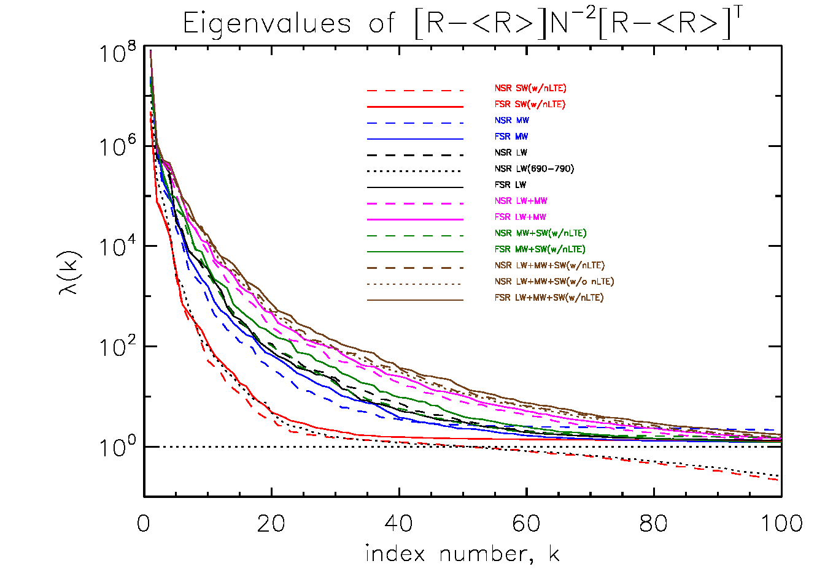
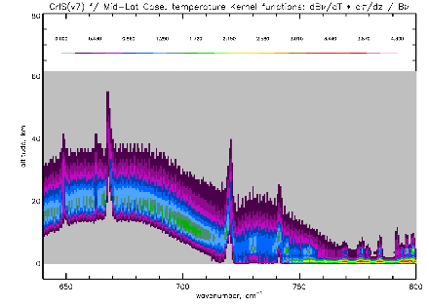
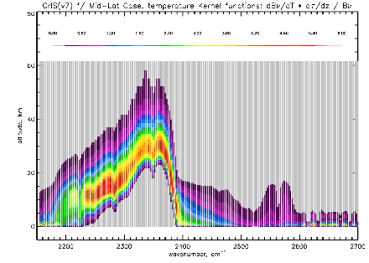
Outlook on SWIR assimilation
SWIR channels show similar information content as LWIR temperature (CO₂) channels.
Data assimilation system enhancements needed to enable SWIR:
Forward operator, Community Radiative Transfer Model (CRTM)
  Modeling of BRDF
  NLTE correction
Cloud detection scheme
  SWIR channels in place of LWIR
New observation errors
  From fixed 1 K to scene-dependent
Overhaul quality control based on above
Activate 52 SWIR channels (2380 – 2507 cm⁻¹)
  Disable 92 LWIR channels
CrIS LW Kernel Functions
CrIS SW Kernel Functions
(LW) Sounding Channels (SW)
Temperature
Courtesy Chris Barnet
~35 dof for SW (red)
~35 dof for LW (690-790 cm⁻¹, black dots)
~65 dof for LW (black)

Slide 5
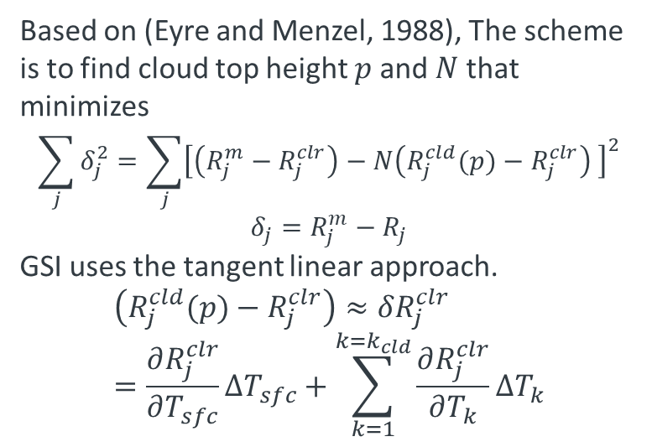
SWIR cloud detection for clear-sky radiances
Based on (Eyre and Menzel, 1988), The scheme is to find cloud top height $p$and $N$ that minimizes
$$\sum_{j}{δ_{j}^{2}}=\sum_{j}{{\left[\left(R_{j}^{m}−R_{j}^{clr}\right)−N\left(R_{j}^{cld}(p)−R_{j}^{clr}\right) \right]}^{2}}$$
$$δ_{j}=R_{j}^{m}−R_{j}$$
GSI uses the tangent linear approach.
$$\left(R_{j}^{cld}(p)−R_{j}^{clr}\right)≈δR_{j}^{clr}=\frac{∂R_{j}^{clr}}{∂T_{sfc}}ΔT_{sfc}+\sum_{k=1}^{k=k_{cld}}{\frac{∂R_{j}^{clr}}{∂T_{k}}ΔT_{k}}$$
Cloud Fraction % using LW
Cloud Fraction % using SW
Number of Observations
Number of Observations
SWIR-based cloud detection allows more SWIR observations to pass cloud check – likely due to increased vertical resolution.
Wavenumber (cm⁻¹)
Wavenumber (cm⁻¹)

Slide 6
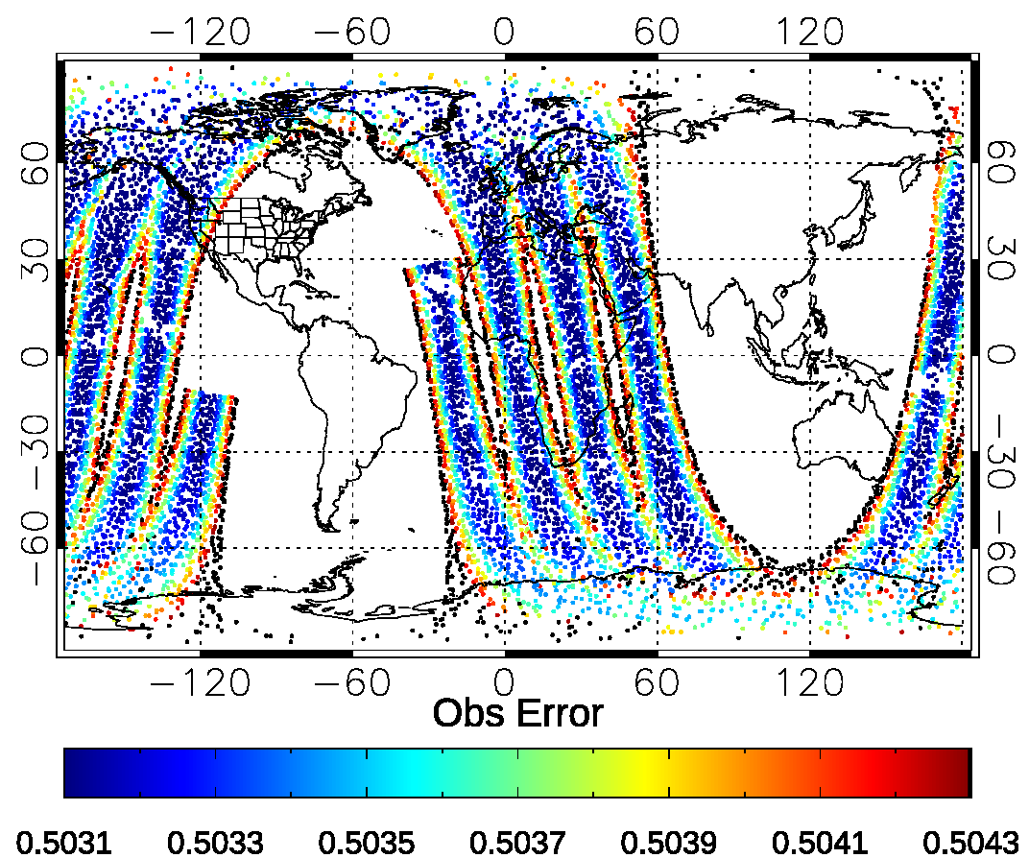
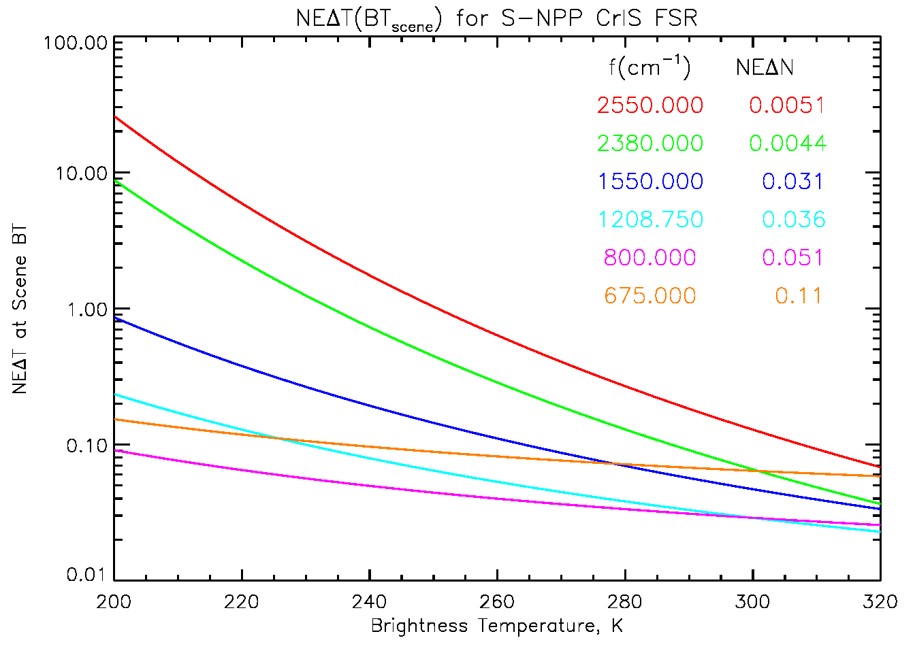
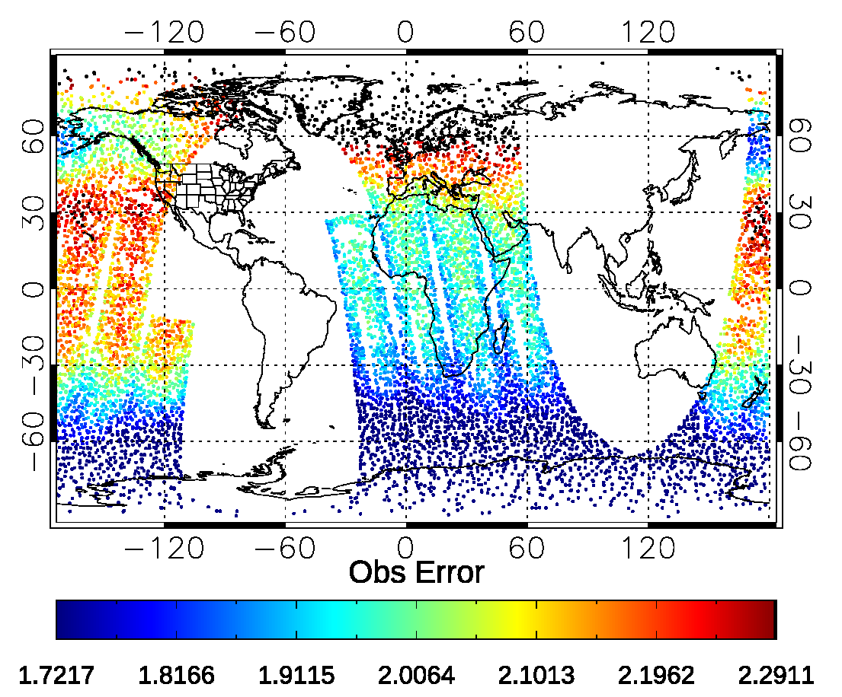
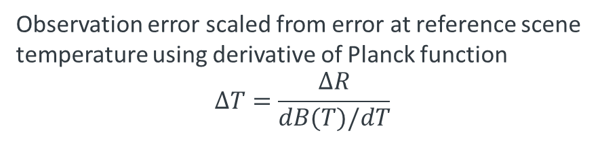
Scene-Dependent Observation Errors
Non-linearity in the Planck function -> noise dependent on scene temperature
690 cm⁻¹ Obs Error
SWIR has strong scene sensitivity
~Constant
2380 cm⁻¹ Obs Error
LWIR, is very insensitive
Courtesy Chris Barnet
Observation error scaled from error at reference scene temperature using derivative of Planck function
$$∆T=\frac{∆R}{dB(T)/dT}$$
Scene-Dep

Slide 7
Observing System Experiment setup
Observation | Baseline (Ops) | LW IR (Control) | SW IR (Exp) | No IR (Exp noIR)
Conventional
Sat-winds
IASI
AIRS
CrIS LW IR
CrIS SW IR
ATMS
AMSU/MHS
GPSRO
Use current operational FV3GFS 4DEnVar at C384 (~25 km)
Experiments run 2018-12-01 to 2019-01-31
Observations assimilated per table; AIRS/IASI turned off to enhance signal of CrIS LW and SW impact
Verified against self analysis and ECMWF analysis
Verification is using analyses/forecasts from 2019-12-08 to 2019-01-24

Slide 8
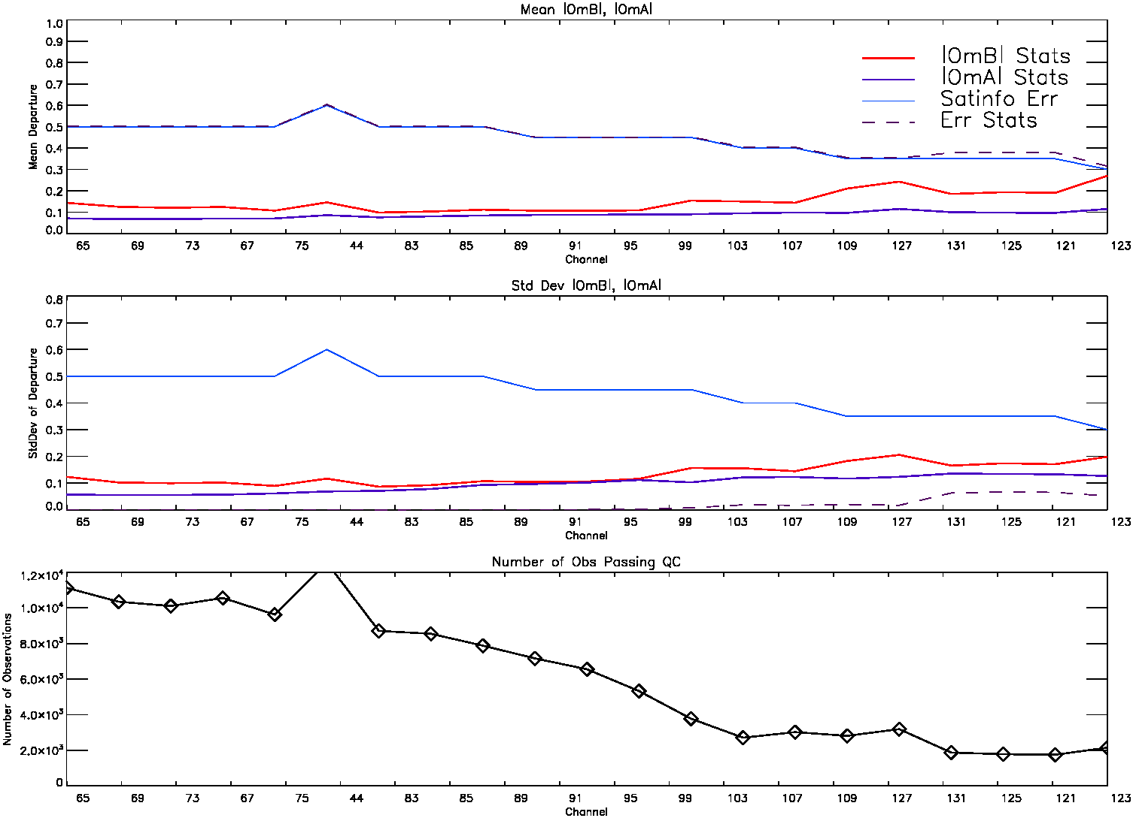
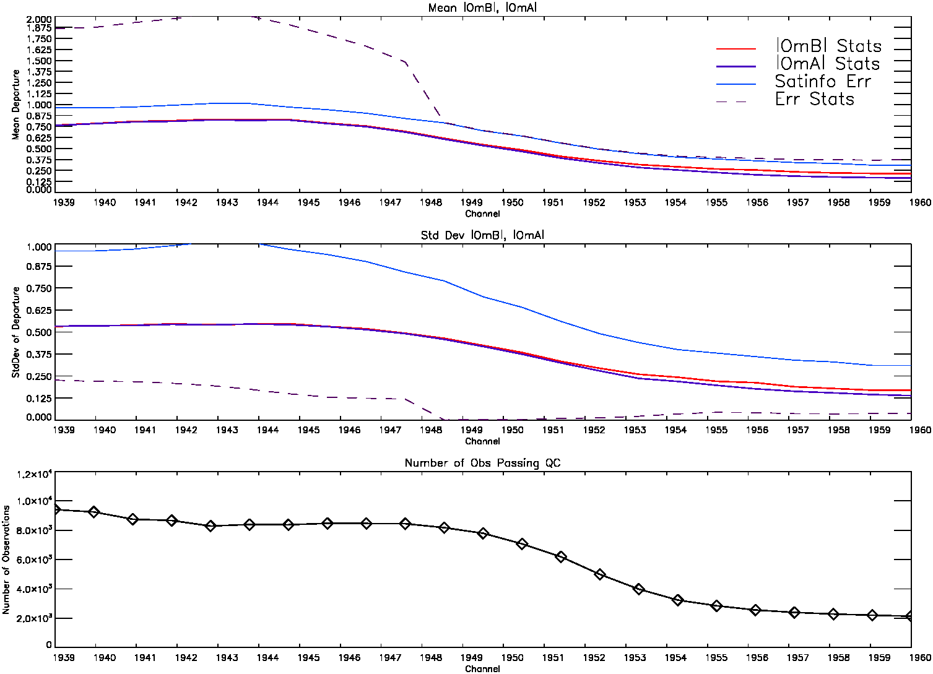
Observation minus background/analysis
1 cycle
CrIS O-B/O-A for LWIR Region
CrIS O-B/O-A for SWIR Region
mean
mean
stdv
stdv
n.obs
n.obs
8k
4k
Channel Number
Channel Number
+2000 LWIR observations assimilated in the UTLS region
+2000 SWIR observations assimilated in the mid-lower troposphere

Slide 9
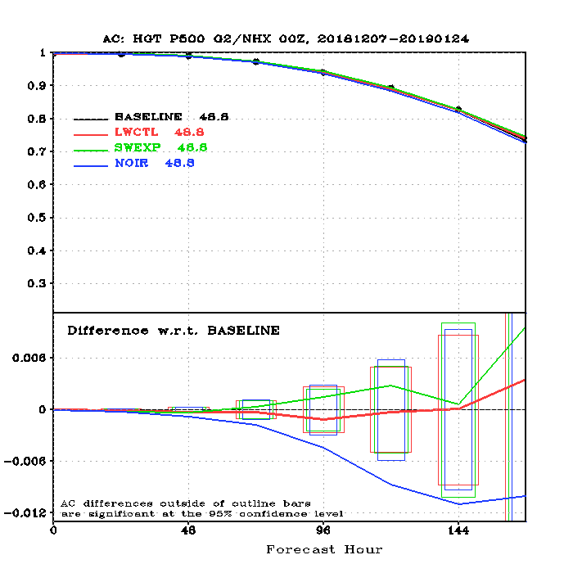
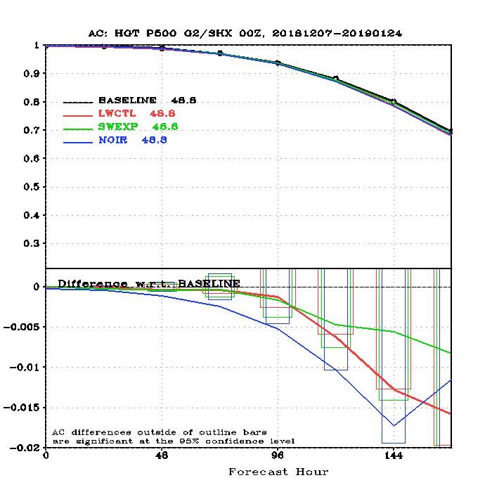
Forecast impact on height anomaly correlation
Height AC, 500 hPa, NH
Height AC, 500 hPa, SH
Anomaly Correlation with SW IR enabled is improved in NH and SH over LW IR assimilation, but neither is statistically significant over Baseline.
Northern Hemisphere
Southern Hemisphere
Better
Better
Significance intervals
Worse
Worse
Forecast Hour
Forecast Hour
500 mb Anomaly Correlation as a function of forecast hour (top).
Change in AC score relative to Baseline (bottom).
Verified against ECMWF.

Slide 10
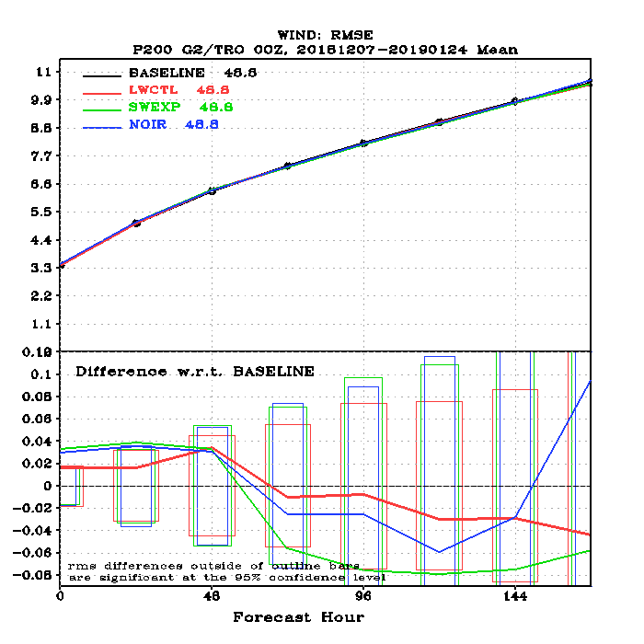
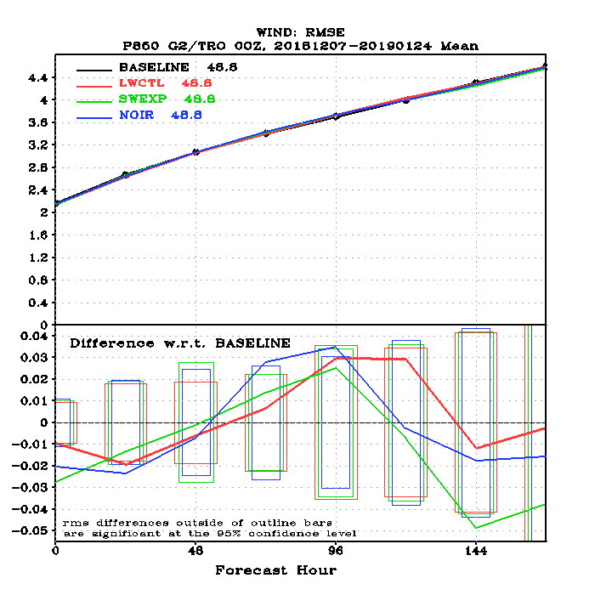
Forecast impact on tropical winds
Wind RMSE, 200 hPa
Wind RMSE, 850 hPa
IR Sounders in general show neutral impact on Tropical wind scores.
Tropics
Tropics
Significance intervals
Worse
Better
Forecast Hour
Forecast Hour
200 and 850 hPa Tropical Wind RMSE as a function of forecast hour (top).
Change in RMSE score relative to Baseline (bottom).
Verified against ECMWF.

Slide 11
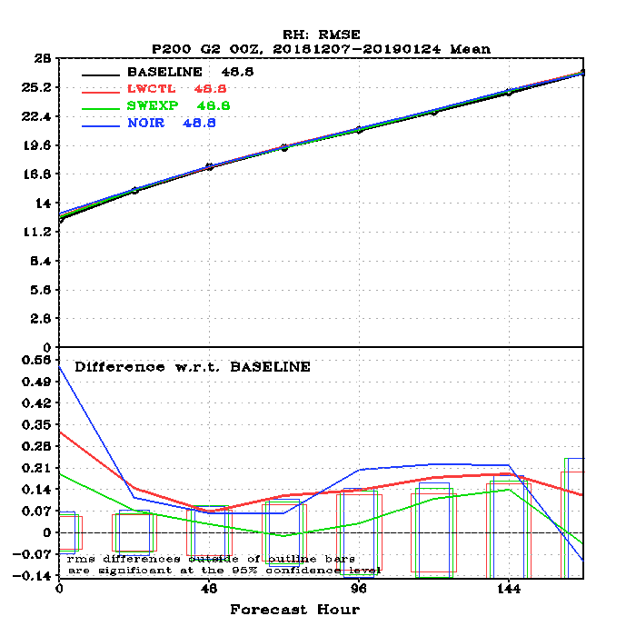
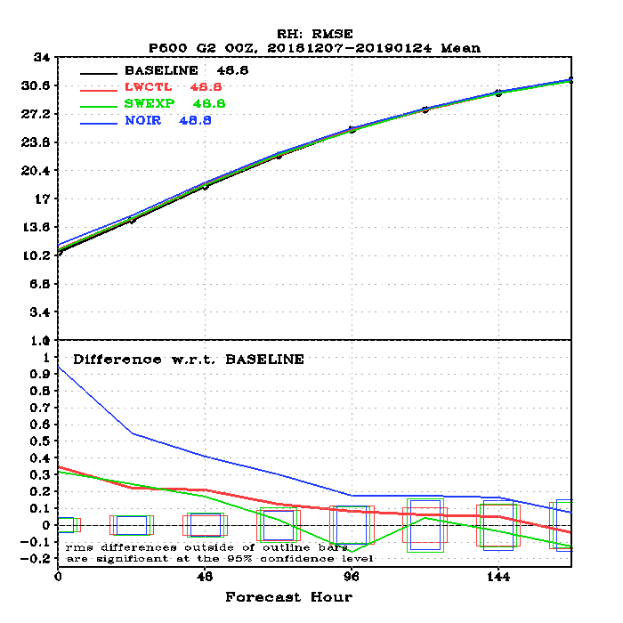
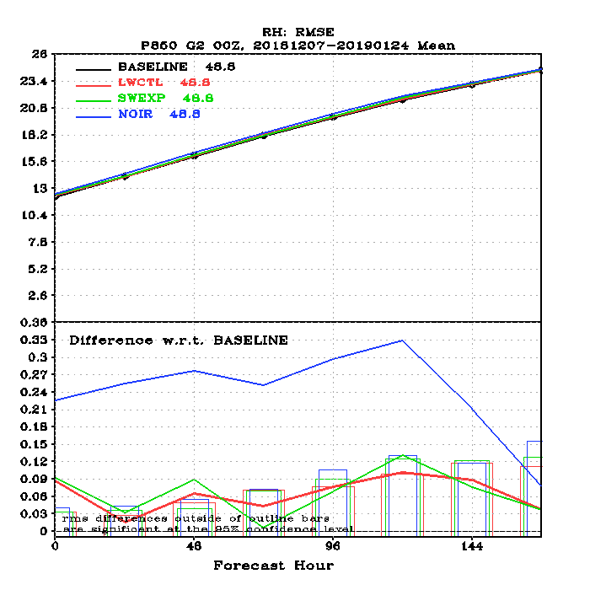
Forecast impact on global Relative Humidity
RH RMSE, 200 hPa
RH RMSE, 500 hPa
RH RMSE, 850 hPa
Worse
Significance intervals
Better
Forecast Hour
Forecast Hour
Forecast Hour
200, 500, and 850 hPa Global RH RMSE as a function of forecast hour (top).
Change in RMSE score relative to Baseline (bottom).
Verified against ECMWF.
Positive reduction in RMSE with SW IR enabled

Slide 12
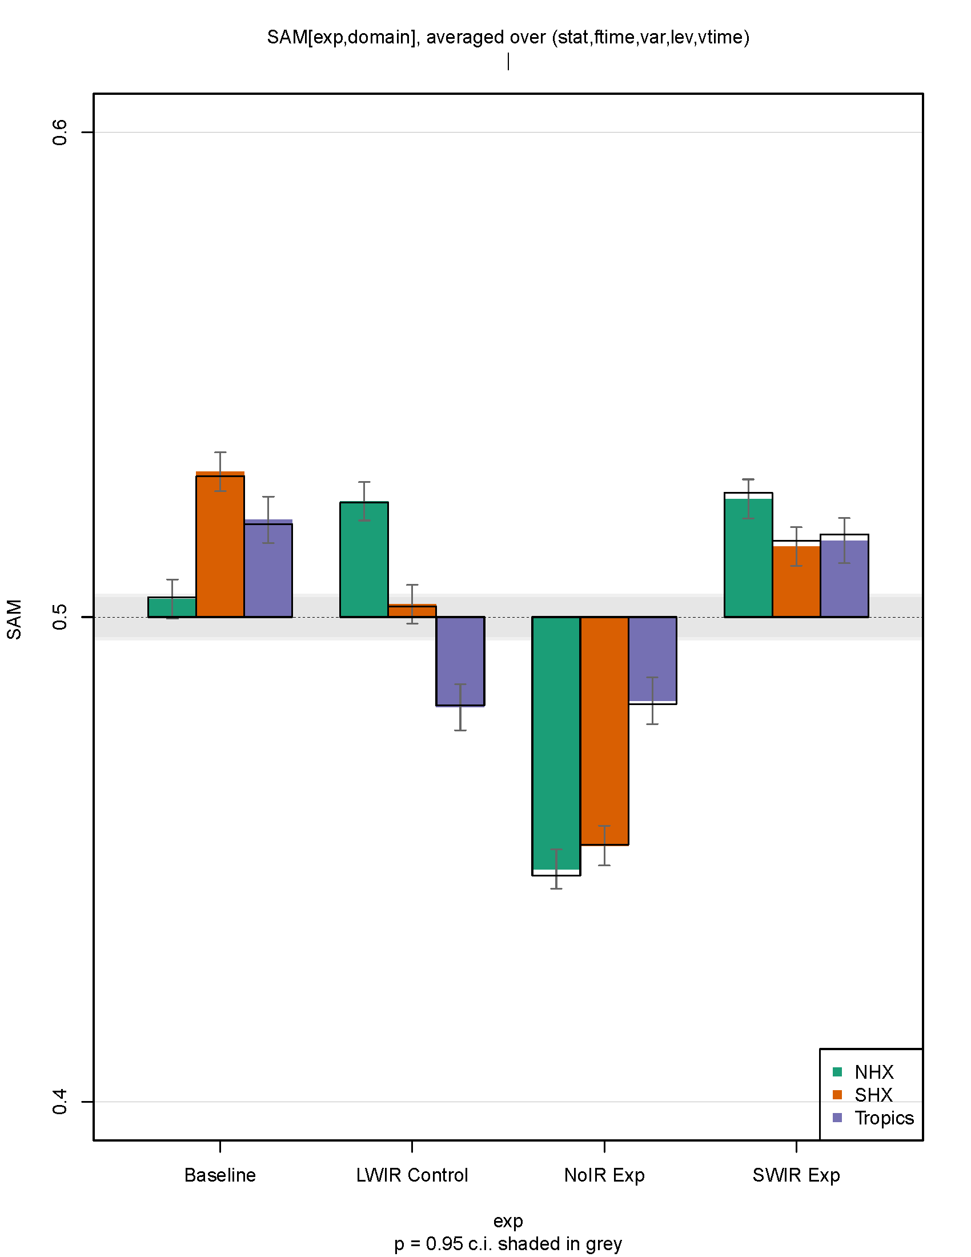
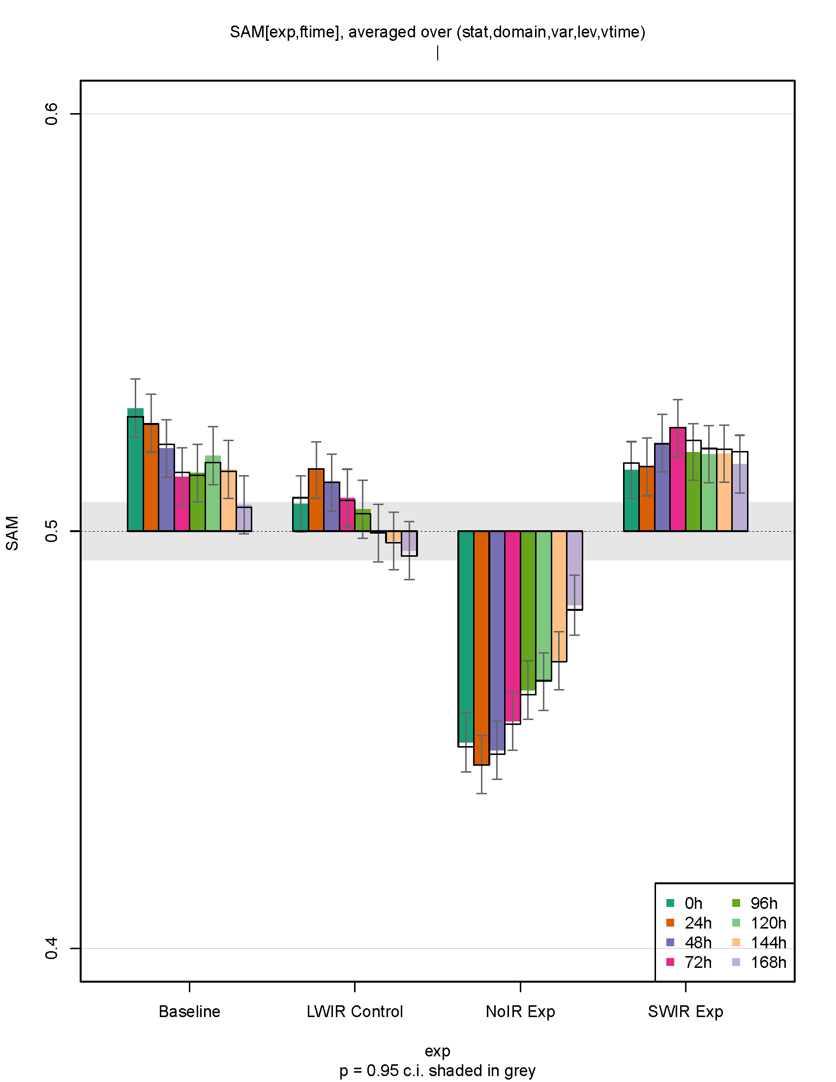
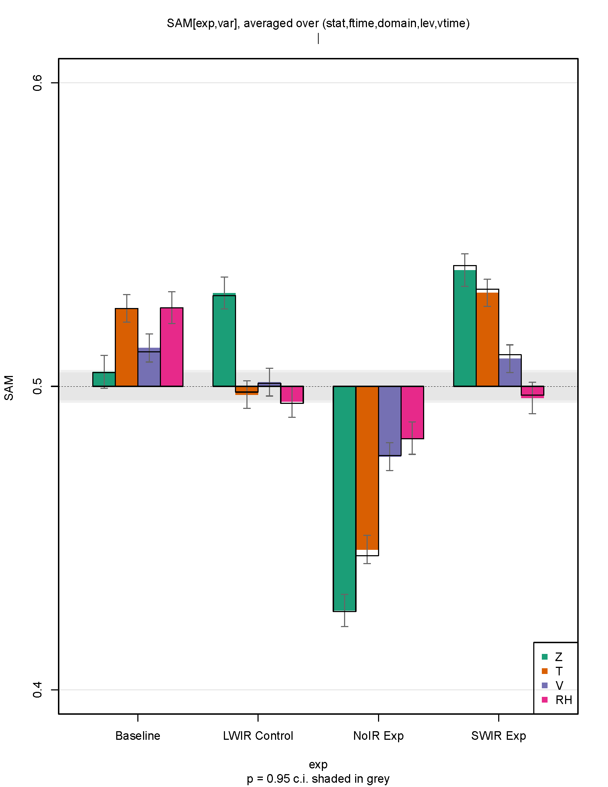
Overall Forecast Scores vs. ECMWF
Summary Assessment Metric (SAM): Global forecast verification against ECMWF
Statistics normalized over all parameters, layers, and forecast lead times
SWIR significant improvement Tropics and SHX vs LWIR scores
Forecast lead time scores normalized for all stats, layers, and parameters
SWIR significant improvement Day 4-7 vs LWIR scores
Parameter scores normalized over all stats, layers, and forecast lead times
SWIR significant improvement in T, V, RH vs LWIR scores
Baseline
LWIR Exp
No IR
SWIR Exp
Baseline
LWIR Exp
No IR
SWIR Exp
Baseline
LWIR Exp
No IR
SWIR Exp

Slide 13
Observing System Experiment setup
Observation | Baseline (Ops) | SW IR (Exp)
Conventional
Sat-winds
IASI
AIRS
CrIS LW IR
CrIS SW IR
ATMS
AMSU/MHS
GPSRO
Use current operational FV3GFS 4DEnVar at C384 (~25 km)
Experiments run 2018-12-01 to 2019-01-31
Verified against self analysis and ECMWF analysis
Verification is using analyses/forecasts from 2019-12-08 to 2019-01-24

Slide 14
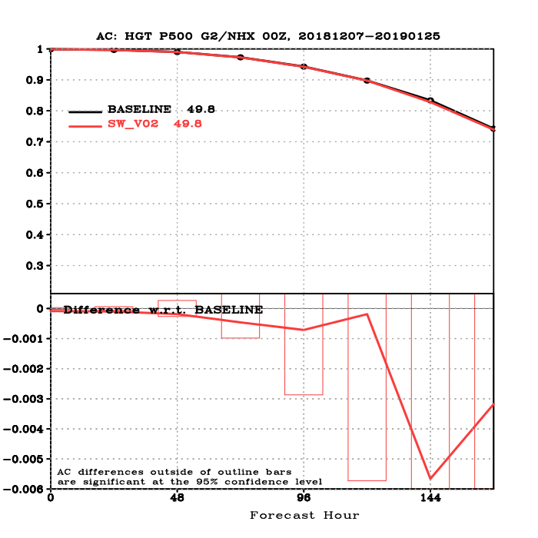
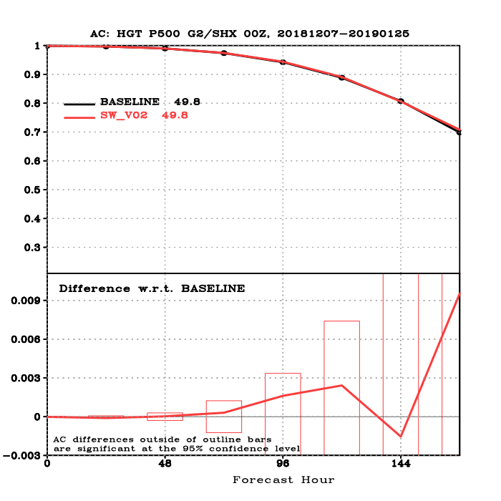
Forecast impact on height anomaly correlation
Height AC, 500 hPa, NH
Height AC, 500 hPa, SH
No Impact switching from LW IR to SW IR on 500 hPa Height Anomaly Correlation.
Forecast Hour
Forecast Hour
500 mb Anomaly Correlation as a function of forecast hour (top).
Change in AC score relative to Baseline (bottom).
Verified against ECMWF.

Slide 15
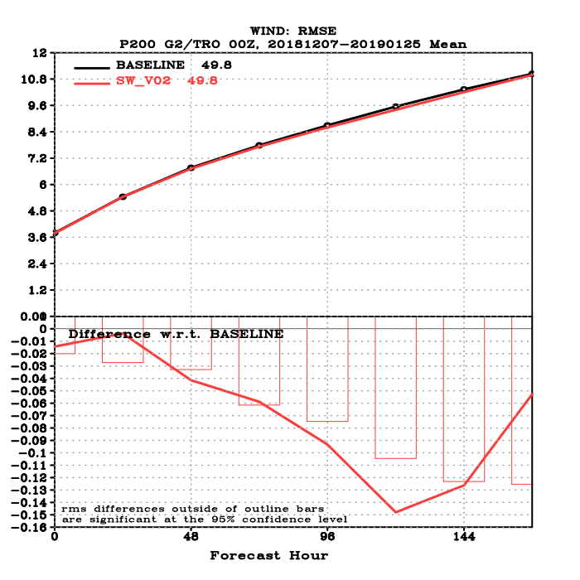
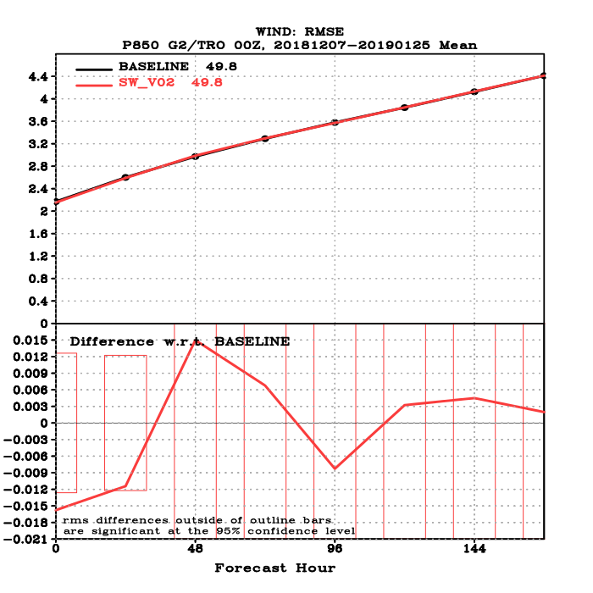
Forecast impact on tropical winds
Wind RMSE, 200 hPa
Wind RMSE, 850 hPa
Some positive impact on Tropical winds RMSE with SWIR assimilated.
Tropics
Tropics
Forecast Hour
Forecast Hour
200 and 850 hPa Tropical Wind RMSE as a function of forecast hour (top).
Change in RMSE score relative to Baseline (bottom).
Verified against ECMWF.

Slide 16
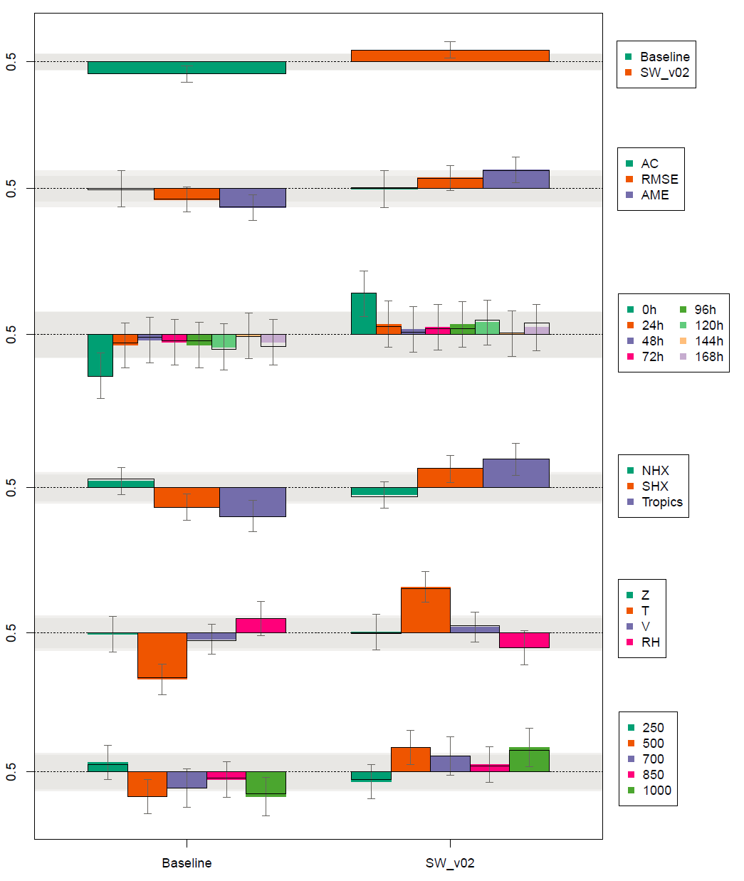
Overall Forecast Score vs ECMWF
Summary Assessment Metric (SAM): Global forecast verification against ECMWF
Forecasts with SWIR assimilated show statistically significant improvement.
SWIR assimilation shows largest impact in temperature forecast.

Slide 17
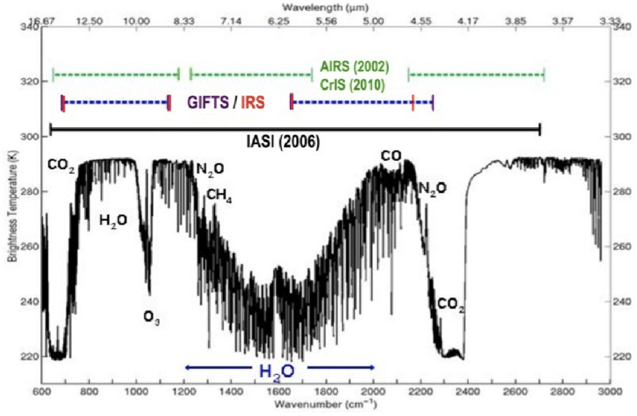
Discussion
 | LWIR | SWIR
Fixed CO2
Fixed N2O
Fixed CO
Fixed O3
H2O absorption
Noise
Resolution (Vert)
Solar
Smith et al. 2009
Potential Limitations for NWP
SWIR provide significant positive impact of LWIR as NWP systems are currently configured. At a minimum, SWIR sounders could complement traditional LWIR sounders. For simply providing temperature information to NWP, SWIR likely could be an alternative solution to LWIR.

