Slide 1
Review of NOAA Unified Forecast System Future Observation Needs
Kevin Garrett
NOAA/NESDIS Center for Satellite Applications and Research
With previous inputs from:
Curtis Alexander, DaNa Carlis, Steve Weygandt, Jim Yoe and many others
SAT Briefing
Satellite and Information Service
04 October 2021

Slide 2
Unified Forecast System
The Unified Forecast System (UFS) is “envisioned to be a community-based, coupled comprehensive Earth system model”
Spans regional to global domains
Predictive times scales (sub hourly to seasonal)
Ocean, Land, Cryosphere, Atmosphere, Space Wx, Air Quality, etc.
Research and Operational
Preprocessing, Data Assimilation, Forecasting, Post. & Verification
Shared components (infrastructure, physics, etc).
https://www.ufscommunity.org/
https://www.weather.gov/media/sti/nggps/UFS%20SIP%20FY19-21_20181129.pdf

Slide 3
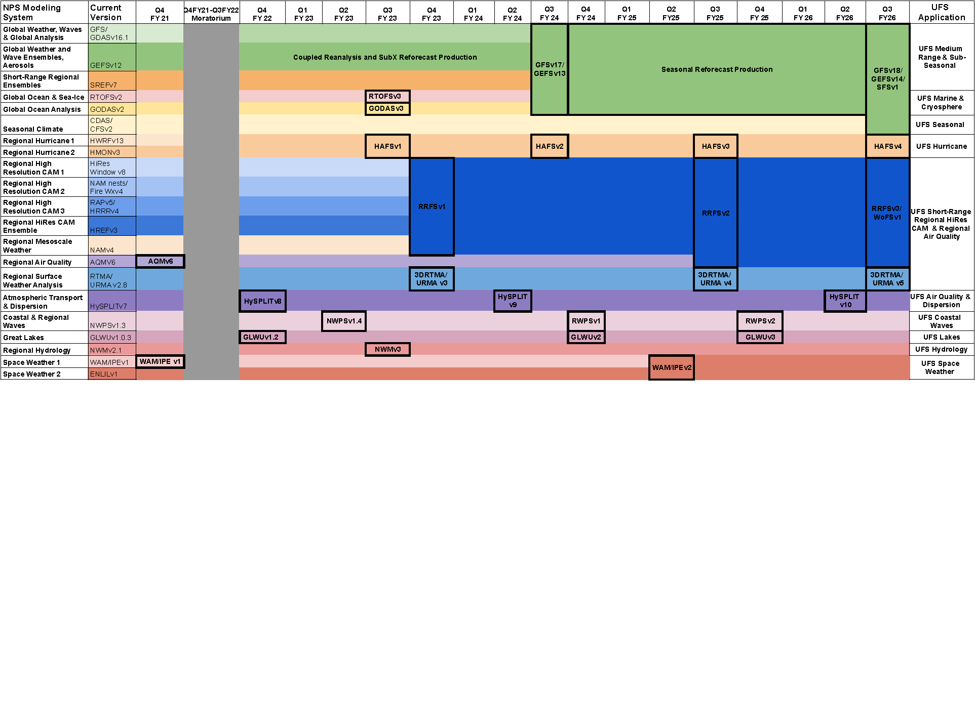
UFS Rainbow Diagram

Slide 4
Capture future model observational requirements
The GEO-XO Requirements Working Group (XORWG) NWP Subteam tasked to identify NWP observation needs from GEO 2030-2050 (parameters but not detailed attributes)
Developed a comprehensive catalog to capture needs more broadly
Aligned with UFS portfolio (NWP focus)
Captured evolution of modeling enterprise/capability (as much as possible); includes both current use and future needs
Not just limited to GEO (orbit agnostic)
Linkage to other observation requirements repositories (NSOSA, COURL); more needed

Slide 5
Linking UFS Capabilities to Observations
Observation Type
Domain/Coverage
Develop catalog that encompasses the current and future state of the UFS.
UFS Models
Assimilated?
(Assimilation) Cycling Interval
GEO Observation
Attributes
Resolution
Model X
Observations
Model Attributes
LEO Observation Attributes
Thinning
Resolution
Latency, Refresh, etc.
Latency/Run-time
Observation volume

Slide 6
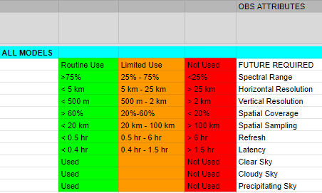
Observation attribute requirements

Slide 7
Summary of all models providing input

Slide 8
Continued Summary
Some notes:
Highest radiance requirements heavily driven by SRW/CAM
Some information (needs) gaps remaining (Ocean, Hurricane)
Attribute ranges may require fine tuning, boundaries (min/max)
Shift to make technology agnostic?

Slide 9
Mapping needs to requirements
GFS

Slide 10
Which models drive future constellations?
GFS
Global vs Regional
Requirements
RRFS

Slide 11
Next steps
Fill in gaps (UFS areas)
Narrow-down model requirements (increased granularity)
Strengthen linkage to existing requirements and to other efforts

