Slide 1
System performance Assessment Team (SAT) Meeting
10 July 2023
Re-examining Cryosphere Applications and Requirements in WMO
Jeff Key
NOAA/NESDIS/STAR
Chair, GCW Observing Requirements Task Team

Slide 2
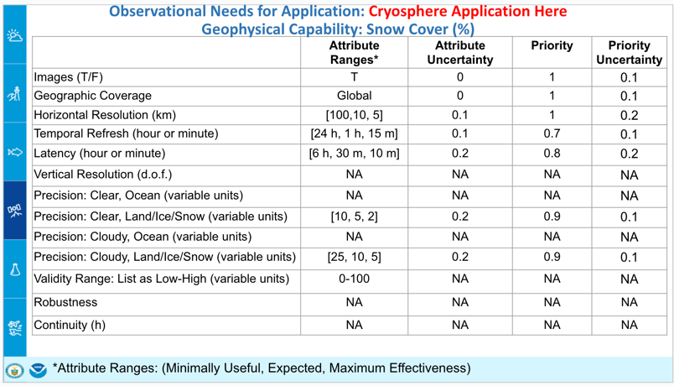
Disclaimers
I am not an official spokesperson for WMO. Don’t be misled by the WMO slide template.
You, the SAT, might be expecting to hear/see detailed requirements for observing the cryosphere. Instead, this presentation is about WMO’s efforts to update and expand the current observational requirements, and to provide gap analyses and recommendations for improving the cryosphere observing system. It is a project that will take at least 1.5 more years to complete.
But first, a little background on the cryosphere…
 | 2

Slide 3
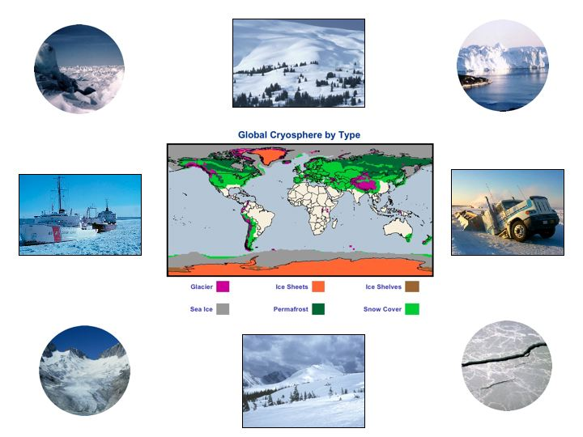
The cryosphere collectively describes elements of the earth system containing water in its frozen state and includes:
solid precipitation, snow cover, sea ice, lake and river ice, glaciers, ice caps, ice sheets, ice shelves, permafrost and seasonally frozen ground.
The cryosphere is global, ~100 countries

Slide 4
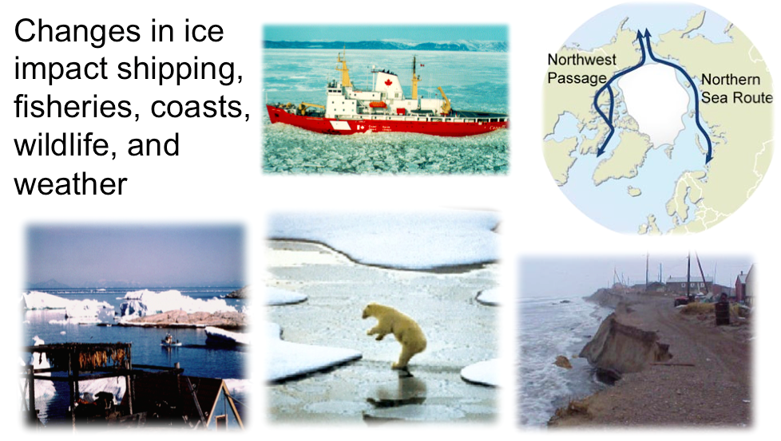
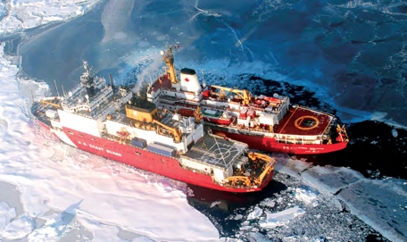
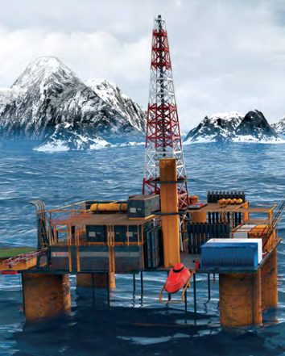
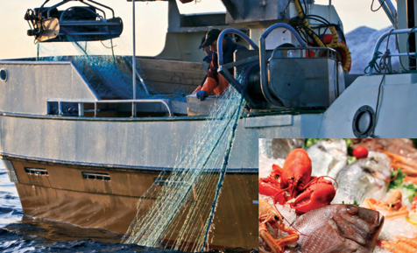
Importance of the Cryosphere
Notes:
Ship photo: USCG

Slide 5
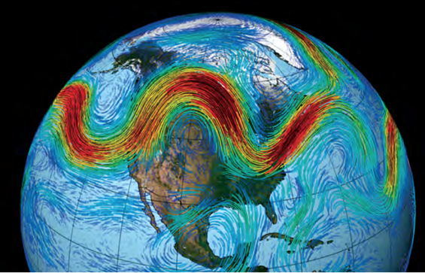
Importance of the Cryosphere
Notes:
Atmospheric circulation image: NASA
New Consensus: Possibility that continued Arctic warming will increase winter storm events that are regional (eastern North America and northeastern Asia), episodic, and extremes of existing weather patterns

Slide 6
Importance of the Cryosphere
Notes:
Manhattan figure from http://freegeographytools.com/2007/high-resolution-sea-level-rise-effects-in-google-earth

Slide 7
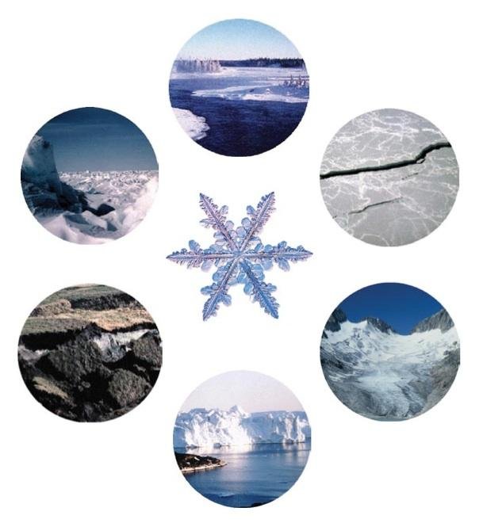
The NESDIS Cryosphere
River and lake ice
✓
Ice sheets, ice caps, ice shelves
✘
✓
Sea ice
Permafrost and seasonally-frozen ground
Snow
✓
✘
✘
Glaciers

Slide 8
WMO has had a focus on the cryosphere for 150 years
2nd IMO Congress (1879) - Resolution :
Congress requested that observations at high elevation and of glaciers length and thickness be organized and data shared, to aid in the solution of problems that may present themselves in the future.
1879 – 2nd International Meteorological Congress:
Cg-IV(1963):
the 1st EC Standing Committee on Antarctic
Cg-14 (2007)
EC-PORS
Cg-16 (2011) GCW
2013-2022
PPP
Cg-17 (2015)
EC-PHORS
2021 – GCW in INFCOM
Cg-19
2024-27:
Draft SO 1.5
Draft Res 3.2(3): Cryosphere Priorities
GCW – Global Cryosphere Watch, EC – WMO Executive Council; EC-P(H)ORS – EC expert panel on Polar (and High Mountain) Observations, Research, and Services, Cg-xx – World Meteorological Congress session xx, INFCOM – Infrastructure Commission, PPP – Polar Prediction Project
 | 8
Notes:
Strategic Objective 1.5 in the WMO Strategic Plan 2024-2027: Accelerate the development of integrated systems and services to address global risks associated with irreversible changes in the cryosphere and downstream impacts on water resources and sea level rise.
Resolution 3.2(3): Priorities to Address Global and Regional Impacts of Changes in the Cryosphere

Slide 9
Cryosphere Priorities in WMO/INFCOM
INFCOM2 (2022), Resolution 4:
3 - Infrastructure roadmap to a fully integrated cryosphere in Earth system models
4 - Enhance the availability of cryosphere observations in WIGOS
5 - Cryosphere data in the WMO Unified Data Policy
6 - Cryosphere data: standardization and increased access through WIS
7 - Integrate cryosphere specific functions in GDPFS/WIPPS
8 - Systematic approach to cryosphere-related hazards in the DRR framework
9 - Cryosphere in the Global Climate Observing System (GCOS)
10 - Roadmap for Research to Services for Polar and High-Mountain Regions
11 - Further research on key questions on the cryosphere and its impacts
12 - Access to cryosphere space-based products: engagement with space agencies
WIGOS - WMO Integrated Global Observing System, GDPFS - Global Data-processing and Forecasting System,
WIPPS - WMO Integrated Processing and Prediction System, DRR – Disaster Risk Reduction
Notes:
WIGOS - WMO Integrated Global Observing System
GDPFS - Global Data-processing and Forecasting System
WIPPS - WMO Integrated Processing and Prediction System
DRR – Disaster Risk Reduction

Slide 10
The WMO Rolling Review of Requirements Process
For each application area, the process consists of four stages:
a review of technology-free Members' requirements for observations, within an area of application covered by WMO programmes and co-sponsored programmes;
a review of the observing capabilities of existing and planned observing systems, both surface- and space-based;
a Critical Review of the extent to which the capabilities (ii) meet the requirements (i); and
a Statement of Guidance based on (iii).
The aim of the Statement of Guidance is:
to inform WMO Members on the extent to which their requirements are met by present systems, will be met by planned systems, or would be met by proposed systems. The Statement of Guidance is essentially a gap analysis with recommendations on how to address the gaps. It also provides the means whereby Members, through the Technical Commissions, can check that their requirements have been correctly interpreted.
to provide resource materials useful to WMO Members for dialogue with observing system agencies regarding whether existing systems should be continued or modified or discontinued, whether new systems should be planned and implemented, and whether research and development is needed to meet unfulfilled aspects of the user requirements.
Notes:
Technology-free means that the requirements do not take into account the available technology for making the observations, whether it is surface-based or space-based; they are independent of observing system capabilities as far as is possible.
This material is from https://wmoomm.sharepoint.com/:b:/s/wmocpdb/ETZhhknsfYJAlCBkkiMfftUBPsJpvtw64vNwiLUisgB-Ug?e=PEveDf

Slide 11
The Rolling Review of Requirements (RRR): Requirements, Gaps, Statement of Guidance
SoG Space
SoG Atmosphere
OSCAR Requirements
Review of Technology Free User Requirements per Earth System Domain
SoG Ocean
Synthesis and recommendations to Members on evolution of observing systems
Gap Analysis
SoG Hydrosphere/Terrestrial
SoG Cryosphere
POCs for AAs
OSCAR Surface & OSCAR Space Current and Planned Capabilities
SoG Integrated Earth System
The Point of Contact (POC) for each Application Area (AA) facilitates a consensus for requirements on observations and submits them to OSCAR (Observing Systems Capability Analysis and Review Tool).

Slide 12
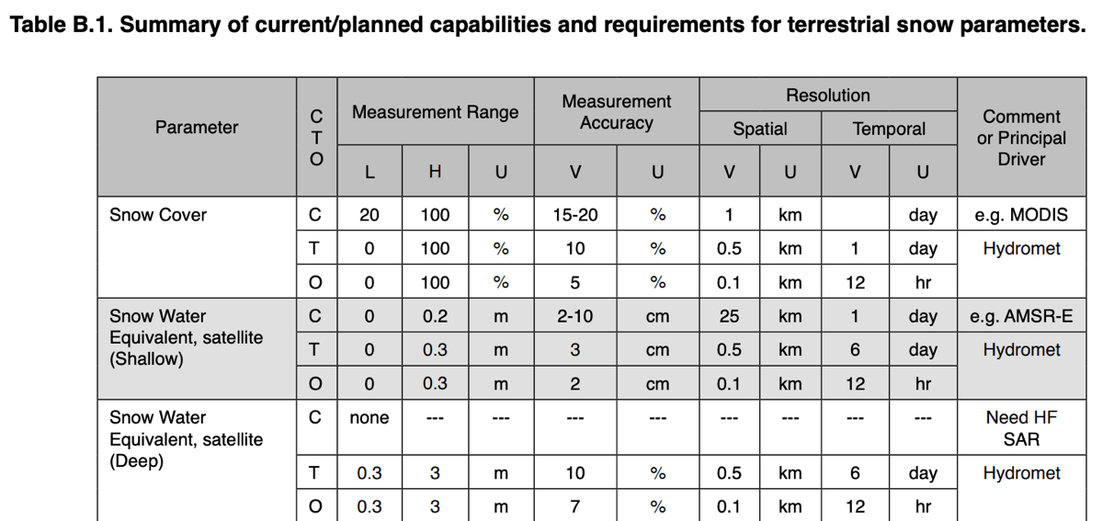
Historical Note
A compilation and consolidation of observational requirements and capabilities for the cryosphere was done and published in a report of the Integrated Global Observing Strategy (IGOS) in 2007.
Available at https://stratus.ssec.wisc.edu/igos/docs/cryos_theme_report.pdf

Slide 13
The Rolling Review of Requirements (RRR)
Cryosphere Earth System Application Category (ESAC)
and its Application Areas
ESAC | 5. Cryospheric Applications | INFCOM/AG-GCW
AA | 5.1 Terrestrial Cryosphere Forecasting and Monitoring | INFCOM/AG-GCW
AA | 5.2 Sea-Ice Forecasting and Monitoring | INFCOM/AG-GCW
AA | 5.3 Cryospheric Climate Monitoring | INFCOM/AC-GCW in collaboration with GCOS/TOPC, OOPC
AA | 5.4 Cryospheric Disaster Risk Reduction | INFCOM/AC-GCW in collaboration with SERCOM/SC-DRR

Slide 14
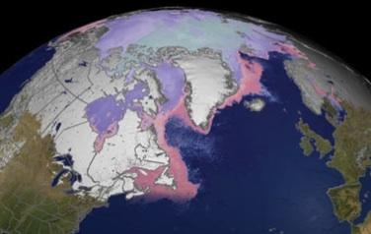
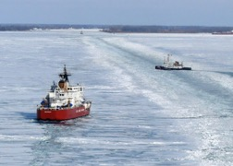
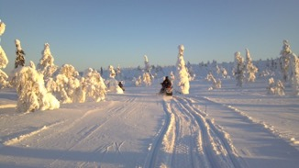
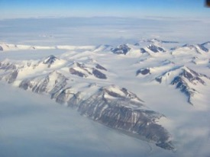
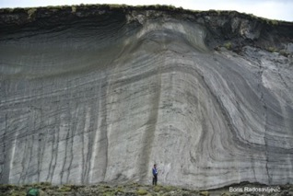
The GCW Pilot Study
The objectives of the GCW pilot study are to follow the RRR process for terrestrial snow and sea ice*. The process includes the following elements:
a review of technology-free Members' requirements for observations, within an area of application covered by WMO programmes and co-sponsored programmes;
a review of the observing capabilities of existing and planned observing systems, both surface- and space-based;
a Critical Review of the extent to which the capabilities (b) meet the requirements (a), i.e., gaps; and
a Statement of Guidance based on (c) for all Application Areas considered within the category.
*While the original plan was to address only terrestrial snow cover, we had already started work on sea ice and will address terrestrial snow later.

Slide 15
GCW has a Task Team Specifically for this: CRYORA
CRYORA mandate: develop cryosphere observing requirements and related guidance in the new RRR.
Expert Teams:
Cryosphere and Polar Observations (ET-CPO)
Cryosphere and Polar Data Interoperability (ET-CPDI)
Sea Ice Watch (ET-SIW)
Snow Watch (ET-SW)
Task Teams:
Cryosphere Observing Requirements (CRYORA)
Glaciers and Ice Caps (GIC-TT)
Permafrost (P-TT)
Coordinators:
GCW Best Practices Coordinator (GCW-BPC)
Polar Regional Climate Centres Focal Point (GCW-PRCC-FP)
Cryosphere Bulletin Coordinator (CBC)
GCW National Focal Points
CRYORA Team and SMEs:
Jeff Key – lead, NOAA
Thomas Lavergne – GCOS ECV
Stefan Kern - GCOS ECV/OOPC
Penelope Wagner – Met Norway, IICWG
Petra Heil – Australian Antarctic Div, IPAB/IABP
Luzmila Gomez – Argentinian Hydrographic Service, IICWG
Alejandro de la Maza – Chile Navy, IICWG
Vasily Smolyanitsky – Arctic&Antarctic RCC
Steffen Tietsche – ECMWF
Keld Qvistgaard – SC-MMO
Sean Helfrich – NOAA
Ludovic Bruckner – NOAA/NIC
Chris Derksen - ECCC

Slide 16
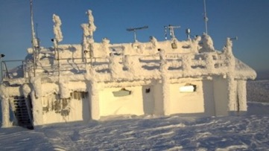
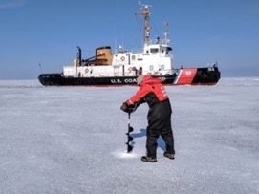
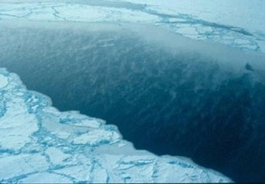
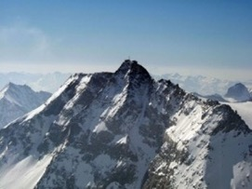
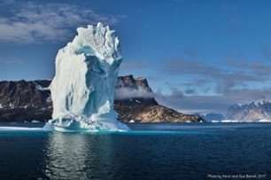
The CRYORA Process, Step 1: Literature Review
Reviewed at least 30 high-level documents for user needs (variables and requirements).
Appendix 1: CRYORA References
Allen, S., H. Frey, and C. Huggel. (2017). Assessment of Glacier and Permafrost Hazards in Mountain Regions. Technical Guidance Document. 10.13140/RG.2.2.26332.90245.
Bippus G., T. Nagler, S. Schiller, K. Luojus, and D. Gustafsson. 2016. Snow, Freshwater Ice, and Glacier information. CryoLand. 49pp.
Bring, A., I. Fedorova, Y. Dibike, L.Hinzman, J. Mård, S. H. Mernild, T. Prowse,O. Semenova, S. L. Stuefer, and M.-K. Woo(2016), Arctic terrestrial hydrology: A synthesis of processes, regional effects, and research challenges, J. Geophys. Res.Biogeosci.,121,621–649, doi:10.1002/2015JG003131.
etc.

Slide 17
Step 2: Identify User Applications
Applications as they appear in the literature have been tabulated.
Weather Prediction
NWP (Numerical Weather Prediction)/Nowcasting
Global NWP
High Res NWP
Nowcasting / VSRF
Weather Research
Weather Forecasting Operations
AOPC
Synopic Met
Atmospheric Research
Ocean Applications
Ocean Apps
Marine Met Services
Species/Organisms and Food Web Change Research
Ocean State and Coastal Zone Change Research
Sea Ice Change Research
Ice Sheet/Glacier Change Research
CLIVAR
GOOS
Oil
Ecosystem Change Research
Risk Management/Disasters/Hazards/Engineering
Engineering Design / Risk Management / Emergency Response
Oil
Climate Change Adaptation Operations
Avalanches
Environmental Impact Assessment
Engineering Design
Operations Planning
Route Planning
Safe Navigation and Operations
Risk Management
Emergency Response
Search and Rescue Operations
Operations Planning
Environmental Impact Assessment
Snow Change Research
Ecosystem Change Research
Ocean State and Coastal Zone Change Research
Land Surface and Use Change Research
Sea Ice Change Research
River/Lake Ice Change Research
Ice Sheet/Glacier Change Research
Permafrost Change Research
TOPC
Weather Research
Weather Forecasting Operations
Climate
….
Transportation/Navigation
….
Agriculture
….
Coastal Applications / Sea Level Rise
Coastal Apps
Species/Organisms and Food Web Change Research
Ecosystem Change Research
Ocean State and Coastal Zone Change Research
Land Surface and Use Change Research
Sea Ice Change Research
Ice Sheet/Glacier Change Research
River/Lake Ice Change Research
Permafrost Change Research
CLIVAR
TOPC
Hydrology/ Water Resources
Hydrological Monitoring
Hydrological forecasting/prediction
Snow Change Research
Land Surface and Use Change Research
River/Lake Ice Change Research
Ice Sheet/Glacier Change Research
Permafrost Change Research
CliC/GEWEX
GCOS/TOPC

Slide 18
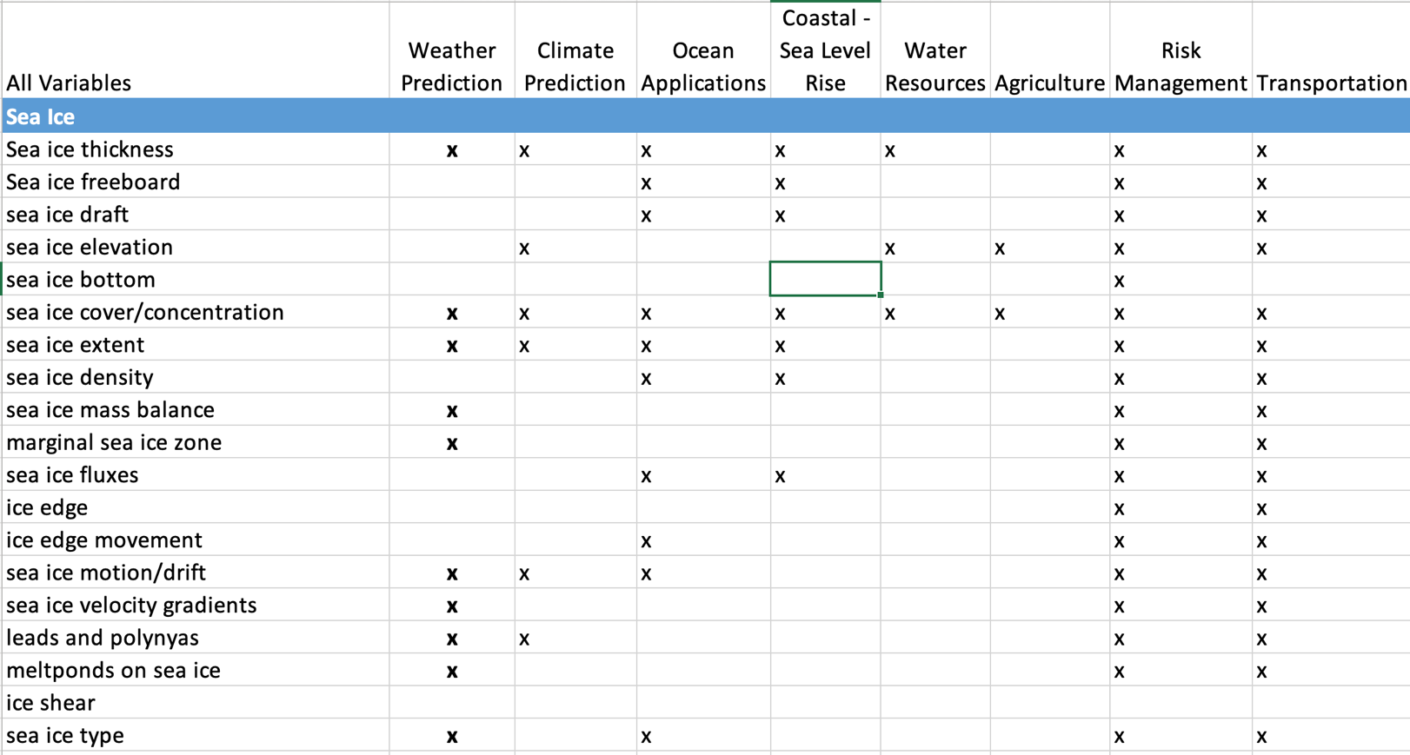
Step 3: Sea Ice Variables and User Applications
x
Note: This not a complete list

Slide 19
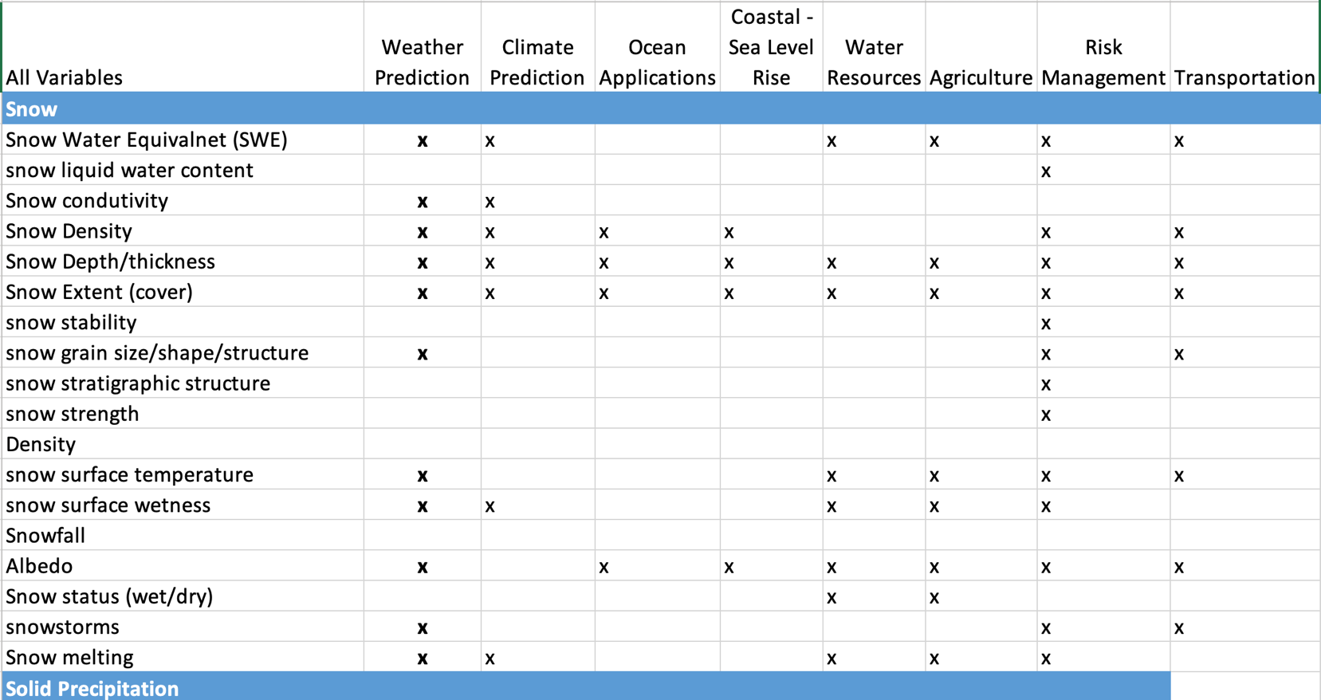
Step 3: Snow Variables and User Applications
Equivalent
Note: This not a complete list

Slide 20
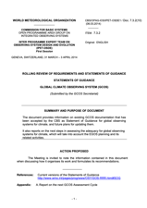
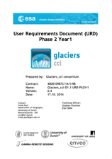
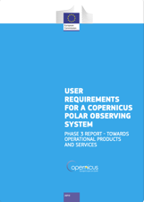
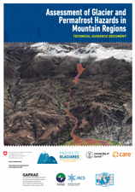
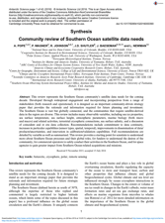
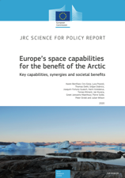
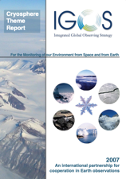
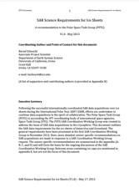
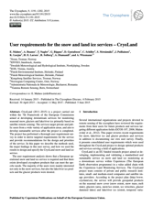
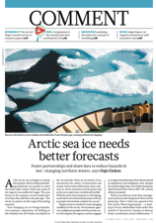
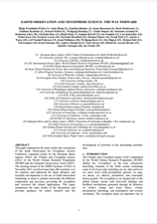
Step 4: Mapping CRYORA Application Areas and Variables to
WMO Earth System Application Categories/Areas
Some variables within GCW Areas will map to multiple WMO Application Categories/Areas and have different requirements
Not a trivial task!
GCW Draft
Application Areas
Earth System Application Category
Weather
Ocean
Space Weather
Coastal / Sea Level Rise
Atmospheric
Ocean
Climate
Hydrological / Terrestrial
Hydrology / Water Resources
Cryospheric*
Agriculture
Integrated Earth System Apps
Risks/Disasters/
Hazards/Eng
Literature Review
for Requirements
and Variables
Transportation/ Navigation
* All GCW Application Areas map to Cryospheric App Category
Arrows not drawn to simplify illustration

Slide 21
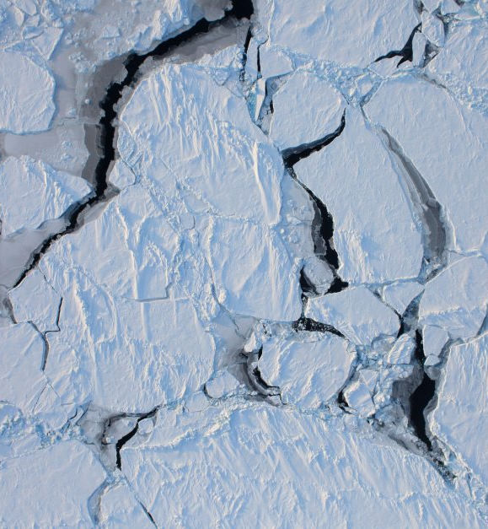
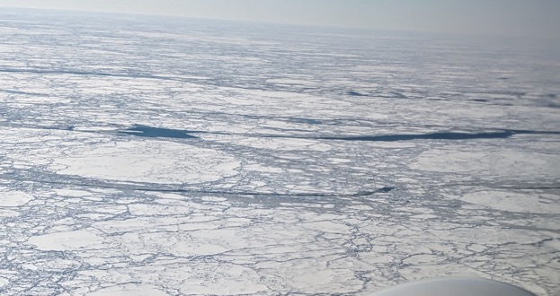
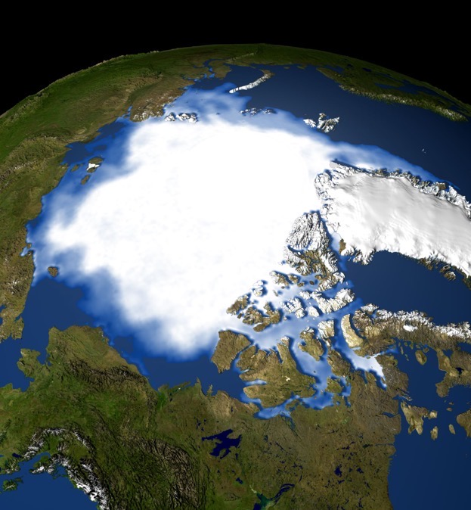
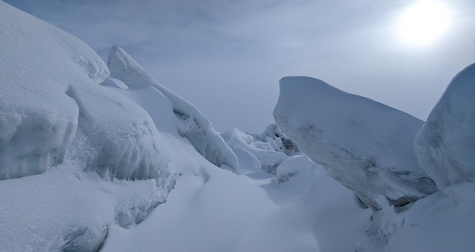
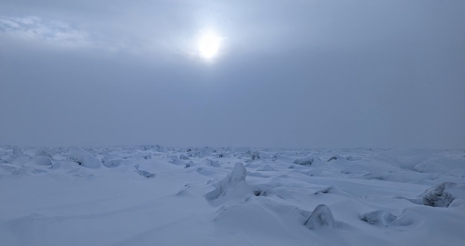
The Pilot Study Focuses on Sea Ice

Slide 22
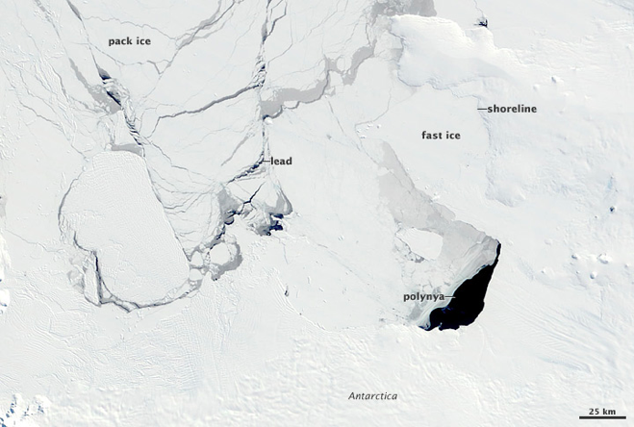
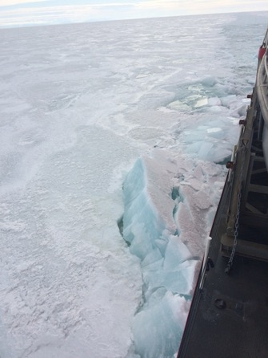
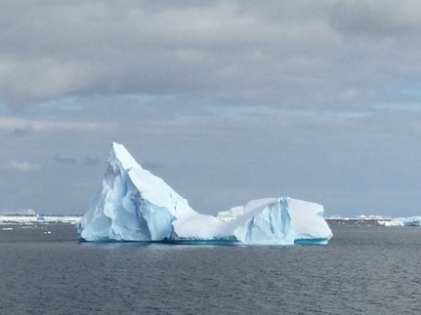
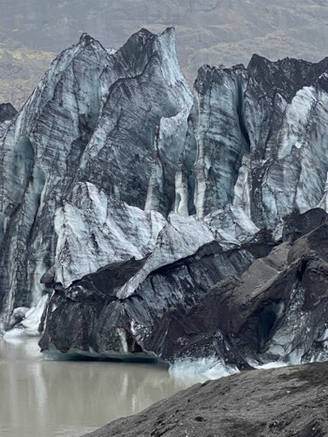
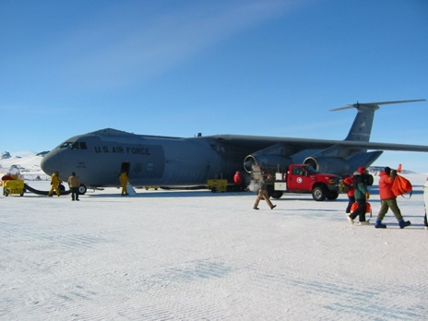
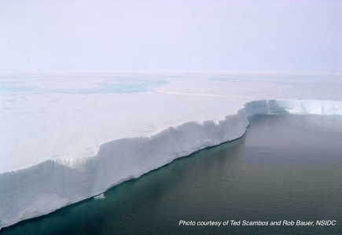
Which are Sea Ice?
(1)
(2)
(3)
Which of these pictures show sea ice?
X
The pictures on the right and below are not of sea ice. What are they? (Answer in the chat)
(From earthobservatory.nasa.gov)
(7)
(4)
(5)
X
(6)
X
The NOAA Observer’s Guide to Sea Ice has lots of information on sea ice types.

Slide 23
Step 5: Determining Essential Sea Ice Variables
 | Tactical (10-500m resolution, now to days ahead) (5.2) | Strategic (days ahead, sub-km resolution)) (5.2) | Short-term planning (km resolution, < 1 year ahead) (5.2) | Long-term planning (> 3km res, years ahead) (5.3): GCOS IP
Stage of development | x | x | x | x
Velocity /Drift | x | x | x | x
Concentration | x | x | x | x
Thickness | x | x | x | x
Sea ice temperature | x |  | x | x
Surface albedo | x |  | x | x
Pressure | x
Divergence/convergence | x
Sea Ice strength | x | x
Ridges (surface characteristics) | x | x
Icebergs (position?) | x | x
Leads and polynyas | x
Floe size | x
Snow thickness | x |  | x | x
Age |  |  | x | x
Stage of melt |  |  | x | x
Melt pond fraction |  |  | x | x
Note: Items in yellow are variables already in OSCAR Requirements, which are to be updated.

Slide 24
Updating OSCAR: Nomenclature is Important
Current OSCAR Req | Proposed changes (GCW) | GCOS Sea Ice ECV products
Sea-ice elevation | Sea-ice freeboard (cm→m)
Sea-ice surface temperature | Sea-ice temperature (K) | Sea Ice Temperature
Sea-ice thickness | Sea-ice thickness (cm→m) | Sea Ice Thickness
Sea-ice cover | Sea-ice concentration | Sea Ice Concentration (%):
Sea-ice motion | Sea-ice velocity (km*d-1 → m * s-1) | Sea Ice Drift (km/d):
Sea ice type | age, roughness, density, etc | Sea Ice Age (d):
Sea ice characteristics | sea-ice surface albedo, meltpond fraction, meltpond length scales, relevant snow (on sea ice) variables | Sea Ice Surface Albedo (l): Snow Depth on Sea Ice (m):

Slide 25
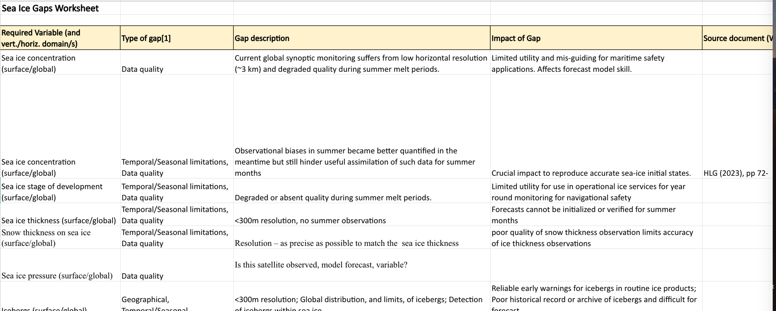
Step 6: Determining Priorities and Gaps
Why is there a gap and what are we going to do about it? A portion of the CRYORA sea ice gaps worksheet:
Notes:
High Level Guidance on the evolution of global observing systems during the period 2023-2027 in response to the Vision for WIGOS in 2040

Slide 26
Status of Pilot Project
GCW is engaged in a pilot study to assess gaps for the Sea Ice Forecasting and Monitoring application area. We are adding Cryospheric Climate Monitoring based on recent work for GCOS. Terrestrial snow will come later. Status of the activity:
Formed a GCW Task Team for this activity, CRYORA, building on the work of the IGOS Cryosphere Theme.
Performed a literature review to assess user needs (variables, requirements) and applications;
Compiled tables of variables, applications, requirements, and sources;
Map applications from the literature to RRR Earth System Application Categories and Application Areas, and reconcile findings with the JET-EOSDE RRR structure;
Prioritize variables (only sea ice so far);
Consolidate and refine numerical requirements;
Compile gaps, impact, and recommendations.
Prepare a Statement of Guidance (SoG).
Done
In progress
Just started

Slide 27
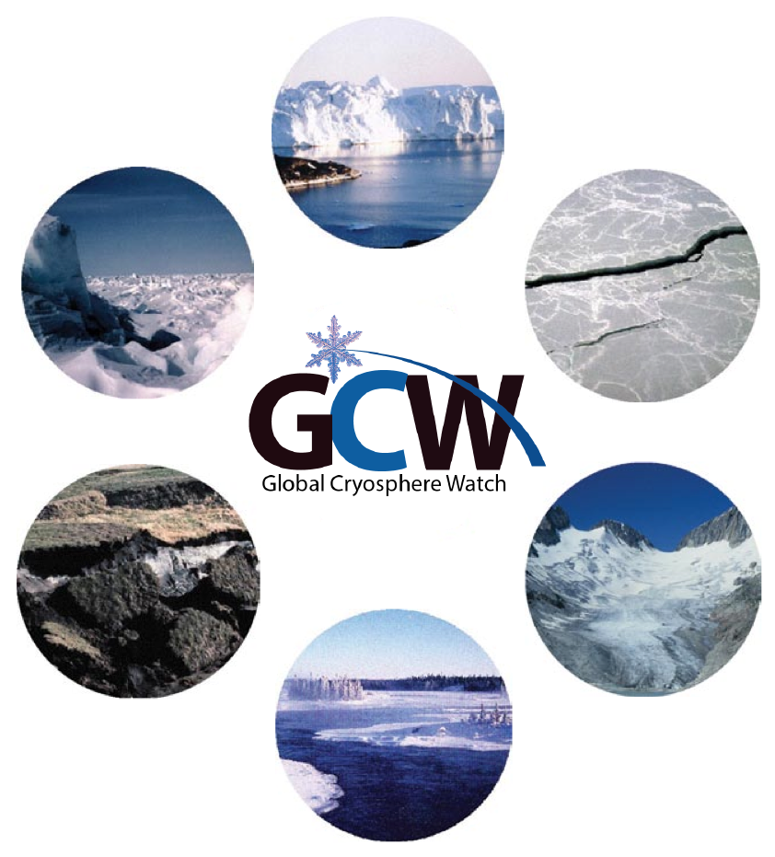
Thank you!

