Slide 1
Overview of Observational Needs Assessment:
Taking stock What we have
achieved, what we plan to do and for what purpose.
Sid Boukabara and Frank Gallagher
SAT co-chairs
Major contributions from Ross Hoffman and the ASPEN team

Slide 2
What was done so far:
Discussing the Driving applications (discussion led by Mitch)
Collected Global NWP Observational Needs
Next steps:
Review other GNWP needs as collected by XORWG, TPIO, UE at the core-SAT
Review and codify these GNWP needs into signed memo for future reference
Extend the assessment to future GNWP needs: Talk in progress with OAR/NWS UFS folks and with Future NWP WG
Based on previous SAT ‘driving applications’ discussion, we plan to Extend the assessment of observational needs to (1) nowcasting (2) air quality and (3) oceans. See discussions in this SAT meeting

Slide 3
For what purpose?
(are we collecting these observational needs)

Slide 4
For what purpose?
Enterprise Approach:
Needs should be assessed in a comprehensive fashion from users, independent of specific solutions
Funnel existing obs needs, consolidate/review/codify
Driving the next-gen Architecture:
Needs will be reviewed internally in NOAA. These will impact what gets adopted as requirements, to be put in the PLR of the space programs
Architecture Evaluation (performance assessment/validation) and optimization:
Use of ASPEN tool
Use of SAT (and formal recommendation using core-SAT) as a mechanism to review ASPEN tool science results

Slide 5
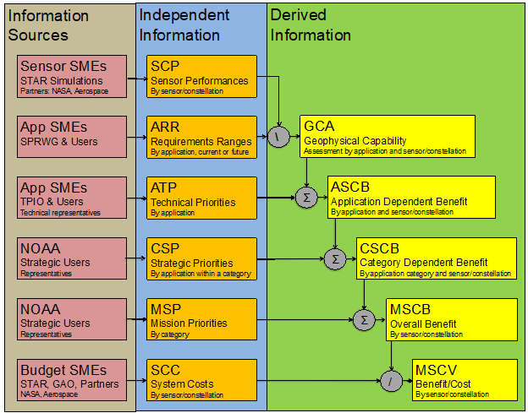
Where do these obs needs fit in the assessment process?

Slide 6
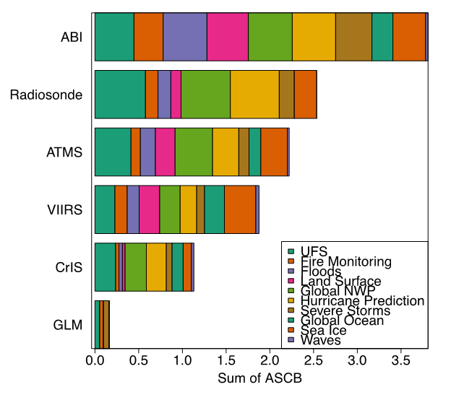
Why it is important that we explore multiple applications?

Slide 7
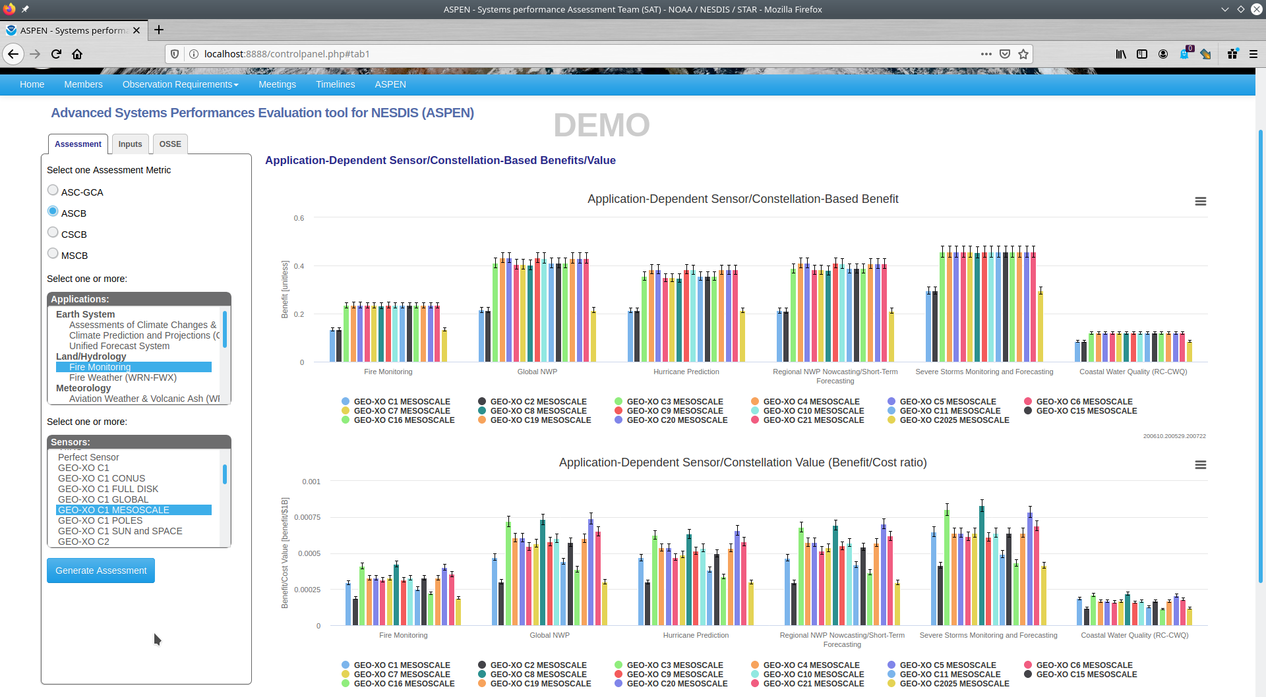
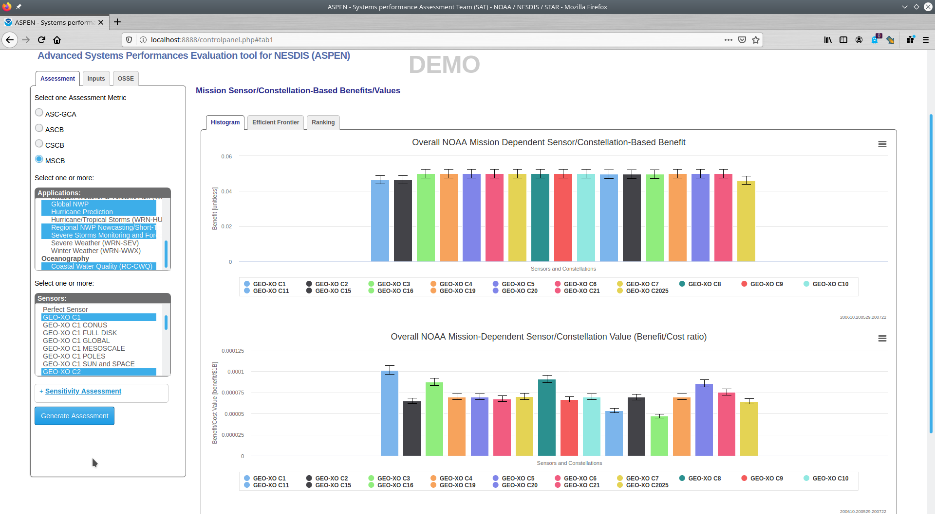
Example: GEO-XO Constellations Assessment: Case of 22 Constellations
Comparison of 17 out of 22 constellations
Using 6 example applications: (Fire, GNWP, Hurricane, Regional NWP, Severe Storms, Coastal water)
Const 1, 2 and 2025 have the lowest benefit, consistently.
Other Constells seem to have relatively similar performances & benefits
Costs however seem to be a defining factor for those 17 constells
Benefit Assessment of 17 constellations (mesoscale mode)
Benefit Assessment of 17 constellations (NOAA mission)
Bottom Line: Based on these ‘preliminary’ results, when rolled up to the NOAA mission level, constellations 1 (highest) 3,8 and 20 seem to have the highest values for many applications. These results do generally hold at individual applications, but not all. Constellation 16 seems to have the lowest value.

Slide 8
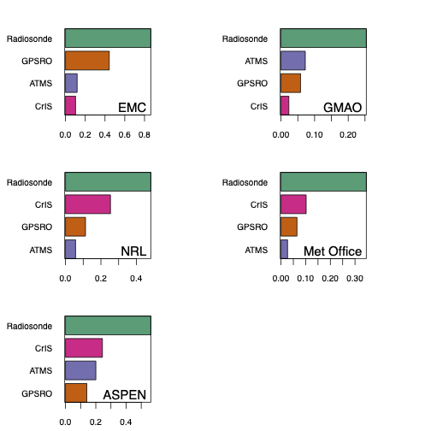
Assessment of ASPEN: How trustable is ASPEN evaluation?
FSOI
FSOI
FSOI-based assessment Intercomparison (UCAR/JCSDA) showing variability of FSOI results between centers and between sensors
FSOI
FSOI
ASPEN
ASPEN-based assessment showing overall compatibility of ASPEN results with FSOI

Slide 9
Things to keep in mind Going forward
Comprehensive approach is important: democratization of the assessment process.
Keeping the observational needs solution-agnostic is important to truly explore the most optimal solutions offered
ASPEN is just a tool. SMEs expertise is critical for the interpretation
Distinction between observational needs and sensors specifications (a later stage step)
Observational needs means: observables, their attributes, and their priorities, their uncertainties (if known), for different applications within a domain.
Ultimately, domain experts should also provide us with assessments of the priorities of different applications within a domain
We do realize it is a major undertaking with potential obstacles, but it is a worthwhile undertaking: to optimize the NOAA next gen space architecture

