Slide 1
SAT Discussion on Smallsats:
Quality vs Quantity
S.-A. Boukabara, E. Maddy, S. Bunin

Slide 2
What are Our Sounding Commitments? (to WMO)
WMO WIGOS 2040 vision
Subcomponent 1: Backbone system with specified orbital configuration and measurement approaches - This subcomponent shall provide the basis for Members’ commitments and should respond to their vital data needs; These are documented in the CGMS baseline (see next slide)
Subcomponent 2: Backbone system with open orbit configuration and flexibility to optimize implementation - This subcomponent shall be the basis for the open contributions of WMO Members and shall respond to target data goals.
Subcomponent 3: Operational pathfinders and technology and science demonstrators - This subcomponent shall respond to research and development needs.
Subcomponent 4: Additional capabilities - This subcomponent shall include additional contributions by WMO Members, as well as from the academic and private sectors.
The division of the observing capabilities into four subcomponents does not imply sequential priorities, that is, it is not expected that all Subcomponent 1 systems will necessarily be realized before elements of other subcomponents are addressed. The main distinction between the various subcomponents is the current level of consensus about the optimal measurement approach, especially the demonstrated maturity of that approach: there is stronger consensus for the capabilities included in Subcomponent 1 compared to those in Subcomponent 2, and so forth. It is likely that the boundaries between the groups will shift over time, for instance, some capabilities currently listed in Subcomponent 2 could transfer to Subcomponent 1.

Slide 3
What are Our Sounding Commitments? CGMS (LEO)
"....LEO may be sun-synchronous or drifting. Sun-synchronous orbits may have Equatorial Crossing Time (ECT) in the “early morning” (typically, 5:30 and 17:30), the “mid-morning” (typically, 9:30 and 21:30) or the “afternoon” (typically, 13:30 and 1:30). They overfly approximatively the same location of the Earth, including high latitudes, at approximatively the same time twice/day. For large-swath instruments, coverage at 4-hour intervals require three satellite at fairly-spaced ECT’s. Drifting orbit provide more frequent coverage with decreasing latitude (missing high latitudes) and ensure the viewing of the Earth at changing times of the diurnal cycle. "
Sensor | Observation/Measurement | Attributes
Microwave Sounder | Atmospheric temperature, humidity, and precipitation | 3 sun-synchronous orbits, nominally early morning, mid-morning and afternoon
Infrared Sounder | Atmospheric temperature, and humidity | Hyperspectral on 3 sun-synchronous orbits, nominally early AM, mid-AM and PM

Slide 4
What is an Observing System Performance?
(Main Point: a Sensor accuracy is a subset of the Obs. System Performance)
Performance is NOT just Accuracy of sensor measurement
Performance Attributes:
Information Capability : Depends on sensors characteristics
Spatial coverage : Depend on sensor and constellation characteristics
Temporal coverage : Depends on constellation characteristics
Accuracy : Dependent on Sensor characteristics
Vertical Resolution : Depends on sensors characteristics
Spatial resolution : Depends on both sensors and constellation characteristics
Measurement Density : Depends on sensor and constellation characteristics
Vertical validity range : Depends on sensors characteristics
Etc.
Applications put different priorities (and requirements) on the performance attributes
For example: Global NWP values a lot the capability, accuracy (noise level of radiance), the spatial coverage, temporal coverage, etc
Precipitation monitoring, because of strong signal in MW, values spatial and temporal coverage above all (given the POD and FAR metrics used in this application skill assessment)
For the design & evolution of the space architecture, it is preferable to think about the ‘Observing Systems (sensors in constellation configuration)’ performance, rather than single sensor accuracy.

Slide 5
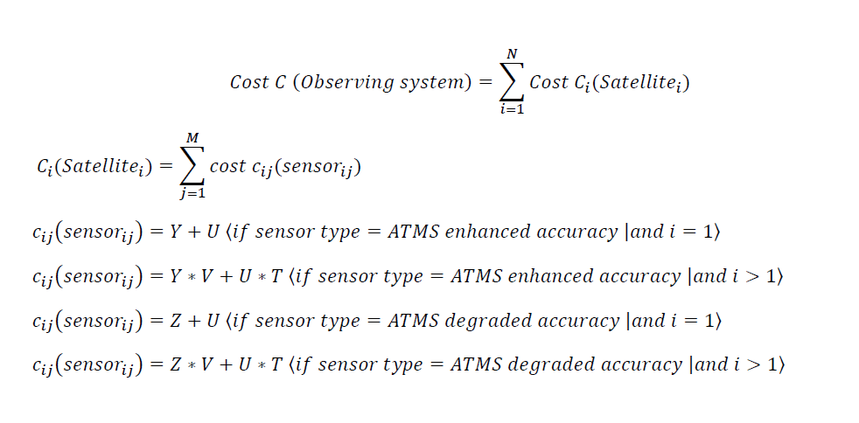
Suggested Approach for Performance & Value Assessment
(How to Account for Accuracy, Refresh and Costs at the same time in assessing the Observing Systems ability to meet NOAA Requirements)
Step 1: Define performance (SCP) in terms of accuracy, refresh, other attributes (resolution, etc) using Remote sensing Science (information content extraction) and SMEs
For Observing System 1: Accuracy Option A, Refresh Rate Option DA , (and options of Spatial resolution)
For Observing System 2: ….
Etc
Step 2: Compute cost based on formula (assuming observing system is composed of N satellites, each with a number M of similar sets of sensors Sensor_j (j=1,M) on each of the satellite_i (i=1,N),
Step 3: Use ASPEN with SCP inputs and Cost estimates above. Assess using the Global NWP ref

Slide 6
Questions for SAT
What are the global NWP requirements in 2030-2040 and technical weights? (see table)
How important we have 100% coverage, can we tolerate orbital gaps?, how much? 90% is ok?
If we have to make compromises on the sensor design itself (to save cost, to add spatial coverage, and temporal refresh, etc) what could be downgraded: channels, noise levels, spatial resolution, vertical resolution, etc?
Thoughts about the approach suggested (using ASPEN) on proposing the different technology solutions ?
Quality vs Quantity and optimal Observing Systems: For IR, are two orbits of a CrIS-class sounder (0930/1330) better than six or twelve orbits of disaggregated SW/MW and LW/MW sounders that increase temporal and spatial coverage?
For Microwave, are two orbits of ATMS-class sounder preferable to 6 or 12 orbits of smallsats-type MW Sensors with significantly improved refresh rate (and seemingly ATMS-equivalent sounding accuracy)?
What is ideal sounding capability of the future? (cost-effective smallsats/cubesats swarm of capable sounders, JPSS-style constellation with ATMS/CrIS sounders but one orbit only, Hybrid approach of both...)
 | Observable Weights | Observable Precision/Accuracy (std) weight | Observable Refresh rate weight | Std/Accuracy Requirement Range | Refresh Requirement Range
Temperature (K) | 1 | 1 | 0.5 | [2.5,2,1.5 1] | [4h, 2h, 1h]
Moisture (%) | 0.5 | 1 | 0.5 | [24,16,8] | [4h, 2h, 1h]

Slide 7
BACKUP

Slide 8
Sensors MW Precision Overall Assessment (Moving to High Freqs and Lower Noise)
 | Temperature performance wrt ATMS | Moisture performance wrt ATMS | TRL | Added Benefits | Approximate Cost comparison wrt A
A: ATMS Baseline channels, ATMS noise levels |  |  |  | TPW, RR, SWE, SIC, Cloud, etc | Cost-A
B: A with Improved Noise (0.25K for 50GHz, 0.35K for the 183GHz) | Improvement relative to baselines is mostly due to improved noise |  |  |  | Cost-B = fraction of Cost-A
C: A plus 118GHz and 204 w Improved Noise (0.25K for 50GHz, 0.35K for the 183GHz 0.3K for 118GHz) |  |  |  |  | Cost-C = fraction of Cost-A
D: A plus 118 and 204 but w Real Noise levels from ATMS, MicroMAS-2 | F similar to E, a little worse in middle troposphere, but better in stratosphere |  |  |  | Cost-D = fraction of Cost-A
E: A minus 23, 31 but plus 118 and 204, w Improved Noise (0.25K for 50GHz, 0.35K for 183GHz 0.3K for 118GHz) |  | Small bump/degradation in middle/lower troposphere without low freq. |  |  | Cost-E = fraction of Cost-A
F: A but 50GHz replaced by 118 and w 204GHz and Improved Noise ( 0.35K for the 183GHz 0.3K for 118GHz) | Slight degradation in the stratosphere |  |  |  | Cost-F = fraction of Cost-A
G: TEMPEST (only WV channels) |  |  |  |  | Cost-G = fraction of Cost-A
Significantly higher (>15%)
Higher (5-15%)
Equivalent (within 5%)
Lower (5-15%)
Significantly Lower (>15%)

