Slide 1
Radiance Bias Correction
and
the Use of TDR/SDR
Microwave Radiances at NCEP
Emily, Huichun Liu, Scott Sieron, Haixia Liu
and
NCEP EMC MDAB-DA & QC Group
Satellite Meeting
March 15, 2021

Slide 2
Variational Bias Correction for Radiances at NCEP
Automatically detect any new/missing/recovery of radiance data and initialize/monitor new radiance data, facilitating the R2O processes
Built-in self-initialization: the quasi-mode of all data
Adaptive background error variances for bias predictor coefficients base on the Hassian (analysis error) from the previous cycle
Modified pre-conditioning --- speed up convergence in the minimization
Capability of estimating bias correction for passive channels (set passive_bc .true.)
Perform at the end of each analysis cycle
Help to adjust to any changes in calibration or data processing
Cross validation for similar channels

Slide 3
Variational Bias Correction
Variational scan-angle dependent bias correction estimated together with other bias predictor inside the GSI
Scan angle bias is estimated as a 4th order polynomial (K=4)
both estimated inside of GSI
where
where
To handle RTM errors in SRF
(weighting function)

Slide 4
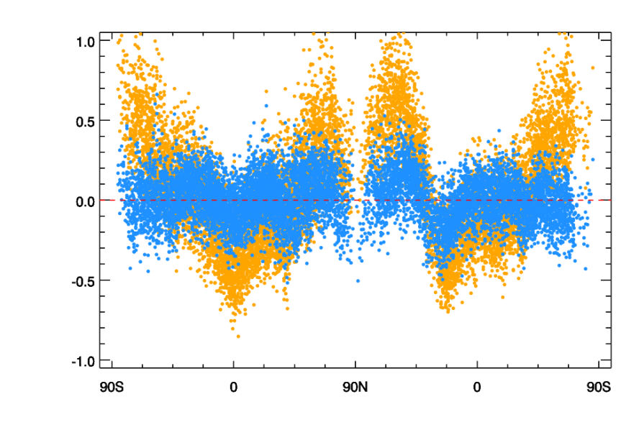
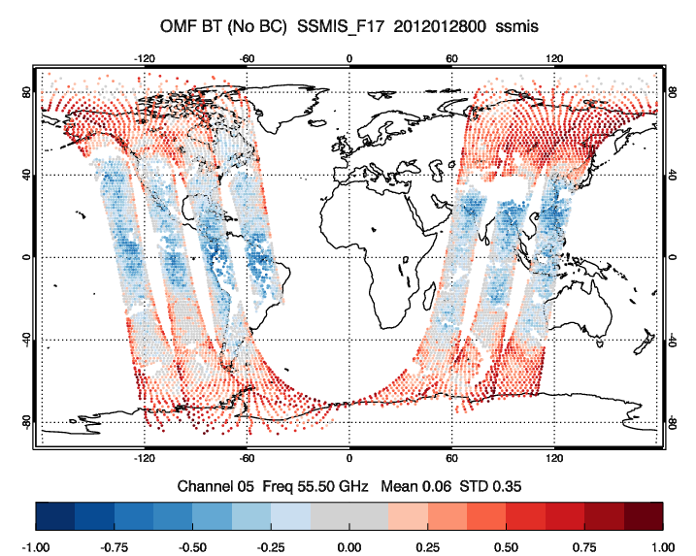
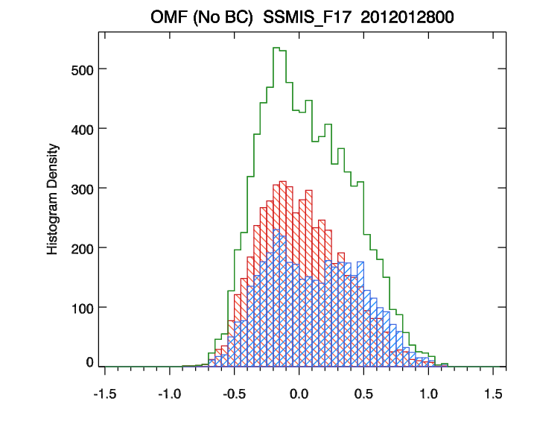
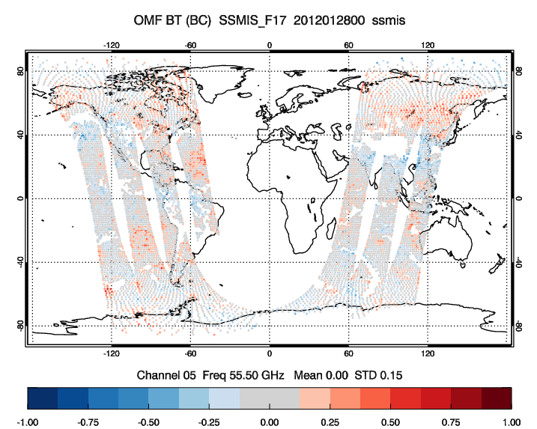
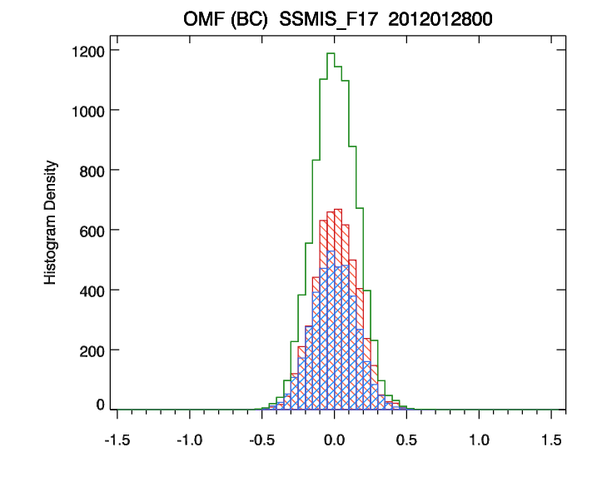
Variational Bias Correction Example - SSMIS Ch 05
SSMIS Calibration Issues
Warm load intrusion by direct and reflected solar radiance
--- results in ~1.5K depression in BT
Main reflector emission from its coating material (affecting LAS channels)
--- results in strong latitudinal-dependent O-B in NWP system
Unbias Bias Corrected O-B
OmF
before
VarBC
Global
Asc
Ascending Node
Descending Node
Dsc
Latitude
55.5
GHz
OmF
after
BarBC
O-B Mean (wo/ BC)
Global
O-B Mean(w/ BC)
O-B Std Dev(wo/ BC)
Asc
O-B Std Dev (w/ BC)
Dsc
Scan Position

Slide 5
Variational Bias Correction at NCEP - Summary
Use variational bias correction with caution
Interaction between bias correction and quality control
Bias correction is applied to quality-controlled data
Quality control uses bias-corrected data
Anchoring observations such as radiosonde and GPS data help to distinguish forecast model bias from radiance observation bias ----- be cautious at places where there are no anchoring observations
Carefully select radiance data sample that are used in estimating radiance bias correction, avoid O-F with large forecast model errors
For all-sky MW assimilation, only observations with matched cloud information from background and observations are included in bias correction estimation
GFS next operational system extends vertical levels to 127 levels (~80 km)
Highest peaking channels from AMSU-A (channel 14) and ATMS (channel 15) are assimilated
No bias correction is applied to these channels to avoid aliasing forecast model bias into bias correction estimation

Slide 6
The Use of TDR/SDR in GDAS
GTS
AMSU-A and MHS
Normal Feed - TDR (Ta)
Direct Broadcast Net - SDR (Tb)
GSI - current - assimilating Ta
AMSU-A and MHS
Normal Feed - TDR ( Ta )
Direct Broadcast - SDR ( Tb ) ------> TDR ( Ta )
ATMS - TDR ( Ta )
Variational Bias Correction handles
Air-mass bias correction
Scan-angle bias correction
Antenna correction
NESDIS
ATMS
Normal Feed - TDR (Ta, Tb)
Direct Broadcast Net - SDR (Ta, Tb)
Observations from GTS and NESDIS
AMSU-A and MHS observations in the normal feed are antenna temperatures (Ta)
AMSU-A and MHS DBNet (EARS) observations are brightness temperatures (Tb)
ATMS observations are available in both Ta and Tb from the Normal and DBNet feed
DBNet provides data covering data-sparse area, and within 30 minutes of the instrument observations
CRTM
CRTM produces simulated brightness temperature (Tb) from the model background
EUMETSAT antenna correction coefficients (ACC) are available from CRTM
GSI Analysis
GSI has been assimilating Ta from the normal feed
For consistency, Tb from the DBNet are converted from Tb to Ta for assimilation
The variational bias correction has been burdened with the inconsistency between Ta observations and Tb background
GFS v16.2
Implementation Plan
GSI - experiment to assimilate Tb
AMSU-A and MHS
Normal Feed - TDR ( Ta ) ------> SDR ( Tb )
Direct Broadcast - SDR ( Tb )
ATMS - TDR ( Tb )
Variational Bias Correction handles
Air-mass bias correction
Scan-angle bias correction

Slide 7
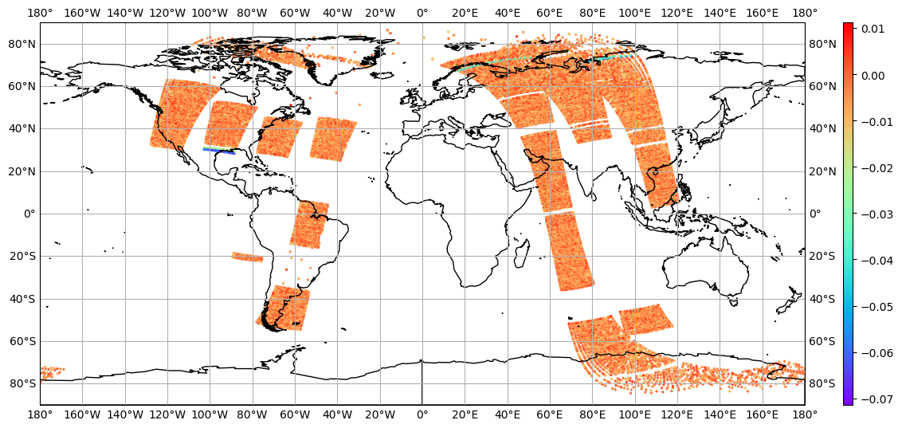
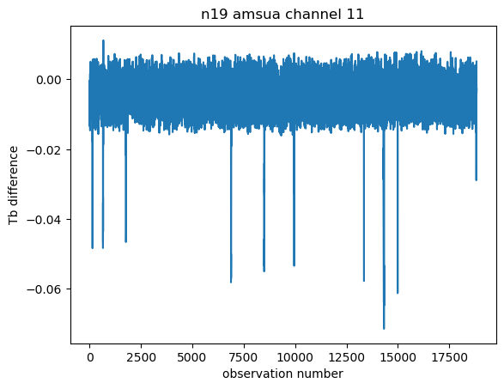
Tb Differences NOAA-19 AMSU-A Channel 11
T_{b, DBNet} - F(T_{a, normal} , ACC)
Check Tb difference between Normal and DBNet
The conversion is imperfect but working well enough

Slide 8
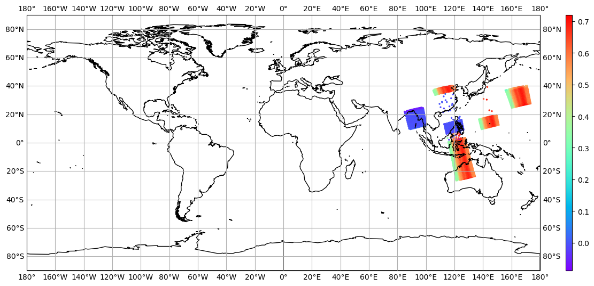
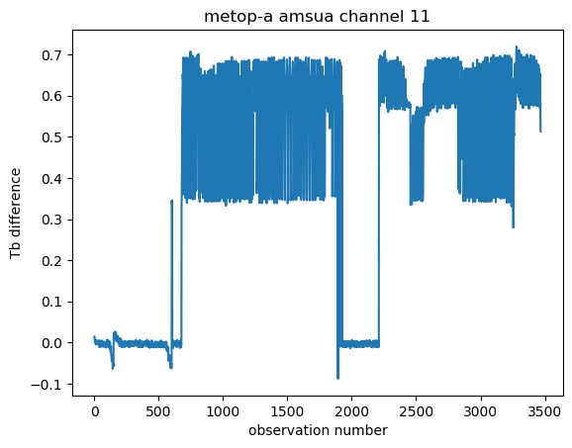
Tb Differences MetOp-A AMSU-A Channel 11
T_{b, DBNet} - F(T_{a, normal} , ACC)
Check Tb difference between Normal and DBNet
Many observations show a seriously big difference

Slide 9
Antenna Correction Coefficients from EUMETSAT
TDR - Antenna Temperature Data Record (Ta)
SDR - Sensor Data Record (Antenna-Corrected Brightness Temperature Tb)
Ta = Ae * Tb + Ab * Tb + As * Ts
Tb = (Ta - As * Ts) / (Ae + Ab)
Where Ae = antenna efficiency for the Earth view
Ab = antenna efficiency for satellite platform
As = antenna efficiency for cold space view
Ts = cosmic background temperature
Antenna Correction Coefficients (ACCs)
Antenna Correction Coefficients for ATOVS Sensors (NWP SAF EUMETSAT - AAPP)
All ATOVS DBNet data use version 1 (pre-launch) except for AMSU-A MetOp-A and NOAA-18
AMSU-A MetOp-A and NOAA-18 use version 2 (post-launch)
Unfortunately, some DBNet AMSU-A MetOp-A data providers are still using version 1
NCEP BUFR contains mnunomics Satellite Antenna Corrections Version (SACV) number (1 or 2)
CRTM has pre-launch (version 1) ACC from EUMETSAT

Slide 10
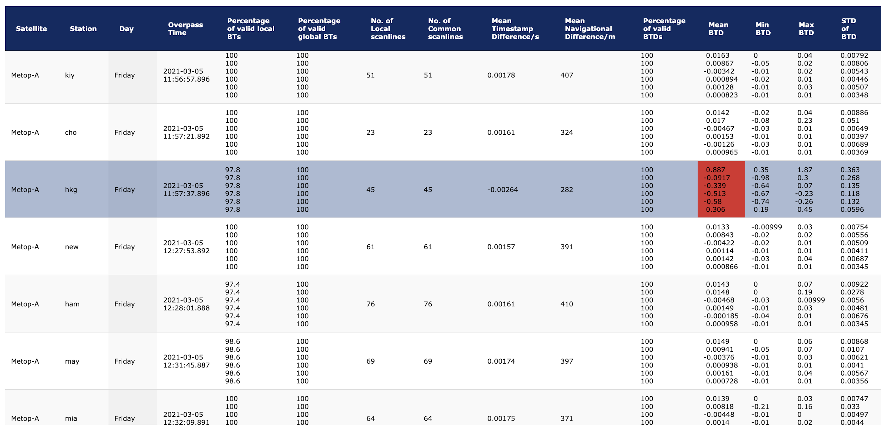
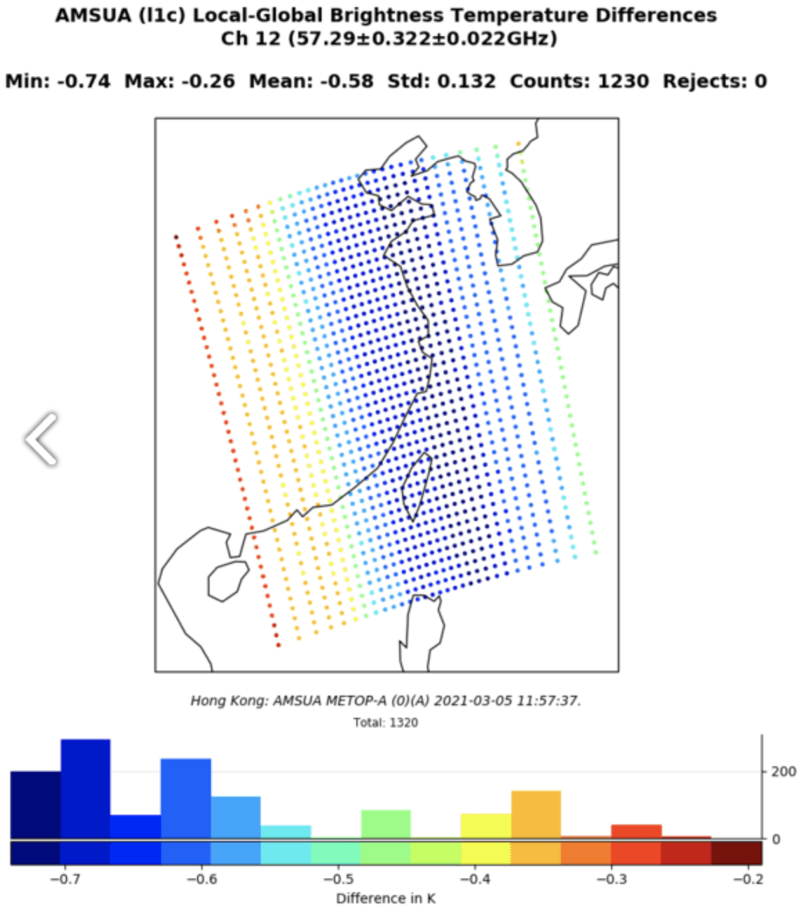
Satellite Antenna Correction Version (SACV) from BUFR
SACV is a mnemonic in BUFR for DBNet observations.
Observations originating from Australia, Japan and South Korea have had a version 2 of the antenna correction coefficients applied.
Hong Kong is (still) using version 1.
CRTM is using version 1 (ACC=ACC₁)
EUMETSAT Local DBNet and Global data consistency monitoring
EUMETSAT ERAS Monitoring Site

Slide 11
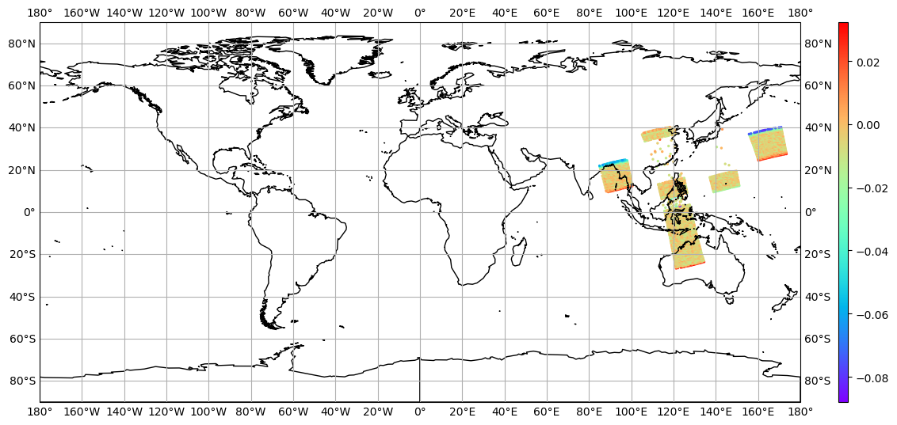
Tb Differences between Normal and DBNet
MetOp-A AMSU-A Channel 11
T_{b, DBNet} - F(T_{a, normal} , ACC₁)
F(F’(T_{b,DBNet}, ACC₂ w/ SACV), ACC₁) - F(T_{a, normal} , ACC₁)

Slide 12
Plan for GFS v16.2 Implementation
Apply the antenna correction to the global antenna temperature (Ta) and have everything assimilated as Tb
AMSU-A MetOp-A and NOAA-18
GSI - read_bufrtovs.f90 for Normal Feed T_{a,normal}
Apply antenna correction coefficients version 2 (post-launch)
(Per Communication with Nigel Atkinson, DBNet AMSU-A MetOp-A should use version 2)
T_{a,normal} ------> F(T_{a} , SACV=2) = Tb
GSI - read_bufrtovs.f90 for DBNet T_{b}
Read SACV (1 or 2) from DBNet
Undo antenna correction if SACV is 1 and then apply ACCs version 2
(Per Communication with Nigel Atkinson, DBNet AMSU-A MetOp-A should use version 2)
T_{b, sacv=1} ------> T_{a} ------> F(T_{a} , SACV=2) = Tb
CRTM
Add antenna correction coefficients version 2 for AMSU-A onboard of MetOp-A and NOAA-18 in CRTM, so GSI can access both versions of ACCs

