Slide 1
Constellations of Smallsats/Cubesats to Provide Global, Hourly Observations
Stan Kidder and Tom Vonder Haar
CIRA/Colorado State University
August 22, 2022

Slide 2
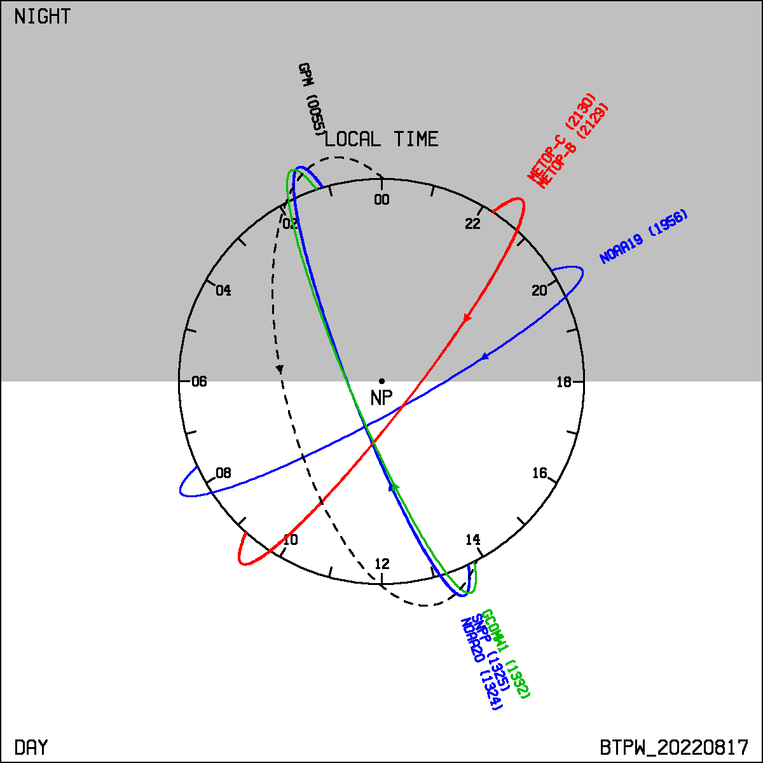
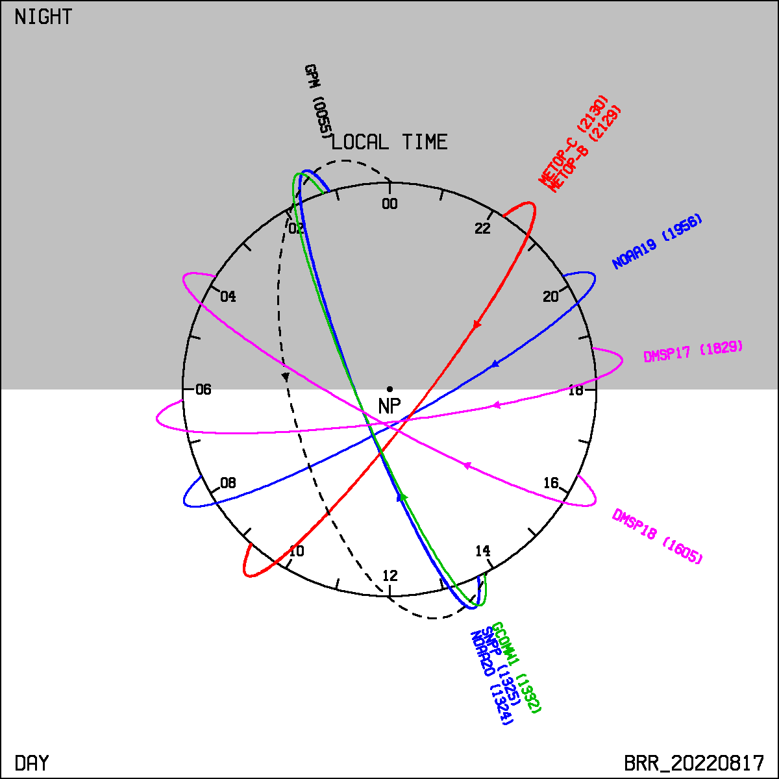
Introduction
A LEO constellation for microwave observations of Earth has long been a dream of satellite meteorologists.
Current observations are not optimal. (Blended TPW and Blended Rain Rate). And only 1330 (NOAA) and 2130 (Metop) satellites can be counted on in the future.

Slide 3
History
We (Kidder & Vonder Haar) presented a poster about this in 2004 at the 13th AMS Conference on Satellite Meteorology and Oceanography (http://cat.cira.colostate.edu/Kidder/SatMet13_P1.1.pdf).
We updated this two weeks ago at the 25th AMS Conference on Satellite Meteorology, Oceanography, and Climate in Madison, Wisconsin (http://cat.cira.colostate.edu/Kidder/SatMet25_P177.pdf)

Slide 4
Simple Rules for Constellation Formation
Choose a height for the circular orbit.
Avoid low orbits (less than 400 km) due to atmospheric drag
Avoid heights above 1000 km due to Van Allen Belt radiation, which requires hardening of the spacecraft and, thus, extra weight and expense.
Perhaps avoid heights below about 600 km due to other constellations, like Starlink

Slide 5
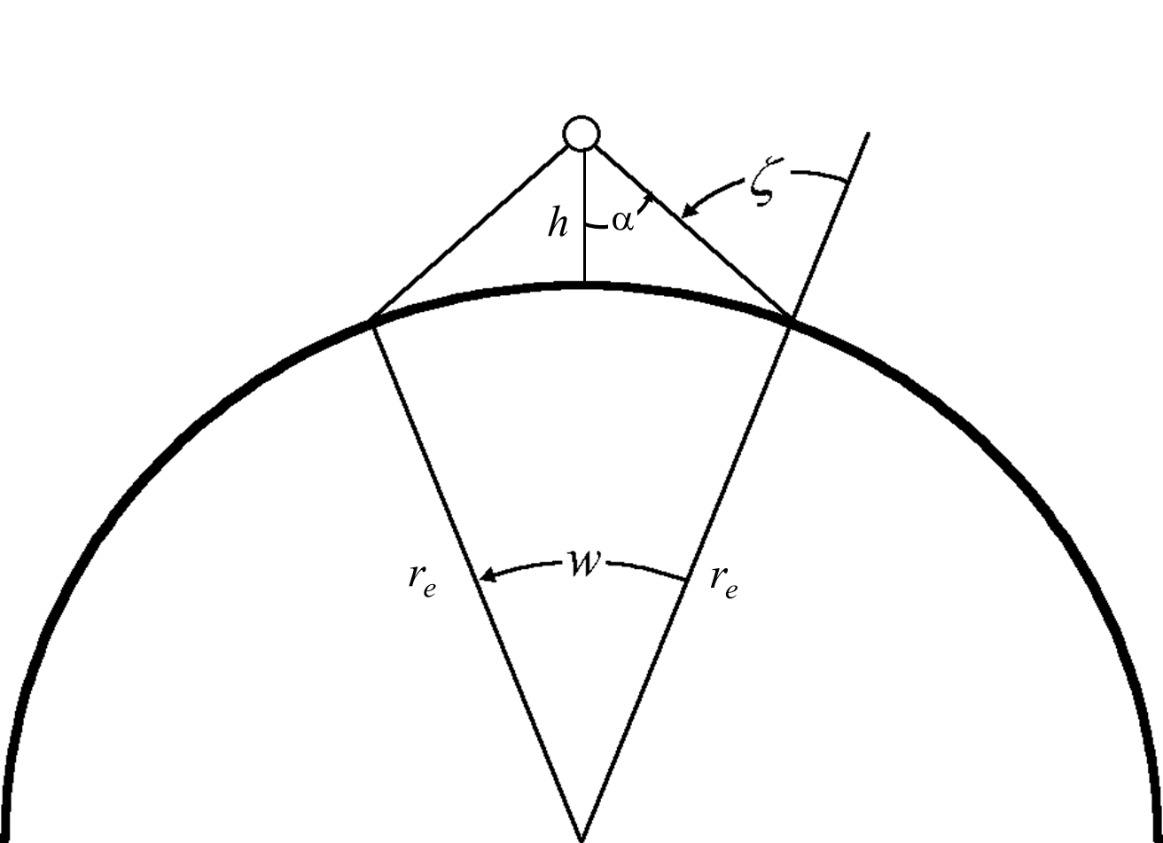
Simple Rules for Constellation Formation
Calculate the swath width (w) of the instrument, based on the height (h) and the maximum scan angle (α), or maximum viewing zenith angle (ζ). sin(ζ) = sin(α) (r_{e} + h) / r_{e} w = 2 (ζ – α)

Slide 6
Simple Rules for Constellation Formation
Choose an inclination angle ( i ) such that the poles are within the swath, that is,
90° – w / 2 < i < 90° + w / 2
Note that sunsynchronous inclinations are within this range, but the constellation does not require sunsynchronous inclination. Calculate the equator crossing angle:
i’ = –ATAN2 [ (2π / P) cos(i) – dΩ_{e}/dt, – (2π / P) sin(i) ]
where P is the satellite’s nodal period, and dΩ_{e}/dt is Earth’s rotation rate. See Kidder and Vonder Haar (1995) for details (or just ask).

Slide 7
Simple Rules for Constellation Formation
Calculate the effective swath width (w’):
w’ = w / sin(i’)

Slide 8
Simple Rules for Constellation Formation
Calculate the number of planes needed for “no gap” overage:
N_{p} = 180° / w’
If not an integral result, round up to the next higher integer. Note that in this design, all the satellites in one hemisphere are traveling north, and all the satellites in the opposite hemisphere are traveling south.

Slide 9
Simple Rules for Constellation Formation
Choose the number of satellites per plane (N_{sat}), remembering that the time between of observations (at the equator) is P / N_{sat}. For a “full” constellation (like Iridium) choose N_{sat} = 2 N_{p}. For a “sparse” constellation, choose N_{sat} = 2, which, at the heights recommended, will result in observation spacing less than 1 hour.

Slide 10
Simple Rules for Constellation Formation
Recalculate the required maximum scan angle (α), which changed due to rounding in step 5.
w’’ = 180°/ N_{p} * sin(i’)
α = $\operatorname{atan}\left[\frac{sin\left(\frac{w^{′′}}{2}\right)}{\left(\frac{r_{e}+h}{r_{e}}\right) −cos\left(\frac{w^{′′}}{2}\right)}\right]$

Slide 11
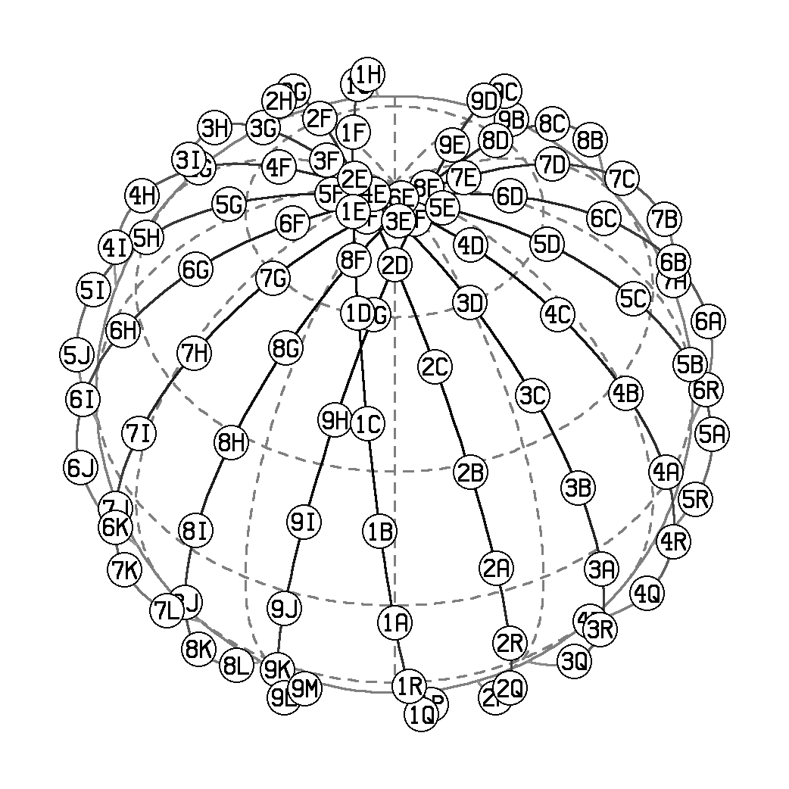
Example: Full 516 Constellation
Parameter | Value
Orbital Height (h, km) | 516
Maximum Viewing Zenith Angle (ζ, degrees) | 72.5
Inclination (i, degrees) | 97.5
Nodal Period (P, min) | 95.1
Number of Planes (Number of Launches) | 9
Satellites per Plane (Satellites per Launch) | 18
Total Satellites | 162
Time Between Observations (min) | 5.28
Require Maximum Scan Angle (α, degrees) | 60.7

Slide 12
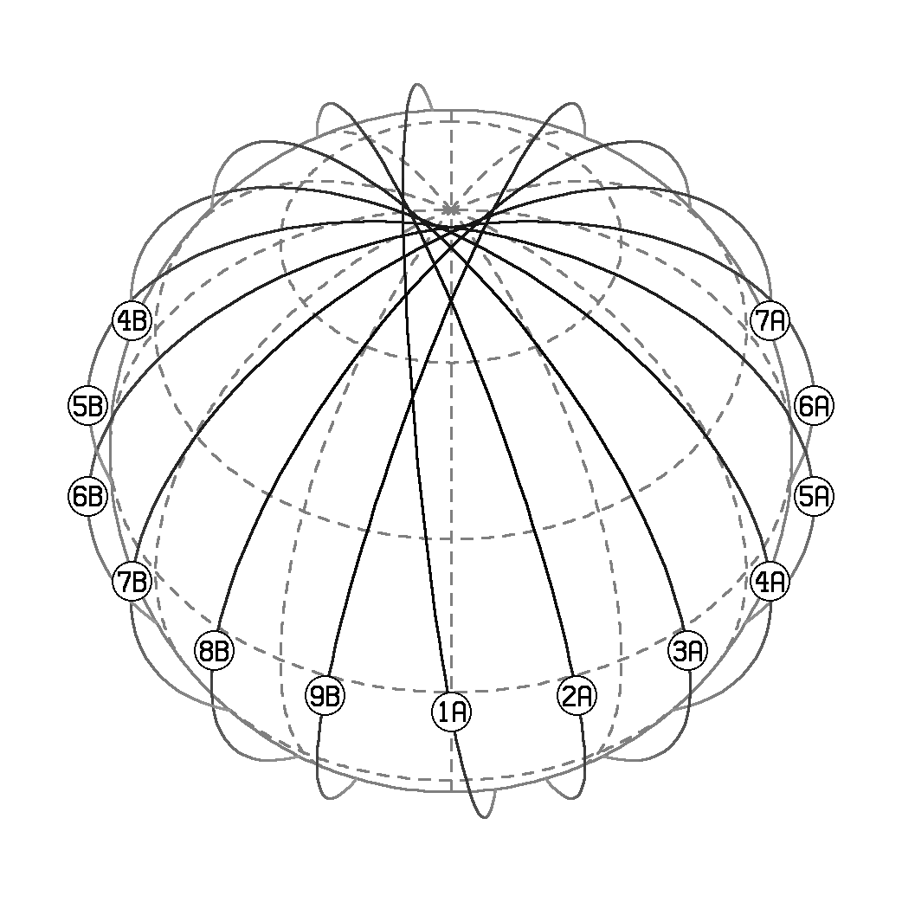
Example: Sparse 516 Constellation
Parameter | Value
Orbital Height (h, km) | 516
Maximum Viewing Zenith Angle (ζ, degrees) | 72.5
Inclination (i, degrees) | 97.5
Nodal Period (P, min) | 95.1
Number of Planes (Number of Launches) | 9
Satellites per Plane (Satellites per Launch) | 2
Total Satellites | 18
Time Between Observations (min) | 47.53
Require Maximum Scan Angle (α, degrees) | 60.7

Slide 13
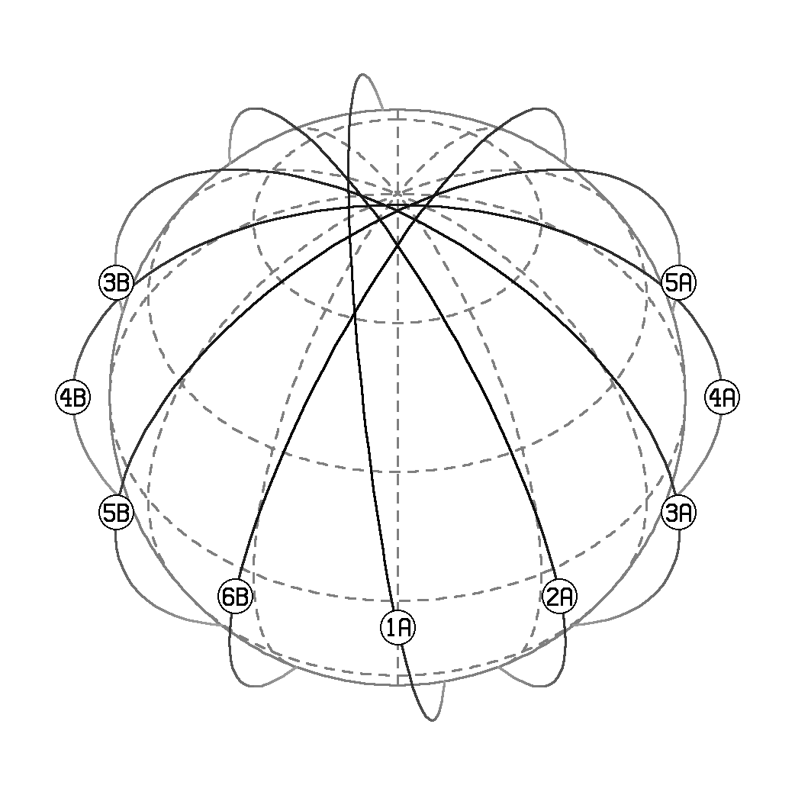
Example: Sparse 824 Constellation (AKA Supplemental Sunsynchronous Constellation)
Parameter | Value
Orbital Height (h, km) | 824
Maximum Viewing Zenith Angle (ζ, degrees) | 72.5
Inclination (i, degrees) | 98.7
Nodal Period (P, min) | 101.5
Number of Planes (Number of Launches) | 6
Satellites per Plane (Satellites per Launch) | 2
Total Satellites | 12
Time Between Observations (min) | 57.63
Require Maximum Scan Angle (α, degrees) | 57.4

Slide 14
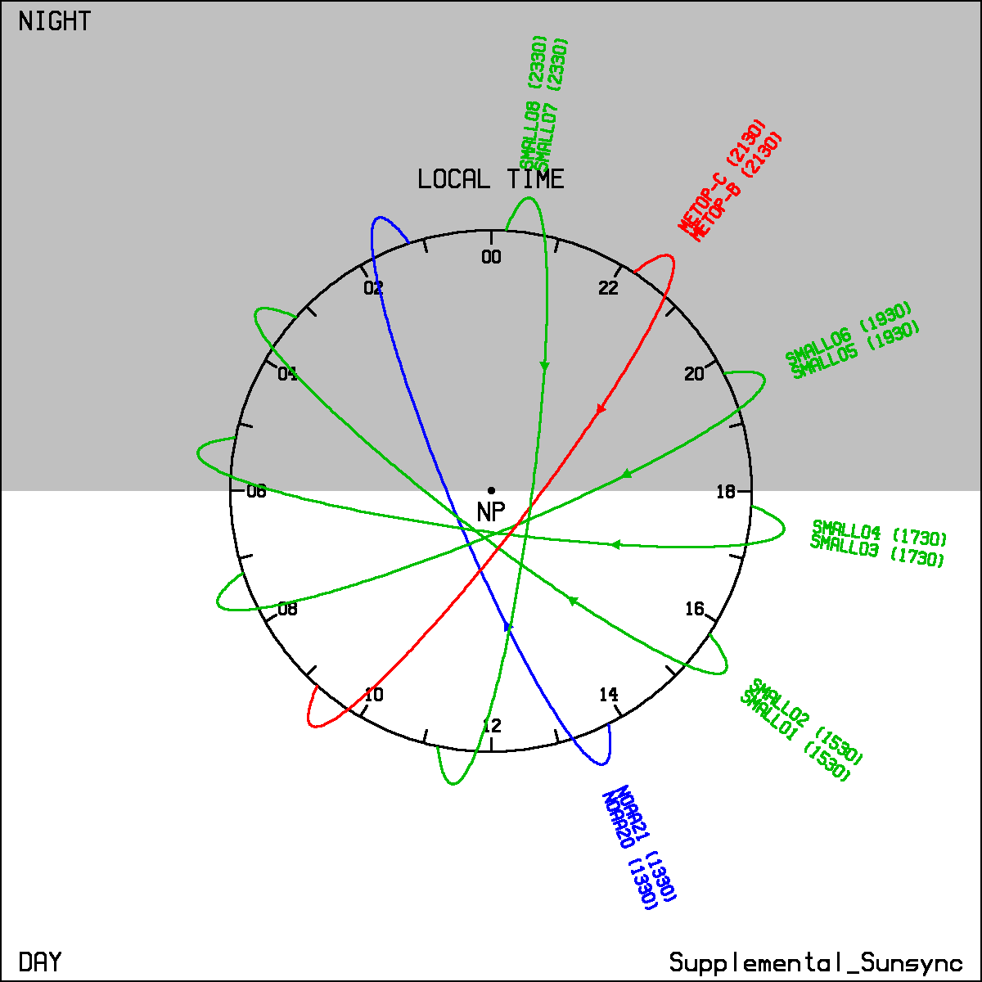
Supplemental Sunsynchronous Constellation
Two of the six orbital planes are already populated with NOAA (1330) and Metop (2130) satellites.
Completing the constellation would require four launches of two satellites each.
This is likely to be the cheapest way to achieve hourly observations everywhere.

Slide 15
Conclusions
Global, hourly observations of Earth from Low Earth Orbiters are indeed possible.
Current microwave smallsats/cubesats likely can be used.
Processing all the data (including the ground link) in a timely fashion might be a problem.

