Slide 1
Stewardship and Use of NOAA’s Observational Technical Needs
Prepared for SAT
Meredith Wagner, OSAAP’s TPIO team Foundations Team Lead
David Helms, OSAAP’s TPIO team
Analysis Team Lead
August 2021
Notes:
What are Production Notes?
Production Notes are notes that you may see in the readers notes for each slide (this section) which guide our efforts to splice together a briefing without deleting slides prematurely. They are different from the talking points and key messages that help the speaker give the briefing, because Production Notes will be completely deleted before the briefing is printed and given. They will not appear in the speaker’s copy during the briefing. Remember that this is a master deck. If you wish to delete a slide or a section, please DO NOT delete slides from the master. Instead, add a Production Note directing us to delete the slide from the listener’s version of the briefing when we proceed to tailor it for her.
You are welcome to add Production Notes that you think may be useful, understanding that they will (eventually) be deleted once they are resolved. Please add Production notes in orange text, or highlight them in orange.
-------------------------------------------

Slide 2
Outline
TPIO’s Portfolio Management Capabilities and Analysis Services
Overview of NOAA user observation requirements
TPIO’s Support to ASPEN
TPIO’s Support to NESDIS 5-Year Plan
Infusion of NOSIA Refresh
Notes:
TPIO’s scope and role supporting NOAA strategic observing system investment decisions is defined in NOAA Administrative Order 212-16.
Background:
TPIO aligns & enhances its analytic capabilities to support NOAA priorities, including those guided by legislation such as:
● Weather Research & Forecasting Innovation Act (WRFIA) – instructs NOAA to prioritize improving weather data, modeling, computing, forecasting and warnings for the protection of life and property and for the enhancement of the national economy
● Integrated Coastal and Ocean Observation System Act (ICOOSA) – instructs NOAA to establish a national integrated system of ocean, coastal, and Great Lakes observing systems coordinated at the federal level.
● Commercial Engagement Through Ocean Technology Act (CENOTE) – directs NOAA to coordinate the assessment and acquisition of unmanned maritime systems.
● National Integrated Drought Information System Reauthorization Act (NIDISRA) – instructs NOAA to establish the Earth Prediction Innovation Center (EPIC) to accelerate community-developed scientific and technological enhancements into the operational applications for numerical weather prediction (NWP).
The TPIO team has contributed observing system data and analysis capabilities to several recent NOAA observing system trade studies and acquisition plans, including:
● NOAA Satellite Observing System Architecture (NSOSA) Study – Provided requirements for the study objective definition and developed architecture assessment tools using mission impact sensitivity to support the design of the next generation NOAA satellite flight architecture,
● NEXRAD Service Life Extension Program – Provide a value chain impact assess indicating NEXRAD was the second most impactful observing system in the nation, providing the strong argument to successfully secure funding to keep and maintain the current NEXRAD network in working order until the next generation of weather radars are identified, developed, and deployed.
● NOAA Fleet Recapitalization Plan – Supported a validation process that created a baseline of objectively verifiable and prioritized at-sea data and observation requirements used to assess the current and future at-sea observational infrastructure needs of NOAA in carrying out its mission of protecting lives, livelihoods, and valuable natural resources for the American public.
● NOAA Uncrewed Systems Strategy – Conducted an assessment of current uncrewed system support across the organization to identify opportunities to increase the application and use of uncrewed aircraft and marine systems to improve the quality and timeliness of NOAA science, products, and services. TPIO uses NOAA’s foundational datasets to provide requirements based UxS portfolio recommendations.
● NESDIS Enterprise Product Management Planning – Providing prioritization inputs and potential impacts of satellite measurements in support of the next generation of platforms LEO, GEO, and Space Weather portfolios.

Slide 3
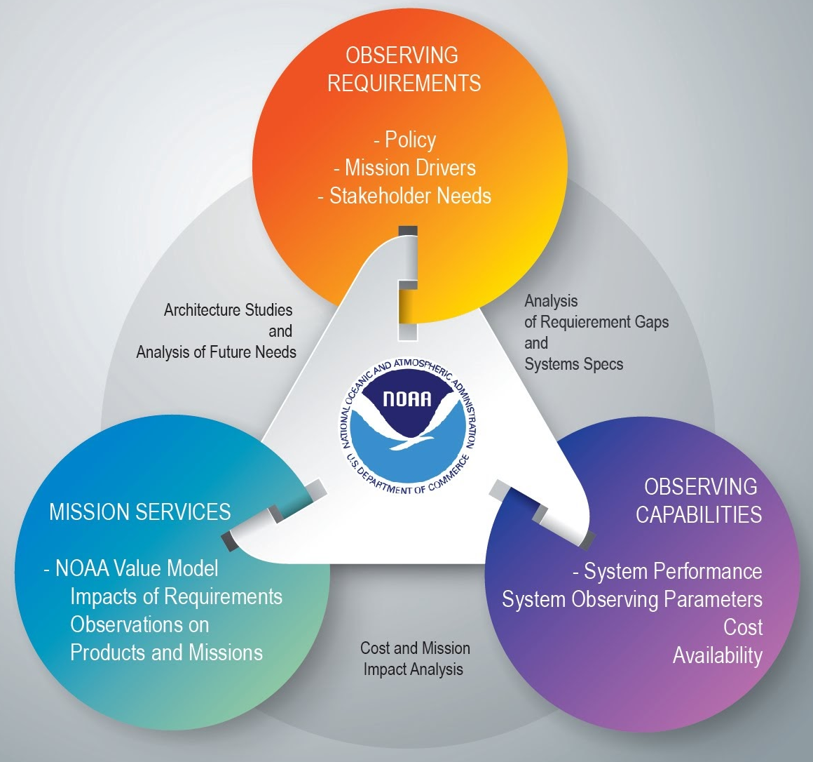
Managing NOAA's Observing System Portfolio
NOAA is driving toward an enterprise observing architecture that
addresses mission priorities;
is flexible and responsive to assess and incorporate evolving technology opportunities; and
is economically sustainable.
TPIO developed the NOAA Observing System Portfolio Management Capability to support NOAA and NESDIS decision-making through a process oriented view.
Notes:
Speaker notes:
NOAA’s vision is to achieve and sustain an observing system portfolio that is mission-effective, integrated, adaptable, and affordable.
The colored circles (blue, purple, orange) represent the three Foundational Datasets.
OSAAP TPIO collects and maintains foundational datasets on:
Purple: User observation needs: a dataset that captures NOAA’s needs
Blue: Observing systems: a dataset that captures what NOAA can already do; the Systems we already have, as well as non-NOAA observing systems that NOAA uses.
Orange: Mission products and services that NOAA generates.
This diagram depicts how these three functions work together to support the management of NOAA’s observing systems portfolio.
OSAAP TPIO analysts are able to mine all of these these data sets to provide robust and detailed analyses about NOAA’s observing systems portfolio.
Alternative treatment: Spoken Walk-through of diagram
Here’s an example of how the speaker could provide a step-by-step walkthrough of the diagram to a “New to NOAA” audience:
The colored circles (blue, purple, orange) represent the three Foundational Datasets.
The Blue circle represents “Observing Requirements,” a dataset that captures NOAA’s needs.
The Purple circle represents “Observing Capabilities,” a dataset that captures what NOAA can already do; the Systems we already have, as well as non-NOAA observing systems that NOAA uses.
The Orange circle up top represents “Mission Services.”
Linking these datasets are the types of analysis work that we do on the relationship between each pair of datasets.
When we analyze how Requirements relate to Capabilities, for instance, we can identify the Gaps we have in what we need, and analyze what the specs will need to look like for future systems, if we are to bridge and fill those Gaps.
When we analyze how Mission Services relate to Requirements, we can conduct Architecture Studies, and attempt to predict future needs.
When we analyze how Mission Services relate to Capabilities, we can analyze Costs and other impacts to the mission.
Altogether, it allows to support NOAA’s vision to achieve and sustain an observing system portfolio that is mission-effective, integrated, adaptable, and affordable.

Slide 4
Managing NOAA's Observing Systems Portfolio
3 Foundational datasets:
User Observation Requirements System agnostic user needs for environmental parameters required to produce specific products and services to meet mission objectives
Observing Capabilities – NOAA owned and leveraged observing systems that collect environmental parameters of the Earth and space
Mission Value Tree – Describes the relationships between observing systems and products, and their impacts on NOAA’s missions and goals
Types of cross-analysis:
Stack Requirements alongside Capabilities, and we can identify gaps in what we need and determine what the specs will need to look like for future systems if we hope to bridge those gaps.
Stack Mission Services alongside Requirements, and we can conduct Architecture Studies that predict future needs.
Stack Mission Services alongside Capabilities, and we can analyze costs and study impacts to the mission.
Notes:
Speaker notes:
NOAA’s vision is to achieve and sustain an observing system portfolio that is mission-effective, integrated, adaptable, and affordable.
The colored circles (blue, purple, orange) represent the three Foundational Datasets.
OSAAP TPIO collects and maintains foundational datasets on:
Purple: User observation needs: a dataset that captures NOAA’s needs
Blue: Observing systems: a dataset that captures what NOAA can already do; the Systems we already have, as well as non-NOAA observing systems that NOAA uses.
Orange: Mission products and services that NOAA generates.
This diagram depicts how these three functions work together to support the management of NOAA’s observing systems portfolio.
OSAAP TPIO analysts are able to mine all of these these data sets to provide robust and detailed analyses about NOAA’s observing systems portfolio.
Alternative treatment: Spoken Walk-through of diagram
Here’s an example of how the speaker could provide a step-by-step walkthrough of the diagram to a “New to NOAA” audience:
The colored circles (blue, purple, orange) represent the three Foundational Datasets.
The Blue circle represents “Observing Requirements,” a dataset that captures NOAA’s needs.
The Purple circle represents “Observing Capabilities,” a dataset that captures what NOAA can already do; the Systems we already have, as well as non-NOAA observing systems that NOAA uses.
The Orange circle up top represents “Mission Services.”
Linking these datasets are the types of analysis work that we do on the relationship between each pair of datasets.
When we analyze how Requirements relate to Capabilities, for instance, we can identify the Gaps we have in what we need, and analyze what the specs will need to look like for future systems, if we are to bridge and fill those Gaps.
When we analyze how Mission Services relate to Requirements, we can conduct Architecture Studies, and attempt to predict future needs.
When we analyze how Mission Services relate to Capabilities, we can analyze Costs and other impacts to the mission.
Altogether, it allows to support NOAA’s vision to achieve and sustain an observing system portfolio that is mission-effective, integrated, adaptable, and affordable.

Slide 5
Requirement Sources: NOAA, Civil Agency, WMO
Consolidated User Observational Requirements (COURL):
User needs from NOAA’s Line Offices that have been reviewed, and validated by the NOAA Observing Systems Council (NOSC).
Space Platform Requirements Working Group (SPRWG) Objectives:
Future needs and relative priorities for weather, space weather, and environmental remote sensing space-based observations developed by an expert panel in support of the NOAA Satellite Observing System Architecture (NSOSA) study.
USGEO Satellite Needs Working Group (SNWG) Submissions:
Federal Agency submissions to the bi-annual USGEO-led process to identify needs that could be met from existing or upcoming satellite missions.
WMO Observing Systems Capability Analysis and Review (OSCAR) Requirements:
Database containing the official repository of requirements for observation or physical variables in support of WMO Programmes.

Slide 6
COURL Requirements
User Observation Requirements System agnostic user needs for environmental parameters required to produce specific products and services to meet mission objectives
User observation needs from NOAA’s Line Offices that have been reviewed, and validated by the NOAA Observing Systems Council (NOSC)
User Observation Requirements
are owned by the line offices
map to a Mission Service Area
are one of three foundational datasets (user observation requirements, observing capabilities, value tree)
managed by OSAAP/TPIO on behalf of the NOSC, OSC, and LOs
require NOSC approval and signature, and therefore, authoritative

Slide 7
NOAA User Observation Requirements - Example
Requirement | Threshold (T) Objective (O) | Priority | Geographic Coverage | Vertical Resolution | Horizontal Resolution | Measurement Accuracy | Sampling Interval
Lightning | T | 1 | Global | na | 4 km | 30% | 10 sec
 | O |  | Global |  | 4 km | 1% | 1 sec
Ocean Temperature: Upper Ocean | T | 1 | Global Ocean | 10 m | 300 km | 0.01 K | 24 Day
 | O |  | Global Ocean | 1 m | 1 km | 0.0001 K | 1 day
Priority Levels
Validation Level
Mission Critical: Cannot meet operational mission objectives without this data. Not having these data will prevent performance of mission or preclude satisfactory mission accomplishment. Only Priority 1s go through NOSC review and validation
1
Direct Validation Documentation
Associated
2
Mission Optimal: Data not critical but would provide significant improvement to operational capability
SME Consensus Documentation
Not Validated
Mission Enhancing: Needed to enhance state of knowledge / assess potential for operational capability
Attribute Not Applicable
3

Slide 8
TPIO’s Analysis Services
Observing Capability Impact Analyses
Capability Trades Analyses (e.g. NSOSA, NESDIS Ground (NGES))
Room-to-Run Analyses
Requirement Satisfaction Assessments (e.g., expert elicitations, COURL/Observing gap analysis (CAS/RT))
Improving the fidelity of underpinning data
Refresh Surveys of Services Environment (NOSIA Refresh)
Refresh User Observation Requirements (COURL Refresh)

Slide 9
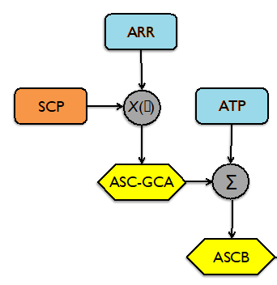
TPIO’s Support to ASPEN
Inputs:
ARR Application-dependent Requirement Range(s)
SCP Sensor/Constellation-based Performance(s)
ATP Application-dependent Technical Priority (priorities) [geophysical space]
Provided ATP and ARR Tables
Leveraged NOAA Value Tree for ATP’s and COURL for ARRs
MSAs represented ASPEN Applications
COURL
Value Tree
Outputs:
ASC-GCA or GCA Application-dependent sensor/constellation-based geophysical capabilities assessment
ASCB Application-dependent sensor/constellation-based benefit(s)

Slide 10
TPIO’s Support to NESDIS 5-Year Plan
Objectives:
Deliver Geophysical Parameter and NESDIS Baseline Product Priorities of NOAA’s Services (Value Tree)
Deliver Geophysical Parameter and NESDIS Baseline Product Improvement Priorities of NOAA’s Services (Value Tree R2R)
Both NESDIS 5-Year Plan and ASPEN priorities depend on mapping geophysical parameters to NOAA’s services, and both are sensitive to the evolution of these services (need for refresh/fidelity)
Changes in data source relevance and performance
Changes in services

Slide 11
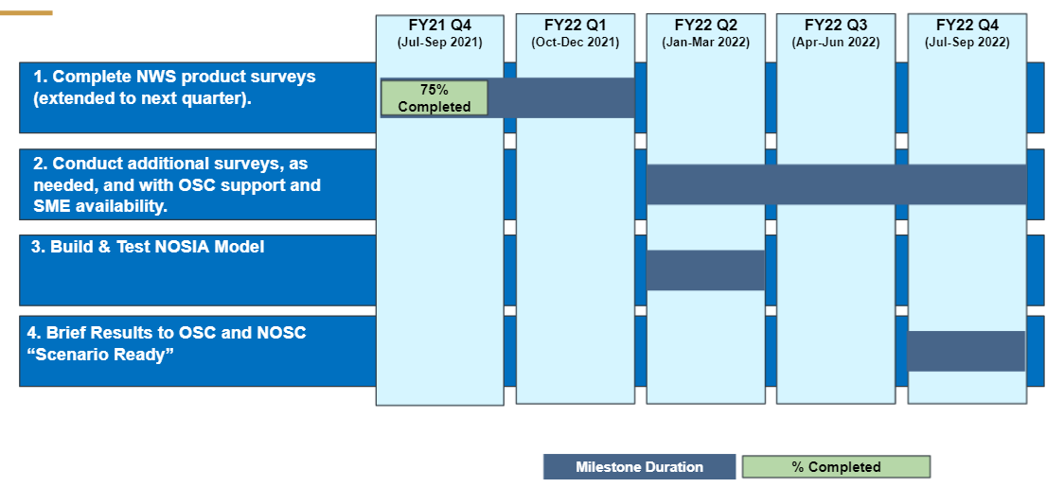
Infusion Of NOSIA Refresh
Updating Representation of Services Environment For Analysis
164 services re-surveyed to date: Most WRN MSAs captured
25 services scheduled at EMC and 10 more elsewhere to complete PWX, MWX, and WWX MSAs.

Slide 12
