Slide 1
Easterly Monsoon
Nevada, Arizona
July 25-29, 2021
Tony Reale
(STAR)
Bomin Sun, Michael Pettey, Ryan Smith, Charles Brown
(IMSG-STAR)
July 27, 2021
NUCAPS User Initiative
Dec 10, 2021

Slide 2
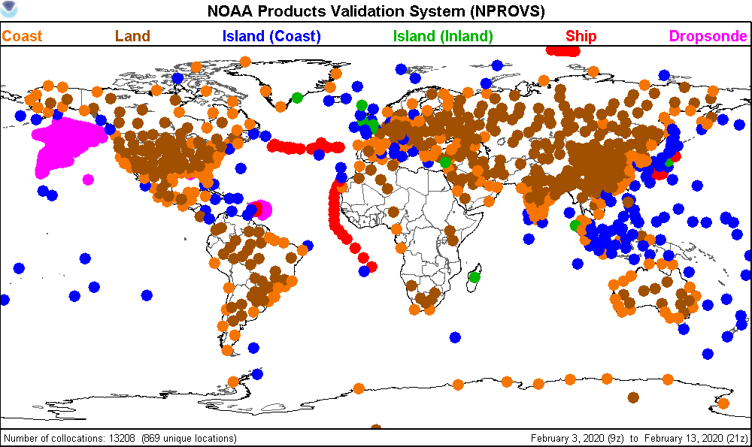
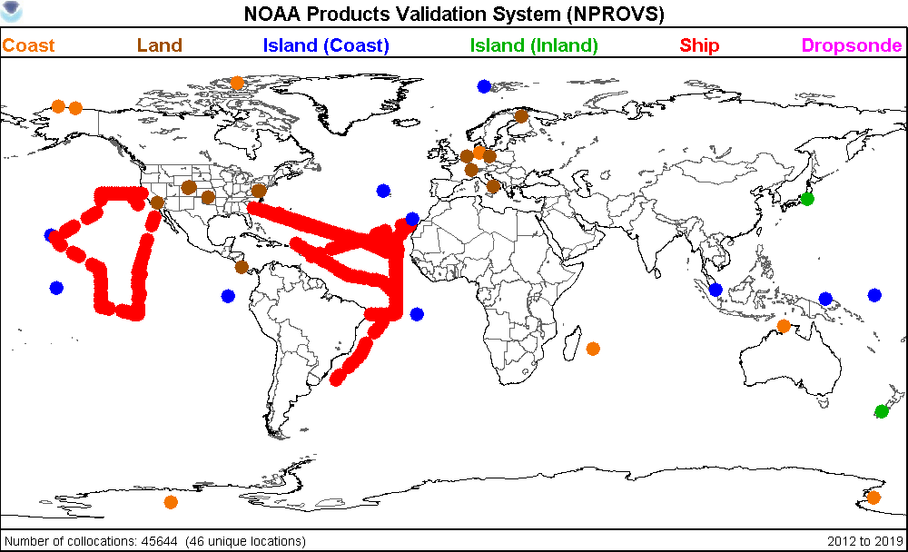
NOAA Products Validation System (NPROVS)
NUCAPS
NOAA20
S-NPP
MetOp-A,B,C
NOAA
MIRS
S-NPP
NOAA20
NOAA-18,19
MetOp-A,B,C
NOAA
AIRS v.6
Aqua-EOS
NASA
IASI-L2
MetOp-A, B, C
EUMETSAT
Conventional
Radiosonde
GFS 6-hr
CFSR
Special Radiosonde:
JPSS
DOE / ARM
GRUAN
NWS …
INPUTS
Geophysical Profiles
ATOVS
NOAA-19
MetOp-B
NOAA
GOES
?
NOAA
GRAS
MetOp-A,B,C
EUMETSAT
COSMIC
UCAR
KOMPSAT
Korea
NWP
(Analysis)
NOAA
ECMWF
Parallel
Test
Systems
All
Collocation Processing
(daily)
VisualizationTools
ODS
PDISP
NARCS
NPROVS-C
NPROVS-S
OUTPUT
(Collocated Radiosonde and Satellite
Observations)
NPROVS
Collocation
Archive
NPROVS-S
Collocation
Archive
VALAR
(Sensor)
Conventional
Special
SDR
Algorithm
Development
FTP
Notes:
Operated daily … 1000 conventional raobs per day
NARCS produces Atmospheric Vertical Time Series …

Slide 3
Outline
VIIRS, NUCAPS, GFS Analysis ‘Horizontal’ Comparison for Southern Nevada Storm; July 26
VIIRS, NUCAPS, GFS Analysis ‘Horizontal’ Comparison for Arizona Storms; July 27-29
Comparison of NUCAPS vs Collocated Radiosonde:
Las Vegas Radiosonde
3 Raobs in Arizona
Summary

Slide 5
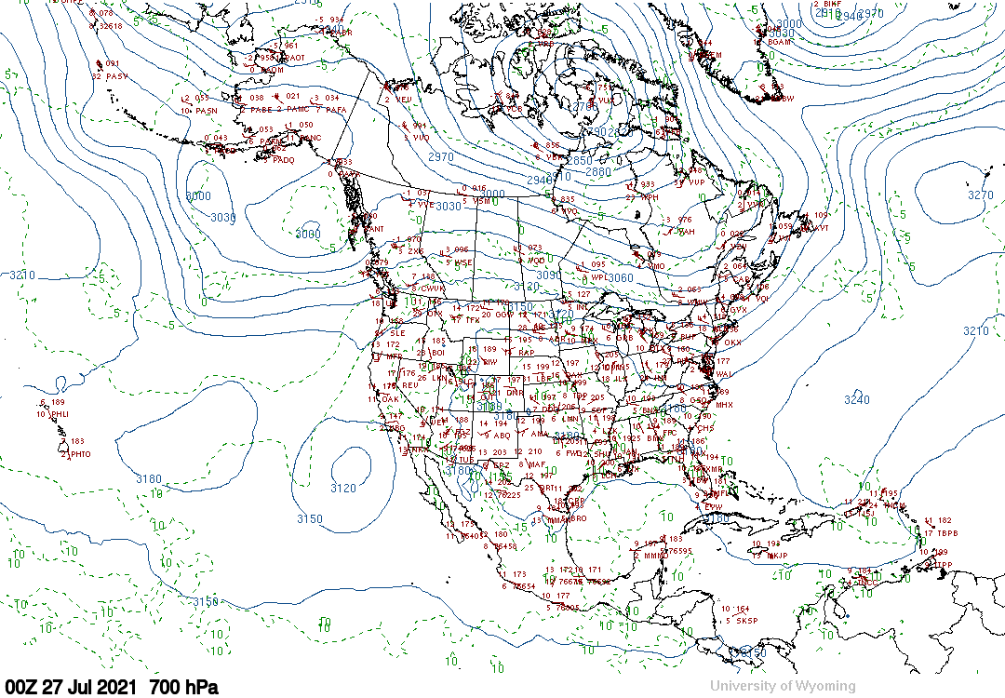
July 26, 2021
after precipitation event, Las Vegas; +3hr from VIIRS /NUCAPS

Slide 6
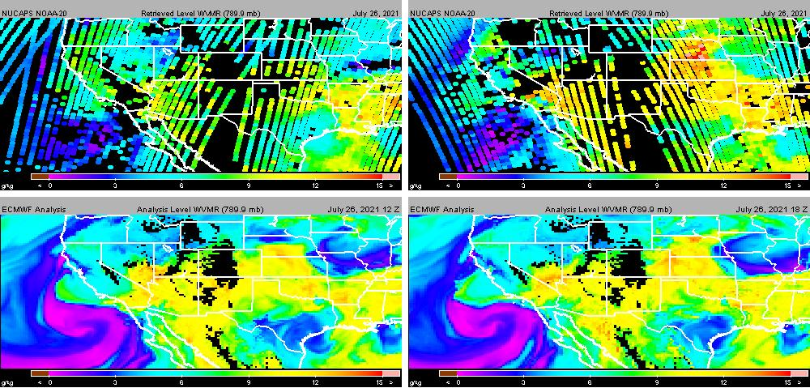
July 26, 2021
789 hPa H20 Vapor MR (g/kg)
matches VIIRS
N20
09Z
ECMWF
12Z
N20
21Z
ECMWF
18Z
precipitation event, Las Vegas

Slide 7
Vegas, valid 12Z on 26th, before precipitation event

Slide 8
Radar is finally starting to dry out in Pahrump but the flood threat remains. Flash Flood Warning in place for another hour with a rain gauge in the area measuring close to 2” since 11AM. Please remember most flood deaths occur in vehicles, NEVER drive across flooded roads! @KTNV
after precipitation event, Las Vegas

Slide 9
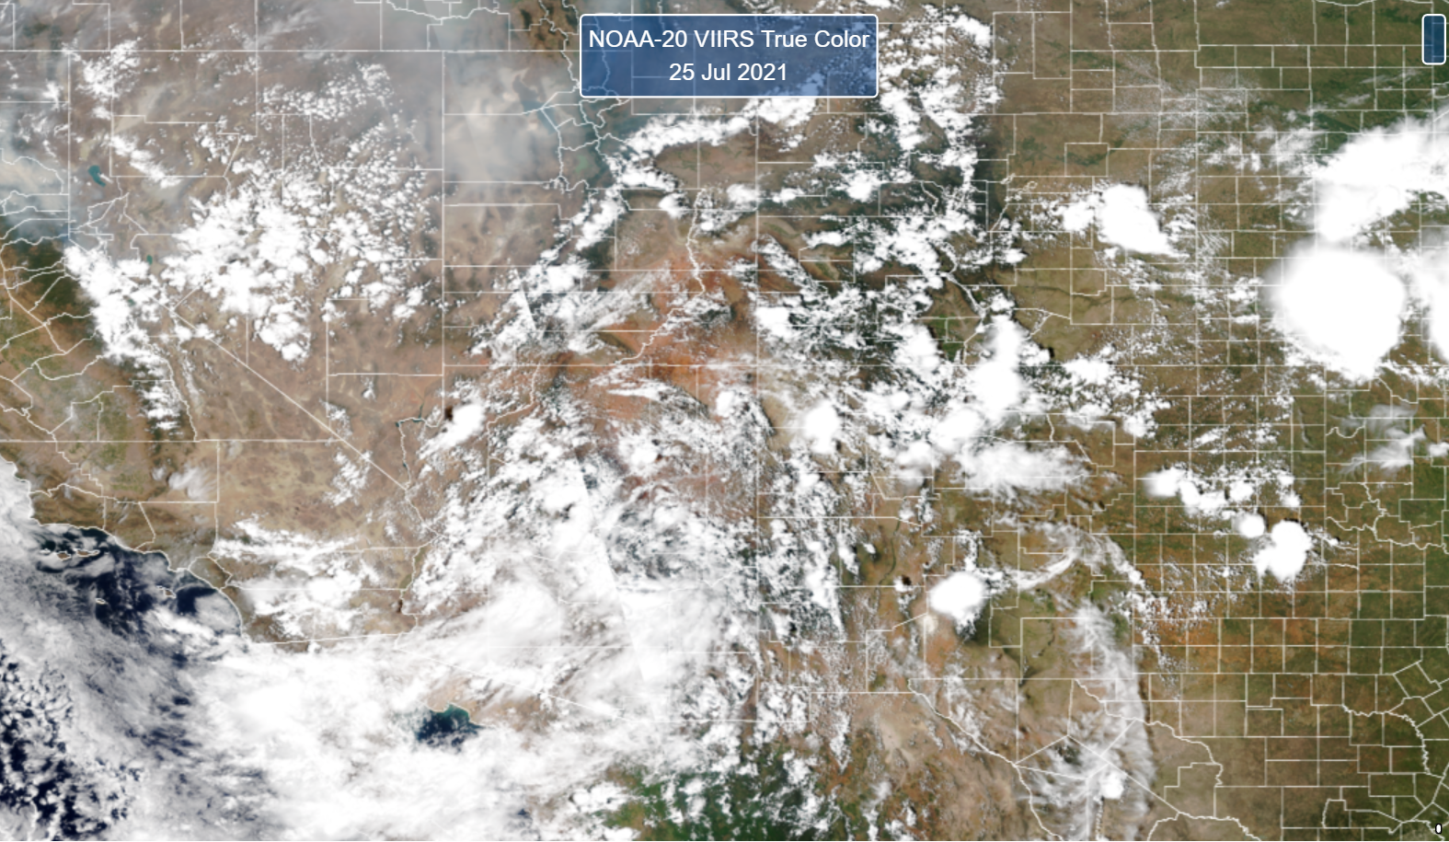
July 25, 2021
Precipitation Event, Las Vegas

Slide 10
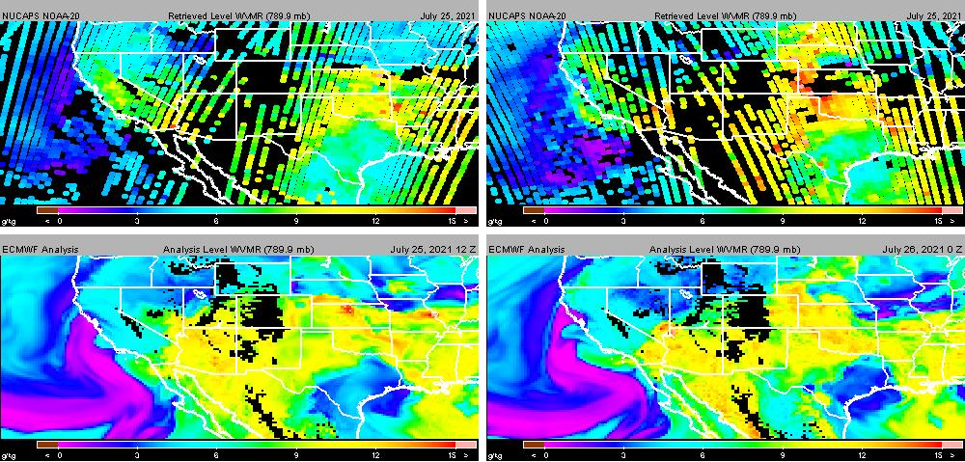
July 25, 2021
789 hPa H20 Vapor MR (g/kg)
matches VIIRS
N20
09Z
ECMWF
12Z
N20
21Z
ECMWF
00Z
(26th)
before precipitation event, Las Vegas

Slide 11
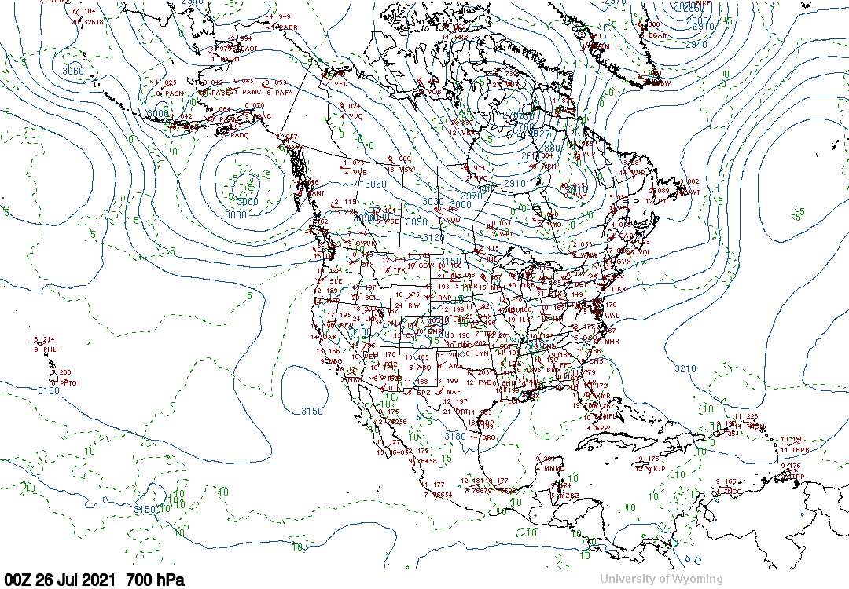
July 25, 2021
before precipitation event, Las Vegas, +3hr from VIIRS /NUCAPS

Slide 12
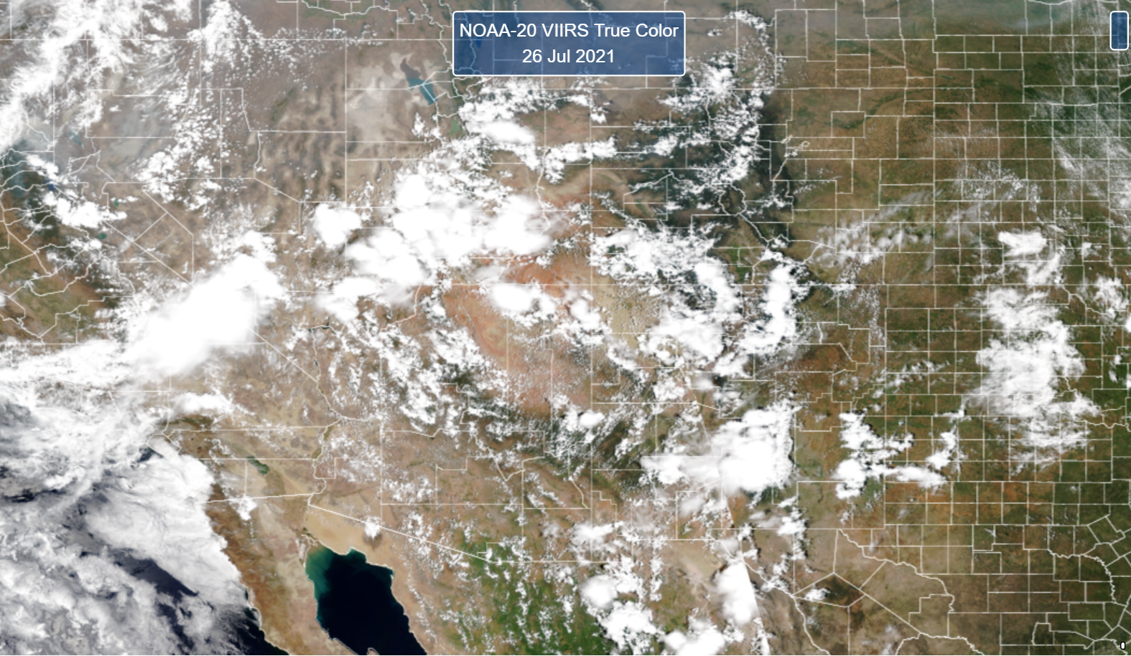
July 26, 2021
Precipitation Event, Las Vegas

Slide 13
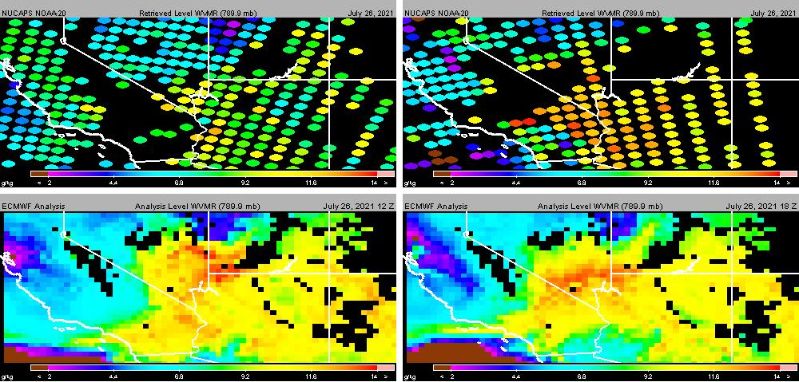
July 26, 2021
789 hPa H20 Vapor MR (g/kg)
matches VIIRS
N20
09Z
ECMWF
12Z
N20
21Z
ECMWF
18Z
X
V

Slide 14
July 26, 2021
X
V
Precipitation Event, Las Vegas (V)

Slide 15
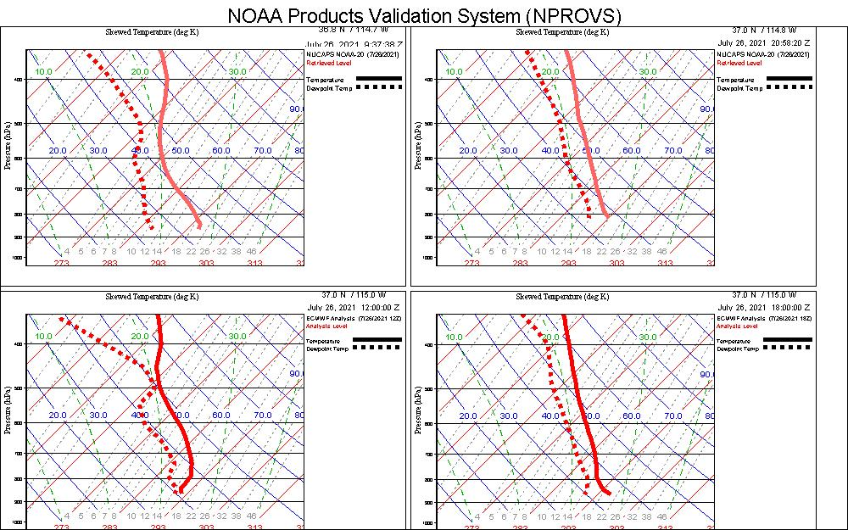
July 26, 2021
N20
09Z
ECMWF
12Z
N20
21Z
ECMWF
18Z
Soundings: Location X (previous slide)

Slide 16
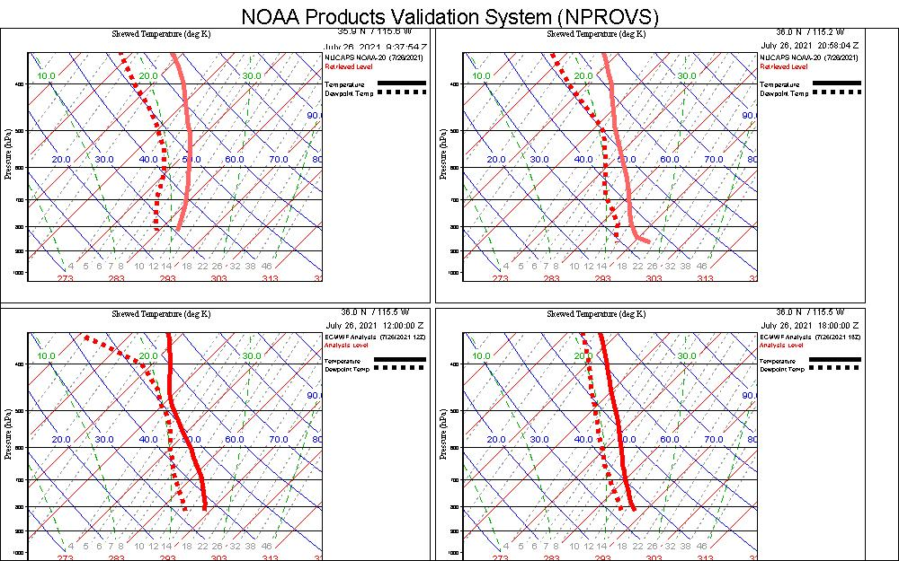
July 26, 2021
N20
09Z
ECMWF
12Z
N20
21Z
ECMWF
18Z
Soundings. Location V (Vegas)

Slide 17
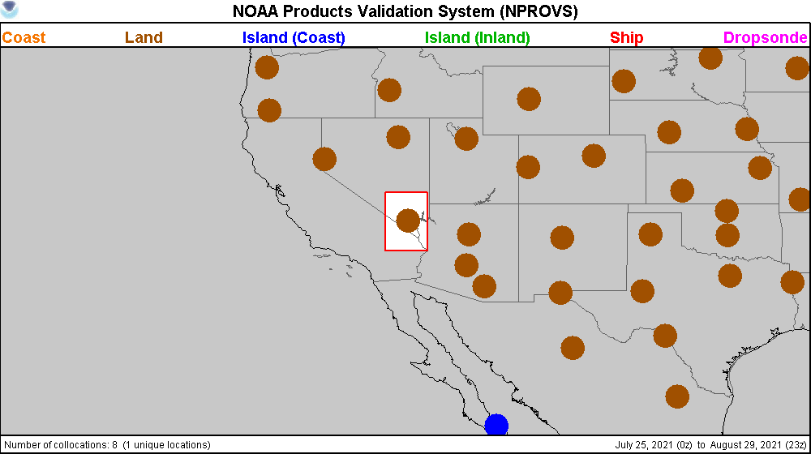
NUCAPS/Radiosonde Collocations July 25-29; Las Vegas (box)

Slide 18
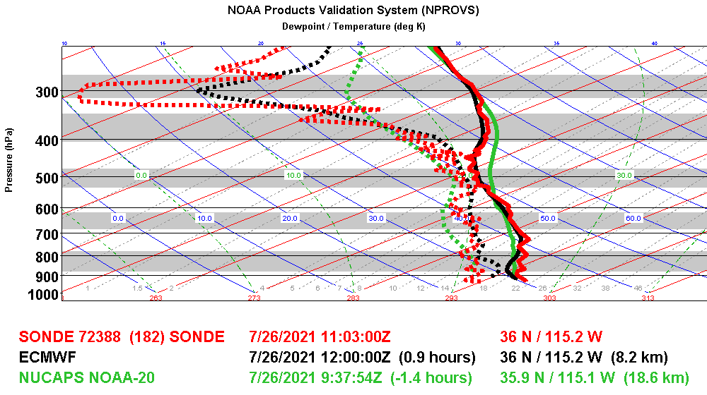
precipitation event, Las Vegas

Slide 19
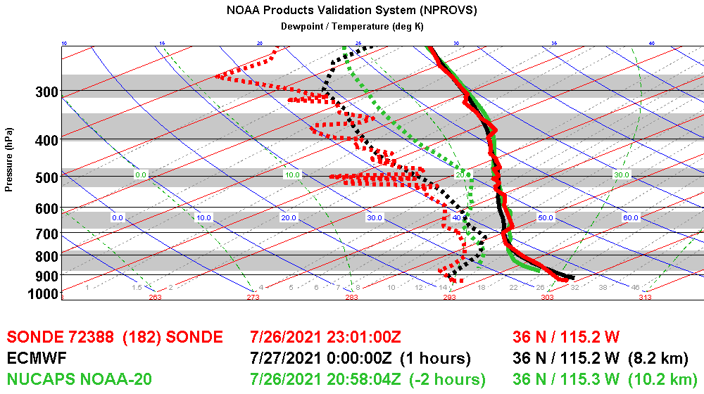
precipitation event, Las Vegas

Slide 20
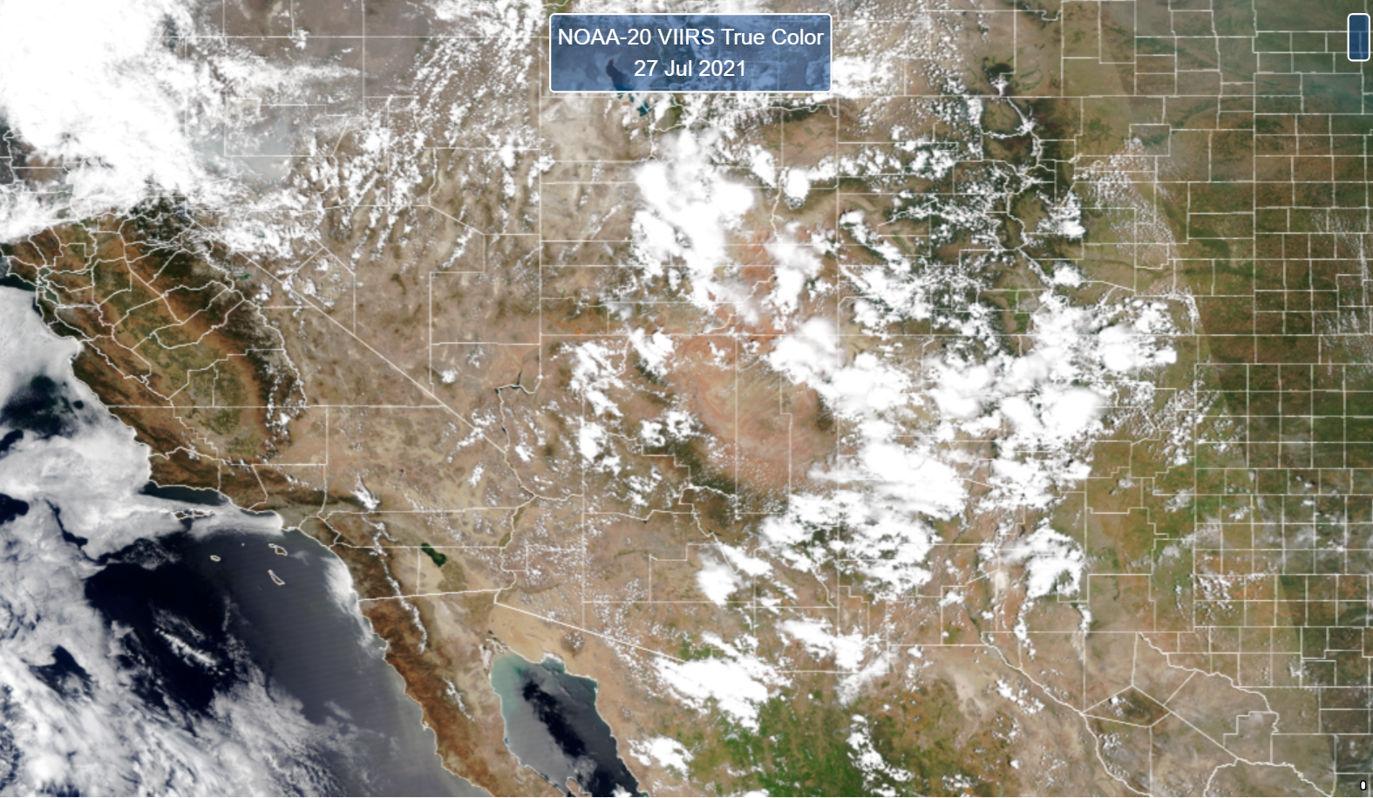
July 27, 2021

Slide 21
July 27, 2021

Slide 22
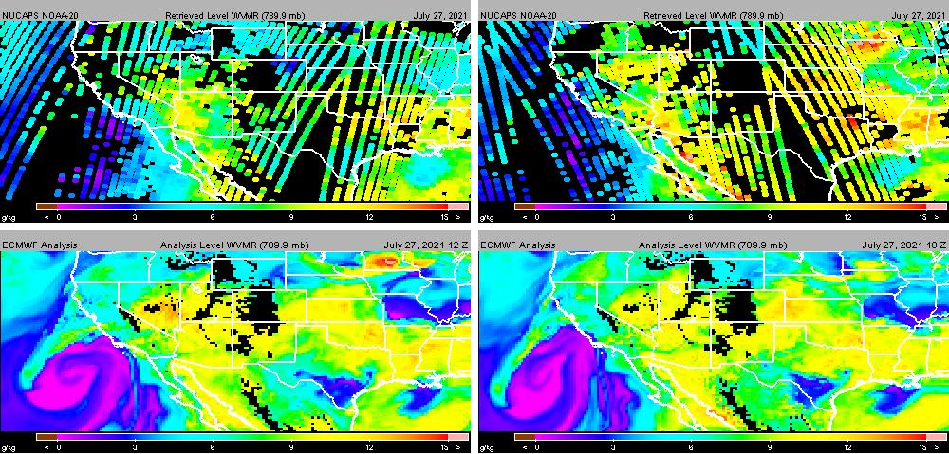
July 27, 2021
789 hPa H20 Vapor MR (g/kg)
matches VIIRS
N20
09Z
ECMWF
12Z
N20
21Z
ECMWF
18Z

Slide 23
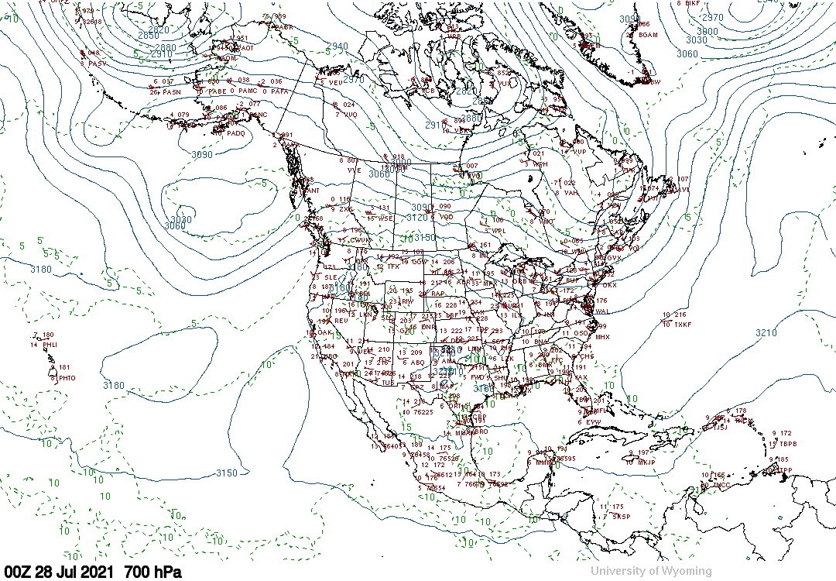
July 27, 2021

Slide 24
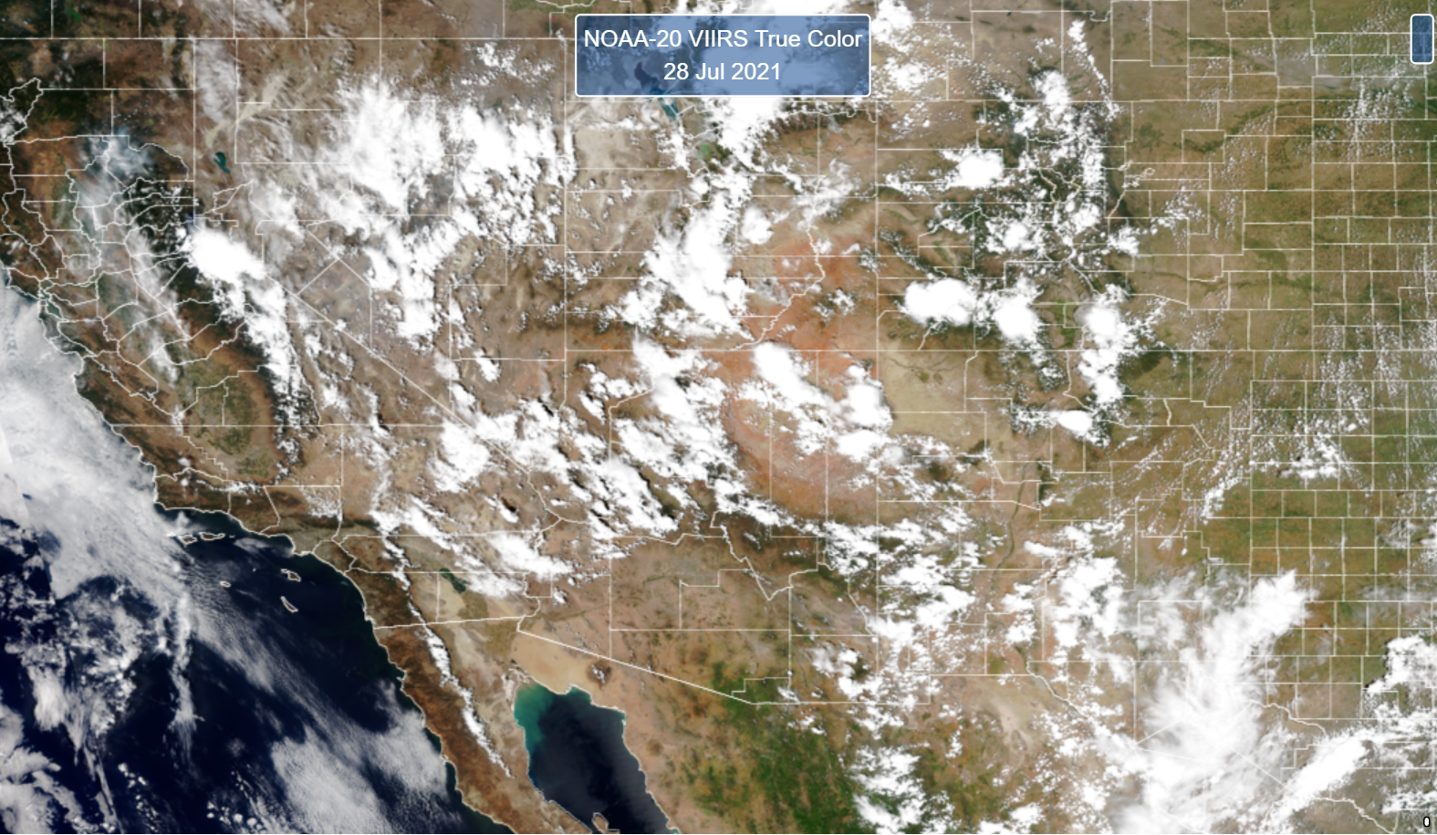
July 28, 2021

Slide 25
July 28, 2021

Slide 26
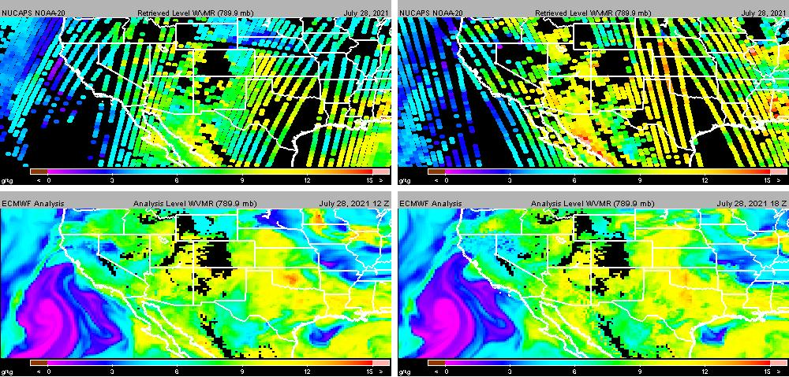
July 28, 2021
789 hPa H20 Vapor MR (g/kg)
matches VIIRS
N20
09Z
ECMWF
12Z
N20
21Z
ECMWF
18Z

Slide 27
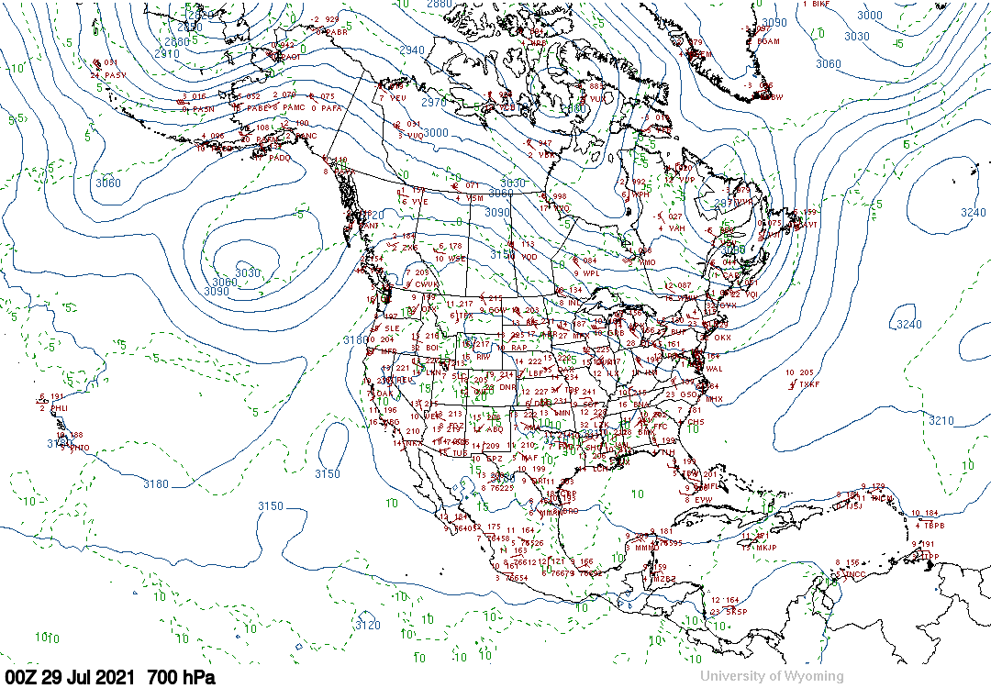
July 28, 2021

Slide 28
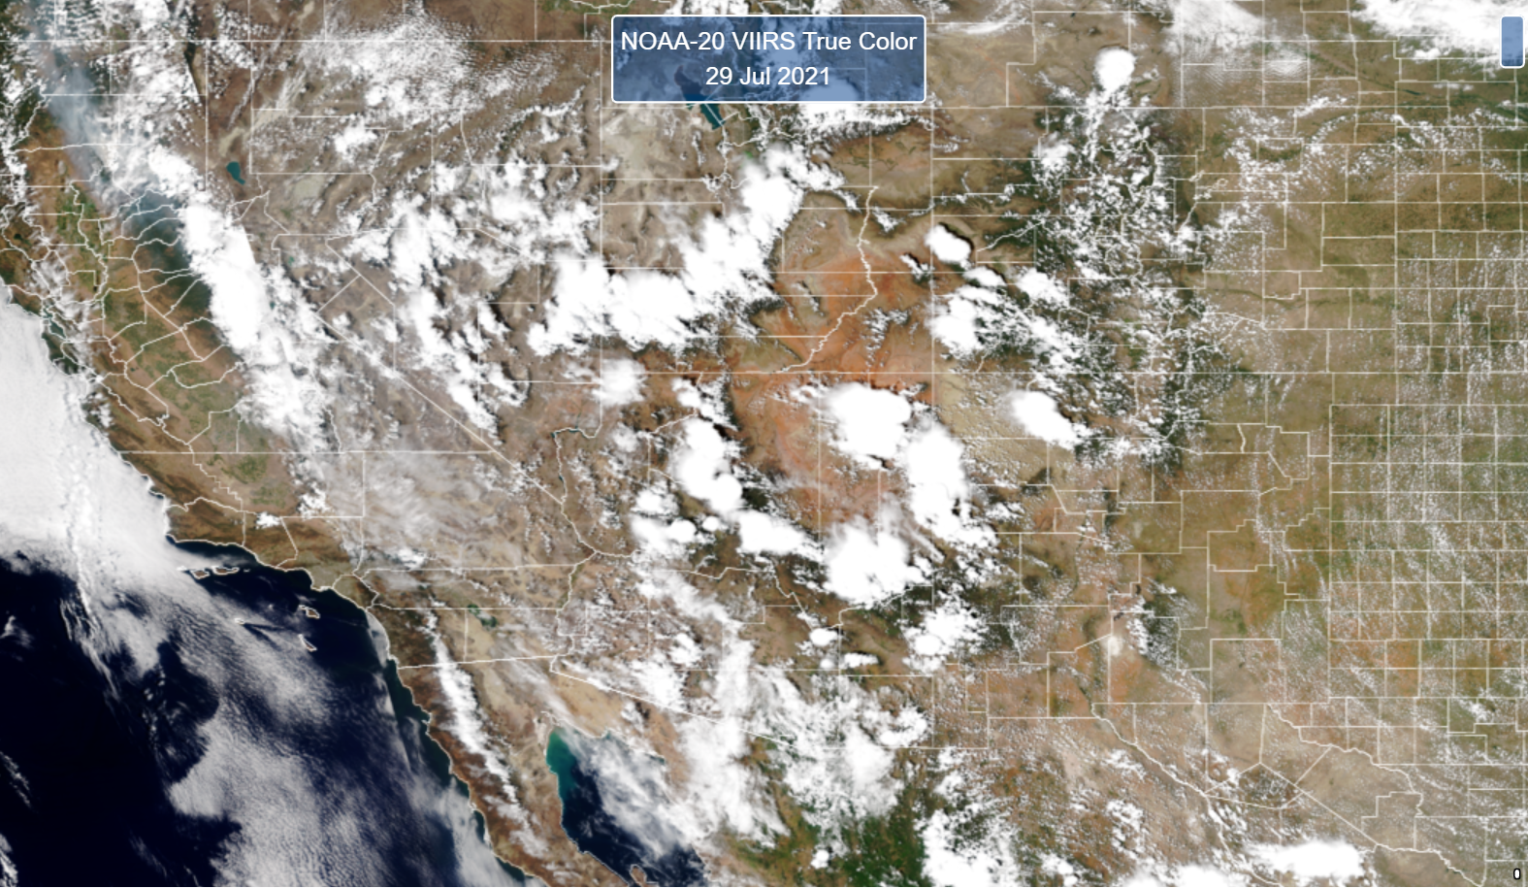
July 29, 2021

Slide 29
July 29, 2021

Slide 30
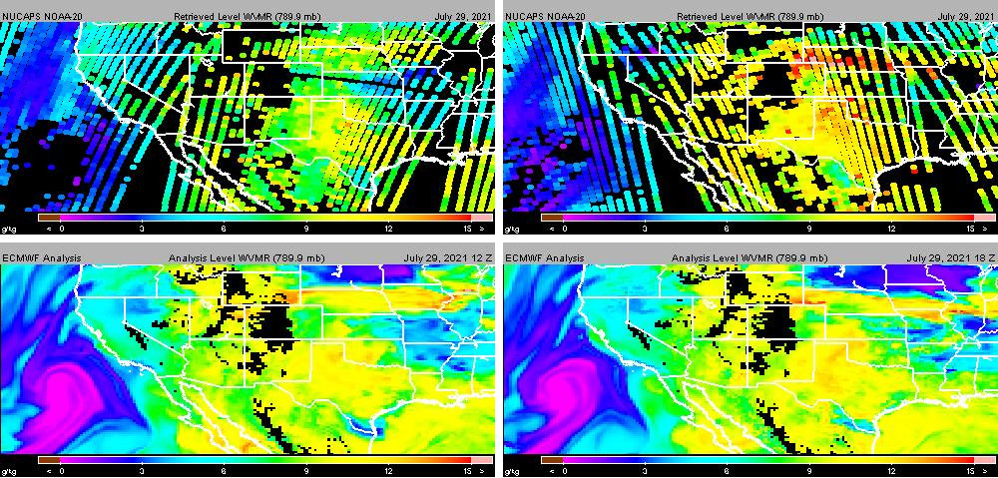
July 29, 2021
789 hPa H20 Vapor MR (g/kg)
matches VIIRS
N20
09Z
ECMWF
12Z
N20
21Z
ECMWF
18Z

Slide 31
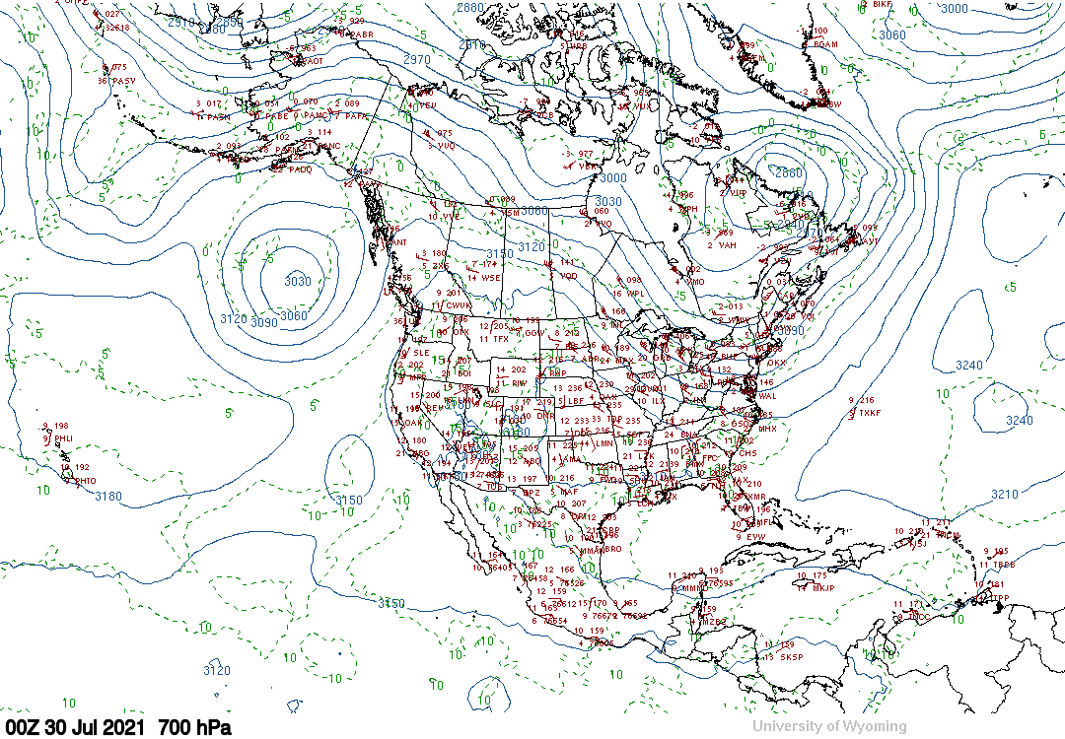
July 29, 2021

Slide 32
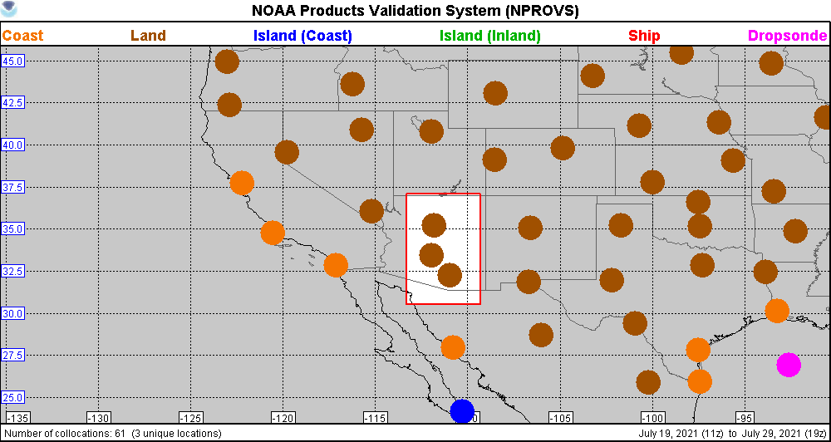
NUCAPS/Radiosonde Collocations July 25-29; Arizona
Flagstaff, Phoenix, Tuscon

Slide 33
R
R
R
Arizona; July 27

Slide 34
July 27, 2021
R
R
R

Slide 35
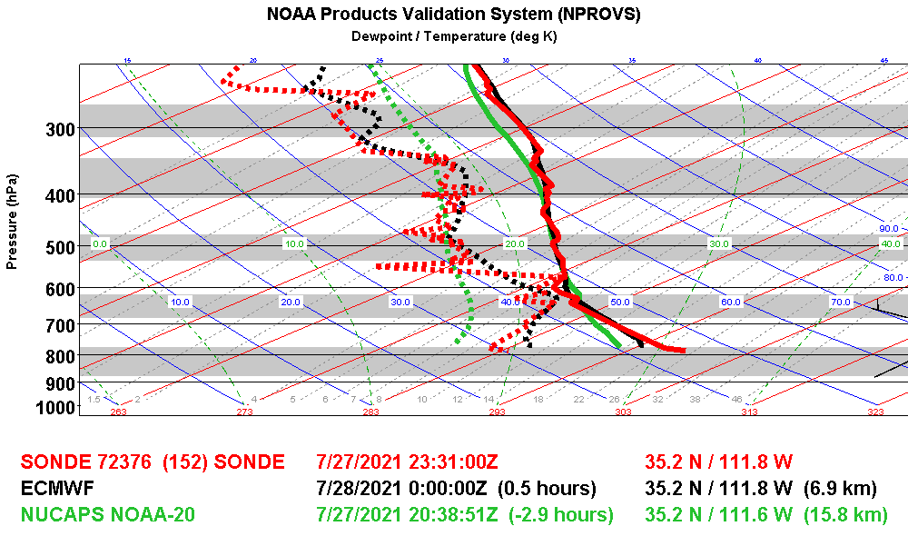
Flagstaff

Slide 36
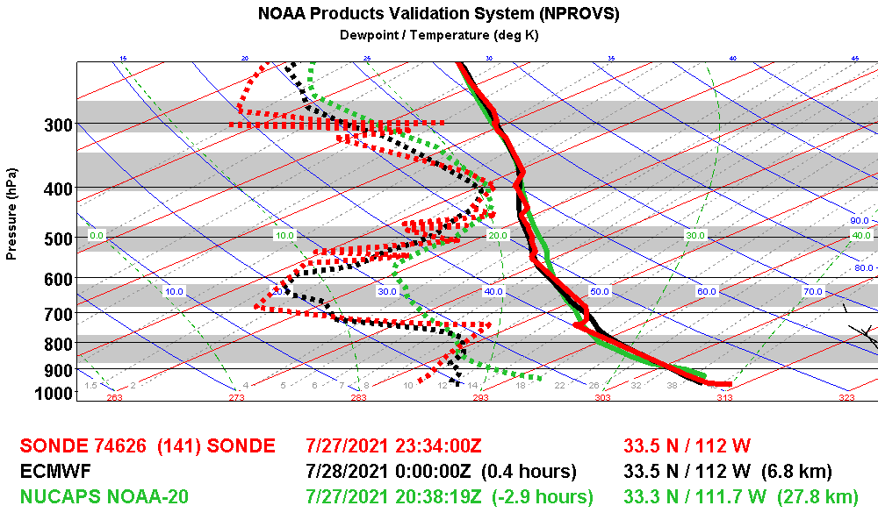
Phoenix

Slide 37
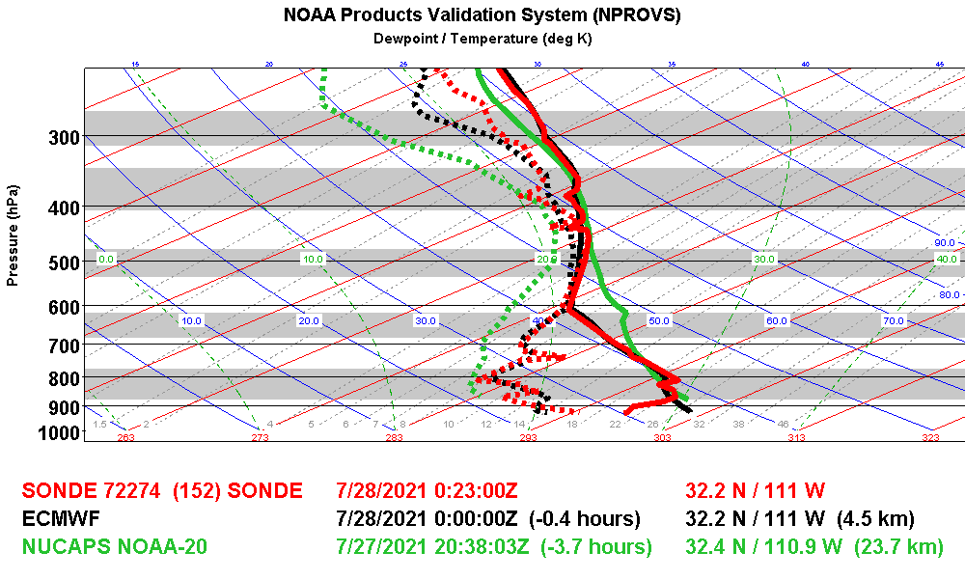
Tuscon

Slide 38
R
R
R
Arizona; July 28

Slide 39
July 28, 2021
R
R
R

Slide 40
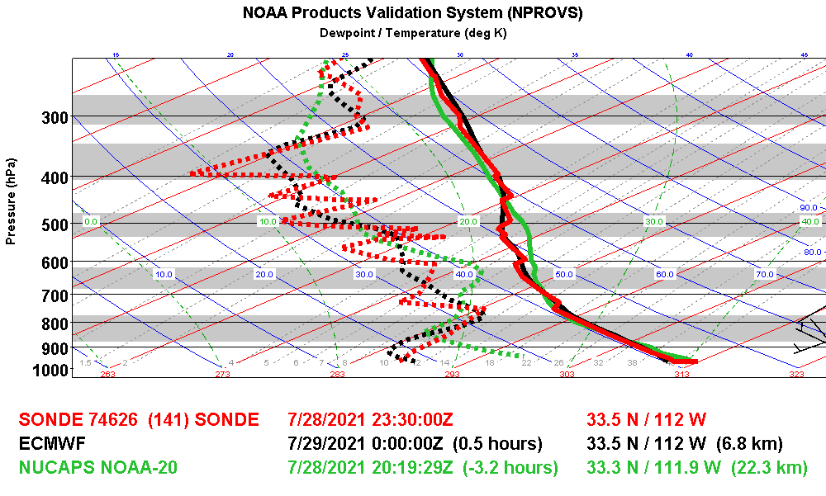
Phoenix

Slide 41
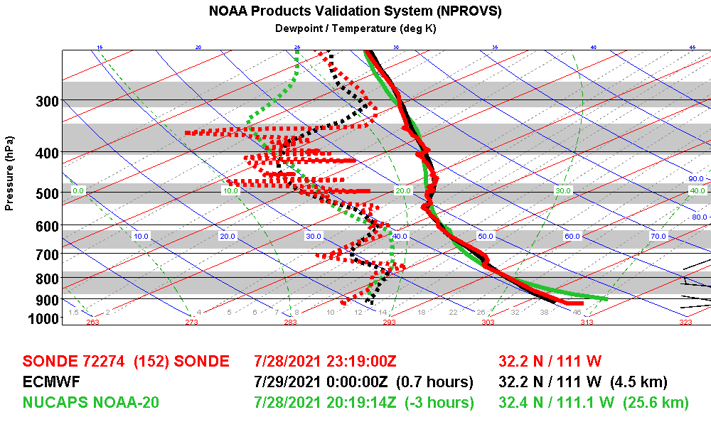
Tuscon

Slide 42
R
R
R
Arizona; July 29

Slide 43
July 29, 2021
R
R
R

Slide 44
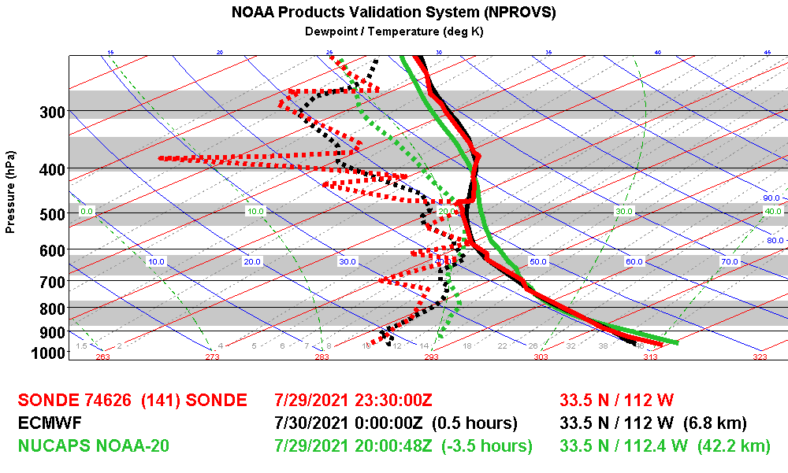
Phoenix

Slide 45
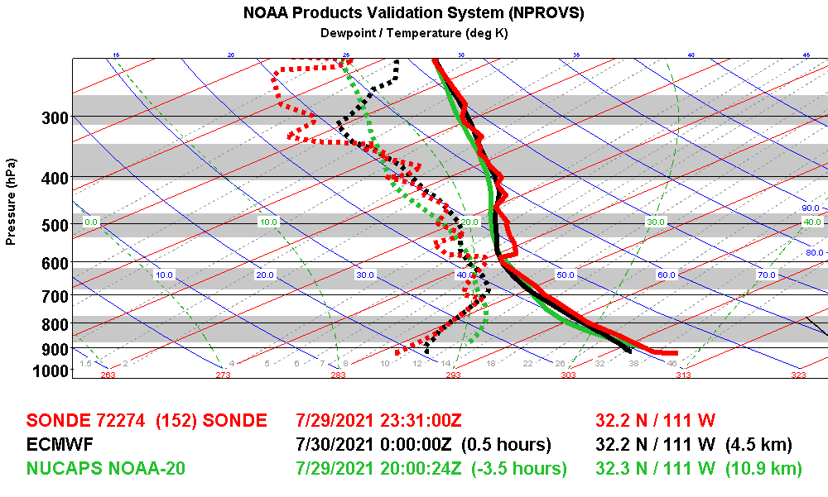
Tuscon

Slide 46
Summary
Many successful NUCAPS (NOAA-20) IR+MW in vicinity of storms; good “visual agreement” with VIIRS imagery
Provides meaningful observations of local/synoptic features in a monsoon environment, improves spatial/temporal coverage
Possible indication that NUCAPS H20 during day is systematically higher than NUCAPS at night (vicinity 800 Hpa, 2km)
Good Job NUCAPS !

