Slide 1
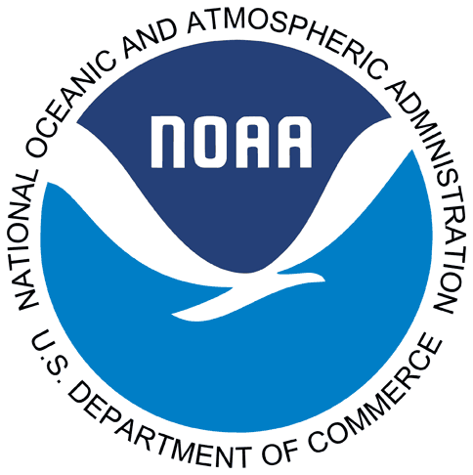
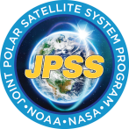
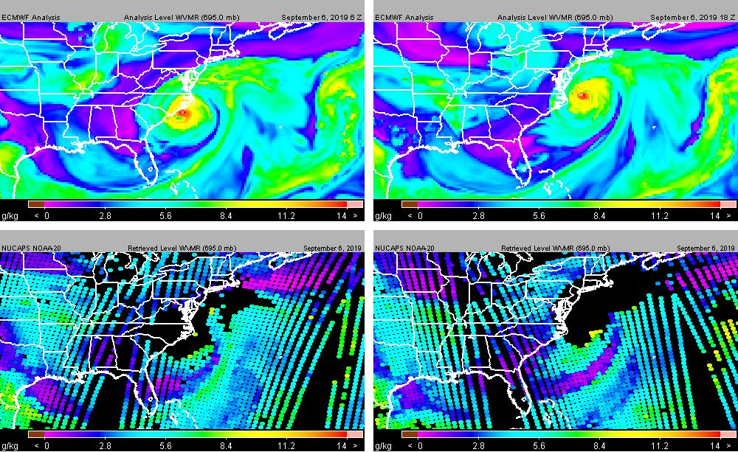
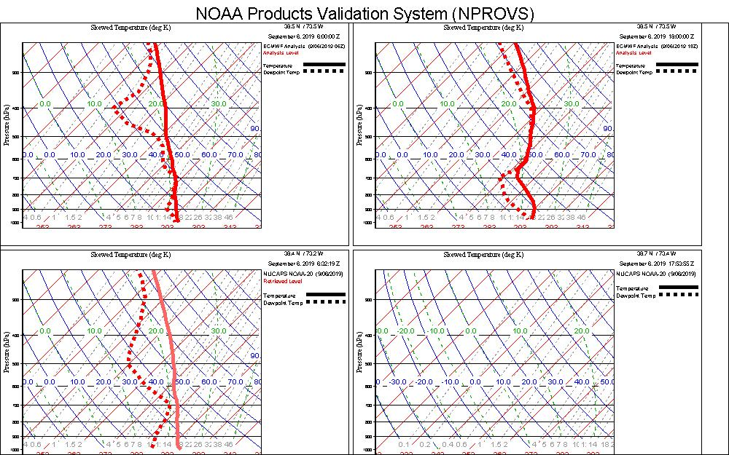
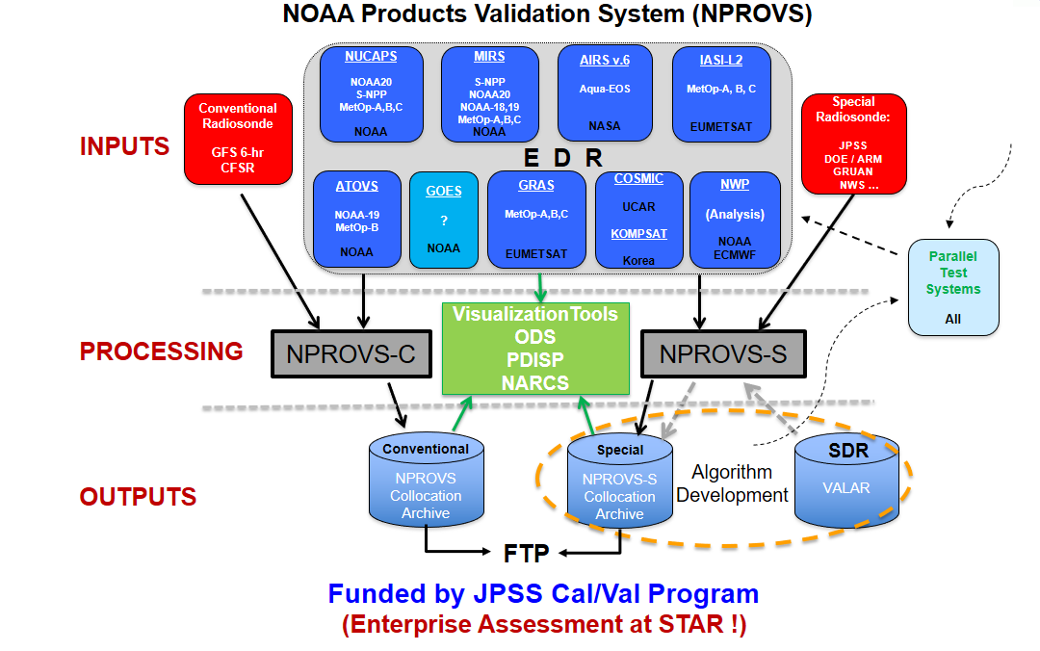
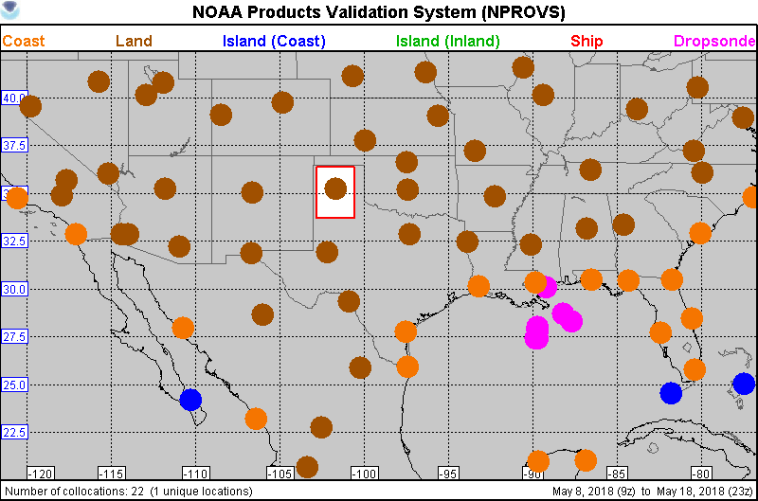
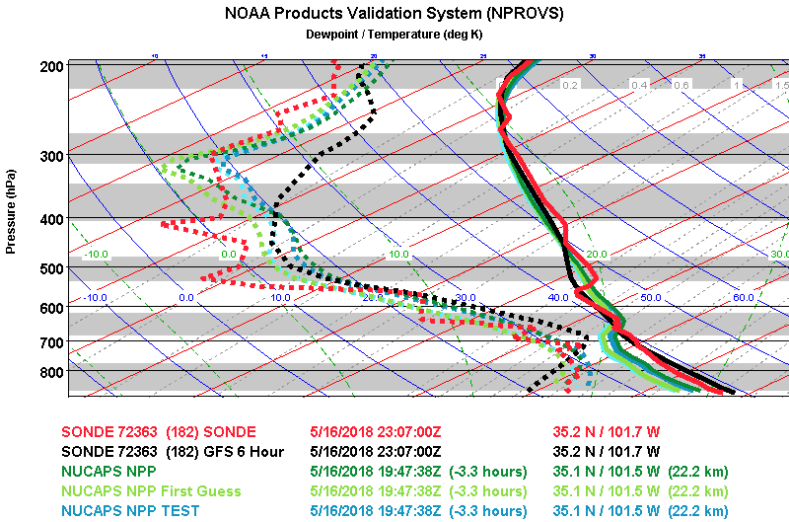
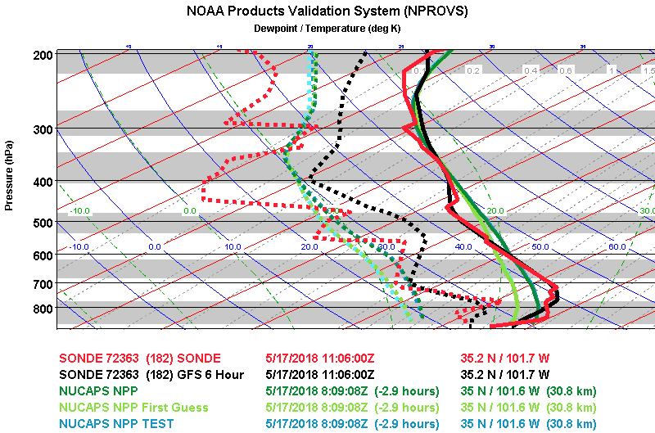
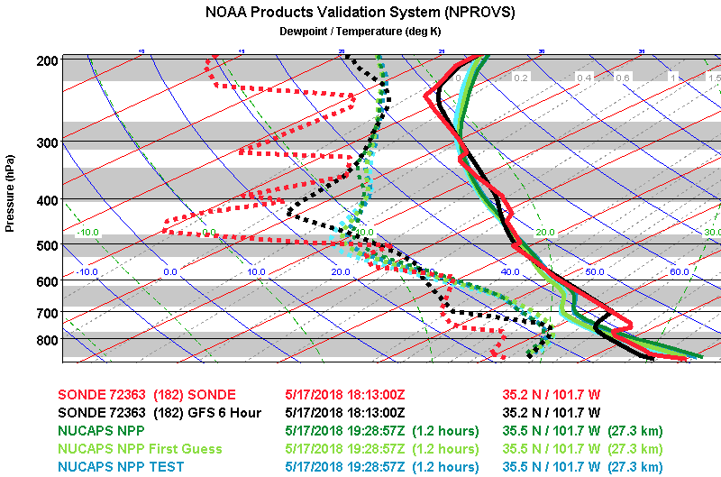
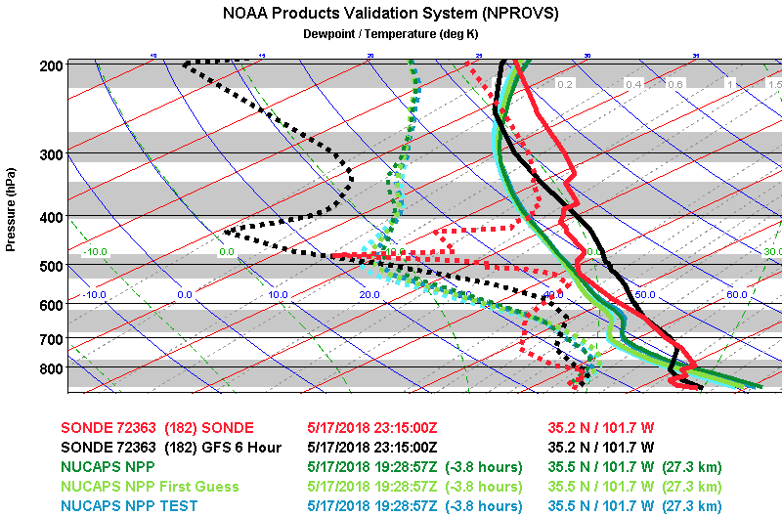
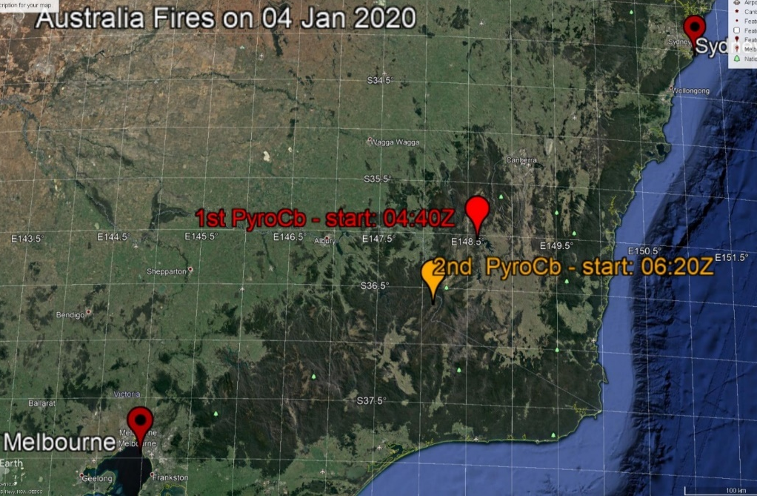
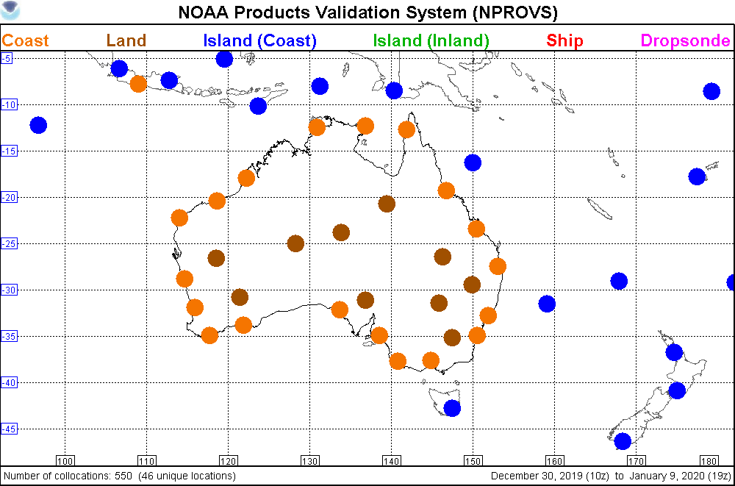
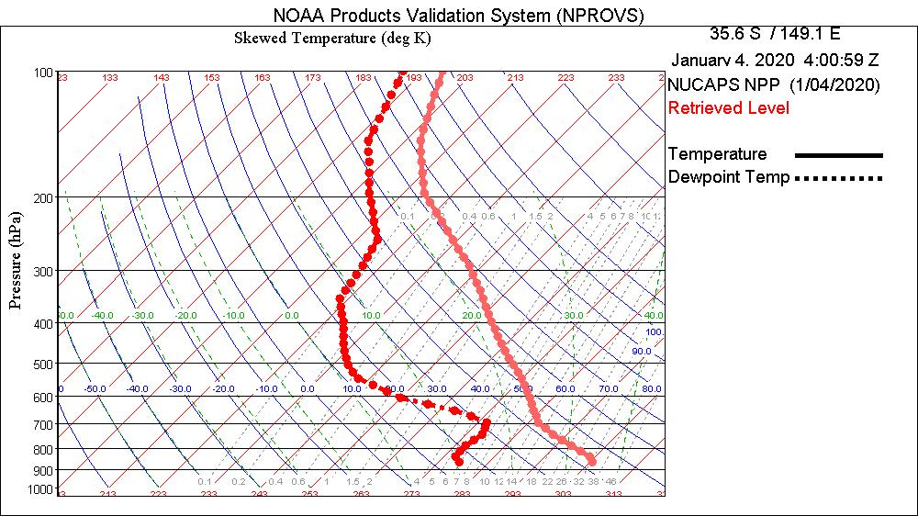
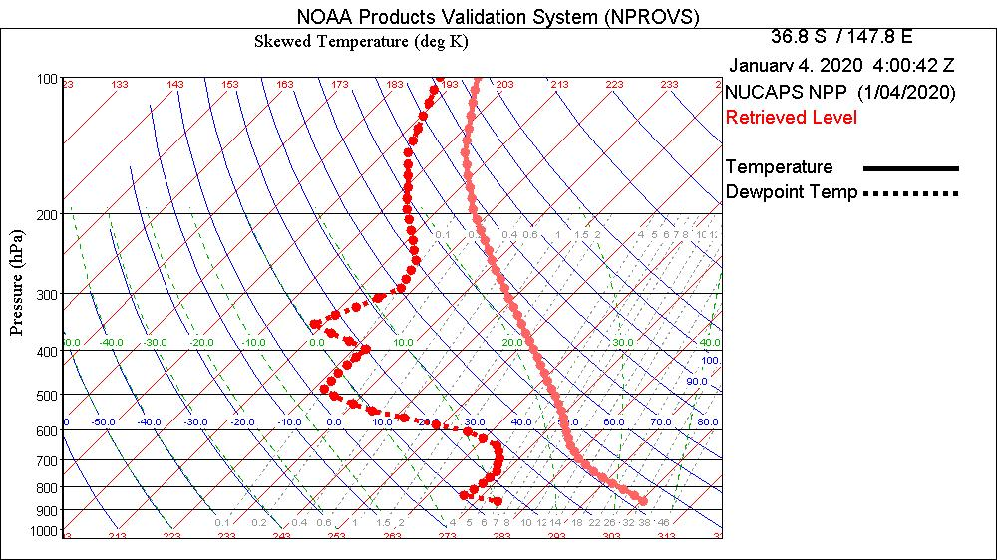
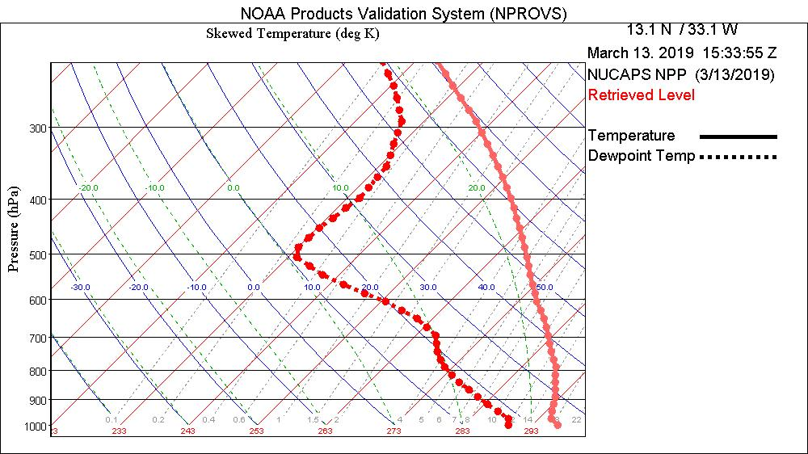
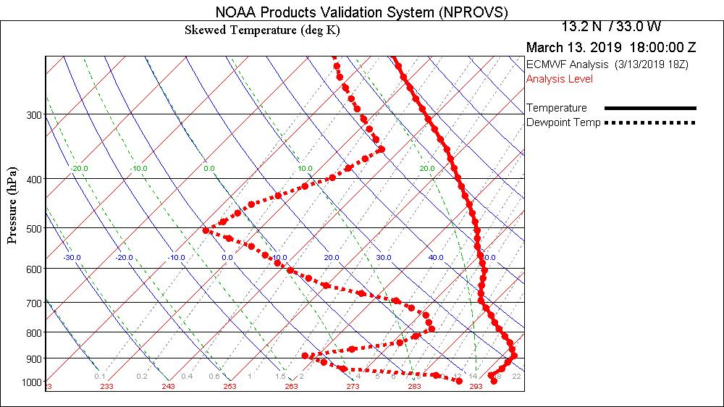
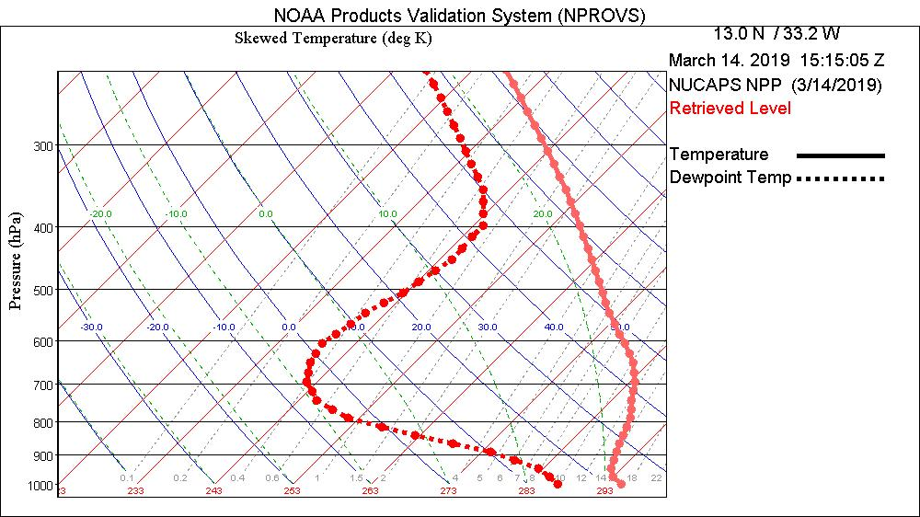
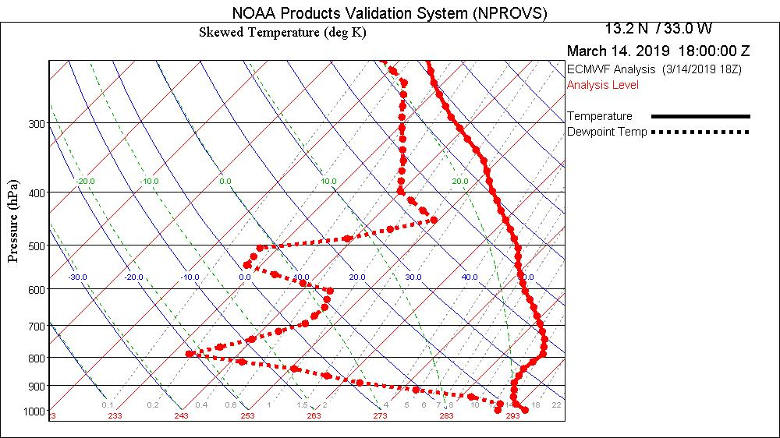
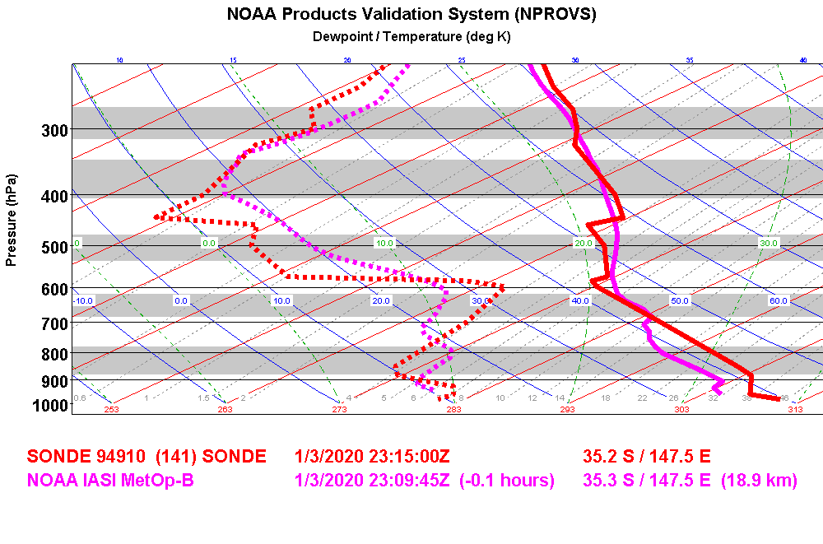
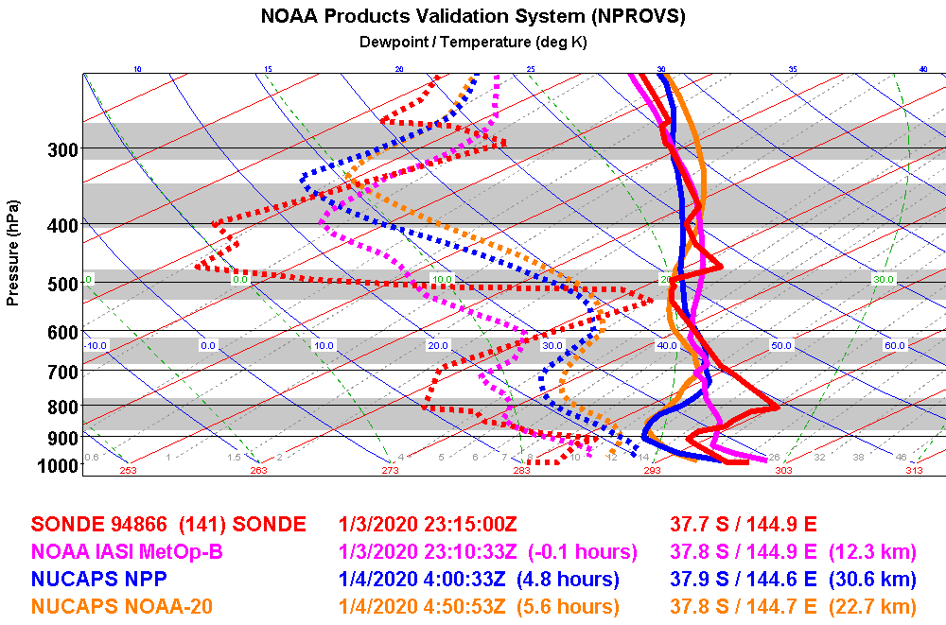
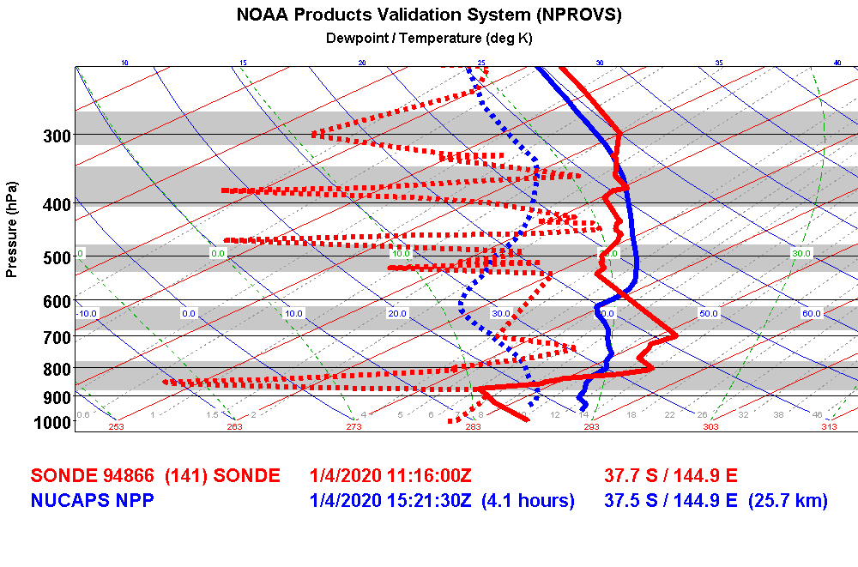
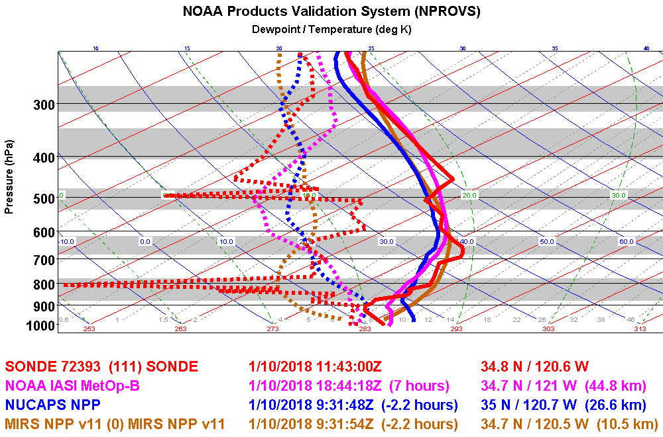
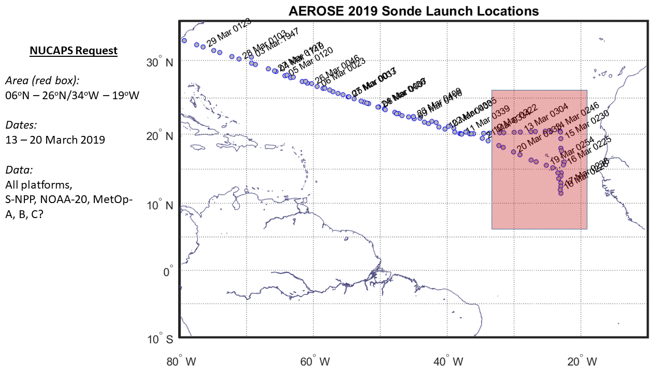
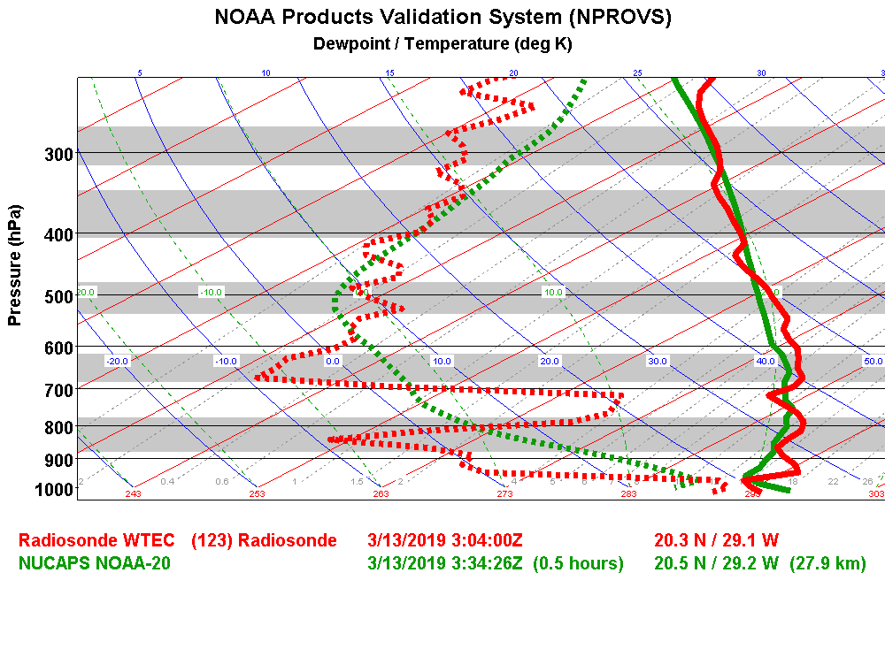
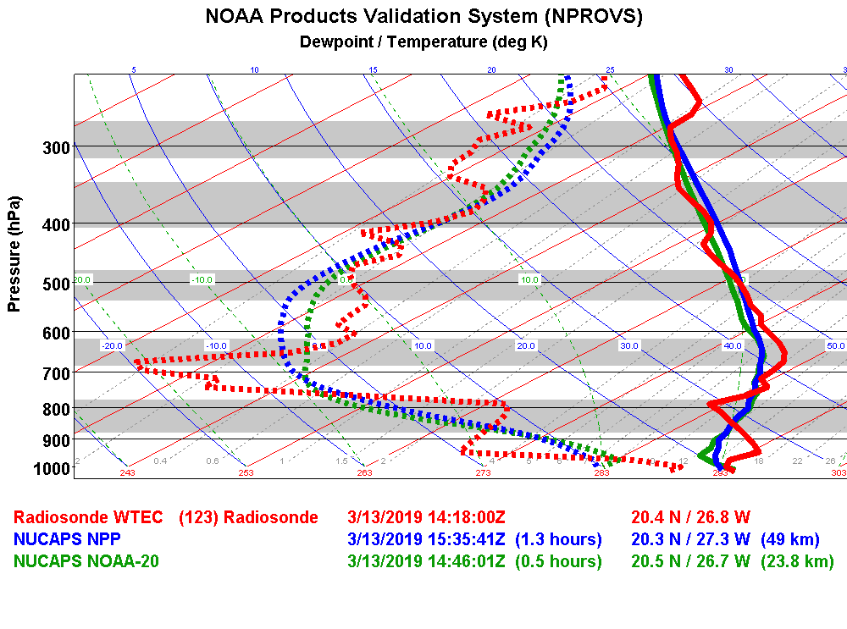
JPSS NUCAPS Soundings Support (NWS) Forecasters
Anthony Reale¹, Bomin Sun^{1,2}, Nick Nalli^{1,2}, Michael Pettey^{1,2}, Arunas Kuciauskas³
and Ryan Smith^{1,2}
¹ NOAA/NESDIS/STAR, College Park, MD, USA; ²I. M. Systems Group, Inc., Rockville, MD, USA, ³Naval 5resrach lab, Monterey, CA
Abstract
JPSS - HWTB
Hurricane Dorian
NOAA Unique Combined Atmospheric Product System (NUCAPS) derived sounding products provide global observations of atmospheric temperature and moisture profiles in the troposphere (and stratosphere). These profiles have provide information useful to Local and regional weather forecasters in cases of severe weather. NUCAPS soundings from NOAA-20 and SNPP are routinely available to NWS field offices (mainly CONUS) via AWIPS-2 with additional programs available / developing to distribute NUCAPS soundings outside CONUS … for example, recent JPSS / NWS sponsored workshops were held South America and Barbados with NUCAPS availability in the Alaska region and recently confirmed at GUAM. The following report provides a cross section of case studies demonstrating NUCAPS performance.
The NOAA Products Validation System (NPROVS, Reale et al. 2012), operated at NESDIS Office of Satellite Applications and Research (STAR), provides routine processing and archive of collocated Conventional (WMO) and Special (targeted) Radiosondes with various Satellite Products and Forecasts. These directly support of NOAA Joint Polar Satellite System (JPSS) calibration/validation program for NUCAPS and are leveraged in the case studies (retrospective) assessments shown below.
Case studies span from within CONUS, for example, Atmospheric River (US West Coast) and Pre-convective (Great Plains USA) environments to Tropical Storm (Barbados), Special NOAA AEROSE (Saharan Air Layer) trans-Atlantic campaigns and the Brush Fires in Australia.
Week | Case # | Date | Weather Region | Product | Success/ Failed | Details
2 | 3 | 5/10 2018 | Eastern Wyoming | Mid-Level Moisture | Success | NUCAPS sounding captured higher moisture levels better than NAM12 NUCAPS helped forecaster diagnose storm mode and indicating where the mixing is occurring ahead front
 | 4 | 5//9 2018 | South Central Illinois | CAPE | Failed | NUCAPS CAPE was very high, however severe storms did not occur CAPE anomaly sounding near Newton, IL
3 | 5 | 5/14 2017 | Texas panhandle up to Kansas City | CAPE | Success | NUCAPS CAPE closer to high resolution guidance than AllSky CAPE
 | 6 | 5/17 2018 | Amarillo, TX | Lapse Rates | Failed | Gridded NUCAPS lapse rates were not steep enough compared to models
X
X
ECMWF 6Z
D
ECMWF 18Z
D
X
X
JPSS hazardous Weather test bed (HWTB) offers opportunities for forecast users and NUCAPS providers to interact on case studies of interest; Case Study 6, Amarillo Texas, May 17, 2018 is summarized below
NUCAPS N20 AM
D
NUCAPS N20 PM
D
ECMWF (top) and NUCAPS NOAA-20 (IR+MW pass QC, bottom) at 06Z (left) and 18Z (right) on Sept. 6, 2019; “D” indicates Dorian’s center and “X”
the target location for NUCAPS
X
X
ECMWF 6Z
ECMWF 18Z
X
X
NOAA-20 AM
NA
Consecutive overpasses of NUCAPS MetOp-B (lower, 0930 LST) ) and SNPP (upper, 1330 LST) for temperature (left) and H2O vapor (right) confirm the advection of warm moist air northeastward toward Amarillo (X) and heightened potential for convection.
ECMWF (top) and NUCAPS (IR+MW pass QC, bottom) at 06Z (left) and 18Z (right) on Sept. 6, 2019 at locations ‘X”; NUCAPS in good agreement at 06Z in the path of Dorian but not available at 18Z in vicinity of eye-wall
RS92
D
Special NOAA dropsondes on September 3 and 4 include subsets in Dorians projected path; cases of interest in the context of NUCAPS soundings are circled
NPROVS provides routine compilation of collocated radiosondes, numerical weather prediction model and operational satellite atmospheric temperature and water vapor sounding profiles derived from multiple satellite platforms (NOAA, NASA, EUMETSAT …); a single “closest” sounding from each platform (and NWP) is collocated to a given radiosonde within 6 hr and 150 km.
Collocations of NUCAPS SNPP with Amarillo Radiosonde from late 5/16 through 5/17 confirm NUCAPS sensitivity to increasing atmospheric temperature and moisture consistent with the radiosonde; notice the non-synoptic 18Z radiosonde!
Collocated NUCAPS, ECMWF Analysis, GFS 6-hr forecast and Dropsondes demonstrate utility of NUCAPS soundings both in the vicinity (left) and further out ahead of Dorian (right).
Atmospheric River
AEROSE (2019) / SAL
Australia Brush Fires
Fire eruption zone, “Pryo” targets (left) and available Radiosondes (WMO, right) collocated to NUCAPS soundings on January 4, 2020
NUCAPS vertical profiles (lower right) compared to special targeted radiosondes (low left) captures circulation (Hadley cell) regimes (top) of the central tropical/sub-tropical region
NUCAPS (Top) and ECMWF Analysis (Bottom) for March 13, 14, mid-afternoon; 695 hPa H20 vapor: “X” Target; “S” ship
January 2018
ECMWF and NUCAPS (IR+MW pass QC) 750hPa H20 vapor across fire zone corresponding to NPP afternoon overpass (06Z) on January 4, 2020
ICAP Dust AOD forecast valid at 18Z on March 13 (left @ 66hr) and March 14 (right @ 90hr); “X” Target; “S” ship
Near
Pyro 1
Near
Pyro 2
NUCAPS NPP soundings closest to “Pyro” targets suggesting instability promoting fire expansion
NUCAPS (v5, low left) 800 hPa Atmospheric River moisture pattern compares favorably to ECMWF Analysis (up right) and NOAA operational MiRS (low right). The upper left denotes successful NUCAPS IR+MW (blue) that are plotted below; yellow and red are regions where IR+MW failed.
NUCAPS and ECMWF Analysis Temperature (solid) and H2O vapor (dash) on March 13 (left) and March 14 (right) at the location “X”; penetration into SAL manifested in enhanced dry subsidence layer vicinity of 700 hPa in both NUCAPS and ECMWF
NUCAPS NOAA-20, NPP and/or MetOp-B (pass QC) closest to Radiosondes near the targets zone and 06Z on Jan 4, 2020;
References
Reale, A., B. Sun, F. Tilley, and M. Pettey, 2012: The NOAA Products Validation System (NPROVS). Journal of Atmospheric and Oceanic Technology. 29, DOI:10.1175/JTECH-D-11-00072.1.
Nalli, N., and Coauthors, 2011: Multi-year observations of the tropical Atlantic atmosphere: Multidisciplinary applications of the NOAA Aerosols and Ocean Science Expeditions(AEROSE). Bull. Amer. Meteor. Soc., 92, 765–789, doi:10.1175/2011BAMS2997.1.
NUCAPS (and MiRS) soundings collocated with WMO radiosonde 1-day after Ca Mud Slide (location X) shows overall good agreement; lower layer remains moist with drying in mid-troposphere
NUCAPS and targeted AEROSE Radiosonde profiles for Temperature (solid) and H2O vapor (dash) on March 13 at 3Z (left) and 14Z (right) at the RHB ship locations “S”; deeper penetration of RHB into the SAL on the 14th manifested in enhanced dryness vicinity 700 hPa
Poster 30, JPSS / GOESR Proving Ground Risk Reduction Summit
24-28 February 2020, National Center for Weather and Climate Prediction (NCWCP)
College Park, MD
(corresponding author: Tony.reale@noaa.gov)

