Slide 1
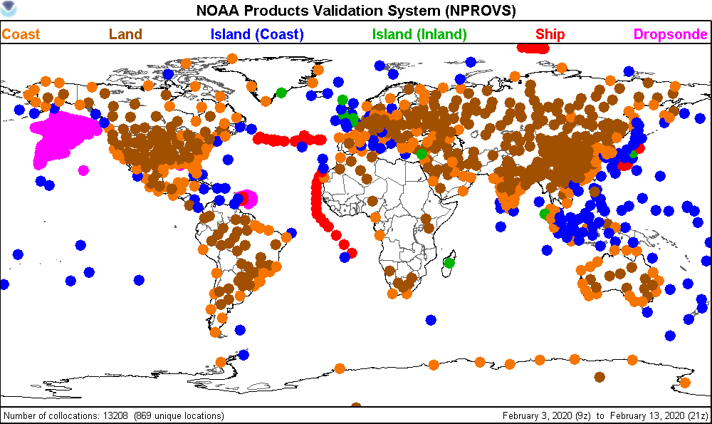
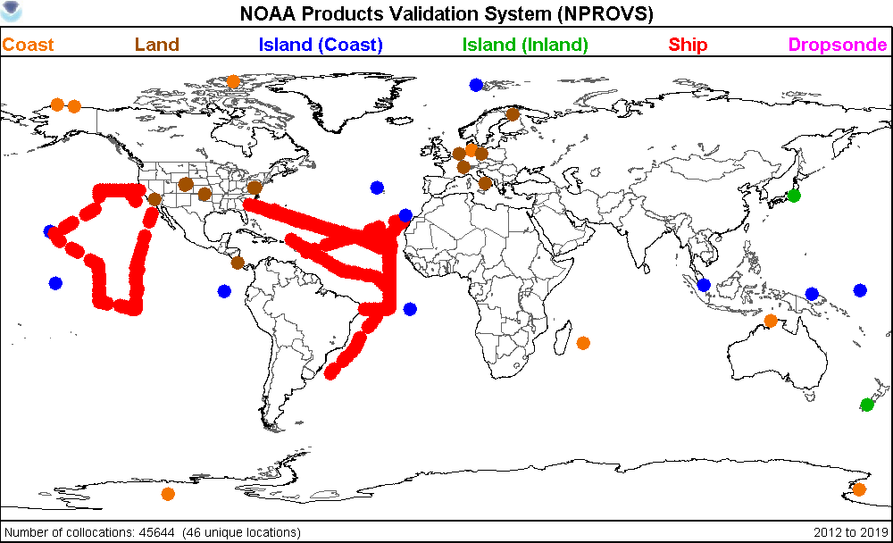
NOAA Products Validation System (NPROVS)
NUCAPS
NOAA20
S-NPP
MetOp-A,B,C
NOAA
MIRS
S-NPP
NOAA20
NOAA-18,19
MetOp-A,B,C
NOAA
AIRS v.6
Aqua-EOS
NASA
IASI-L2
MetOp-A, B, C
EUMETSAT
Conventional
Radiosonde
GFS 6-hr
CFSR
Special Radiosonde:
JPSS
DOE / ARM
GRUAN
INPUTS
Geophysical Profiles
ATOVS
NOAA-19
MetOp-B
NOAA
GOES
?
NOAA
GRAS
MetOp-A,B,C
EUMETSAT
COSMIC
UCAR
KOMPSAT
Korea
NWP
(Analysis)
NOAA
ECMWF
Parallel
Test
Systems
All
Collocation Processing
(daily)
VisualizationTools
ODS
PDISP
NARCS
NPROVS-C
NPROVS-S
OUTPUT
(Collocated Radiosonde and Satellite
Observations)
NPROVS
Collocation
Archive
NPROVS-S
Collocation
Archive
VALAR
(Sensor)
Conventional
Special
SDR
Algorithm
Development
FTP

Slide 2
NOAA Products Validation System (NPROVS)
Satellites
ObservatIons
GRUAN
Radiosonde and
Ancillary
Observations
NOAA20
S-NPP
MetOp-C
MetOp-B
MetOp-A
NASA-AIRS
GRAS
COSMIC
KOMPSAT
…
Models
Geophysical Profiles
Sensor Observations
(IR, MW, GPSRO)
NWP
NOAA
ECMWF
…
Collocated Radiosonde and Satellite Observations
Archive
Graphical Applications
Daily collocated radiosonde and satellite observations supporting JPSS Cal/Val and Dedicated Radiosonde programs …

Slide 3
NOAA Products Validation System (NPROVS)
Satellites
ObservatIons
Radiosonde:
Conventional
Special
Models
NOAA20
S-NPP
MetOp-C
MetOp-B
MetOp-A
NASA-AIRS
GRAS
COSMIC
KOMPSAT
Geophysical Profiles
Sensor Observations
(IR, MW, GPSRO)
NWP
NOAA
ECMWF
Collocated Radiosonde and Satellite Observations
Archive
Daily collocated radiosonde and satellite observations supporting JPSS Cal/Val and Dedicated Radiosonde programs …

Slide 4
NOAA Products Validation System (NPROVS)
NUCAPS
NOAA20
S-NPP
MetOp-A,B,C
NOAA
MIRS
S-NPP
NOAA20
NOAA-18,19
MetOp-A,B,C
NOAA
AIRS v.6
Aqua-EOS
NASA
IASI-L2
MetOp-A, B, C
EUMETSAT
Conventional
Radiosonde
Special Radiosonde
INPUTS
Geophysical Profiles
ATOVS
MetOp-B
NOAA
GOES
NA
NOAA
GNSS
GRAS MetOp-A,B,C
COSMIC-2 UCAR
KOMPSAT Korea
NWP
NOAA GFS 6-hr
ECMWF ANAL
…
Collocation Processing
(daily)
Graphical Applications
ODS
PDISP
NARCS
NPROVS-C
NPROVS-S
OUTPUT
(Collocated Radiosonde and Satellite
Observations)
NPROVS-C
Collocation
Archive
Special
SDR
(Radiance)
Archive
Conventional
NPROVS-S
Collocation
Archive
NetCDF
FTP

Slide 5
Metop-B,C
10-day
v3 (HEAP) vs Oper

Slide 6
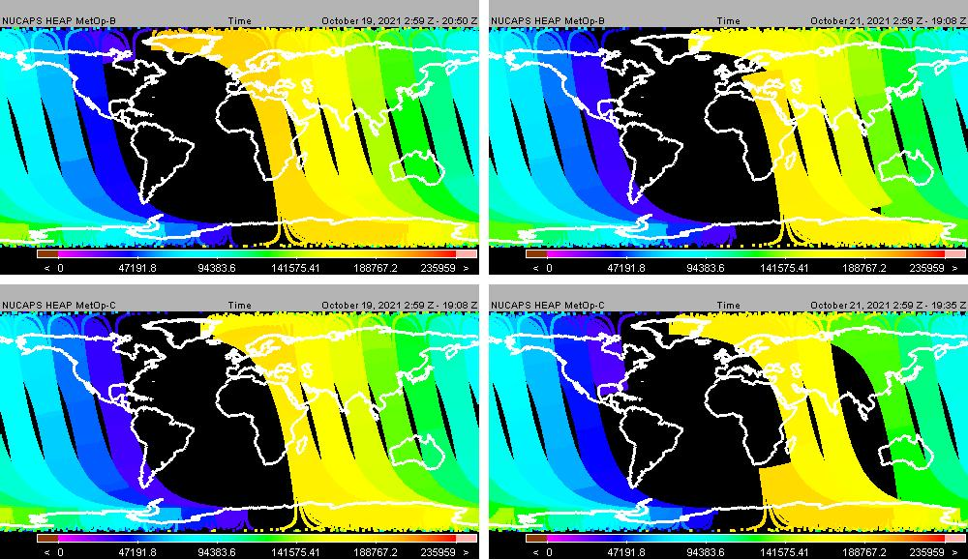
HEAP
MetOp-B
Time (Z)
Oct 19
HEAP
MetOp-C
Time (Z)
Oct 19
HEAP
MetOp-B
Time (Z)
Oct 21
HEAP
MetOp-C
Time (Z)
Oct 21
HEAP Time Gap 19Z to 2Z … observed most days
(ascending node)

Slide 7
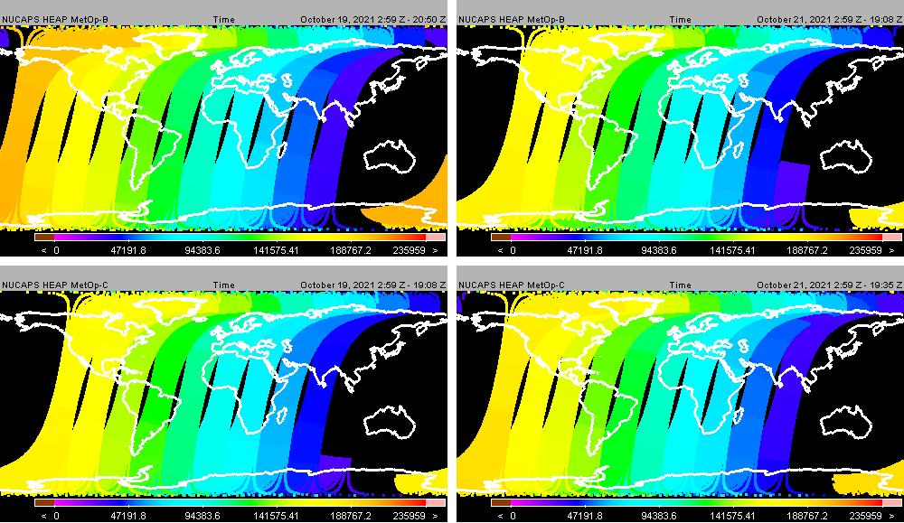
HEAP
MetOp-B
Time (Z)
Oct 19
HEAP
MetOp-C
Time (Z)
Oct 19
HEAP
MetOp-B
Time (Z)
Oct 21
HEAP
MetOp-C
Time (Z)
Oct 21
HEAP Time Gap 19Z to 2Z … observed most days
(descending node)

Slide 8
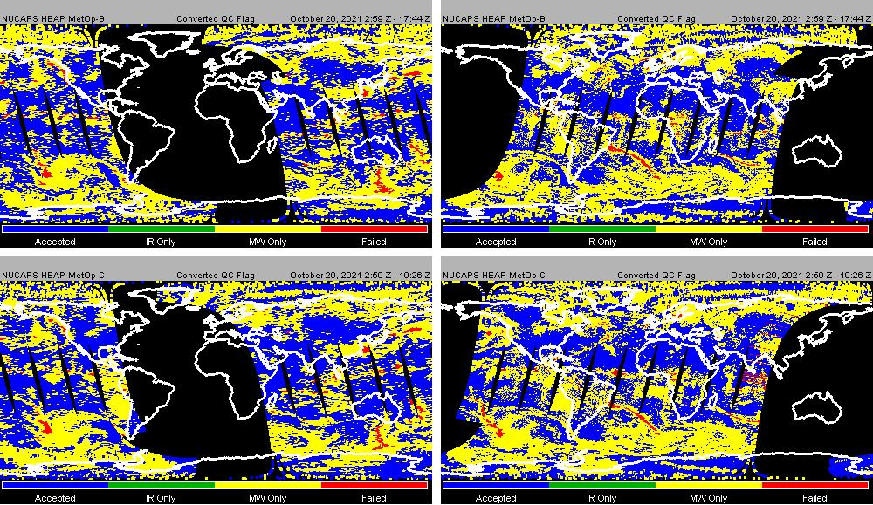
HEAP
MetOp-B
QC Flag
Oct 20
HEAP
MetOp-C
QC Flag
Oct 20
HEAP
MetOp-B
QC Flag
Oct 20
HEAP
MetOp-C
QC Flag
Oct 20
QC Flags HEAP MetOp-B vs MetOp-C are overall similar …

Slide 9
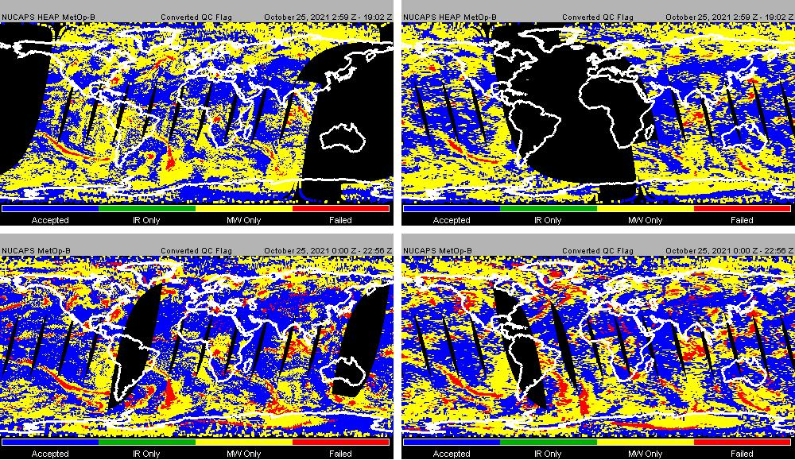
HEAP
MetOp-B
QC Flag
Oct 25
Oper
MetOp-B
QC Flag
Oct 25
HEAP
MetOp-B
QC Flag
Oct 25
Oper
MetOp-C
QC Flag
Oct 25
QC Flags HEAP MetOp-B vs Oper MetOp-B
HEAP slightly less IR+MW pass QC (Blue) and less “Both Fail (red)” vs Oper

Slide 10
IR+MW

Slide 11
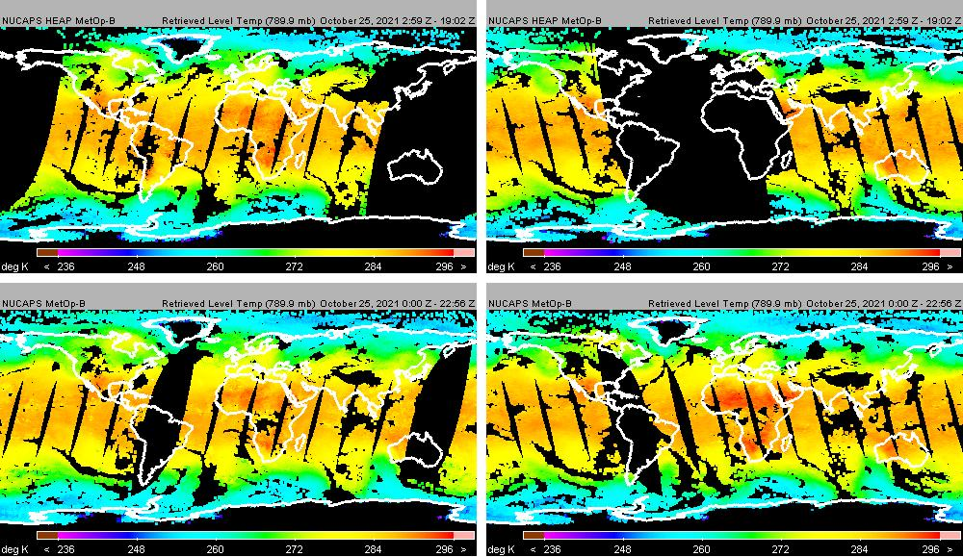
HEAP
MetOp-B
789 hPa
Temp
Oct 25
Oper
MetOp-B
789 hPa
Temp
Oct 25
HEAP
MetOp-B
789 hPa
Temp
Oct 25
Oper
MetOp-B
789 hPa
Temp
Oct 25
HEAP vs Oper have similar IR+MW global temperature features …

Slide 12
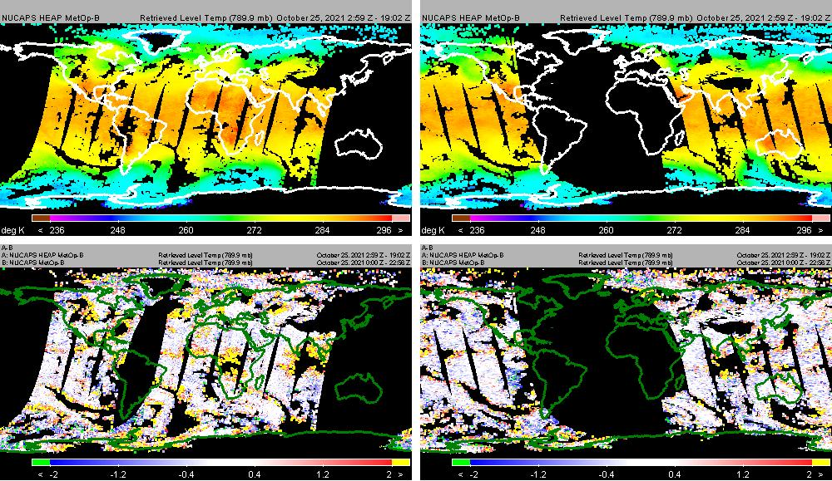
HEAP
MetOp-B
789 hPa
Temp
Oct 25
HEAP-Oper
MetOp-B
789 hPa
Temp
Oct 25
HEAP
MetOp-B
789 hPa
Temp
Oct 25
HEAP-Oper
MetOp-B
789 hPa
Temp
Oct 25
HEAP vs Oper have similar IR+MW global temperature features …

Slide 13
HEAP
MetOp-B
789 hPa
FG Temp
Oct 25
Oper
MetOp-B
789 hPa
FG Temp
Oct 25
HEAP
MetOp-B
789 hPa
FG Temp
Oct 25
Oper
MetOp-B
789 hPa
FG Temp
Oct 25
HEAP vs Oper have similar IR+MW global first guess temperature features …

Slide 14
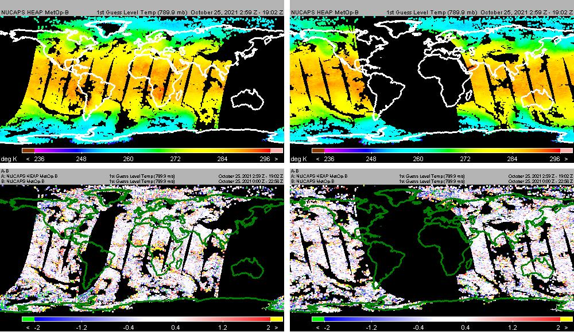
HEAP
MetOp-B
789 hPa
FG Temp
Oct 25
HEAP-Oper
MetOp-B
789 hPa
FG Temp
Oct 25
HEAP
MetOp-B
789 hPa
FG Temp
Oct 25
HEAP-Oper
MetOp-B
789 hPa
FG Temp
Oct 25
HEAP vs Oper have similar IR+MW global first guess temperature features …

Slide 15
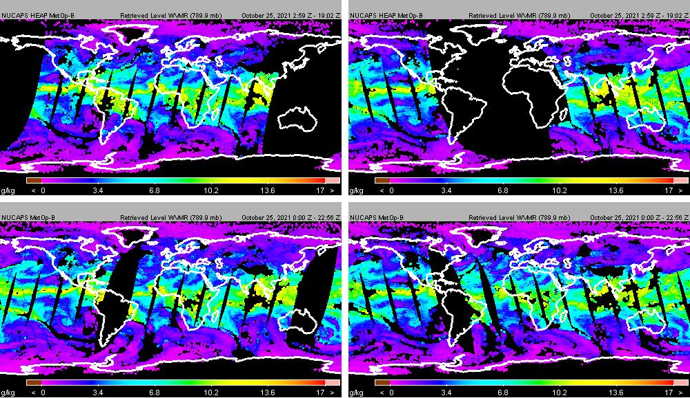
HEAP
MetOp-B
789 hPa
WVMR
Oct 25
Oper
MetOp-B
789 hPa
WVMR)
Oct 25
HEAP
MetOp-B
789 hPa
WVMR
Oct 25
Oper
MetOp-B
789 hPa
WVMR
Oct 25
HEAP vs Oper have similar IR+MW global WVMR features …

Slide 16
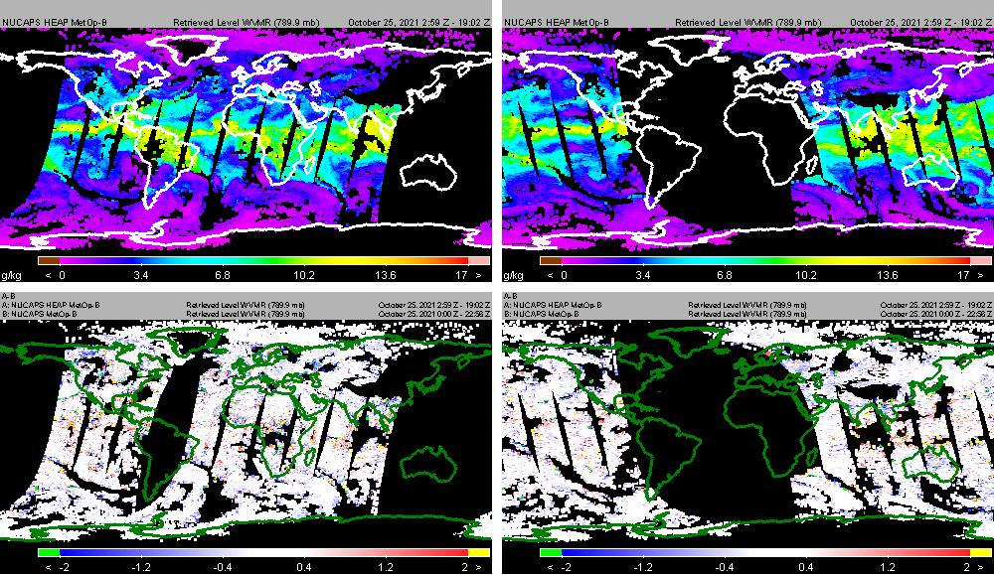
HEAP
MetOp-B
789 hPa
WVMR
Oct 25
HEAP-Oper
MetOp-B
789 hPa
WVMR
Oct 25
HEAP
MetOp-B
789 hPa
WVMR
Oct 25
HEAP-Oper
MetOp-B
789 hPa
WVMR
Oct 25
HEAP vs Oper have similar IR+MW global WVMR features …

Slide 17
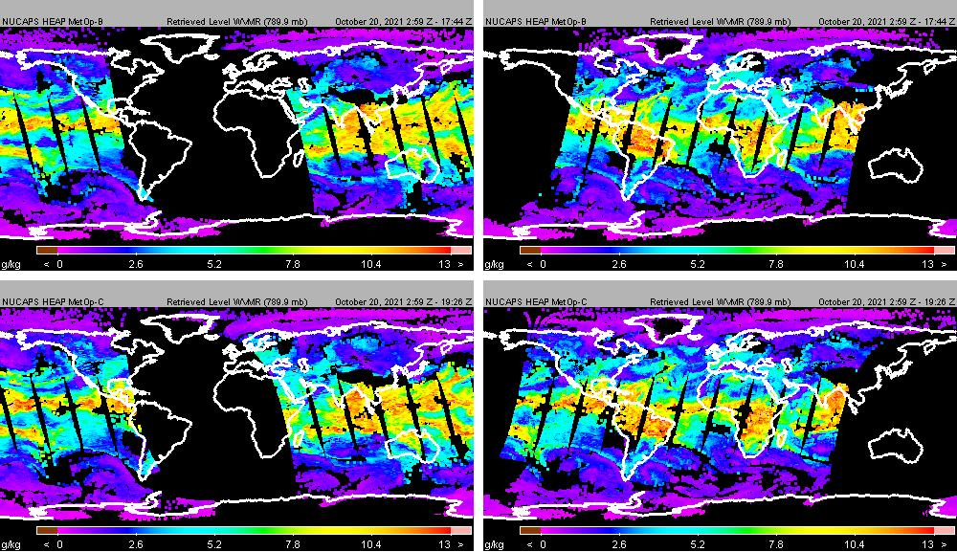
HEAP
MetOp-B
789 hPa
WVMR
Oct 25
HEAP
MetOp-C
789 hPa
WVMR
Oct 25
HEAP
MetOp-B
789 hPa
WVMR
Oct 25
HEAP
MetOp-C
789 hPa
WVMR
Oct 25

Slide 18
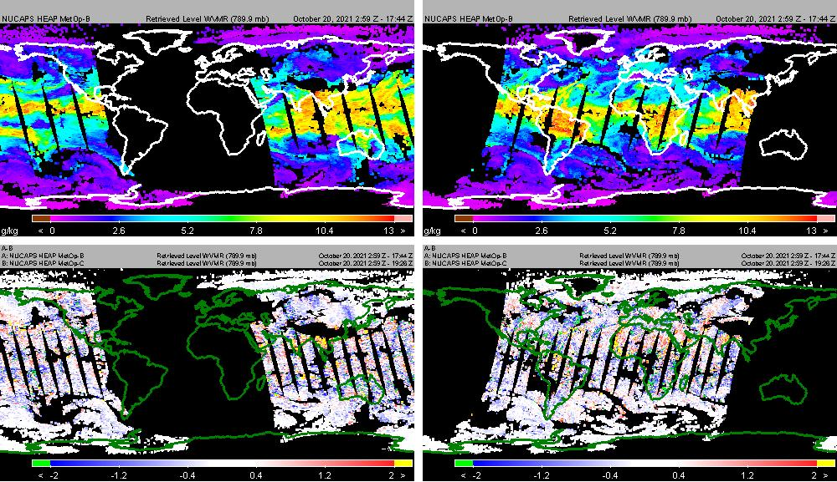
HEAP
MetOp-B
789 hPa
WVMR
Oct 25
HEAP
MetOp B-C
789 hPa
WVMR
Oct 25
HEAP
MetOp-B
789 hPa
WVMR
Oct 25
HEAP
MetOp B-C
789 hPa
WVMR
Oct 25
HEAP MetOp B-C differences small …

Slide 19
MW-only
(Baselined to MiRS)

Slide 20
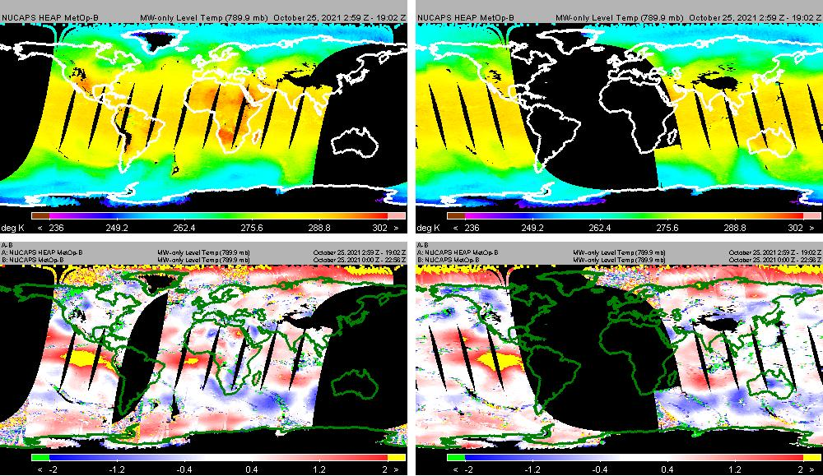
HEAP
MetOp-B
789 hPa
MW Temp
Oct 25
HEAP-Oper
MetOp-B
789 hPa
MW Temp
Oct 25
HEAP
MetOp-B
789 hPa
MW Temp
Oct 25
HEAP-Oper
MetOp-B
789 hPa
MW Temp
Oct 25
HEAP vs Oper Temperature for MW-only show differences mainly over Sea

Slide 21
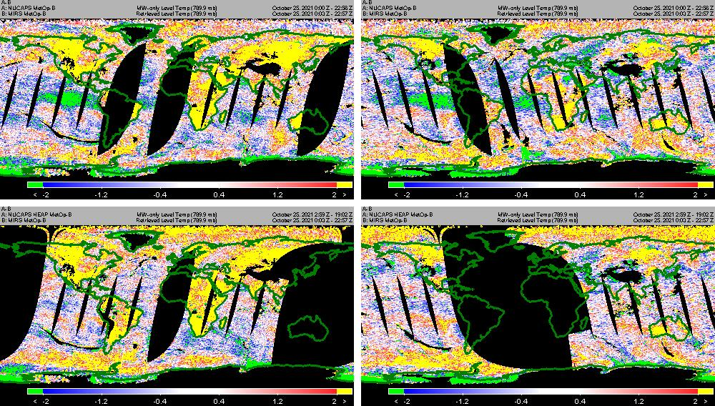
Oper-MiRS
MetOp-B
789 hPa
MW Temp
Oct 25
HEAP-MiRS
MetOp-B
789 hPa
MW Temp
Oct 25
Oper-MiRS
MetOp-B
789 hPa
MW Temp
Oct 25
HEAP-MiRS
MetOp-B
789 hPa
MW Temp
Oct 25
HEAP MW-only temperature appear overall closer to MiRS (vs Oper) over Sea

Slide 22
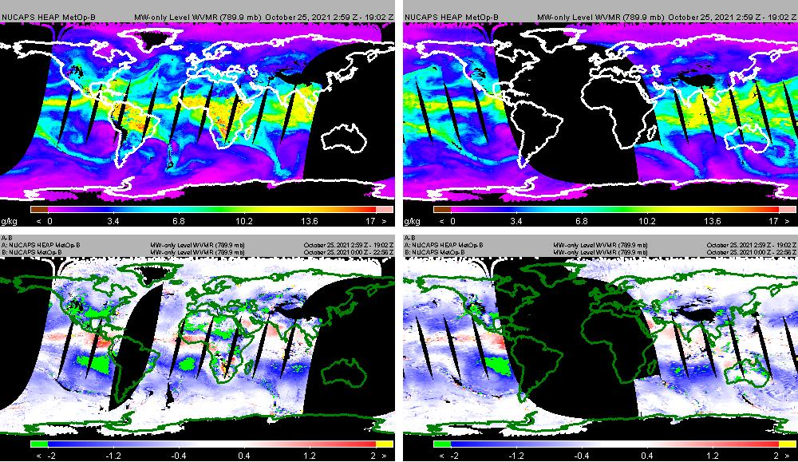
HEAP
MetOp-B
789 hPa
MW WVMR
Oct 25
HEAP-Oper
MetOp-B
789 hPa
MW WVMR
Oct 25
HEAP
MetOp-B
789 hPa
MW WVMR
Oct 25
HEAP-Oper
MetOp-B
789 hPa
WVMR
Oct 25
HEAP vs Oper WVMR (g/kg) for MW-only show differences over Sea and Land

Slide 23
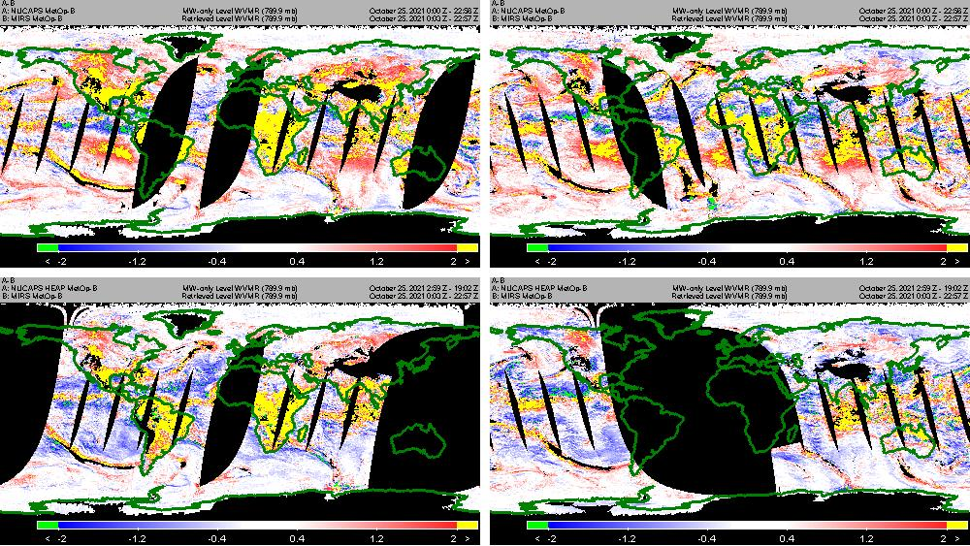
Oper-MiRS
MetOp-B
789 hPa
MW WVMR
Oct 25
HEAP-MiRS
MetOp-B
789 hPa
MW WVMR
Oct 25
Oper-MiRS
MetOp-B
789 hPa
MW WVMR
Oct 25
HEAP-MiRS
MetOp-B
789 hPa
MW WVMR
Oct 25
HEAP MW-only WVMR (g/kg) appear overall closer to MiRS (vs Oper) over Sea and Land …

Slide 24
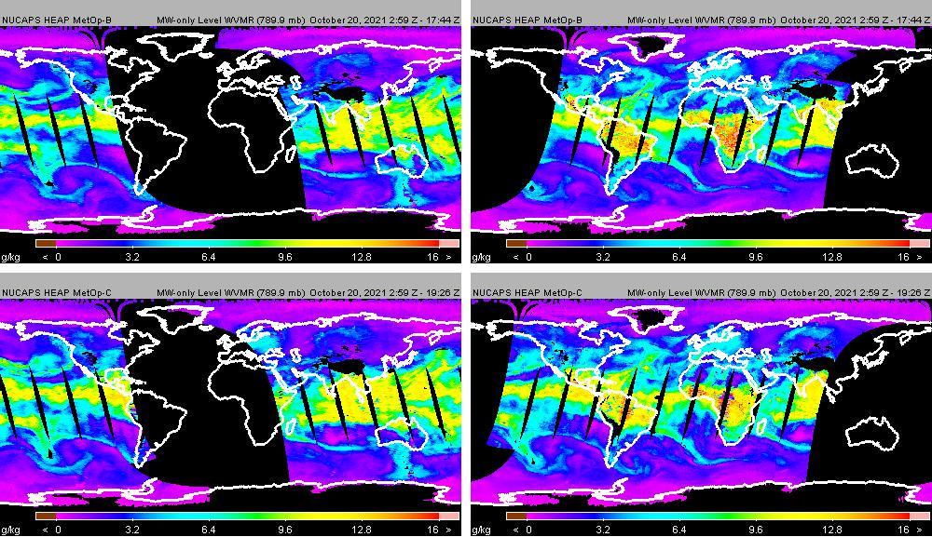
HEAP
MetOp-B
789 hPa
MW WVMR
Oct 25
HEAP
MetOp-C
789 hPa
MW WVMR
Oct 25
HEAP
MetOp-B
789 hPa
MW WVMR
Oct 25
HEAP
MetOp-C
789 hPa
MW WVMR
Oct 25

Slide 25
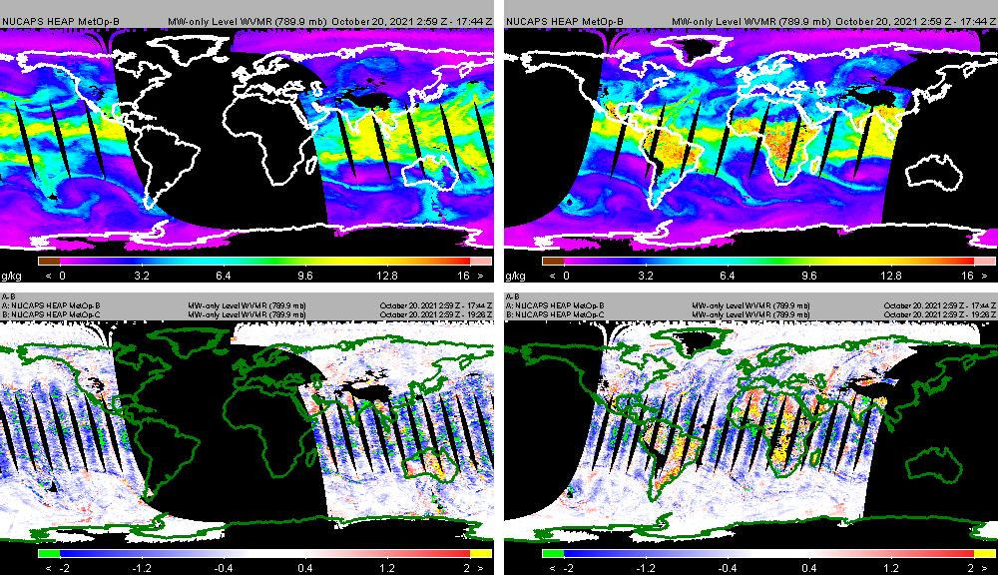
HEAP
MetOp-B
789 hPa
MW WVMR
Oct 25
HEAP
MetOp B-C
789 hPa
MW WVMR
Oct 25
HEAP
MetOp-B
789 hPa
MW WVMR
Oct 25
HEAP
MetOp B-C
789 hPa
MW WVMR
Oct 25
HEAP MetOp B-C difference patterns interesting …

Slide 26
Summary
MetOp-B v3 (HEAP) systematically missing orbits between about 18Z and 02Z (slides 6,7)
Metop-B v3 (HEAP) have slightly more IR+MW fail QC and less “Both” fail QC vs Oper (slides 8.9)
MetOp-B v3 (HEAP) vs Oper temperature and WVMR fields for IR+MW pass QC appear similar (800 hPa) (slides 11-16)
MetOp-B v3 (HEAP) vs Oper temperature for MW-only show differences mainly over sea (slide 18)
MetOp-B v3 (HEAP) vs Oper WVMR for MW-only show differences over sea and land (slide 20)
MetOp-B v3 (HEAP) for MW-only appear closer to MiRS (baseline) vs Oper for temperature and WVMR (slides 19, 21)
MetOp-B vs MetOp-C for v3 overall similar except possibly for WVMR (slide 25 )
Preliminary VSTATS (one day, 20th) support findings (slides 27-31)

Slide 27
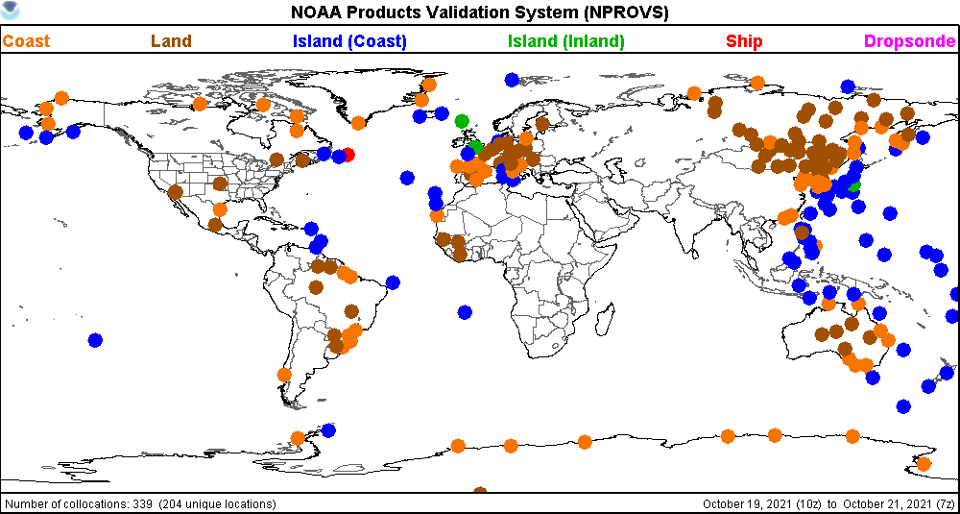

Slide 28
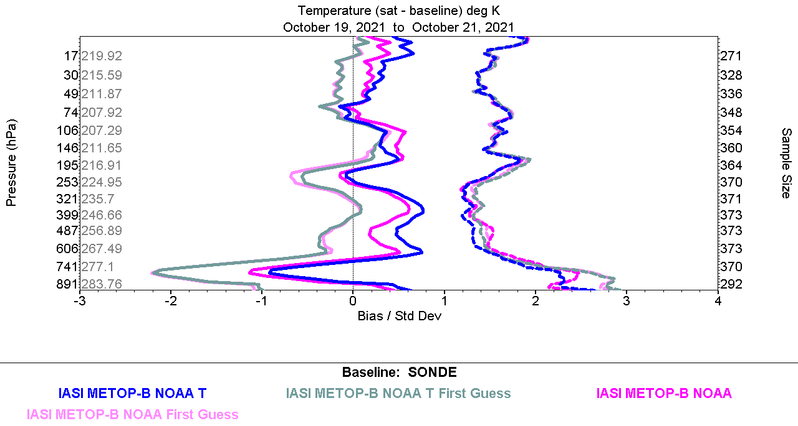
HEAP vs Oper have similar IR+MW global temperature features …

Slide 29
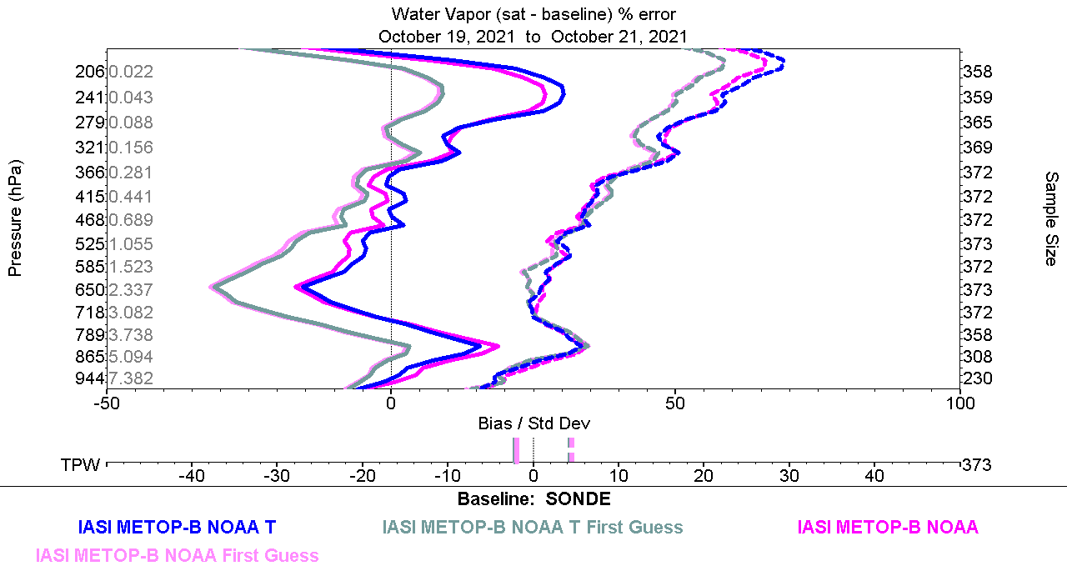
HEAP vs Oper have similar IR+MW global WVMR features …

Slide 30
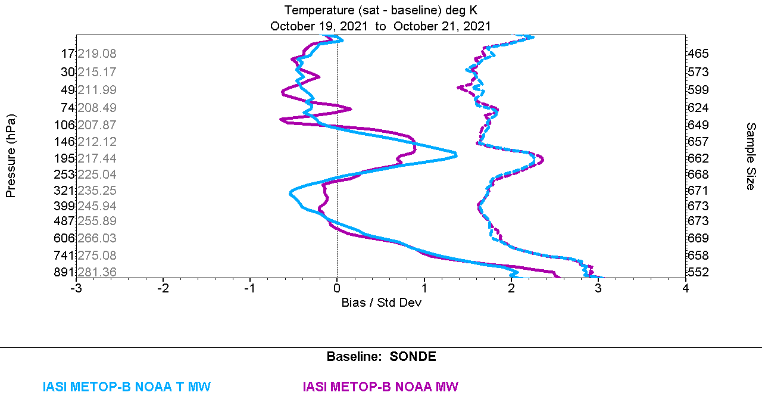
HEAP vs Oper Temperature for MW-only show differences mainly over Sea

Slide 31
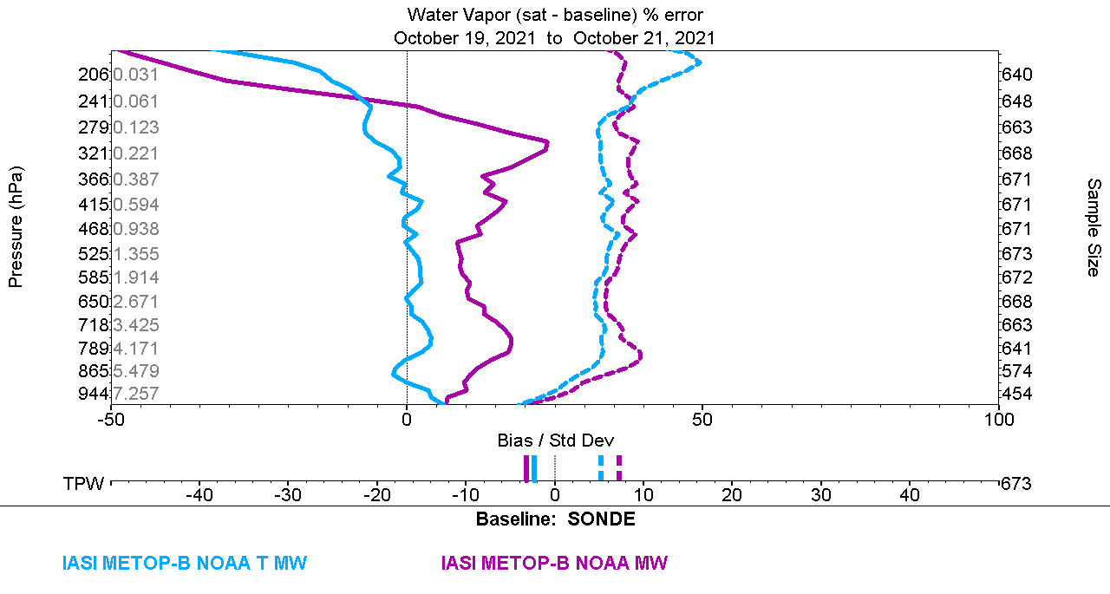
HEAP vs Oper WVMR (g/kg) for MW-only show differences over Sea and Land

