Slide 1
STAR NPROVS Updates/Accomplishments
NUCAPS All-Hands Meeting
(Part-2)
March 1, 2023
Tony Reale (STAR)
Bomin Sun, Mike Pettey, Cassandra Calderella and Charles Brown
STAR (IMSG)

Slide 2
NUCAPS v3 Performance

Slide 3
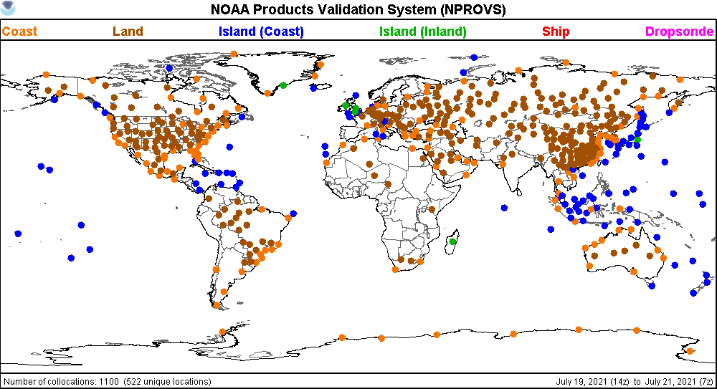
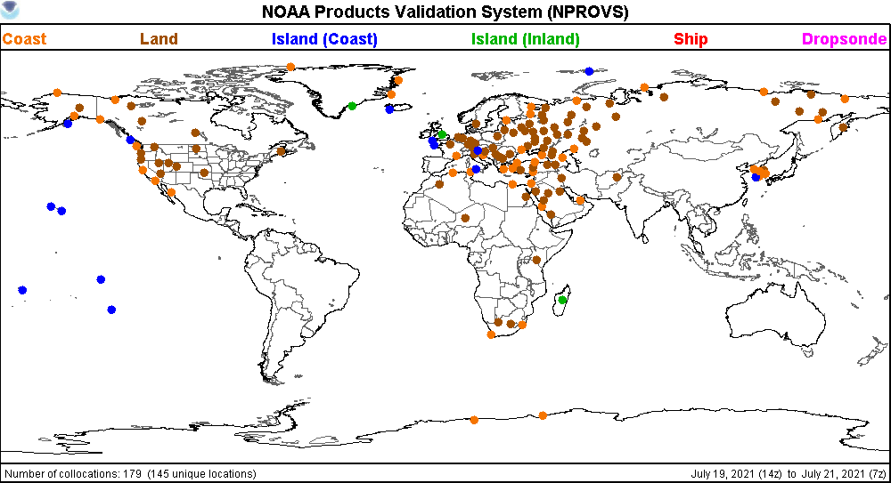
6-hr Global 2-hr

Slide 4
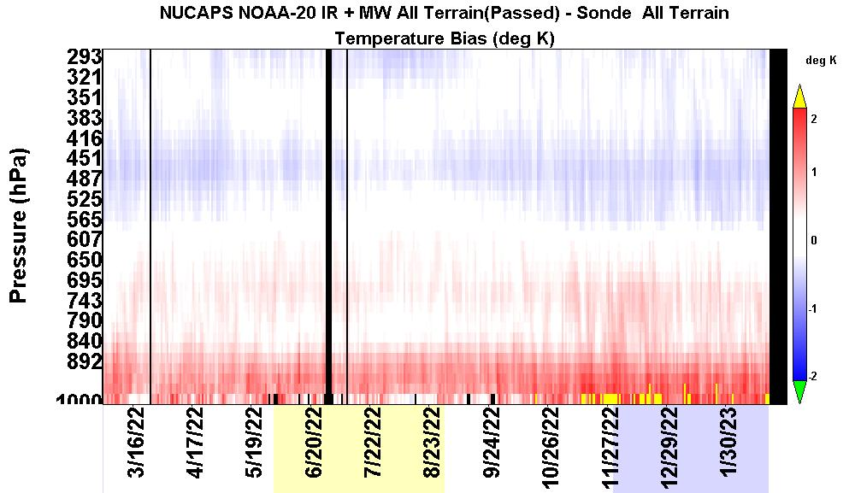
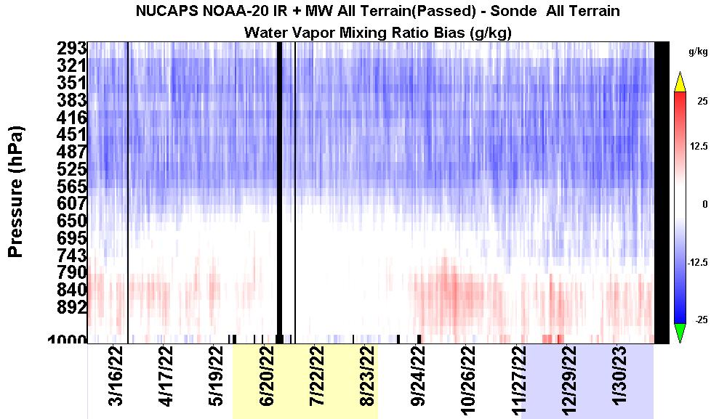
NUCAPS
IR+MW
NOAA-20
Global 6-hr/100km Daily Mean Bias (800)
January 2022 to February 2023; characteristic performance

Slide 5
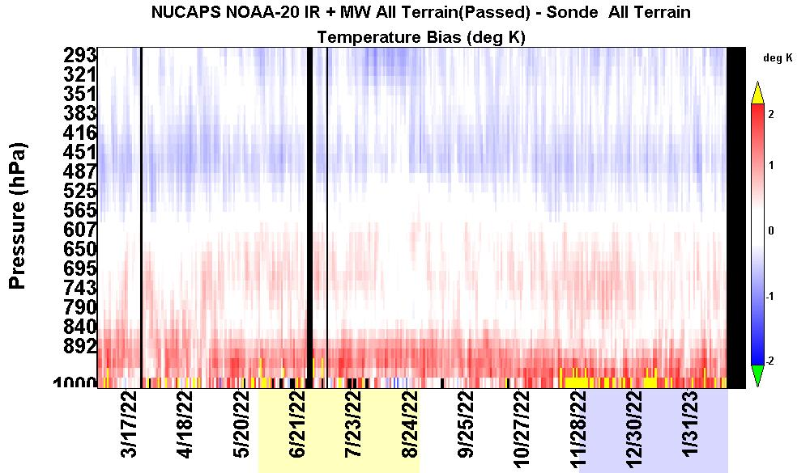
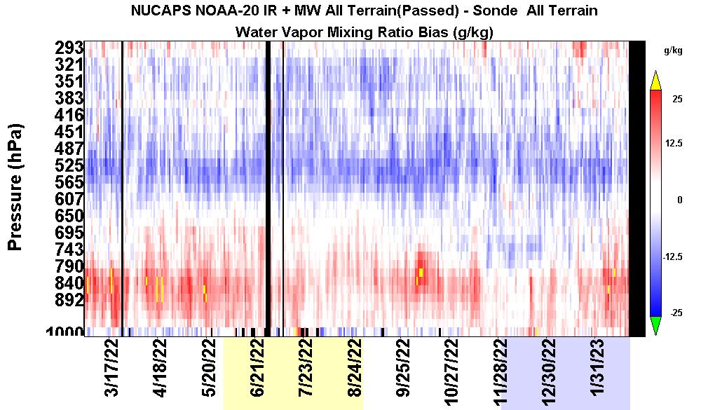
NUCAPS
IR+MW
NOAA-20
Global 2-hr/100km Daily Mean Bias (200)
January 2022 to February 2023; characteristic performance

Slide 6
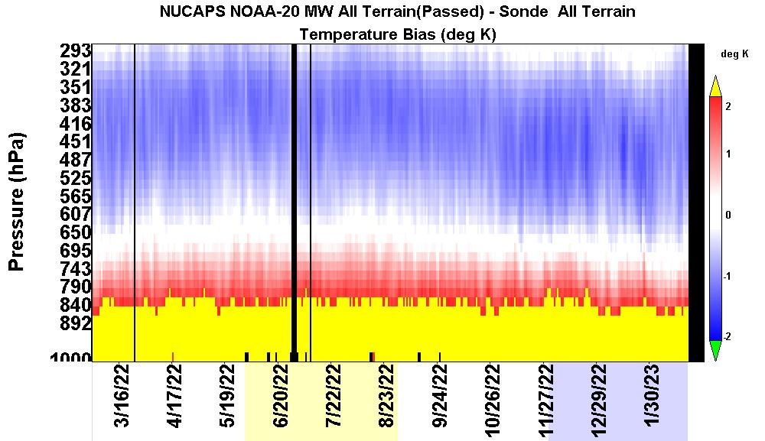
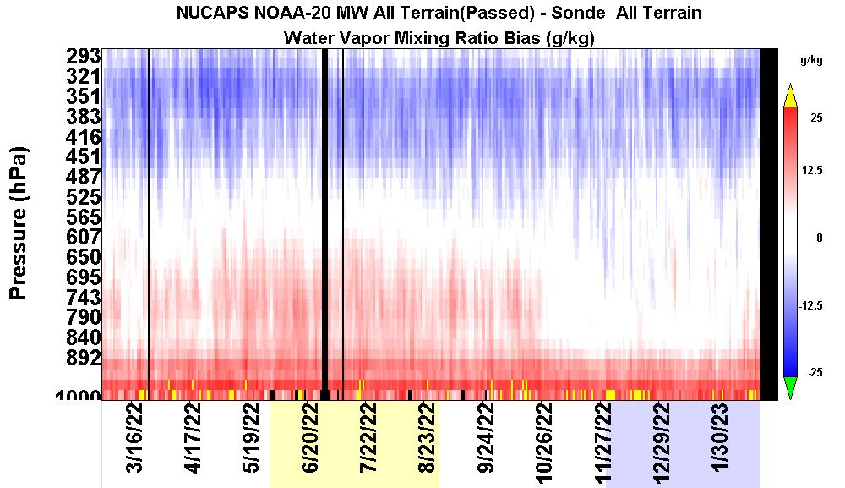
NUCAPS
MW-only
NOAA-20
Global 6-hr/100km Daily Mean Bias (1000)
January 2022 to February 2023; characteristic performance

Slide 7
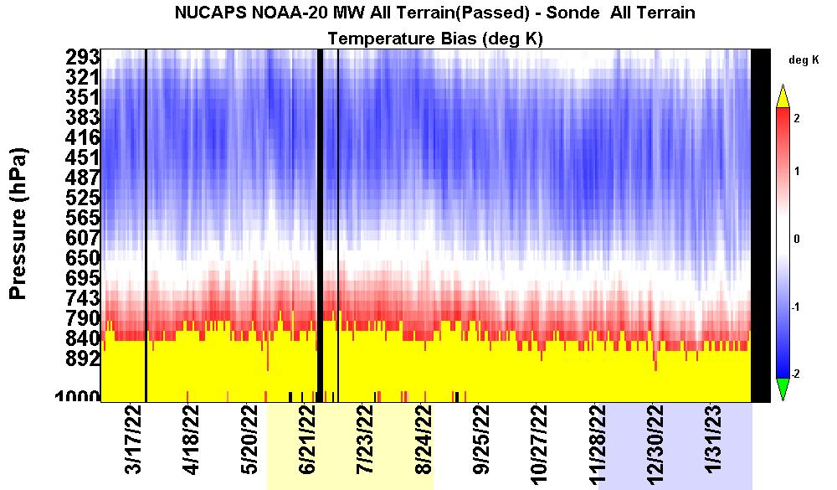
NUCAPS
MW-only
NOAA-20
Global 2-hr/100km Daily Mean Bias (300)
January 2022 to February 2023; characteristic performance

Slide 8
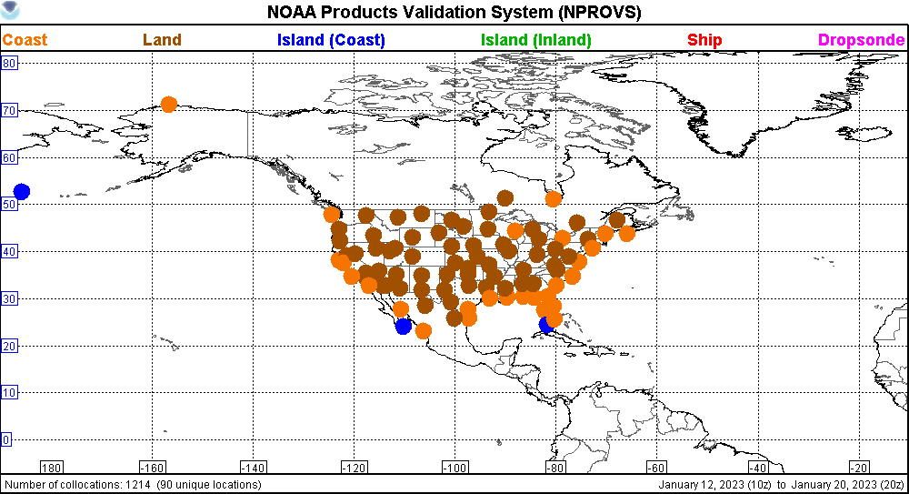
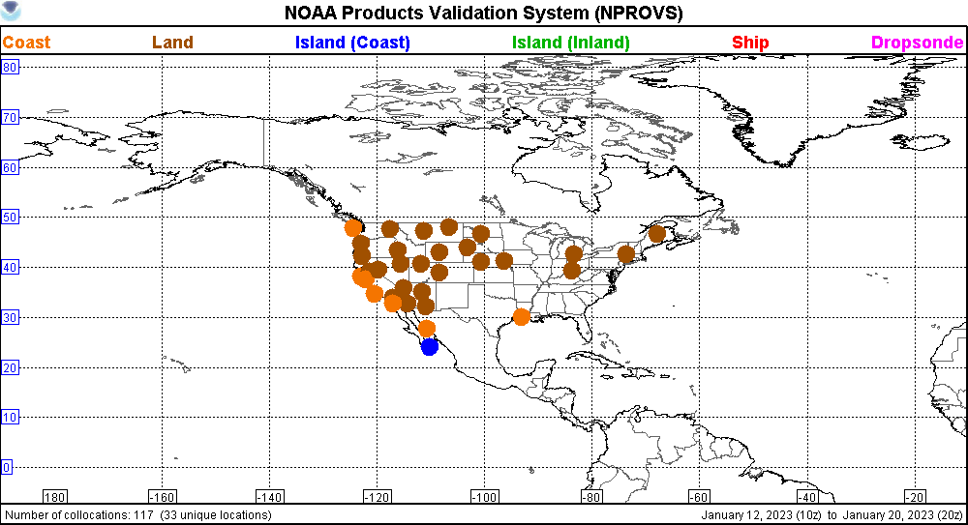
NPROVS ARChive Summary (NARCS)
SAT-Raob Ensemble Statistical Time Series
(Bias)
6-hr/100km CONUS 2-hr

Slide 9
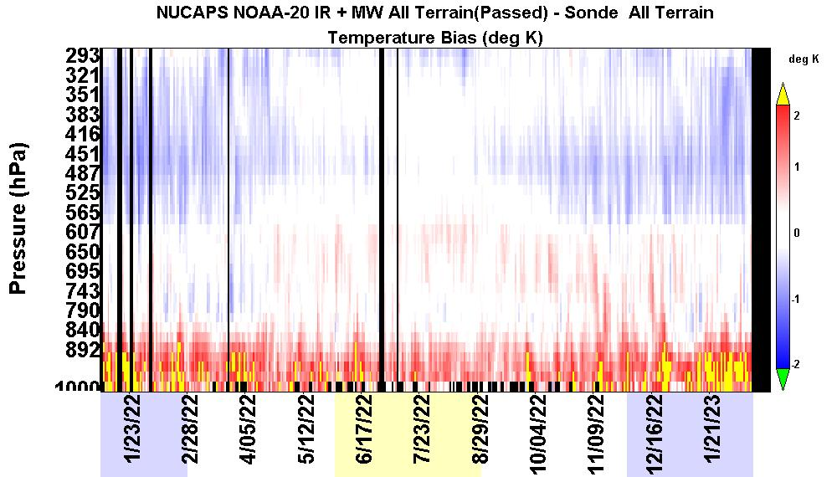
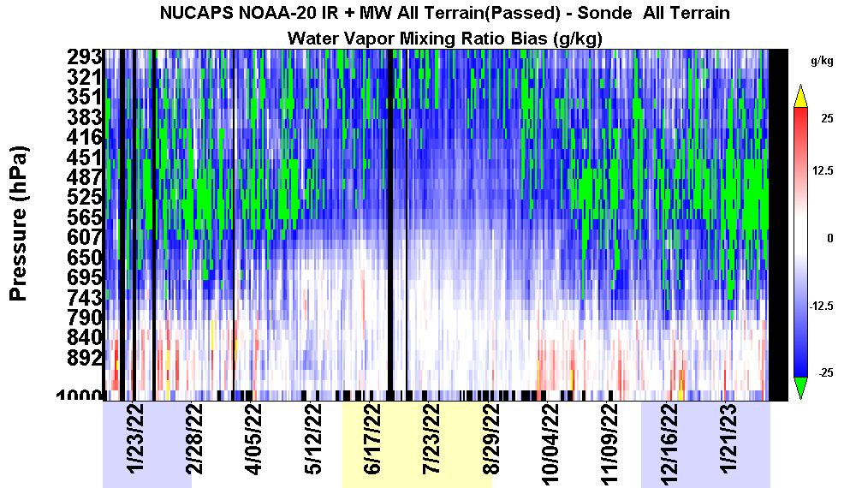
NUCAPS
IR+MW
NOAA-20
%
CONUS 6-hr/100km Daily Mean Bias (175)
January 2022 to February 2023; characteristic performance

Slide 10
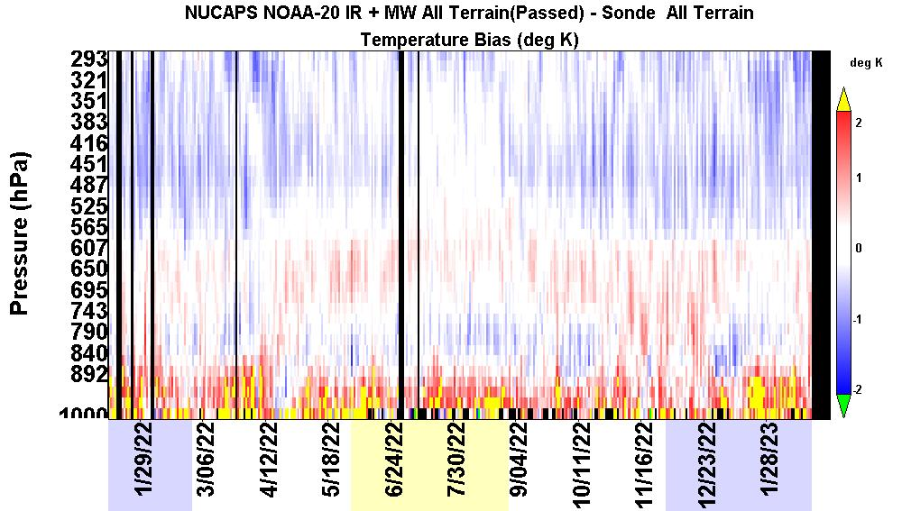
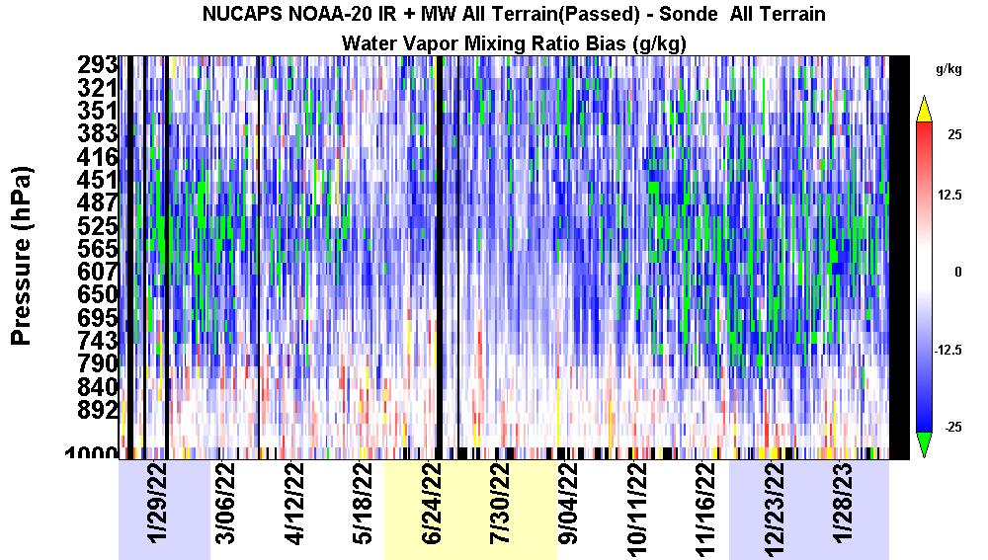
NUCAPS
IR+MW
NOAA-20
CONUS 2-hr/100km Daily Mean Bias (50)
January 2022 to February 2023; characteristic performance

Slide 11
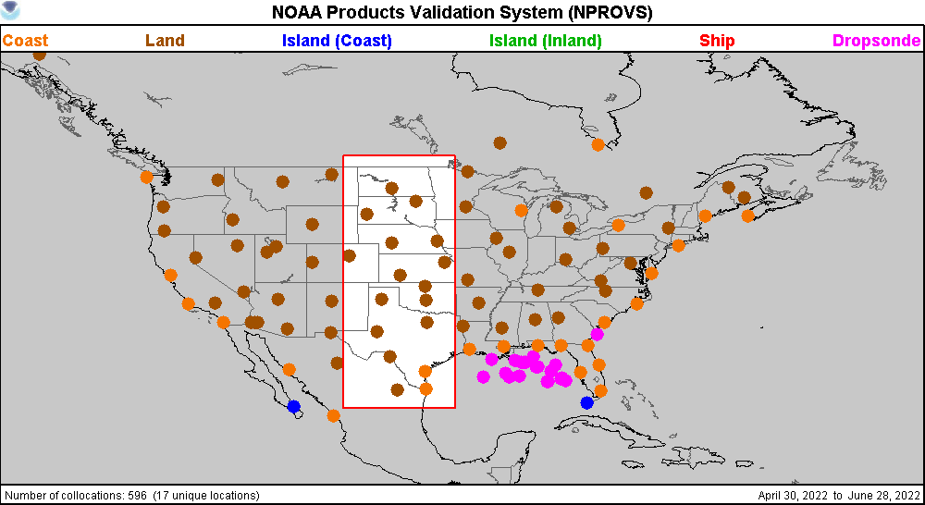
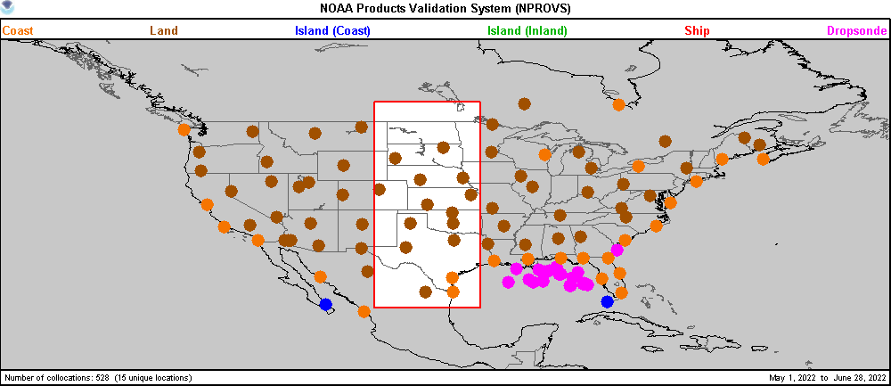
Original Screened
Texas/Dakota Corridor
6-hr

Slide 12
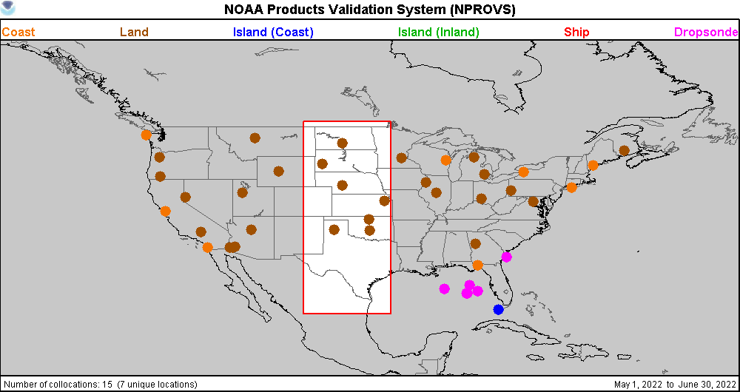
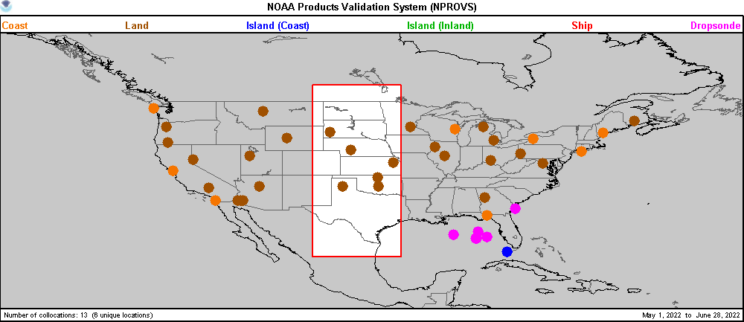
2-hr
Original Screened
Texas/Dakota Corridor
2-hr

Slide 13
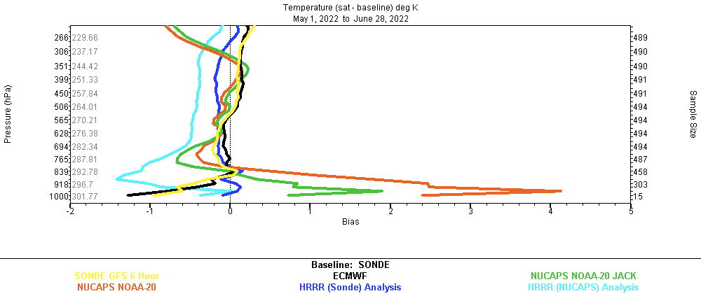
Screened
Texas/Dakota Corridor
6-hr

Slide 14
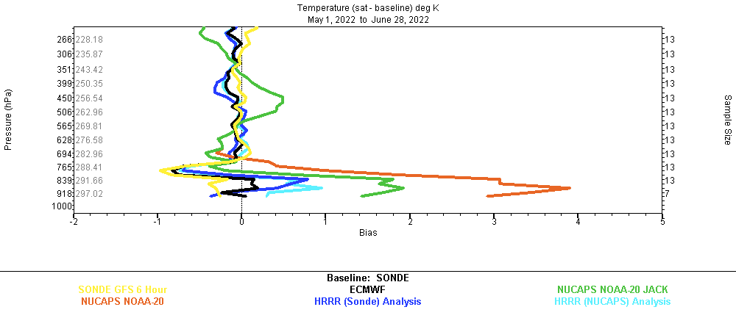
Screened
Texas/Dakota Corridor
2-hr

Slide 15
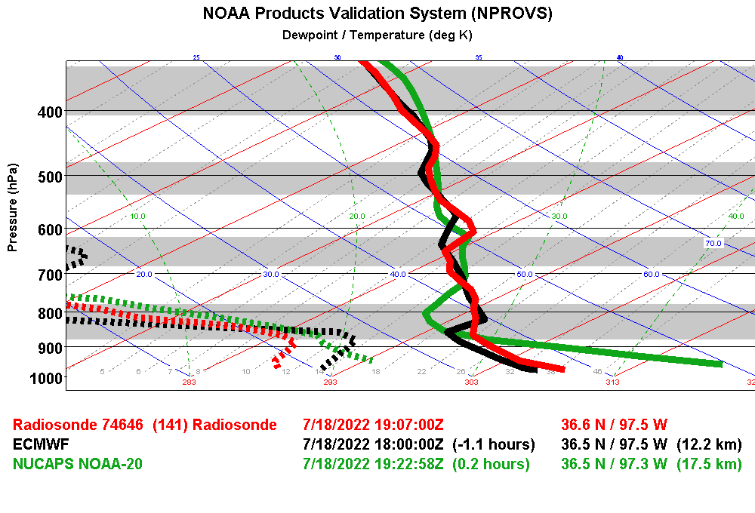
JPSS Dedicated Raob at SGP

Slide 16
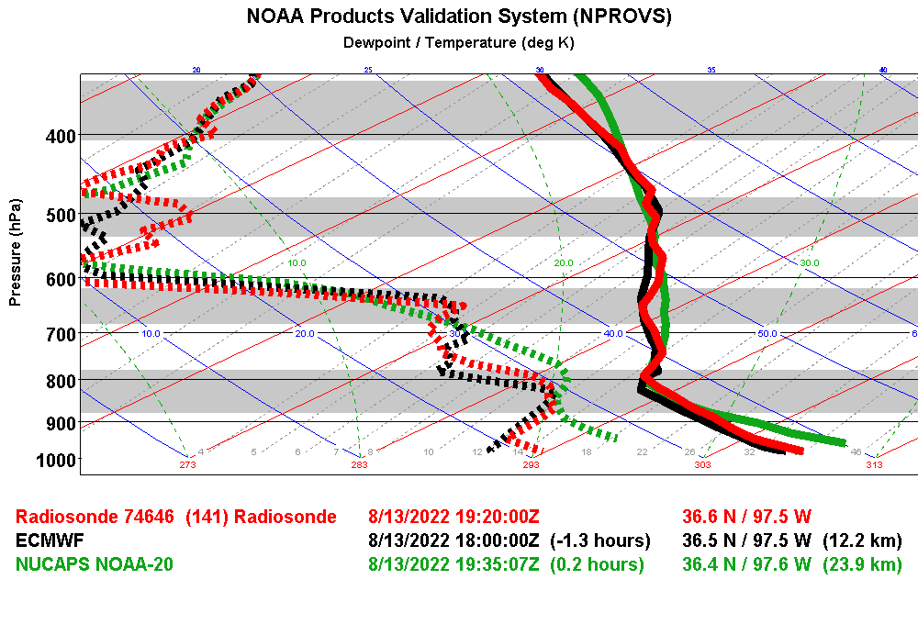
JPSS Dedicated Raob at SGP

Slide 17
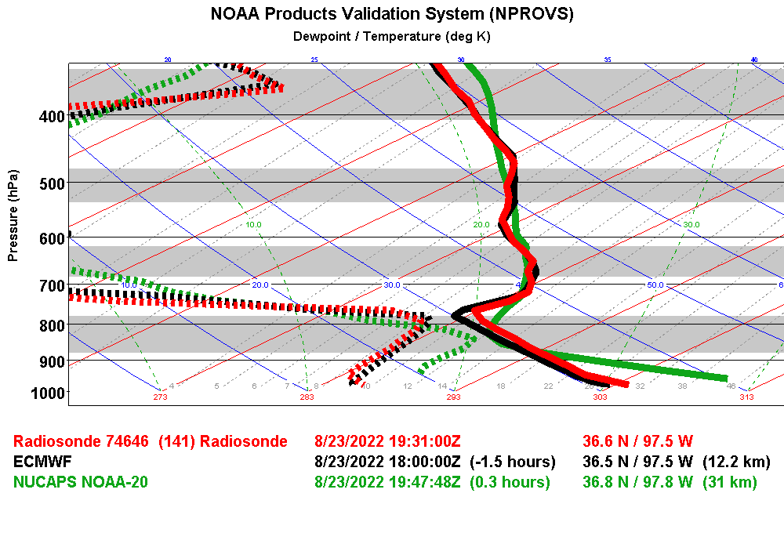
JPSS Dedicated Raob at SGP

Slide 18
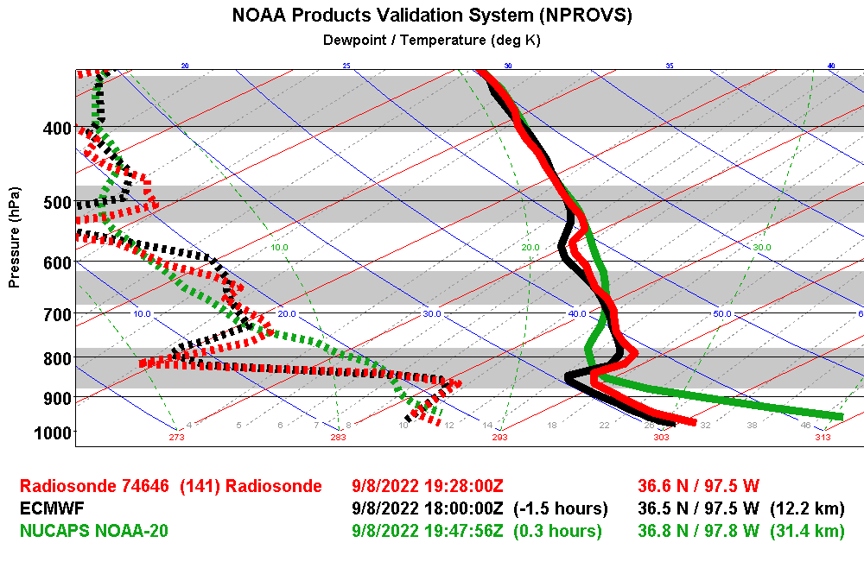
JPSS Dedicated Raob at SGP

Slide 19
NUCAPS v3.1 (Test) Performance:
Damping
Focus days: July 20, Dec 23/24, Jan 19 ?
ASSISTT (also N21)
Srfc Air Temp, H20 vapor

Slide 20
Damping

Slide 21
6-hr Summer 2-hr

Slide 22
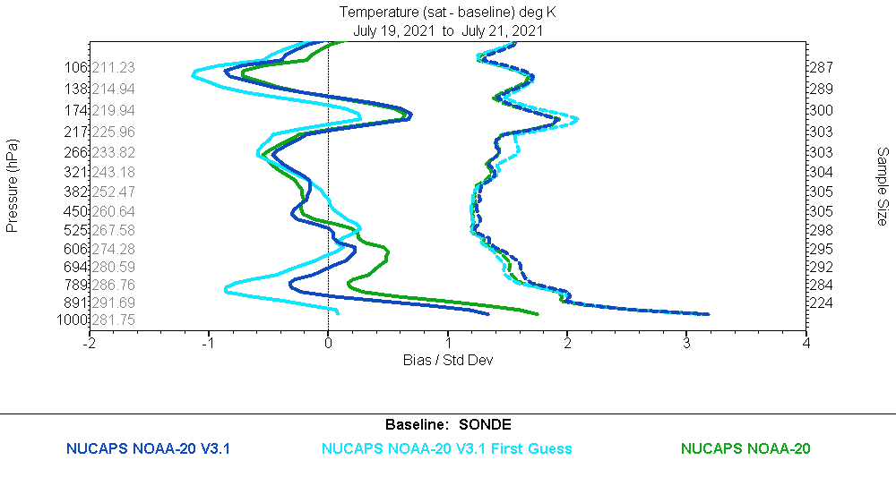
for V3 and v3.1
the Guess are
identical !
Day 6-hr

Slide 23
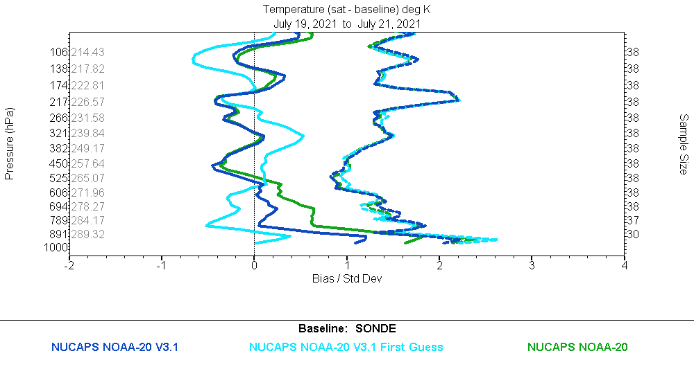
for V3 and v3.1
the Guess are
identical !
Day 2-hr

Slide 24
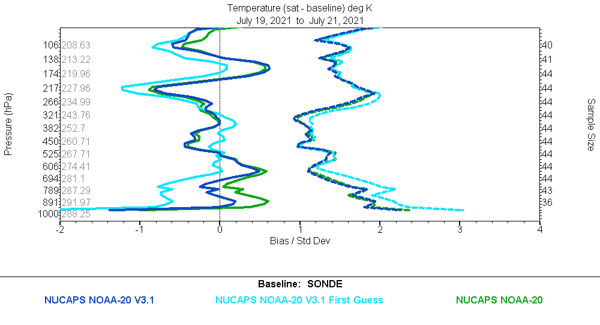
for V3 and v3.1
the Guess are
identical !
Nite 6-hr

Slide 25
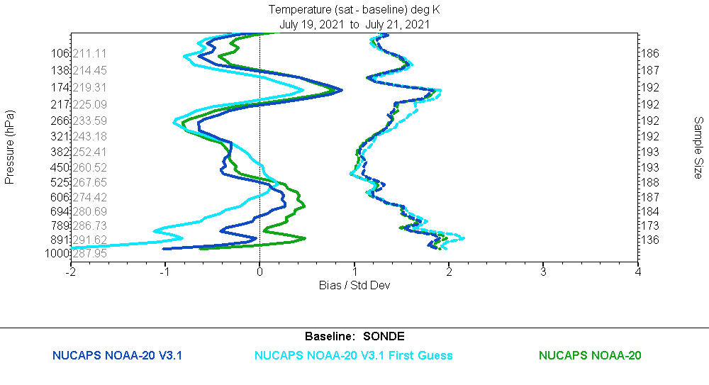
for V3 and v3.1
the Guess are
identical !
Dusk 6-hr

Slide 26
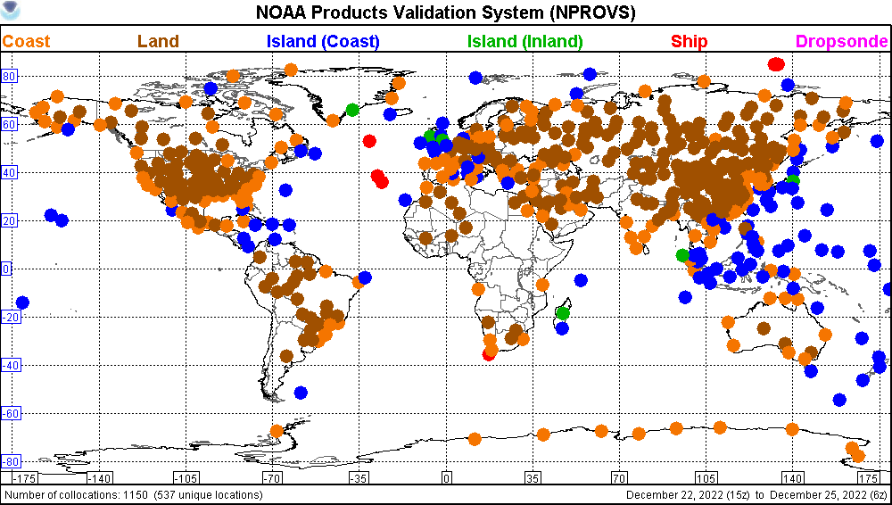
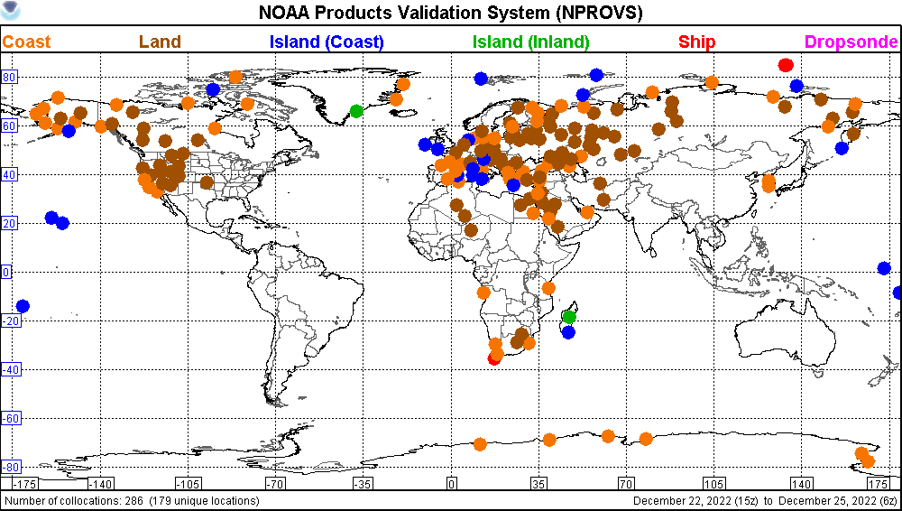
6-hr Winter 2-hr

Slide 27
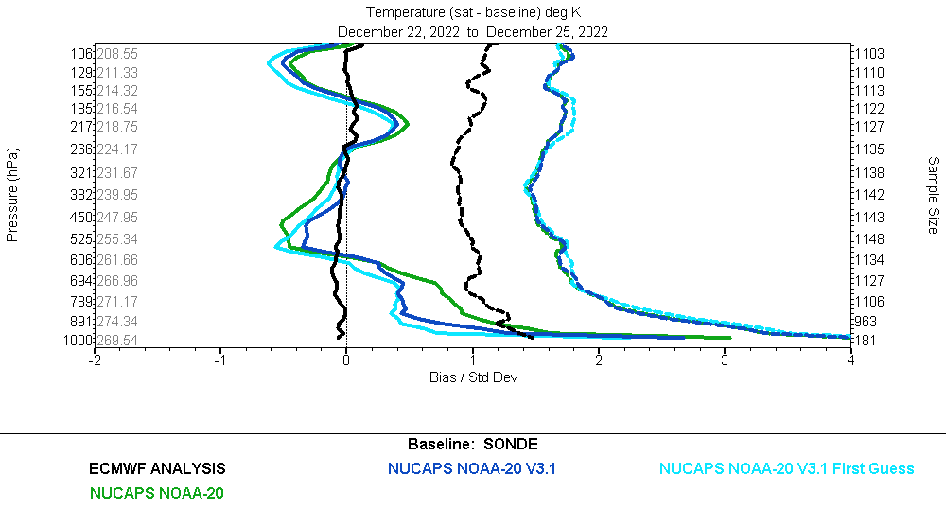
4.1
Global 6-hr

Slide 28
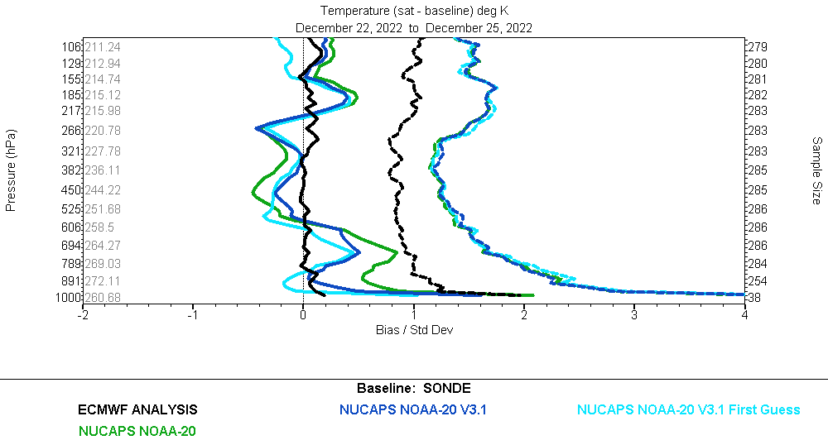
4.4
Global 2-hr

Slide 29
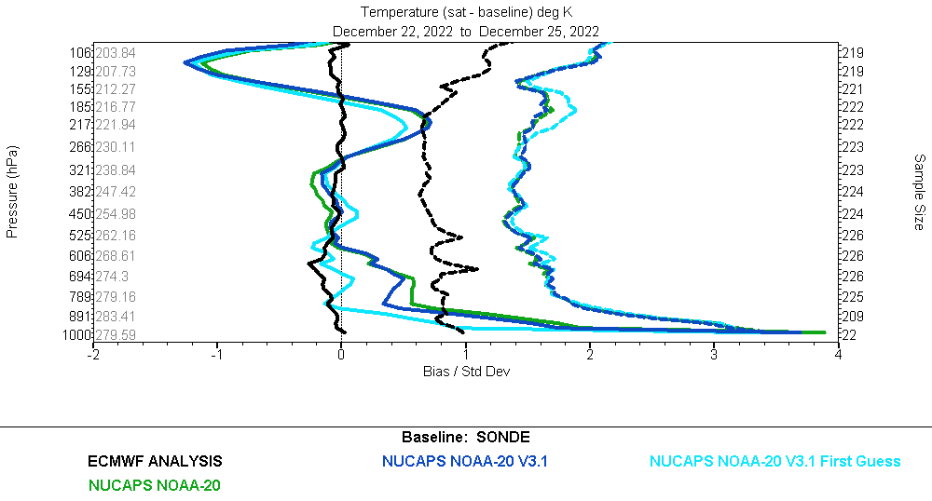
Global 6-hr Day

Slide 30
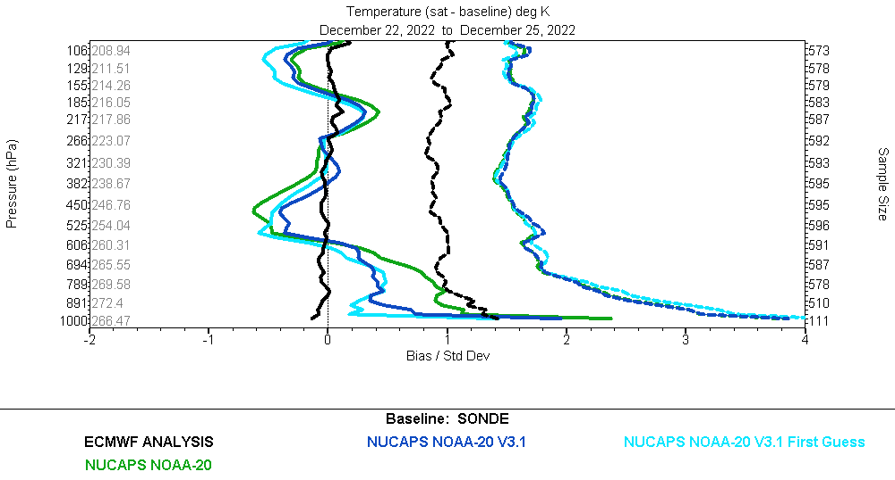
Global 6-hr Nite

Slide 31
Surface Air Temperature/WVMR

Slide 32
P Peff T WVMR
V3 … Srfc P 784hPa

Slide 33
P Peff T WVMR
v3.1

Slide 34
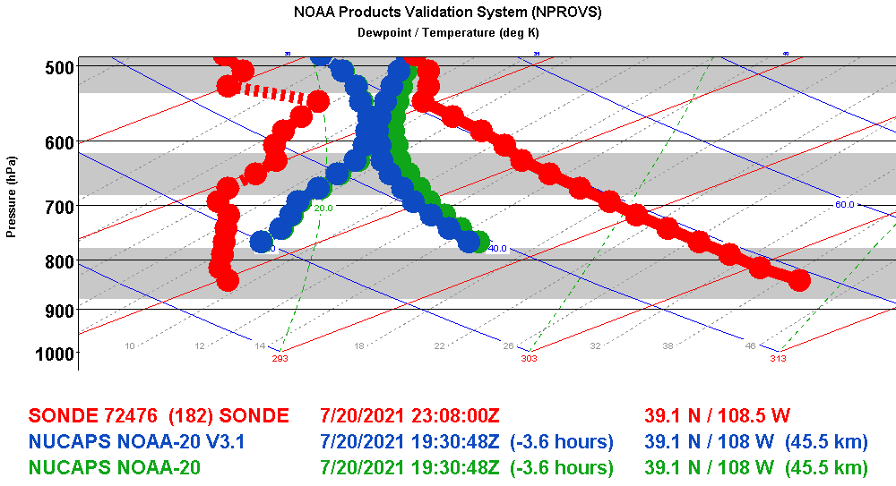
??
?
303K
Srfc Air T. WVMR

Slide 37
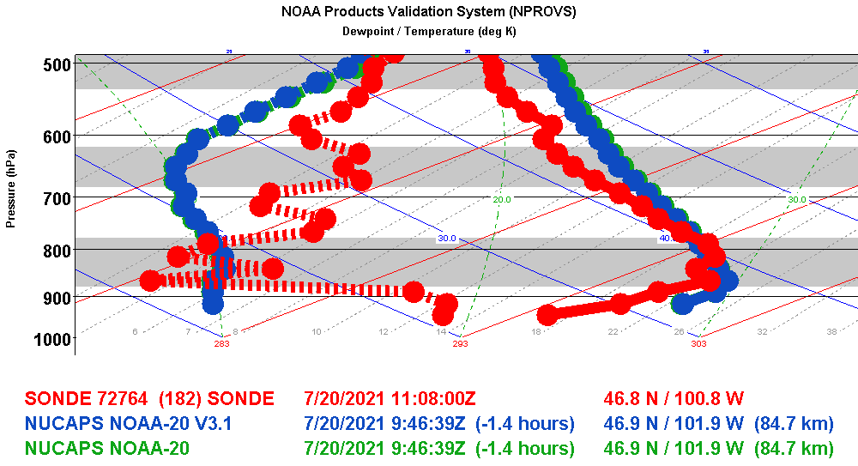
Summary
Persistent warm T bias for N20 IR+MW seems related to warm bias in MW-only; v3 H20 vapor consistent among 3 satellites (and MiRS); MetOp-C looking good
IR+MW pass QC most frequent for N20 and least frequent for MetOp-B
NUCAPS v3.1 may have issue wrt Srfc Air Temp/H20 Vapor calculation
AEROSE “descending node” debugging underway with focus on drift parameters
NPROVS Special Reprocessing progress (GRUAN)
Progress on CLIMCAPS integration into NPROVS …
?
?
293K
Srfc Air T. WVMR

Slide 38
Summary
Persistent warm T bias for N20 IR+MW seems related to warm bias in MW-only; v3 H20 vapor consistent among 3 satellites (and MiRS); MetOp-C looking good
IR+MW pass QC most frequent for N20 and least frequent for MetOp-B
V3.1 damping reduces warm bias but bias still evident (in retrieval)
Bias appears embedded in MW-Only retrieval component … (see Chris, Extra)
NUCAPS v3.1 may have issue for Srfc Air Temp/H20 Vapor calculation

Slide 39
Extra

Slide 40
Feedback from C. Barnet …
-------- Forwarded Message -------- Subject: can you check something for me Date: Tue, 16 Aug 2022 17:25:49 -0400 From: Chris Barnet <chrisdbarnet@gmail.com> To: Mike Wilson <michael.wilson@noaa.gov> CC: Murty Divakarla <Murty.Divakarla@noaa.gov> Mike, are you using this file for the tuningmaskfile = 170214_hr_cris_tuning_mask_guard.asc in the for NOAA-20 IO namelist? If so this would be the cause of the NOAA-20 system behaving differently than the S-NPP and possibly even the metop systems. Let me know if you are still using this file and then I will explain. I am still checking out some things at my end.
Here I am forwarding the issue I raised back in August. The bug is microwave tuning was turned off. Looks like it is only in the NOAA-20 system -- S-NPP, all Metop's are AOK. Tong Zhu has the fix and was going to check it out. My system(s) all work significantly better than STAR's for S-NPP and NOAA-20 (I don't do Metop for NASA). It has to do with a number of things 1) my regression code and training - I shared my code but I do not know how it was implemented. I know it was hacked significantly due to lack of diagnostics in the STAR files 2) CAMEL emissivity 3) optimization: some minor improvements in damping and channel lists. Chris Barnet (Cell) 301-789-6934

