Slide 1

Ordering VIIRS and ABI Data Files from NOAA CLASS

Slide 2
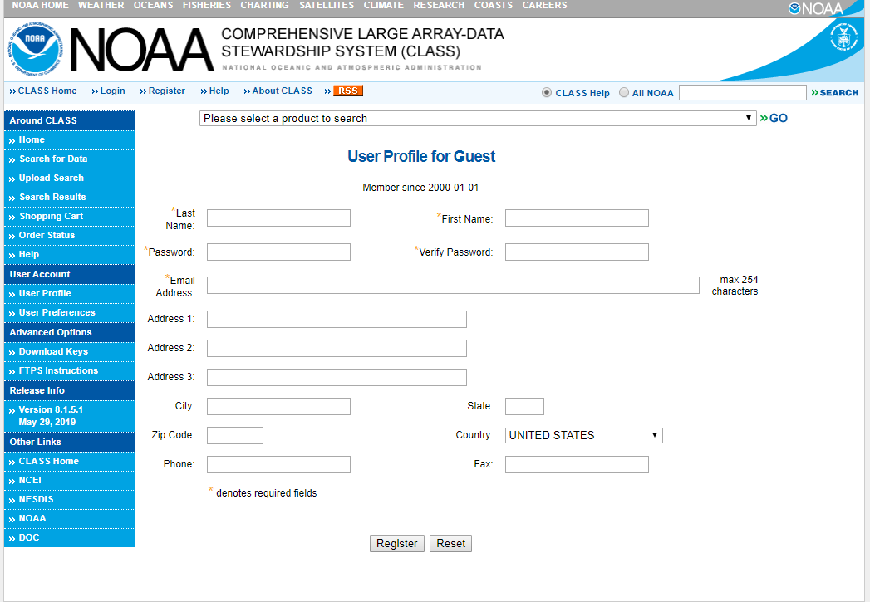
https://www.avl.class.noaa.gov/saa/products/user_profile
In order to download data, you must register with CLASS
You may search and browse for datasets without registering
Once you submit your information, your userID will appear near the top of the page – make a note of it for future logins

Slide 3
VIIRS Aerosol and Fire Products
(Enterprise Algorithm):
  Aerosol Optical Depth
  Aerosol Detection (smoke/dust)
  Active Fires

Slide 4
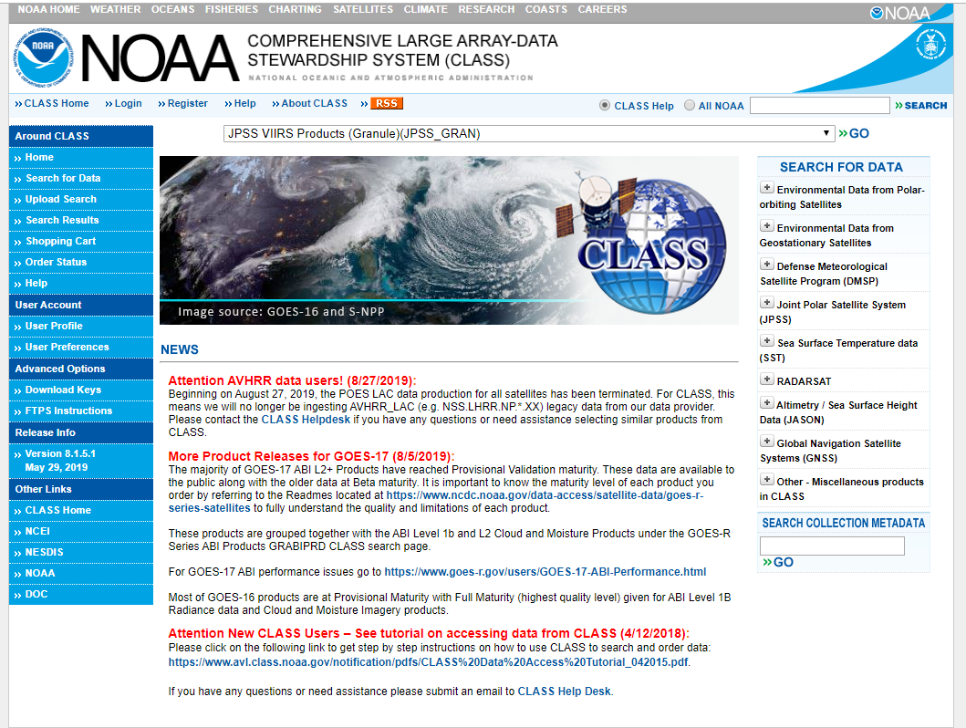
https://www.avl.class.noaa.gov/saa/products/welcome
From the drop-down menu at the top of the CLASS home page, select:
JPSS VIIRS Products(Granule)(JPSS_GRAN)
and click GO

Slide 5
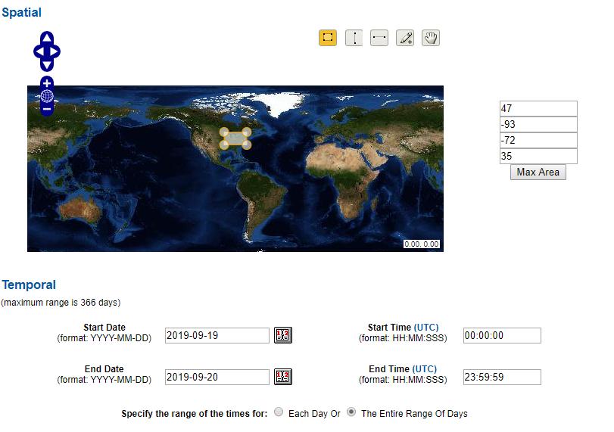
The Search page will open
  Select the desired geographic area from the Spatial section
  Select the date/time period of interest from the Temporal section

Slide 6
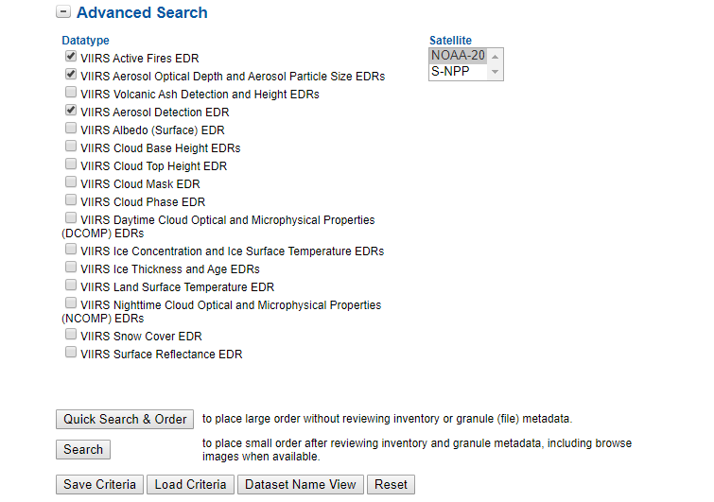
In the Advanced Search section, under Datatype select:
  VIIRS Active Fires EDR and/or
  VIIRS Aerosol Optical Depth and Aerosol Particle Size EDRs and/or
  VIIRS Aerosol Detection EDR
Select the Satellite (NOAA-20 or S-NPP)
Then click Quick Search & Order or Search, depending on the size of your request

Slide 7
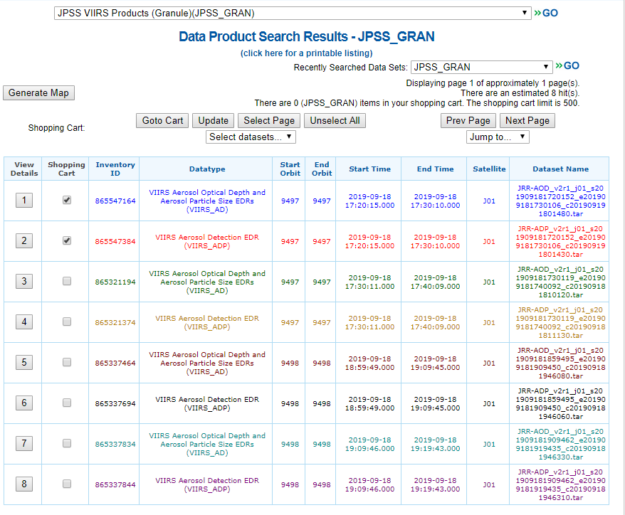
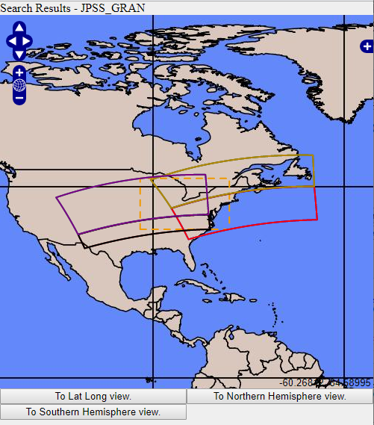
A new page will open
All the files for the time period and geographic area you selected will be listed
  Select the files you want by clicking manually, by using the Select Page and Unselect Page buttons, or the Select datasets… drop down menu
  You can also click on the Generate Map button to see a map of the available data swaths
When you are done, click the Update button and then the Goto Cart button

Slide 8
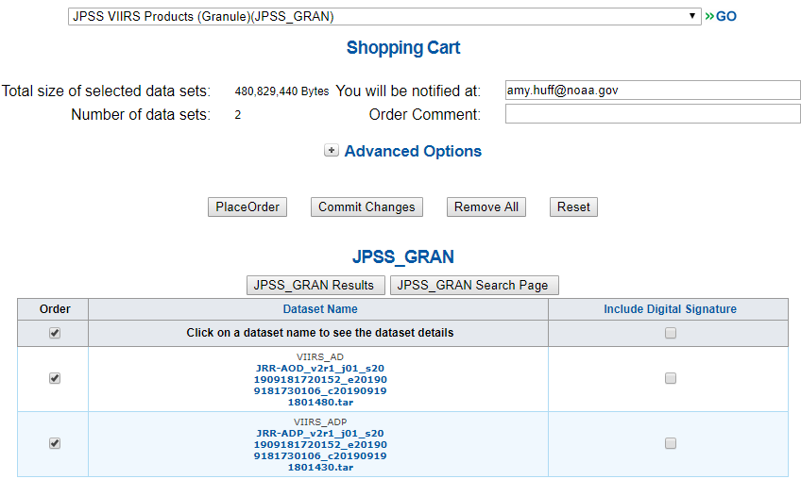
The Shopping Cart page will open
Check the file selection again if needed
Click the Place Order button to place your order
You will receive a verification email saying your order is in progress
When the order is ready, you will receive another email with instructions on how to access the files (see slide 15)
IMPORTANT: You must be registered in CLASS and logged into your account to place an order!
If you don’t see the Place Order button, you need to register or log in!

Slide 9
ABI Aerosol and Fire Products:
  Aerosol Optical Depth
  Aerosol Detection (smoke/dust)
  Fire Hotspot/Characterization

Slide 10
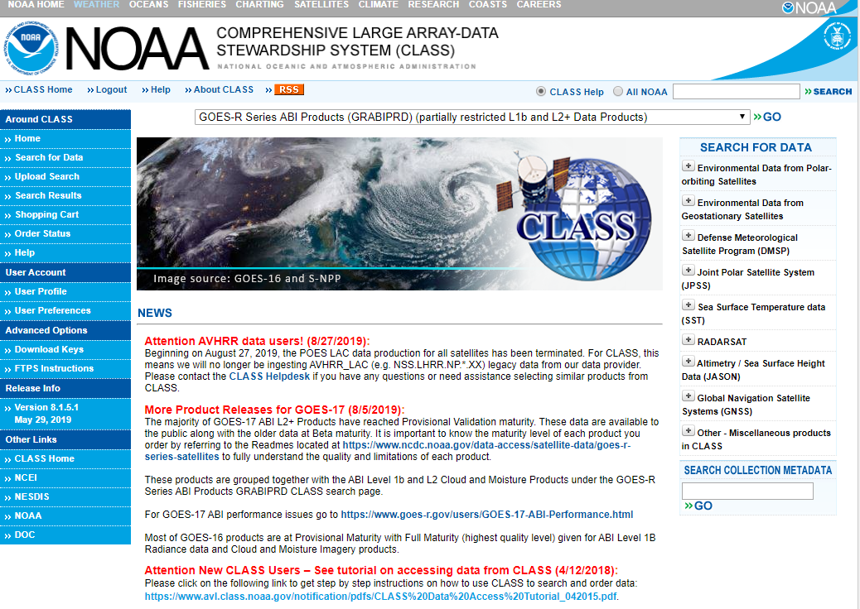
https://www.avl.class.noaa.gov/saa/products/welcome
The process to download ABI data is very similar to that for VIIRS data, but you will select a different data product
From the drop-down menu at the top of the CLASS home page, select:
GOES-R Series ABI Products (GRABIPRD)
and click GO

Slide 11
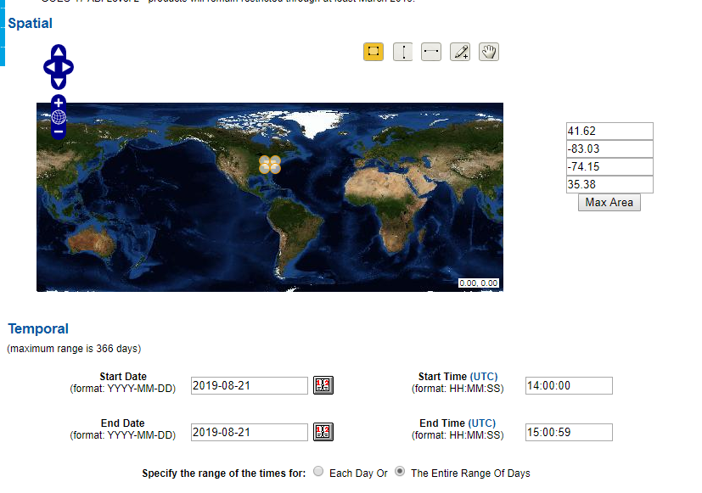
The Search page will open
  Skip the Spatial section; you will select the region when you select the data (at bottom of page)
  Select the date/time period of interest from the Temporal section
ABI has 5-min resolution (~12 observations per hour)! So be mindful of the Temporal selections!

Slide 12
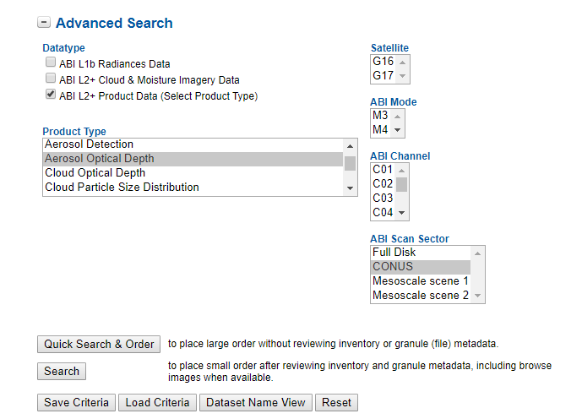
In the Advanced Search section, under Datatype select:
  ABI L2+ Product Data
Under Product Type, select
  Aerosol Detection or
  Aerosol Optical Depth or
  Fire/Hot Spot Characterization
Select the Satellite (G16 or G17)
Select the ABI Scan Sector
  Full Disk
  CONUS
  Mesoscale scene 1 or 2
Then click Quick Search & Order or Search, depending on the size of your request
For best results, leave these options unselected

Slide 13
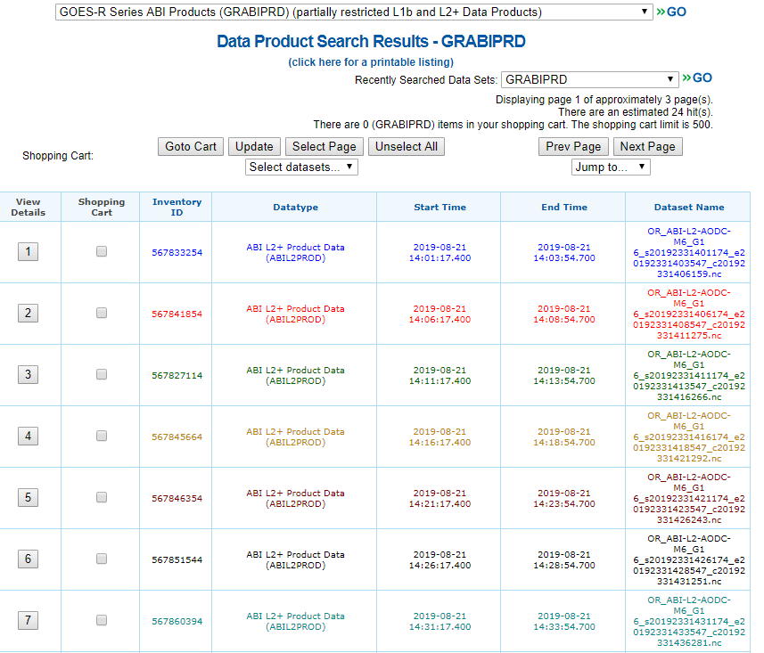
The Search Results page will open
All the files for the time period and geographic area you selected will be listed
  Select the files you want by clicking manually, by using the Select Page and Unselect Page buttons, or the Select datasets… drop down menu
When you are done, click the Update button and then the Goto Cart button

Slide 14
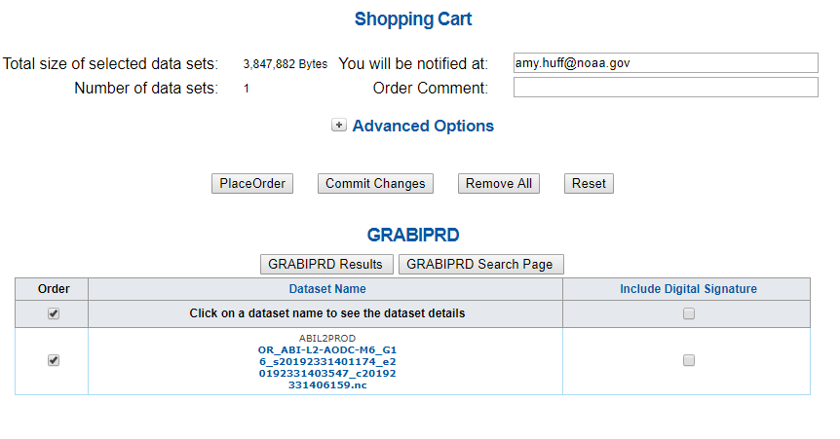
The Shopping Cart page will open
Check the file selection again if needed
Click the Place Order button to place your order
You will receive a verification email saying your order is in progress
When the order is ready, you will receive another email with instructions on how to access the files (see slide 15)
IMPORTANT: You must be registered in CLASS and logged into your account to place an order!
If you don’t see the Place Order button, you need to register or log in!

Slide 15
How to Download Files from CLASS

Slide 16
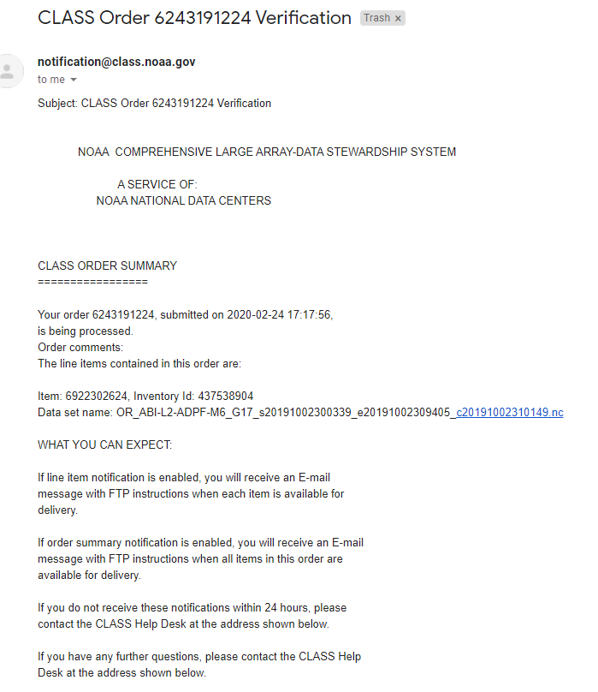
After you submit your order to CLASS, you will get a Verification email, like this one, confirming your order
You don’t need to do anything at this point

Slide 17
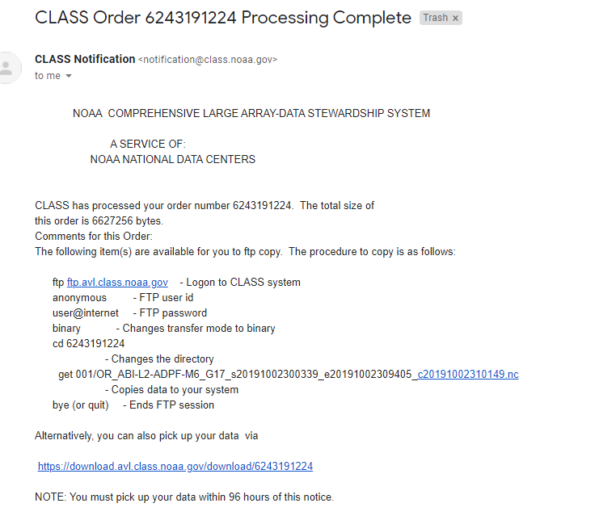
When your order is ready, you will receive a Processing Complete email, like this one
At this point, there are 2 ways to access your files:
anonymous ftp
  Best for large orders (many files)
  See slide 19 for instructions
download URL
  Best for small orders (a few files)
  Click on the provided URL
  Example on slide 18
1.
2.

Slide 18
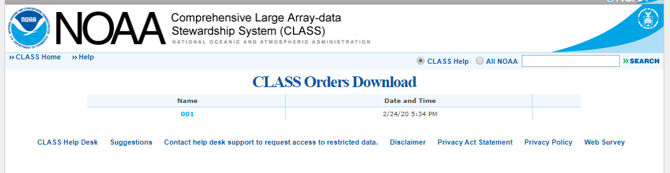
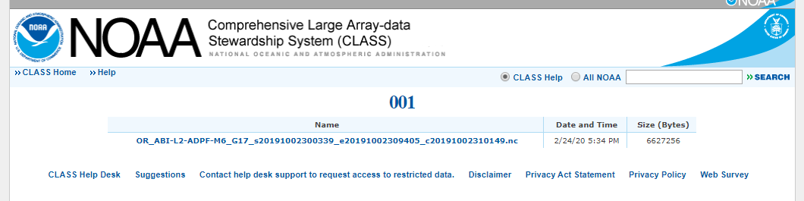
Example of file download via URL
Step 1: Click on “001” near top of the page
Step 2: The list of your files will open. Click on each file to download.

Slide 19
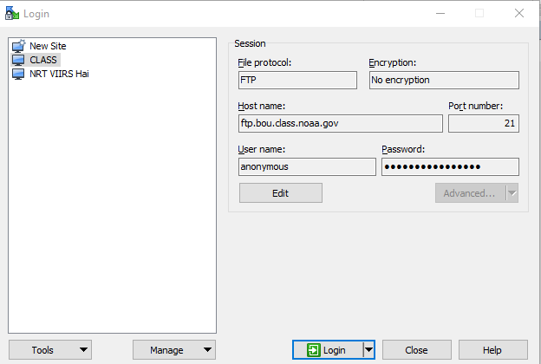
Download via anonymous ftp
If you have a Windows machine, use the WinSCP program (shown here)
Do NOT use the options given on the CLASS “FTPS Instructions” page, because they don’t work
Use these options:
  File protocol: FTP
  Encryption: No encryption
  Host name: ftp.bou.class.noaa.gov
  Port number: 21
  User name: anonymous
  Password: user@internet
Once you connect, find the folder corresponding to your order number
  In example from slide 16-19, order number is: 6243191224
Your files are inside this folder – you can transfer them directly to your computer!

Slide 20
A more in-depth CLASS Data Access Tutorial is available from the CLASS website at: https://www.avl.class.noaa.gov/notification/pdfs/CLASS%20Data%20Access%20Tutorial_042015.pdf

