Slide 1
Identifying Gaps in GHRSST services to: the users and their applications
Prasanjit Dash¹, Jorge Vazquez², Gary Corlett³
1. NOAA/CSU CIRA; 2. JPL/Caltech; 3. GHRSST PO/Univ Leicester

Slide 2
Identifying Gaps in GHRSST service delivery: GHRSST service quality
Users’ expectations of SST products (if clearly defined)
(1) Knowledge gap
Producer/agency perception of user expectation
(2) Standards gap
Specification standards
(3) Delivery gap
Actual delivery (meeting specs, routine and incidents)
(4) Communication gap
User perception of data
(wrong use of right data!)

Slide 3
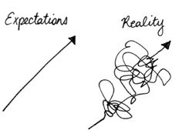
1. Knowledge (awareness) Gap
How well we know our users and what is their
intended application?
e.g., ACSPO produces L2 VIIRS@1km, but turns out L4 developers find L3 to be easier to assimilate. Hence, an L3U has been developed.
H-8 AHI L2P SST is produced each 10min, but many users will shy away from using it because of volume of data or choose an interval. Should then high temporal resolution be under-sampled to a lower res?
Many products may have no users! And sometimes users don’t exactly find what they need, e.g., gap-free global diurnally resolved SST
Key requirements:
Understand what ‘they’ need and expect (= user expectation)
Reinforces the need of an extensive user survey and exchange of information about users, if such a database exists.

Slide 4
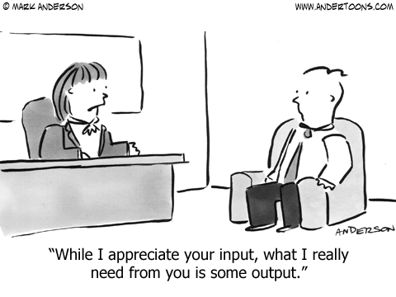
2. Standards Gap
How to set target accuracy and precision?
Follow agency specs; sometimes specs are set by program managers w/o consulting the producers
Ed showed ~77 products at PO.DAAC. Should GHRSST come up with a specs suggestion?
e.g., before branding a product as ‘GHRSST product’, how to ensure that certain standards are met? (GHRSST can benefit from producers contribution and can also be blamed for producers’ inefficiency!)

Slide 5
3. Delivery gap
Gap in terms of quality, increased latency in time than expected, corrupt data etc
In case of technical failures, sometime data are corrupt and still make their way to PO.DAAC and LTSRF. An ‘innocent’ user will not know of this which will result in wrong application output.
Any QC or warning system, in a timely manner to prevent slipping in of such data? These are random events are hard to detect in a timely manner? Any thoughts?
a few examples: next 2 slides

Slide 6
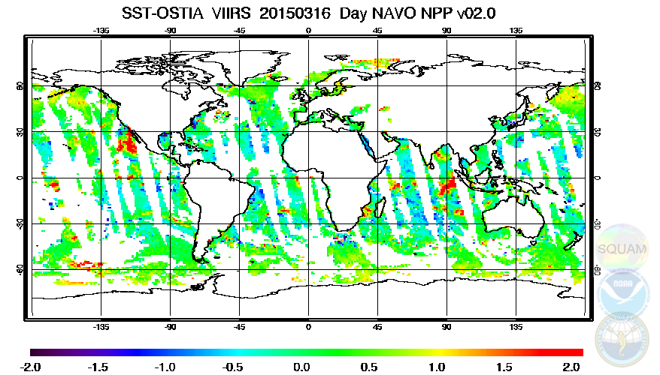
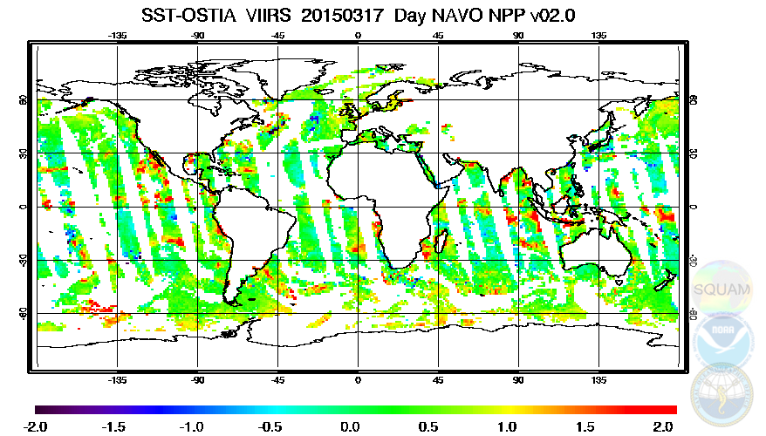
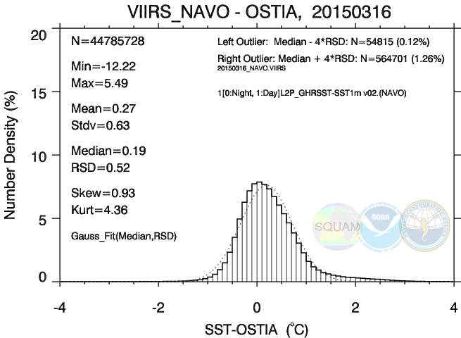
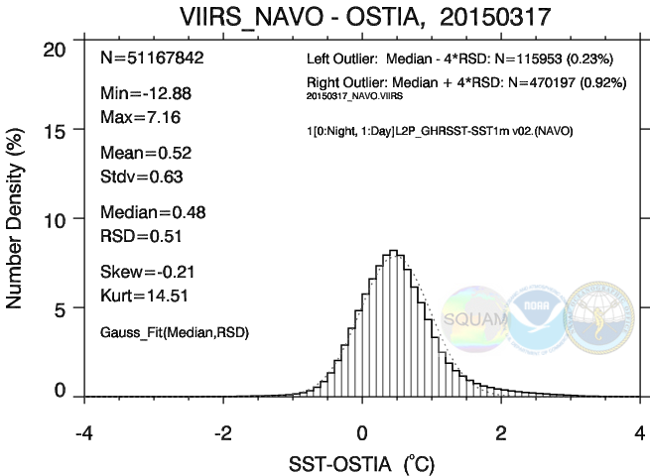
3. Delivery gap … continued … example of corrupt data being archived
(a) NAVO VIIRS L2P Daytime affected by WuCD sensor calibration (and so is ACSPO)
NAVO VIIRS – CMC, A typical day
NAVO VIIRS – CMC, affected day
Typical day (expected)
Incident day

Slide 7
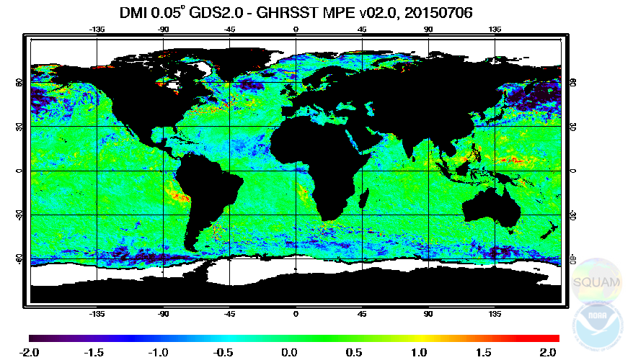
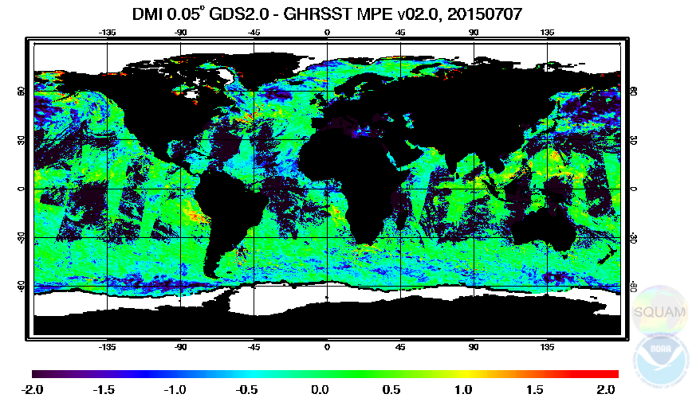
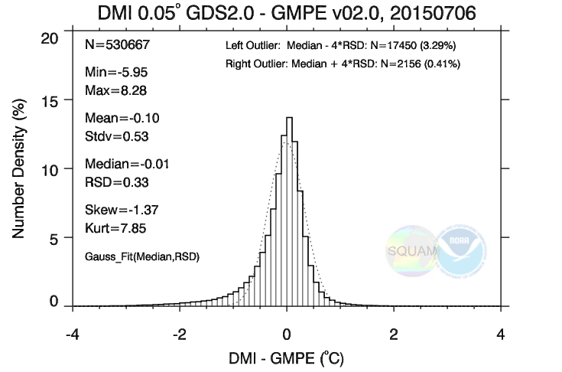
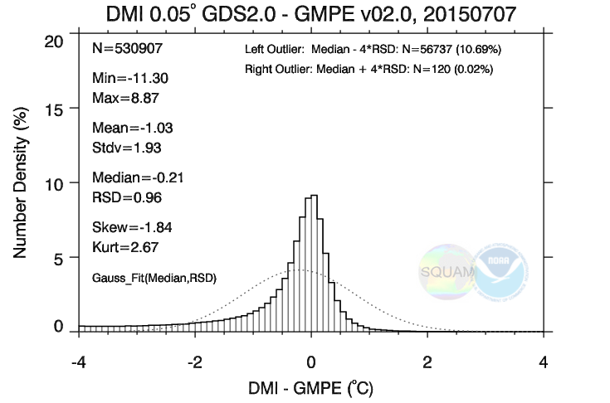
3. Delivery gap … continued … example of corrupt data being archived
(b) DMI OISST (system malfunction to decode MODIS data)
DMI – GMPE, A typical day
DMI – GMPE, incident day
Typical day (expected)
Incident day
Shift happens

Slide 8
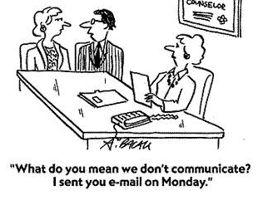
4. Communication Gap
User not being fully aware about suitability of data for specific uses
Are long-term L3/L4 products necessarily suitable for trend-studies?
Key requirements:
Reinforces the need of quick start guide to help users choose a datasets suitable for their intendent applications.
Are these ‘gap’ concerns valid?
If yes, what do we do about it?

