Slide 1
VIPER Quality Assessment Overview
Presenter:
Sathyadev Ramachandran, SPS Inc

Slide 2
VIPER Subsystem Requirements:
Quality Assessment
Input Products
Expect swath and geo-located CWhdf format datasets (NUPs)
IDPS-NDE, l2gen products, ESA, ISRO, JAXA native products in CWhdf format
Different spatial resolutions and bands
Timeliness
Expect data ingest within 24 hours of acquisition for NRT QA processes
Automated scripts run daily and output products available for web publishing.
Software platform & distribution
IDL, Perl, Web display of QA products
Hardware
Tethys cluster ; ~ 10 TB of disk space for 1 year data (multiple sensors) for limited CW regions
Heritage sensors + VIIRS + OCM-2
Currently the QA process runs on only one node (orbit102l)

Slide 3
NOAA Unique Product (NUP)
Criteria to satisfy being called a NOAA Unique Product
Product used NOAA unique algorithms (@ L2 products)
(OC2_RS, SWIR) ; e.g. (nLw, Rrs, Chlor_a)
NOAA user requested “region list” (@ L3 products)
All L3 products whether based on NOAA unique algorithms or input data or not but binned into standard CoastWatch boxes and custom projections are deemed NUPs.
Spatial Binned or Temporally binned (@ L4 products)
Temporal : Daily Composites
61-day Composites (e.g. Harmful Algal Bloom)
7-day composites
Spatial: Coarser resolution - Climate products (TBA)
NUPs can also include non-NOAA (MERIS, OCM, GCOM) L2 native products converted to NOAA CWhdf using any of the above criteria

Slide 4
VIPER QA Processes
Phase I
Comparison of new sensor with heritage sensors (MODIS and SeaWiFS) Ocean Color products
Chlor_a, nLw or Rrs
Comparison of the standard products from IDPS/NDE (in case of VIIRS) or other new sensors (OCM-2) with alternate sources
L2gen (from OBPG) generated NOAA Unique products.
Phase II
Validation of NUPs with in-situ data where available
MOBY over Hawaii and other coastal water regions.

Slide 5
VIPER QA Products generated
Time series of NRT products.
Mean, median, std-dev for specific CoastWatch regions.
Histograms
Chlor_a and nLw with relevant statistics for the distribution
Inter-sensor comparison products
Scatter plots and Residuals with relevant statistics
For specific CoastWatch regions.
Further stratified by near coastal waters and open ocean pixels within each region.
Mean residuals (measure of bias)
Mean std-dev (measure of noise)
Relative error estimates with a standard of reference.
ASCII file archives of the statistics computed to be used later for any dynamic plots
Validation web page linked to the CoastWatch page to host limited Validation products or plots.

Slide 6
Masked Data Inter-sensor comparison
Due to spatial resolution differences
CoastWatch regions
Initial inter-sensor on full CW box using bulk statistics easiest to implement (like in NRT-QA)
To do pixel to pixel comparison
Need (pixel clusters) of equivalent foot-print across sensors
MERIS-hires (3x3) pixel maps to (1x1) of VIIRS
AQUA, SeaWiFS, MERIS (3x3) maps to (5x5) for VIIRS
MERIS-hires (5x5) maps to (1x1) MERIS
Or use Daily Composites already masked for appropriate flags and remapped (binned) to comparable spatial grid

Slide 7
QA timelines
Phase I
6 weeks from data access to provide a preliminary assessment of the product quality.
Need test (synthetic data) 3 months before launch to meet the above requirement.
90 days for the next assessment.
Assuming > 30% matchup efficiency and > 30% for clear sky pixels we expect to see >> 10 days of good matchups for CONUS region CW boxes.
4 seasons (one year) of data collection to provide a more detailed assessment and create an adequate time-series for the new sensor.
Phase II
More than 2 years of data analysis to get to peer reviewed publication quality QA. (STAR Ocean toolkit for data extraction)

Slide 8
Distribution of QA Products
Web-page layout
Current
we have the CW regions bulk statistics
Statistics plotted as time-series (static(IDL) and dynamic(Java)) to monitor product quality
Future
Pixel to Pixel and Pixel cluster comparisons across new and heritage sensors.
http://coastwatch.noaa.gov/own/ow_calval.html
http://coastwatch.noaa.gov/validation/oc_calval.html

Slide 9
NUPs Validation Process flow
Tethys cluster
Okeanos ftpserver (OSDPD)
Tethys STAR Internal QA page
Phase I
SeaWiFS
Single sensor stats:
mean, median, std-dev, histograms for CW regions gives trends
Inter-sensor stats:
scatter plots, residual , relative error and stats for pixel clusters
MODIS
QA Webpage linked from
CoastWatch
MERIS
Tethys QA
Disk/SAN
VIIRS
OCM-2
Phase II
Rigorous QA :
In-situ comparisons
2 year from launch
publications
Tethys-okeanos (STAR)
Limited results will be posted to web following internal review

Slide 10
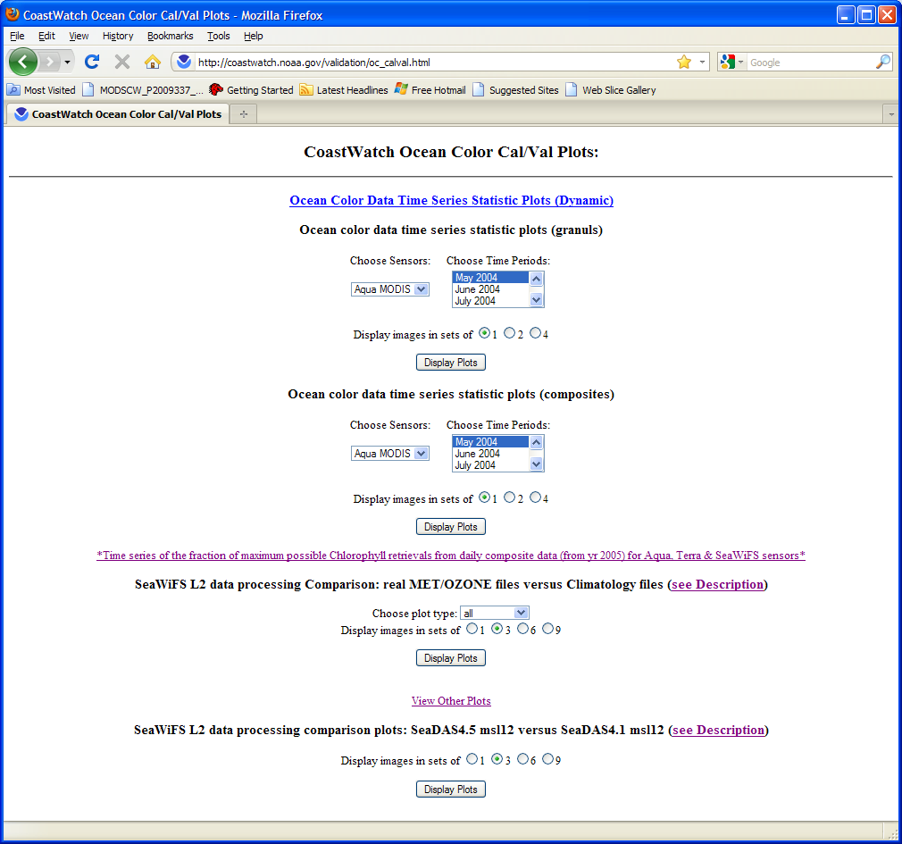
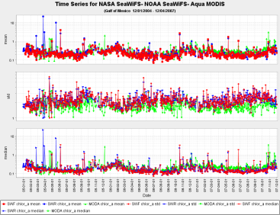
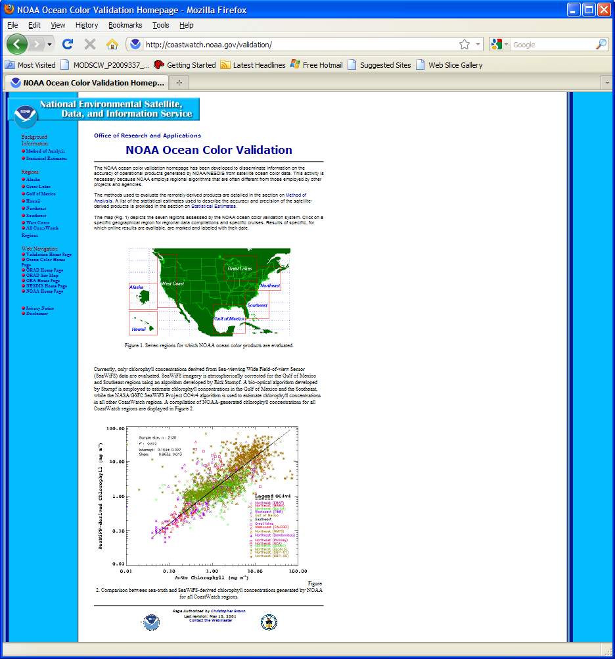
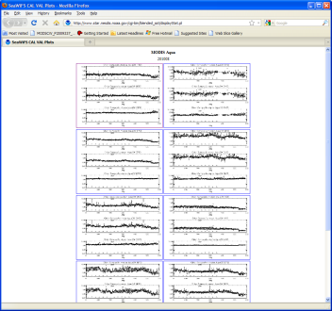
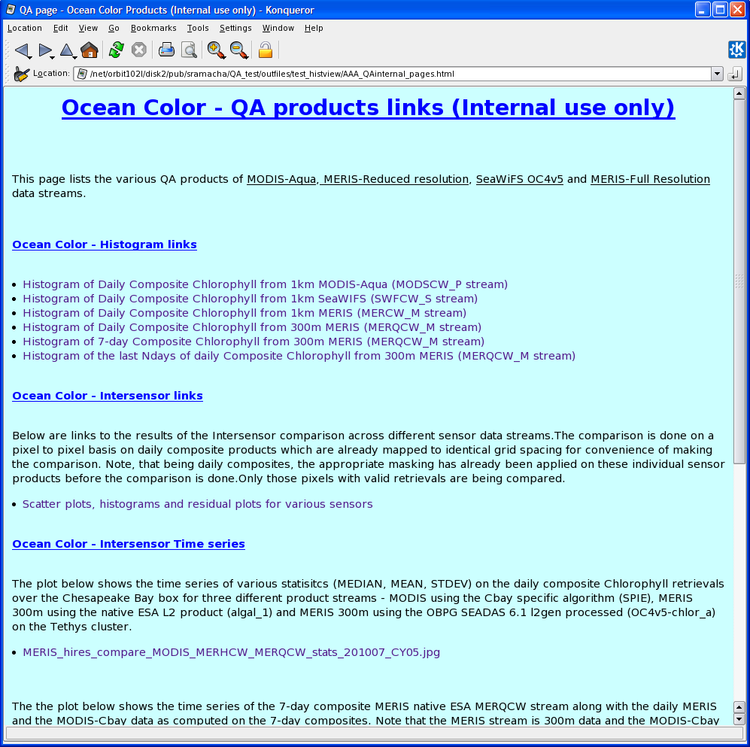
QA Web pages

Slide 11
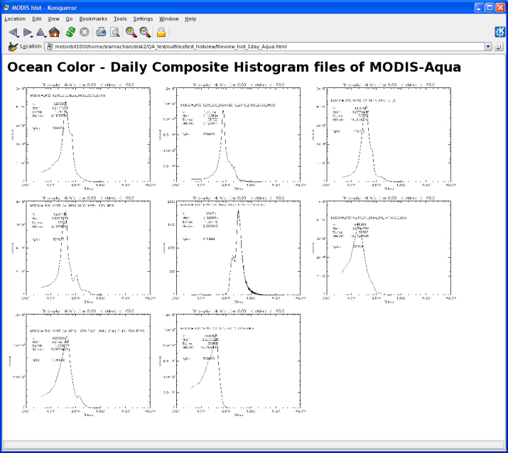
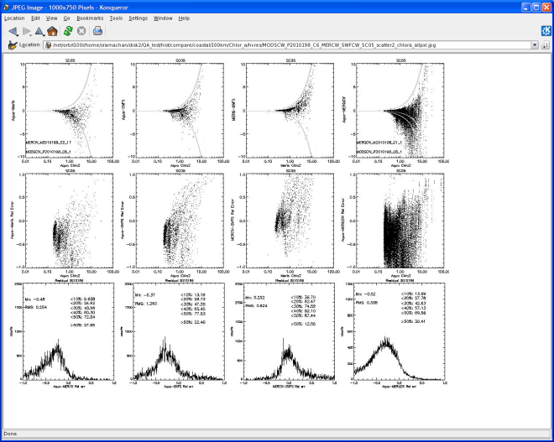
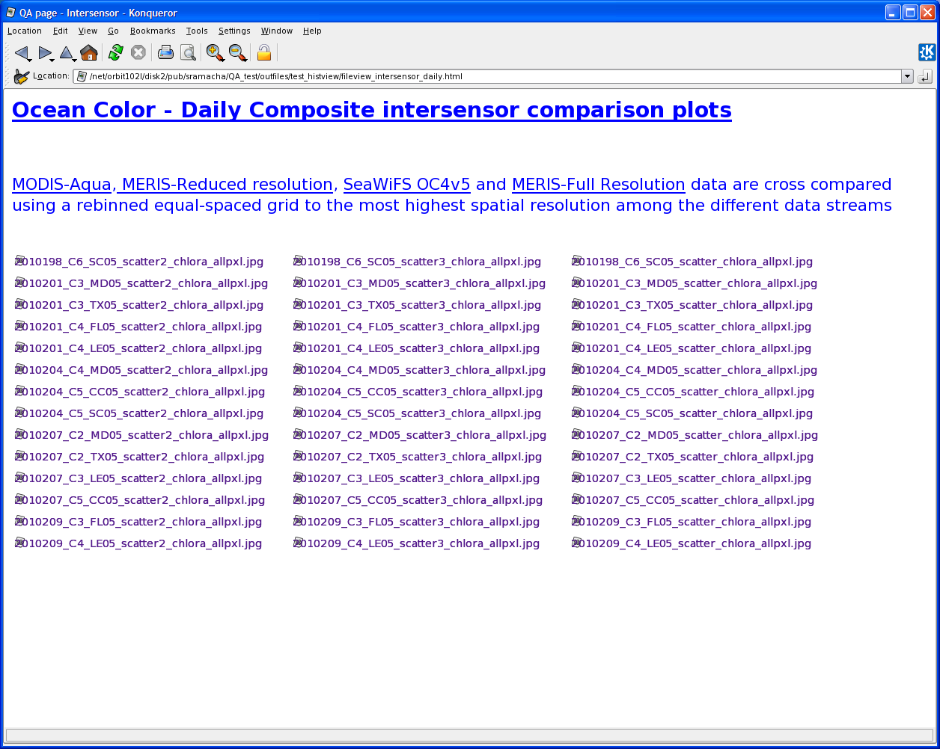
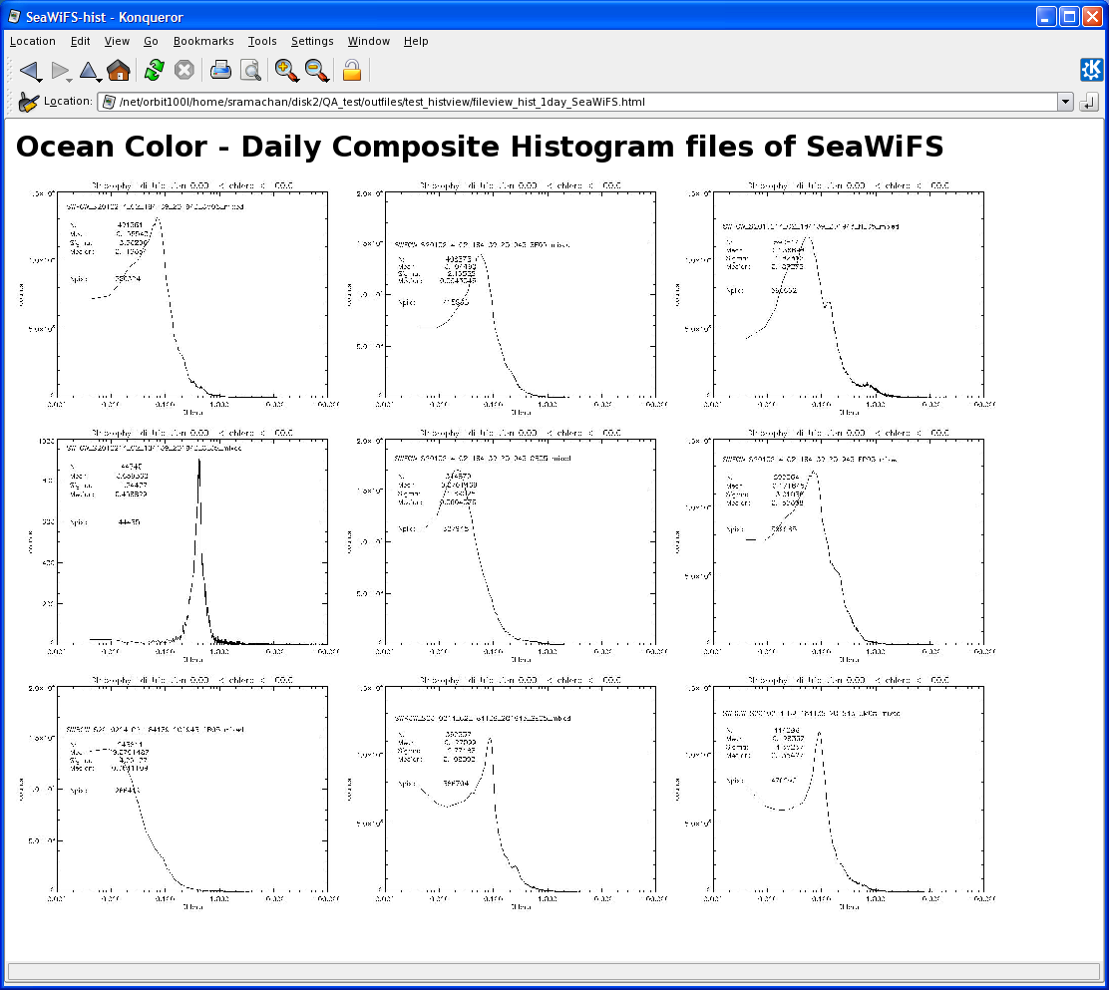
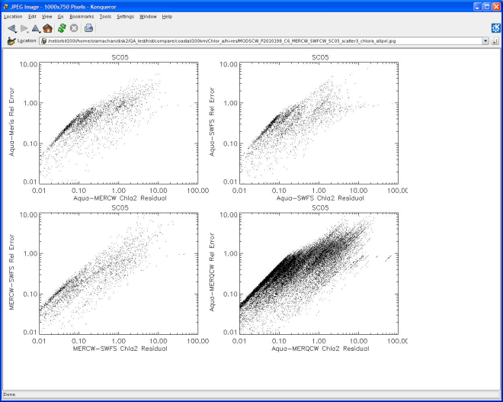
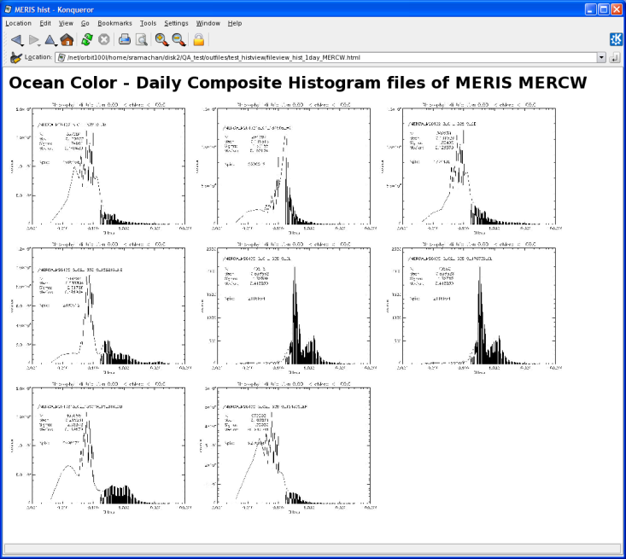
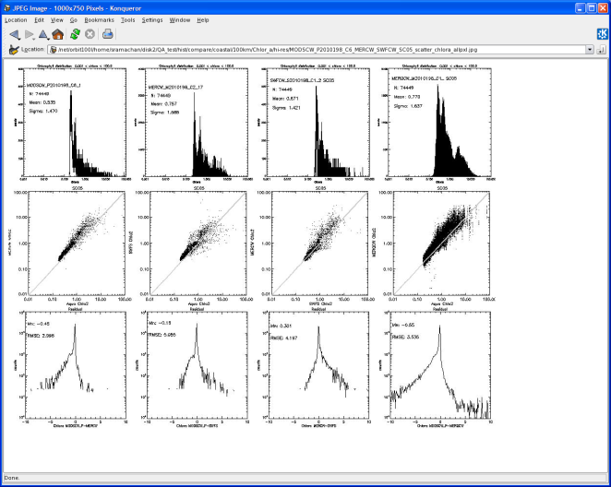
Prototype QA html pages - internal

Slide 12
Tools available to OSDPD for Quality checks
CDAT tools provide line command executables as well as through interactive graphics for individual data file Quality checks.
Detailed probe will require scripting line commands using Perl or IDL invoking CDAT function calls.
Java tool (Ocean Toolkit) for time series display will be maintained on the Cal/Val webpage with OSDPD access. All STAR produced QA products will be displayed on this webpage.
Visual inspection via link to CWpage for daily collection of images
http://www.osdpd.noaa.gov/ml/ocean/color.html

