Slide 1
Monitoring and validation of high-resolution Level 2 SSTs from AVHRR FRAC, MODIS, (A)ATSR and VIIRS in SQUAM http://www.star.nesdis.noaa.gov/sod/sst/squam/HR/
The 15th GHRSST 2014 meeting, ST-VAL Breakout session 2–6 Jun, 2014, Cape Town, South Africa
ST VAL breakout
GHRSST XV, 2014
3 Jun 2014, X:XX-X:XX AM
Prasanjit Dash^{1,2}, Alex Ignatov¹, Yuri Kihai^{1,3}, John Stroup^{1,4}, John Sapper¹, Boris Petrenko^{1,3}
¹NOAA NESDIS, NCWCP College Park, MD
² Colorado State Univ, CIRA
³ GST, Inc, MD, USA
⁴ STG, Inc, VA, USA
(Emails: FirstName.LastName@noaa.gov)
SQUAM objective: A global, web-based, community, quasi NRT, monitor for SST producers & users !

Slide 2
Acknowledgments
Level-2 SST: VIIRS/AVHRR/MODIS
NESDIS SST Team : ACSPO (GAC: 5 platforms, FRAC: Metop-A & B, VIIRS: NPP, MODIS: Terra/Aqua)
P. LeBorgne, H. Roquet : O&SI SAF Metop-A FRAC
D. May, B. McKenzie : NAVO SEATEMP
S. Jackson : IDPS (NPP)
C. Merchant, Owen Embury: L2P ARC (ongoing effort as a prep for Sentinel-3 SLSTR)
Level-3 SST: AVHRR/(A)ATSR:
K. Casey, R. Evans, J. Vazquez, E. Armstrong: PathFinder v5.0
C. Merchant, Owen Embury: L3 ARC (future work)
Level 4 SSTs:
R. Grumbine, B. Katz : RTG (Low-Res & Hi-Res)
R. Reynolds, V. Banzon : OISSTs (AVHRR & AVHRR+AMSRE)
M. Martin, J. R. Jones : OSTIA foundation, GHRSST Median Product Ensemble, OSTIA Reanalysis
D. May, B. McKenzie : NAVO K10
J.-F. Piollé, E. Autret : ODYSSEA
E. Maturi, A. Harris, J. Mittaz : POES-GOES blended
B. Brasnett : Canadian Met. Centre, 0.2° foundation
Y. Chao : JPL G1SST
H. Beggs : ABOM GAMSSA
J Hoyer : DMI OISST
M. T. Chin, J. Vazquez, E. Armstrong : JPL MUR
GHRSST support: Peter Minnett, Craig Donlon, Alexey Kaplan
Definitions of levels:
L2: at observed pixels (satellite)
L3: gridded with gaps (satellite)
L4: gap-free gridded, time-averaged
Major SST data providers: Projects and international group
CMC

Slide 3
Outline
1. High-resolution (HR) SQUAM 2. Example Monitoring of L2 SST with SQUAM metric Maps, Histograms, Time series, Dependence 3. Time-series Validation against QC’ed drifters 3.1. Sensitivity to space-time window for monthly stats 4. Persistent features in monthly maps 5. Drifter error from triple collocation method and correlation between residuals (satellite SST minus Drifters) 6. Summary and future work | p: 4 p: 5 p: 6-10 p: 11-12 p: 13 p: 14 11 slides

Slide 4
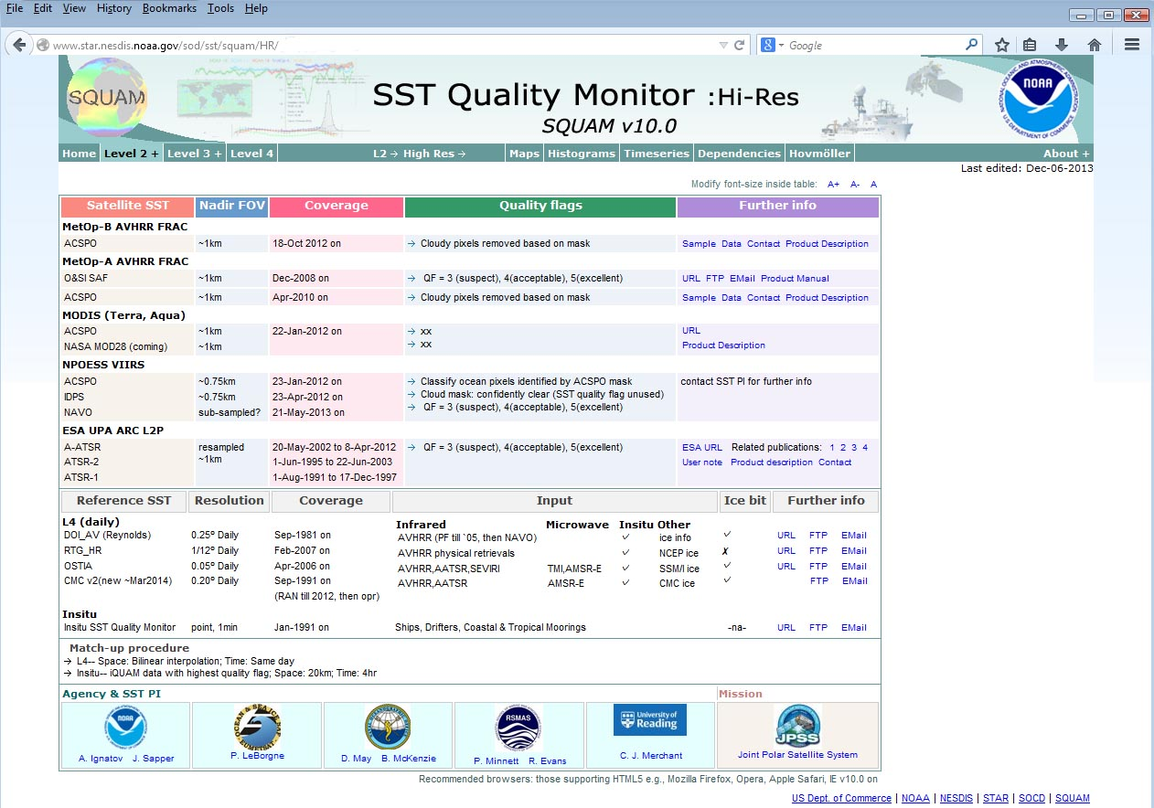
1. High-res (HR) SQUAM and SST products
Locate this website: Google: “SST + SQUAM + HR”
L2: The SST Quality Monitor (SQUAM), J.Tech, 27, 1899-1917, 2010

Slide 5
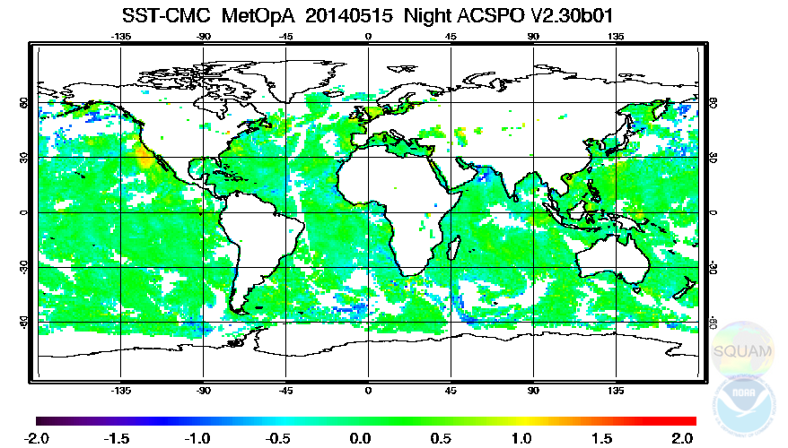
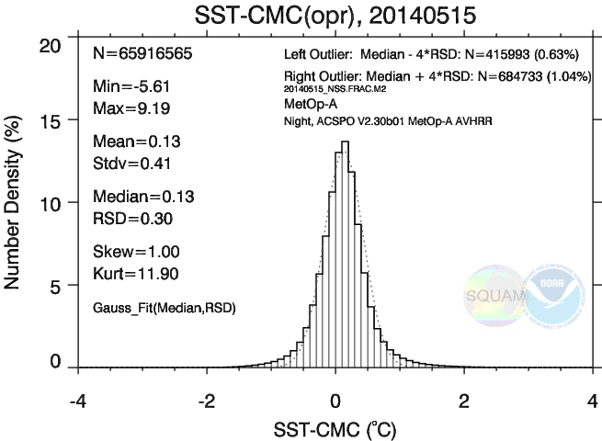
2. Monitoring in HR-SQUAM (Example 15 May 2014, Night)
Maps | Histograms | Time-series | Dependencies | Hovmöller
ACSPO Metop-A – CMC L4
ACSPO Metop-A – CMC L4
Some -ve residuals suggesting possible cloud leakages
Maps used to check cloud leakage, coverage, and other anomalous situations

Slide 6
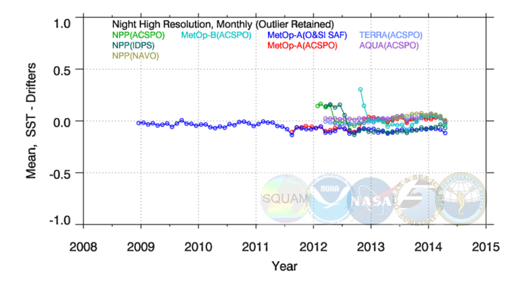
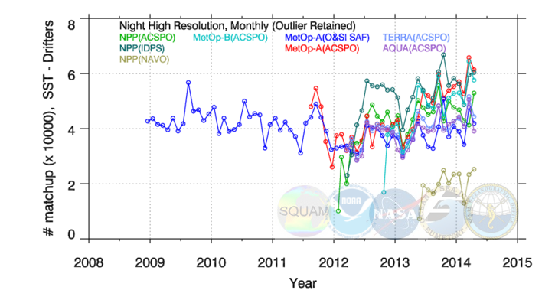
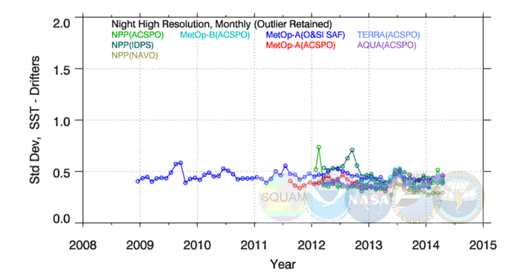
3. Monthly Nighttime VAL vs. iQuam Drifters (20km × 4hr)
Maps | Histograms | Time-series | Dependencies | Hovmöller
NAVO:
Smaller Domain
Improved Std Dev

Slide 7
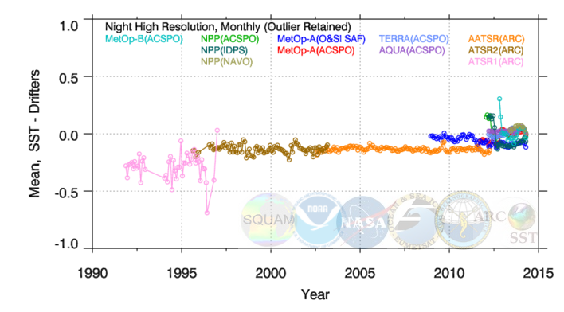
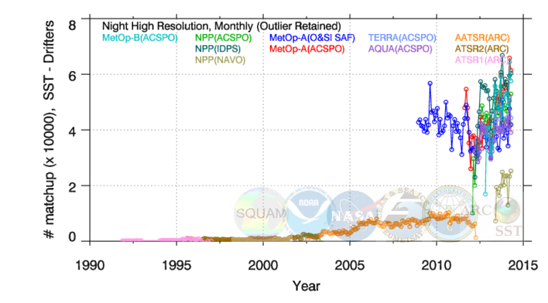
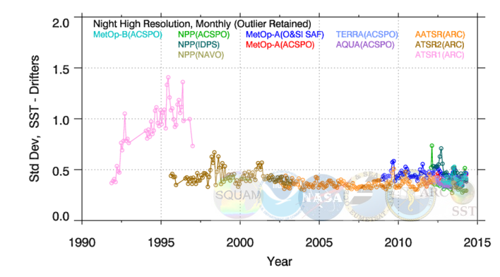
3. Monthly Nighttime VAL vs. iQuam Drifters (20km × 4hr)
Maps | Histograms | Time-series | Dependencies | Hovmöller
ATSR1 sensor issue
Now including ARC (QF GE 3)

Slide 8
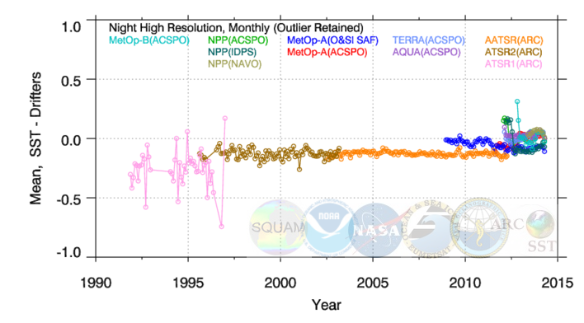
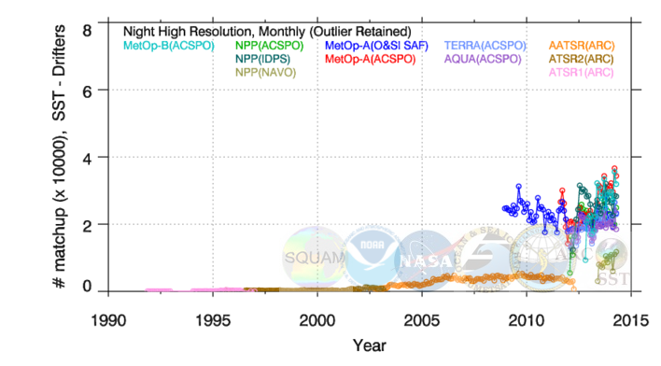
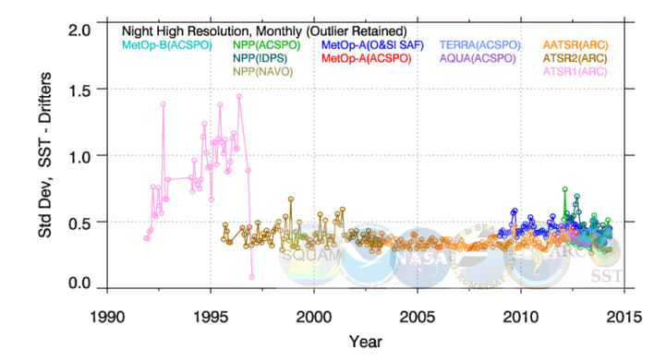
3. Monthly Nighttime VAL vs. iQuam Drifters (10km × 2hr)
Maps | Histograms | Time-series | Dependencies | Hovmöller
Reduced window size ×½ space ×½ time
Sample size reduced by ×½
Std Dev reduced but not significantly

Slide 9
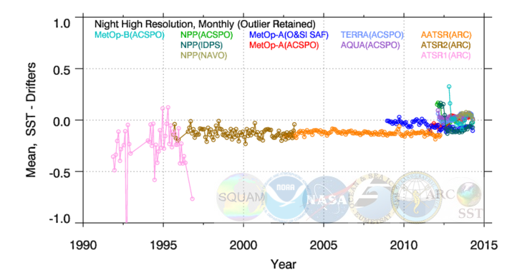
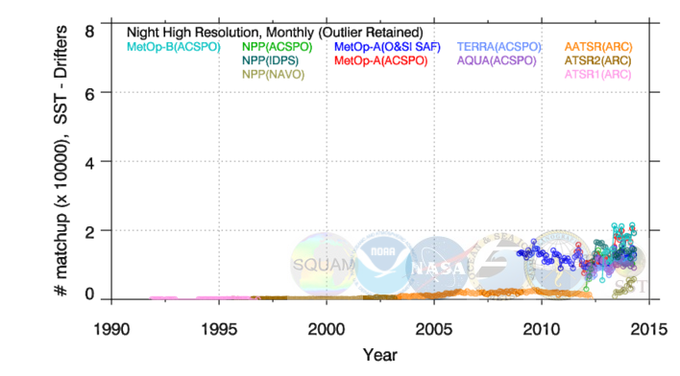
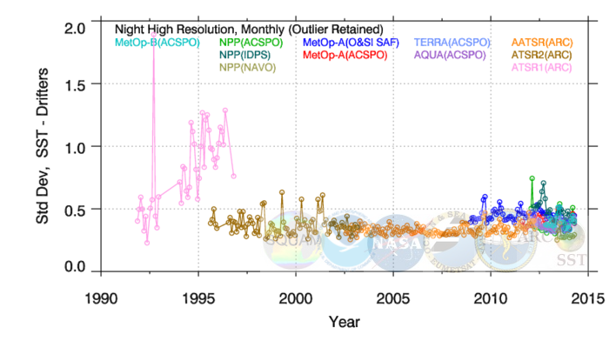
3. Monthly Nighttime VAL vs. iQuam Drifters ( 5km × 1hr)
Maps | Histograms | Time-series | Dependencies | Hovmöller
Reduced window size ×¼ space ×¼ time
Sample size reduced by ×¼
Std Dev reduced not significantly

Slide 10
3. Validation (20 km 4 hr, Mar 2014) : Summary**
Products | ~ECT | # of matches | Min / Max (◦C) | Mean / Median | Std Dev / RSD | Skew / Kurt
ACSPO NPP | 13:30 | 42917 (night) 42586 (day) | -2.61 / 5.92 -2.82 / 4.12 | -0.03 / 0.04 0.06 / 0.06 | 0.39 / 0.25 0.42 / 0.33 | 2.77 / 35.04 0.35 / 4.46
NAVO NPP |  | 12912 10063 | -2.58 / 2.20 -1.80 / 4.31 | 0.06 / 0.09 0.05 / 0.03 | 0.29 / 0.22 0.38 / 0.32 | -0.97 / 7.51 0.58 / 5.89
IDPS NPP |  | 48638 46208 | -6.62 / 2.83 -8.04 / 6.43 | -0.06 / 0.00 -0.07 / 0.02 | 0.42 / 0.26 0.65 / 0.42 | -2.00 / 15.51 -1.68 / 11.23
ACSPO Aqua |  | 40728 42083 | -3.18 / 6.07 -3.18 / 3.91 | 0.05 / 0.06 0.12 / 0.10 | 0.41 / 0.28 0.44 / 0.38 | 2.22 / 24.69 0.28 / 2.76
ACSPO Metop-A | 9:30 | 52591 46594 | -2.33 / 6.60 -2.43 / 4.99 | 0.03 / 0.04 0.00 / 0.01 | 0.44 / 0.28 0.42 / 0.37 | 2.84 / 31.62 -0.10 / 2.91
OSISAF Metop-A |  | 34215 40430 | -4.24 / 5.60 -3.68 / 5.13 | -0.08 / -0.01 0.10 / 0.16 | 0.43 / 0.29 0.51 / 0.39 | -1.19 / 10.79 -0.63 / 4.12
ACSPO Metop-B | 9:30 | 48837 44574 | -2.83 / 7.21 -2.39 / 4.71 | 0.05 / 0.06 0.03 / 0.04 | 0.42 / 0.29 0.43 / 0.38 | 2.09 / 27.67 0.11 / 2.56
ACSPO Terra | 10:30 | 40285 39385 | -2.19 / 5.84 -2.29 / 4.46 | 0.06 / 0.06 0.06 / 0.06 | 0.41 / 0.28 0.45 / 0.41 | 1.94 / 22.74 0.28 / 3.54
ARC AATSR | 10:00 | 5533 7446 | -4.04 / 2.19 -3.93 / 2.28 | -0.16 / -0.12 -0.12 / -0.10 | 0.41 / 0.25 0.49 / 0.34 | -1.89 / 14.16 -1.22 / 8.89
ARC ATSR2 | 10:30 | 1591 1957 | -3.11 / 1.63 -4.88 / 2.38 | -0.11 / -0.12 -0.18 / -0.16 | 0.36 / 0.27 0.52 / 0.39 | 0.04 / 5.39 -0.74 / 6.17
* QC’ed drifters from iQuam: www.star.nesdis.noaa.gov/sod/sst/iquam/; outliers not removed
** All Data for Feb 2014, except: ARC AATSR (Feb 2012), ARC ATSR2 (Feb 2003); ARC ATSR1 not shown (sensor issues)

Slide 11
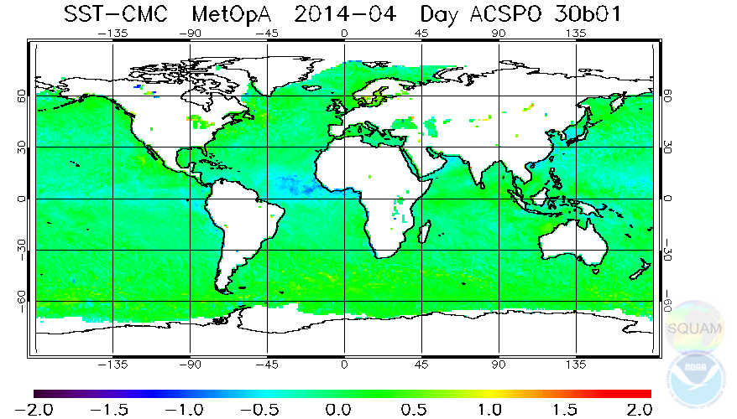
4. Persistent features (monthly aggregated)
Maps | Histograms | Time-series | Dependencies | Hovmöller
Day: Metop-A (ACSPO) minus CMC L4, Apr-2014
Negative residuals possibly suggest cloud/aerosol leakages

Slide 12
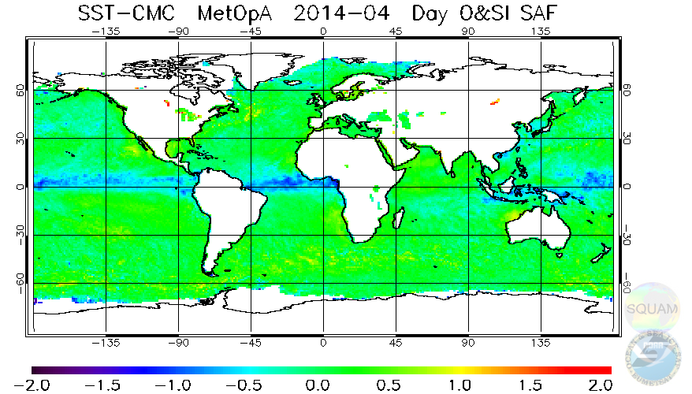
4. Persistent features (monthly aggregated)
Maps | Histograms | Time-series | Dependencies | Hovmöller
Day: Metop-A (OSISAF) minus CMC L4, Apr-2014
More negative residuals possibly suggesting more cloud/aerosol leakages
Coverage similar to ACSPO (at grid-level; # obs different)

Slide 13
5. Drifter error using Triple Collocation Method (TCM; O’Carroll et al., 2008) and correlation of residuals (Apr 2014)
Combinations for TCM | Avg. Error in Drifters* (1x1 deg; may be an underestimate)
OSISAF Metop-A, ACSPO Terra, Drifters ACSPO Metop-A, ACSPO Terra, Drifters OSISAF Metop-A, ACSPO Metop-B, Drifters NAVO VIIRS, ACSPO Aqua, Drifters | 0.18 (Night) 0.27 (Day) 0.19 0.26 0.18 0.27 0.18 0.24
* Drifter errors from different TCM combinations are close but not exactly same – may be due to some correlated errors. The table below shows correlation between residuals.
Residuals (SST – Drifters) | ~ECT | ACSPO NPP | IDPS NPP | NAVO NPP | ACSPO Metop-A | OSISAF Metop-A | ACSPO Metop-B | ACSPO Terra | ACSPO Aqua
ACSPO NPP | 13:30 | 1.00 (Night) 1.00 (Day) | 0.69 0.67 | 0.49 0.41 | 0.24 0.21 | 0.13 0.15 | 0.22 0.20 | 0.27 0.21 | 0.36 0.38
IDPS NPP |  |  | 1.00 1.00 | 0.54 0.37 | 0.21 0.20 | 0.17 0.19 | 0.28 0.19 | 0.25 0.19 | 0.31 0.32
NAVO NPP |  |  |  | 1.00 1.00 | 0.22 0.18 | 0.18 0.10 | 0.21 0.15 | 0.24 0.15 | 0.29 0.23
ACSPO Metop-A | 9:30 |  |  |  | 1.00 1.00 | 0.47 0.46 | 0.31 0.38 | 0.27 0.31 | 0.18 0.19
OSISAF Metop-A |  |  |  |  |  | 1.00 1.00 | 0.20 0.27 | 0.19 0.22 | 0.09 0.13
ACSPO Metop-B | 9:30 |  |  |  |  |  | 1.00 1.00 | 0.16 0.19 | 0.25 0.33
ACSPO Terra | 10:30 |  |  |  |  |  |  | 1.00 1.00 | 0.28 0.27
ACSPO Aqua | 13:30 |  |  |  |  |  |  |  | 1.00 1.00
Correlation higher for different products from the same sensor
Correlation lower for the same product from different sensors

Slide 14
6. Summary
Monitoring/Validation against L4 fields and QC’ed iQuam drifters shows:
Most products show comparable performance
In preparation for SLSTR, ARC AATSR (QF GE 3) retrievals are evaluated: Domain is ~6-9 smaller than from Metop, performance statistics comparable
NAVO VIIRS has better VAL stats than ACSPO, but in a ~1/3 retrieval domain
Sensitivity to space-time window on monthly matchup shows:
At night, 20km/4hr, 10km/2hr, 5km/1hr, reduces # of matches but does not result in measurable improvements in VAL std dev
Triple-Collocation analysis and residual correlation
Random errors in 1°×1° drifter data ~0.18°C(night)/0.26°C(day), globally
Many products show a high degree of correlation in residuals (SST – drifters). The L4 producers may use this to minimize redundancy in input L2Ps
THANK YOU!

