Slide 1
17th GHRSST Science Team Meeting 6-10 June 2016, Washington D.C., USA
NOAA ACSPO Himawari-8 SST Product
Sasha Ignatov
Maxim Kramar, Boris Petrenko, Prasanjit Dash*,
Yury Kihai, Irina Gladkova, Xingming Liang, Yanni Ding
NOAA; GST Inc; CCNY; CIRA (*now with EUMETSAT)
Support by US GOES-R and NOAA PSDI

Slide 2
NOAA SST Algorithms and Products
NOAA pioneered SST regression algorithms..
1970/80s: Multi-Channel SST (MCSST)
1990s: Non-Linear SST (NLSST)
.. and operational SST products
1981: Polar (from NOAA-7/AVHRR2)
1999: Geo (from GOES-8/Imager)
Historically, the polar and geo SST systems at NOAA have evolved independently and diverged over time
Currently, NOAA is consolidating SST processing under the ACSPO (Advanced Clear-Sky Processor for Ocean) Enterprise System
The objective is to facilitate data production (Management / Research & Development / Operations/ Maintenance/ Cost), monitoring and use (unified formats/ performance/ archives/..)

Slide 3
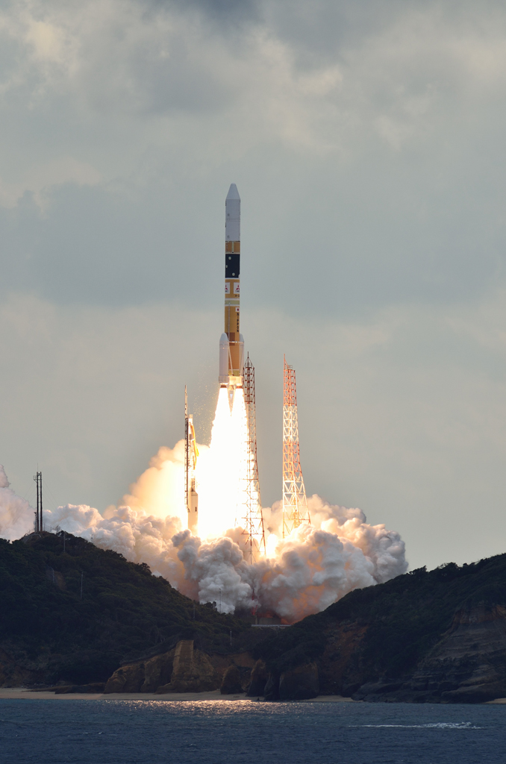
ACSPO SST from Himawari-8 (H8) AHI
Himawari-7 (MTSAT2) SST was produced by the NOAA heritage geo system
At the same time, ACSPO Team worked on GOES-R SST Algorithm (will launch in Oct 2016)
H8 launched in Oct 2014 with AHI sensor onboard (AHI is a sister sensor to GOES-R ABI)
NOAA management asked us to produce AHI SST using ACSPO system
to replace the H7 SST in the NOAA geo-polar blended
H8 SST was also viewed as GOES-R risk reduction

Slide 4
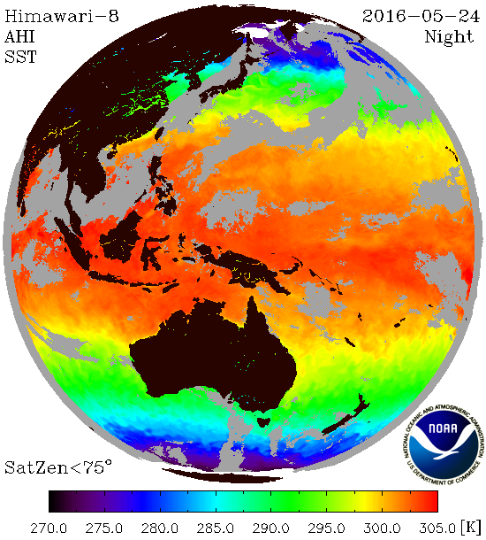
ACSPO H8 SST
Current Status
1 Jul 2015: Experimental ACSPO L2P SST (10min, swath projection) produced, 46 GB/day
L2P files and AHI vs. VIIRS images available online ftp://ftp.star.nesdis.noaa.gov/pub/sod/sst/acspo_data/l2/ahi/
Data from 1 Apr 2015 monitored in SQUAM www.star.nesdis.noaa.gov/sod/sst/squam/GEO/ along with NOAA H7 and JAXA H8 SSTs
4 Dec 2015: AACSPO SST assimilated into geo-polar blended (hourly; 5/6 granules not used)
Ongoing Work
Generate 1hr H8 L2C/L3C (4-6GB/day) and archive
Improve clear-sky mask based on pattern recognition and generate thermal fronts product
Revisit SST algorithm, ensure sensitivity = 1
Support GOES-R Algorithm & Cal/Val (Oct’2016)

Slide 5
AHI/ABI Bands
Notes:
Specific for nesdis

Slide 6
GOES-R/ABI Himawari/AHI SST Bands
Band | AHI/ABI |  |  | VIIRS |  |  | MODIS
 | B | CW (µm) | SR (µm) | B | CW (µm) | SR (µm) | B | CW (µm) | SR (µm)
IR37 | 7 | 3.85 | 3.59-4.11 | M12 | 3.70 | 3.66-3.84 | 20 | 3.75 | 3.66-3.84
IR86 | 11 | 8.60 | 8.12-9.07 | M14 | 8.58 | 8.40-8.70 | 29 | 8.55 | 8.40-8.70
IR10 | 13 | 10.45 | 9.90-10.96
IR11 | 14 | 11.20 | 10.31-12.18 | M15 | 10.73 | 10.26-11.26 | 31 | 11.03 | 10.78-11.28
IR12 | 15 | 12.35 | 11.17-13.66 | M16 | 11.85 | 11.54-12.49 | 32 | 12.02 | 11.77-12.27
Temporal AHI Sampling: 10min
Spatial resolution in IR bands (at nadir): 2 km

Slide 7
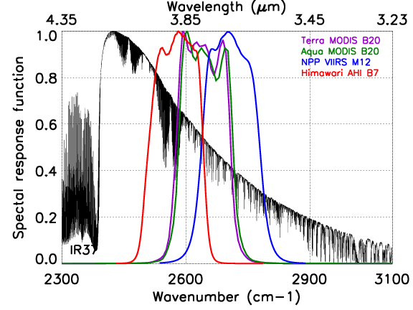
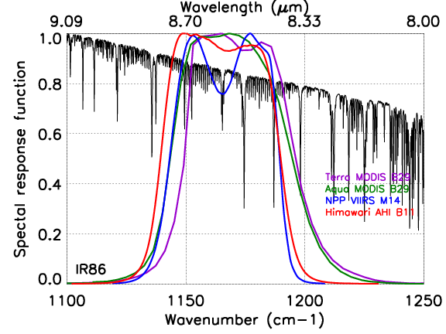
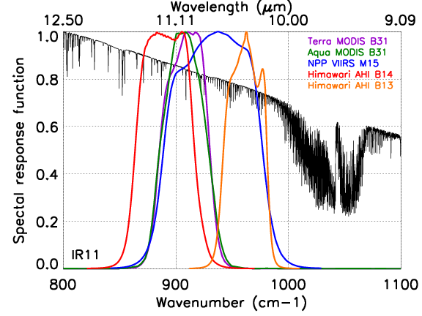
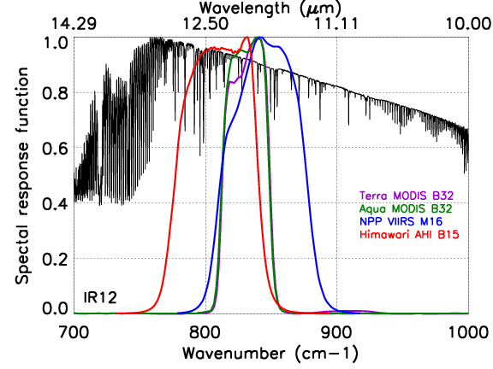
ABI/AHI SST Bands
IR37
IR86
IR10
IR11
IR12
Three bands in the longwave IR (vs. 2 on polar sensors) + 8.6 µm band
The 3.9 band is shifted to longwave and covers two N2O absorption lines

Slide 8
ACSPO Algorithms
Notes:
Specific for nesdis

Slide 9
ACSPO AHI Algorithms
ACSPO Clear-Sky Mask (Petrenko et al., JTECH, 2010)
Current ACSM is “in-pixel” (with the exception of spatial uniformity test)
Somewhat overly conservative (especially in dynamic and coastal areas)
Analyses of spatial / temporal context underway to improve coverage
ACSPO Single-Sensor Error Statistics (SSES; Petrenko et al, JTECH, 2016)
SSES derived against in situ data with piece-wise regressions as a function of Fisher distance
Correction for SSES biases improves consistency with in situ data (NB: monitored in SQUAM and shown here are non-SSES bias corrected)
We recommend to SSES-bias correct for the use in L4s blending with in situ and aiming at foundation SST (e.g., CMC, OSTIA, GAMSSA, Reynolds)
SST algorithm: Regression vs. Drifters/Trop. Moorings (Petrenko et al, JGR 2014)
OSI-SAF-like algorithms (which focus on VZA dependencies) are employed in ACSPO, as opposed to MODIS/PF-like (which focus on water-vapor correction)
Unlike polar algorithms (stratified by day/night), one H8 algorithm is used
The shortwave 3.9 µm band is not used in the regression

Slide 10
AHI SST Algorithm
T_{S} = a₀ + a₁T_{10.4} + a₂(T_{10.4} – T₁₂) + [a₃(T_{10.4} – T_{8.6}) + a₄(T_{10.4} – T_{11.2})]S_{θ} +
+ [a₅(T_{10.4} – T_{8.6}) + a₆(T_{10.4} – T_{11.2}) + a₇(T_{10.4} – T_{12.4})]T_{S}⁰
T_{8.6}, T_{10.4}, T_{11.2}, T_{12.4} observed BTs at 8.6, 10.4, 11, and 12.4 μm
S _{θ}=1/cos(θ) where θ is the satellite view zenith angle
T_{S}⁰ first guess SST (in °C) (CMC L4)
a regression coefficients (estimated from matchups)
The ACSPO SST is anchored to buoys → it is sub-skin (not biased -0.17K)
Currently, only SSTs with QL=5 are recommended to users and used in SQUAM.
(Per G16 recommendation, work is underway to revisit – see Petrenko et al. poster)
Single SST equation is used for AHI (unlike polar algorithms, which use different equations at night and during the daytime)
This minimizes SST and clear-sky mask discontinuities in the terminator zone and facilitates analysis of the diurnal cycle
The AHI 3.9 μm band proved inefficient for SST retrievals and is not used in the SST algorithm (apparently, it was shifted back to 3.7 µm on ABI – need to verify)

Slide 11
Evaluation of H8 SSTs in SQUAM
www.star.nesdis.noaa.gov/sod/sst/squam/GEO/
Notes:
Specific for nesdis

Slide 12
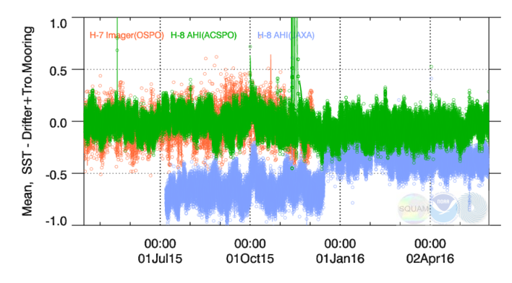
VAL BIAS wrt. iQuam Drifters + Tropical Moorings
NOAA Heritage H7
NOAA ACSPO H8
JPSS/H8 specs: ±0.2K
JAXA H8
Each data point: H8 = 10min L2P granule; H7 (ended 4 Dec 2015) = 1 hr
ACSPO H8 SST is close to meeting JPSS and H8 specs. Tighter than H7 SST
JAXA H8 SST is a skin product. -0.17K bias is expected. JAXA changed algorithm in Dec 2015. Remains biased ~-0.15K cold (on the top of the expected -0.17K bias)

Slide 13
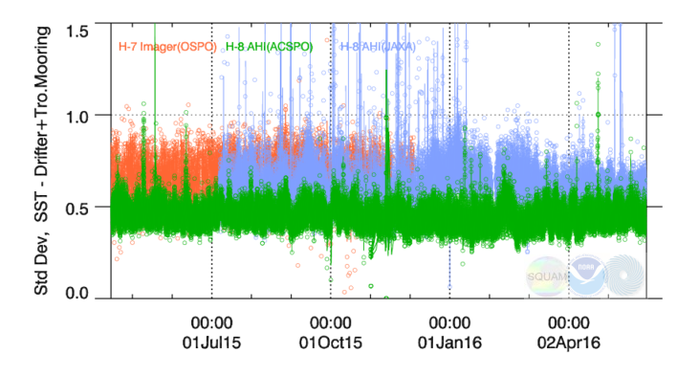
VAL SD wrt. iQuam Drifters + Tropical Moorings
NOAA Heritage H7
NOAA ACSPO H8
JPSS/H8 specs: 0.6K
JAXA H8
SD smaller at night when skin SST closer to bulk buoy, and larger during daytime
H8 ACSPO SDs range from ~0.4K (Night) to ~0.6K (Day). Close to JPSS/H8 specs
SDs for H8 ACSPO are smaller than for the NOAA heritage H7 and H8 JAXA SSTs. Outliers in JAXA SSTs reduced in 2016

Slide 14
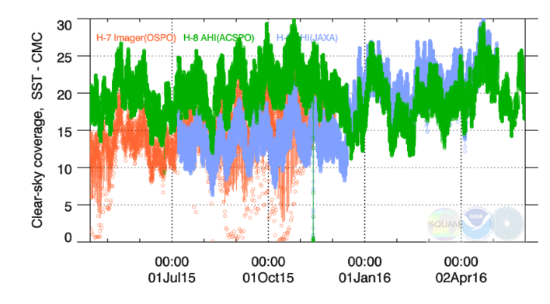
Clear-Sky Coverage in the H7/H8 SST Products
NOAA Heritage H7
JAXA H8
NOAA ACSPO H8
H8 ACSPO Clear-Sky Coverage exceeds NOAA H7 and initial JAXA H8
After fixes in Dec 2015, JAXA coverage is comparable to ACSPO
Large-scale variations in clear-sky fraction occur in sync in the three products, and are likely due to real changes in cloud coverage over the Himawari domain

Slide 15
Ongoing Work – 1:
Ensure Sensitivity to true SST = 1;
Accurately Resolve
Diurnal Cycle & Spatial Gradients
Notes:
Specific for nesdis

Slide 16
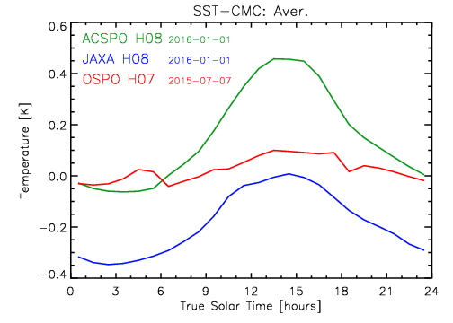
Diurnal Cycle in Retrieved SST Averaged over FD
Sensitivity to true SST (Merchant et al., GRL 2009) matters!
Should we output sensitivity in GDS2?
The ACSPO, JAXA, and H7 systems all run RTM, so the “sensitivity infrastructure” is there
The shape of the diurnal cycle: Similar between H8 ACSPO and JAXA, noisy in H7
ACSPO (& H7) SSTs agree with CMC at night as expected, and deviate during daytime
At night, JAXA SST is biased -0.3K cold (-0.17K expected, -0.15K unexplained).
During daytime, JAXA and ACSPO are offset by -0.45K
Diurnal amplitudes are ~0.55K in ACSPO H8; ~0.35K in JAXA; 0.15K in H7

Slide 17
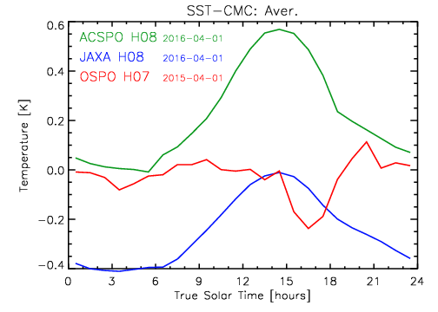
Diurnal Cycle in Retrieved SST Averaged over FD
Sensitivity to true SST (Merchant et al., GRL 2009) matters!
Should we output sensitivity in GDS2?
The ACSPO, JAXA, and H7 systems all run RTM, so the “sensitivity infrastructure” is there
The shape of the diurnal cycle: Similar between H8 ACSPO and JAXA, noisy in H7
ACSPO (& H7) SSTs agree with CMC at night as expected, and deviate during daytime
At night, JAXA SST is biased -0.3K cold (-0.17K expected, -0.15K unexplained).
During daytime, JAXA and ACSPO are offset by -0.45K
Diurnal amplitudes are ~0.55K in ACSPO H8; ~0.35K in JAXA; 0.15K in H7

Slide 18
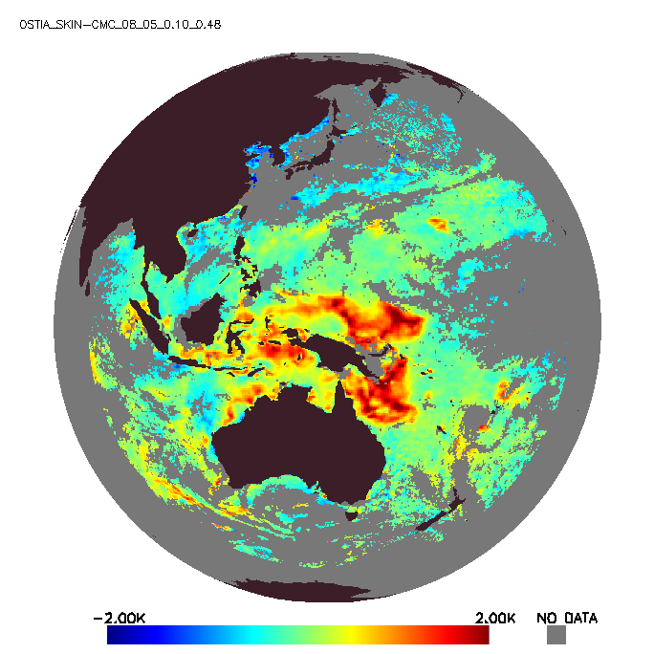
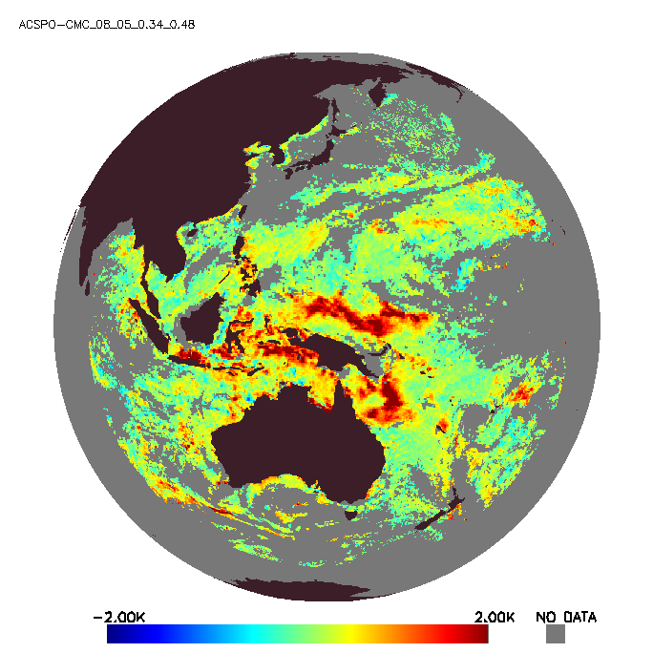
OSTIA Diurnal and ACSPO wrt CMC, Himawari-8 AHI, 8 January 2016, 5:00 UTC (Day)
OSTIA_SKIN – CMC: Bias=0.10 K, SD=0.48 K
ACSPO_SUBSKIN – CMC: Bias=0.34 K, SD=0.48 K
OSTIA_SKIN and ACSPO_SUBSKIN show different yet similar global biases with respect to CMC
OSTIA_SKIN is -0.24K colder (-0.17K comes from “skin”). Two products show close global SDs
Thanks to UKMO James While, Matt Martin, Chongyuan Mao

Slide 19
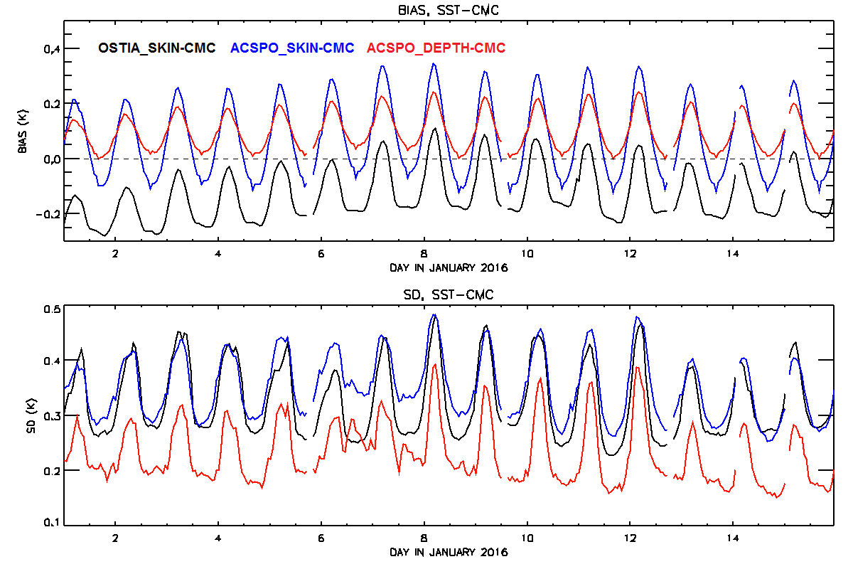
Bias & SD in OSTIA and ACSPO – CMC SST Himawari-8 AHI, 1-15 January 2016
(ACSPO_DEPTH = ACSPO_SUBSKIN – SSES bias)
Diurnal cycle in all products suppressed (function of UTC rather than local time). OSTIA_SKIN: Biased ~-0.17K cold wrt CMC, as expected. ACSPO_subsin: ~50% more diurnal warming than OSTIA_SKIN
ACSPO_DEPTH is closest to CMC at night and least affected by diurnal warming
Thanks to UKMO James While, Matt Martin, Chongyuan Mao

Slide 20
Ongoing Work – 2:
Use Pattern Recognition to
Improve Coverage in Dynamic Areas
and Derive Thermal Fronts
Notes:
Specific for nesdis

Slide 21
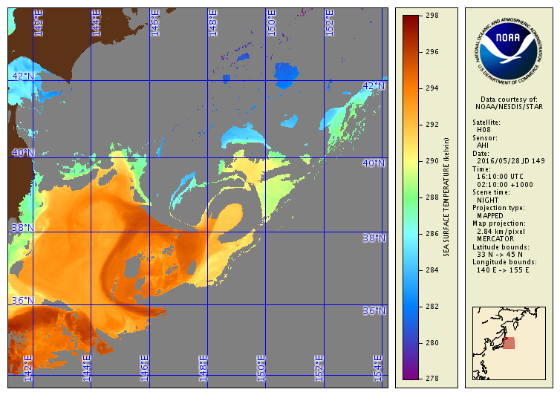
H8 AHI SST, 28 May 2016 @16:10UTC
ACSPO Clear-Sky Mask is overly conservative
Future version of ACSPO will utilize pattern recognition to fix this for VIIRS
Next step will be implementation of pattern recognition to H8 SST
ACSPO Clear-Sky Mask overly conservative
www.star.nesdis.noaa.gov/sod/sst/arms/

Slide 22
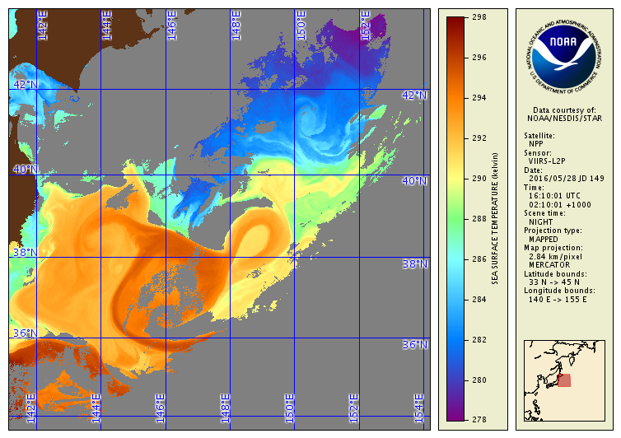
S-NPP VIIRS SST, 28 May 2016 @16:10UTC
ACSPO Clear-Sky Mask is overly conservative
Future version of ACSPO will utilize pattern recognition to fix this for VIIRS
Next step will be implementation of pattern recognition to H8 SST
ACSPO Clear-Sky Mask overly conservative
www.star.nesdis.noaa.gov/sod/sst/arms/

Slide 23
Ongoing Work – 3:
Use Temporal Context to
Increase SST Domain, Reduce Noise,
and Generate L2C/L3C Product
Notes:
Specific for nesdis

Slide 24
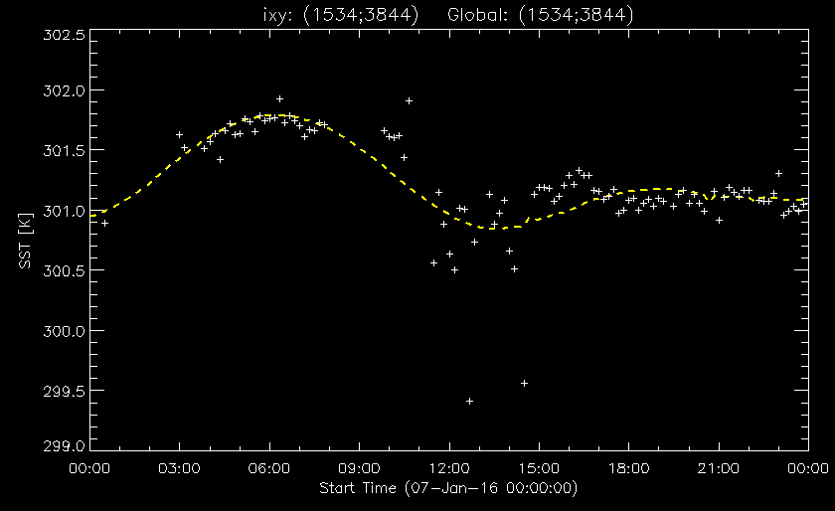
L2C (“Collated in Time”) AHI SST Product: 1 hr
White crosses: ACSPO L2P SST clear-sky pixels
Yellow line: Reconstructed SST
Cyan arrows: The proposed L2C Product (1hr; collated in time)

Slide 25
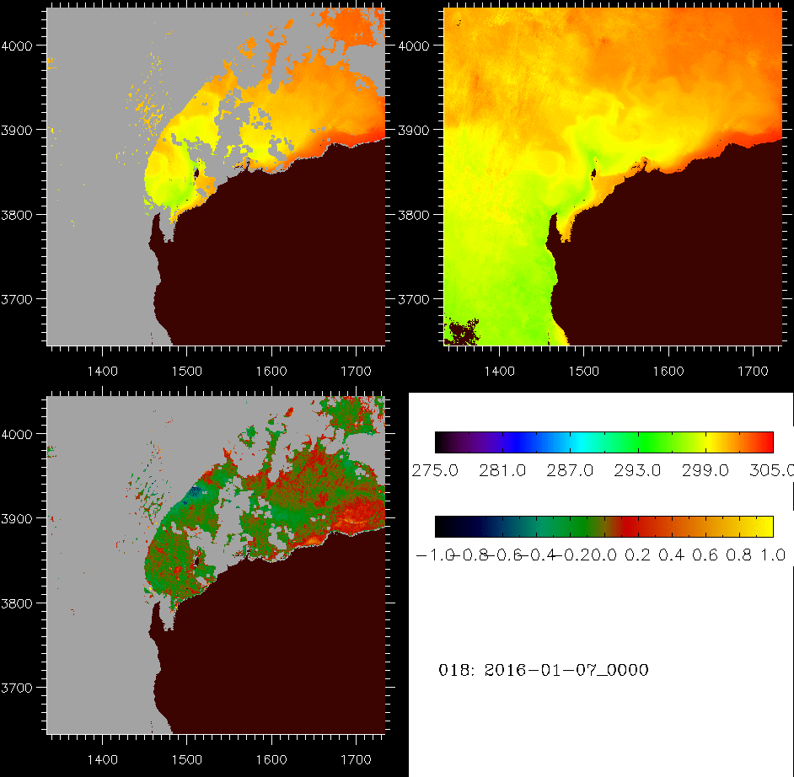
L2C “Collated” AHI SST Product
The users cannot use 10min data and the archives cannot archive, due to large size
The L2C product will reduce the data volume to ~6GB/day (from 45 GB/day in L2P)
L2C: in original swath projection but collated in time (reported @1hr not 10min)
The “temporal noise” will be reduced by fitting a smooth curve through cloud free data
Many cloud gaps will be filled “from temporal context” (but areas with persistent cloud will still remain data void)
L2P AHI SST
L2C AHI SST
L2C – L2P

Slide 26
Summary
NOAA ACSPO H8 SST Product
Successfully replaced the H7 SST as input in geo-polar blended
Risk reduction exercise for GOES-R
Product performance
Meets formal NOAA requirements for accuracy (±0.2K) and precision (0.6K)
Realistically resolves SST diurnal cycle
Improves upon NOAA heritage H7 SST (improved sensor, algorithms)
Compares favorably with JAXA H8 product
Work ahead
Derive L2C/L3C of reduced size & archive
Revisit SST algorithm, ensure sensitivity to true SST = 1
Implement pattern recognition algorithms, derive thermal fronts
Support launch of GOES-R in October 2016
Notes:
Specific for nesdis

