Slide 1
17th GHRSST Science Team Meeting 6-10 June 2016, Washington D.C., USA
Three AVHRR “CDRs” from 2002-2015:
Initial Comparisons with iQuam (Night)
Sasha Ignatov and Xinjia Zhou
NOAA STAR and CSU CIRA
Support by NOAA ORS Program
Thanks to Prasanjit Dash

Slide 2
3 long-term AVHRR SST Products
Pathfinder V5.2 (PFV5.2)
Data available from 1981 – 2012
Skin SST (a -0.17K bias is expected)
Kilpatrick et al, JGR, 2001; Casey et al, 2010; Kilpatrick, CATBD, 2013;
CCI
Data available from 1991 – 2010
Skin SST (a -0.17K bias is expected)
Merchant et al, Geosci Data J., 2014
AVHRR RAN1
Data available from Jul’2002 – Dec’2015
Sub-skin SST (no bias wrt in situ expected)
Shown below are SSES bias corrected
(Petrenko et al , JTECH 2016; better proxy for “depth” SST)
Ignatov et al, Remote Sens., 2016
Comparison only done for Night, QL=5, from Jul’2002 – Dec’2015
Notes:
Specific for nesdis

Slide 3
With respect to
Drifters and Tropical Moorings
RAN1 SST_depth
(SSES bias corrected)
Notes:
Specific for nesdis

Slide 4
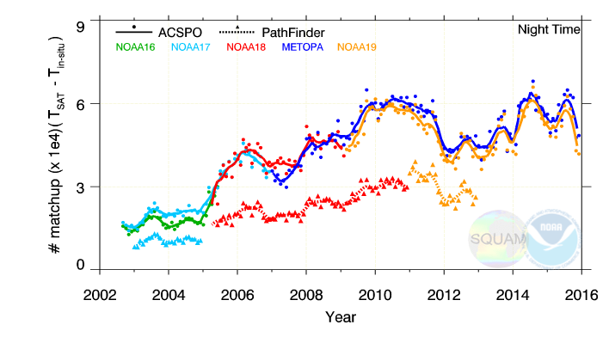
AVHRR RAN1 and PFV5.2: Number of Matchups
against iQuam (Drifters + Tropical Moorings)
RAN1 reported from 2 satellites (PM & mid-AM) vs. one in PFV5.2
PFV5.2 is only produced through Dec’2012
Number of retrievals with QL=5 is factor of 2 larger in RAN1
RAN1 is a L2 and PF is a L3 (0.04º) product
RAN1: QL=5 retrievals made in full swath (PF: only within VZA<55º)

Slide 5
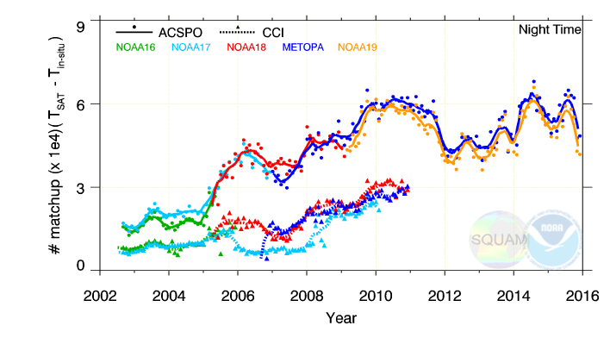
AVHRR RAN1 and CCI: Number of Matchups
against iQuam (Drifters + Tropical Moorings)
CCI is a L2 product , only produced through Dec’2010
Reported from all available satellites (up to 3-4 satellites at a time)
Several months of N15 in 2002 and 1 month of N17 in 2010 omitted
Number of CCI QL=5 retrievals is comparable with PFV5.2
QL=5 retrievals made within VZA<55º as in PFV5.2

Slide 6
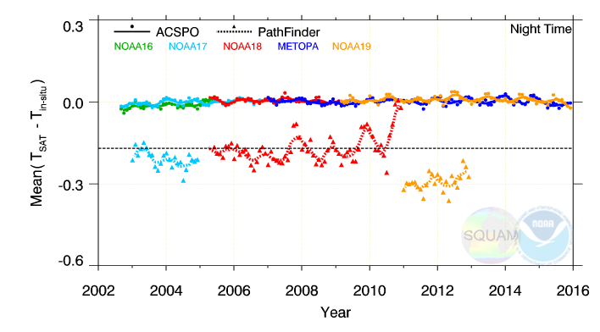
AVHRR RAN1 and PFV5.2: Mean Bias
against iQuam (Drifters + Tropical Moorings)
RAN1 regression coefficients smoothed using moving ±45day window
RAN1 SST is SSES-bias corrected (Petrenko et al, JTECH 2016)
PFV5.2 is a “skin product”: -0.17K bias is expected

Slide 7
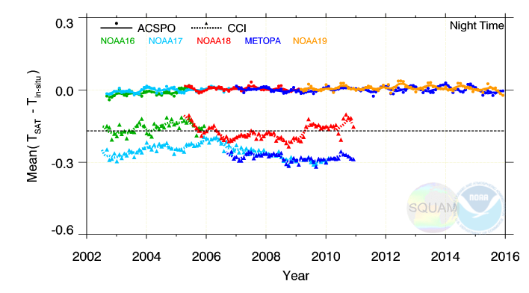
AVHRR RAN1 and CCI: Mean Bias
against iQuam (Drifters + Tropical Moorings)
CCI is a “skin product”: -0.17K bias is expected
PM and mid-AM platforms are offset by 0.10-0.15K.. Is that larger than expected from diurnal cycle between 9:30pm – 2am?
CCI shows more variations in time than RAN1

Slide 8
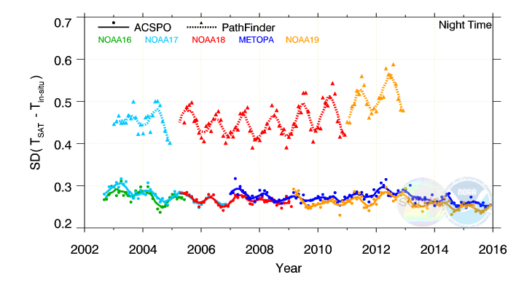
AVHRR RAN1 and PFV5.2: Std. Dev.
against iQuam (Drifters + Tropical Moorings)
Typically, RAN1 validates to within SD~0.30±0.04K
PFV5.2 validates with SD~0.4-0.6K
N19 in PFV5.2 is somewhat out of family

Slide 9
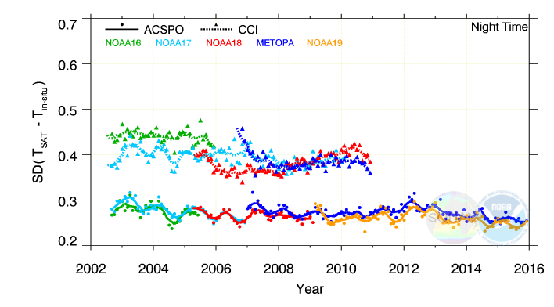
AVHRR RAN1 and CCI: Std. Dev.
against iQuam (Drifters + Tropical Moorings)
CCI validates with SD~0.35-0.45K (between PFV5.2 and RAN1)
Before 2006, SD for N16 larger than for N17 – counterintuitive?
N18 initially had smaller SDs than N17 – as expected. But then increased and became larger than for mid-AM N17 and Metop-A

Slide 10
Points to note
SQUAM can support CDAF
NOAA match-up codes and SQUAM processing capability are in place
Currently, we are understaffed & overwhelmed w/JPSS and H8 projects
Work load will increase with launch of GOES-R (Oct’2016) & J1 (Jan’2017)
Our GHRSST/CDAF involvement is “best effort”, cannot commit to any deliverables and/or deadlines
Ongoing ACSPO RAN1 work
Work is underway to generate RAN2 (using AVHRR/2 data from 1994-pr)
RAN2 will be compared with PFV5.2 and CCI for this more complete period
Notes:
Specific for nesdis

Slide 11
With respect to
Argo Floats
RAN1 SST_depth
(SSES bias corrected)
Notes:
Specific for nesdis

Slide 12
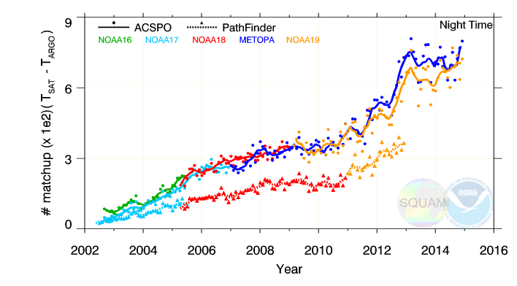
AVHRR RAN1 and PFV5.2:
Number of Matchups against iQuam Argo Floats
RAN1 reported from 2 satellites (PM & mid-AM) vs. one in PFV5.2
PFV5.2 is only produced through Dec’2012
Number of retrievals with QL=5 is factor of 2 larger in RAN1
RAN1 is a L2 and PF is a L3 (0.04º) product
RAN1: QL=5 retrievals made in full swath (PF: only within VZA<55º)

Slide 13
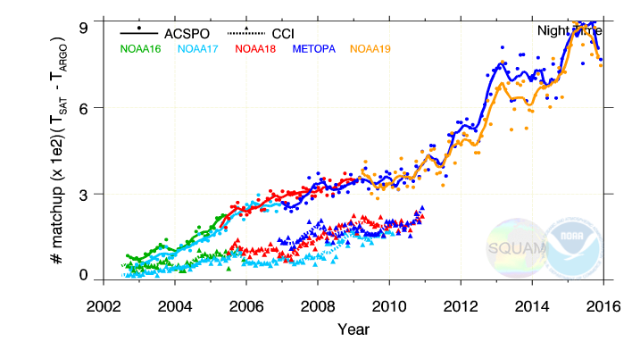
AVHRR RAN1 and CCI:
Number of Matchups against iQuam Argo Floats
CCI is a L2 product , only produced through Dec’2010
Reported from all available satellites (up to 3-4 satellites at a time)
Several months of N15 in 2002 and 1 month of N17 in 2010 omitted
Number of CCI QL=5 retrievals is comparable with PFV5.2
QL=5 retrievals made within VZA<55º as in PFV5.2

Slide 14
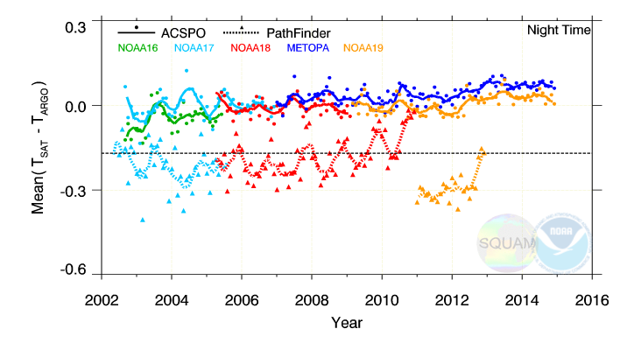
AVHRR RAN1 and PFV5.2:
Mean Bias against iQuam Argo Floats
RAN1 regression coefficients smoothed using moving ±45day window
RAN1 SST is SSES-bias corrected (Petrenko et al, JTECH 2016)
PFV5.2 is a “skin product”: -0.17K bias is expected

Slide 15
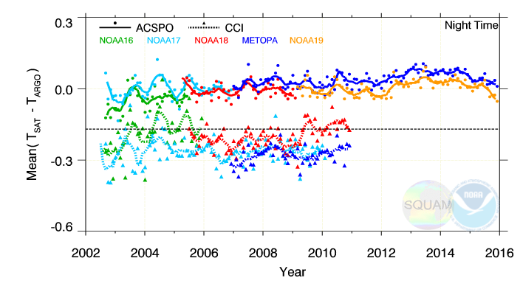
AVHRR RAN1 and CCI:
Mean Bias against iQuam Argo Floats
CCI is a “skin product”: -0.17K bias is expected
PM and mid-AM platforms are offset by 0.10-0.15K.. Is that larger than expected from diurnal cycle between 9:30pm – 2am?
CCI shows more variations in time than RAN1

Slide 16
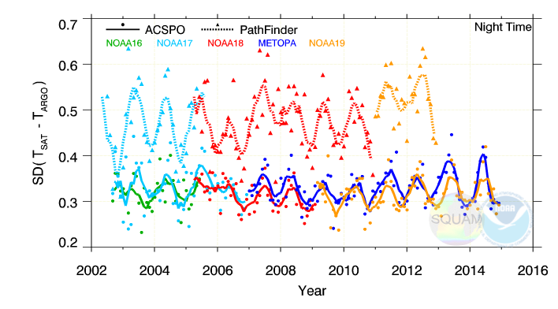
AVHRR RAN1 and PFV5.2:
Std. Dev. against iQuam Argo Floats
Typically, RAN1 validates to within SD~0.30±0.04K
PFV5.2 validates with SD~0.4-0.6K
N19 in PFV5.2 is somewhat out of family

Slide 17
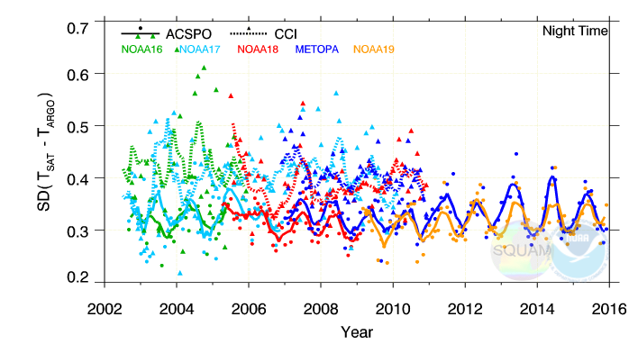
AVHRR RAN1 and CCI: Std. Dev.
against iQuam (Drifters + Tropical Moorings)
CCI validates with SD~0.35-0.45K (between PFV5.2 and RAN1)
Before 2006, SD for N16 larger than for N17 – counterintuitive?
N18 initially had smaller SDs than N17 – as expected. But then increased and became larger than for mid-AM N17 and Metop-A

Slide 18
With respect to
Drifters and Tropical Moorings
RAN1 SST_subskin
(Regression SST)
Notes:
Specific for nesdis

Slide 19
AVHRR RAN1 and PFV5.2: Number of Matchups
against iQuam (Drifters + Tropical Moorings)
RAN1 reported from 2 satellites (PM & mid-AM) vs. one in PFV5.2
PFV5.2 is only produced through Dec’2012
Number of retrievals with QL=5 is factor of 2 larger in RAN1
RAN1 is a L2 and PF is a L3 (0.04º) product
RAN1: QL=5 retrievals made in full swath (PF: only within VZA<55º)

Slide 20
AVHRR RAN1 and CCI: Number of Matchups
against iQuam (Drifters + Tropical Moorings)
CCI is a L2 product , only produced through Dec’2010
Reported from all available satellites (up to 3-4 satellites at a time)
Several months of N15 in 2002 and 1 month of N17 in 2010 omitted
Number of CCI QL=5 retrievals is comparable with PFV5.2
QL=5 retrievals made within VZA<55º as in PFV5.2

Slide 21
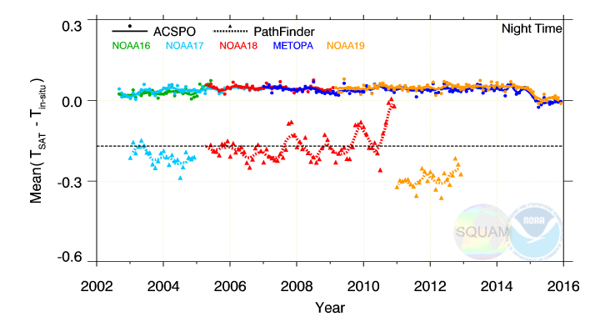
AVHRR RAN1 and PFV5.2: Mean Bias
against iQuam (Drifters + Tropical Moorings)
RAN1 regression coefficients smoothed using moving ±45day window
RAN1 SST is SSES-bias corrected (Petrenko et al, JTECH 2016)
PFV5.2 is a “skin product”: -0.17K bias is expected

Slide 22
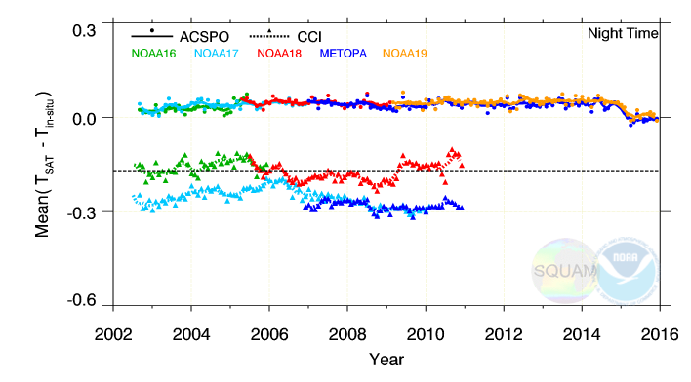
AVHRR RAN1 and CCI: Mean Bias
against iQuam (Drifters + Tropical Moorings)
CCI is a “skin product”: -0.17K bias is expected
PM and mid-AM platforms are offset by 0.10-0.15K.. Is that larger than expected from diurnal cycle between 9:30pm – 2am?
CCI shows more variations in time than RAN1

Slide 23
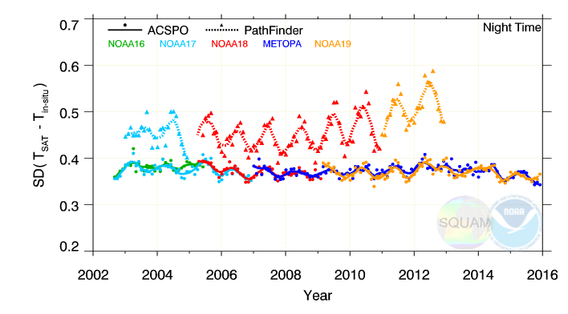
AVHRR RAN1 and PFV5.2: Std. Dev.
against iQuam (Drifters + Tropical Moorings)
Typically, RAN1 validates to within SD~0.30±0.04K
PFV5.2 validates with SD~0.4-0.6K
N19 in PFV5.2 is somewhat out of family

Slide 24
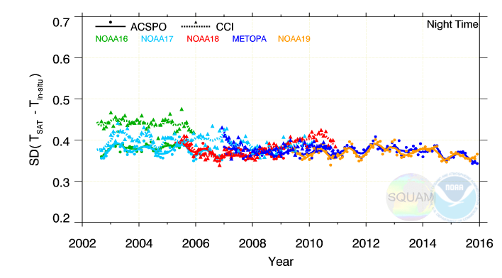
AVHRR RAN1 and CCI: Std. Dev.
against iQuam (Drifters + Tropical Moorings)
CCI validates with SD~0.35-0.45K (between PFV5.2 and RAN1)
Before 2006, SD for N16 larger than for N17 – counterintuitive?
N18 initially had smaller SDs than N17 – as expected. But then increased and became larger than for mid-AM N17 and Metop-A

