Slide 1
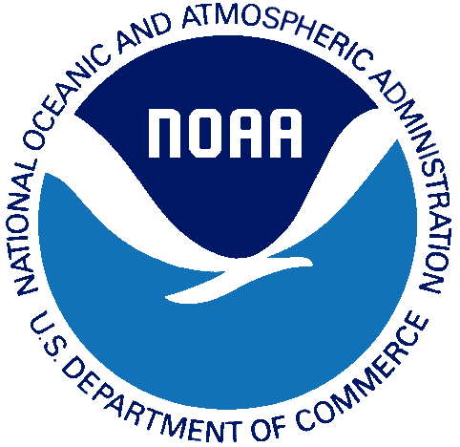
Filling the Gaps of Missing Data in Global Ocean Color Product Using the DINEOF Method
Xiaoming Liu and Menghua Wang
Ocean Color Team
NOAA/NESDIS Center for Satellite Applications and Research (STAR)
NOCCG Seminar, June 3, 2020

Slide 2
Outline
Introduction
Merging VIIRS ocean color data from SNPP and NOAA-20
DINEOF applied on merged SNPP/NOAA-20 VIIRS data
Ocean features revealed from the global gap-free ocean color data
Adding OLCI/S3A data to the SNPP/NOAA-20
High-resolution gap-free data
Conclusions

Slide 3
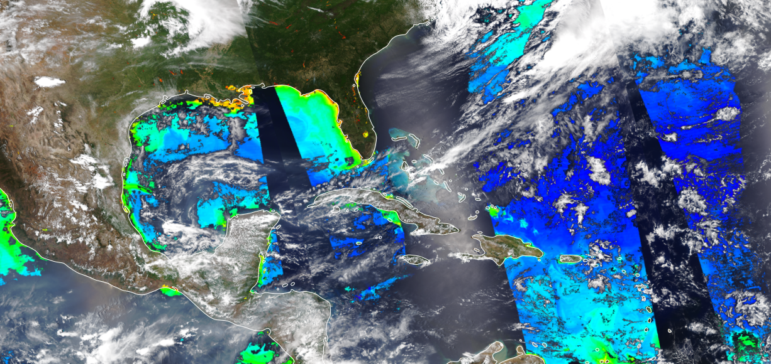
Introduction (1)
Visible Infrared Imaging Radiometer Suite (VIIRS) ocean color products are very useful for monitoring and understanding of biological and ecological ocean processes and phenomena. However, VIIRS-derived daily ocean color image either on the SNPP or NOAA-20 is limited in ocean coverage due to its swath width, high sensor-zenith angle, high sun glint, and cloud, etc.
High sun glint
High sensor-
zenith angle
NOAA-20 VIIRS true color image overlapped on ocean color Chlorophyll-a image of 4/27/2020.
Credits: https://www.star.nesdis.noaa.gov/socd/mecb/color/ocview/ocview.html

Slide 4
Introduction (2)
Merging VIIRS ocean color products derived from the SNPP and NOAA-20 significantly increases the spatial coverage of daily images. Two VIIRS sensors on the SNPP and NOAA-20 satellites have similar sensor characteristics, and global ocean color data are derived routinely using the same Multi-Sensor Level-1 to Level-2 (MSL12) ocean color data processing system. Therefore, the merged VIIRS ocean color data are expected to have high data quality with consistent statistical property and accuracy globally.
The Data Interpolating Empirical Orthogonal Function (DINEOF) is a method to reconstruct missing data in geophysical datasets based on Empirical Orthogonal Function (EOF). It utilizes both temporal and spatial coherencies of data to infer a solution at the missing locations (Alvera-Azcarate et al., 2005). In this study, the DINEOF is used to fill up gap pixels in the merged SNPP and NOAA-20 VIIRS global ocean color images.
The possibility of adding more data from more satellite sensors will also be explored. Specifically, additional ocean color data from the Ocean and Land Colour Instrument (OLCI) on the Sentinel-3A will be tested.

Slide 5
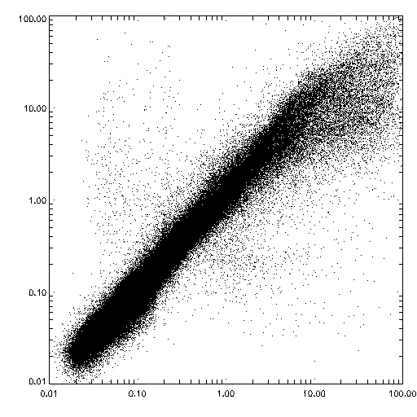
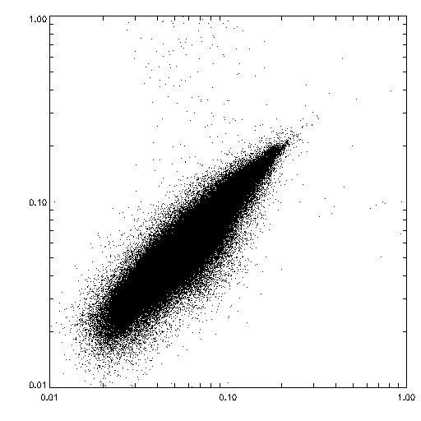
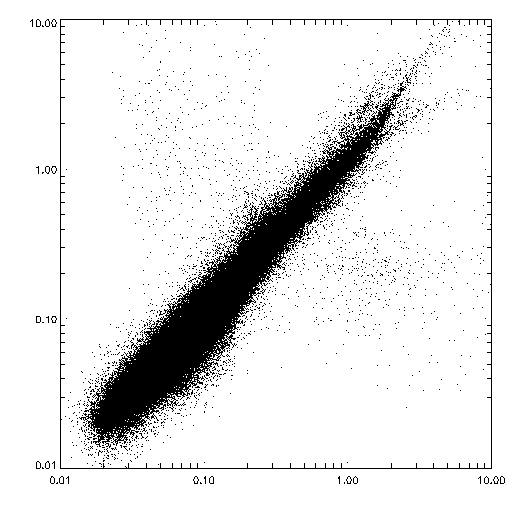
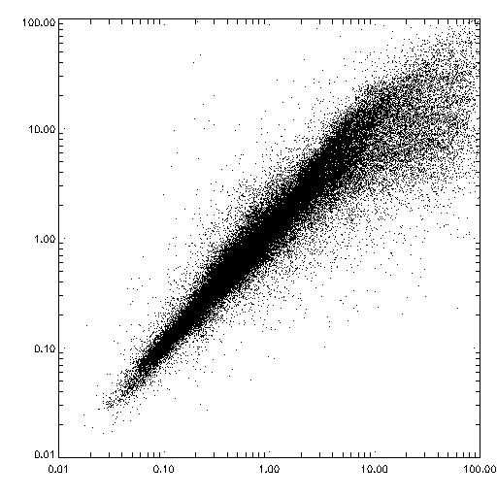
Merging SNPP and NOAA-20 Ocean Color Data
All
Oligotrophic
06/21/2018 Chl-a (OCI)
NOAA-20
SNPP and NOAA-20 have similar sensor characteristics, spatial and time resolution, little time difference, and the ocean color data are processed using the same EDR software, i.e., MSL12. The statistics of the two data sets are very close.
Mean: 1.069
STD: 0.212
Mean: 1.024
STD: 0.162
Deep-water
Coastal-water
NOAA-20
Mean: 1.057
STD: 0.175
Mean: 1.127
STD: 0.336
SNPP
SNPP

Slide 6
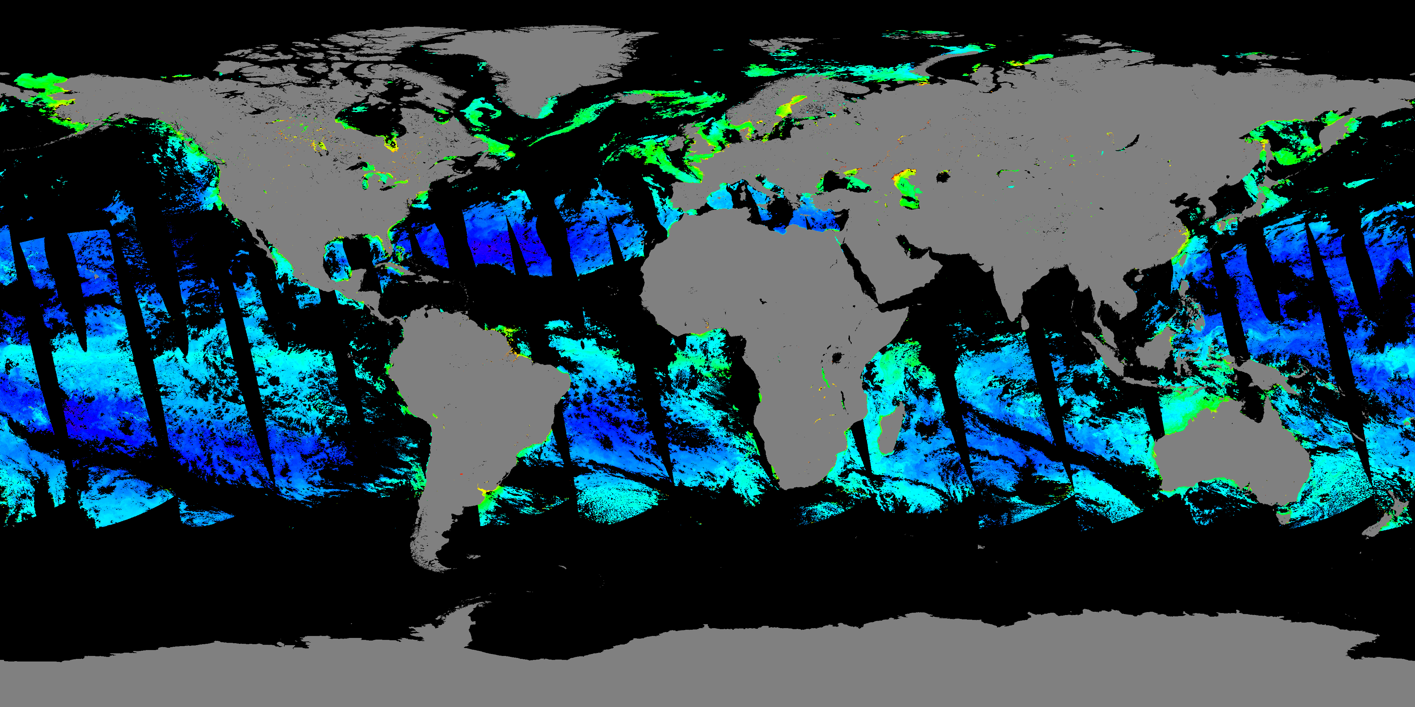
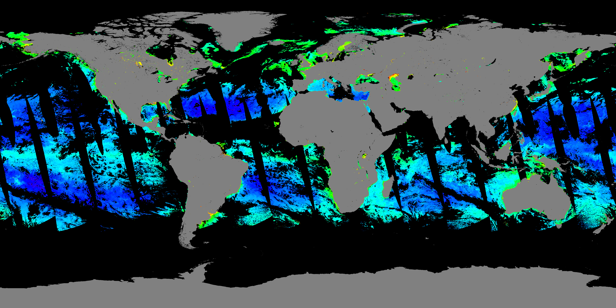
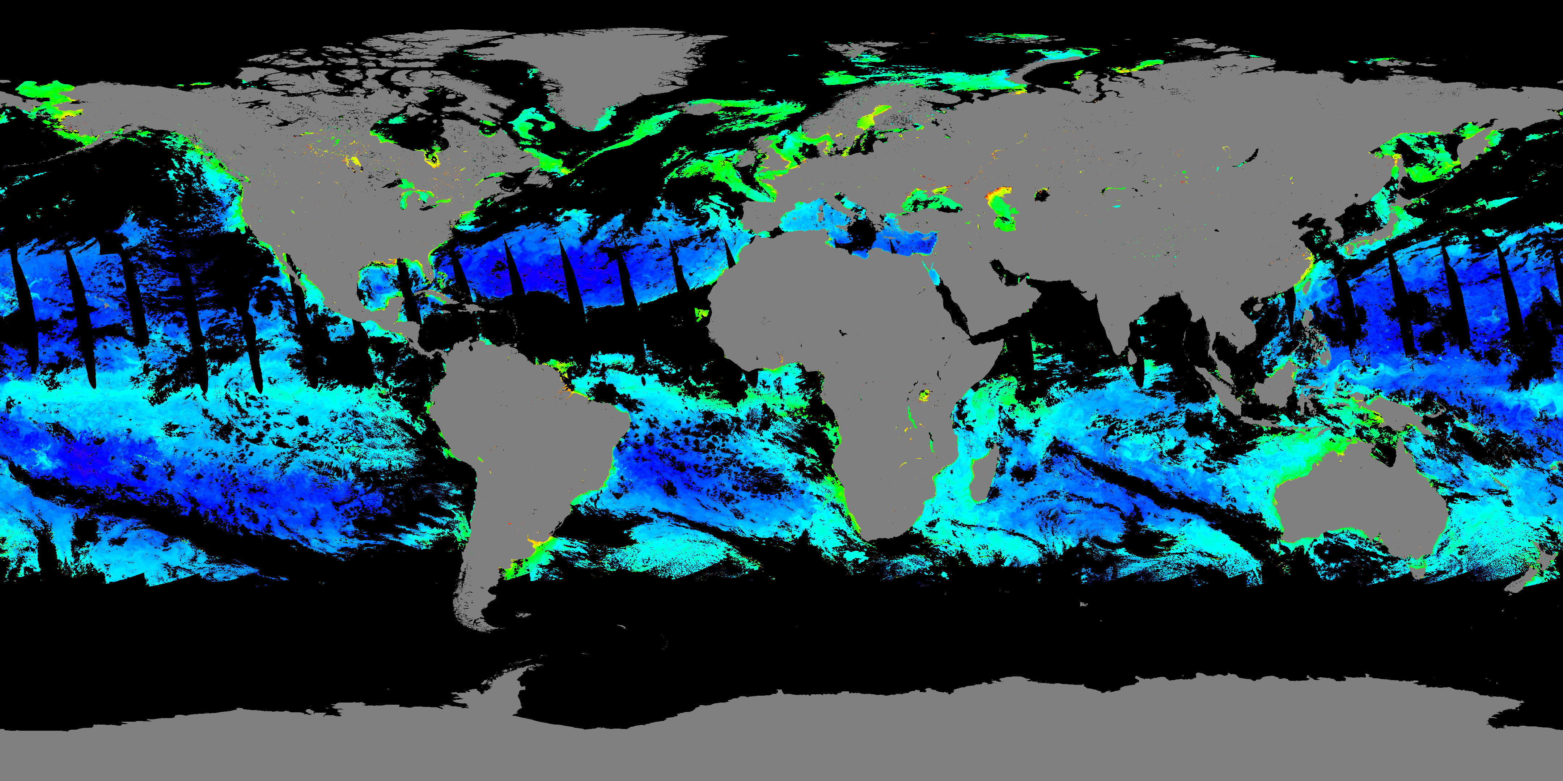
Merging SNPP and NOAA-20 Ocean Color Data
Example of Global 9km Chl-a Level-3 images (6/21/2018)
SNPP
NOAA-20
Merging (L3bin)
Merging SNPP and NOAA-20 can increase valid ocean color pixels by ~38%
Merged

Slide 7
How DINEOF Works?
Empirical Orthogonal Function (EOF) analysis is a method often used to study possible spatial patterns (i.e., EOF modes) of a spatio-temporal field and how they change with time. The EOF modes are ordered by its importance to the contribution to the time series of data.
Data Interpolating Empirical Orthogonal Functions (DINEOF) procedure:
The original dataset is first stored in a spatio-temporal matrix with m x n dimensions, where m is the number of grids in the spatial domain and n is the number of time steps in the time series.
Initially, the temporal and spatial mean is removed from the data, and all missing values are set to zeroes.
The first EOF mode is calculated and used to replace the missing values as the initial guess. The first EOF mode is then recalculated iteratively using the previous best guess as the initial value of the missing data for the subsequent iteration until the process converges.
Subsequently, the number of EOFs increases one by one and for each EOF mode, the whole reconstruction is operated again. Then, by using a cross-validation technique, the optimal number of EOF modes can be determined.

Slide 8
Reconstruct Global Daily Data Using DINEOF (Implementation for Routine Global Data Processing)
Input: 30 days of Global daily SNPP and NOAA-20 merged Level-3 binned data files of 9-km resolution.
To increase DINEOF performance, global data are divided into 16 zonal sections: 80°S-70°S, 70°S-60°S, … 10°S-0°, 0°-10°N, 10°-20°N, … 60°-70°N, 70°-80°N.
Replace pixels that are missing for the whole month with climatology value.
Apply DINEOF on each of the 16 zonal sections, fully reconstruct all pixels, including non-missing pixels.
Output: Fully reconstructed (gap-filled) global daily Level-3 binned data.
Liu, X. and M. Wang, "Gap filling of missing data for VIIRS global ocean color product using the DINEOF method", IEEE Trans. Geosci. Remote Sens., 56, 4464-4476 (2018). https://dx.doi.org/10.1109/tgrs.2018.2820423
Liu, X. and M. Wang, “Filling the gaps of missing data in the merged VIIRS SNPP/NOAA-20 ocean color product using the DINEOF method,” Remote Sens., 11, 178, 2019. https://dx.doi.org/10.3390/rs11020178

Slide 9
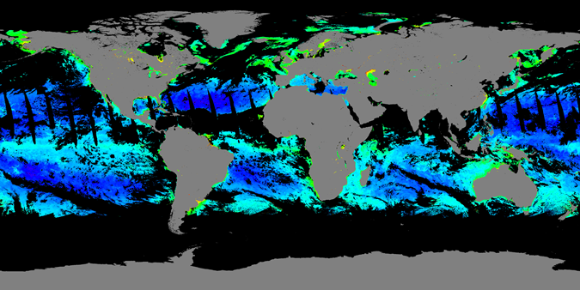
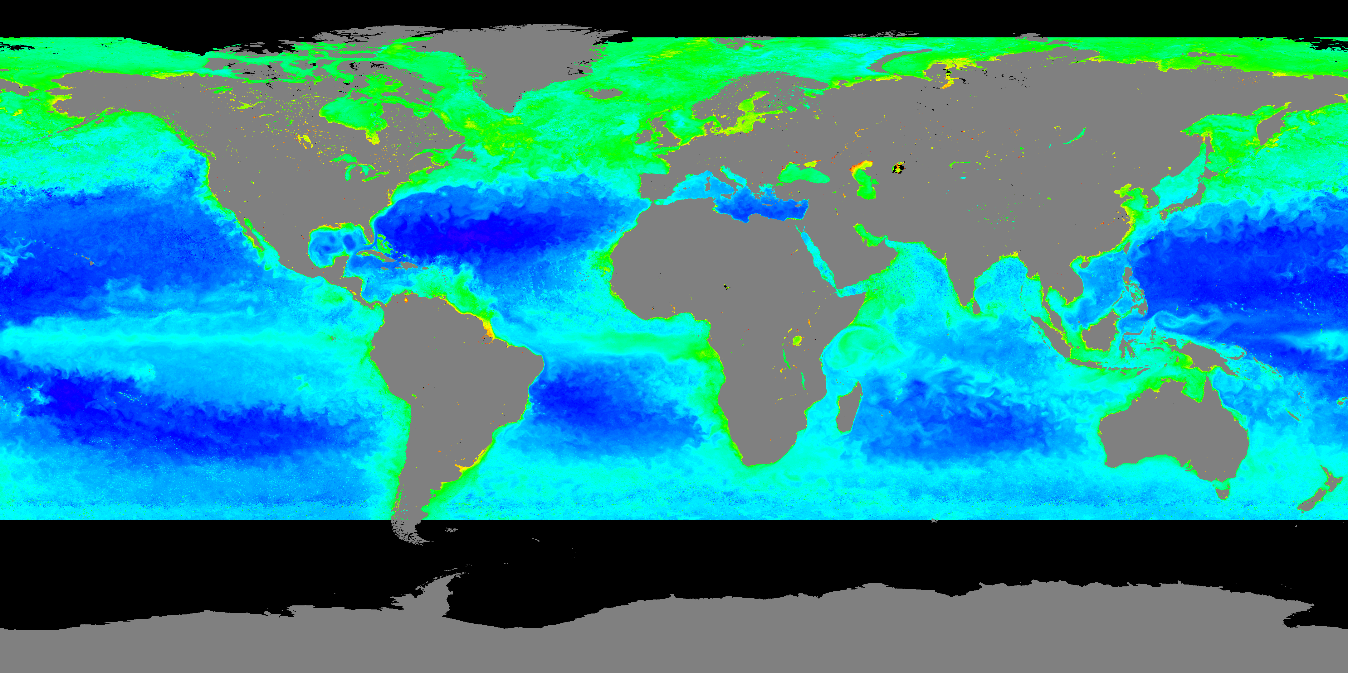
Example of Gap-filled Products
Global 9-km Chl-a Level-3 images (6/21/2018)
Merged product
Gap-filled Product
Chlorophyll-a (mg/m³)

Slide 10
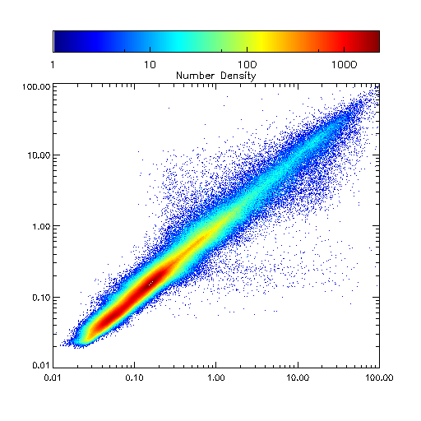
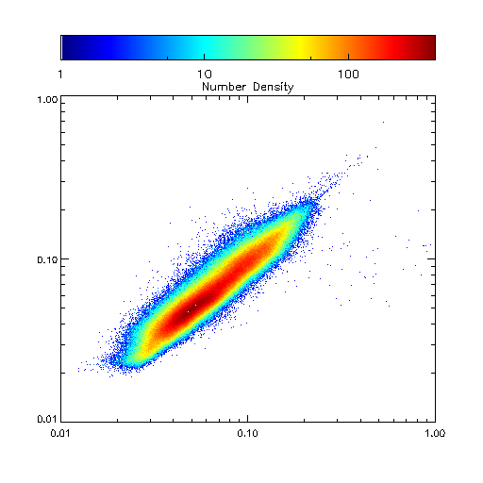
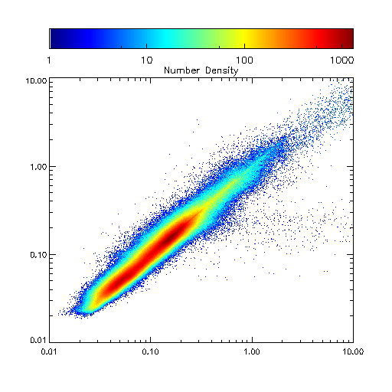
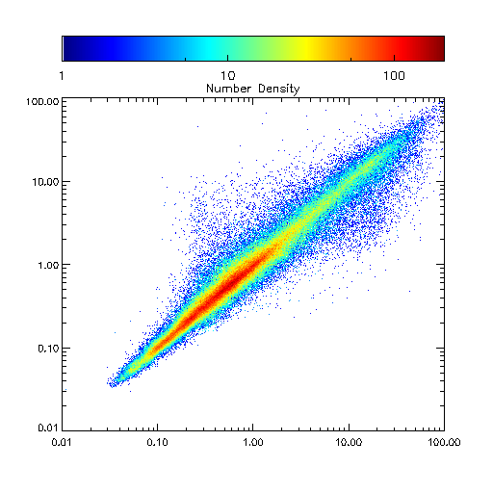
Gap-filled Results Evaluation
Validation: 5% of valid (non-missing) pixels in the original Level-3 data were randomly selected, and intentionally treated as “missing pixels.”
These pixels were reconstructed and compared with the original data for validation.
All
Oligotrophic Waters
Gap-filled
Gap-filled
Mean: 1.007
STD: 0.191
Mean: 1.007
STD: 0.157
Merged
Merged
Deep Waters
Coastal Waters
Gap-filled
Gap-filled
Mean: 1.010
STD: 0.171
Mean: 0.995
STD: 0.281
Merged
Merged

Slide 11
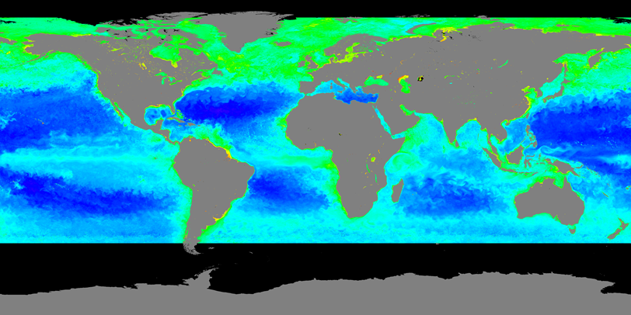
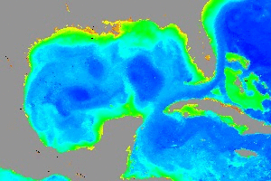
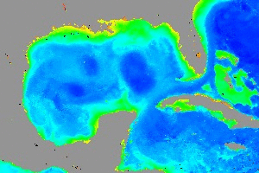
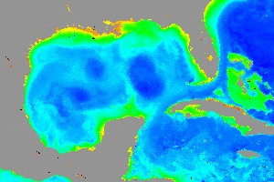
VIIRS Chl-a Merged vs. SNPP or NOAA-20
Movies (6/19–7/18, 2018)
merged
S-NPP
NOAA-20
Merged
SNPP
NOAA-20

Slide 12
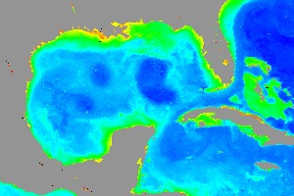
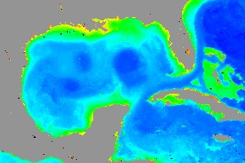
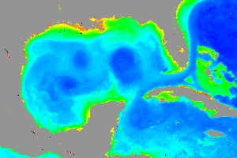
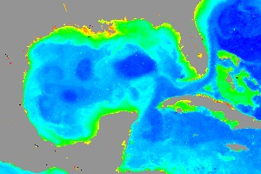
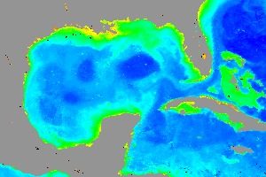
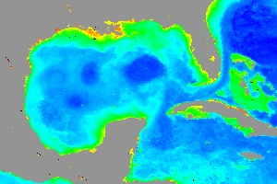
VIIRS Chl-a Merged vs. SNPP or NOAA-20
Merged
SNPP
Merged
SNPP
NOAA-20
NOAA-20
6/21
6/21
6/21
6/30
6/30
6/30
7/18
7/18
7/18

Slide 13
Product Evaluation/Validation/Tools
DINEOF Reconstructed/Original Ratio
Region | SNPP |  | NOAA-20 |  | Merged
 | Mean | STD | Mean | STD | Mean | STD
All | 1.007 | 0.191 | 1.007 | 0.206 | 1.012 | 0.200
Deep Water | 1.010 | 0.171 | 1.009 | 0.191 | 1.015 | 0.182
Coastal & Inland Water | 0.995 | 0.281 | 0.995 | 0.273 | 0.997 | 0.287
Oligotrophic Water | 1.007 | 0.157 | 1.009 | 0.182 | 1.012 | 0.164
Liu, X. and M. Wang, "Filling the gaps of missing data in the merged VIIRS SNPP/NOAA-20 ocean color product using the DINEOF method", Remote Sens., 11, 178 (2019). doi:10.1390/rs11020178

Slide 14
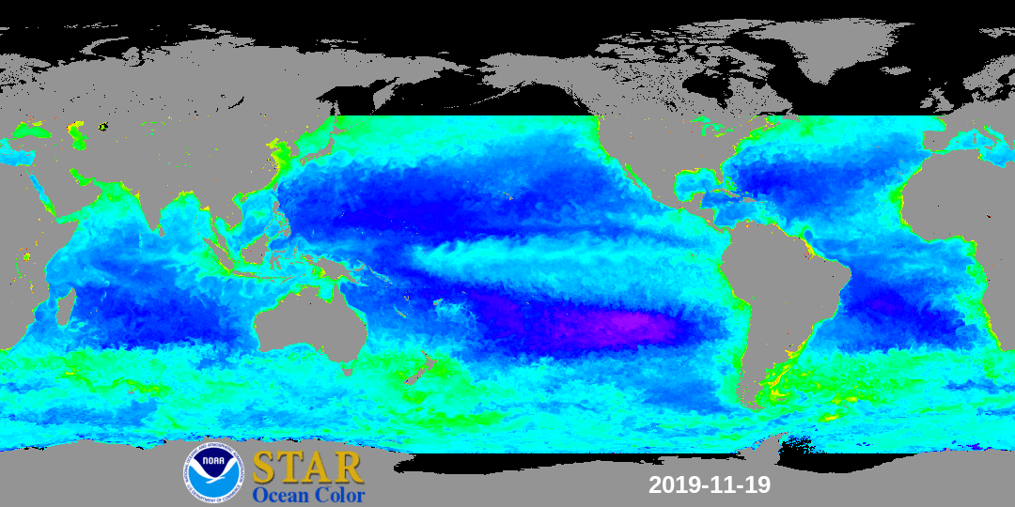
Global Ocean Features in the Gap-Free Chl-a Data
Chlorophyll-a (mg/m³)

Slide 15
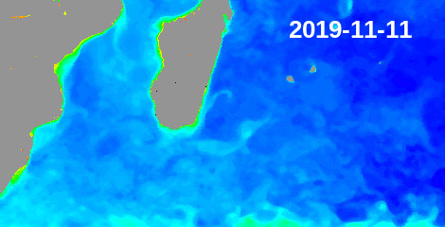
Meso-Scale Ocean Features in the Gap-Free Chl-a Data (1)
In the movie:
Merging of two eddies in the Mozambique channel
East Madagascar current
Mozambique
Madagascar
EMC

Slide 16
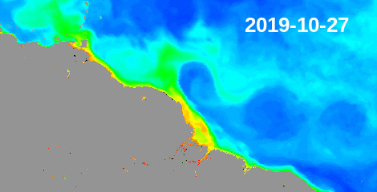
Meso-Scale Ocean Features in the Gap-Free Chl-a Data (2)
In the movie:
Formation of the Northern Brazel Current (NBC) rings

Slide 17
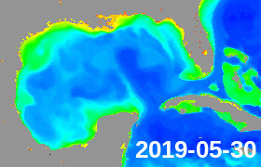
Meso-Scale Ocean Features in the Gap-Free Chl-a Data (3)
In the movie:
Formation of Loop Current Eddy (LCE): a LCE shedding from the Loop Current around 7/10/2019

Slide 18
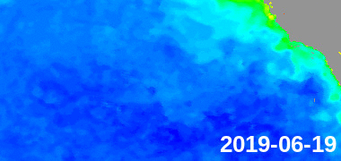
Meso-Scale Ocean Features in the Gap-Free Chl-a Data (4)
In the movie:
California Costal Current and eddies
CCC

Slide 19
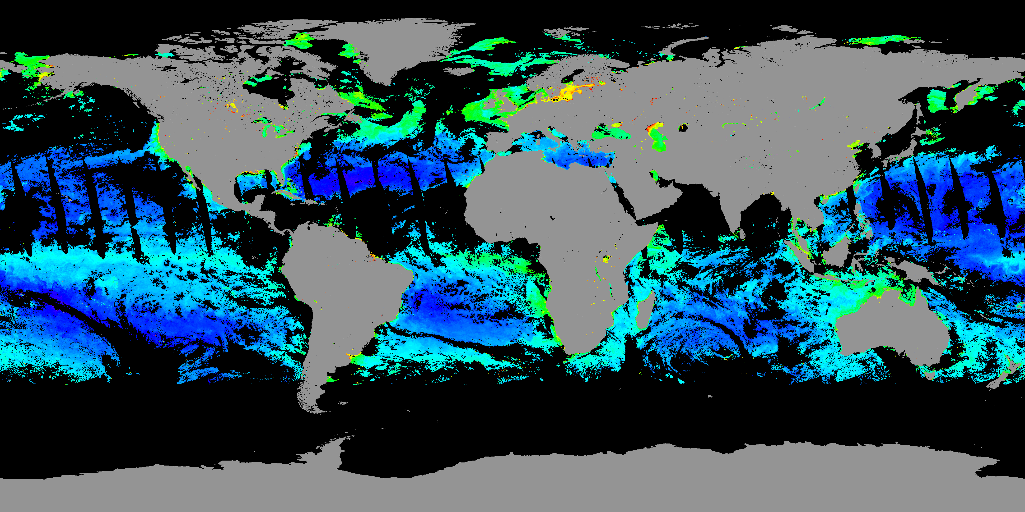
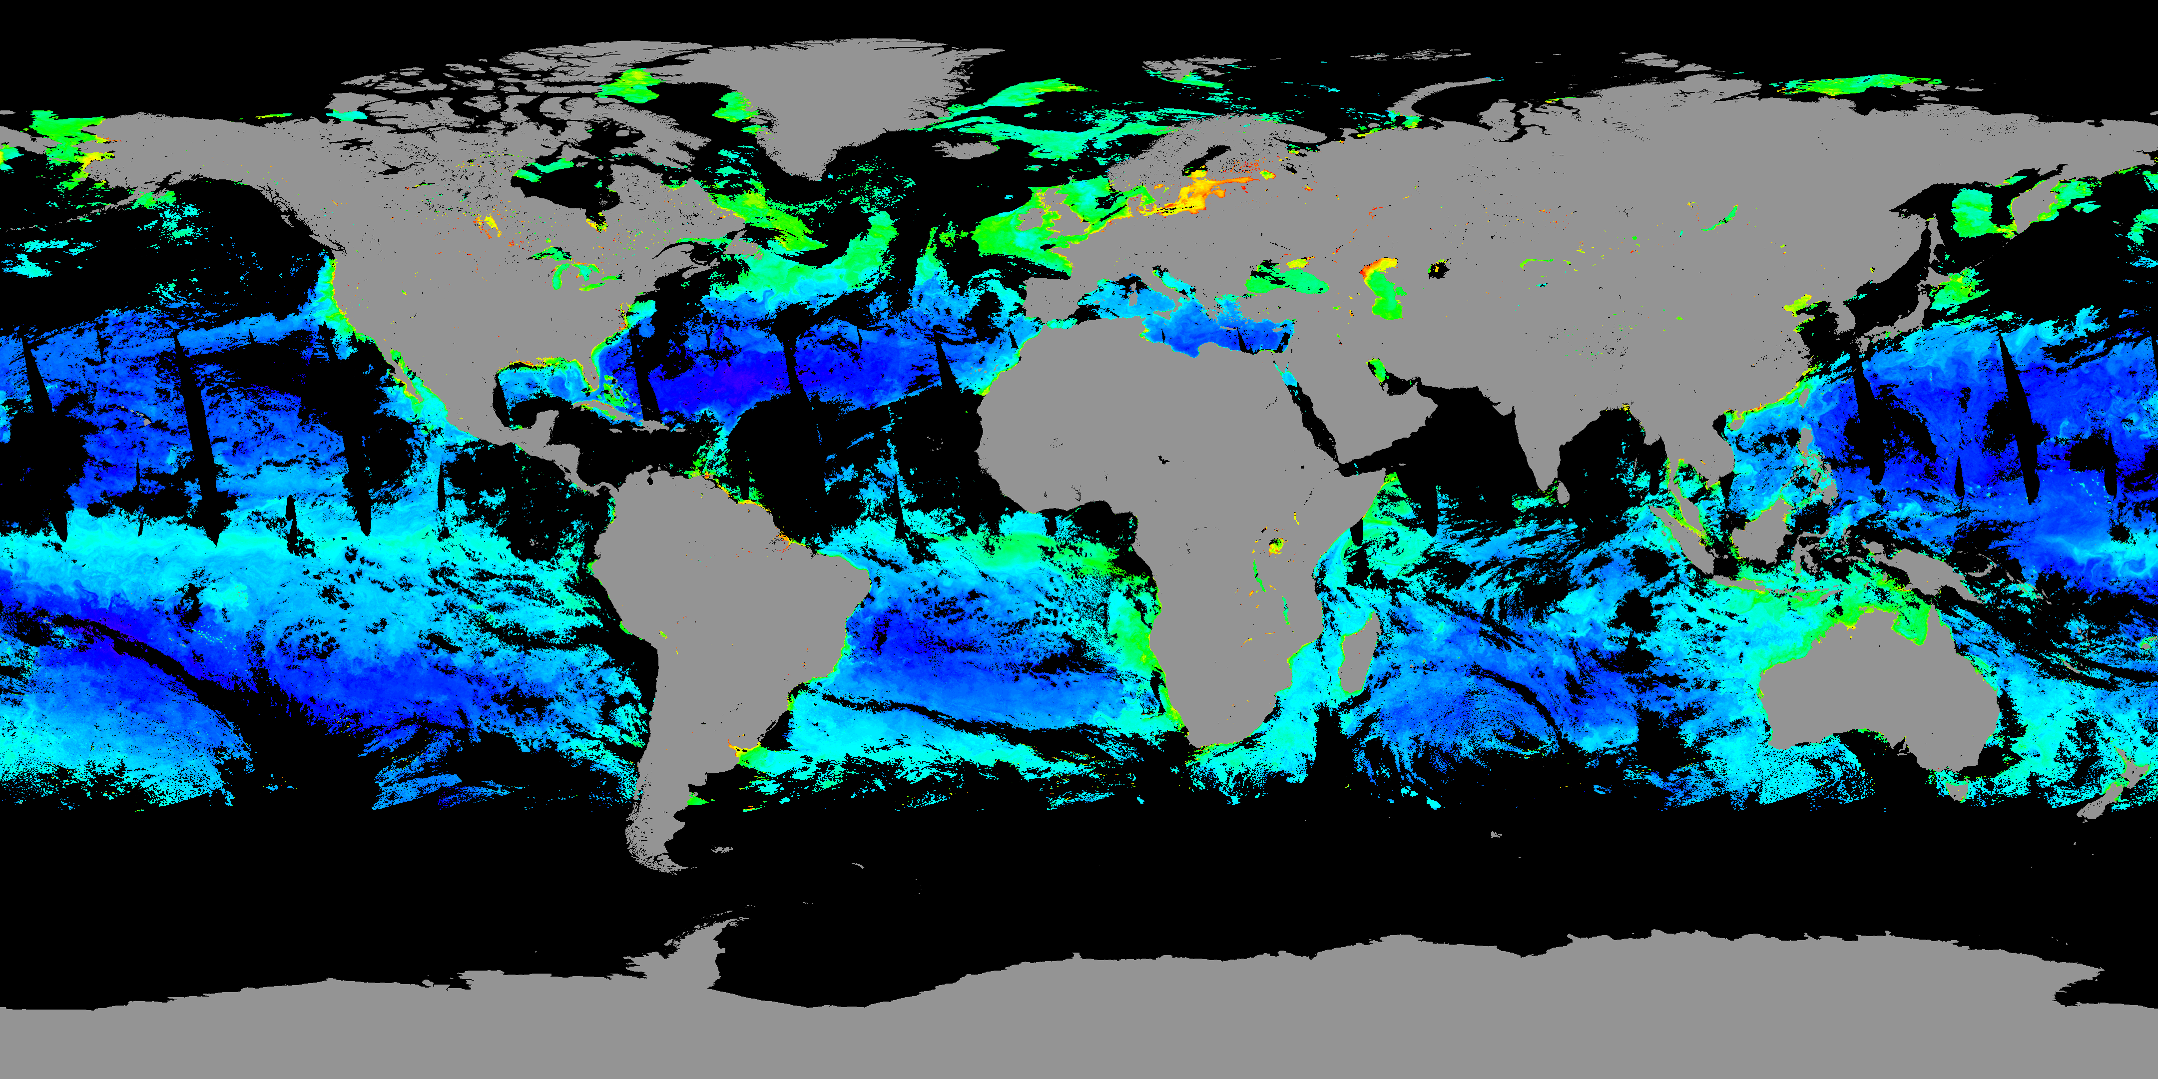
Adding OLCI/S3A to SNPP/NOAA-20 Data
Adding OLCI/S3A to Merged SNPP/NOAA20 VIIRS data increases valid pixels by ~10-12% globally
Oligotrophic Waters
Chl-a (OCI)
VIIRS/(SNPP + NOAA20)
28 June 2018
VIIRS/(SNPP + NOAA20) + OLCI/S3A

Slide 20
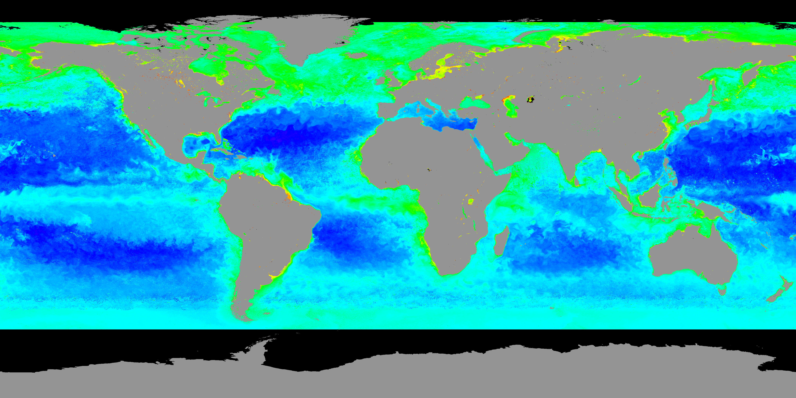
Adding OLCI/S3A to SNPP/NOAA-20 Data
VIIRS/(SNPP + NOAA20)
28 June 2018
VIIRS/(SNPP + NOAA20) + OLCI/S3A
Chlorophyll-a (mg/m³)

Slide 21
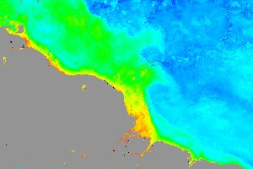
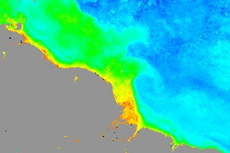
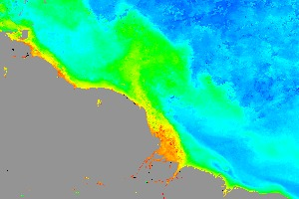
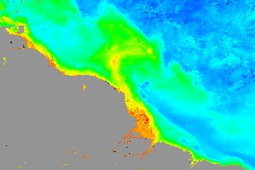
Example: Gap-free Chl-a Movie from
VIIRS-SNPP, VIIRS-NOAA-20, and OLCI-Sentinel-3A
Northern Brazil Current Movie (June 19-July 18, 2018)
Two VIIRS
Two VIIRS and OLCI
Two VIIRS & OLCI Chl-a
Two VIIRS Chl-a
July 15, 2018
July 15, 2018
Two VIIRS & OLCI Chl-a
Two VIIRS Chl-a

Slide 22
DINEOF in High Spatial Resolution
Since adding OLCI/S3A to the merged SNPP/NOAA-20 VIIRS data could significantly reduce the amount of missing data in ocean color images, it is possible to apply DINEOF to 2-km resolution data, at least for regional applications.
With the availability of super-resolved 375-m resolution VIIRS ocean color data (Liu and Wang, 2020) from both SNPP and NOAA-20, the possibility of generating gap-free high-resolution ocean color data for coastal oceans can also be explored.
Liu, X. and M. Wang, "Super-resolution of VIIRS-measured ocean color products using deep convolutional neural network", IEEE Trans. Geosci. Remote Sens. https://doi.org/10.1109/TGRS.2020.2992912 (2020).

Slide 23
Conclusions
DINEOF is applied to the merged SNPP/NOAA-20 VIIRS ocean color data, and the gap-free global 9-km chlorophyll-a data are routinely generated daily in near-real-time. The data can be accessed from the NOAA/CoastWatch servers.
https://www.star.nesdis.noaa.gov/socd/mecb/color/index.php
https://coastwatch.noaa.gov/cw/index.html
The gap-free data based on the VIIRS SNPP/NOAA-20 merged products show more details in ocean features than those based on single sensors alone. This result indicates that adding even more sensors into the merged products could significantly improve the quality of gap-free global ocean color data.
In addition to VIIRS on SNPP and NOAA-20, the OLCI on Sentinel-3A and Sentinel-3B satellites and the SGLI on GCOM–C are also providing unprecedented global views of ocean optical, biological, and biogeochemical properties. We are working to add these sensors into the data-merging process in the near future, which we anticipate will further improve data quality and reduce gaps in global ocean color data.

Slide 24
Thank you!

Slide 25
Super-resolution Applications
Deep convolutional neural network (CNN) is used to glean the high-frequency content from the VIIRS I1 band and transfer to super-resolved M-band ocean color images (Liu and Wang, 2020).
VIIRS-derived original images with 750-m spatial resolution (top row) for (a) nLw(443), (b) nLw(551), and (c) nLw(671), and super-resolved images with 375-m (bottom row) for (d) nLw(443), (e) nLw(551), and (f) nLw(671) on August 14, 2015, in the Baltic Sea.
750-m Resolution
375-m Resolution
Liu, X. and M. Wang, "Super-Resolution of VIIRS-Measured Ocean Color Products Using Deep Convolutional Neural Network", IEEE Trans. Geosci. Remote Sens. https://doi.org/10.1109/TGRS.2020.2992912 (2020).

