Slide 1
How to do Machine Learning on the Cloud: a fast intro
http://bitly.com/science-data-ml
Valliappa (Lak) Lakshmanan
@lak_gcp
lak@google.com

Slide 2
Agenda
5 demos (30 min)
Compute Engine (the old way)
BigQuery (large-scale structured data processing)
Jupyter + Keras/TensorFlow (ML)
Dataflow (large-scale unstructured data processing)
Colab + Earth Engine (large-scale ML)
Hands-on labs (Choose your own adventure, 60 min)

Slide 3
Compute Engine
01
Notes:
To show you what I mean ...

Slide 4

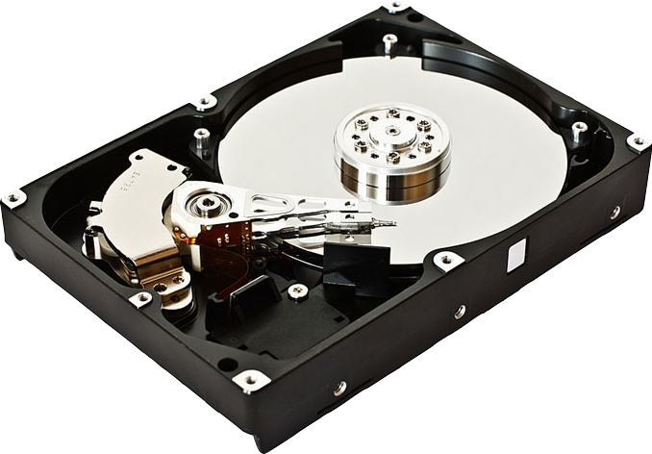
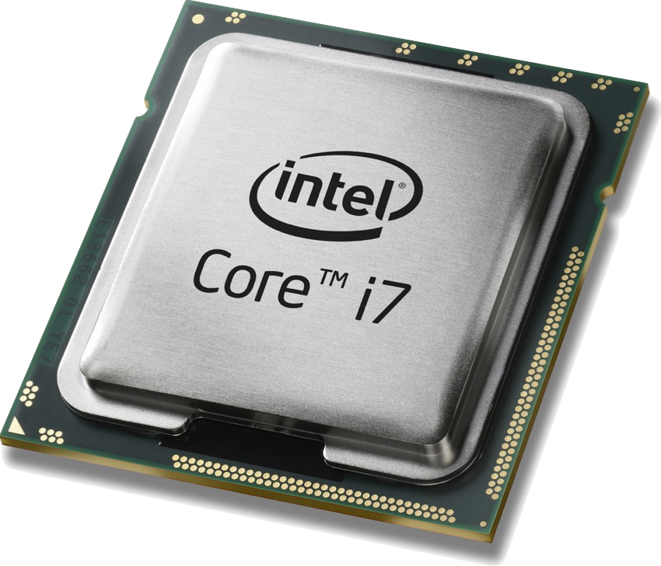
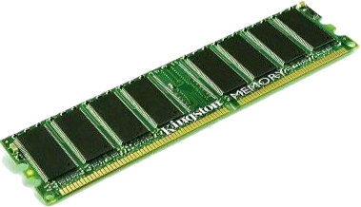
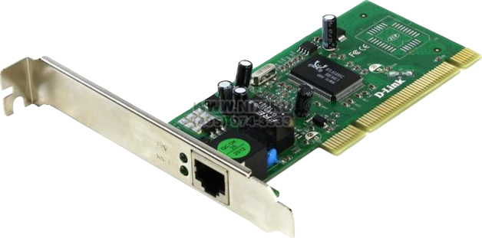
The cloud could be simply rented infrastructure ...
Storage
Processing
Memory
Network
Proprietary + Confidential
Notes:
But if you use it simply as rented infr, you are missing the point

Slide 5
Demo:
Compute Engine
Notes:
Start a compute engine instance, talk them through OS, disk, cpu/gpu, …
Ssh into machine
Sudo apt-get install python-pip
Say … your machine. You can do anything
Stop the machine
Say you can always restart it.
Or if you want to do something cool (this ends up processing USGS earthquake data):
https://github.com/GoogleCloudPlatform/training-data-analyst/blob/master/courses/bdml_fundamentals/demos/earthquakevm/README.md

Slide 6

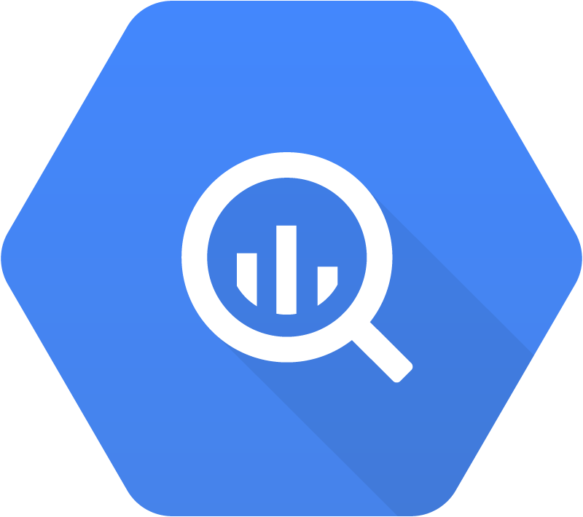

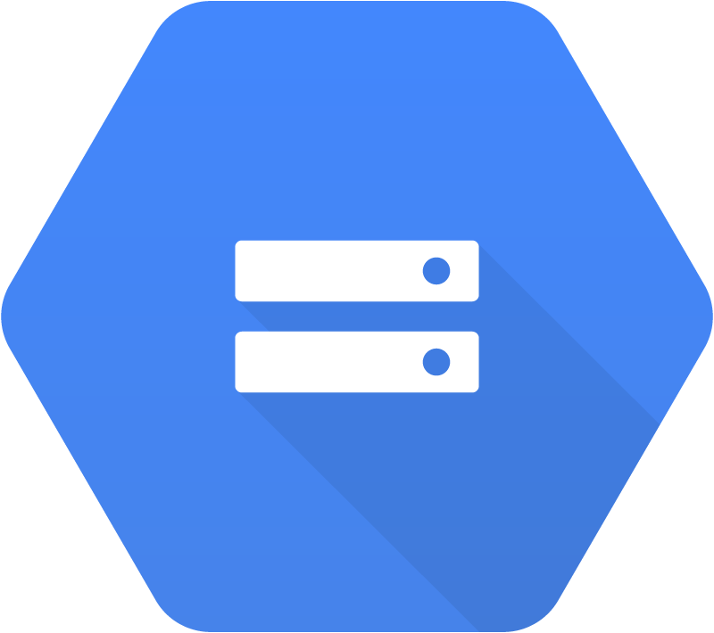

Cloud computing is more powerful and less expensive if you take advantage of:
Data in-place
Serverless compute
Autoscaled clusters
Preemptible VMs
Processing
Good for raster, unstructured datasets
Good for
structured datasets
Spark
workloads
Cloud Dataflow
BigQuery Analytics
Cloud
Dataproc
Cloud Storage
(files)
BigQuery Storage
(tablets)
Cloud Bigtable
(NoSQL)
Data Lake
Data Warehouse
IoT
Storage

Slide 7
BigQuery
02
Notes:
To show you what I mean ...

Slide 8
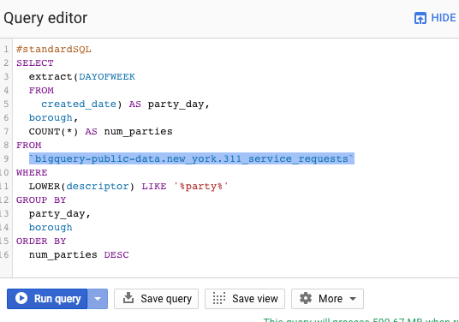

Data Analytics using distributed SQL
Ad-hoc SQL queries TBs in secs
Unique
Real-time analytics on streaming data
Unique
Built-in ML and GIS
Unique
Fully managed and serverless
Unique

Slide 9
Demo:
BigQuery
https://github.com/GoogleCloudPlatform/bigquery-oreilly-book/blob/master/01_intro/queries.txt
Notes:
Go to bigquery
Run:
Walk them through queries in: https://github.com/GoogleCloudPlatform/bigquery-oreilly-book/blob/master/01_intro/queries.txt

Slide 10
BigQuery ML
The data stays in place,
Query distributed over 1000s of workers
create or replace model models.will_buy_banana_example
options(model_type='logistic_reg', input_label_cols=['banana']) AS
with purchases_data AS (
select
CAST(user_id AS string) customer_id,
CAST(zip_code AS string) home_zipcode,
['dawn', 'morning', 'afternoon', 'night'][OFFSET(CAST (TRUNC(order_hour_of_day/6) AS INT64))] AS time_of_day,
(SELECT 24852 IN (SELECT product_id FROM UNNEST(order_lines))) AS banana
FROM operations.orders_with_lines
JOIN operations.customers_loyalty
ON user_id = id
)
select * from purchases_data
Notes:
Show them running this model

Slide 11
Cloud computing is more powerful and less expensive if you take advantage of:
Data in-place
Serverless compute
Autoscaled clusters
Preemptive VMs
Processing
Good for raster, unstructured datasets
Good for
structured datasets
Spark
workloads
Cloud Dataflow
BigQuery Analytics
Cloud
Dataproc
Cloud Storage
(files)
BigQuery Storage
(tablets)
Cloud Bigtable
(NoSQL)
Data Lake
Data Warehouse
IoT
Storage

Slide 12
Notebooks
Keras/TensorFlow
GPU/TPU
03
Notes:
To show you what I mean ...

Slide 13
Demo:
Notebooks + Keras + GPU/TPU
https://github.com/GoogleCloudPlatform/training-data-analyst/blob/master/courses/fast-and-lean-data-science/07_Keras_Flowers_TPU_solution.ipynb
Notes:
Start a AI Platform Notebook instance with a GPU
Show flowers classification:
https://github.com/GoogleCloudPlatform/training-data-analyst/blob/master/courses/fast-and-lean-data-science/07_Keras_Flowers_TPU_solution.ipynb

Slide 14
Dataflow
04
Notes:
To show you what I mean ...

Slide 15
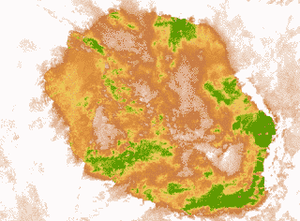
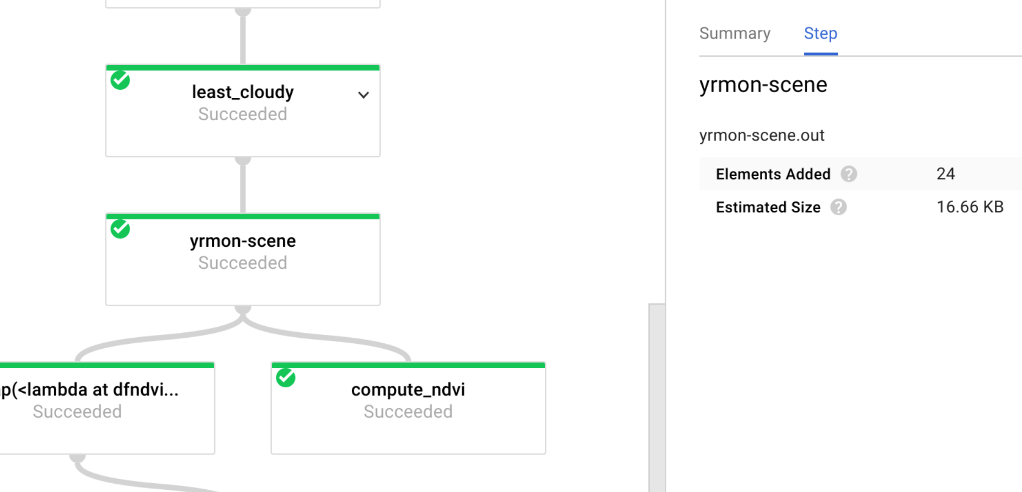
Distributed processing of geo-imagery on GCP
Read this blog post on what this pipeline does
Notes:
Consider using Apache Beam on Cloud Dataflow to scale out compute-intensive jobs that meet these characteristics:
Your data is not tabular and you can not use SQL to do the analysis. (If it is tabular, use BigQuery).
Large portions of the job are embarrassingly parallel -- in other words, you can process different subsets of the data on different machines.
Your logic involves custom functions, iterations, etc..
The distribution of the work varies across your data subsets.
Read this blog post on what this pipeline does, why it does it that way, and what the results look like.

Slide 16
Demo:
Dataflow
https://github.com/GoogleCloudPlatform/training-data-analyst/tree/master/blogs/landsat
this blog post
Notes:
Walk through dfndvi.py and run_oncloud.sh
https://github.com/GoogleCloudPlatform/training-data-analyst/tree/master/blogs/landsat
Then show graphs & pics from this blog post

Slide 17
Cloud computing is more powerful and less expensive if you take advantage of:
Data in-place
Serverless compute
Autoscaled clusters
Preemptive VMs
Processing
Good for raster, unstructured datasets
Good for
structured datasets
Spark
workloads
Cloud Dataflow
BigQuery Analytics
Cloud
Dataproc
Cloud Storage
(files)
BigQuery Storage
(tablets)
Cloud Bigtable
(NoSQL)
Data Lake
Data Warehouse
IoT
Storage

Slide 18
Colab
+
Earth Engine
05
Notes:
To show you what I mean ...

Slide 19

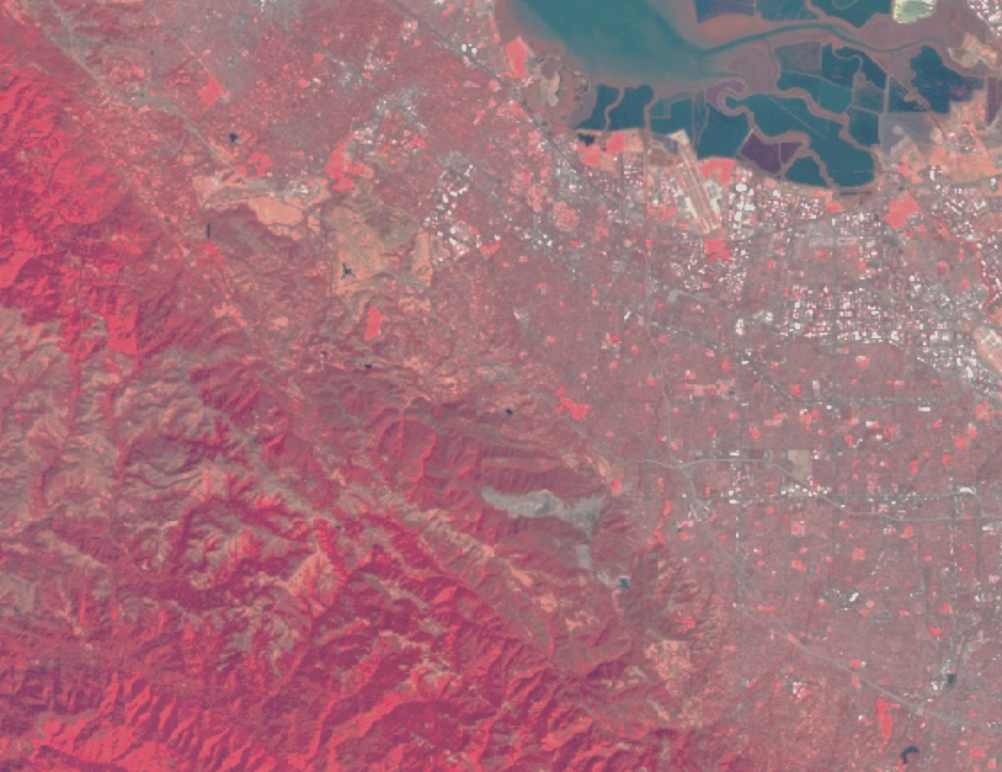
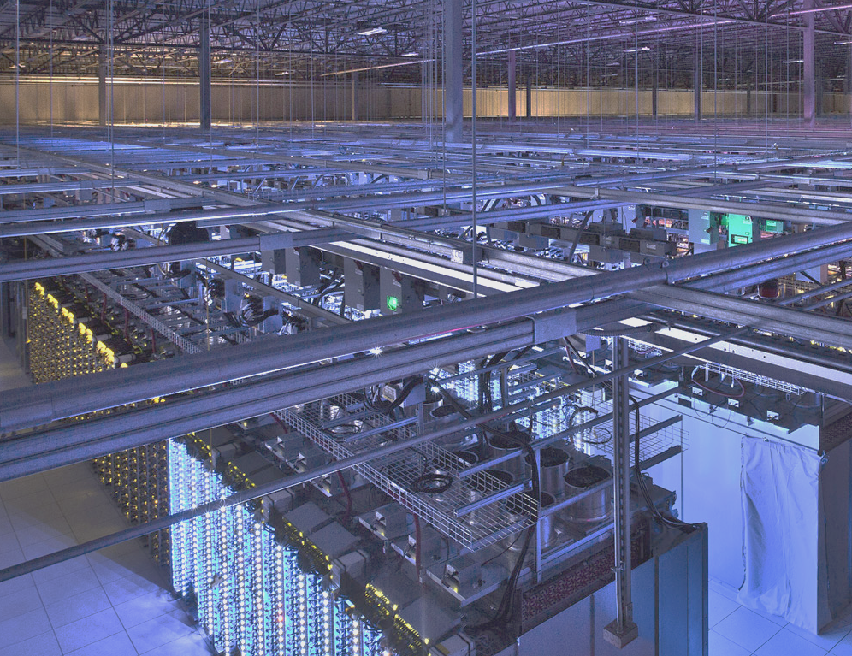
A Data Catalog
The world's best archive of satellite imagery and other geospatial data at your fingertips
A Computation Platform
A revolutionary new tool to analyze and visualize geospatial data at scale

Slide 20
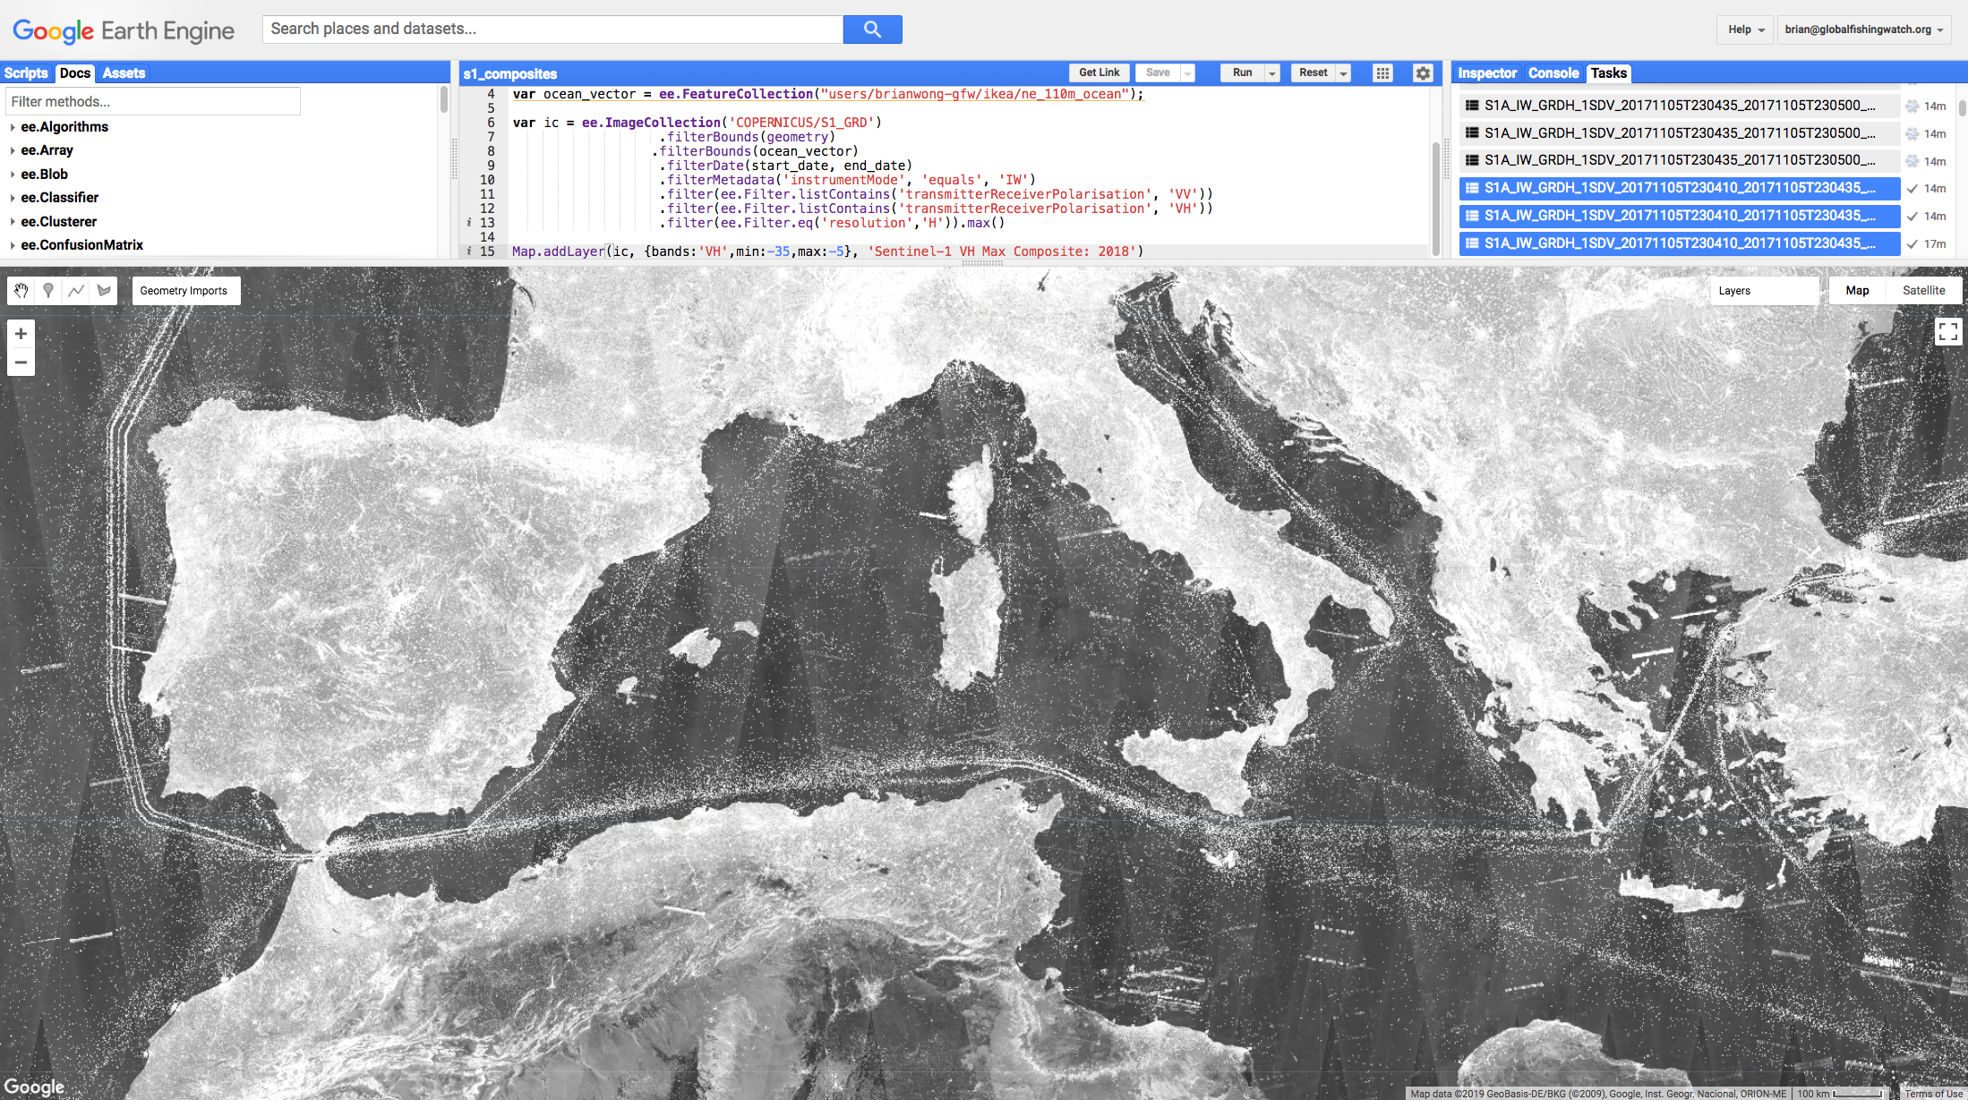
Share your code
Interactively develop
and run analyses
Code editor
Process at global scale using Google Earth Engine
Notes:
GEE instant access to S1

Slide 21
Demo:
Colab +
Earth Engine
https://colab.sandbox.google.com/github/google/earthengine-api/blob/master/python/examples/ipynb/TF_demo1_keras.ipynb
Notes:
https://colab.sandbox.google.com/github/google/earthengine-api/blob/master/python/examples/ipynb/TF_demo1_keras.ipynb

Slide 22
Choose your own adventure
06
Notes:
To show you what I mean ...

Slide 23
Summary
Demos
Compute Engine (the old way)
BigQuery (large-scale structured data processing)
Jupyter + Keras/TensorFlow (ML)
Dataflow (large-scale unstructured data processing)
Colab + Earth Engine (large-scale ML)
Hands-on labs (choose your adventure)

Slide 24
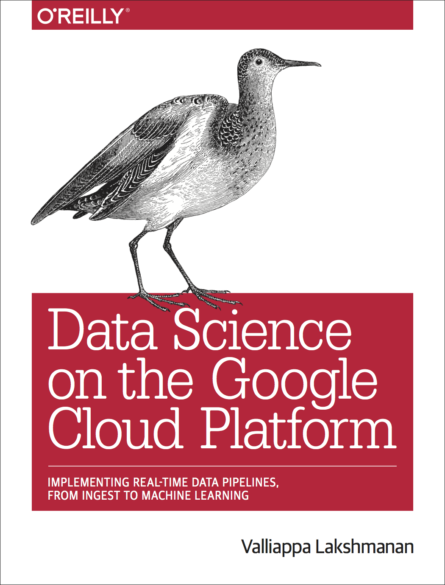
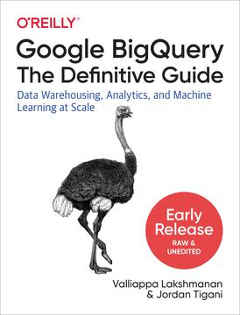
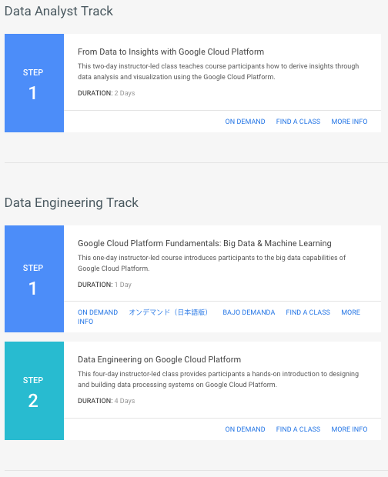
To learn more ...
http://bitly.com/science-data-ml
http://bit.ly/2DrCyXc
(to get 1 month free)

Slide 25
Open an incognito window
Visit: https://www.qwiklabs.com/quests/28
Join Qwiklabs if you don’t already have an account
(Go back to https://www.qwiklabs.com/quests/28)
Pick a lab, and enter access code to get it free
Follow the directions ...

