Slide 1


Atmospheric Chemistry Modeling and Air Quality Forecasting using Machine Learning
Christoph A. Keller
NASA Global Modeling and Assimilation Office (GMAO)
Universities Space Research Association (USRA)
Mat J. Evans
Wolfson Atmospheric Chemistry Laboratories, University of York
National Centre for Atmospheric Sciences, University of York
1st NOAA Workshop on Leveraging AI
23-25 April 2019

Slide 2

Air pollution is a global problem
World Bank: ~$5 trillion
in welfare losses in 2013
The Lancet (2017): Air pollution is responsible for 6-7 millions death / year
christoph.a.keller@nasa.gov

Slide 3
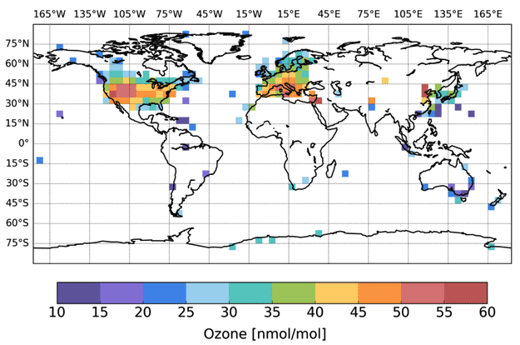
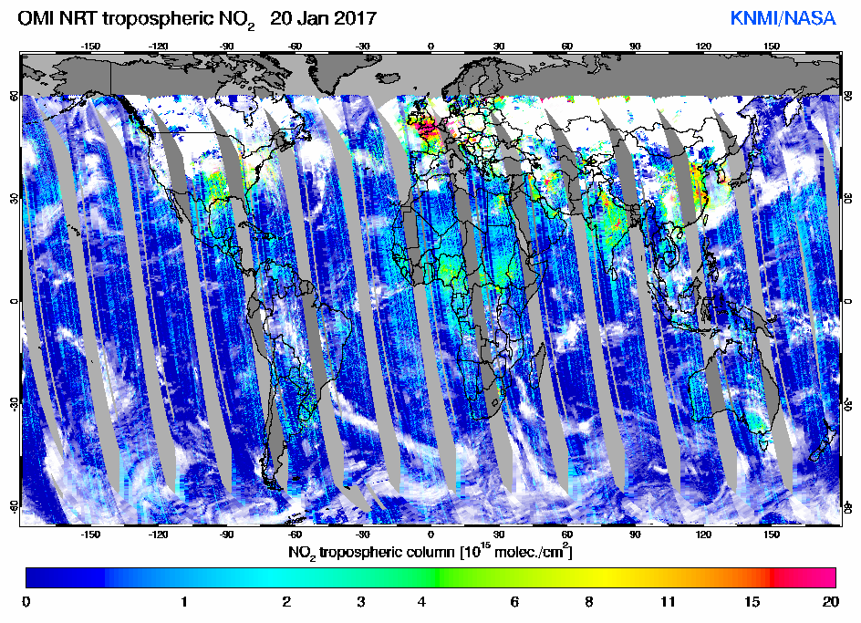
Need models to fill gaps in observations
TOAR (Schulz et al., 2017)
Surface observations are not global
Satellite observations are also discontinous
christoph.a.keller@nasa.gov

Slide 4
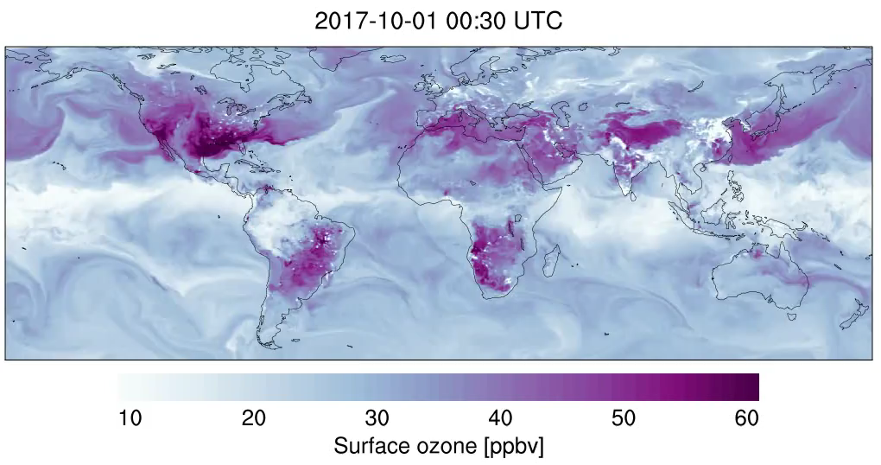
Numerical simulation of atmospheric chemistry
0.25° resolution (~ 25km), 72 levels, 250 chemical species
christoph.a.keller@nasa.gov

Slide 5
Numerical simulation of atmospheric chemistry
Initialize
Transport
Emissions
Sub-grid
Photolysis
Chemical Integrator
Deposition
Diagnostics
christoph.a.keller@nasa.gov

Slide 6
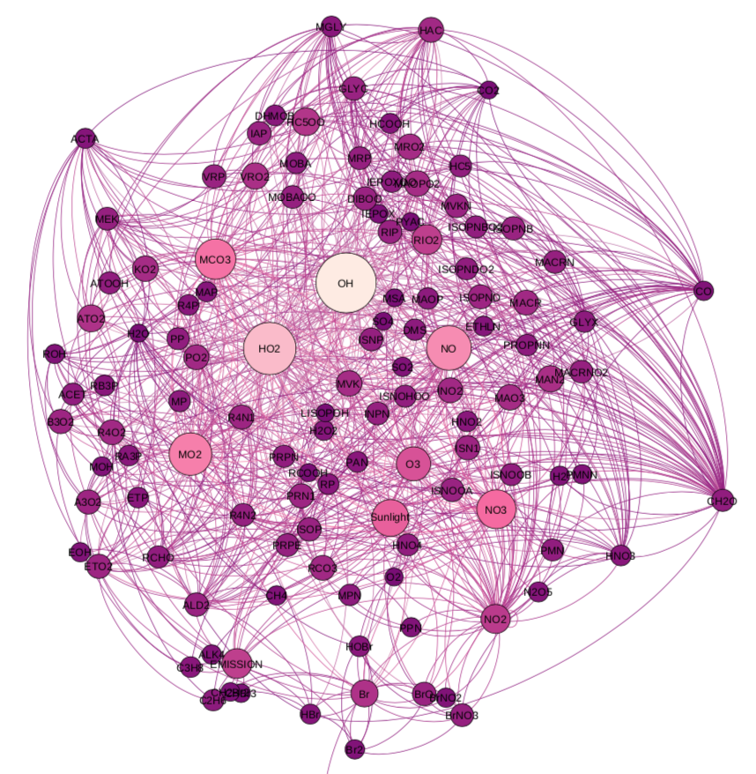
Numerical simulation of atmospheric chemistry
Initialize
Transport
Emissions
Sub-grid
Photolysis
Chemical Integrator
Deposition
Diagnostics
christoph.a.keller@nasa.gov

Slide 7
Numerical simulation of atmospheric chemistry
Initialize
Transport
Emissions
Sub-grid
Photolysis
Chemical Integrator
Deposition
Diagnostics
christoph.a.keller@nasa.gov

Slide 8
Numerical simulation of atmospheric chemistry
Initialize
Transport
Emissions
Sub-grid
Photolysis
Chemical Integrator
Deposition
Diagnostics
christoph.a.keller@nasa.gov

Slide 9
Atmospheric chemistry models are computationally expensive
4x
High-resolution chemistry simulation requires >1000 CPU’s
Throughput: approx. 20 days in 24 hours
www.nccs.nasa.gov
christoph.a.keller@nasa.gov

Slide 10
Atmospheric chemistry models are computationally very expensive
4x
Courtesy of W. Putman, NASA GMAO
High-resolution chemistry simulation requires >1000 CPU’s
Can simulate approx. 20 days in 24 hours
Outputting the full chemical state is 1.5 TB / simulation day
www.nccs.nasa.gov
christoph.a.keller@nasa.gov

Slide 11
Replace chemical integrator with machine learning model
christoph.a.keller@nasa.gov

Slide 12
Replace chemical integrator with machine learning model
christoph.a.keller@nasa.gov

Slide 13
Replace chemical integrator with machine learning model
christoph.a.keller@nasa.gov

Slide 14
Machine learning for atmospheric chemistry modeling
Separate model
for each species
143 chemical species
91 photolysis rates
Temperature
Pressure
Rel. humidity
Solar zenith angle
Concentrations
after chemistry
Ozone
Nitrogen oxides
Training data set: 2.7 billion data points (44 GB)
Tested: (neural network), random forest and XGBoost
etc.
christoph.a.keller@nasa.gov

Slide 15
Many input features have multiple modes
christoph.a.keller@nasa.gov

Slide 16
Impose chemical constraints on ML model to improve (long-term) accuracy
1. Distinguish between short-term vs. long-term species
Long-lived (tendencies): [X_{i}]_{T+△T} = [X_{i}]_{T} + f( k, J, [X] )
Short-lived (steady state): [X_{i}]_{T+△T} = f( k, J, [X] )
2. Predict NO + NO₂ combined (NOx family approach)
NO
VOC / HO_{x}
O_{x} (Ozone)
NO₂
christoph.a.keller@nasa.gov

Slide 17
Neural network has weaker performance than tree methods
Courtesy of J. Zhuang, M. Kelp (Harvard)
2 hidden layers, 300 neurons each
Normalization? Split mechanism (e.g. day/night)?
christoph.a.keller@nasa.gov

Slide 18
Random forest / XGBoost training benchmarks
christoph.a.keller@nasa.gov

Slide 19
Random forest / XGBoost training benchmarks
christoph.a.keller@nasa.gov

Slide 20
Random forest / XGBoost training benchmarks
christoph.a.keller@nasa.gov

Slide 21
Random forest / XGBoost training benchmarks
christoph.a.keller@nasa.gov

Slide 22
Random forest / XGBoost reproduce target concentrations well (single-step prediction)
christoph.a.keller@nasa.gov

Slide 23
Random forest / XGBoost reproduce target concentrations well (single-step prediction)
christoph.a.keller@nasa.gov

Slide 24
Random forest / XGBoost solutions reflect known features of chemical kinetics
christoph.a.keller@nasa.gov

Slide 25
Random forest / XGBoost solutions reflect known features of chemical kinetics
NOx chemistry
christoph.a.keller@nasa.gov

Slide 26
Random forest / XGBoost solutions reflect known features of chemical kinetics
NOx chemistry
VOC chemistry
christoph.a.keller@nasa.gov

Slide 27
Random forest / XGBoost solutions reflect known features of chemical kinetics
NOx chemistry
VOC chemistry
Photolysis
christoph.a.keller@nasa.gov

Slide 28
1-month simulation with random forest emulator
christoph.a.keller@nasa.gov

Slide 29
Random forest overestimates ozone surface concentrations over remote regions
christoph.a.keller@nasa.gov

Slide 30
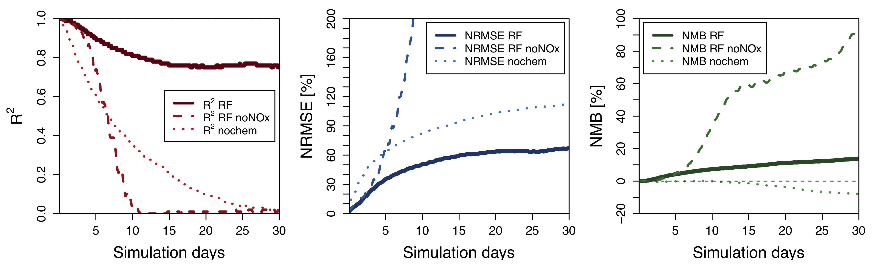
Machine learning model remains stable over the long-term (but only if NOx is predicted as a family)
Model with NOx family prediction
Model without NOx family prediction
christoph.a.keller@nasa.gov

Slide 31
Surface concentrations over polluted regions are well reproduced by ML model
christoph.a.keller@nasa.gov

Slide 32
Speedup potential
Offline evaluation of single forest is 1000x faster than numerical integration
Current implementation is very inefficient (2x slower than full chemistry)
Currently working on seamless integration of XGBoost
christoph.a.keller@nasa.gov

Slide 33
Summary
Tree models do a decent job at simulating atmospheric chemistry
Adding constraints (e.g., chemical families) to the machine learning model is critical
Potential applications:
  Chemical data assimilation
  (Short-term) air quality forecasting
Issues:
  Train on very large data sets (>1 TB)
  Dynamics for >200 chemical species is still slow
Keller and Evans: Application of random forest regression to the calculation of gas-phase chemistry within the GEOS-Chem chemistry model v10, GMD, 2019.
christoph.a.keller@nasa.gov

Slide 34
christoph.a.keller@nasa.gov

Slide 35
Prediction of NOx
christoph.a.keller@nasa.gov

Slide 36
Surface concentrations over polluted regions are well reproduced by ML model
christoph.a.keller@nasa.gov

