Slide 1
Nonlinear Wave Ensemble Averaging using Neural Networks
Ricardo M. Campos
riwave@gmail.com
"Improving Global Wind-Wave Probabilistic Forecasts and Products Beyond Week 2"
Award Number: NA16NWS4680011
Vladimir Krasnopolsky, Jose-Henrique Alves, Steve Penny, Ricardo Martins Campos.

Slide 2
Outline
Quick introduction to GWES
MLP Neural Networks applied to non-linear ensemble averaging
First tests at single locations
  NN Architectures
  Tests with number of neurons, normalization etc
  Error as a function of Forecast time and Severity (Percentiles)
NN spatial approach
  NN Training Strategy
  Spatial Distribution of Wind and Wave Climates
  Assessment of GWES using NDBC buoys and Altimeters
  Large sensitivity test: number of neurons, initialization, filtering
  (1) GoM and (2) Global

Slide 3
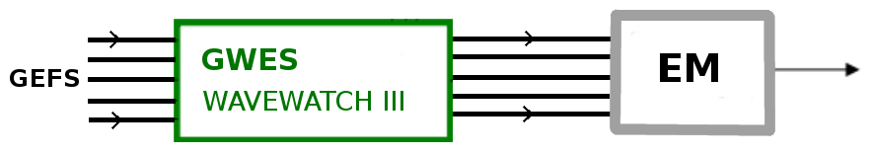
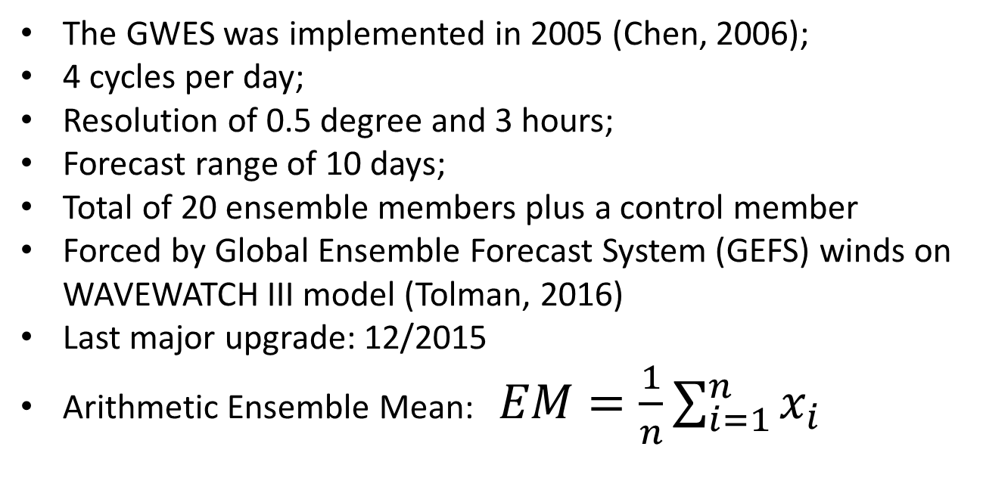
Global Wave Ensemble System (GWES)
The GWES was implemented in 2005 (Chen, 2006);
4 cycles per day;
Resolution of 0.5 degree and 3 hours;
Forecast range of 10 days;
Total of 20 ensemble members plus a control member
Forced by Global Ensemble Forecast System (GEFS) winds on WAVEWATCH III model (Tolman, 2016)
Last major upgrade: 12/2015
Arithmetic Ensemble Mean: $EM=\frac{1}{n}\sum_{i=1}^{n}{x_{i}}$

Slide 4
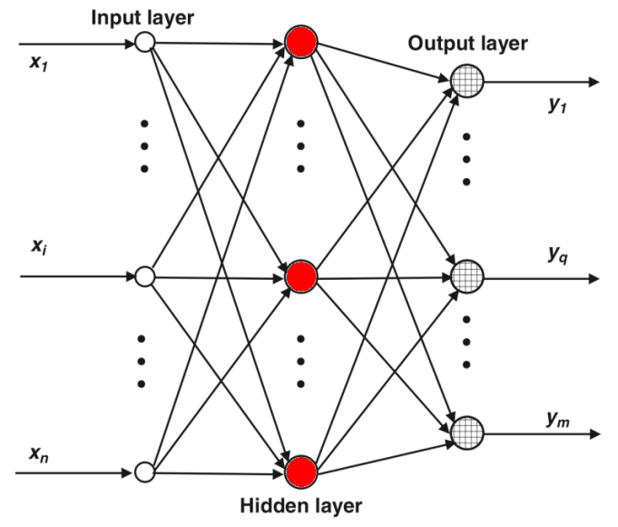
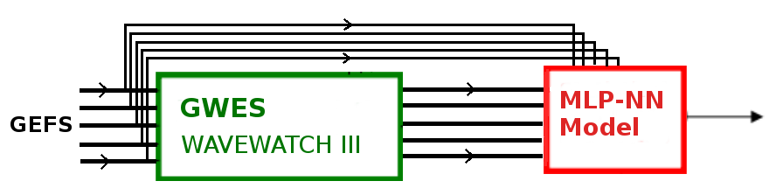
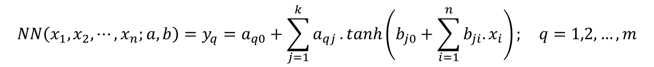
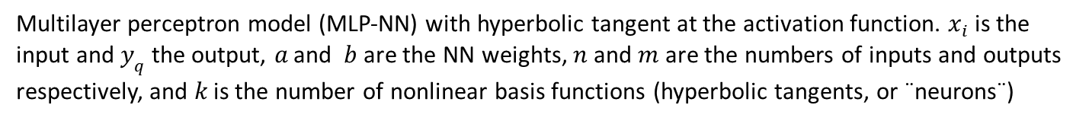
MLP Neural Networks
Multilayer perceptron model (MLP-NN) with hyperbolic tangent at the activation function. $x_{i}$ is the input and $y_{q}$ the output, $a$ and $b$ are the NN weights, $n$ and $m$ are the numbers of inputs and outputs
respectively, and $k$ is the number of nonlinear basis functions (hyperbolic tangents, or ¨neurons¨)
$$NN\left(x_{1},x_{2},⋯,x_{n};a,b\right)=y_{q}=a_{q0}+\sum_{j=1}^{k}{a_{qj}}.tanh\left(b_{j0}+\sum_{i=1}^{n}{b_{ji}.x_{i}}\right); q=1,2,…,m$$
AI techniques provide a number of advantages, including easily generalizing spatially and temporally, handling large numbers of predictor variables, integrating physical understanding into the models, and discovering additional knowledge from the data (McGovern et al., 2017).
Constructed based on Haykin (1999), Krasnopolsky (2013), and Krasnopolsky and Lin (2012)
NNs have been used in a wide variety of meteorology applications since the late 1980s (Key et al. 1989), from cloud classification (Bankert 1994), tornado prediction and detection (Marzban and Stumpf 1996; Lakshmanan et al. 2005), damaging winds (Marzban and Stumpf 1998), hail size, precipitation classification, tracking storms (Lakshmanan et al. 2000), and radar quality control (Lakshmanan et al. 2007; Newman et al. 2013).

Slide 5
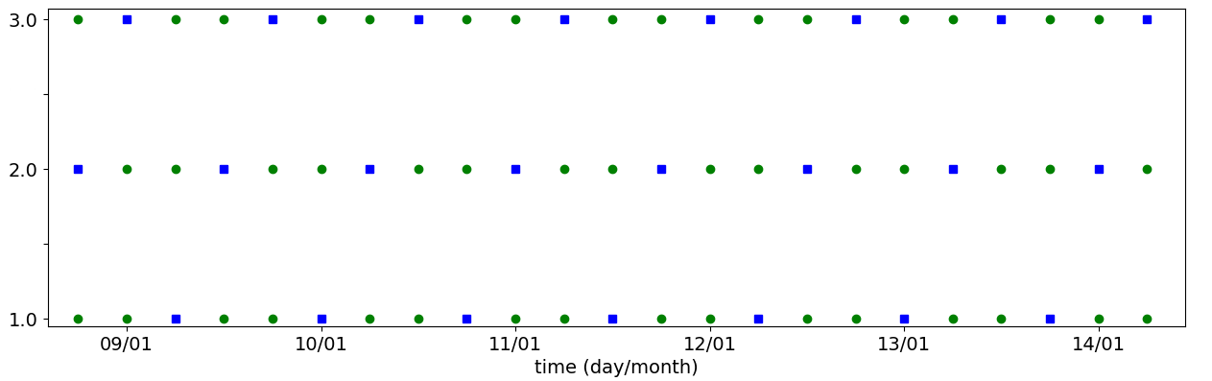
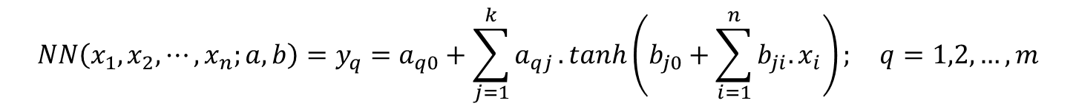
MLP Neural Networks
$$NN\left(x_{1},x_{2},⋯,x_{n};a,b\right)=y_{q}=a_{q0}+\sum_{j=1}^{k}{a_{qj}}.tanh\left(b_{j0}+\sum_{i=1}^{n}{b_{ji}.x_{i}}\right); q=1,2,…,m$$
Input variables: 10-meter wind speed (U10m), significant wave height (Hs), peak wave period (Tp), mean period, wave height of wind-sea, wave period of wind-sea;
Target variables: U10m, Hs, Tp from measurements;
Evaluated against buoy/altimeter observations during the training process;
21 ensemble members (20 plus the control member) per variable, plus the sin and cosine of time;
Latitude and Longitude (sin,cos) are included as inputs during the regional analyses;
One NN per forecast time / forecast time as new degree of freedom;
Training (2/3) and test set (1/3);
Cross-validation with 3 cycles.

Slide 6
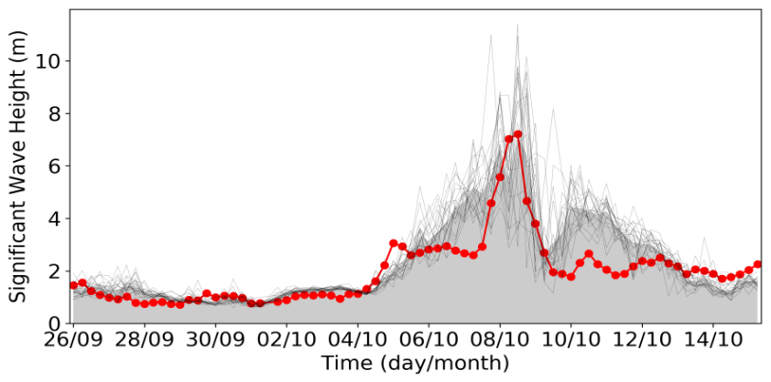
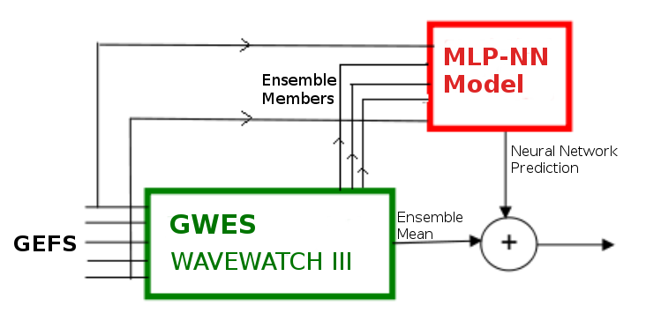
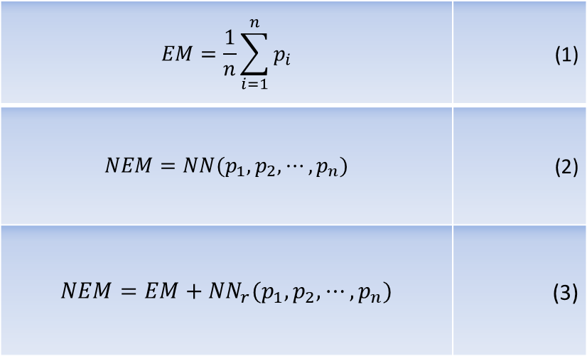
First tests at single locations
¨NNs are never used (or should never be used) for problems that can be solved using linear models¨ (Krasnopolsky, 2014) .
NN models are indicated primarily to nonlinear problems;
NN cannot deteriorate the EM!
Residue (measurements - model) as the target variable
$$EM=\frac{1}{n}\sum_{i=1}^{n}{p_{i}}$$ | (1)
$$NEM=NN(p_{1},p_{2},⋯,p_{n})$$ | (2)
$$NEM=EM+{NN}_{r}(p_{1},p_{2},⋯,p_{n})$$ | (3)

Slide 7
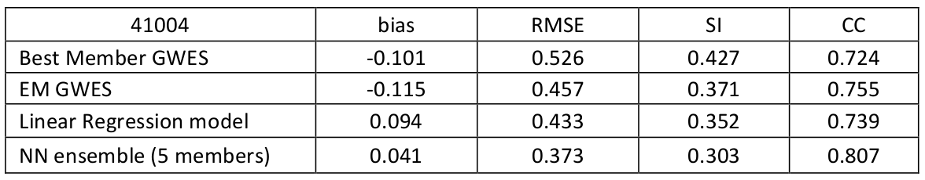
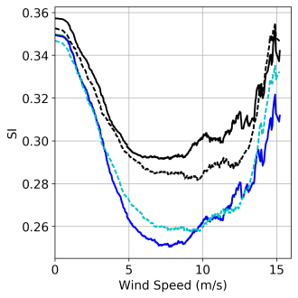
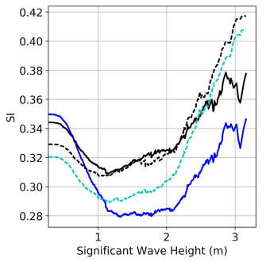
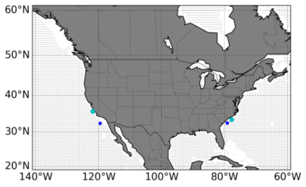
First tests at single locations
The best NN model: 11 neurons at the intermediate layer
Reduction of the error with increasing quantiles.
Results of the NN simulation at the two Atlantic Ocean buoys. Curves of scatter indexes as a function of quantiles; black: arithmetic mean of ensembles (EM); blue: NN-training set (buoy 41004), cyan: NN-validation set (buoy 41013). Solid lines indicate buoy 41004, and dashed lines buoy 41013.

Slide 8
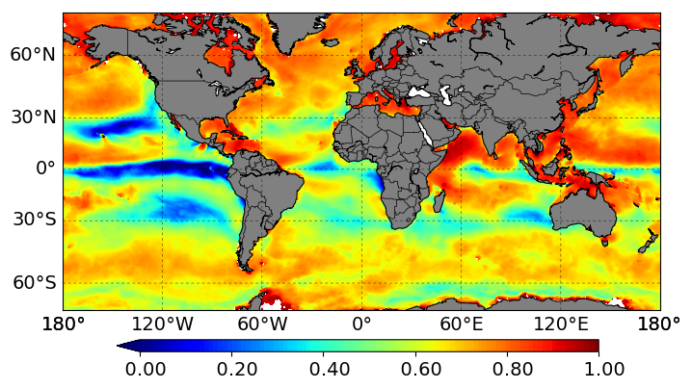

NN spatial approach
Introduction of Lat/Lon as input variables instead of building one NN per grid point;
Increase of NN complexity, Krasnopolsky (2013):
$N_{c}=k.\left(n+m+1\right)+m$
Different wind and wave climates. Correlation Coefficient Map of U10m and Hs

Slide 9
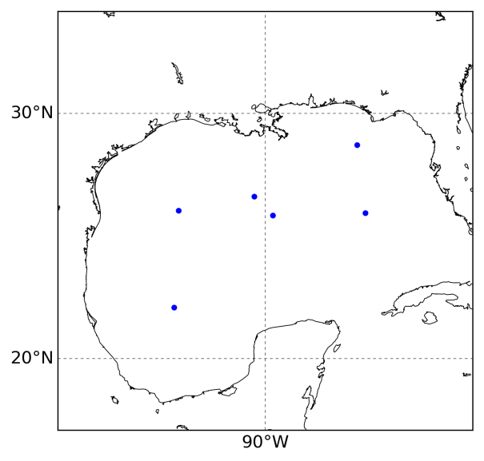
NN spatial approach - GOM
Simulation at the Gulf of Mexico. Sensitivity test:
Total of 12 different numbers of neurons
N [ 2, 5, 10, 15, 20, 25, 30, 35, 40, 50, 80, 200]
8 different filtering windows
FiltW [ 0, 24, 48, 96, 144, 192, 288, 480] hours
100 seeds for the random initialization
Separated NNs for specific forecast days, from Day 0 to Day 10
Total of 105,600 NNs
NN training, 2/3 of inputs were selected for training and 1/3 for the test set, using a cross-validation scheme with 3 cycles
scikit-learn (python) to reduce computational cost
Six buoys appended to build the array with size 7913. NN is using sequential training

Slide 10
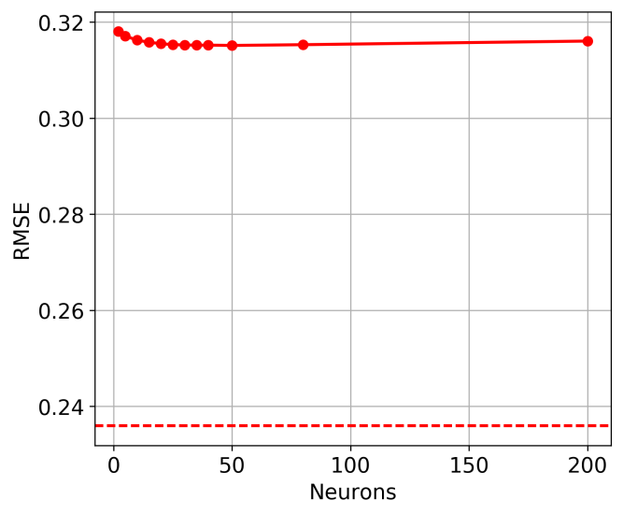
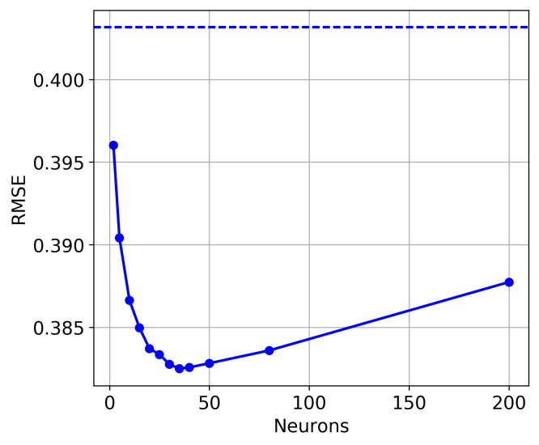
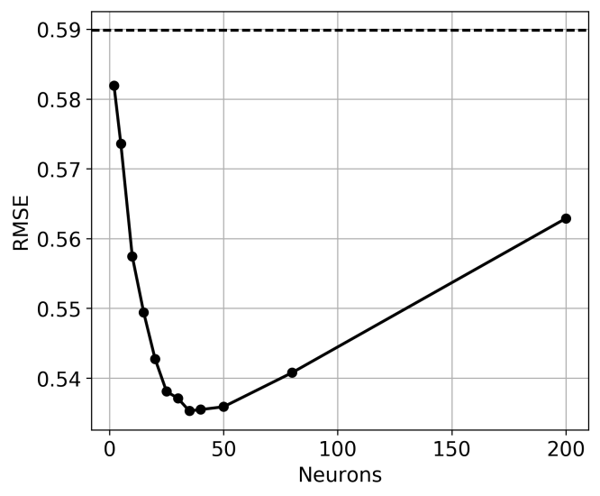
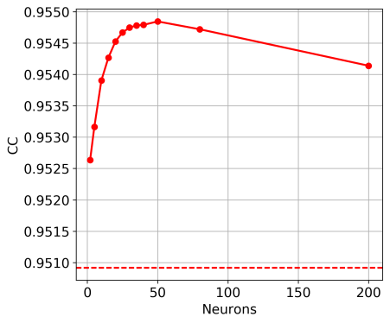
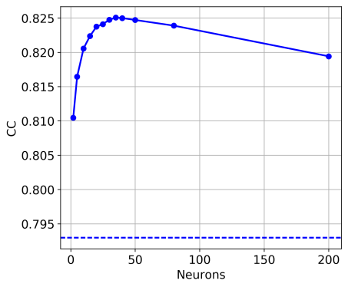
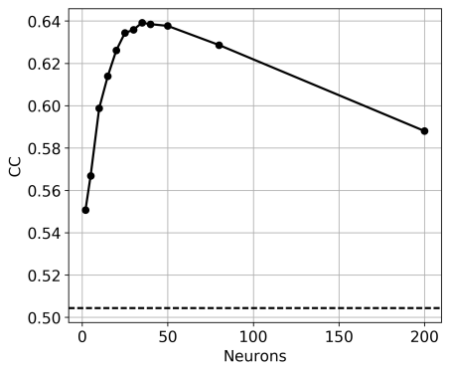
NN spatial approach - GOM
Hs
Day 0
Day 5
Day 10
Figure 9 - NBias, SCrmse, and CC according to equations 5, 8, and 11, resulted from the NN training tests on forecast Day 0

Slide 11
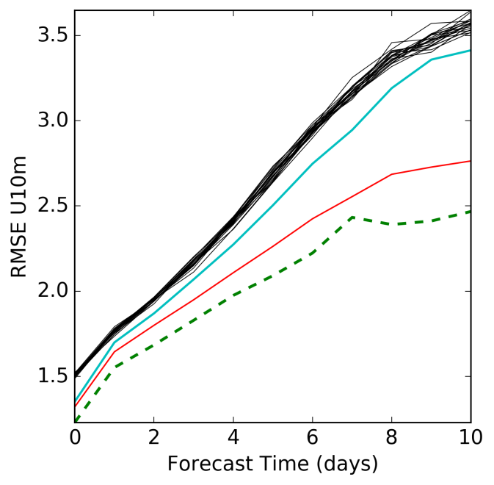
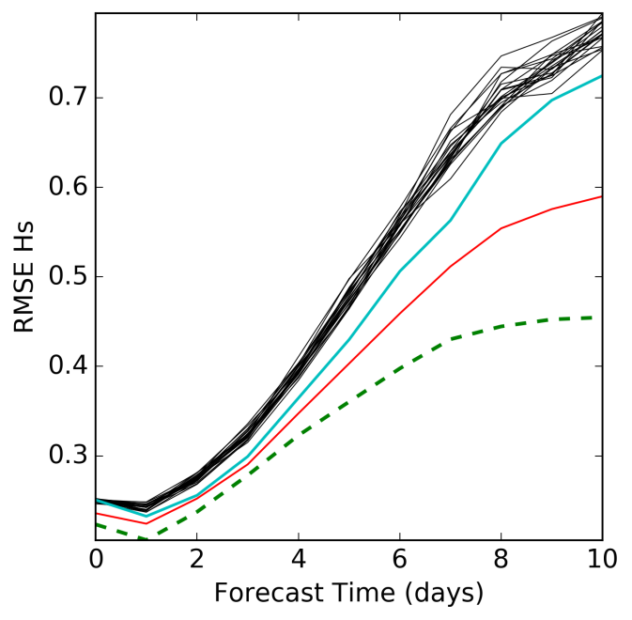
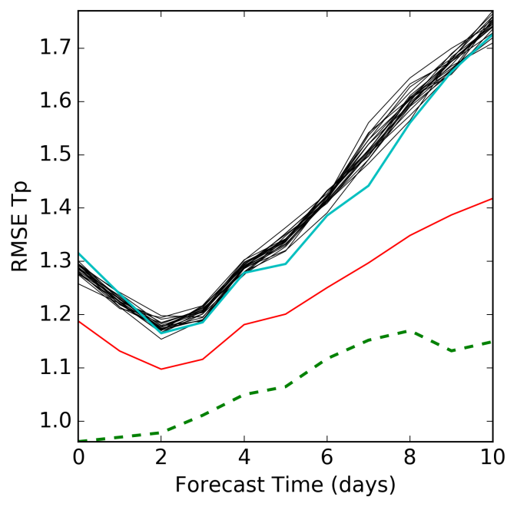
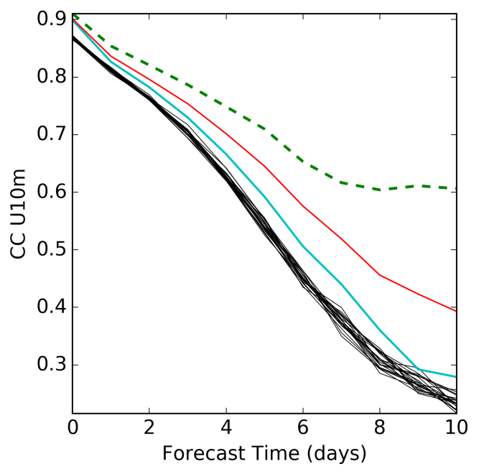
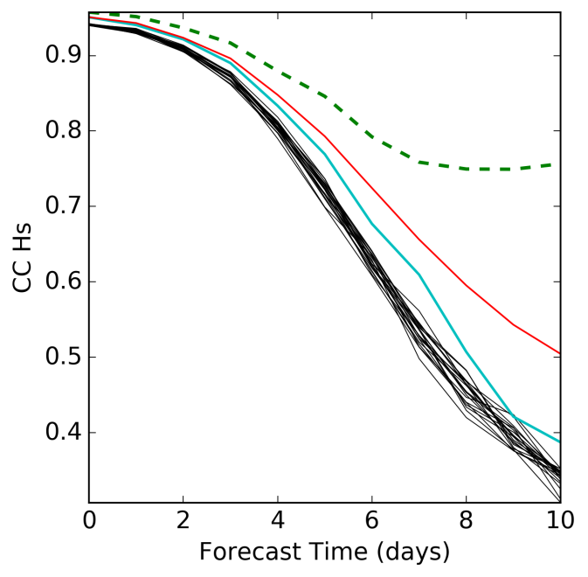
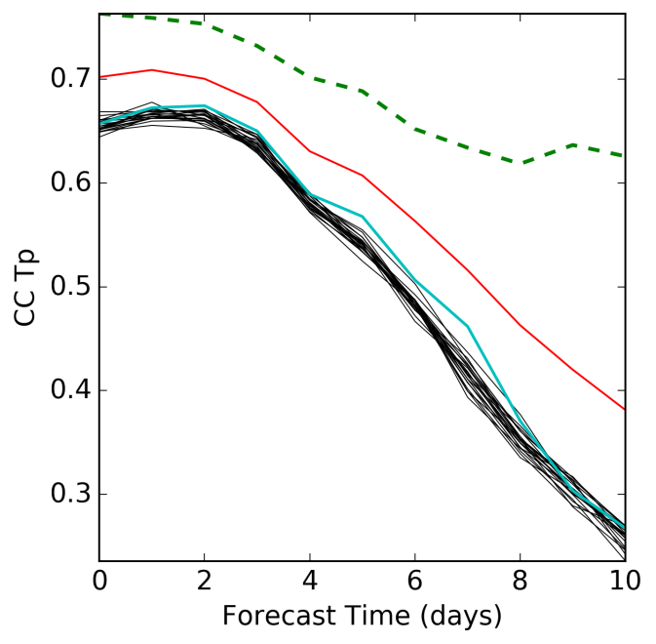
Results: NN spatial approach - GOM
-Black: ensemble members
-Red: ensemble mean
-Cyan: control run
--Green: NN

Slide 12
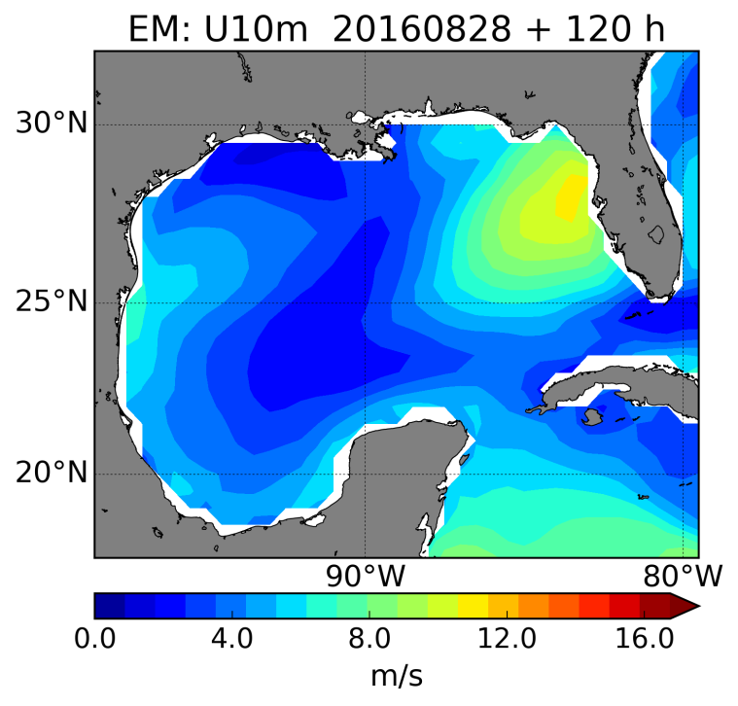
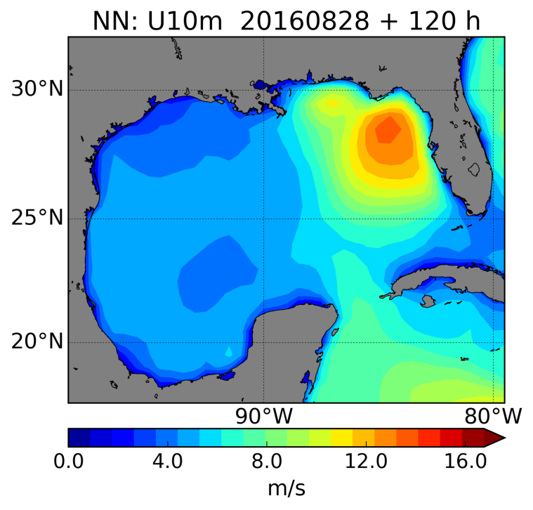
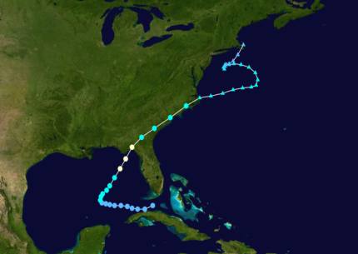
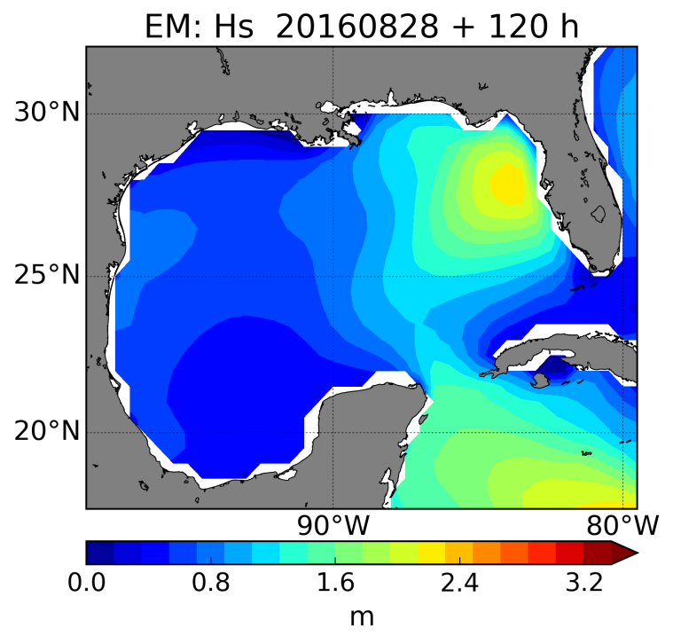
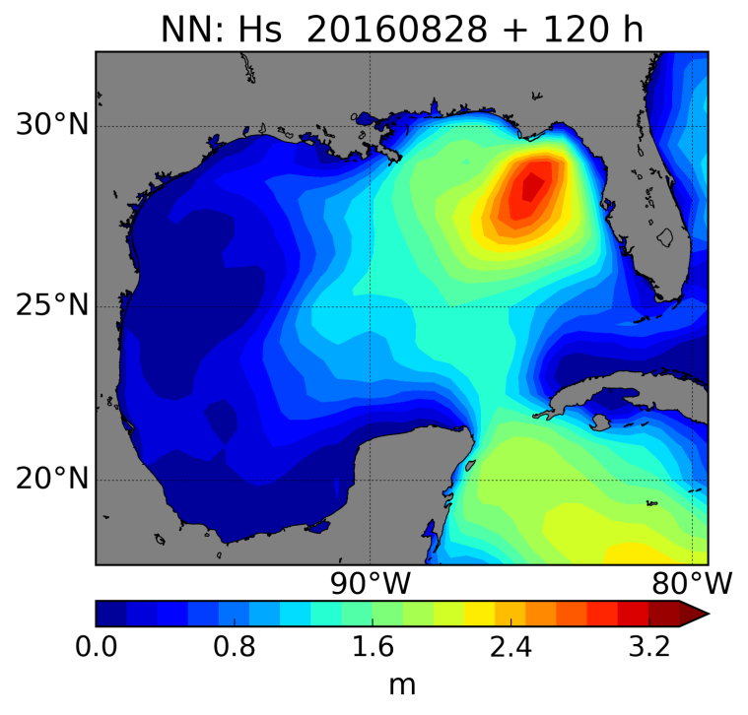
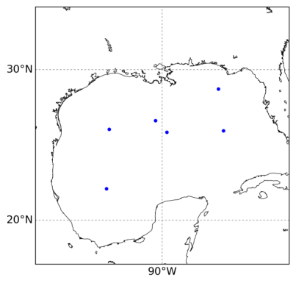
NN spatial approach - GOM
Hurricane Hermine (September 02, 2016 – 00Z)
Highest winds (1-minute sustained): 80 mph (36 m/s)
Lowest pressure: 981 hPa

Slide 13
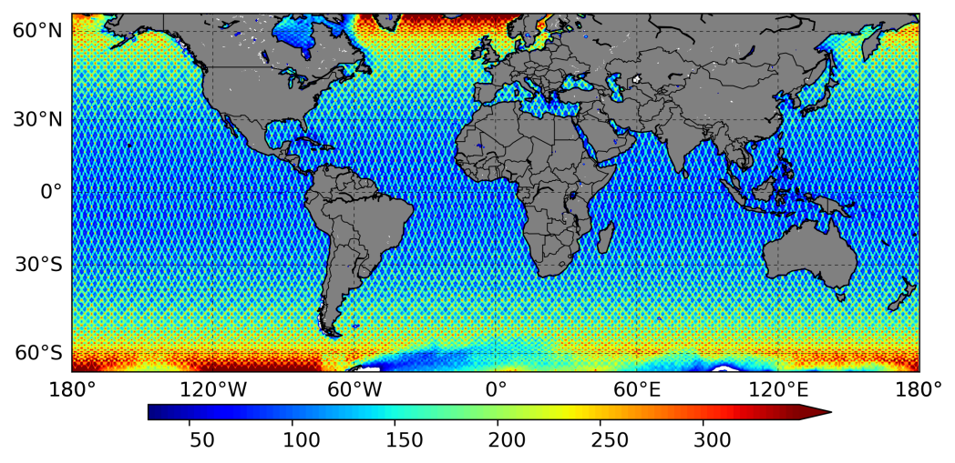
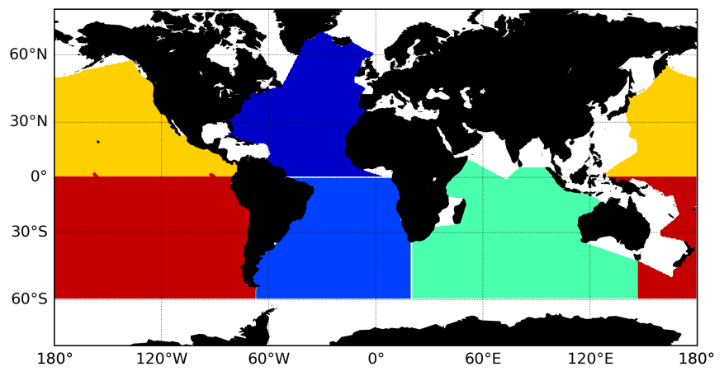
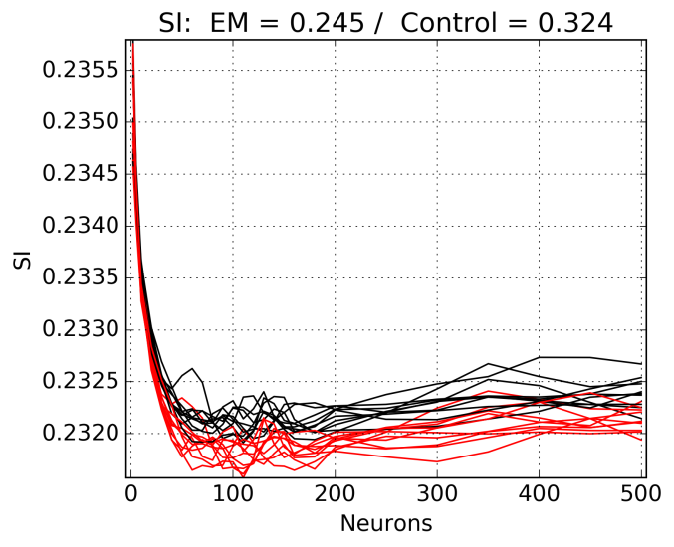
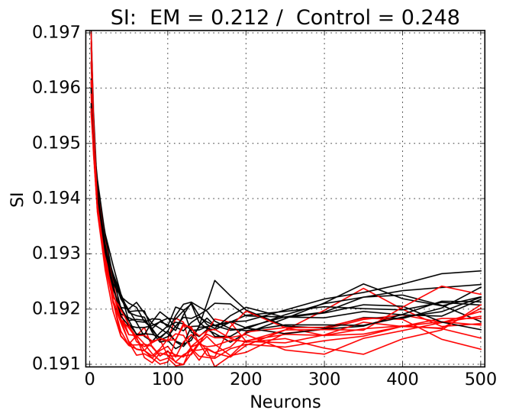
NN spatial approach - Global
NN modeling (whole globe) using altimeter data and joining all forecast times into the training (new degree-of-freedom);
07/2016 – 07/2017
4 satellite missions: 15,993,200 measurements between 60°S and 60°N
26 neurons [2-500], 10 seeds, and 3 datasets: total of 780 NNs
U10
Hs

Slide 14
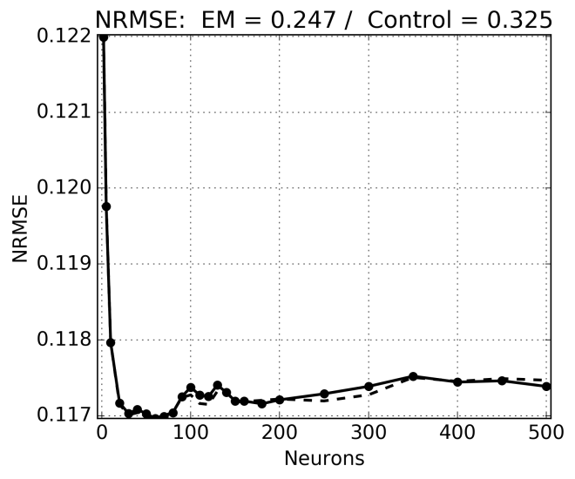
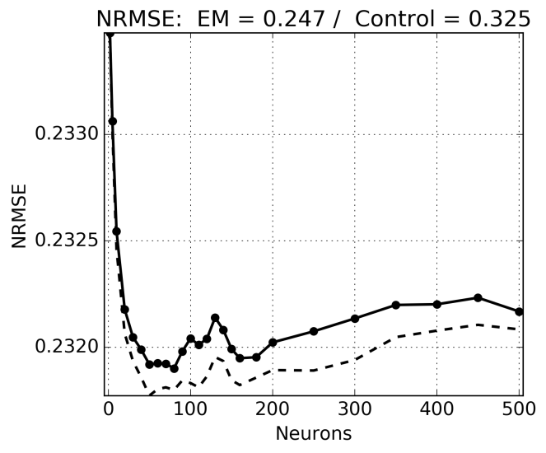
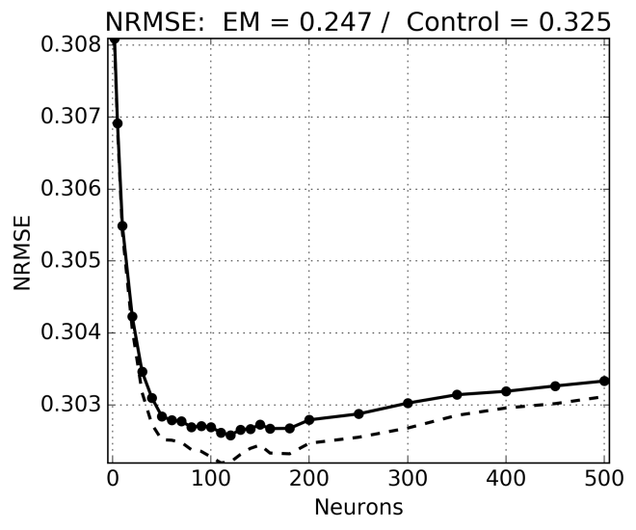
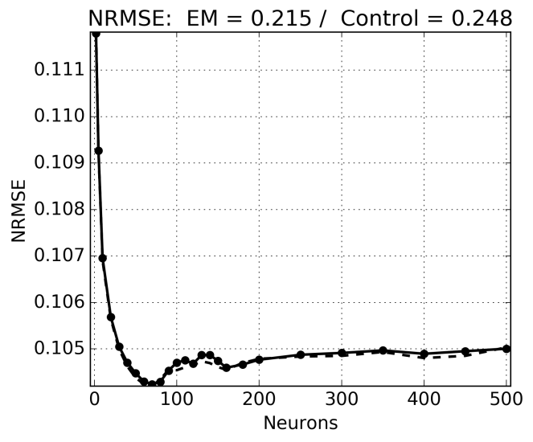
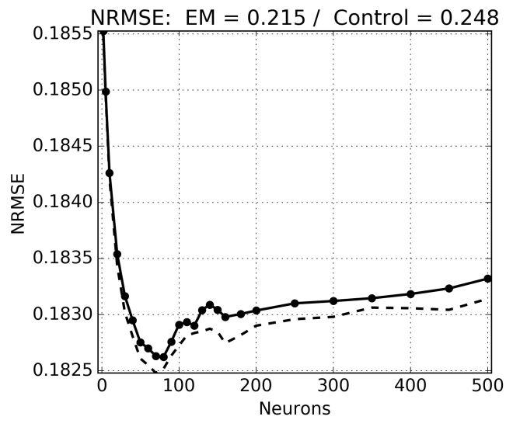
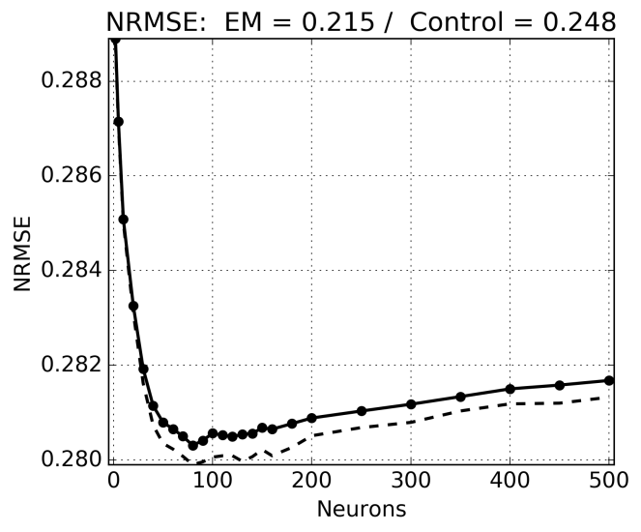
NN spatial approach - Global
Fday 0: sharp decay of the curve; 50 to 80 neurons
Fday 5: second minimum is found around 160 to 180 neurons.
Fday 10: best results using between 120 to 180 neurons. Higher RMSE for NNs with neurons equal to or less than 110.
The increasing scatter error of the surface winds at longer forecast ranges requires more complex NNs. Distance between the NN curves of training and test set.
U10
Day 0
U10
Day 5
U10
Day 10
Hs
Day 0
Hs
Day 5
Hs
Day 10

Slide 15
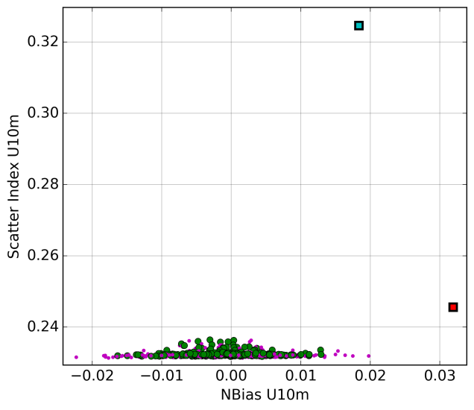
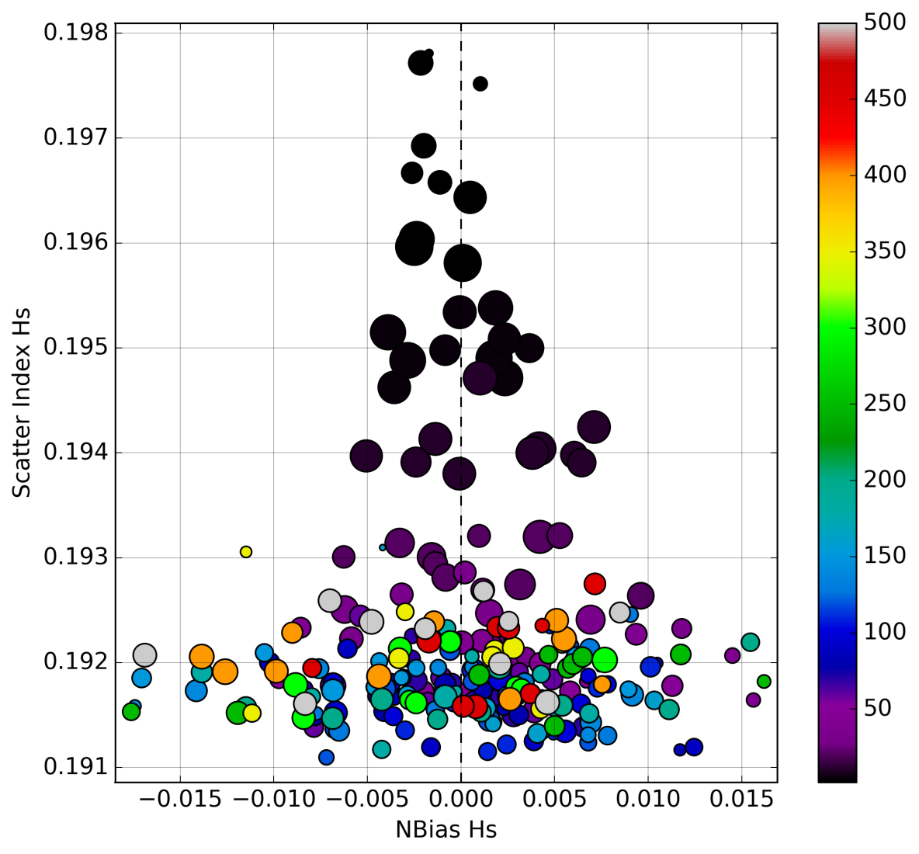
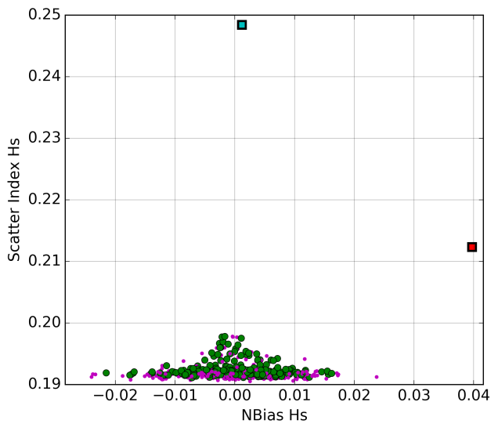
NN spatial approach - Global
Results of 260 NNs, in terms of scatter error (y-axis) and systematic error (x-axis).
Left plots: training set in magenta and test set in green, compared to the control run (red square) and the arithmetic EM (cyan square)
Right plot: zoom-in the test set. Colorbar: number of neurons. Size of dots: normalized standard deviation of scatter error throughout different forecast ranges.

Slide 16
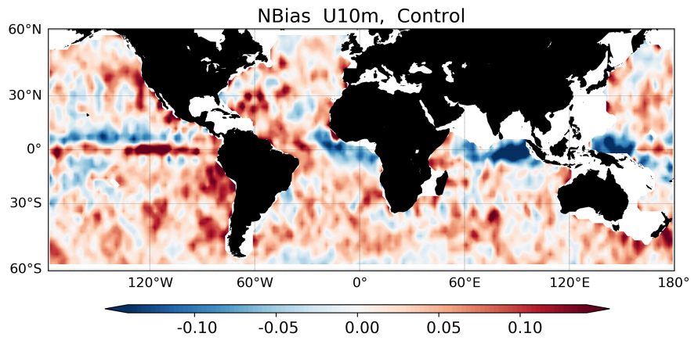
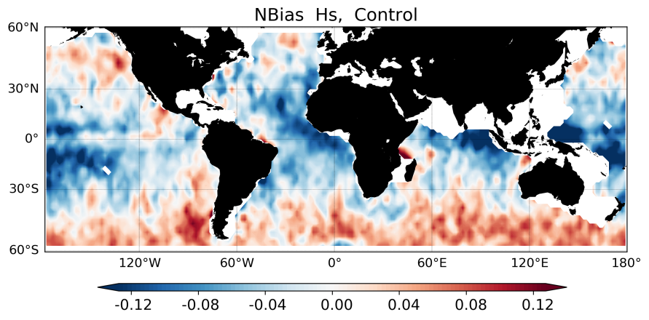




NN spatial approach - Global
“Best” selected based on three steps (ranking and excluding large errors). Final NN containing 140 neurons at the hidden layer. Weights/Biases and normalization parameters saved.

Slide 17


Conclusions
Wave Ensemble: Critical systematic and scatter errors are identified beyond the 6th- and 3rd- day forecasts, respectively.
The main advantage of the methodology using NNs at longer forecast ranges beyond four days.
Small number of neurons are sufficient to reduce the bias, while 35 to 50 neurons (GoM) produce the greatest reduction in both the scatter and systematic errors.
More complex NN models for global simulations incorporating the whole forecast range.
Systematic errors: very few neurons are sufficient to efficiently remove the bias, while more neurons are necessary to reduce the scatter error and improve the CC.
60 to 80 neurons can minimize the errors of the nowcast but 120 (or more) neurons are necessary to properly address the errors of forecast day 10.
The operational implementation of the nonlinear ensemble averaging using NN is simple!
Next Step: ensemble of NNs based on Krasnopolsky and Lin (2012)
- Control -.- EM
-- NN

Slide 18
Obrigado!
Nonlinear Wave Ensemble Averaging using Neural Networks
Ricardo Campos, AOSC/UMD riwave@gmail.com ricardo.campos@centec.tecnico.ulisboa.pt
"Improving Global Wind-Wave Probabilistic Forecasts and Products Beyond Week 2"
Award Number: NA16NWS4680011
Vladimir Krasnopolsky, Jose-Henrique Alves, Steve Penny, Ricardo Martins Campos.

