Slide 1
Using Artificial Neural Networks to Improve CFS Week 3-4 Precipitation & 2m Temperature Forecasts
Yun Fan¹, Chung-Yu Wu¹, Jon Gottschalck¹
Vladimir Krasnopolsky²
^{1. NOAA/NCEP/CPC}
^{2. NOAA/NCEP/EMC}
Acknowledgement: Dr. Huug van den Dool
NOAA 1st AI Workshop, NCWCP, Apr 25, 2019

Slide 2
Outline
Motivation
NN Basic
Early Results
Summary

Slide 3
Motivation
Demand: Week 3-4 P & T2m Fcst Steadily Increasing
Problem: Low Forecast Skill
Post-Processing:
Data Sets
{ ( f₁,f₂, ….., f_{n} )_{p}, O_{p} }_{p=1,2,……N}
Where
f₁,f₂, ….., f_{n} -- predictors: 1999-2018 daily CFS Week 3-4 P & T2m fcsts, ……
O_{p} -- predictands: 1999-2018 daily Week 3-4 P & T2m Obs
Mapping: O = M(F)
Can Machine Learning or AI add additional value?

Slide 4
Big Data!!!
Output Layer
Input Layer
Y₁
X₁
t₁
Predictors
Predictands
X_{i}
t_{j}
Y_{q}
t_{k}
X_{n}
Hidden Layer
Y_{m}
Non-linear impact
$E= \frac{1}{N}\sum_{i=1}^{N}{{\left[Z_{i}−NN(X_{i})\right]}^{2}}$
Pattern relationship
Co-variability
Notes:
Increase complexity or nonlinearity by increasing # of neuron

Slide 5
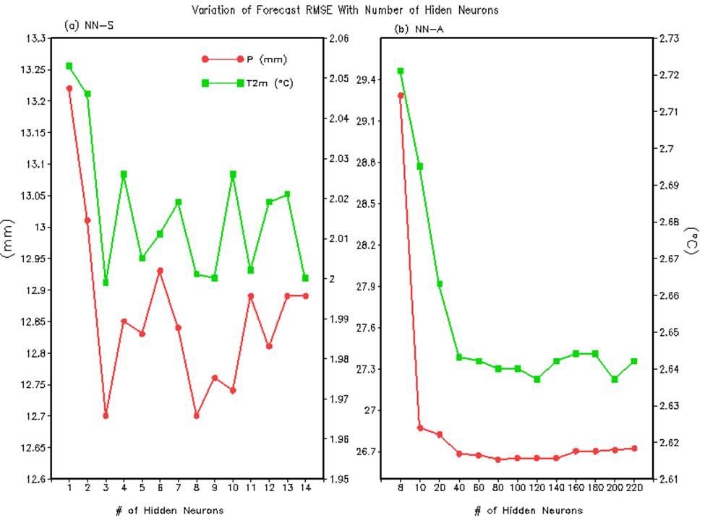
01/01/2017 - 12/31/2018
730 days
Notes:
Dependent Forecasts

Slide 6
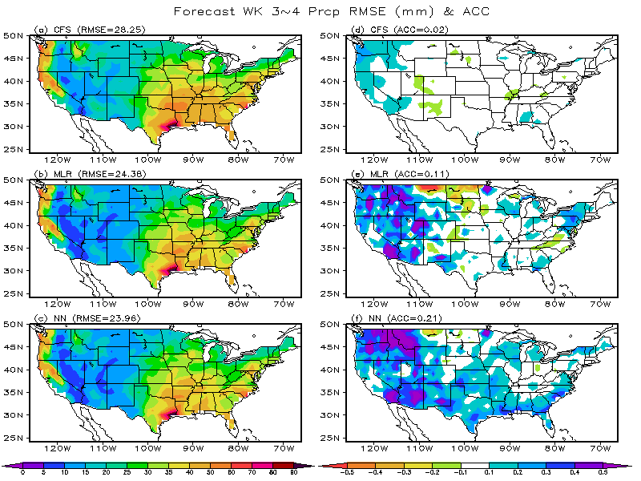

Slide 7
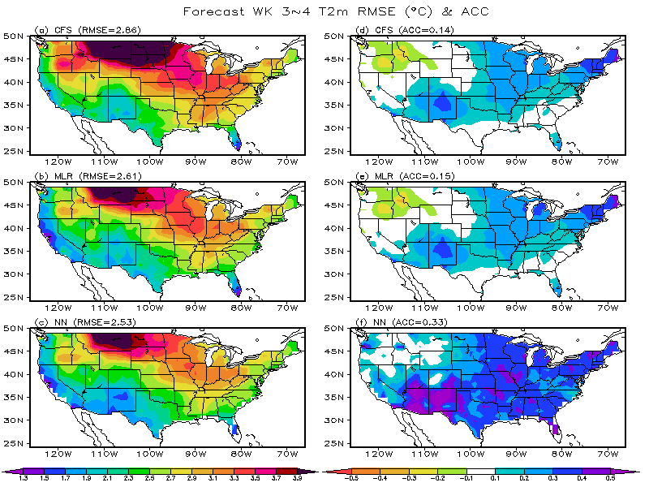

Slide 8
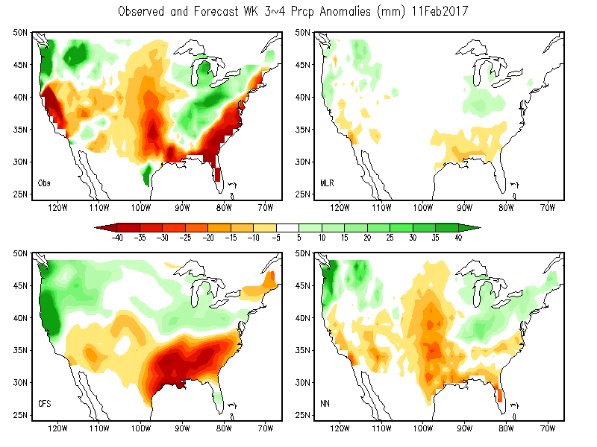
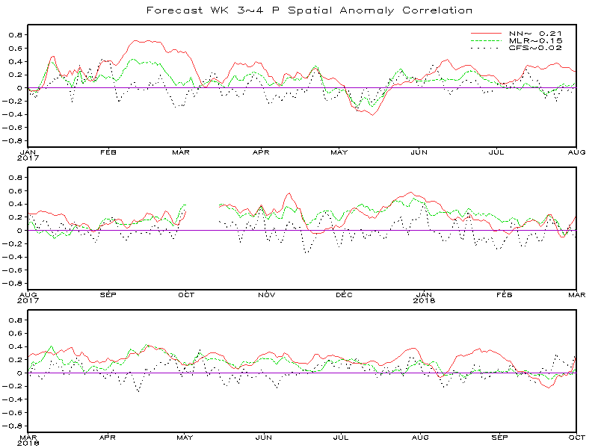
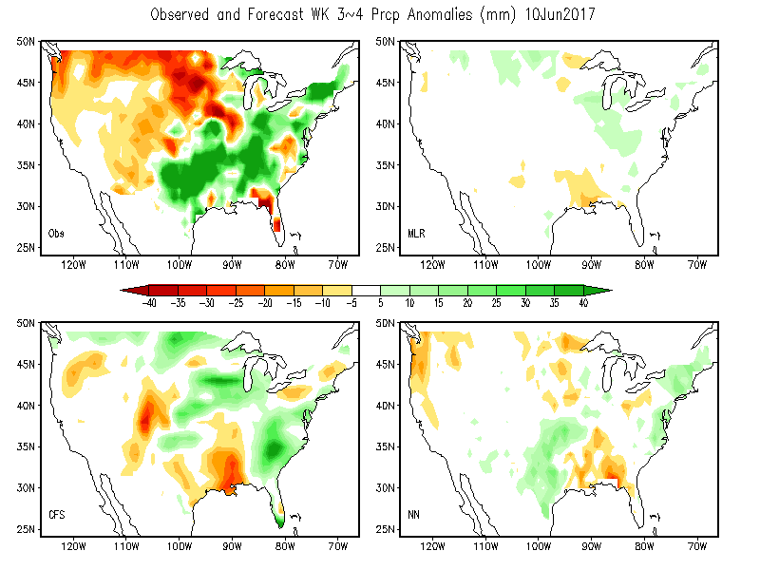
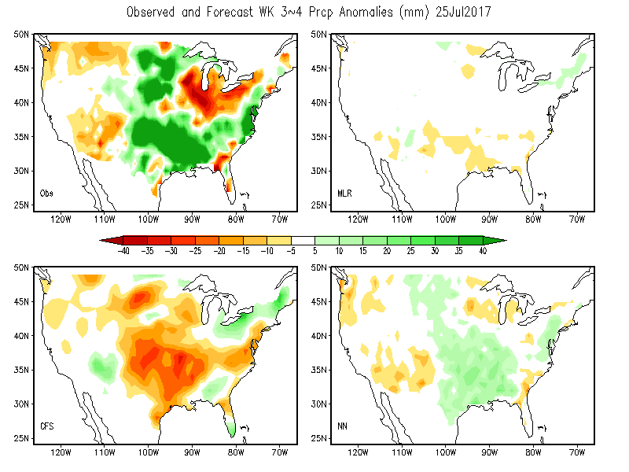
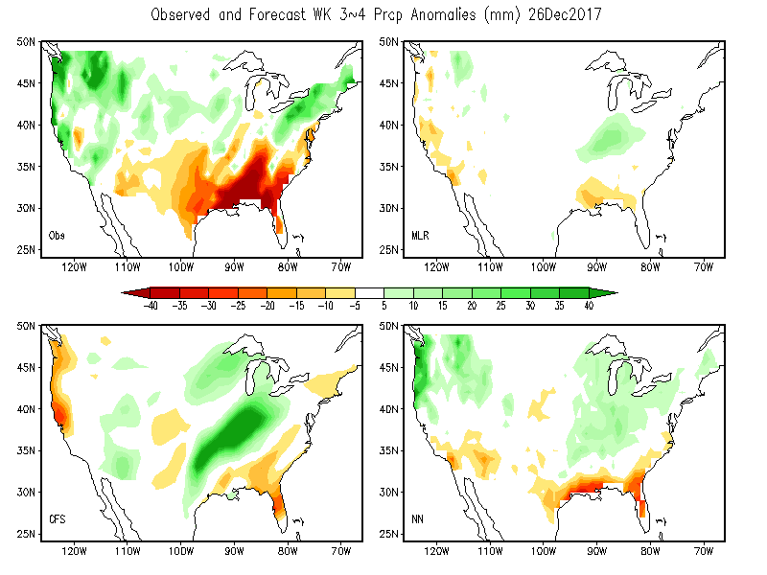
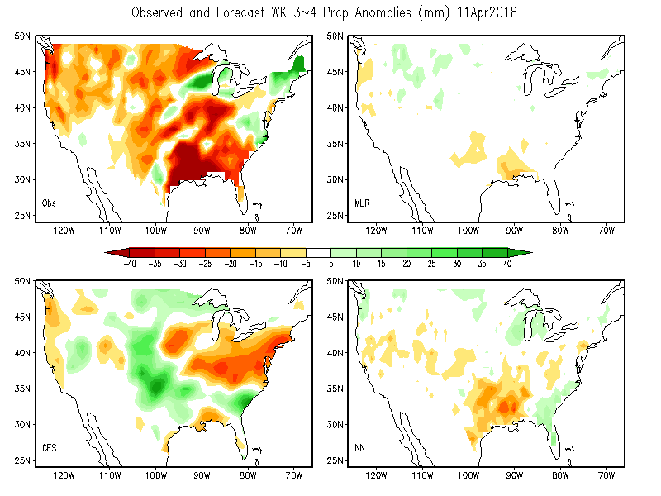
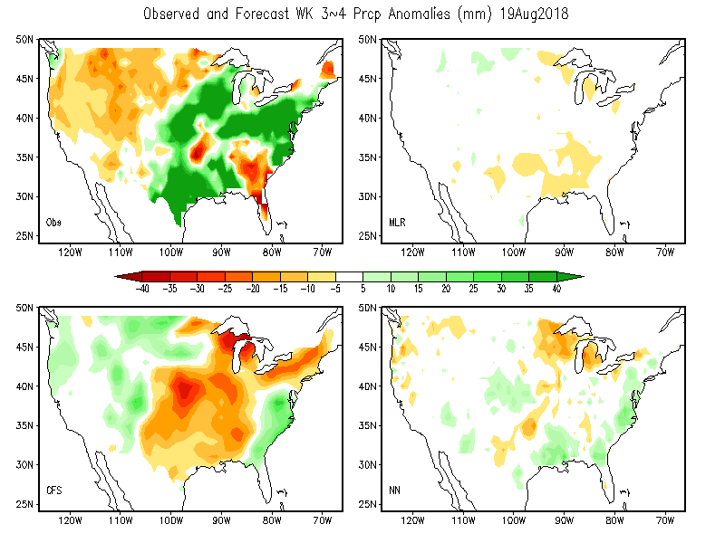

Slide 9
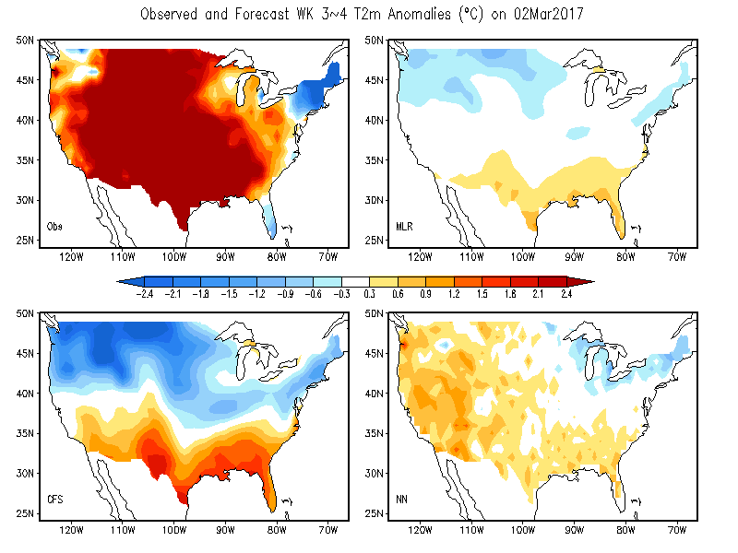
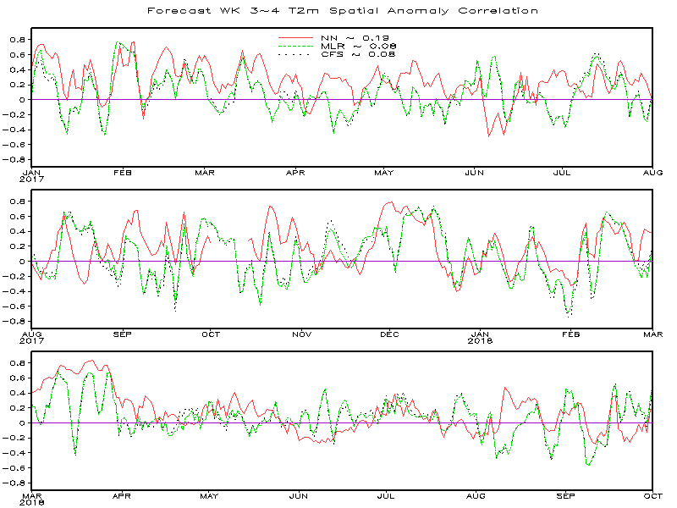
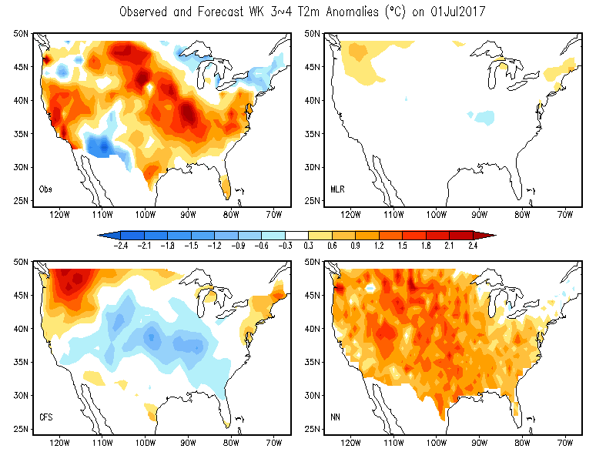
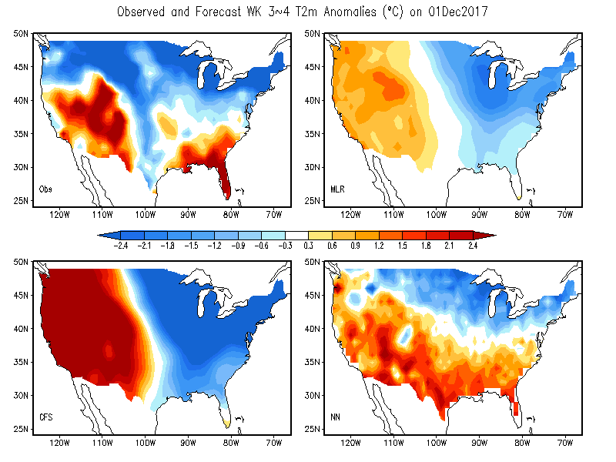
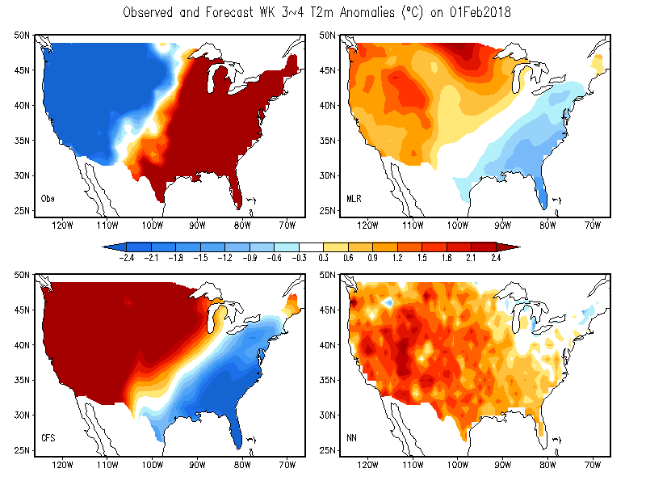
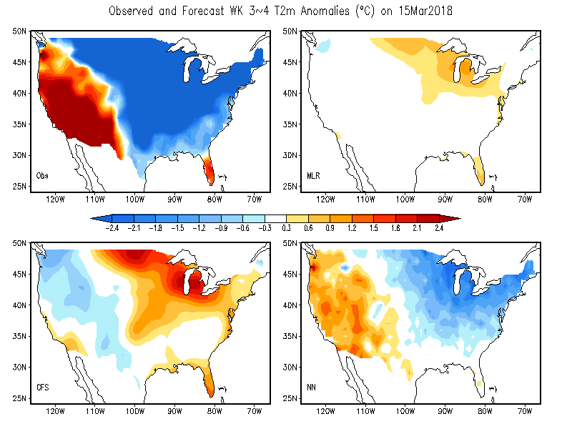
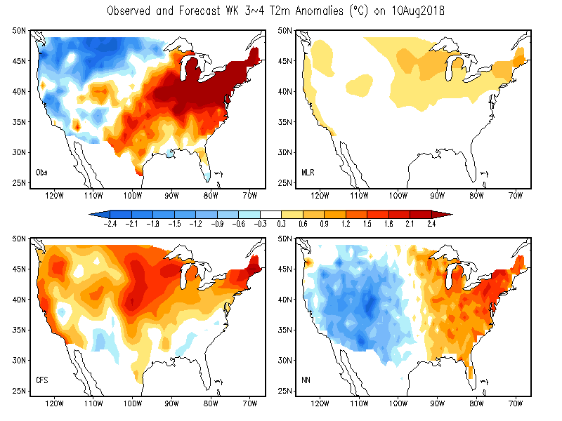

Slide 10
Summary
NN advantages:
Flexible nonlinear tool
Easy to handle BIG DATA
Unique & beneficial NN architectures can account for
Non-Linear Impact, Pattern Relationship, Co-Variability
among Predictors and Predictands
NN Significantly Improves CFS Week 3~4 Precip & T2m
over CFS & MLR

