Slide 1
Machine-Learning at NCAR
Sue Ellen Haupt,
David John Gagne, Tyler McCandless, Jim Cowie, Bill Petzke
Research Applications Laboratory
April 23, 2019

Slide 2
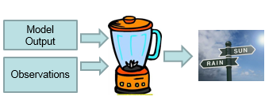
NCAR’s First Big AI Success: DICast®
Dynamic
Integrated
foreCast
System
DICast® In a Nutshell
Machine-Learning Post-processer of model data
  Create predictive relationships between model output, observations and desired forecast variables
Optimal Forecast Combiner
  Create best combination of inputs
Jim Cowie

Slide 3
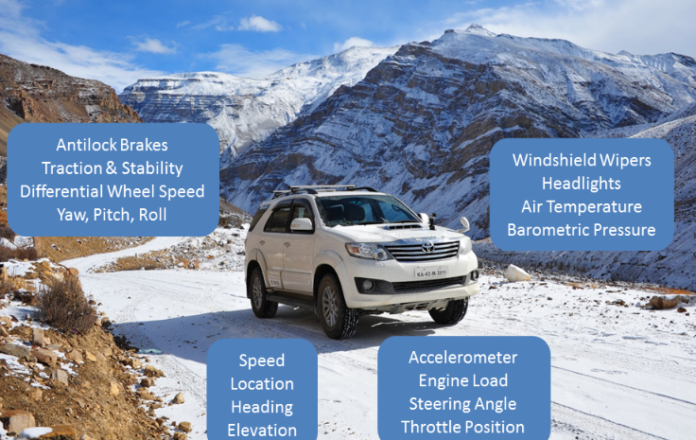
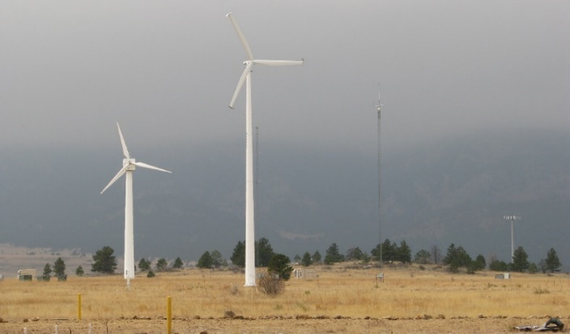
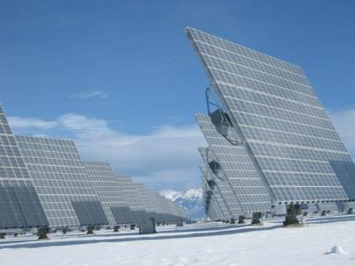

History of DICast®
Originally developed for The Weather Channel (now The Weather Company - part of IBM) to produce public-oriented forecasts
Development started in 1999 in Research Applications Program
Used in many other projects as the ‘weather engine’
  Transportation (MDSS, Pikalert®, DIA, MSP)
  Solar Energy (DOE, Kuwait)
  Wind Energy (Xcel Energy, Kuwait)
  Agriculture (NASA)
  Commercial forecasting companies
    DTN/Schneider/Telvent/Meteorlogix/Kavouras
    Panasonic Weather Systems
    Global Weather Corp
    Skymet Weather Services of India
Notes:
DICast was originally developed for The Weather Channel/Company in 1999.
NCAR and The Weather Company own the IP to DICast.
DICast’s applicability was clear from the beginning and it was used for the winter Maintenance Decision Support System as the weather engine.
It has also been used extensively in renewable energy projects.
Commercial weather providers also use DICast.
Most recently, we have contracted with Indian Skymet Weather Services to implement. Skymet’s goals are to improve the agricultural forecasts for farmers.

Slide 4
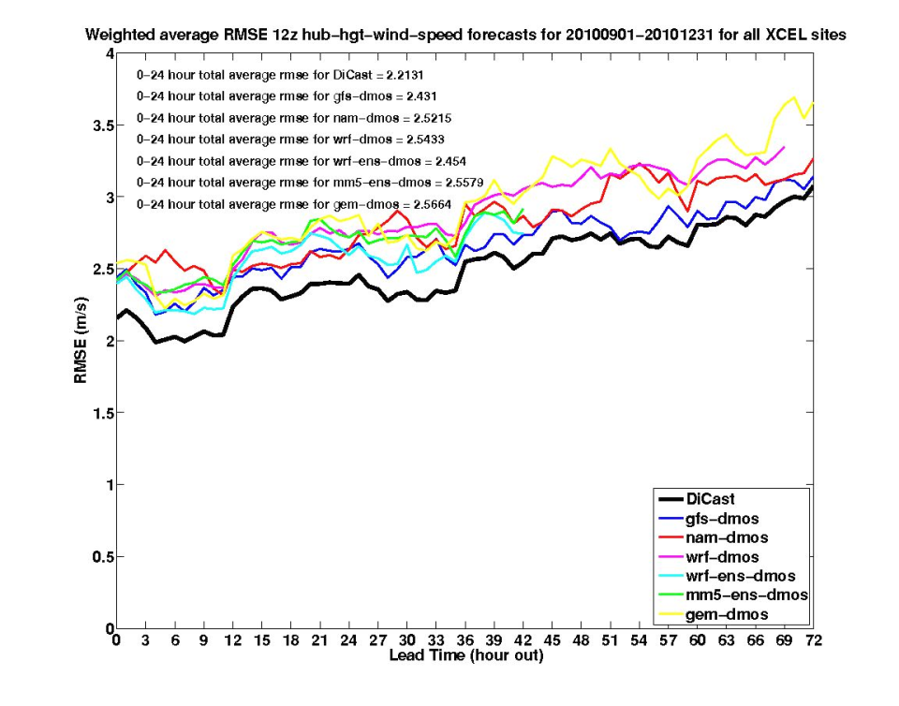
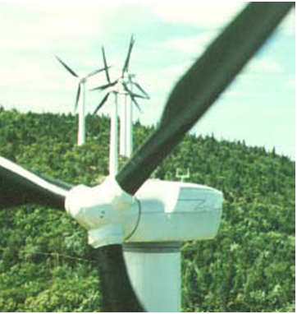
DICast® In a Nutshell
Dynamic Integrated foreCast System
Customize WRF
Integrator
HRRR
Nacelle Winds
RAP
Error
GFS
Wind Speed Forecast
Wind speed example
10-15% decrease in error
GEM
NAM
.
.
.
Jim Cowie
Seth Linden
Bill Petzke
Other Model Data
Notes:
At the heart of the system is RAL’s Dynamic Integrated ForeCast System (DICast), which integrates observations and model data, continuously bias correcting model input and providing the best weights for those data using real time statistical learning methods. DICast is trained to match the forecasts to the nacelle anemometer wind speeds at each turbine, which is highly correlated with power production. This approach allows the system to take into account availability information that Xcel requires from the individual wind farms. The consensus wind forecast for each turbine is then converted to power using statistical approaches. The wind energy forecast data for each turbine and connection node are provided to Xcel Energy decision makers via both text files (for integration into Xcel’s load balancing and power trading systems) and Graphical User Interfaces (GUIs). The power grid operators are provided with a GUI display of projected power output plus error bars. The DICast system provides a 10-15% improvement on the best NWP model that goes into it.

Slide 5
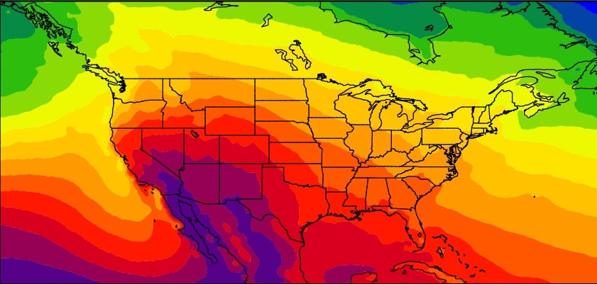
Gridded Atmospheric Forecasts: GRAFS-Solar
Observations
SMUD
MADIS
OK Mesonet
BNL
SURFRAD
Xcel
DeSota
ARM
NWP Models
NAM
GFS
WRF-Solar
GEM
RAP/HRRR
Initial Grid
Interpolated to 4 km CONUS Grid
1-Hour Averaging
Archive data near observation sites
Statistical Correction/Blending
DICast Correction
Gradient Boosted Regression Trees
Cubist
Random Forests
Analog Ensemble
Output Products
Maps of solar irradiance
Single point forecasts
% of clear sky irradiance
Other met. Variables
David John Gagne
Jim Cowie
Seth Linden
Bill Petzke

Slide 6
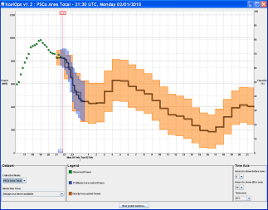
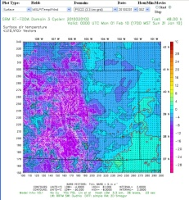
NCAR Variable Energy Forecasting System
CSV Data
Center Data
NAM, GFS, HRR, RAP, ECMWF, GEM
Wind Farm Data
Nacelle wind speed
Generator power
Node power
Met tower
Availability
Operator GUI
Statistical
Verification
WRF RTFDDA System
Dynamic, Integrated Forecast System
(DICast®)
WRF RTFDDA System
Wind to Energy Conversion Subsystem
Meteorologist GUI
Ensemble System
Ensemble System
Potential Power Forecasting
Solar Energy Forecast
VDRAS
(nowcasting)
WRF Model Output
Data Mining for Load Estimation
Supplemental
Wind Farm Data
Met towers
Wind profiler
Surface Stations
Windcube Lidar
Expert System
(nowcasting)
AI Method
Probabilistic and Analog Forecast
Extreme Weather Events

Slide 7
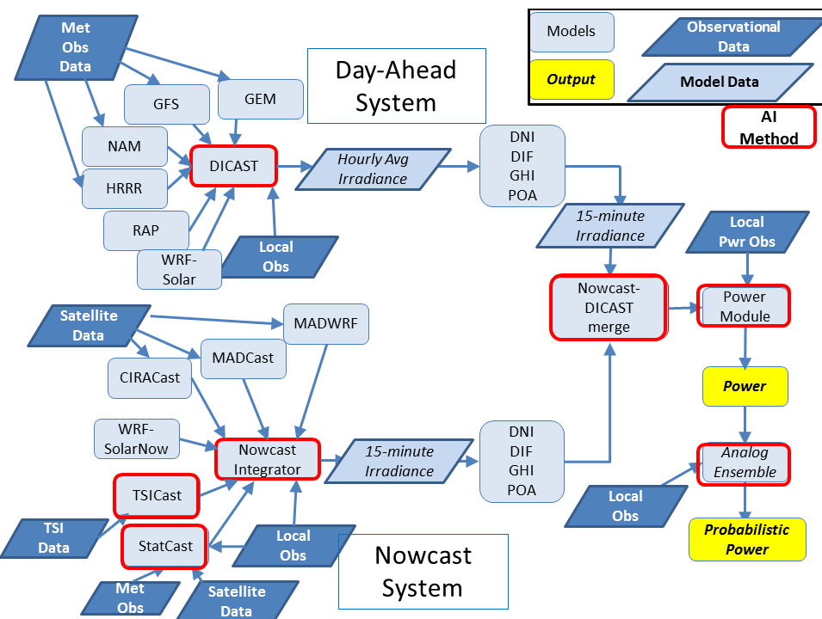
AI as Part of Systems Engineering
Engineering the Sun4Cast® System

Slide 8
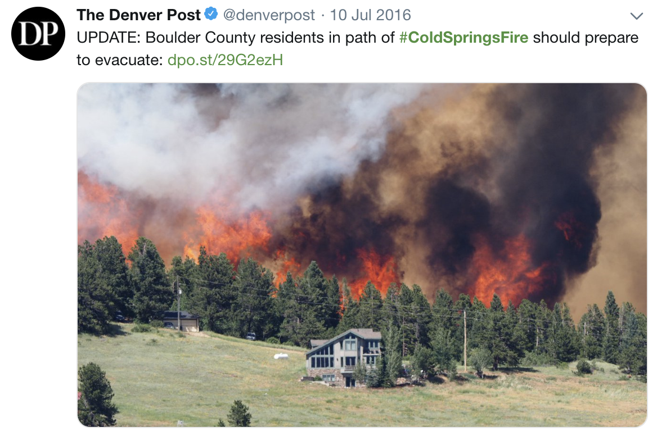

Machine Learning to Improve Wildland Fire Prediction:
Better Estimates of Fuel Moisture with
Satellite Data and Machine Learning
Tyler McCandless
Branko Kosovic
Bill Petzke

Slide 9
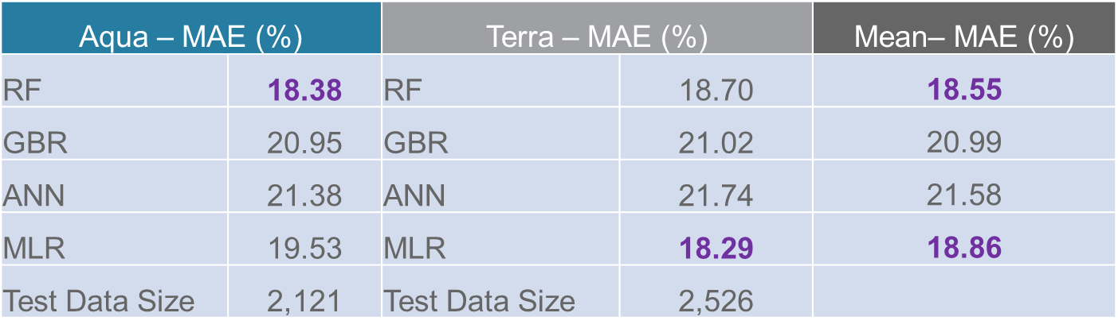
Developing the System
Final Models for Dead Fuel Moisture Content Prediction
Aqua – MAE (%) |  | Terra – MAE (%) |  | Mean– MAE (%)
RF | 2.04 | RF | 1.96 | 2.00
GBR | 2.25 | GBR | 2.09 | 2.17
ANN | 1.85 | ANN | 2.28 | 2.06
MLR | 2.01 | MLR | 2.24 | 2.12
Test Data Size | 18,565 | Test Data Size | 17,611
Random Forest Used for Dead Fuel Moisture Content
Final Models for Live Fuel Moisture Content Prediction
Multilinear Regression Used for Dead Fuel Moisture Content
Tyler McCandless

Slide 10
Developing the System
Final Models for Live Fuel Moisture Content Prediction
Retrained RF with Five Predictors
(Elevation and Bands 1, 2, 3, 5)
RF Error Reduced from 21.21 → 18.55
MLR Error Reduced from 20.39 → 18.86
Tyler McCandless

Slide 11
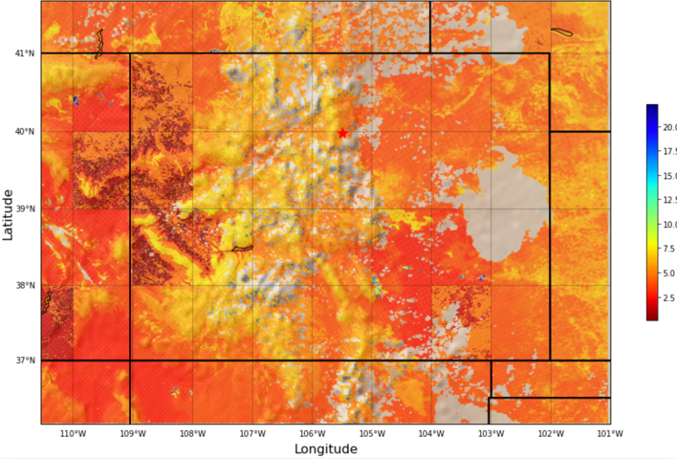
Fuel Moisture Content Prediction System
Example Outputs
Original interpolated observations for DFMC
Predictions from Random Forest for DFMC
Tyler McCandless
Notes:
Dead FMC values on the left are obtained by interpolating sparse surface observations while on the right we used satellite observations and a machine learning model to estimate the dead FMC. Significantly finer structure of satellite observations based FMC is a result of variability in observations and also accounting for local terrain and fuels.

Slide 12
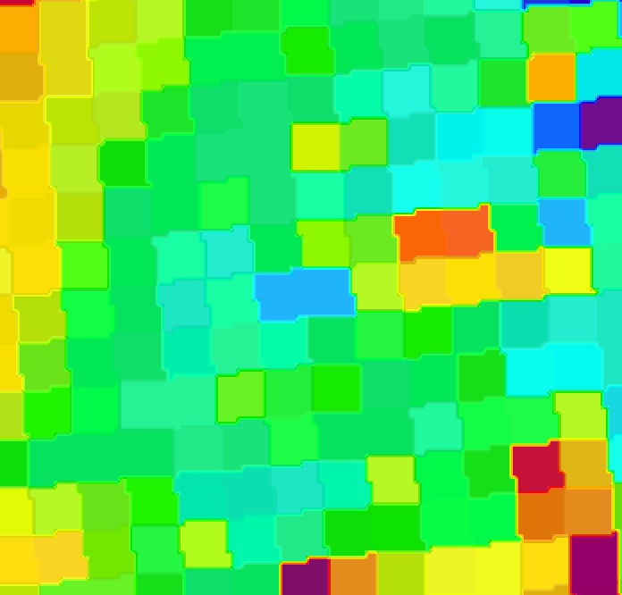
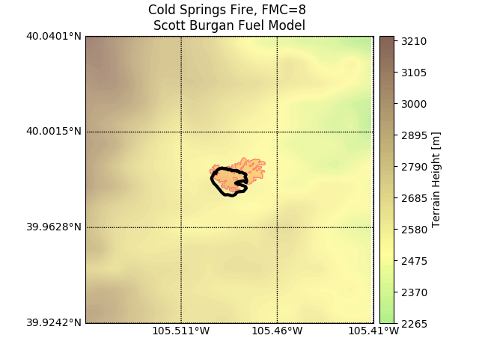
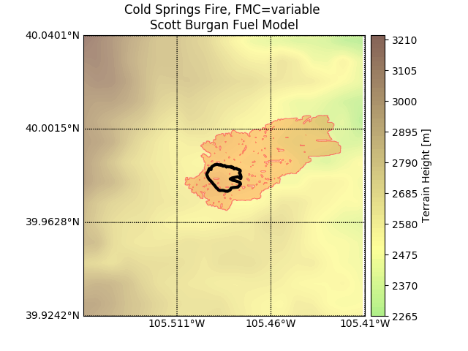
Fuel Moisture Content Prediction System
Preliminary Cold Springs Fire Analysis
Distribution of the estimated DFMC
Cold Springs fire simulated using constant Dead Fuel Moisture Content of 8% and machine learning predicted DFMC
Our NWP-based wildland fire prediction model tends to overestimate the rate of spread of fire due to lack of including fire suppression
Thus, it is positive to see burn area increase
Constant DFMC
ML-based DFMC - RF
Tyler McCandless

Slide 13
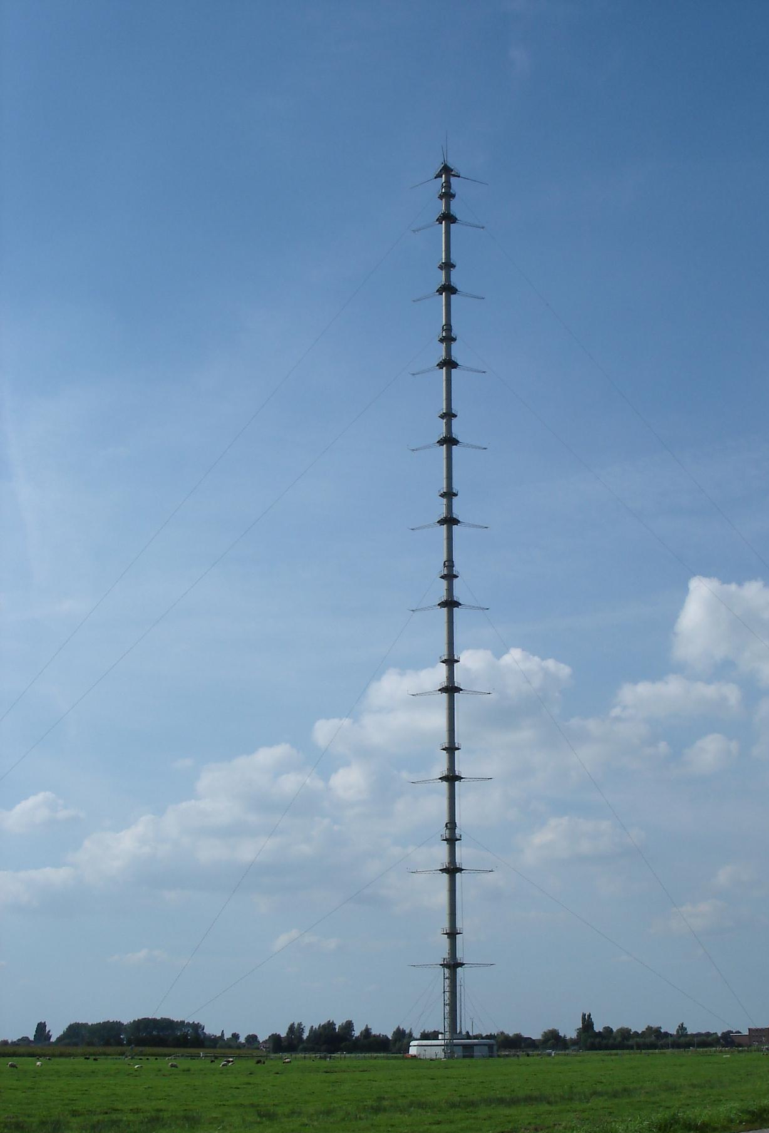
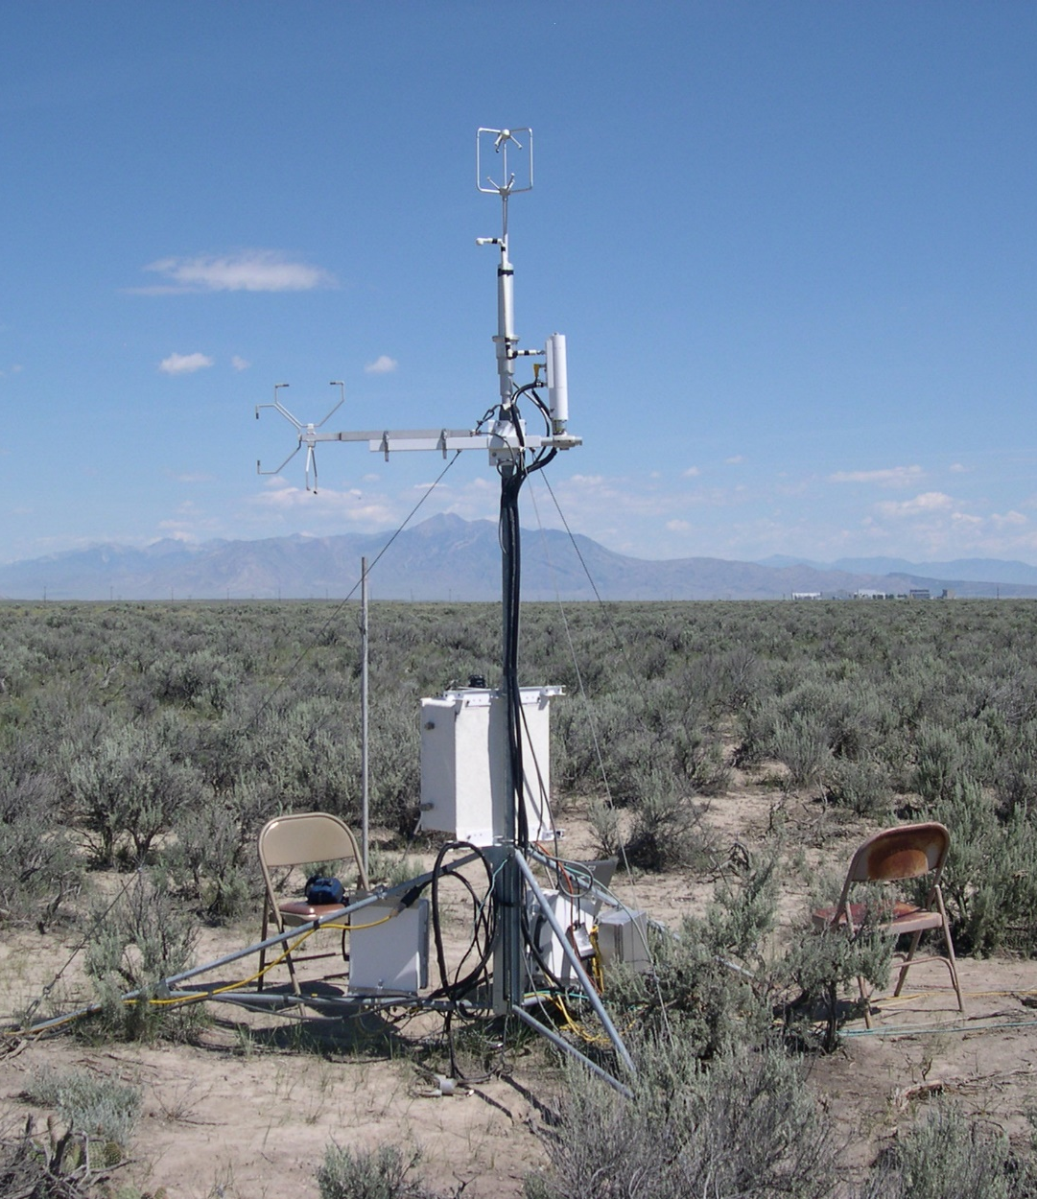
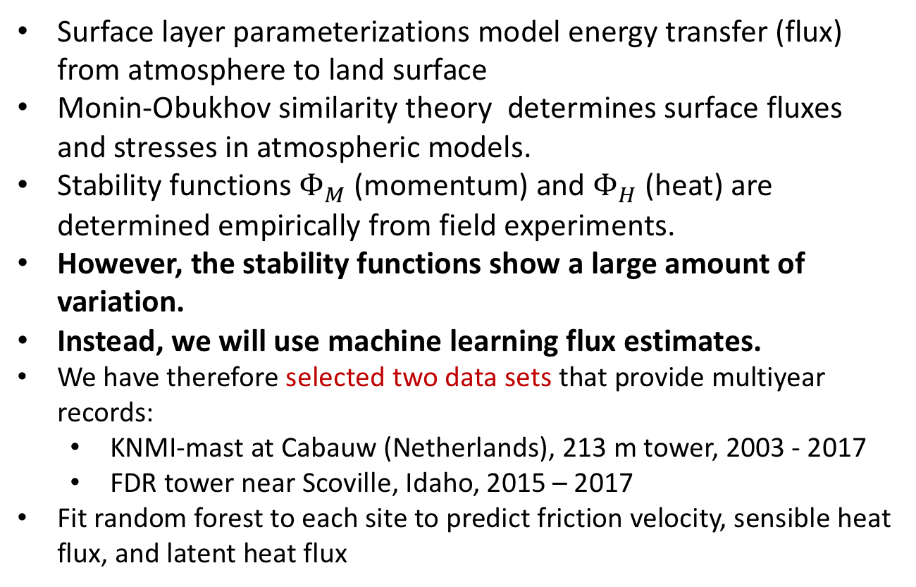
Machine Learning for
Surface Layer Parameterization
Surface layer parameterizations model energy transfer (flux) from atmosphere to land surface
Monin-Obukhov similarity theory determines surface fluxes and stresses in atmospheric models.
Stability functions $Φ_{M}$ (momentum) and $Φ_{H}$ (heat) are determined empirically from field experiments.
However, the stability functions show a large amount of variation.
Instead, we will use machine learning flux estimates.
We have therefore selected two data sets that provide multiyear records:
  KNMI-mast at Cabauw (Netherlands), 213 m tower, 2003 - 2017
  FDR tower near Scoville, Idaho, 2015 – 2017
Fit random forest to each site to predict friction velocity, sensible heat flux, and latent heat flux
https://nevada.usgs.gov/et/measured.htm
Cabauw
Idaho
Gagne, McCandless, Kosovic, Haupt

Slide 14
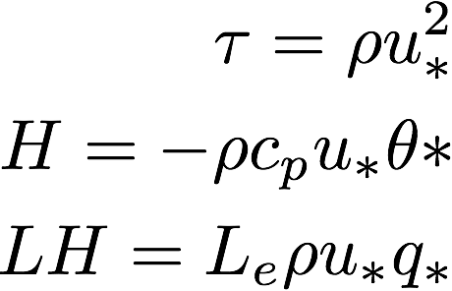
Input and Output Variables
Output equations
Common Variables | Heights (Idaho/Cabauw)
Potential Temperature (K) | 2m, 10m, 15m/20m, 40/45m
Solar Radiation (w m-2) | Surface
Wind Speed (m/s) | 10m, 15m/20m, 40/45m
Bulk Richardson number | 10 m- 0 m
Pressure (hPa) | Surface
Relative Humidity (%) | 2 m, 10 m
Moisture Availability (%) | 5cm/3cm
Skin Temperature (K) | 0 m
Solar Zenith Angle (degrees) | 0 m
Predictands
u*=Friction velocity
θ*=Temperature scale
q*=Moisture scale
Gagne, McCandless, Kosovic, Haupt

Slide 15
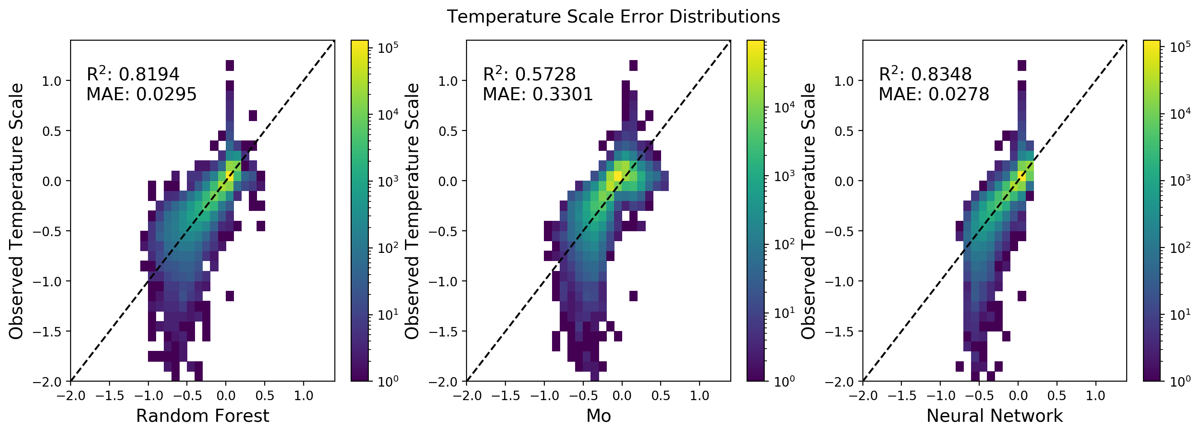
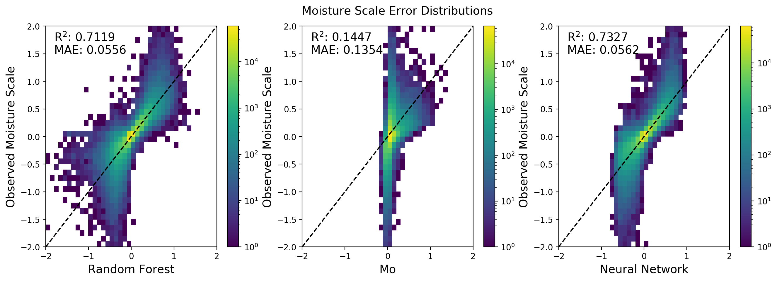
Random Forest Prediction of Surface Layer Variables
Temperature Scale
Both Random Forest and Neural Networks consistently outpredict Monin-Obukov Similary Theory
Higher Correlation
Lower MAE
Moisture
Scale
Gagne, McCandless, Kosovic, Haupt
Random Forest M-O Neural Network

Slide 16
Cross-Testing ML Models
 | R² |  |  | MAE
Idaho Test Dataset | Friction Velocity | Temperature Scale | Moisture Scale | Friction Velocity | Temperature Scale | Moisture Scale
MO Similarity | 0.85 | 0.42 |  | 0.077 | 0.203
RF Trained on Idaho | 0.91 | 0.80 | 0.41 | 0.047 | 0.079 | 0.023
RF Trained on Cabauw | 0.88 | 0.76 | 0.22 | 0.094 | 0.139 | 0.284
 | R² |  |  | MAE
Cabauw Test Dataset | Friction Velocity | Temperature Scale | Moisture Scale | Friction Velocity | Temperature Scale | Moisture Scale
MO Similarity | 0.90 | 0.44 | 0.14 | 0.115 | 0.062 | 0.135
RF Trained on Cabauw | 0.93 | 0.82 | 0.73 | 0.031 | 0.030 | 0.055
RF Trained on Idaho | 0.90 | 0.77 | 0.49 | 0.074 | 0.049 | 0.112
Random Forest significantly outperforms Monin-Obukov Theory
True even when applied to site that is different than the one trained
Currently working to implement in WRF
(See poster by DJ Gagne)
Tyler McCandless
Gagne, McCandless, Kosovic, Haupt

Slide 17


Interpretable Deep Learning for Severe Weather Research and Forecasting
Convolutional Neural Networks
Feature Visualization by Optimization
Desired Label
Storm Patch
Conv Net with fixed weights
Forward pass to infer probability
Backpropagate error to update input image
David John Gagne
Repeat steps 2-4 until prediction matches desired output

Slide 18
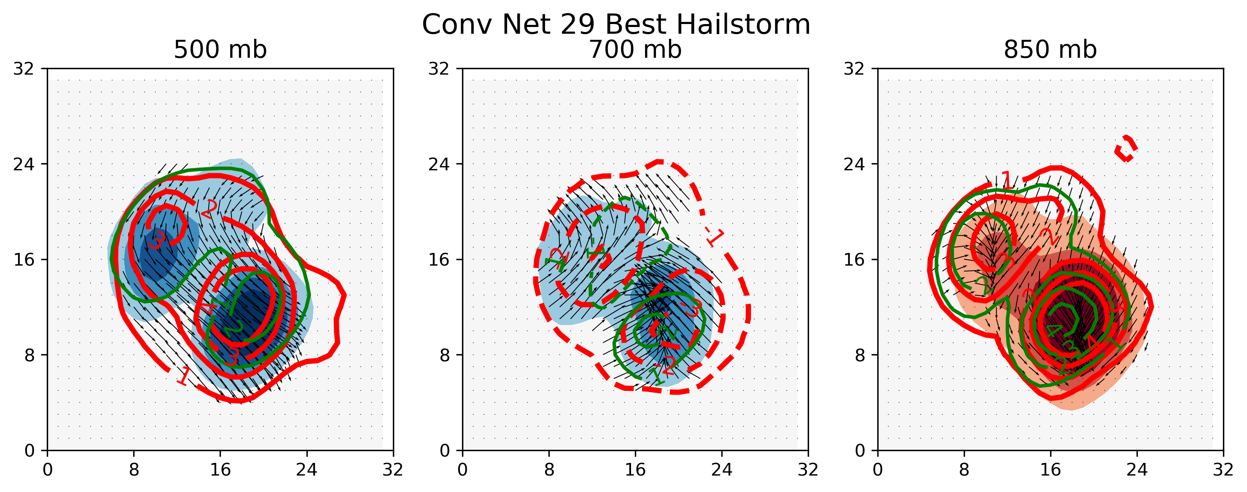
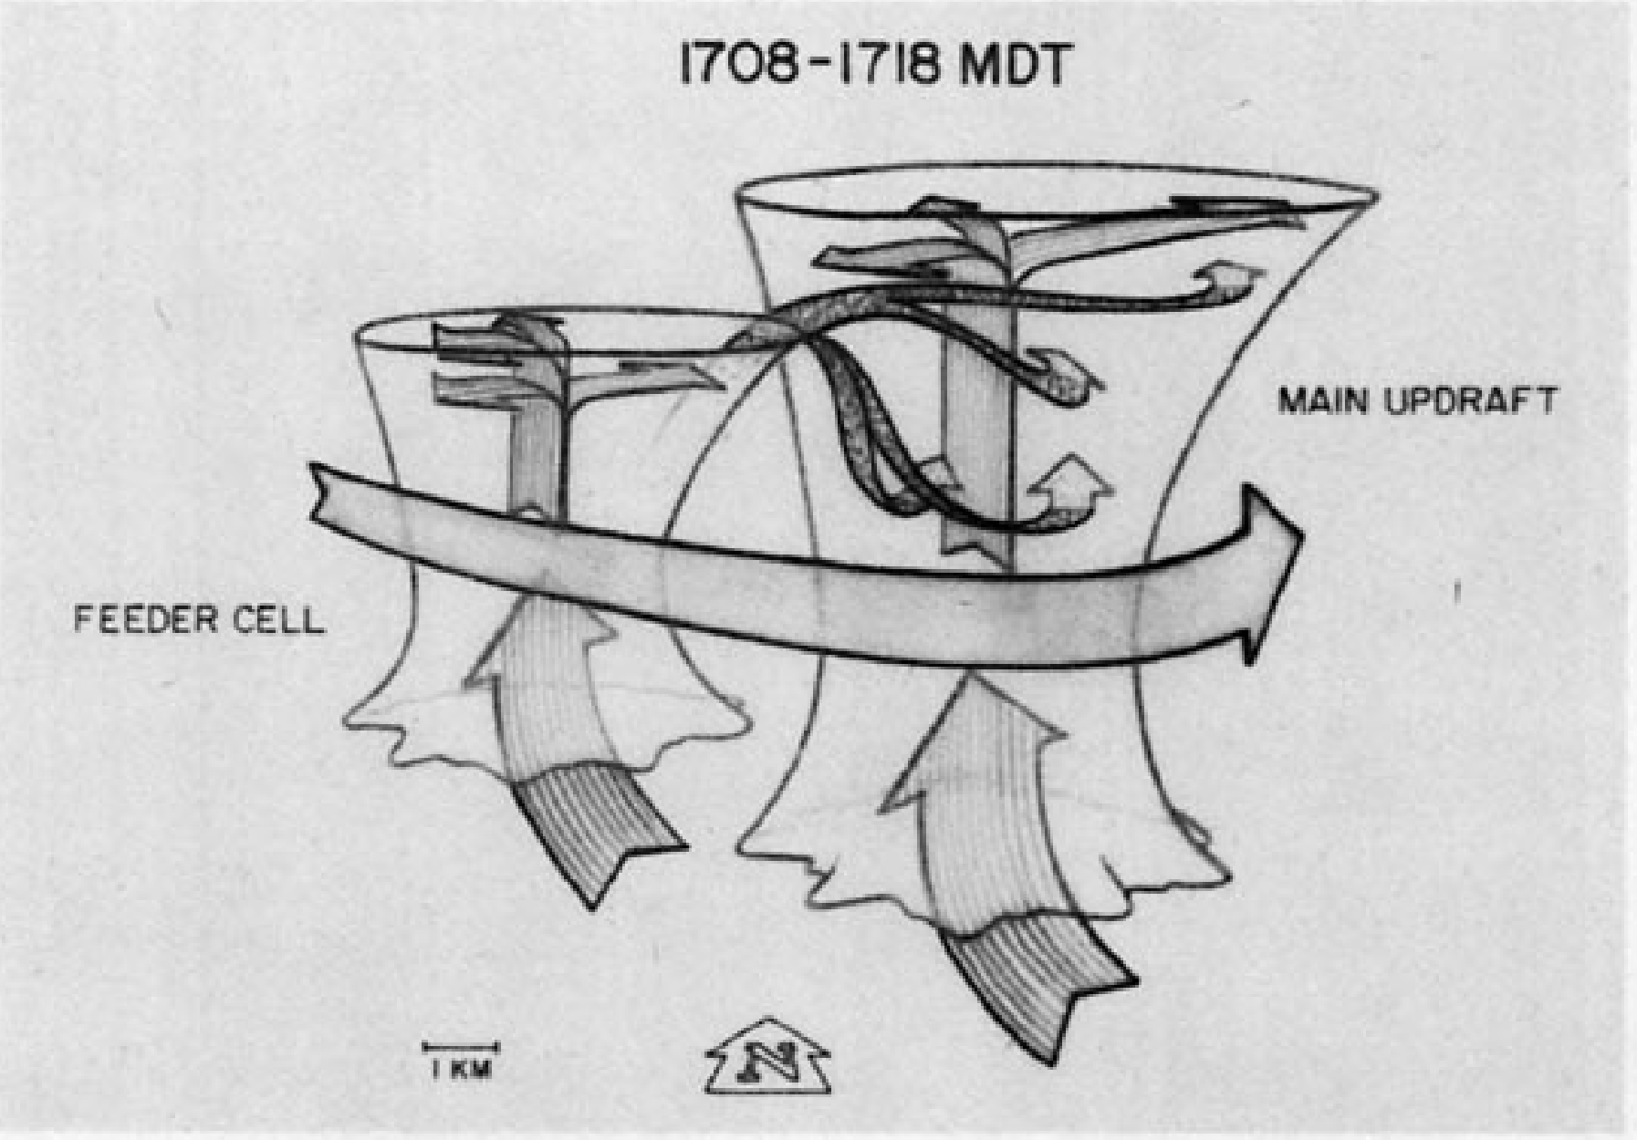
Optimized Conv Net Hailstorm
Graupel Seeding
Confluent warm, moist air
Red: Temperature
Green: Dewpoint
Filled Contours: Geopotential Height
Feeder-Seeder Mechanism (Heymsfield 1980)
David John Gagne, III

Slide 19
Hailstorm Neuron Activations
Visualized the filters in the last convolutional layer using feature optimization
Filters encode different storm types
Each storm type has a positive association with severe hail
Captures supercells, squall lines, and intermediate stages
David John Gagne, III

Slide 20
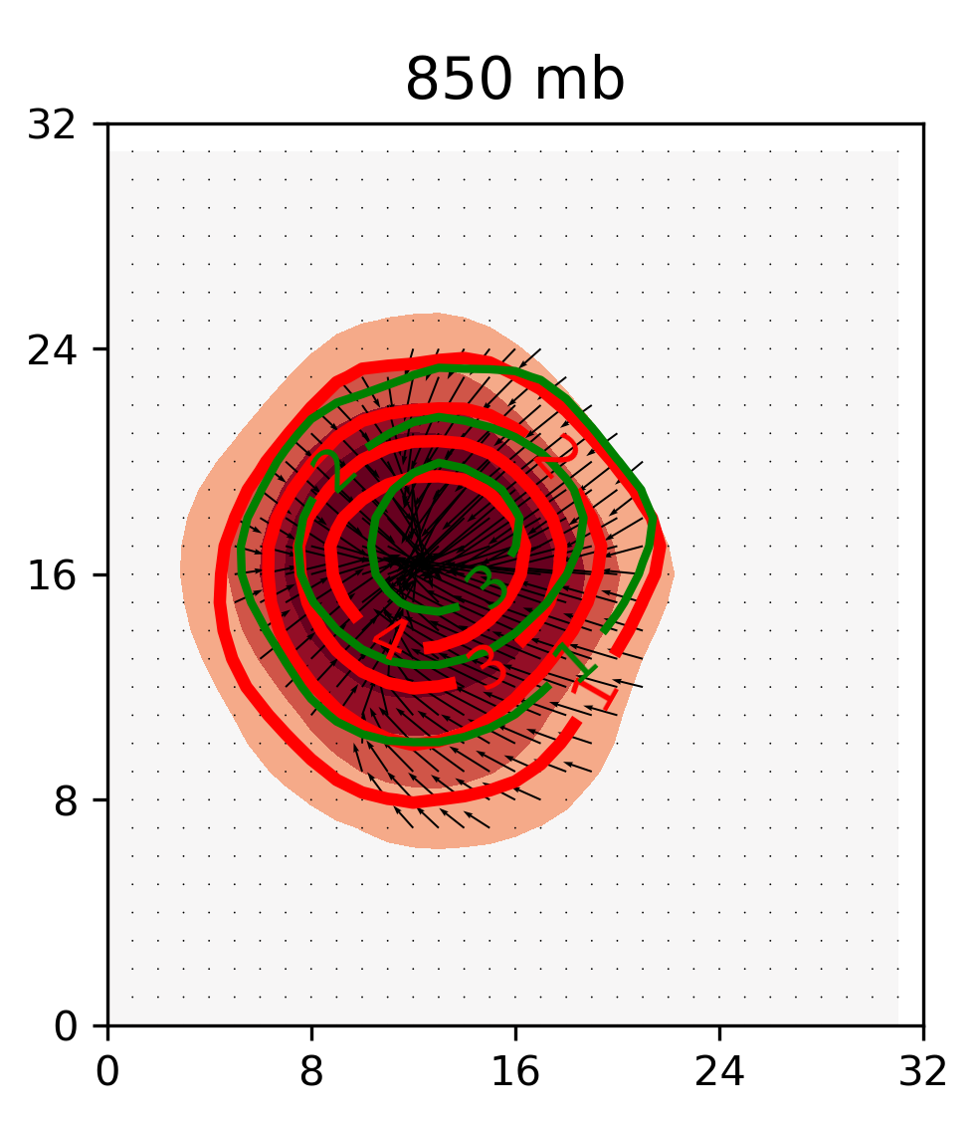
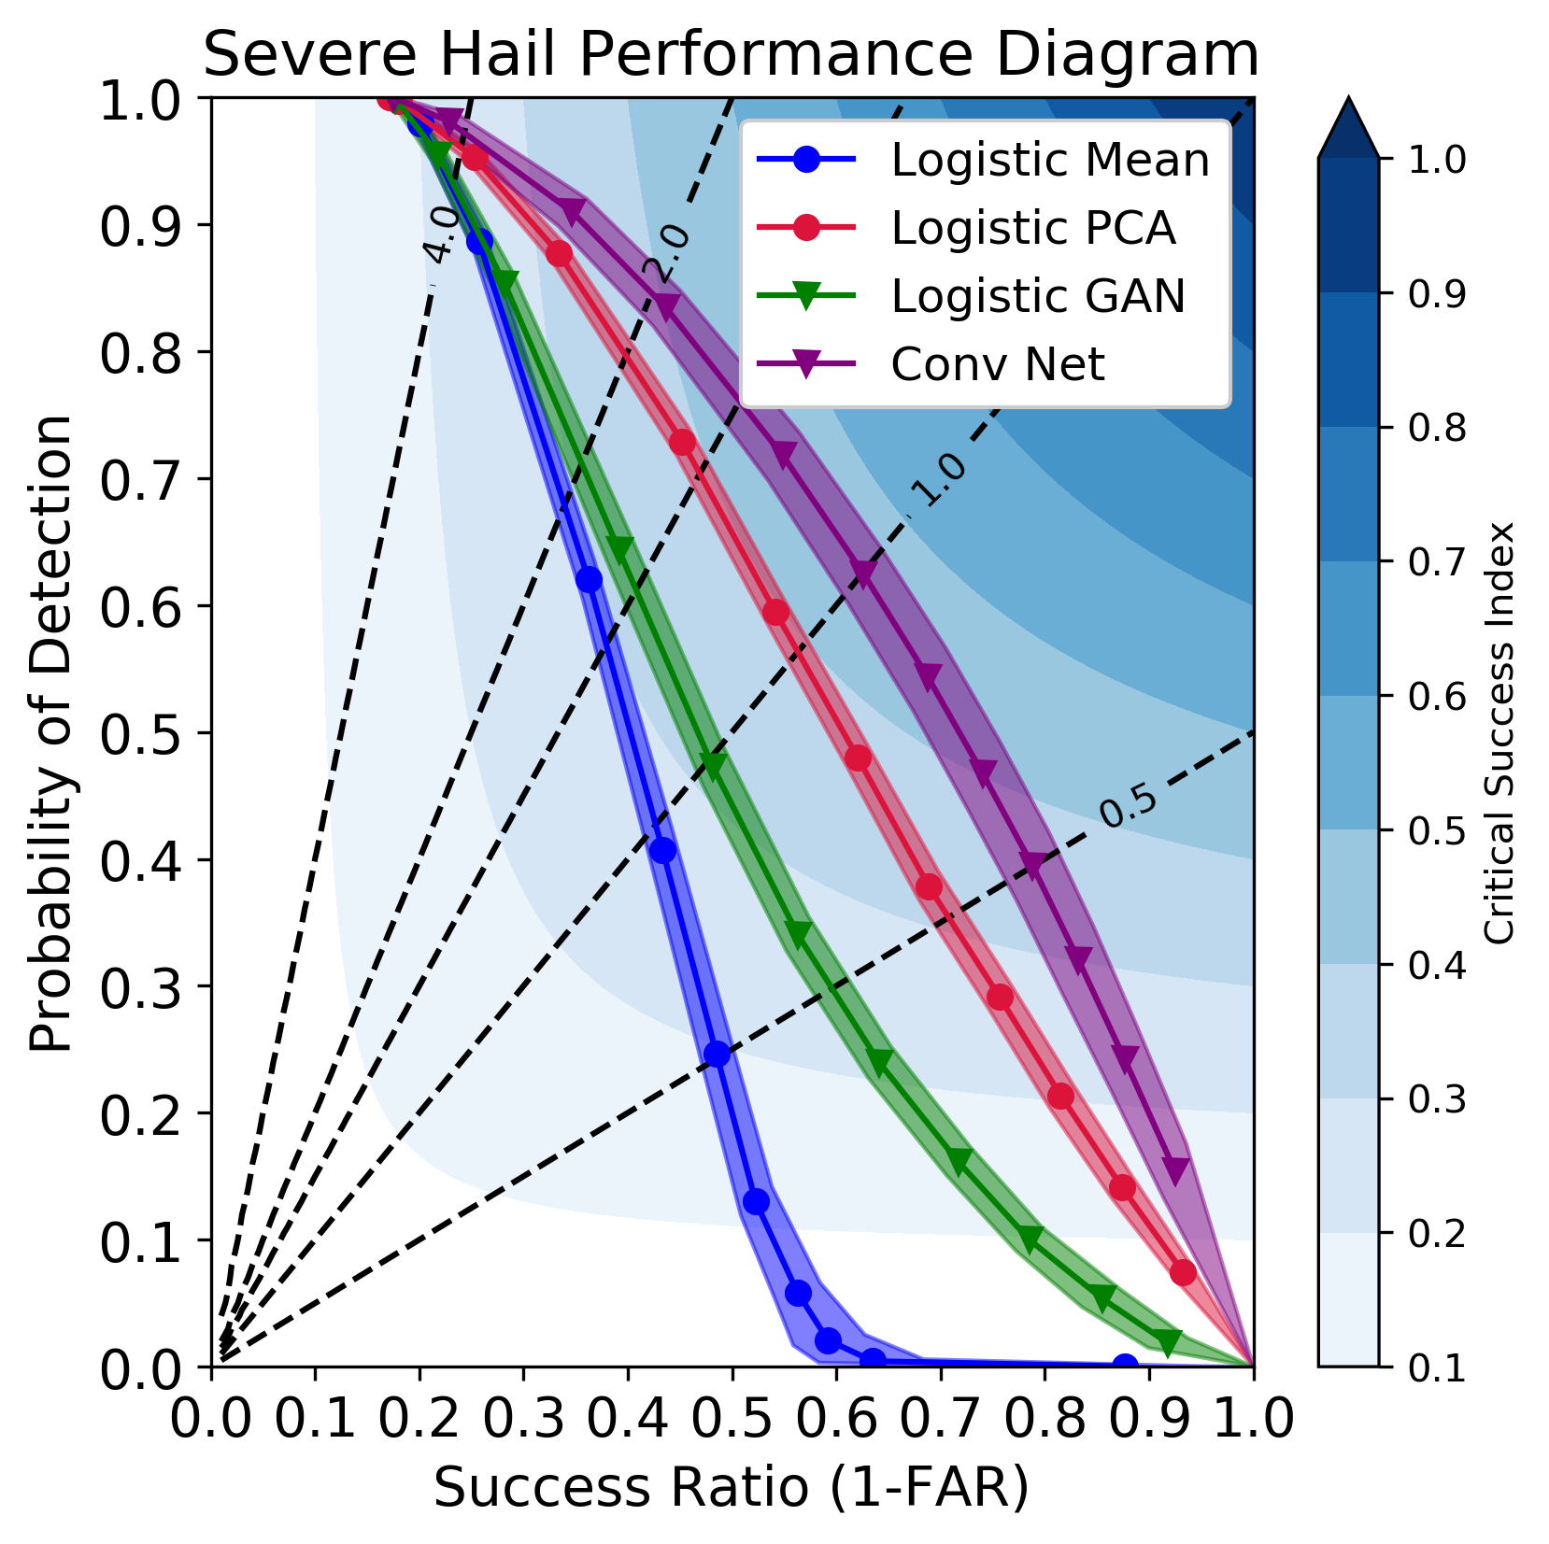
Impact of Using Convolutional Neural Networks
Convolutional neural networks produce more skilled hail predictions than other models.
Convolutional neural networks encode realistic storm features and hail growth processes.
Internal representations of deep learning models could enable more sophisticated analysis of large weather and climate data.
Gagne II, D.J., S.E. Haupt, D.W. Nychka, G. Thompson, 2019: Interpretable Deep Learning for Spatial Severe Hail Forecasting, Monthly Weather Review, accepted.
David John Gagne, III

Slide 21


Summary:
Artificial Intelligence is advancing
applications of weather forecasting
NCAR has been involved for a couple decades
A Big Data application
A necessary component of modern
weather forecasting systems
NCAR Applications include:
    NWP Postprocessing
    Renewable Energy Forecasting
    Wildland Fire Forecasting
    Improving NWP models through emulating physical processes
    Forecasting for surface transportation, aviation, agriculture, and more
NCAR is sponsored by the National Science Foundation

Slide 22
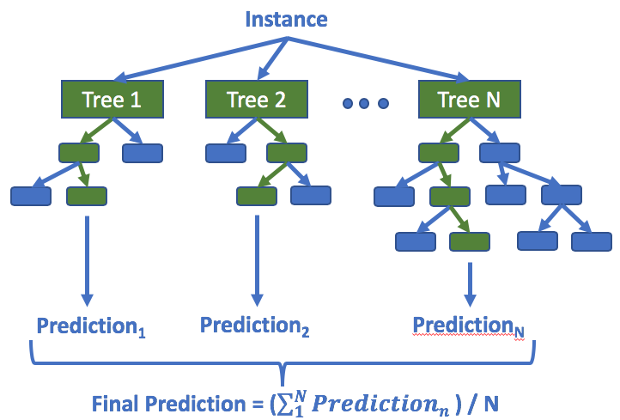
ML Model: Random Forest
Gagne, McCandless, Kosovic, Haupt

Slide 23
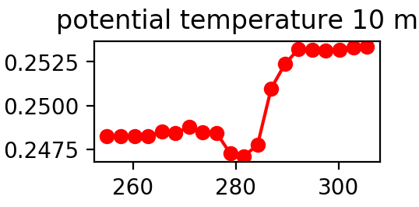
Partial Dependence Plots
1. Set all instances for one variable in a dataset to a single value
2. Feed fixed data through model
3. Calculate mean prediction for fixed value
Temperature | Dewpoint | Pressure
288 | 10 | 986
288 | 14 | 1014
288 | 2 | 992
288 | 25 | 1025
288 | 6 | 950
Machine Learning or Physical Model
Mean Prediction
4. Repeat process for range of input values
Example: Temperature=[20, 22, ..., 40]
Gagne, McCandless, Kosovic, Haupt

Slide 24
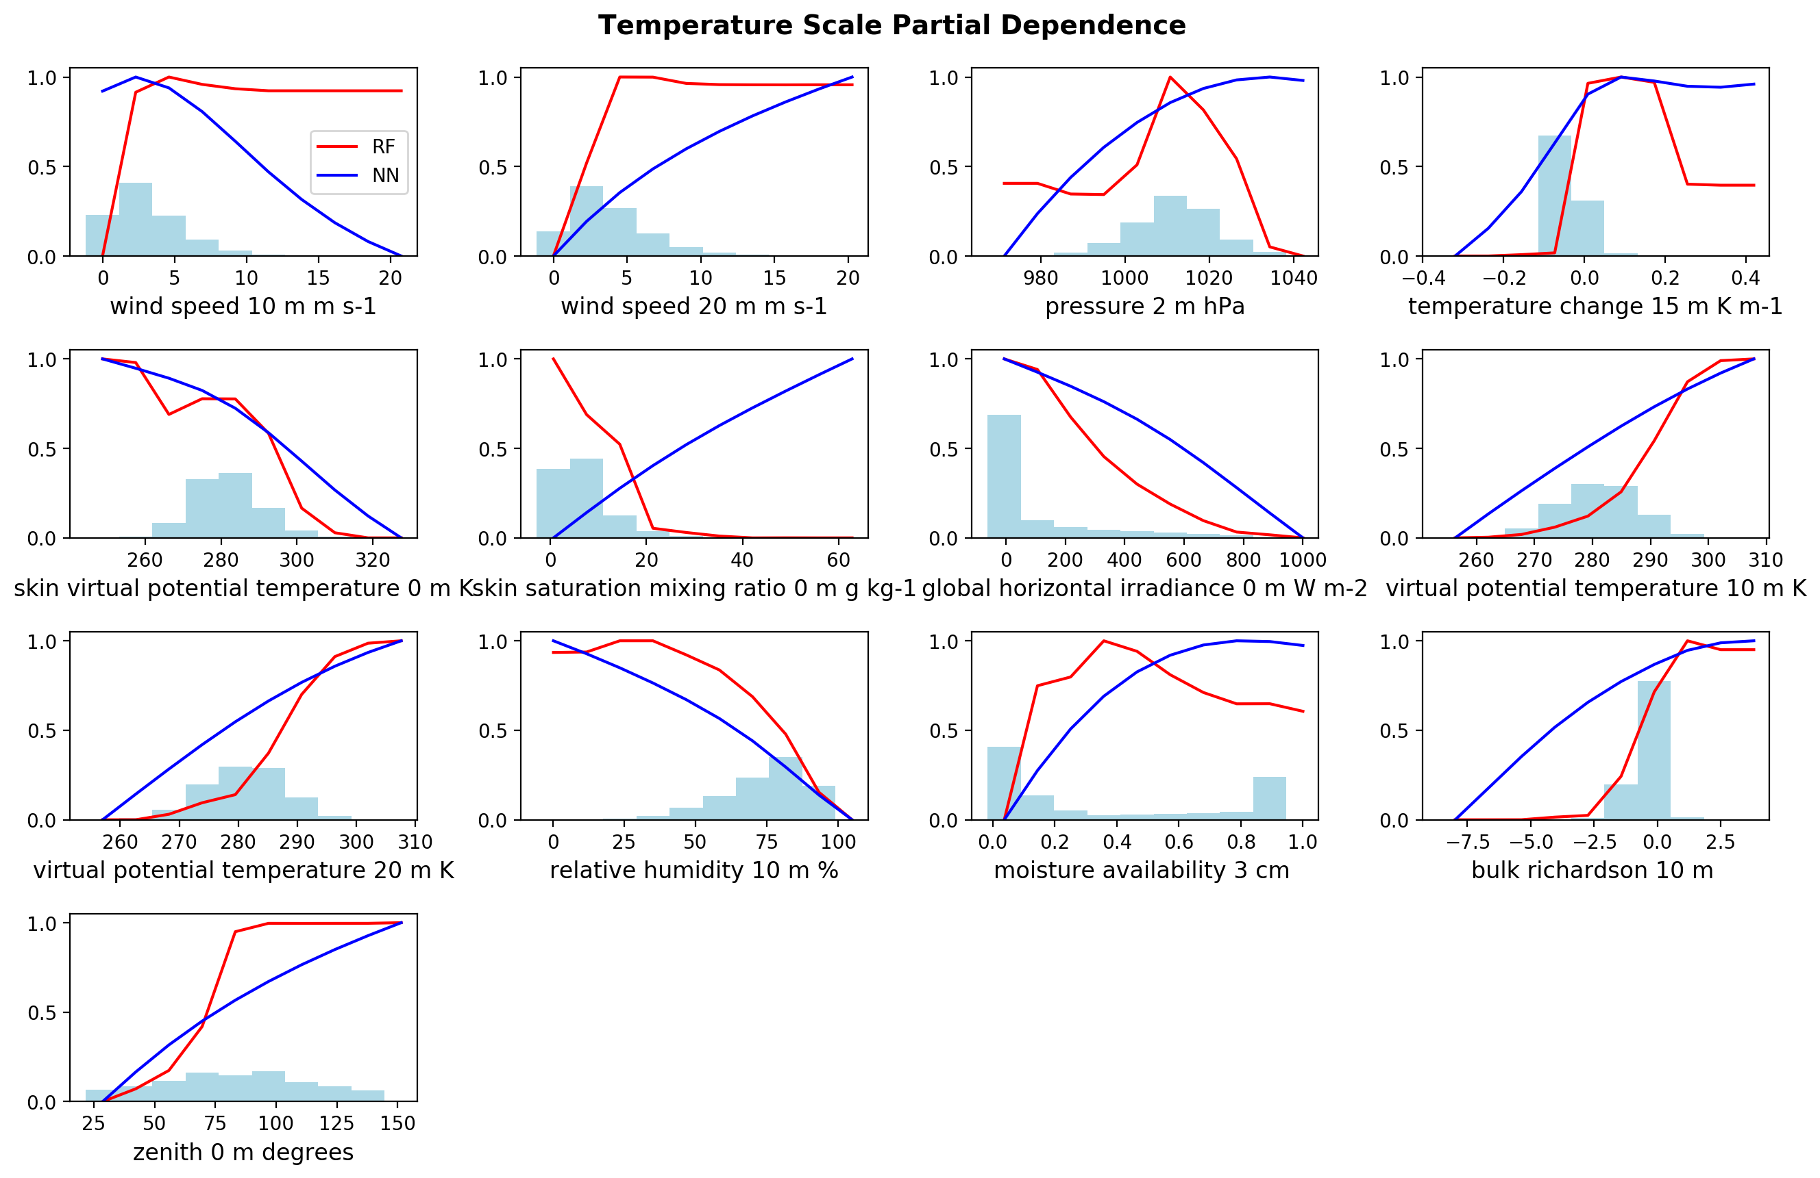
Interpret with Partial Dependence Plots
Gagne, McCandless, Kosovic, Haupt

Slide 25
Variable Importance Scores

Slide 26
Spatio-temporal Distribution of Storm Types
David John Gagne, III

