Slide 1
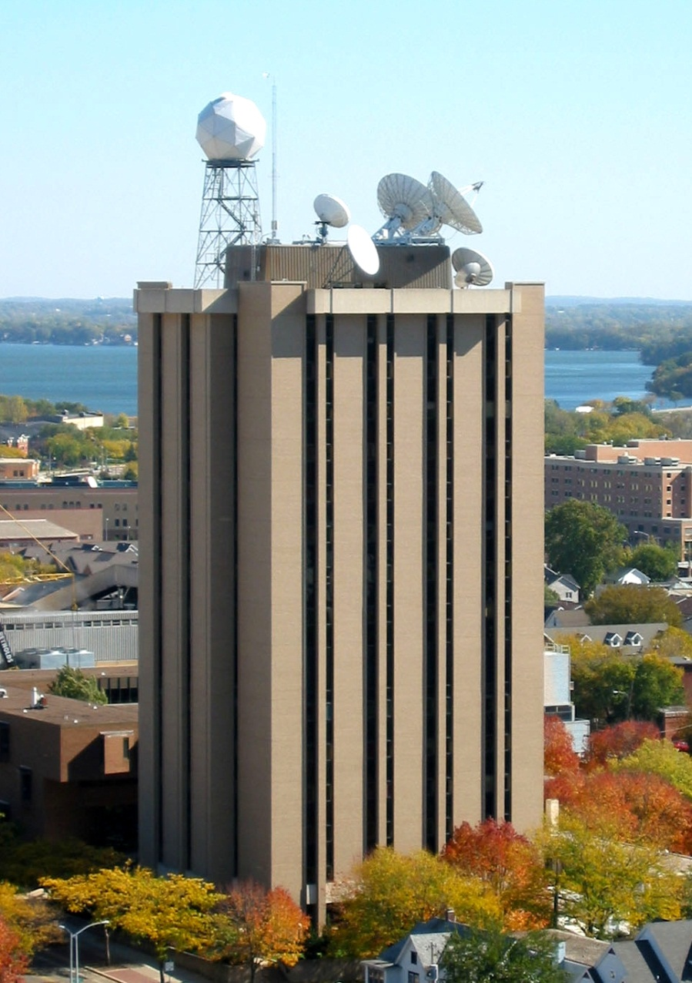





Preparing AI-Enabled Weather and Environment Satellite Big Data
Allen Huang
Space Science & Engineering Center (SSEC) University of Wisconsin-Madison
1st Workshop on Leveraging Artificial Intelligence (AI) in the Exploitation of Satellite Earth Observations and Numerical Weather Prediction
NOAA Center for Weather and Climate Prediction, College Park, Maryland
April 23-25, 2019

Slide 2
Preparing AI-Enabled Weather and Environment Satellite Big Data
Data Is The Foundation For Artificial Intelligence And Machine Learning - Forbes
It therefore seems counterintuitive that only 3-5 percent of satellite observations are actually used in preparing numerical weather forecasts – Space News – Dr. Sid Boukabara
According to a recent report from AI research and advisory firm Cognilytica, over 80% of the time spent in AI projects are spent dealing with and wrangling data - Forbes

Slide 3
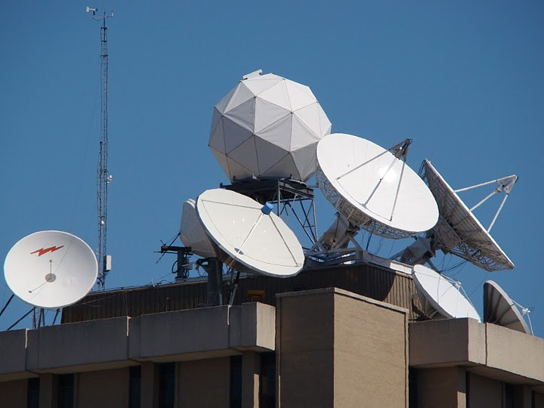
SSEC Data Center Antennas
C-Band
11 meter heated (87° West – SES-2, POES Wallops Relay, MSG)
7.3 meter backup (101° West – SES-1, POES Fairbanks Relay, MTSAT, Noaaport)
6.3 meter heated (101° West – SES-1, POES Fairbanks Relay, MTSAT, Noaaport)
L-Band
7.3 meter (75° West –GOES-East Primary)
4.6 meter (135° West –GOES-West Primary)
4.5 meter (60° West –GOES-SA auto tracking)
4.5 meter (90° West –GOES-test/spare)
3.7 meter (offline spare)
X-Band
4.4 meter (Tracking – EOS)
X/L Band
2.4 meter (Tracking – Suomi NPP, EOS, metop, FY1 and FY3)
3

Slide 4
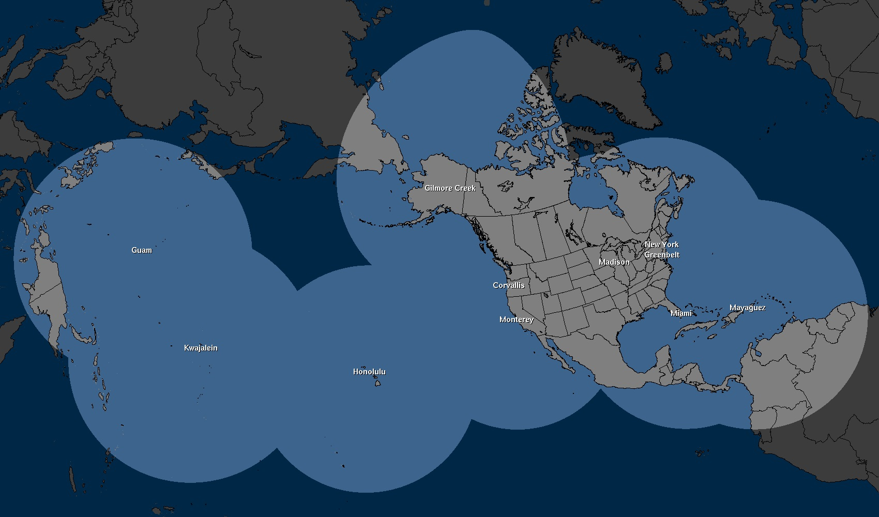
NOAA DBNet - Governmental & Academic partners
Name Location
Honolulu Community College Honolulu, HI
NOAA “Sandy Dog” Gilmore Creek, AK
UW-Madison Madison, WI
NOAA AOML Miami, FL
Univ. Of Puerto Rico Mayaguez, PR
NOAA Monterey Monterey, CA
NOAA Guam Guam, Marianas Islands
Oregon State Univ. Corvallis, OR
Hampton Univ. Hampton, VA
CREST/CCNY New York City, NY

Slide 5
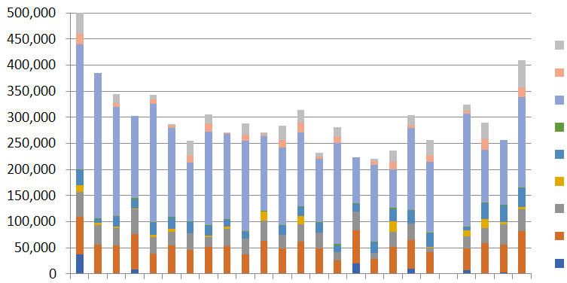
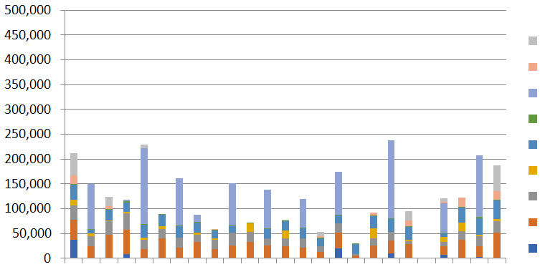
Radiance observation counts w/ and w/o DBNet data
Sample from 22 Aug. 2017
ALL satellite obs
CrIS
ATMS
IASI
SEVIRI
SNDR
SSMI
MHS
AMSU
AIRS
Missing Data
00 01 02 03 04 05 06 07 08 09 10 11 12 13 14 15 16 17 18 19 20 21 22 23 00 z
NO DBNet satellite obs
CrIS
ATMS
IASI
SEVIRI
SNDR
SSMI
MHS
AMSU
AIRS
00 01 02 03 04 05 06 07 08 09 10 11 12 13 14 15 16 17 18 19 20 21 22 23 00 Z
42 39 36 39 69 31 63 29 22 53 27 48 25 52 19 77 14 39 78 37(100)37 42 81 46 %
38% 54% 34% 33% 49% 43% 58% 56%
Missing Data
00 01 02 03 04 05 06 07 08 09 10 11 12 13 14 15 16 17 18 19 20 21 22 23 00 z

Slide 6
CSPP – NOAA Satellite S/W tool for global community
CSPP (Community Satellite Processing Package) is a collection of software systems for processing data from 7 meteorological satellites (S-NPP, METOP A/B, NOAA, FY-3) so far.
The primary goal of CSPP is to support users who
Receive satellite data via direct broadcast;
Create Level 1B and higher level products and applications (SDR, EDR & IDR) in real time.
Conceived by Dr. Goldberg of NOAA & funded by JPSS NOAA since 2011.
http://cimss.ssec.wisc.edu/cspp/

Slide 7


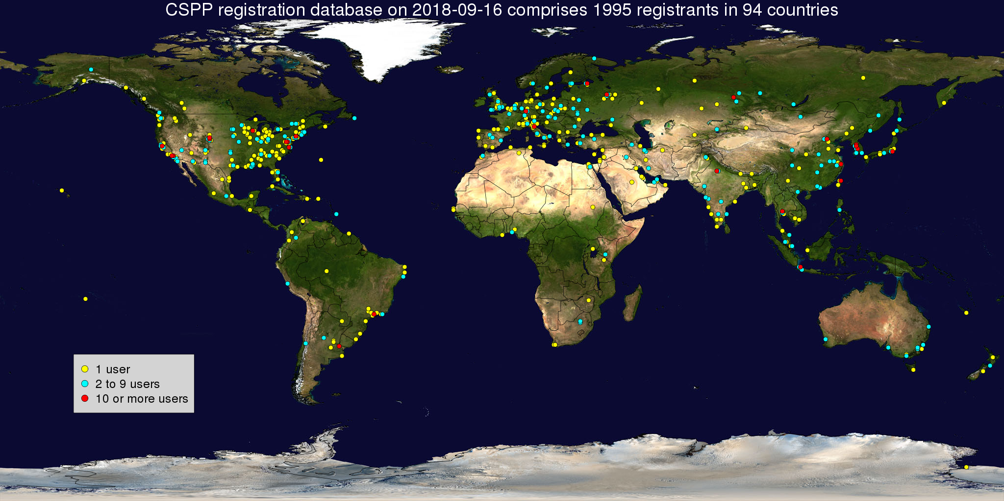
CSPP Registrants ~2,088 in 97 countries so far

Slide 8
CSPP LEO Software
CSPP Software | Product Description
1. SDR | S-NPP and NOAA-20 VIIRS, CrIS, and ATMS geolocated and calibrated earth observations.
2. VIIRS EDR | VIIRS imager cloud mask, active fires, surface reflectance, vegetation indices, sea surface temperature, land surface temperature, and aerosol optical depth.
3. HSRTV | Hyperspectral infrared sounder retrievals of temperature and moisture profiles, cloud properties, total ozone, and surface properties.
4. Polar2Grid | Reprojected imagery (single and multi-band) in GeoTIFF and AWIPS formats.
5. Hydra | Interactive visualization and interrogation of multispectral imagery and hyper spectral soundings.
6. MIRS | Microwave sounder retrievals of temperature and moisture profiles; surface properties; snow and ice cover; rain rate; and cloud/rain water paths.
7. CLAVR-x | Multispectral imager retrievals of cloud properties; aerosol optical depth; surface properties; ocean properties.
8. NUCAPS | Combined hyperspectral infrared sounder and microwave sounder retrievals of temperature and moisture profiles, cloud cleared radiances, and trace gases.

Slide 9
CSPP LEO Software Continued
CSPP Software | Product Description (continued)
9. IAPP | Combined infrared sounder and microwave sounder retrievals of temperature and moisture profiles, water vapor, total ozone, and cloud properties.
10. ACSPO | Multispectral imager retrievals of sea surface temperature.
11. Sounder Quicklook | Projected 2D maps of temperature and water vapor retrievals, and Skew-T profiles for individual atmospheric profiles.
12. VIIRS Imagery EDR | VIIRS imagery subset in Ground Track Mercator.
13. VIIRS Active Fires | S-NPP VIIRS M-Band fire and fire radiative power.
14. VIIRS Flood Detection | VIIRS 375m resolution global flood detections.

Slide 10
CSPP Software/Sensor Matrix January 2019
CSPP Software | Suomi-NPP | NOAA-20 | Metop-A/B | NOAA-18/19 | Terra | Aqua
1. SDR | VIIRS,CrIS,ATMS | VIIRS,CrIS,ATMS | AAPP | AAPP | SeaDAS | SeaDAS
2. HSRTV | CrIS NSR, FSR | CrIS NSR, FSR | IASI | N/A | N/A | AIRS
3. Polar2Grid | VIIRS, ATMS | VIIRS, ATMS | AVHRR | AVHRR | MODIS | MODIS
4. HYDRA | VIIRS,CrIS,ATMS | VIIRS,CrIS,ATMS | AVHRR, IASI | AVHRR, AMSU | MODIS | MODIS, AIRS
5. MIRS | ATMS | ATMS | AMSU, MHS | AMSU, MHS | N/A | N/A
6. CLAVR-x | VIIRS | Coming Soon | AVHRR | AVHRR | MODIS | MODIS
7. NUCAPS | CrIS, ATMS | CrIS, ATMS | IASI, AMSU, MHS | N/A | N/A | Future Version
8. IAPP | N/A | N/A | HIRS, AMSU, MHS | HIRS, AMSU, MHS | N/A | N/A
9. ACSPO | VIIRS | Coming Soon | AVHRR | AVHRR | MODIS | MODIS
10. Sounder Quicklook | CrIS, ATMS | Coming Soon | IASI, AMSU, MHS | AMSU, MHS | N/A | AIRS
12. VIIRS Flood | VIIRS | VIIRS | N/A | N/A | N/A | N/A
VIIRS Active Fires | VIIRS | Coming Soon | N/A | N/A | N/A | N/A

Slide 11
6. MIRS
MIRS (Microwave Integrated Retrieval System) creates atmospheric profiles, precipitation, and surface products from microwave sounder data.
Heritage | Developed at NOAA/NESDIS by Quanhua (Mark) Liu and Chris Grassotti, Sid Boukabara
Satellites/Sensors | Suomi-NPP and NOAA-20 ATMS; Metop-A/B AMSU, MHS; NOAA-18/19 AMSU, MHS.
Products | Temperature and moisture profiles, total precipitable water, surface skin temperature and emissivity, rain rate, cloud liquid water, rain water path, ice water path, liquid water path, sea ice concentration, snow water equivalent, and snow cover.
Features | Multi-sensor common algorithm. Physics-based retrieval. Retrieves land and ocean products in all sky conditions. Extensively validated and documented.

Slide 12
NUCAPS (NOAA Unique Combined Processing System)
NUCAPS retrieves atmospheric temperature, moisture, & trace gases from combined infrared and microwave observations.
Heritage | Developed at NOAA/NESDIS/STAR by Antonia Gambacorta, Nadia Smith and Chris Barnet.
Satellites/Sensors | Suomi-NPP and NOAA-20 CrIS/ATMS; Metop-A and Metop-B IASI/MHS/AMSU-A
Products | Temperature, water vapor, and ozone profiles; trace gas profiles including ozone, carbon monoxide, methane, carbon dioxide, nitrous oxide, sulphur dioxide; infrared and microwave surface emissivity; cloud cleared radiances.
Features | Multi-sensor common algorithm. NUCAPS is the official NOAA sounding product for JPSS

Slide 13
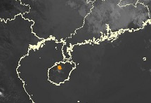
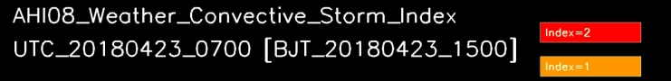
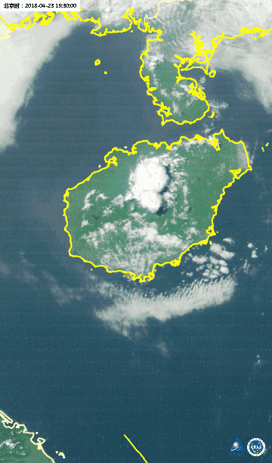
Storm Warning In Pre-convection Environment (SWIPE) - A new real-time product based on high resolution geostationary satellite and NWP data with AI Jun LI (Jun.Li@ssec.wisc.edu), Zhenglong Li, CIMSS/University of Wisconsin-Madison
Random forest is applied to predict the possibility of local severe storm outbreak based on geostationary satellite (AHI) observations and short term NWP forecast output. A 40-min lead time is achieved for the case demonstrated.
SWIPE sees at 14:50 pm, storm initiated at 15:30 pm, 40 min ahead!

Slide 14
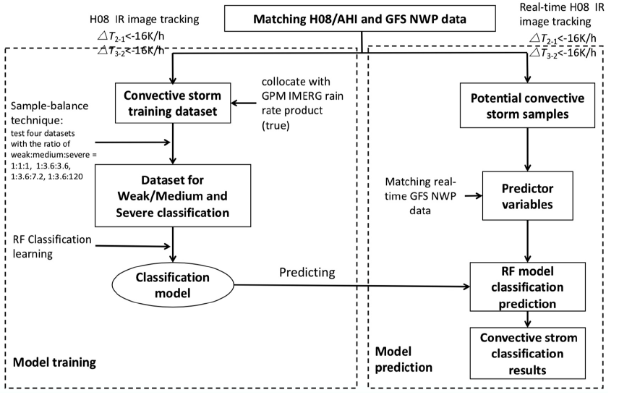
Storm Warning In Pre-convection Environment (SWIPE)

Slide 15
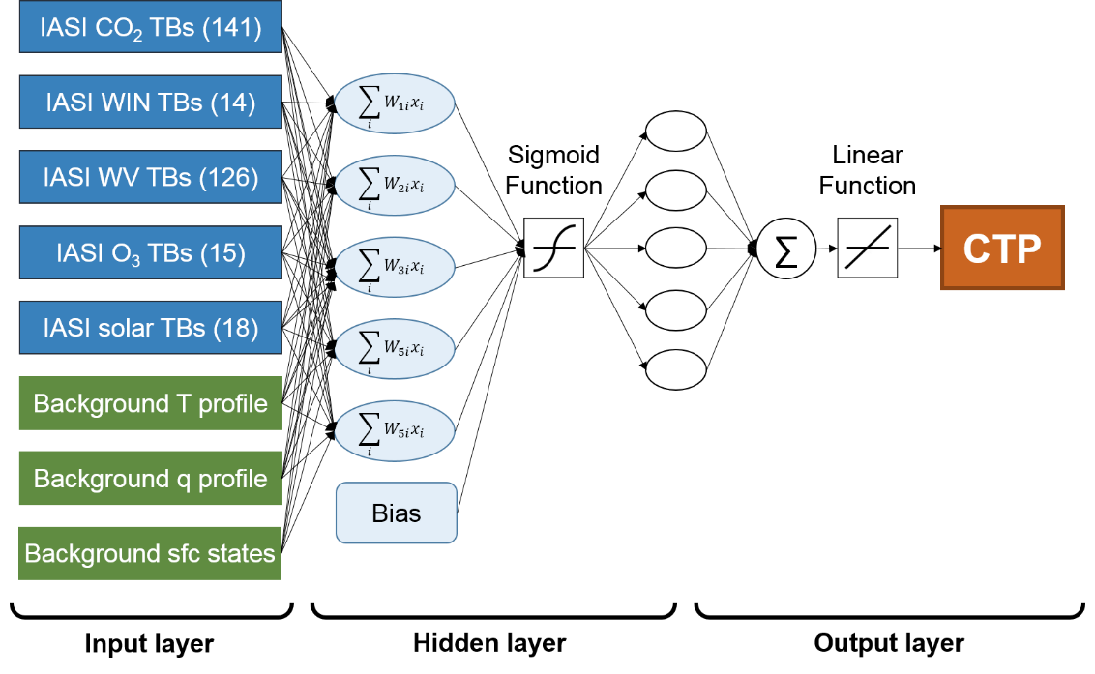
ANN for CTP retrieval optimization
8 types of Inputs:
IASI 314 TBs,
Background 43L T/q profiles
Background sfcT/q, skin T
1 Output: CTP
Stability
Convection Index
Icing potential
Turbulence
others
Training Dataset
• 28039 profiles
8380 (30°N-90°N), 7922 (30°S-30°N), 8379 (90°S-30°S)
• 3 Layers: an Input layer,
A Hidden layer, & an Output Layer
• 5 neurons in hidden layer
• Activation Function:
Tangent sigmoid function
Validation Dataset
• 6018 profiles (90°S-90°N)
2044 (30°N-90°N), 1930 (30°S-30°N), 2044 (90°S-30°S)
After Ahreum Lee, B.J. Sohn & others SNU

Slide 16
Data Format for CSPP Processing (1/5)
Support 12 data formats including:
RDRs (Lev 0), SDRs (Lev 1), and EDRs (Lev 2) data format: netCDF3/4 or HDF4/5
Ancillary/auxiliary data format: HDF4, HDF4/5, netCDF3/4, GRIB1/2
Radiance channel sets for NWP DA: BUFR
Other Products: Binary, ASCII, HDFEOS, GeoTIFF, KML

Slide 17
Data Format for CSPP Processing (2/5)
netCDF (Network Common Data Form):
is a set of software libraries and self-describing, machine-independent data formats that support the creation, access, and sharing of array-oriented scientific data
The core library is written in C, and provides an API for C, C++ and two APIs for Fortran applications, one for Fortran 77, and one for Fortran 90, and Java

Slide 18
Data Format for CSPP Processing (3/5)
HDF4/5:
Hierarchical Data Format (HDF) is a set of file formats (HDF4, HDF5) designed to store and organize large amounts of data
HDF is supported by many commercial and non-commercial software platforms, including Java, MATLAB, Scilab, Octave, Mathematica, IDL, Python, R, Fortran, and Julia. The freely available HDF distribution consists of the library, command-line utilities, test suite source, Java interface, and the Java-based HDF Viewer (HDFView).[2]
The current version, HDF5, differs significantly in design and API from the major legacy version HDF4.

Slide 19
Data Format for CSPP Processing (4/5)
GRIB (GRIdded Binary or General Regularly-distributed Information in Binary form) is a concise data format commonly used in meteorology. It is standardized by the World Meteorological, and is used operationally worldwide by most meteorological centers, for Numerical Weather Prediction output (NWP). A newer generation has been introduced, known as GRIB second edition, and data is slowly changing over to this format. Some of the second-generation GRIB are used for derived product distributed in Eumetcast of Meteosat Second Generation. Another example is the NAM (North American Mesoscale) model.

Slide 20
Data Format for CSPP Processing (5/5)
The Binary Universal Form for the Representation of meteorological data (BUFR) is a binary data format maintained by the World Meteorological Organization (WMO).
BUFR was designed to be portable, compact, and universal. Any kind of data can be represented, along with its specific spatial/temporal context and any other associated metadata. In the WMO terminology, BUFR belongs to the category of table-driven code forms, where the meaning of data elements is determined by referring to a set of tables that are kept and maintained separately from the message itself

Slide 21
Data Labeling - General
Need to convert the data into a common format and import it to a common system, where it can be used to build models.
Labeling is an indispensable stage of data preprocessing in supervised learning. Historical data with predefined target attributes (values) is used for this model training style. An algorithm can only find target attributes if a human mapped them.

Slide 22
Data Labeling – Specific to Satellite Data for Weather
In-situ Data:
Co-location: Spatial and geometrically
Synchronization: Temporal
Characterization: no guarantee 100% matching
Well Known performance (considered gold standard)
Synthetic/Simulated:
Mimics real data
One to one mapping
Required accurate model between data pair
Need model error estimation
Need error estimation of Observations

Slide 23
Preparing AI-Enabled Weather and Environment Satellite Big Data Summary (1/2)
CSPP:
14 S/W packages for
25 sensor suites covering
7 international LEO satellites uses
9 data formats with
Over 9 legacy and modern library/language and used by
Over 2,000 users in 97 countries (including 22 government agencies)
To lower the barriers of entry in increasing optimal use of comprehensive NOAA big satellite data, within CSPP, can we provide an AI friendly infrastructure for satellite community?

Slide 24
Preparing AI-Enabled Weather and Environment Satellite Big Data Summary (2/2)
AI is contagious, adopting AI and ML is a journey, not a silver bullet that will solve problems in an instant. It begins with gathering data into simple visualizations and statistical processes that allow you to better understand your data and get your processes under control – Willem Sundblad/Forbes
If CSPP is to embrace AI it will be to:
Unified input/output, ancillary/auxiliary data format
Labeled the data & leverage the tool
Co-Located in-situ with satellite obs.
Use synthetic/simulated as training data pool
Incrementally and consistently increase/enhance big satellite data
Leverage emerging AI algorithms best suited for wx/environment applications
Achieving a goal for wx. Satellite community to ~80% using AI algorithms with only ~20% in preparing the data

