Slide 1
Development of Convolutional Neural Networks for Ice and Flood Detection from Synthetic Aperture Radar (SAR)
Sean Helfrich¹ , Christopher Jackson¹ , Xiaofeng Li¹ , Kaden Weaver¹ , Shaowu Bao² , and Francis Monaldo¹
NOAA/NESDIS/STAR—5830 University Research Ct., Suite 3233, College Park, MD 20740, USA
Coastal Carolina University, 290 Allied Drive, Conway, SC 29526 USA

Slide 2
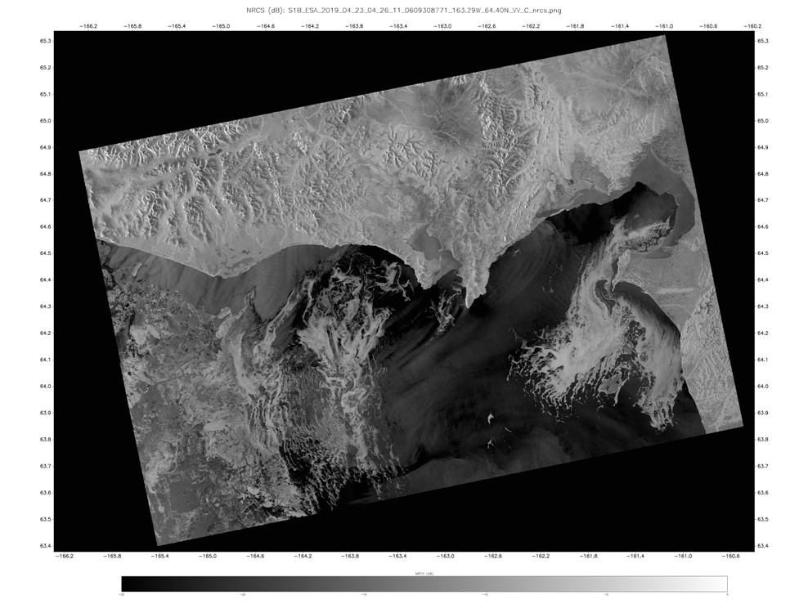
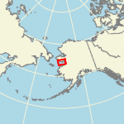
What is SAR?

Slide 3
SAR Basics
A SAR transmits radar signals and receives backscattered returns whose levels are directly dependent on the roughness of the ocean’s surface.
characteristic frequencies 400 MHz to 10 GHz, (3 to 75 cm wavelength)
SAR achieves its fine in the along track direction by using the Doppler shifts in the return signals that result from the SAR’s motion past a point on the surface.
Backscatter comes from surface roughness components.
Wind-generated short waves (capillary to short gravity waves (wavelengths between a few to a few tens of centimeters and periods less than one second) modulated by . longer gravity waves and currents which produce characteristic patterns on the radar imagery which reveal the presence of the feature.
Sea Ice surface roughness
SAR imagery of the ocean surface is a very complex mix of oceanographic and atmospheric phenomena and the ocean’s motion during the SAR parameters (frequency , polarization, imaging geometry)
Challenge to derive quantitative information on what these image patterns uniquely provide on upper ocean processes and air-sea exchange.

Slide 4
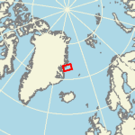
Current SAR Automated Ice Extent
2018-03-11 18:28:36 UTC, 18.89W,73.34N
Input parameters:
Difference between SAR and GFS model wind speed,
Wind speed variance,
HH/HV cross correlation,
SST and Past IMS ice extent
Each is computed over a 2km x 2km window

Slide 5
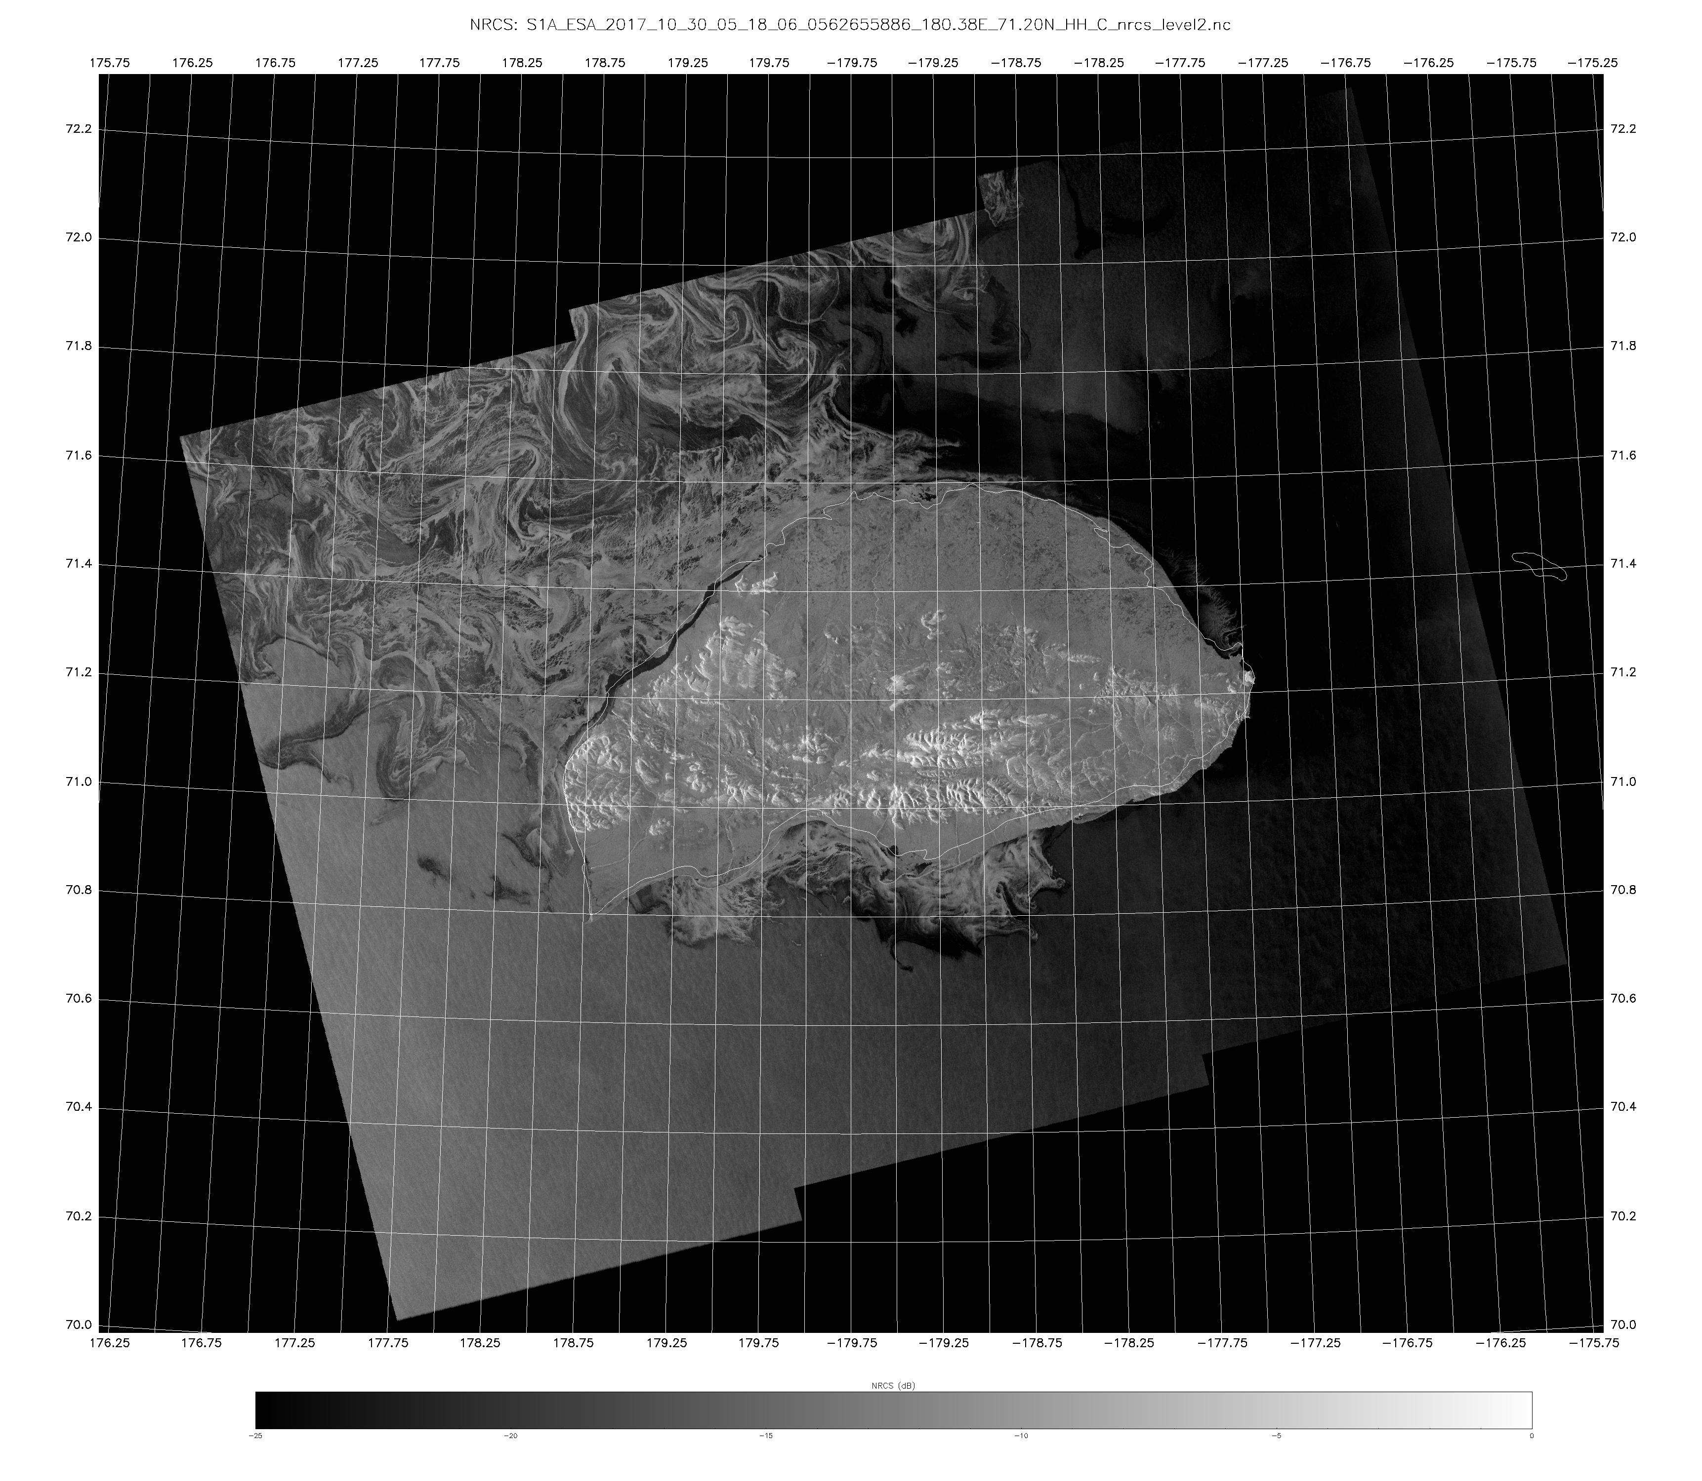
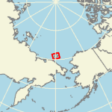
The Ice Type Challenge
Wide variety of sea ice types
and roughness characteristics

Slide 6
Objectives
Explore how to effectively apply the growing availability of Synthetic Aperture Radar (SAR) data
Explore machine/deep learning to assist ice and flood analysis
Seek path to reduced time needed to generate flood and ice maps
Reduce human bias
Generate automated ice and flood concentration
This presentation is to present the potential and show where we are in the exploration

Slide 7
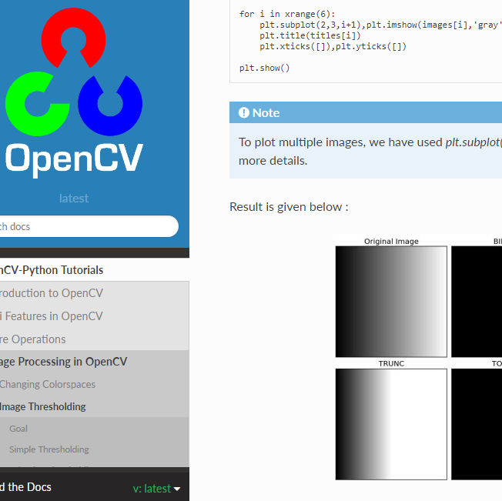
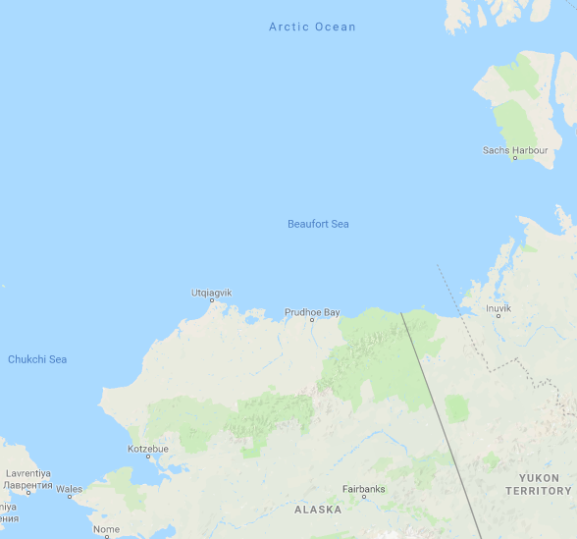
Ice CNN - Data and Software
SAR Normalized Radar Cross Section
From Sentinel 1 (ESA), collected at 80m resolution, resampled to 500m
Using both HH and HV polarizations
Training Data from July 2015 –Oct. 2015, Beaufort Sea north of AK
Data Preparation: OpenCV
AI: Keras Functional API with TensorFlow backend

Slide 8
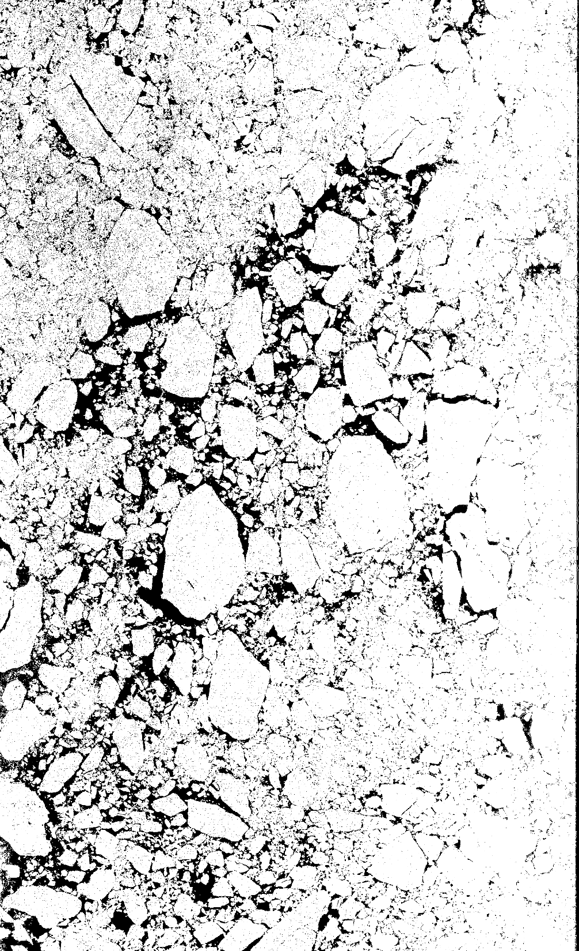
Ice CNN - Data Preparation
Cropped SAR imagery and applied threshold manually
Dataset: take square samples of pure ice or open water (according to threshold)
Each sample corresponds to binary identifier (1/0 ice/water)
Cropped HH scene
Mask created with manual threshold

Slide 9
Ice CNN - Model Architecture & Inputs
Model accepts two input samples (HH + HV)
Adapted model for different input sizes: 40x40, 25x25, 16x16, 8x8
Number of Training/Testing samples increases with smaller inputs
Architecture alternates twice between convolution and pooling before two fully-connected layers
Last layer classifies the entire input sample as either ice or water
Parameters: SGD optimizer, binary crossentropy loss

Slide 10
Ice CNN - Results
Training and testing accuracy over 90%
Pixelated mask output
False positives on striping and textured water
Tradeoff: detail + denoise vs filling
16x16 AI Output
SAR HH Scene
8x8 AI Output

Slide 11
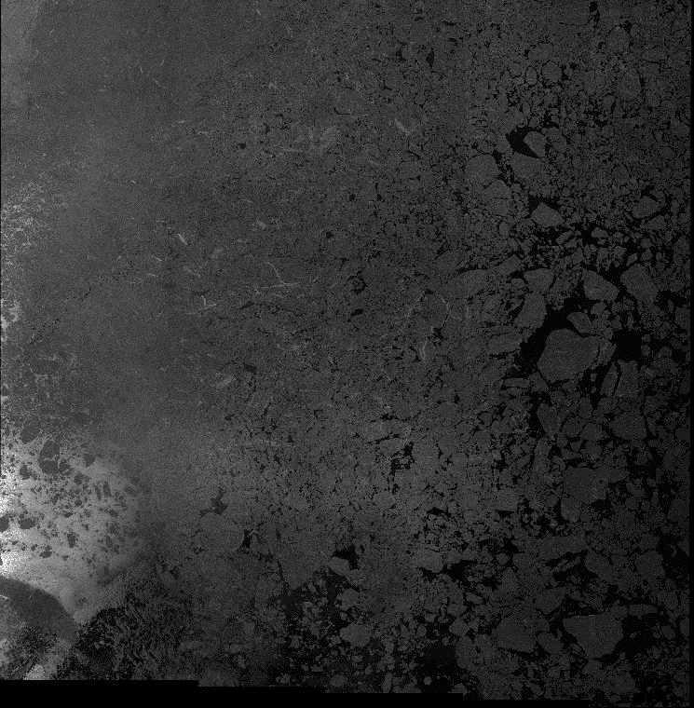
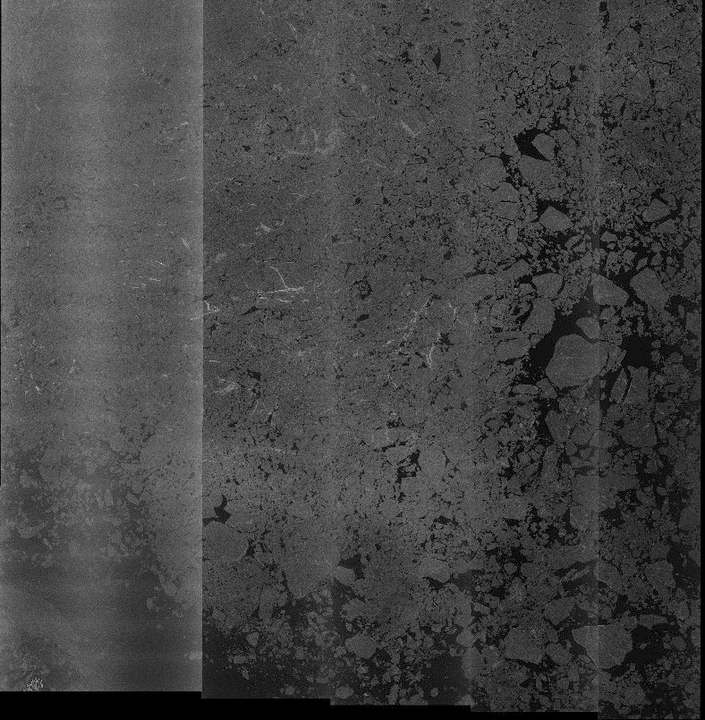
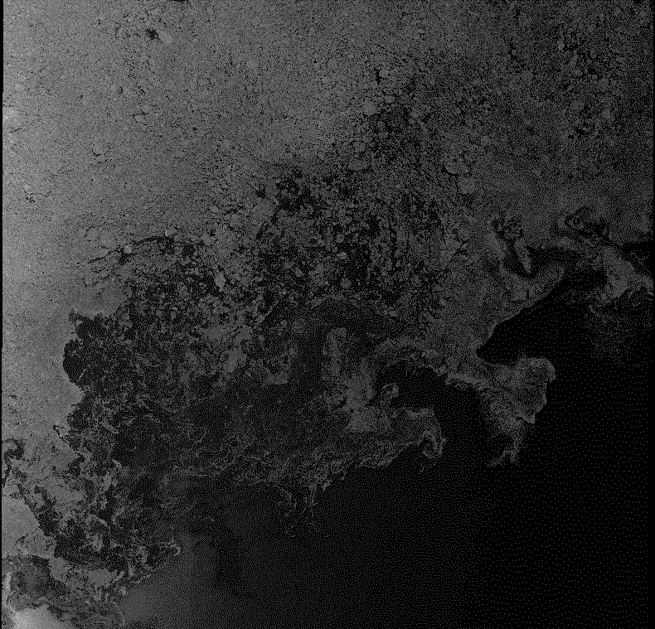
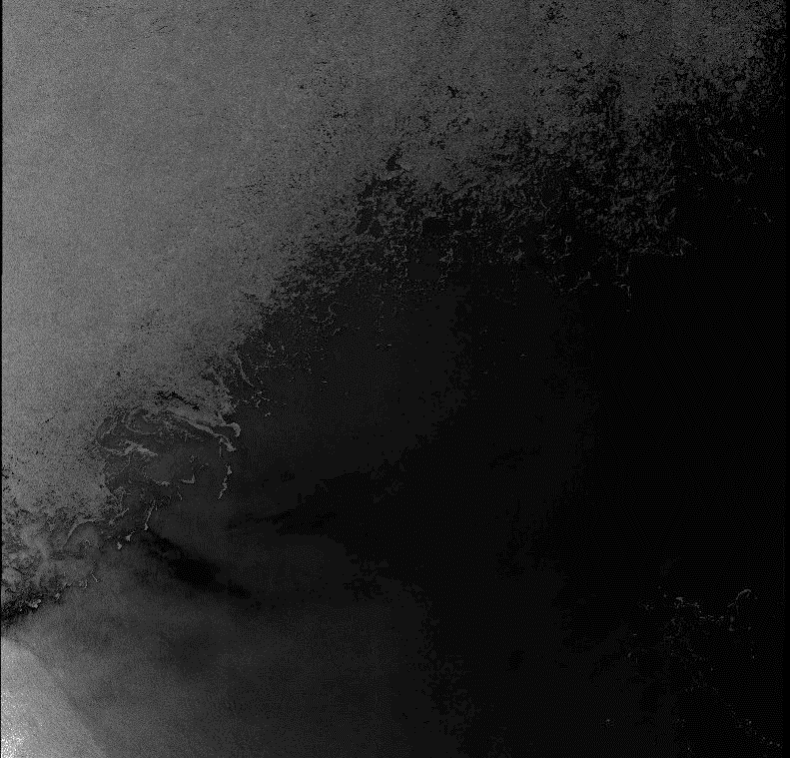
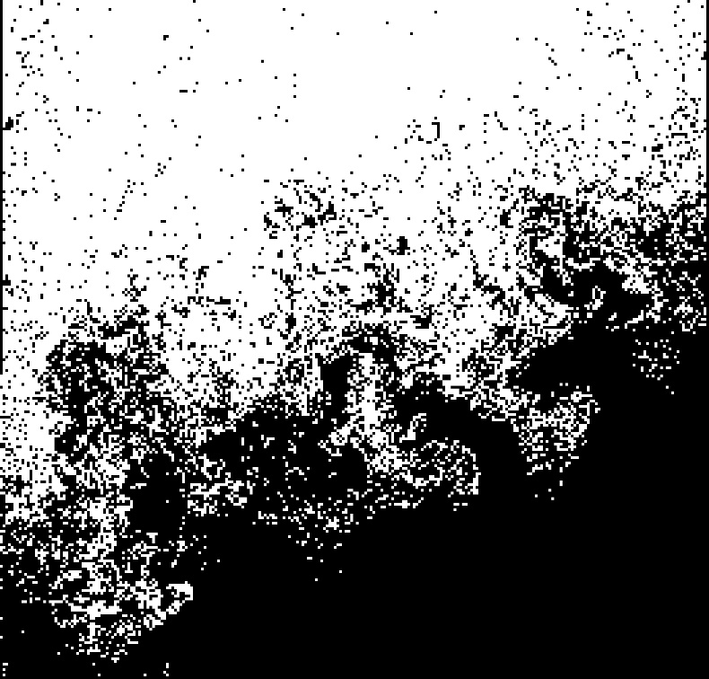
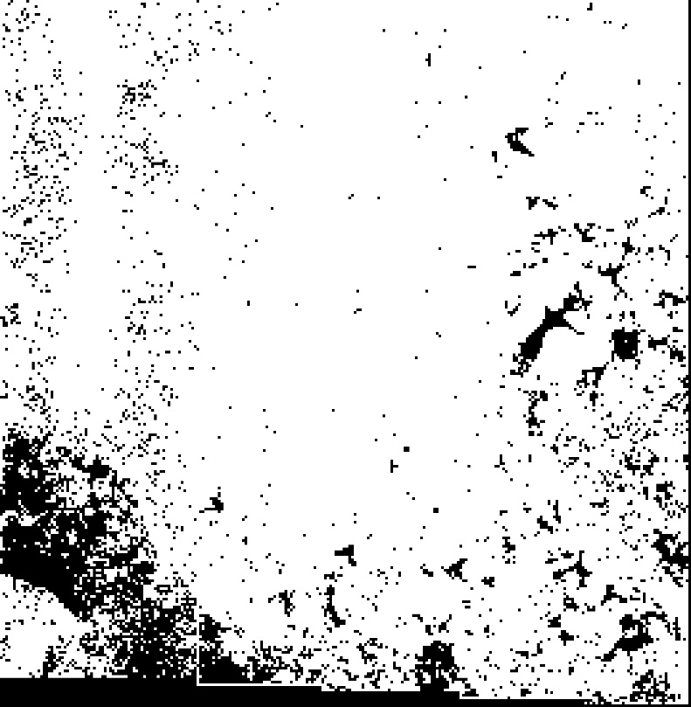
SAR HH
SAR HV
AI Prediction – 16x16
AI Prediction – 8x8

Slide 12
Ice CNN - Moving Forward
Threshold on smaller NRCS crops to improve ground truth
Use semantic segmentation approach
Add decoder to current network
Utilize prebuilt segmentation structure
Use mask to derive other measurements
Ice concentration
Floe size

Slide 13
Flood CNN - Model Architecture
Input: SAR time series images
Model: based on “U-Net”
Output: inundation map
Data: Sentinel-1A/B
Ground Truth: Copernicus Emergency Management Service rapid mapping products
Notes:
The model is based on the U-Net. Each image loop contains 4 images: before-storm, after-storm, ground truth, AI-based detection. Accuracy reaches 99%

Slide 14
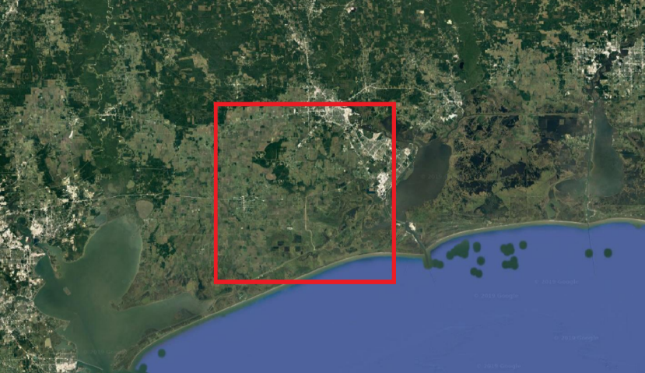
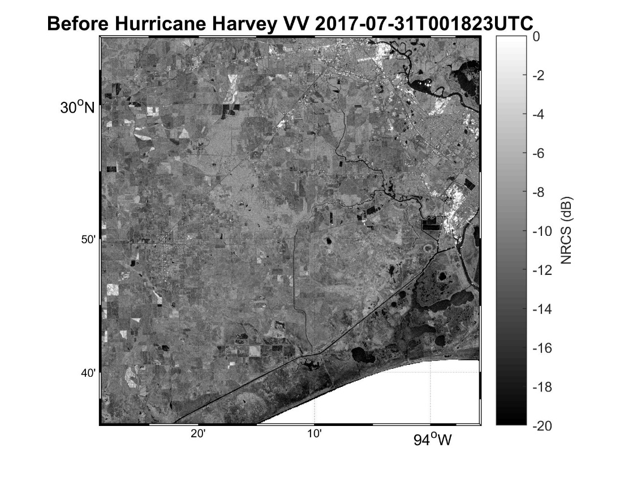
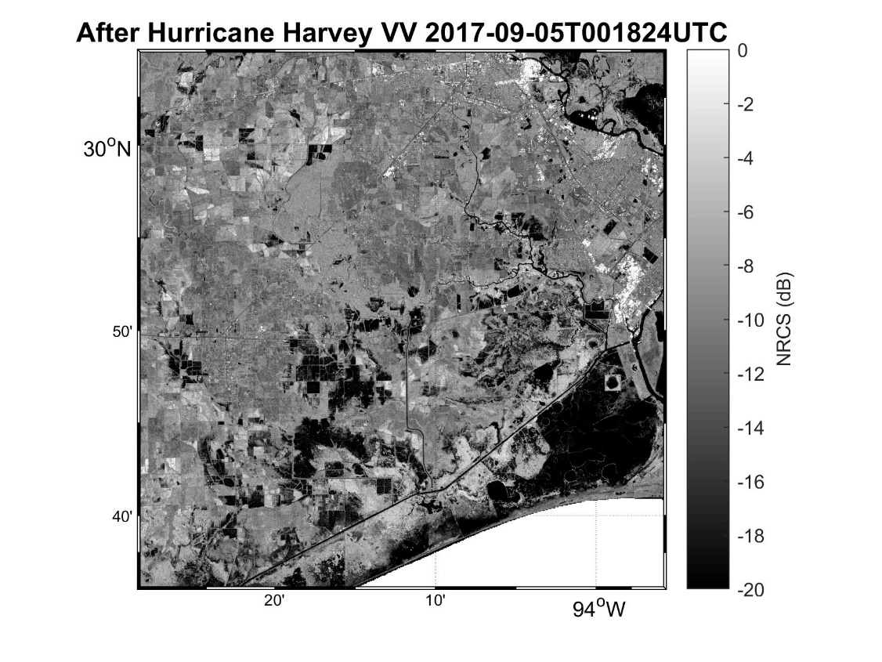
Flood CNN – Hurricane Harvey Example
Example 1: 2017 Hurricane Harvey – Houston Texas
Before Hurricane
After Hurricane

Slide 15
Flood CNN – Harvey Results
Inundation map of 2017 Hurricane Harvey
Sentinel-1, Mapping Accuracy: 98.91%

Slide 16
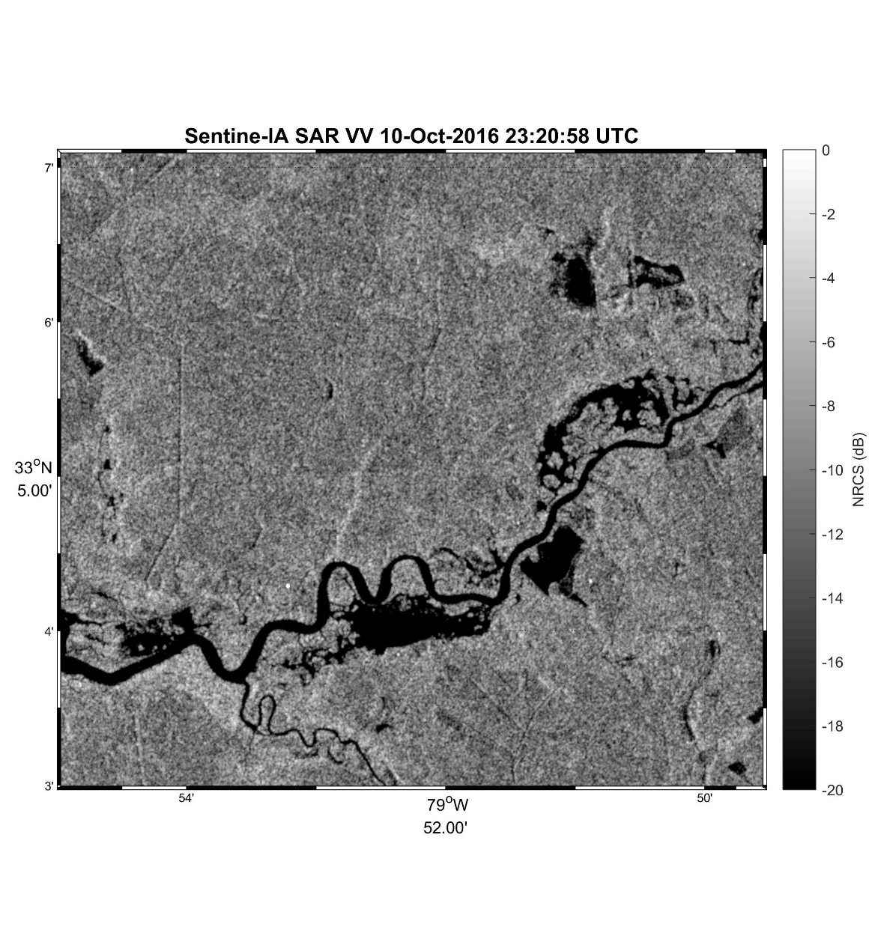
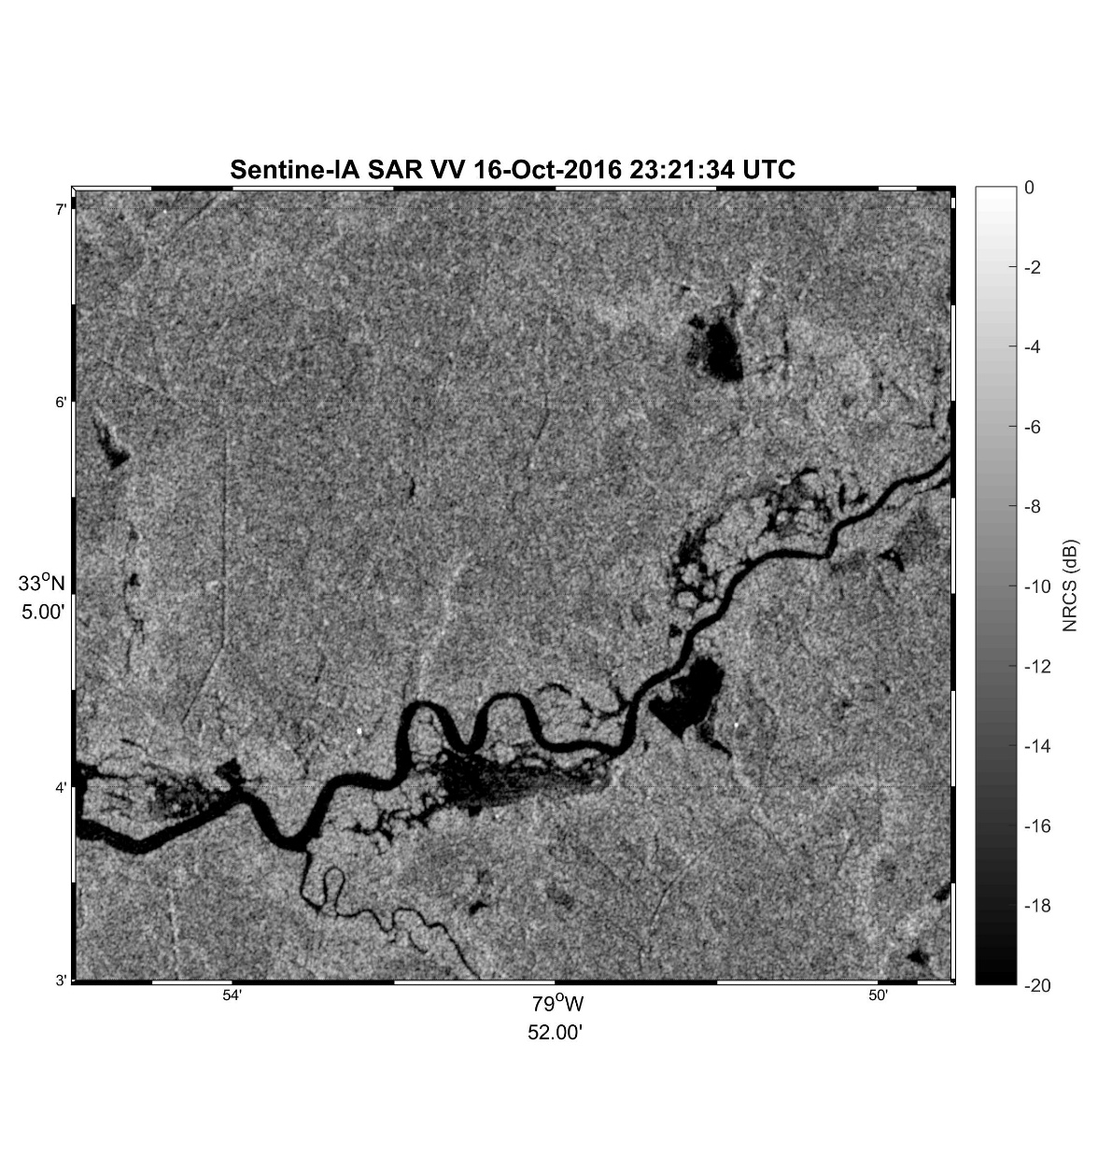
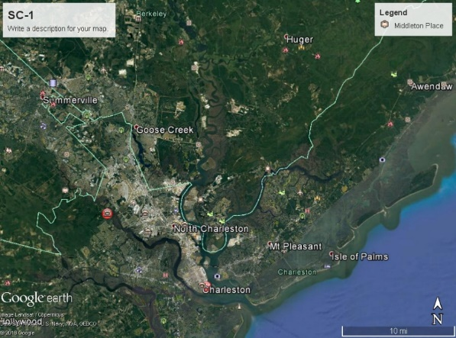
Flood CNN – Hurricane Matthew Example
Example 2: 2016 Hurricane Matthew – South Carolina
Before Hurricane
After Hurricane

Slide 17
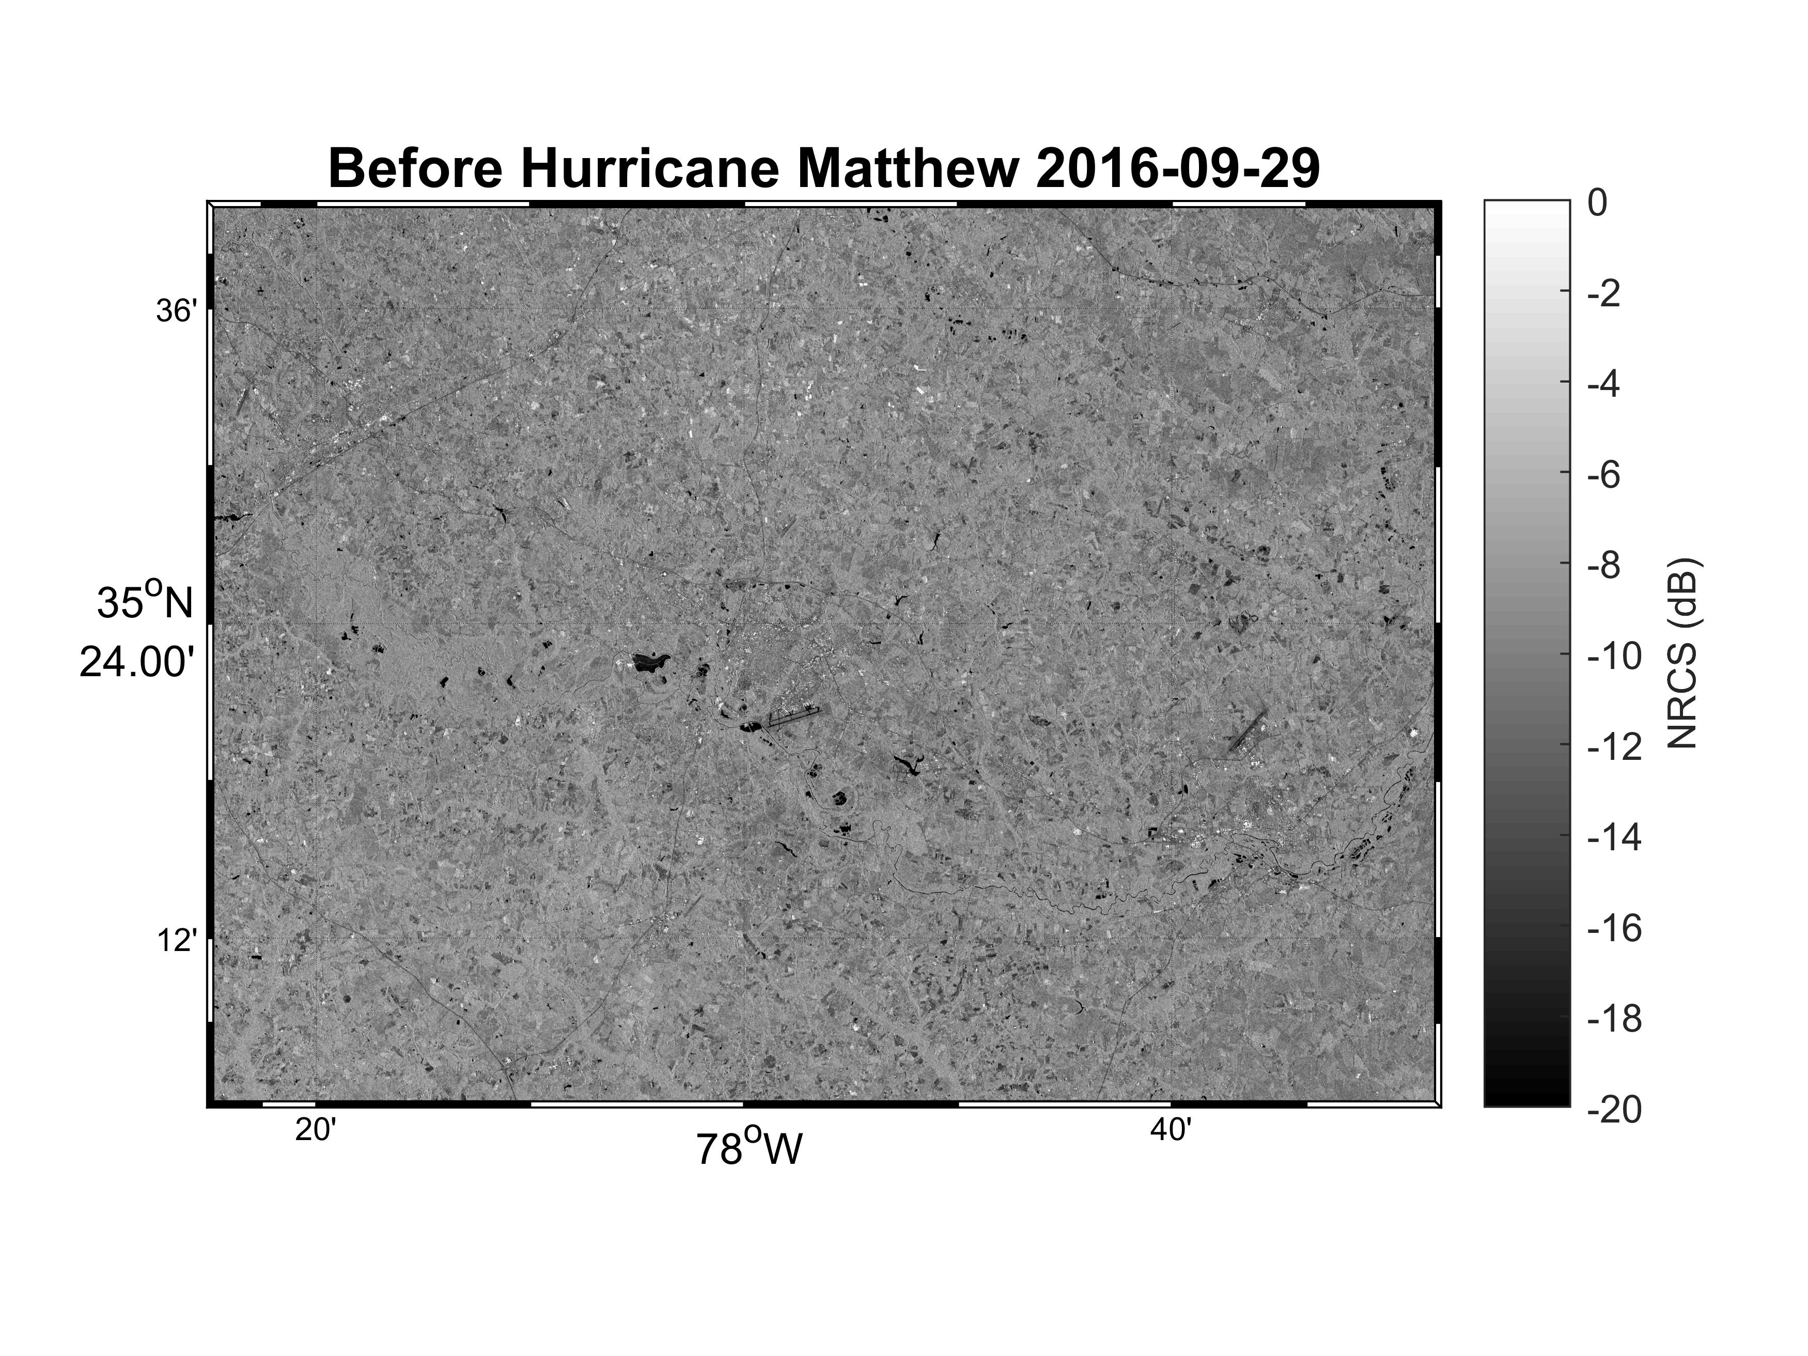
Flood CNN – Matthew Results
Inundation map of 2016 Hurricane Matthew
Sentinel-1, Mapping Accuracy: 99.07%
Notes:
The model is based on the U-Net. Each image loop contains 4 images: before-storm, after-storm, ground truth, AI-based detection. Accuracy reaches 99%

Slide 18
Flood CNN - Moving Forward
Further training and testing for other flood events
Establish a library of flood extent and floodwater depth data for the hurricanes that affected the proposed States (TX, FL, SC and NC) in the past five years, 2014-2018, for which SAR data are available.
Use half of these library data for the calibration of the interactively coupled river-ocean model to obtain an optimal set of parameters. Use the other half of the library data for the validation of the coupled model
Work with NWS operational river and hydrology groups to evaluate this model
Test ability to improve flood risk warning systems and facilitate communication between emergency management authorities and the public.
Use mask to derive other measurements
Flood concentration

Slide 19
Thank you

