Slide 1
Development of Merged Cloud Forecasts from Satellite and Numerical Model Data
1st Workshop on Leveraging AI in the Exploitation of Satellite Earth Observations and Numerical Weather Prediction
Jason Nachamkin, Melinda Surratt, David Sidoti, Yi Jin
Naval Research Laboratory
Krishna Pattipati, Adam Bienkowski
University of Connecticut

Slide 2
Outline
Feature selection
AI Method selection
Current experiments
Next steps

Slide 3
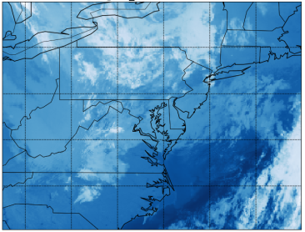
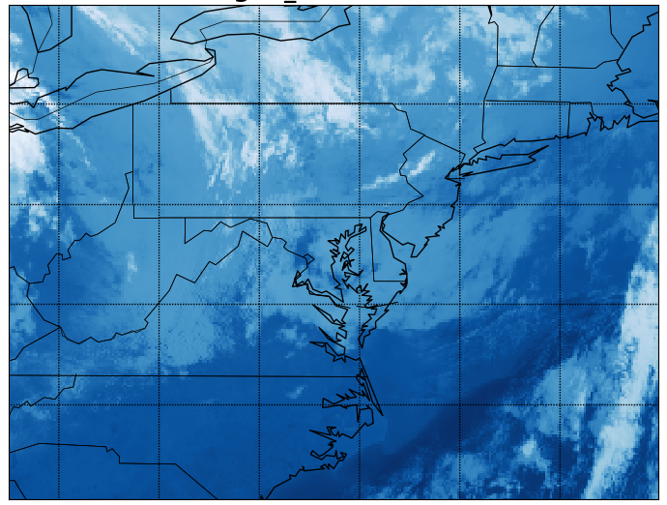
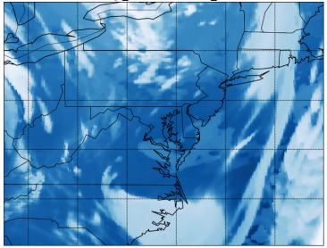
Brightness Temperature Forecasts
Predict GOES 16 Brightness temperatures (10.3 µm radiance) 3-hours into the future
  Initialize from 1200 GMT and predict for 1500 GMT
  GOES 16 observations up to 1200 GMT
  Data: (Jan 2018 – Present)
Determine important predictors and perform feature selection at individual points
GOES Predictors
Predictand GOES IR Brightness Temp 1500 GMT
Hourly IR Brightness Temps: 0600 – 1200 GMT
COAMPS Predictors
COAMPS 5 km, VACAPE 3-hr Forecasts valid 1500 GMT:

Slide 4
Feature Selection
Predictor (Feature) variables at all 41 points and 172 time epochs (1+6+240=247)
  Observed brightness temperature (K) valid at 1200 GMT (41,172)
  COAMPS 2-D fields valid at 1500 GMT(41,6,172)
    Latitude (deg), longitude(deg), land/sea mask (0 – ocean, 1 – land), terrain height (m)
    3-hr rainfall accumulation (mm), brightness temperature (K)
  COAMPS 3-D fields valid at 1500 GMT(41,12,20,172)
    Defined at 20 atmospheric levels (m): 10, 154, 525, 1038, 1489, 2094, 2494, 3004, 3329, 3704, 4129, 4604, 5129, 5704, 6329, 7004, 7729, 8504, 10204, 12104
    Air temp. (K), total pressure (mb), east/west wind (m/s), north/south wind (m/s), vertical wind (m/s), turbulent kinetic energy (m**2/s**2), water vapor mixing ratio (kg/kg), cloud water mixing ratio (kg/kg), graupel mixing ratio (kg/kg), ice crystal mixing ratio (kg/kg), rain mixing ratio (kg/kg), snow mixing ratio (kg/kg)
Predictand (response) variable: Observed brightness temperature (K) valid at 1500 GMT at each of the 41 points for each of the 172 times

Slide 5
Feature Selection
Predictand: Satellite brightness temperatures at the prediction time
Top 8 Features
  Observed brightness temperature valid at current time
  COAMPS predicted brightness temperature
  COAMPS predicted total water vapor at 7004 m
  COAMPS predicted total water vapor at 6329 m
  COAMPS predicted air temperature at 154 m
  COAMPS predicted total water vapor at 7729 m
  COAMPS predicted total water vapor at 8504 m
  COAMPS predicted air temperature at 10 m
For full grid experiments, observed and COAMPS predicted brightness temperatures were used as the sole input feature vectors

Slide 6
Method Selection
Partial Least Squares (PLS)
Linear regression (including LASSO)
Decision trees/Ensemble trees (Random Forests)
Support Vector Machine (SVM)
Gaussian Process Regression (GPR)
Generalized Regression Neural Network (GRNN)
Multi-Layer Perceptrons (MLP)
Long Short Term Memory (LSTM) Networks
Training: 70%; Validation: 15%; Testing: 15%

Slide 7
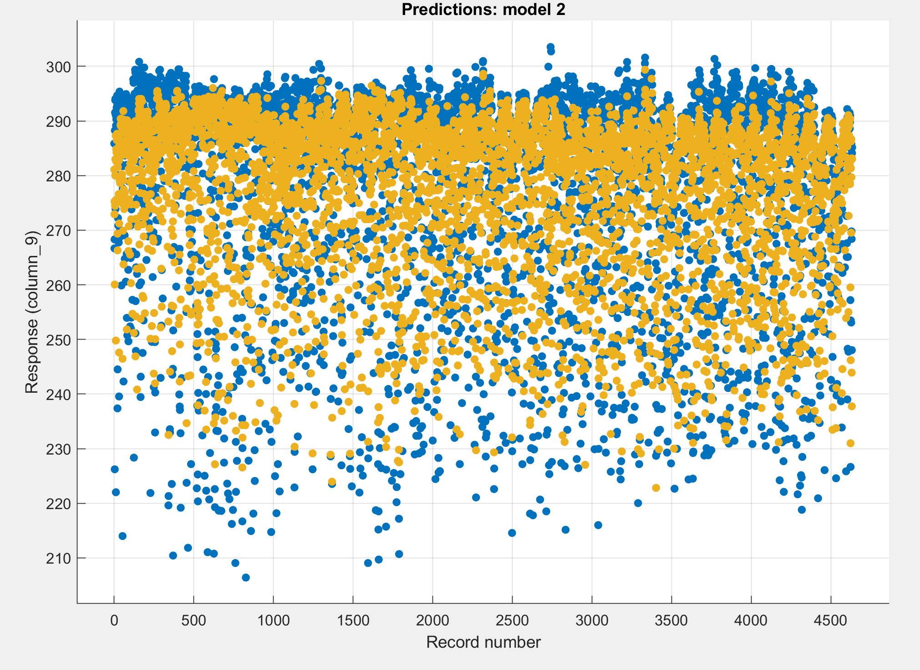
Residual Behavior
Response variable is noisy.
Best responses at high temperatures (clear skies).
Tendency to overestimate brightness temps, especially for cold cloud tops.
Forecasts are under-dispersed
Likely due to location errors
MLP
GPR
Prediction
Predictand

Slide 8
Initial Performance Summary
Some methods performed better than others
Most were unable to achieve RMSE values below 12 K
All were able to beat persistence and COAMPS alone
PLS outperformed
Delay | MSE (RMSE) of GPR-Matern 5/2 (5-fold cross validation) | MSE (RMSE) of MLP (av. of training + validation + testing)
0 | 163.39 (12.78) | 155.41 (12.47)
1 | 157.22 (12.54) | 155.47 (12.47)
2 | 155.85 (12.48) | 155.11 (12.45)
3 | 158.56 (12.59) | 152.04 (12.33)
COAMPS 3hr BT forecast MSE:
407 (20.2 K )
GOES Persistence MSE:
230 (15.2 K)
PLS MSE:
48 (6.9 K)

Slide 9
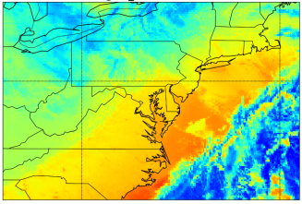
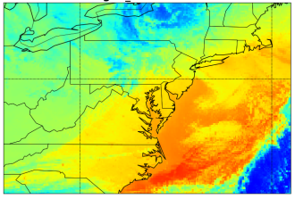
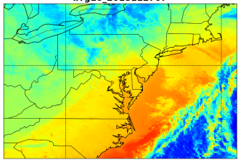
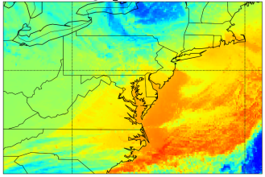
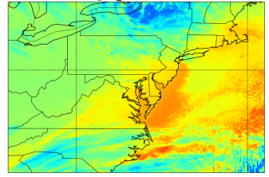
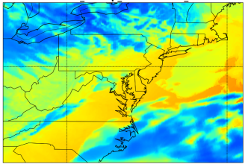
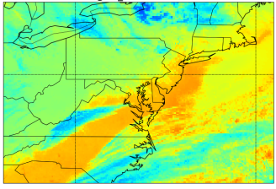
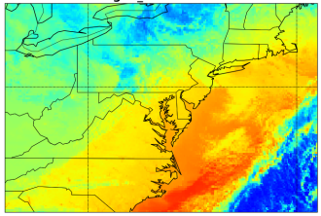
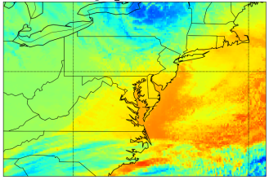

Full Grid Predictions
2018112712
GOES -6 hr
GOES -3 hr
Predictors:
  Previous 6-hours of hourly GOES 16 radiance
  COAMPS 3-hr Forecast
  Land/sea mask
  Terrain
GOES -5 hr
GOES -2 hr
GOES 0 hr
COAMPS +3 hr
GOES +3 hr Predictand
GOES -4 hr
GOES -1 hr
74482 Points, 284 Days (1 Jan 2018 – 31 Jan 2019)
Forecasts initialized at 12 UTC
Previous 6-hours of hourly GOES 16 radiance
COAMPS 3-hr Forecast
Land/sea mask
Terrain
200 220 240 260 280 300
Experimented with LSTM and PLS
Brightness Temperature (K)

Slide 10
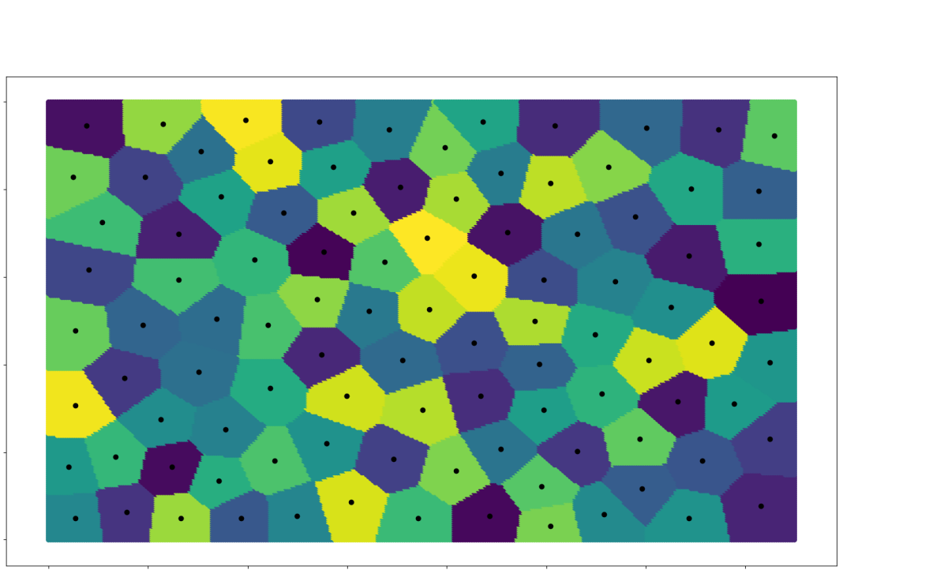
PLS Setup
2018112712
k-medoids, k = 100
44
42
40
Lat
38
36
k-medoids clustering approach for k=10,000
Clusters based on geodesic distance
PLS Model developed for each medoid
Tested on corresponding cluster points
PLS uses 13 Eigenvalue components
34
-84 -82 -80 -78 -76 -74 -72 -70
Lon

Slide 11
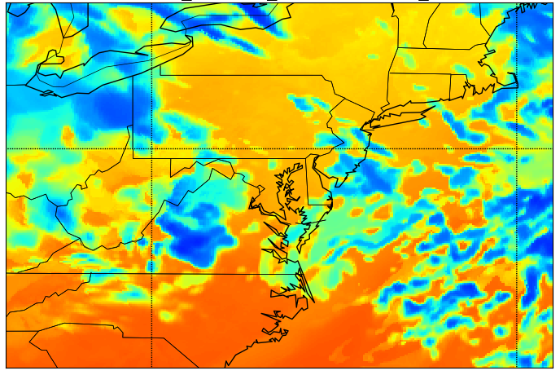
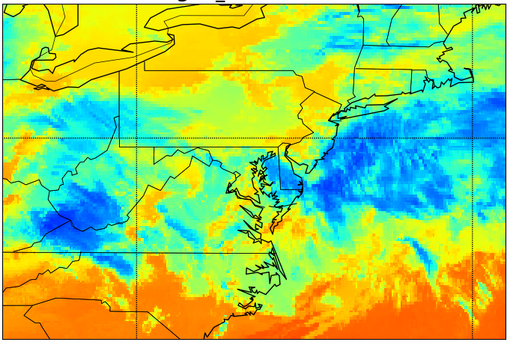
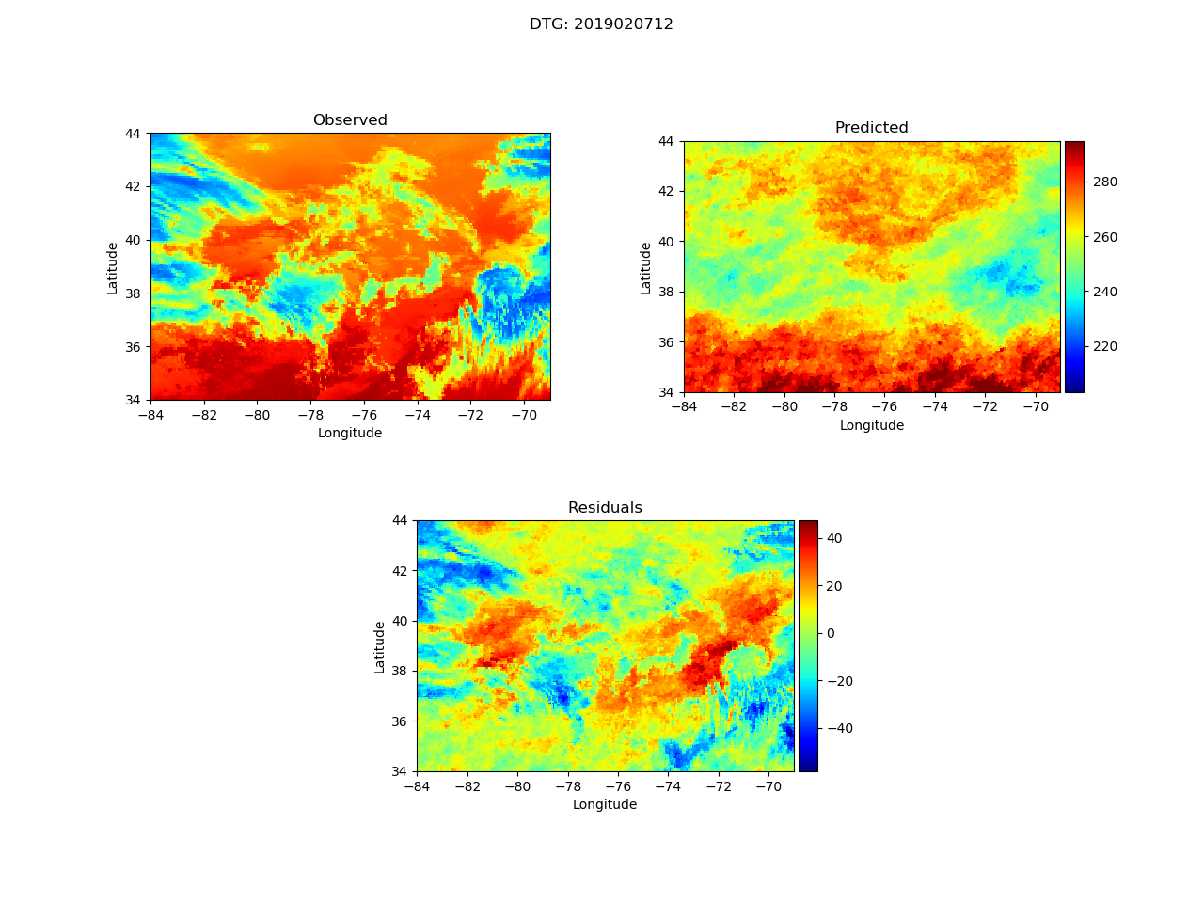
PLS Results
Forecast from 2019020712, Valid at +3 hours (15 UTC)
COAMPS 3-hr
GOES Persistence
GOES Observation
PLS 3-hr Forecast
K
Residuals
Cloud evolution very nonlinear
Results are very smooth
Ave RMSE = 10 K
3 hrs to train on laptop (Nvidia Quadro P3200 with Compute Capability 6.1)
~1 min for a single forecast
K

Slide 12


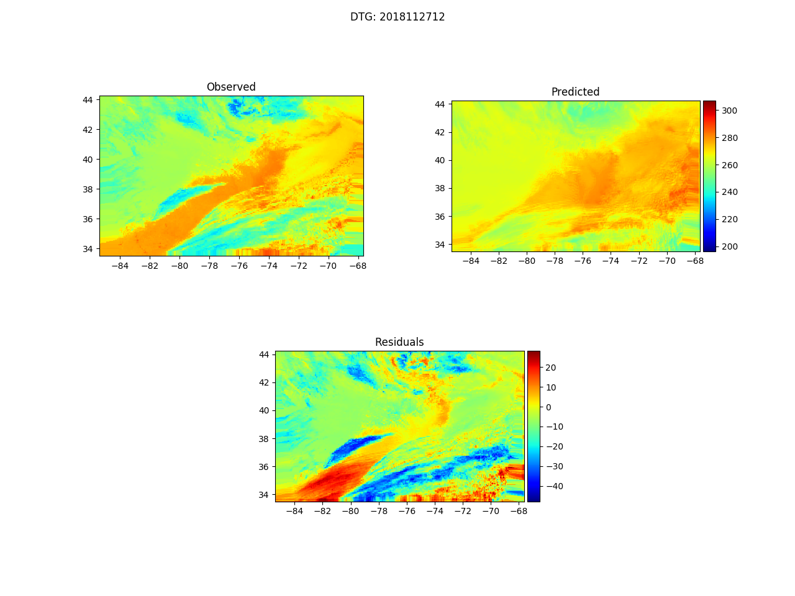
LSTM Results
Forecast from 2018112712, Valid at +3 hours (15 UTC)
COAMPS 3-hr
GOES Persistence
GOES Observation
LSTM 3-hr Forecast
K
Mostly generic settings
3 Convolution layers/batch normalization
3-D average pooling layer
No experiments with the hyperparameters
Training 70%; Validation 15%; Testing 15%
Ave RMSE = 13 K
Results look more cloud-like
Residuals
5 hrs to train on laptop (Nvidia Quadro P3200 with Compute Capability 6.1)
~2 min for a single forecast
K

Slide 13
Next Steps
Use residuals as predictors
Address the cost function
  RMS not representative of highly variable fields
  Predict on smoothed data
Convolutional neural network/generative adversarial network (CNN/GAN)
Develop separate models for brightness temperature intervals
Test additional predictors
  RH, CAPE, winds
Verification
  Compare RMS, correlation coeff from COAMPS, GOES persistence
  Spatial verification techniques (FSS)
Additional products
  6-12 hour forecasts
  Cloud top height, Cloud phase, Geometric thickness, Effective Radius, Visible imagery
  Best to train from satellite retrievals?
  Use predicted radiance as a predictor
  Incorporate CALIOP, CloudSat

