Slide 1
Machine Learning for Climate Extremes:
Training is Everything
William Collins*, Prabhat, and Ankur Mahesh
LBNL and *UC Berkeley
The CASCADE Project
The Gordon Bell Team
NERSC Data and Analytics Services

Slide 2
Roadmap
Extreme phenomena of interest
Types of classification / categorization
Supervised algorithms to detect these extremes
Training climate classifiers at Exascale
Future directions for machine learning and extremes:
  Atmospheric River Transport Method Intercomparison
  ClimateNet data set of labeled phenomena

Slide 3
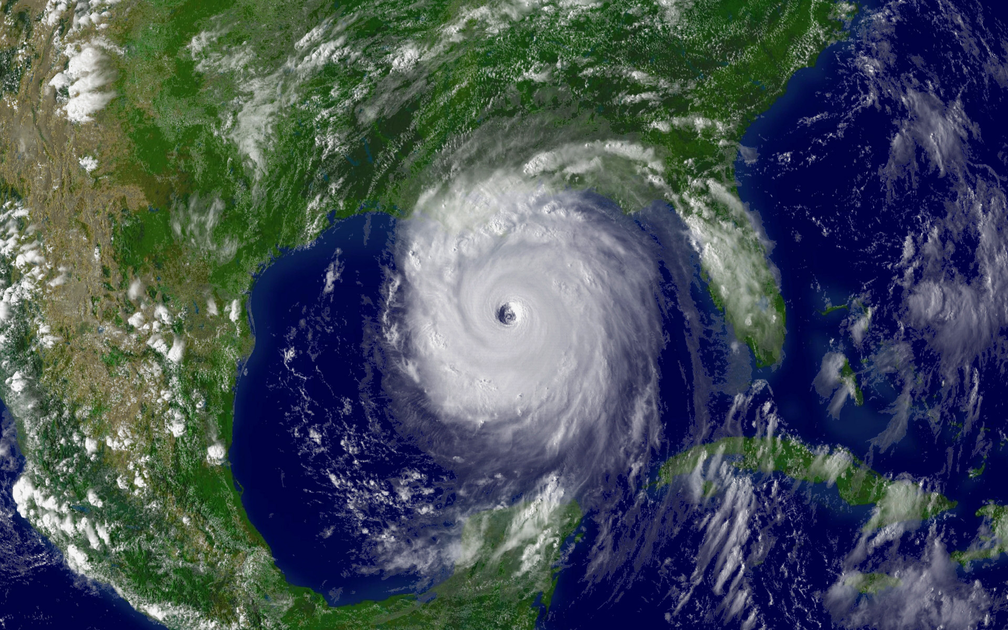
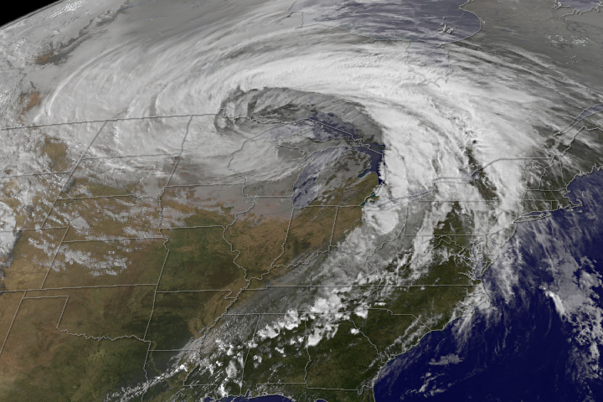
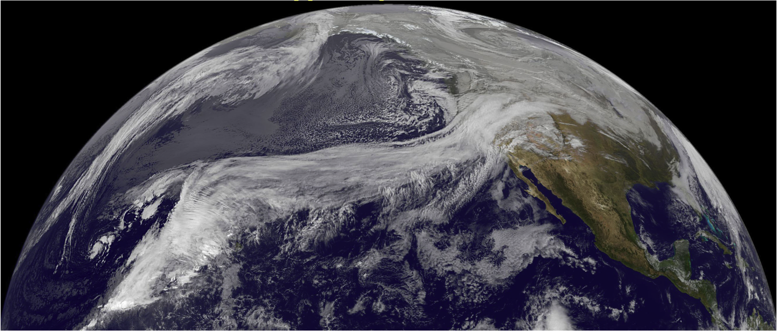
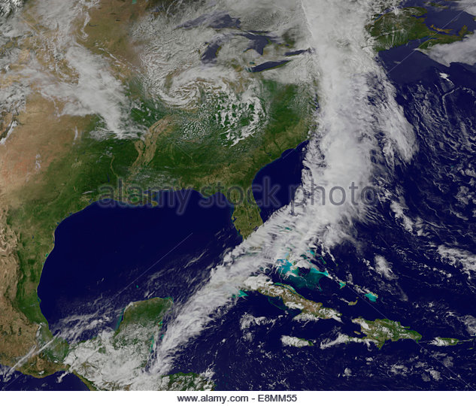
Characterizing Extreme Weather…

Slide 4
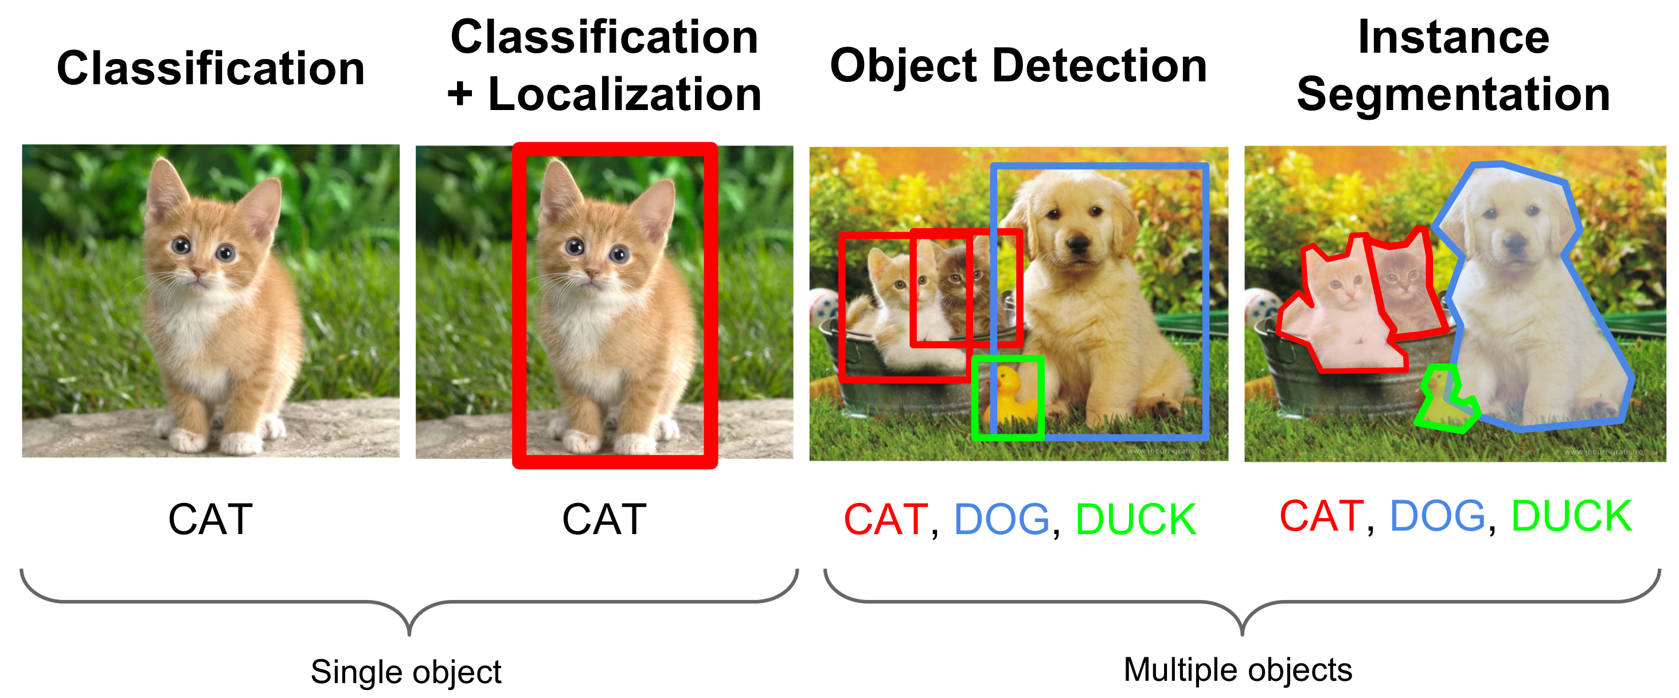
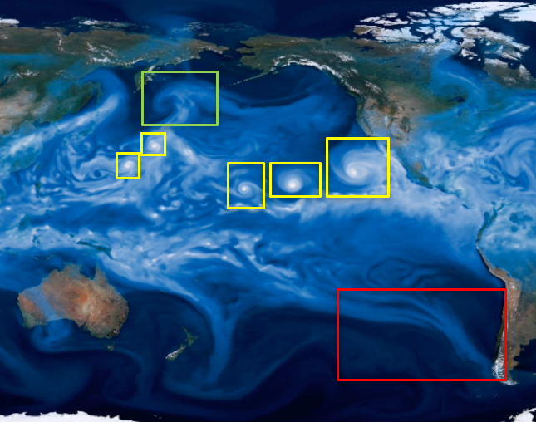
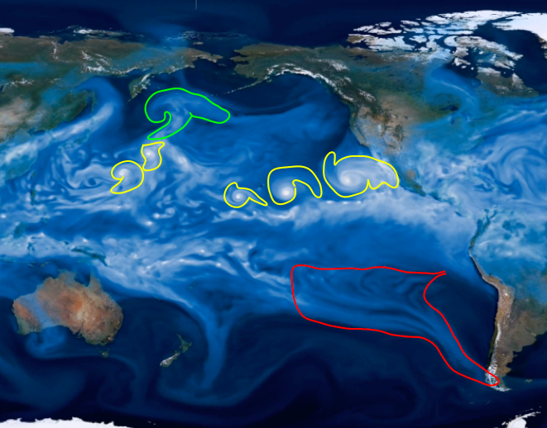


Climate Science Tasks
Liu, et al
ABDA’16
Racah, et al
NIPS’17
Racah, et al, NIPS’17
Kurth, et al, SC’17
Kurth, et al, SC’18

Slide 5
Supervised Learning
Training Input: Cropped, Centered, Multi-variate patches with Labels*
  Tropical Cyclone (TC)
  Atmospheric River (AR)
  Weather Front (WF)
*Labels are provided by TECA, which in turn implements human-specified criteria
Output: Binary (Yes/No) on Test patches
  Is there a TC in the patch?
  Is there an AR in the patch?
  Is there a WF in the patch?

Slide 6
Training Data
Classification | Image Dimension | Variables | Total Examples (+ve) (-ve)
Tropical Cyclone | 32x32 | PSL,UBOT,VBOT,TMQ, U850,V850,T200,T500 | 10000 | 10000
Atmospheric Rivers | 148x224 | TMQ, Land Sea mask | 6500 | 6800
Weather Fronts | 27x60 | T2m, Precip, PSL | 5600 | 6500
Notes:
Table shows the training data for classification task. Image size, channel size, number of positive and negative examples. For all the three types of events we are looking at, the amount of training data is comparatively small (It is like nothing as compared to ImageNet). This is also another reason why we build small and shallow ConvNet. Without enough training data to train large and deep network, usually will end up seeing over fitting. The trained network will have high variance. https://en.wikipedia.org/wiki/Bias–variance_tradeoff
Not enough labeled data is an issue. It is time consuming for labeling and preparing ground truth data. This also an pointer to un-supervised learning (Andrew Ng group is actively working on this these days).
Table shows the training data for localization. Training image size is larger.

Slide 7
Supervised Classification Accuracy
 | Logistic Regression |  | K-Nearest Neighbor |  | Support Vector Machine |  | Random Forest |  | ConvNet
 | Train | Test | Train | Test | Train | Test | Train | Test | Train | Test
Tropical Cyclone | 96.8 | 95.85 | 98.1 | 97.85 | 97.0 | 95.85 | 99.2 | 99.4 | 99.3 | 99.1
Atmospheric Rivers | 81.97 | 82.65 | 79.7 | 81.7 | 81.6 | 83.0 | 87.9 | 88.4 | 90.5 | 90.0
Weather Fronts | 84.9 | 89.8 | 72.46 | 76.45 | 84.35 | 90.2 | 80.97 | 87.5 | 88.7 | 89.4
Hyper-parameter optimization applied with Spearmint for all methods
Notes:
ConvNet performs best in the classification task. Tropical cyclone is a comparatively easy problem. The features of tropical cyclone is quite clear and obvious.
ConvNet is trained well, no over fitting or under fitting. Mostly due to the small and shallow of network.
Classification results of weather front is interesting: none of the conventional classification model is trained well, as can be seen from the difference of training and testing accuracy. On the other hand, ConvNet is trained pretty well and generalized pretty well. Even though the testing accuracy of Logistic Regression and Support Vector Machine is comparable to that of ConvNet, I do not have much confidence that they are proper methods for this problem. Might need to put more regularization on them and train (hyper opt) again.
One significant draw backs of conventional classification methods is that: they are useless in localization scheme (while I guess it depends on how we process localization. If apply sliding window to a larger image and classify each window, these convention methods would still work. But in that sense, it is very computation expensive). However, it seems natural to use ConvNet for localization. Integrating localization and classification into one ConvNet is possible, therefore, detecting can be down.

Slide 8
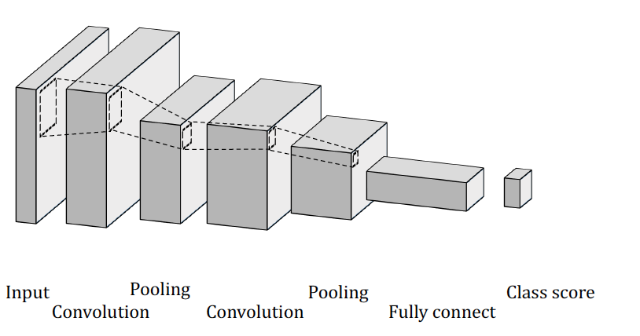
Supervised Convolutional Architecture
Classification | Conv1 | Pool1 | Conv2 | Pool2 | Full | Full
Tropical Cyclone | 5x5-8 | 2x2 | 5x5-16 | 2x2 | 50 | 2
Atmospheric River | 12x12-8 | 3x3 | 12x12-16 | 2x2 | 200 | 2
Weather Fronts | 5x5-16 | 2x2 | 5x5-16 | 2x2 | 400 | 2
Notes:
Table shows classification convolutional architecture. The architecture take AlexNet 2012 for reference. Layer parameters and learning parameters are optimized through Bayesian hyper parameter optimization (Spearmint). I personally do not like the idea of optimizing number of feature maps, layer parameters etc. rather set up the architecture and optimize parameters in learning rule Bengio 2012 paper have suggestions on what hyper parameter to optimize. DO NOT trust non-expert.
Trained separate neural network to classify different types of events, mostly because input images are different size with different channels. Different input size is totally OK for the convolutional layers and pooling layers, which are mostly feature extractors. The classifier usually requires uniform inputs. ( Now we are able to unify them.)
Table shows localization convolutional architecture. The architecture take YOLO 2015 for reference. The architecture is a deeper and larger but simple ConvNet. The optimization is not done on this architecture.

Slide 9
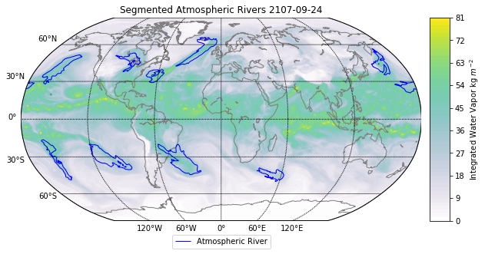
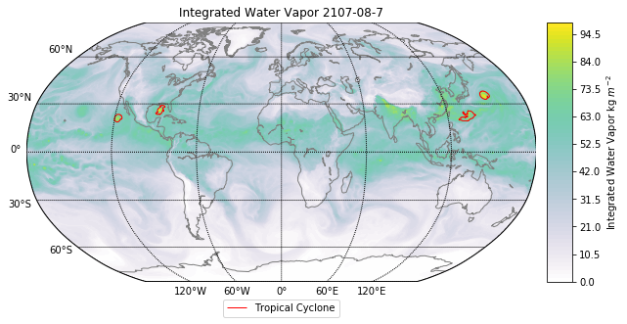
Training at Exascale: Climate Dataset
CAM5 0.25-degree output
  1152x768 pixels, 3-hr
  16 variables
  20 TB
Ground Truth Labels for TC and AR
  Heuristics for detection followed by mask creation
Formulate segmentation problem
  3 classes - background, TC and AR
  high imbalance - most pixels are background high variance - shape of events change over time and in-between themselves

Slide 10
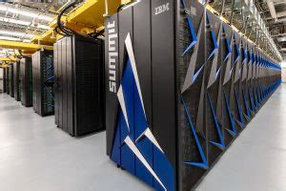
Training at Exascale Hardware: Summit
Leadership class HPC system at OLCF, ranked #1 on Top500
4608 nodes with 2 IBM Power 9 CPU and 6 Nvidia Volta GPU
300 GB/s NVLink connection
800 GB NVMe storage/node
Infiniband network;
~3.45 ExaFlop peak (FP16)
Training code stresses all above
components of the system

Slide 11
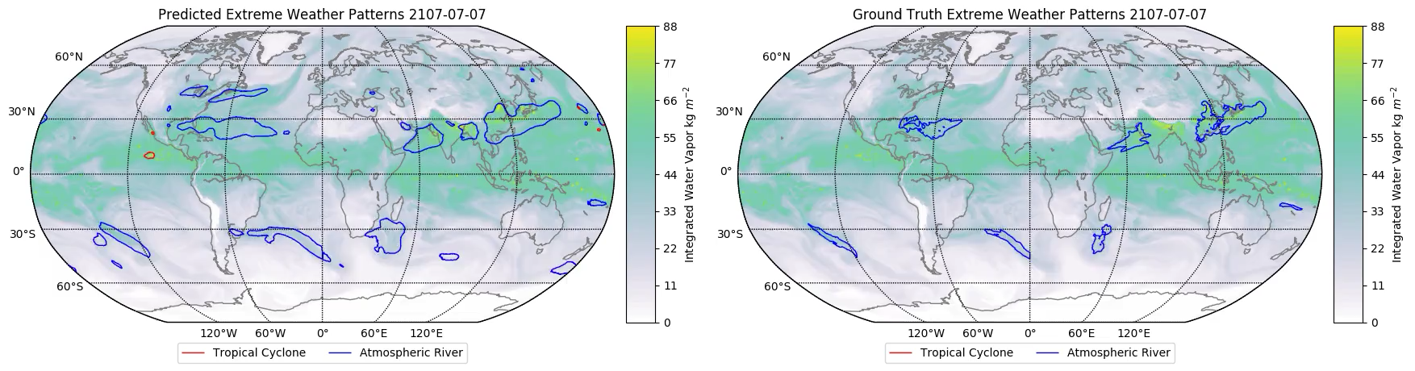
Segmentation Animation

Slide 12
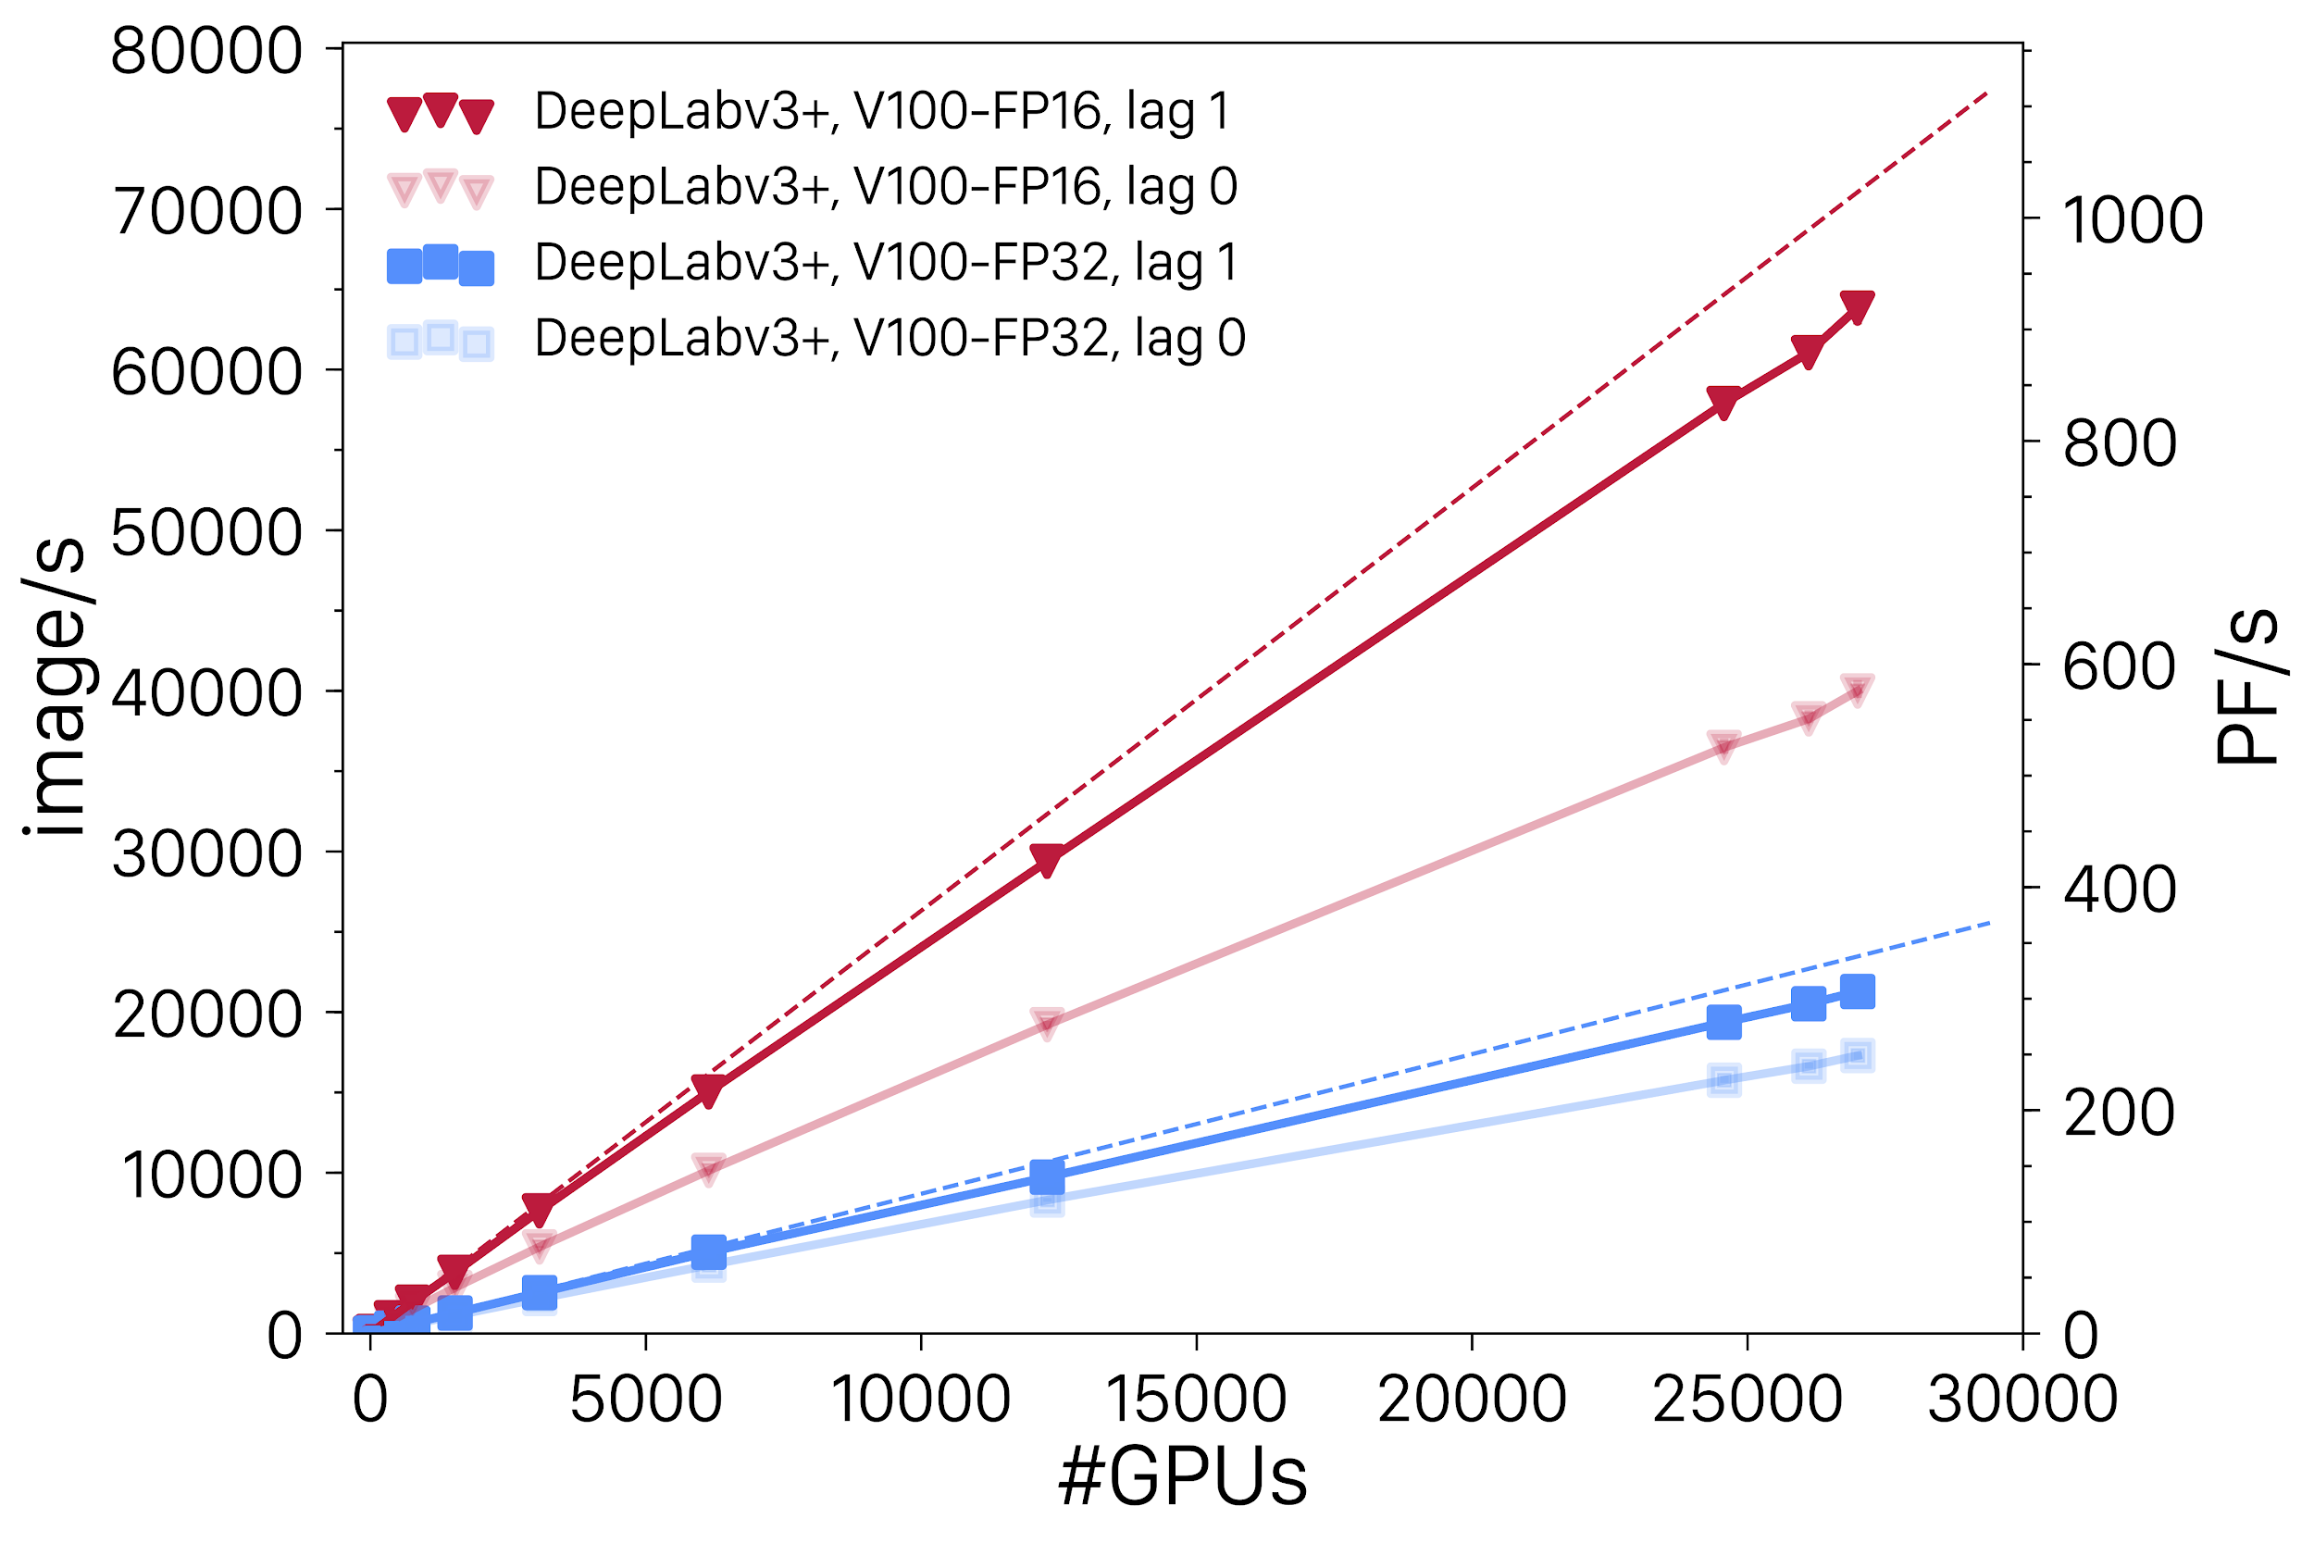
Extreme Scaling
4560 Summit nodes, 27,360 Volta GPUs
1.13 EF peak performance (16-bit)

Slide 13
Deep Learning for Detecting Extremes: Definitions Matter
Atmospheric Rivers (ARs): ”long, narrow, and transient corridors of strong horizontal water vapor transport…” (AMS Glossary)
No community-accepted standard for identifying atmospheric rivers
“You know one when you see one” – ARTMIP 2018 Participant
An AR off the coast of California. Source: The Guardian

Slide 14
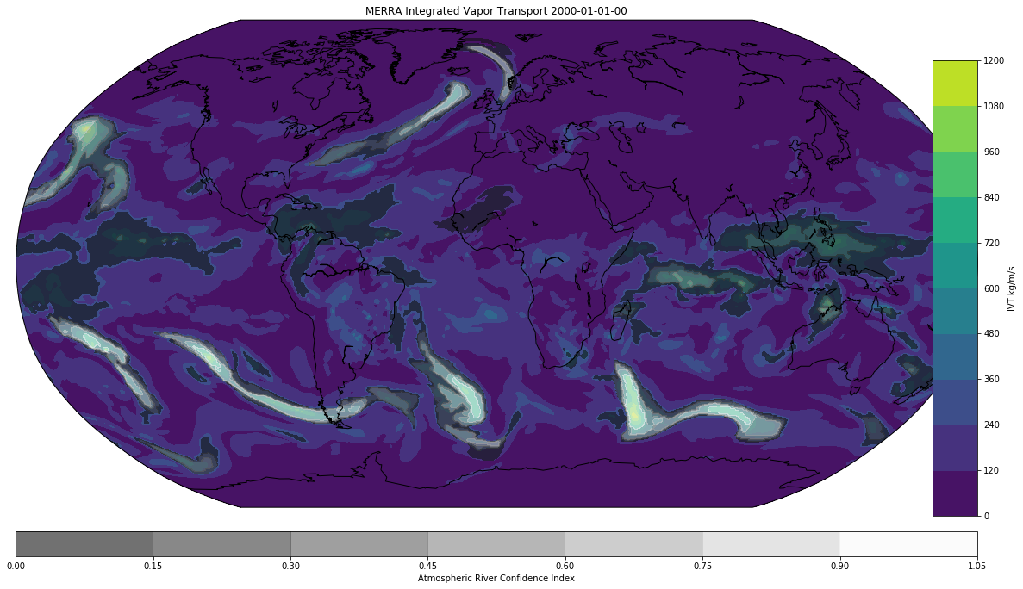
The ARTMIP Dataset
The Atmospheric River Tracking Method Intercomparison Project (ARTMIP) includes AR detections from 14 algorithms in MERRA reanalysis data
Can methods detect ARs in different fields: precipitable water and Integrated Vapor Transport?
Can methods detect ARs in different datasets: MERRA reanalysis and CAM5 climate model
MERRA Integrated Vapor Transport 2000-01-01-00, shown with the mean of the 14 ARTMIP algorithms.
Shields, C. A., Rutz, J. J., Leung, L.-Y., Ralph, F. M., Wehner, M., Kawzenuk, B., … Nguyen, P. (2018). Atmospheric River Tracking Method Intercomparison Project (ARTMIP): project goals and experimental design. Geoscientific Model Development, 11(6), 2455–2474. http://doi.org/10.5194/gmd-11-2455-2018
Notes:
ARTMIP is a multi-institution effort aiming to explore different AR tracking algorithms. 14 algs have already been submitted
All the ARTMIP algorithms rely on arbitrary, subjective thresholds. These are not grounded in theory, and they may change with climate change.
CNNs can track ARs without relying on thresholds. By seeing examples of ARs and the corresponding input fields, they can also learn to recognize ARs in different fields and datasets

Slide 15
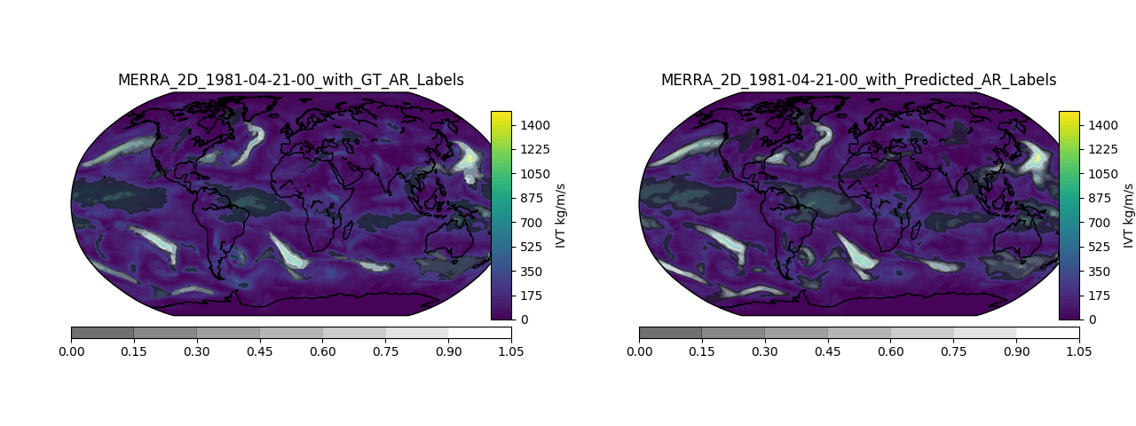
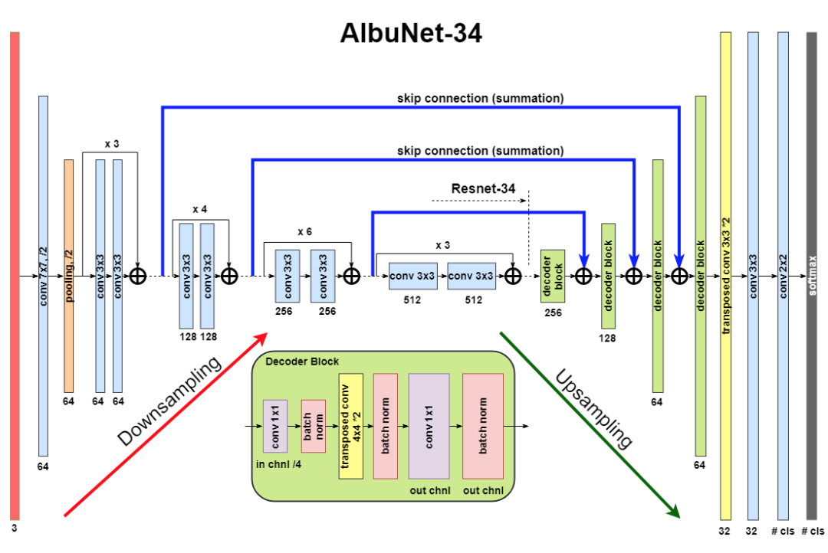
Can CNNs do Probabilistic ‘Segmentation’?
Input Field: Integrated Vapor Transport (IVT)
Output Field: AR Confidence Index [probability]
AR Confidence Index [probability]
Notes:
Segmentation: the task of assigning a label to each pixel. Probabilistic segmentation: assign a probability of an AR to each pixel of an input image.
AlbuNet 34 is the deep learning model architecture. Uses convolutional and pooling layers to extract features (downsampling: red arrow). Maps the extracted features to probabilities at each pixel (upsampling: green arrow).

Slide 16
CNNs Can do Probabilistic Segmentation
Ground Truth
(white shading)
Input Field: IVT
Output Field: AR Prob.
CNN Output
(white shading)
Notes:
Ground truth on top. Deep learning prediction on the bottom.

Slide 17
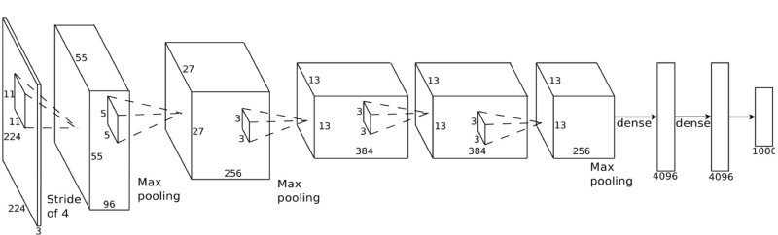
ClimateNet: A path forward for labeled climate data
Avoid heuristics; establish ground truth dataset for weather patterns
Share both dataset + reference DL architectures w/ the community
Training
Inference
Human Experts
Class Labels
Class Labels
Bounding Boxes
Bounding Boxes
Segmentation Masks
ClimateNet
Dataset
Model, satellite, observational datasets
Segmentation Masks
Unified Deep Network

Slide 18
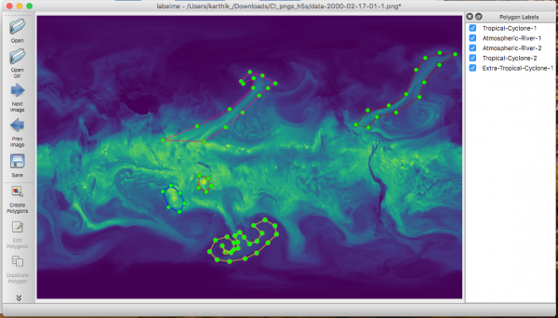
ClimateNet Interface
Avoid heuristics
  Computer vision community 1980-2010
Ground Truth specified by experts using web interface
  Tropical Cyclones
  Atmospheric Rivers
  Extra-tropical Cyclones
  …
https://www.nersc.gov/research-and-development/data-analytics/big-data-center/climatenet/

Slide 19
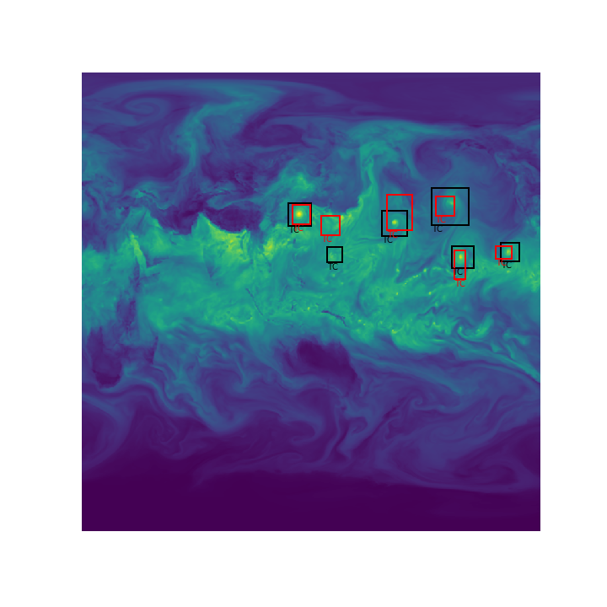

Conclusions
Machine Learning is viable for Pattern Detection in Climate Data:
  Truth data sets from experts or hand-tuned algorithms
  Supervised architectures can match their detection accuracy
  Semi-supervised architectures may discover new patterns
Training of Deep Learning is amenable to acceleration:
  Fast, hybrid methods for parameter optimization
  Moderns libraries enable good performance and scaling
Continuing challenges:
  Scarcity of labeled data: Need labeling “campaigns”
  Interpretability and Visualization: ‘Black Box’ classifier
Opens the door to semantic segmentation
of climate datasets

Slide 20
Open Challenges
Handling Complex Data
  2D/3D/4D, graph, sparse/dense, multi-spectral
Lack of Theory (Machine Learning)
  Limits of supervised, unsupervised, semi-supervised learning
Lack of Theory (Climate Science)
  Unambiguous definitions of phenomena of interest
Interpretability
  Incorporating domain science principles (physical laws)
Uncertainty Quantification

Slide 21
Acknowledgements
This research was supported by the Director, Office of Science, Office of Biological and Environmental Research of the U.S. Department of Energy under
Contract No. DE-AC02-05CH11231 as part of their RGCM Program.
National Energy Research Scientific Computing Center (NERSC), a DOE Office of Science User Facility supported by the Office of Science of the U.S. Department of Energy under Contract No. DE- AC02-05CH11231
Oak Ridge Leadership Computing Facility (OLCF) at the Oak Ridge National Laboratory, supported by the Office of Science of the U.S. Department of Energy under
Contract No. DE-AC05-00OR22725
Swiss National Supercomputing Center (CSCS), project g107
We thank OLCF and CSCS staff, especially Nicholas Cardo, Veronica Melesse Vergara,
Don Maxwell, Matthew Ezell for technical as well as Arjun Shankar, Ashley Barker,
Tjerk Straatsma and Jack Wells for programmatic support

Slide 22
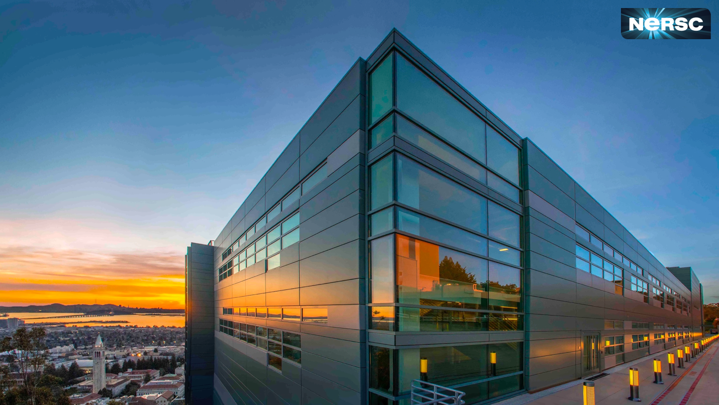
Questions?

Slide 23
BACKUP SLIDES

Slide 24
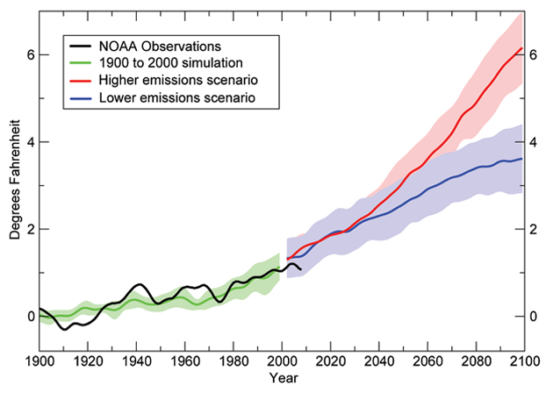
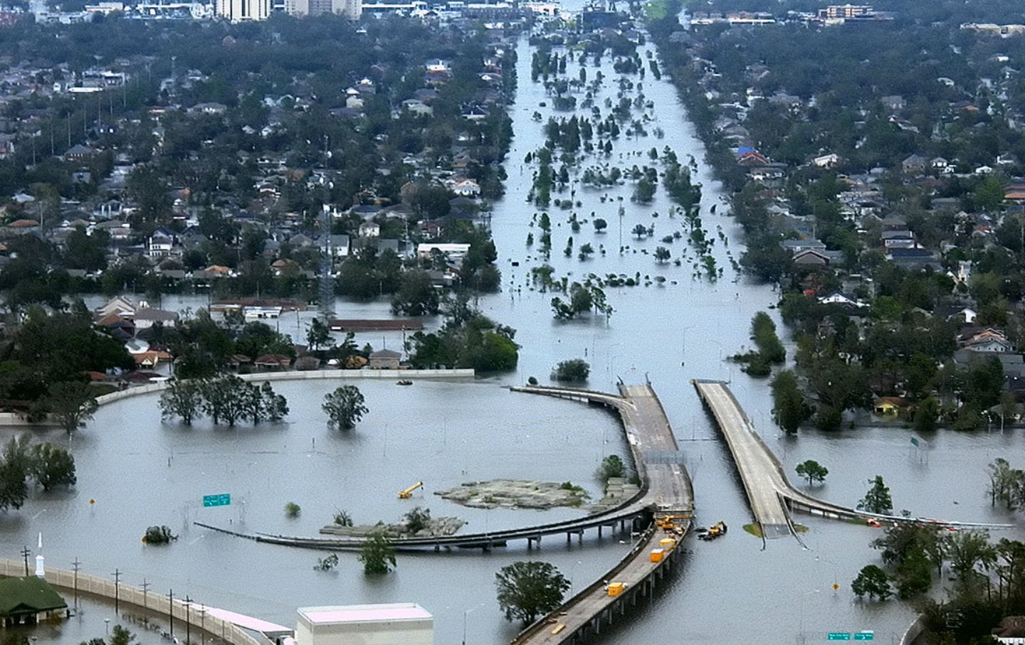
Characterizing Climate Change
How will the mean climate change by 2100?
  will the globe warm up by 1.5 or 2.0 C?
  will the sea level rise by 1 or 2 feet?
How will extreme weather change by 2100?
  Will there be more storms (TC, ETC, AR)?
  Will storms make landfall more often?
  Will storms become more intense?
  Will storms carry more water?

Slide 25
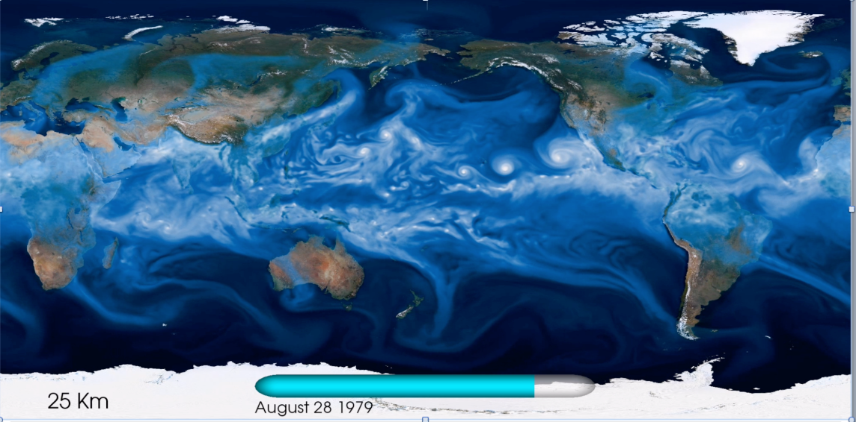
CAM5 0.25-degree simulation data

Slide 26
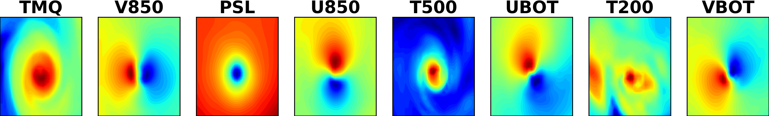
Challenge: Multi-Variate Data

Slide 27
Task: Find Extreme Weather Patterns

Slide 28
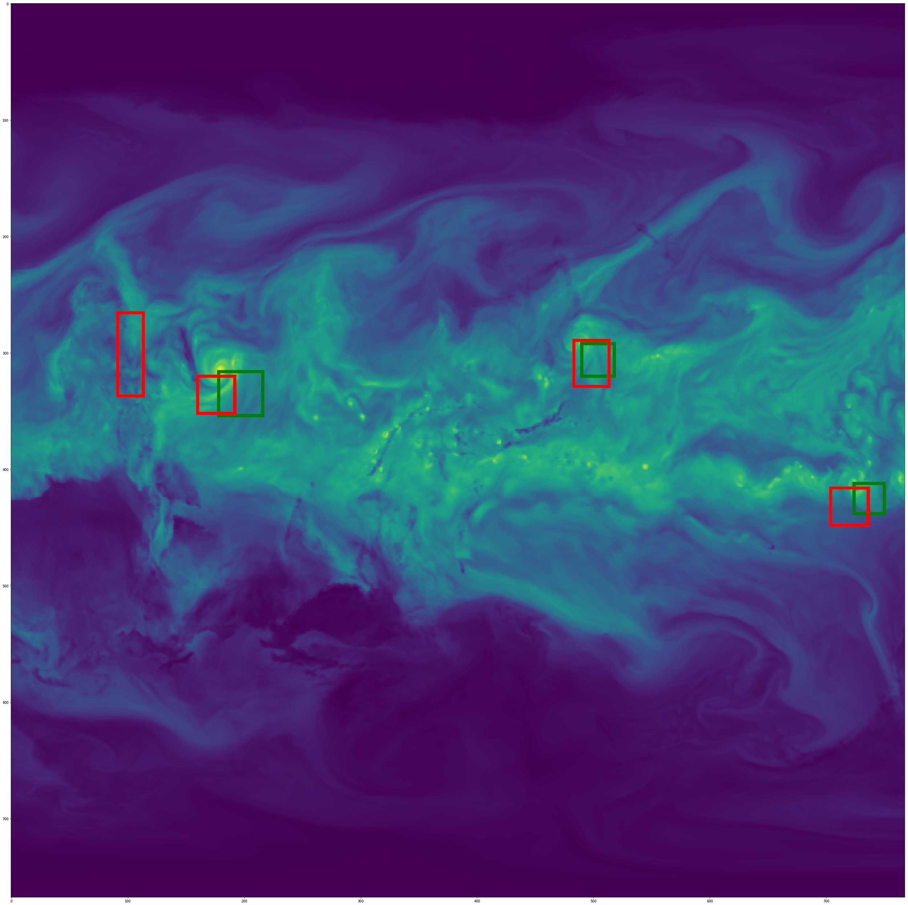
Semi-Supervised Machine Learning
Objectives:
Want to predict bounding box location for weather pattern
Want to discover new patterns despite few/no labels for several weather patterns
Create unified architecture for all weather patterns

Slide 29
Semi-Supervised Convolutional Architecture
Encoder
Decoder
Classification + Bounding Box Regression

Slide 30
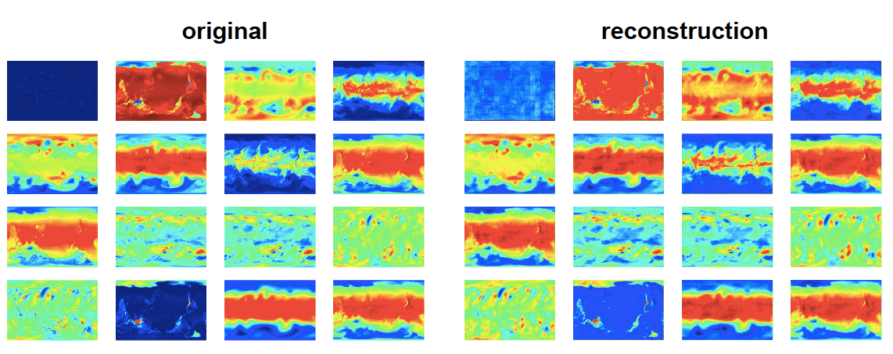
Reconstruction Results

Slide 31
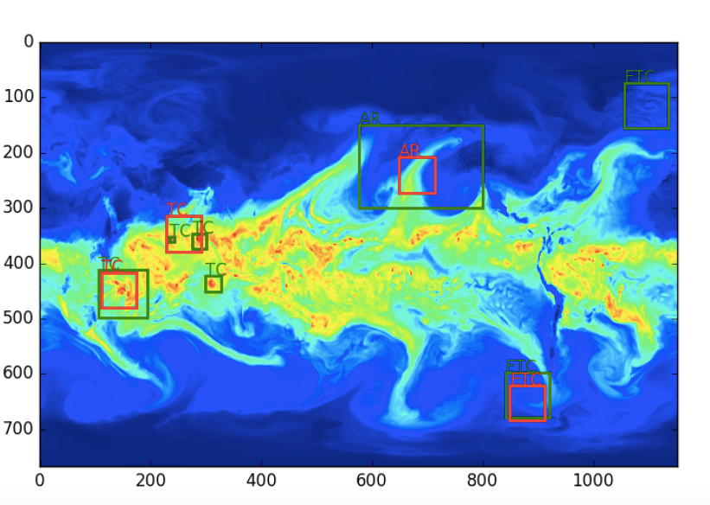
Classification + Regression Results
Ground Truth
Prediction

Slide 32
Evaluating the Neural Network
Intersection over Union: a scale from 0 to 1 representing the similarity between the DL prediction and the ARTMIP labels
Neural network trained on Integrated Vapor Transport: 0.90
Neural network trained on Precipitable Water: 0.81
Source: PyImageSearch
Notes:
Intersection over Union is the standard metric in machine learning for evaluating semantic segmentation models
An IoU score of 0 is bad. An IoU score of 1 means that the model perfectly matches the ARTMIP labels.
The IVT based model is expected to be better than the precipitable water model, because most of the ARTMIP algorithms are based on IVT!
(Note: these numbers are not from the network trained with data augmentation)

Slide 33
Key Advantages of Deep Learning
A single CNN detection algorithm can represent the uncertainty characterized by 14 AR detection algorithms
CNNs can identify high-quality ARs from precipitable water, while most other tracking algorithms require a more memory-intensive field: Integrated Vapor Transport
CNNs can identify ARs in different categories of datasets
(e.g. low-resolution, high-resolution, reanalysis, and future climate models)
Notes:
3 key points are same as in slide

