Slide 1
The 2nd NOAA Workshop on Leveraging AI
in Environmental Sciences
Overview of a Workshop in Slow Motion
Kevin Garrett
NOAA/NESDIS Center for Satellite Applications and Research (STAR)
Chair – Local Organizing Committee

Slide 2
Science and Local Organizing Committees
Science Committee
Government
Sid Boukabara (Chair) | NOAA/NESDIS/STAR
Vladimir Krasnopolsky (Co-Chair) | NOAA/NWS/NCEP
Kenneth Casey | NOAA/NESDIS/NCEI
Jebb Stewart | NOAA/OAR/ESRL, CIRA
Nikunj Oza | NASA/Ames, NASA/ESTO
John Ten Hoeve | NOAA/NWS Office of Org. Excellence
Greg Dusek | NOS
V Ramaswamy | NOAA/OAR/GFDL
William Michaels | NOAA/NMFS
Academia
Kayo Ide | University of Maryland
Amy McGovern | University of Oklahoma
Allen Huang | University of Wisconsin
Phillip Tissot | Texas A&M-Corpus Christi
Sue E. Haupt | NCAR
Private Sector
John Williams | The Weather Company, an IBM Business
Janson Hickey | Google
David Hall | NVIDIA
Local Organizing Committee
Kevin Garrett (Chair)
Vladimir Krasnopolsky
Lori Brown
Stacy Bunin
Ana Carrion
Ross Hoffman
Erin Jones
Katherine Lukens
Eric Maddy
Michael Newton
Narges Shahroudi
Andre Van der Westhuysen

Slide 3
Current Schedule
JUL | AUG |  |  |  | SEP
30 | 6 | 13 | 20 | 27 | 3 | 10 | 17 | 22 | 24 | 29
S1 | S2 | S3 | S4 | S5 | S6 | S7 | S8 | T1 | S10 | P1
Oral Sessions
Thursdays 12:00 ET
Duration 1-2 hours
OCT |  |  |  |  |  | NOV
1 | 8 | 15 | 20 | 22 | 29 | 5 | 10 | 12 | 19 | 26
S12 |  | S13 | T2 | S15 | S16 | S17 | T3 | S19 | S20
Poster Sessions
Select Tuesdays 12:00 ET Lightning round + interactive forum
DEC |  |  |  |  |  |  | JAN ‘21
1 | 3 | 10 | 15 | 17 | 24 | 31 | 7 | 14 | 21 | 28
T4 | S22 |  | P2 | S24 |  |  | S25 |  | S26 | S27
Tutorials
Select Tuesdays Time TBD 6 planned, 4 scheduled
FEB ‘21
4 | 11 | 18 | 25
S28 | S29 | S30 | S31
APR ‘21
19-23
3rd NOAA AI Workshop
Oral Sessions
Poster Sessions
Tutorials

Slide 4
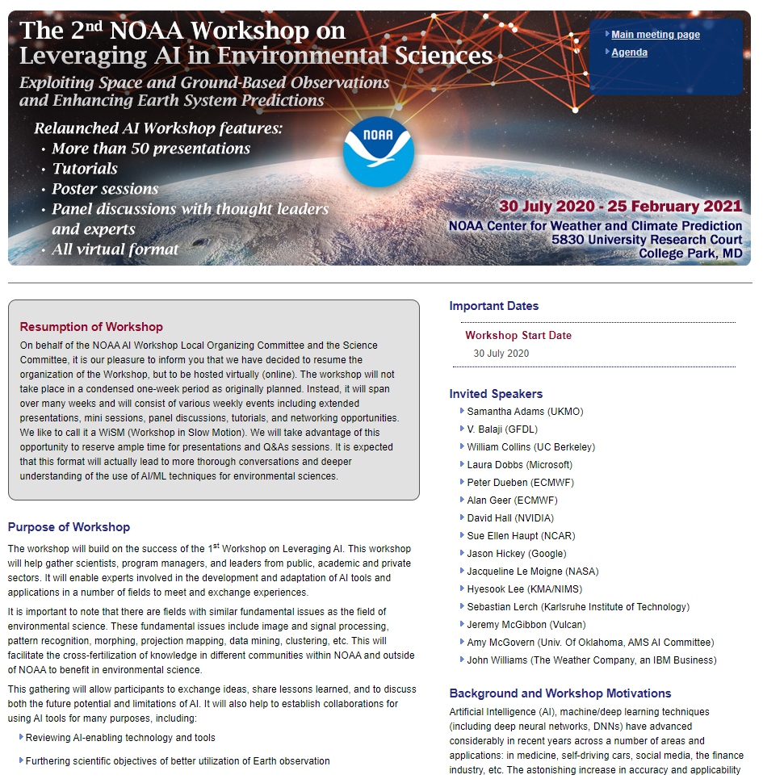
Workshop Communication
https://www.star.nesdis.noaa.gov/star/meeting_2020AIWorkshop.php
Workshop Agenda
Review if you submitted an abstract
New abstracts
Session Announcements
Emails the week/morning of
Coordination with presenters the week prior
Significant Events
Tutorials / Poster session logistics
New events
Check the Website!
News, webinar links, presentations and recordings

Slide 5
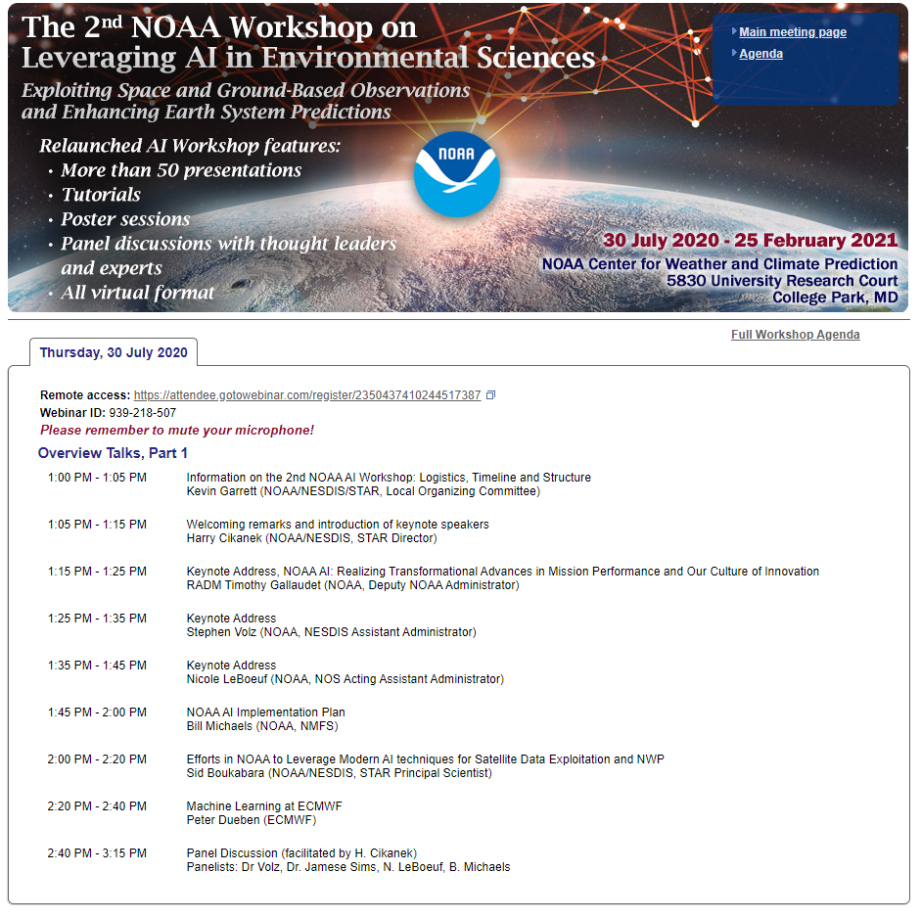
GoToWebinar
Information
Webinar links will be posted in advance
Pre-register!
All sessions will be recorded
Questions to the speakers/panelists may be entered using the Chat
As well as general questions/comments

