Slide 1
Data-driven super-parameterization using deep learning: Experimentation with multi-scale Lorenz 96 systems and transfer-learning
Ashesh Chattopadhyay¹, Adam Subel¹, Pedram Hassanzadeh^{1,2}
¹Department of Mechanical Engineering
²Department of Earth Environmental and Planetary Sciences
Rice University

Slide 2
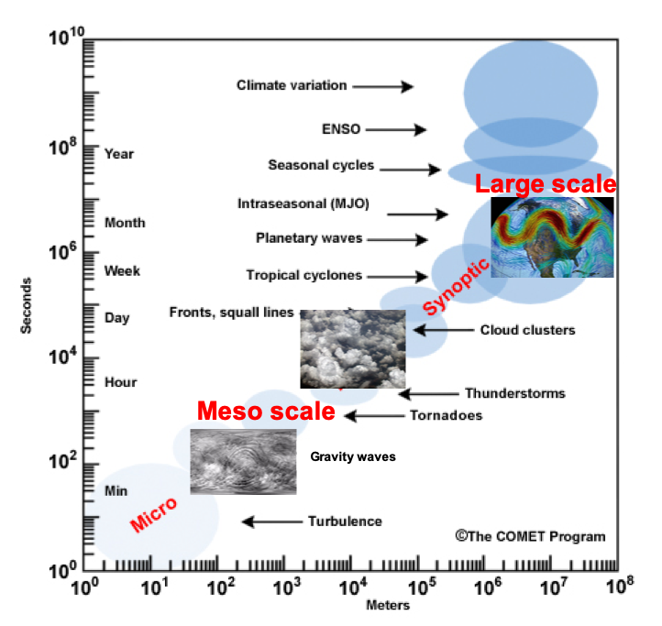
Turbulence and Weather, Climate & their Extremes:
spatio-temporal, multi-scale, multi-physics, high-dimensional & chaotic …
X: large/slow-scale variables
Y: small/fast-scales variables
Z: poorly understood,
hard to observe variables
Notes:
I do applied stuff. AI not designed for out data.

Slide 3
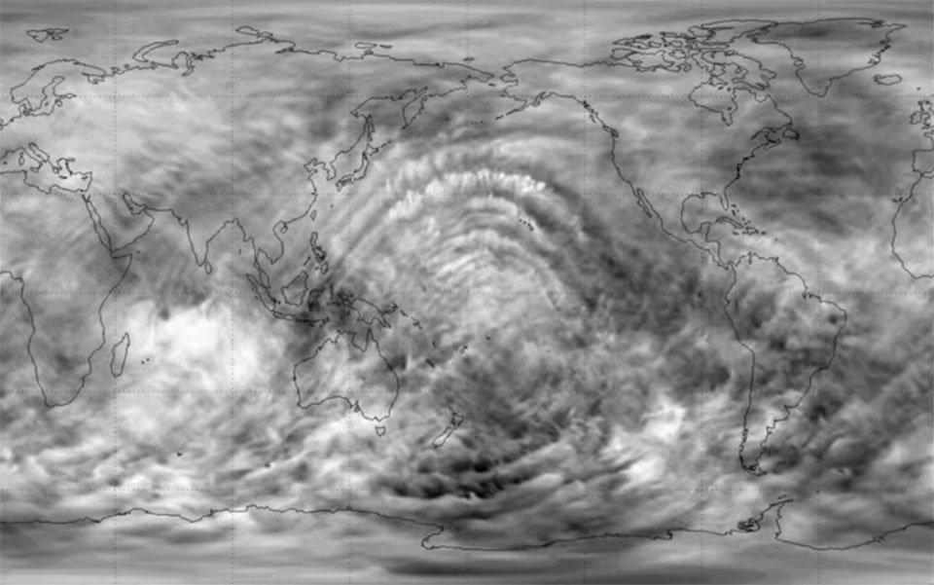
Turbulence and Weather, Climate & their Extremes:
spatio-temporal, multi-scale, multi-physics, high-dimensional & chaotic …
Small-scale (sub-grid) processes Y
Known or partially-known PDEs
1- Physics-based parameterization:
Y = P(X)
Large-eddy simulation, LES (Smagorinsky 1963)
2- Super-parameterization (SP):
Simplified PDEs of Y solved numerically at O(1)-O(10)km resolutions inside each X grid point
(Grabowski & Smolarkiewicz, 1999; Khairoutdinov & Randall, 2001; Majda & Grooms, 2014)
Schneider et al. Nature Climate Change 2019
NCAR/UCAR

Slide 4
Turbulence and Weather, Climate & their Extremes:
spatio-temporal, multi-scale, multi-physics, high-dimensional & chaotic …
Small-scale (sub-grid) processes Y
Known or partially-known PDEs
1- Physics-based parameterization:
Y = P(X)
Large-eddy simulation, LES (Smagorinsky 1963)
2- Super-parameterization (SP):
Simplified PDEs of Y solved numerically at O(1)-O(10)km resolutions inside each X grid point
(Grabowski & Smolarkiewicz, 1999; Khairoutdinov & Randall, 2001; Majda & Grooms, 2014)
AI?
Rasp et al. (2018 PNAS):
Using ANN for moist convection
Yuval et al. (2020 Nat Comm)
Random forests for convection
Bolton & Zanna (2019 JAMES):
Using CNN for ocean eddies

Slide 5





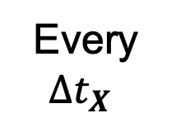




Data-driven super-parameterization
ODE/PDE can be directly integrated with recurrent neural networks efficiently
Chattopadhyay, Subramaniam, Hassanzadeh Data-driven predictions of a multiscale Lorenz 96 chaotic system using machine-learning methods: reservoir computing, artificial neural network, and long short-term memory network, Non Linear Processes in Geophysics, 2020.
$$\frac{dX}{dt}=f\left(X,Y,p\right)$$
$$\frac{dY}{dt}=g(X,Y)$$
$$Δt_{X}$$
$$Δt_{X}>Δt_{Y}$$
Every $Δt_{X}$
$$Δt_{Y}$$
$$Y^{0}$$
$$N$$
$$Y^{Δt_{Y}}$$
$$N$$
$$Y^{2Δt_{Y}}⋯$$
Chattopadhyay, Subel, Hassanzadeh Data-driven super-parameterization using deep learning: Experimentation with multi-scale Lorenz 96 systems and transfer-learning, arXiv:2002.11167, Journal of Advances in Modeling Earth Systems, in revision

Slide 6





Multi-Scale Lorenz 96
$$\frac{dX}{dt}=f\left(X,Y,p\right)$$
$$\frac{dY}{dt}=g(X,Y)$$
$$\frac{dX_{k}}{dt}=X_{k−1}\left(X_{k+1}−X_{k−2}\right)−X_{k}+F−{\frac{hc}{b}Σ}_{j}Y_{j,k} k=1…8$$
$$\frac{dY_{j,k}}{dt}=−Y_{j+1,k}\left(Y_{j+2,k}−Y_{j−1,k}\right)−{cY}_{j,k}+{\frac{hc}{b}X}_{k}−{\frac{he}{d}Σ}_{i}Z_{i,j,k} i,j=1…8$$
$$\frac{dZ_{i,j,k}}{dt}={edZ}_{i−1,j,,k}\left(Z_{i+1,j,k}−Z_{i−2,j,k}\right)−geZ_{i,j,k}+\frac{he}{d}Y_{j,k}$$
Large scale $X$
Intermediate scale $Y$
Small scale $Z$
Thornes et al, Royal Met Soc, 2017

Slide 7
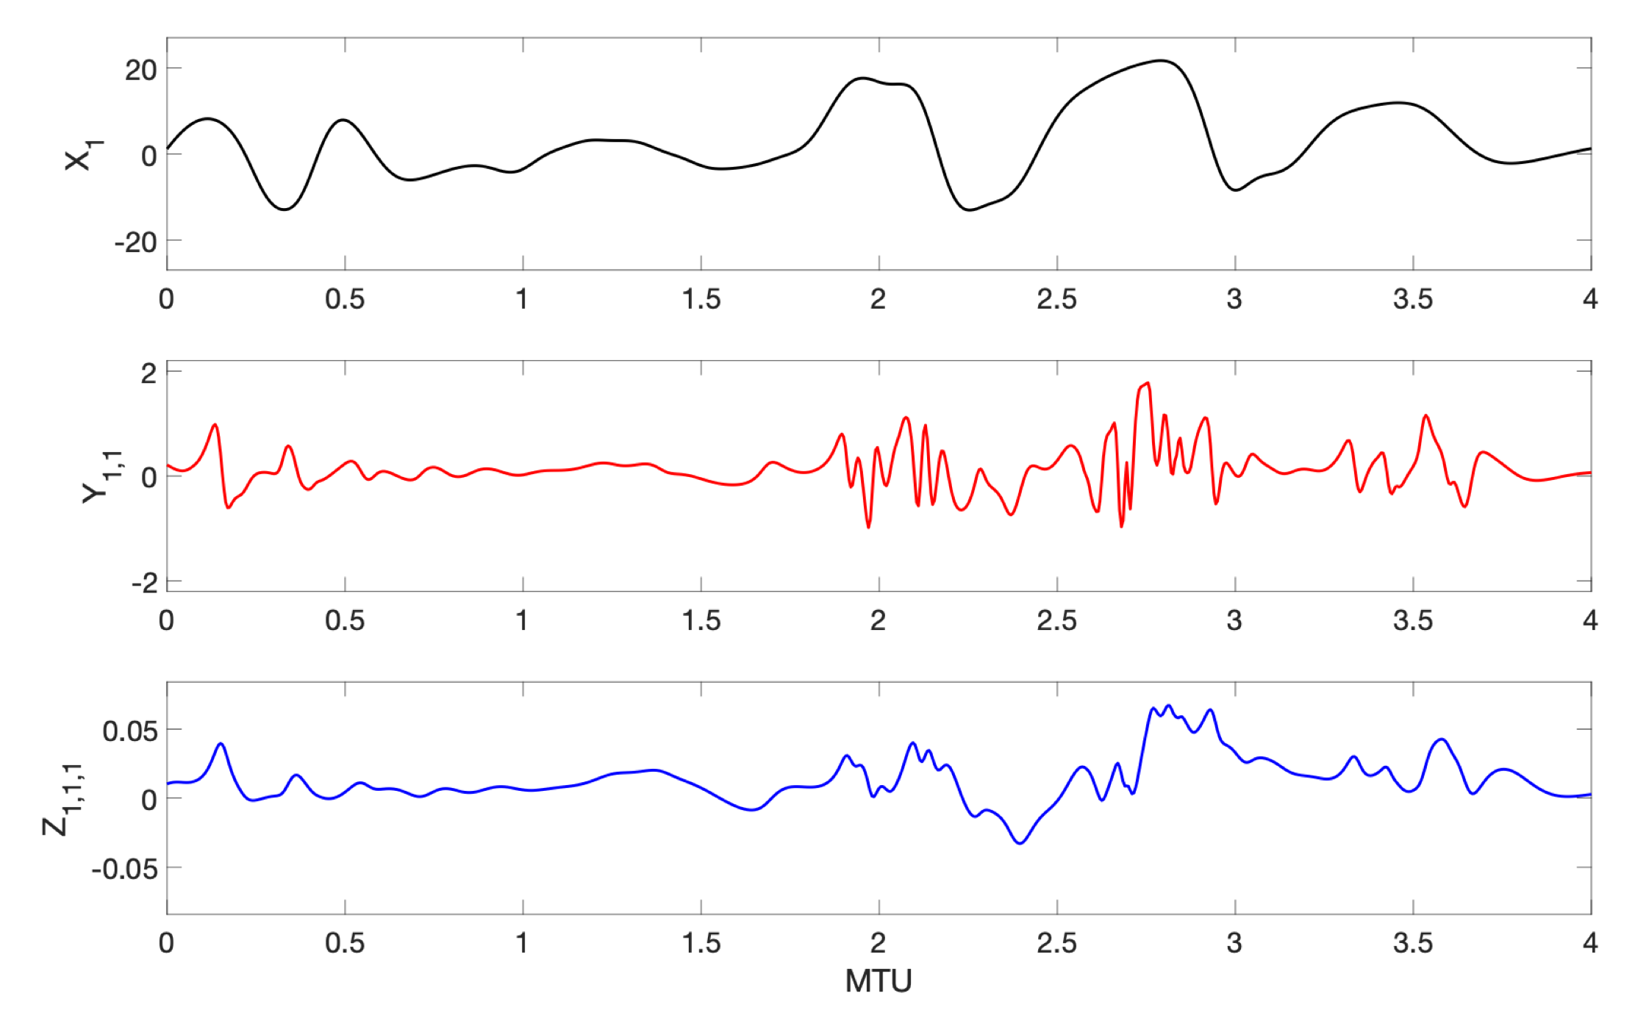
1 MTU = 200∆t = 4.5/λ = 7𝜏_{PC1}

Slide 8
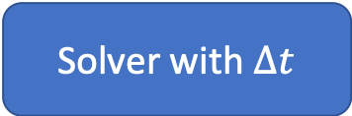
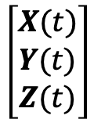
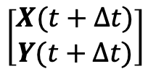
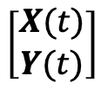
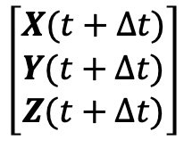
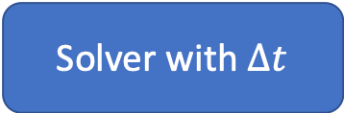
Direct numerical simulation (DNS)
$$\left[\begin{matrix}X(t) \\ Y(t) \\ Z(t)\end{matrix}\right]$$
Solver with $∆t$
$$\left[\begin{matrix}X(t+∆t) \\ Y(t+∆t) \\ Z(t+∆t)\end{matrix}\right]$$
Normalized cost = 1000
High-resolution (HR)
$$\left[\begin{aligned}X(t) \\ Y(t)\end{aligned}\right]$$
Solver with $∆t$
$$\left[\begin{aligned}X(t+∆t) \\ Y(t+∆t)\end{aligned}\right]$$
Normalized cost = 123

Slide 9


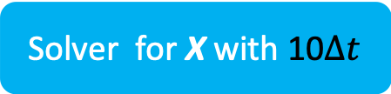


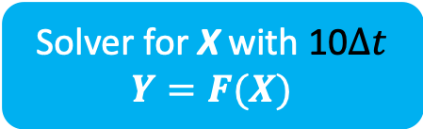

Parameterization
(LR)
Solver for X with 10$∆t$
$$Y=F(X)$$
$$\left[X(t)\right]$$
$$\left[X(t+10∆t)\right]$$
Normalized cost = 1.4
Solver for X with 10$∆t$
$$\left[X(t)\right]$$
$$\left[X(t+10∆t)\right]$$
Super-parameterization
(SP)
Solver for Y with $∆t$
Normalized cost = 111

Slide 10
DNS
SP
1 MTU = 200∆t = 4.5/λ = 7𝜏_{PC1}

Slide 11
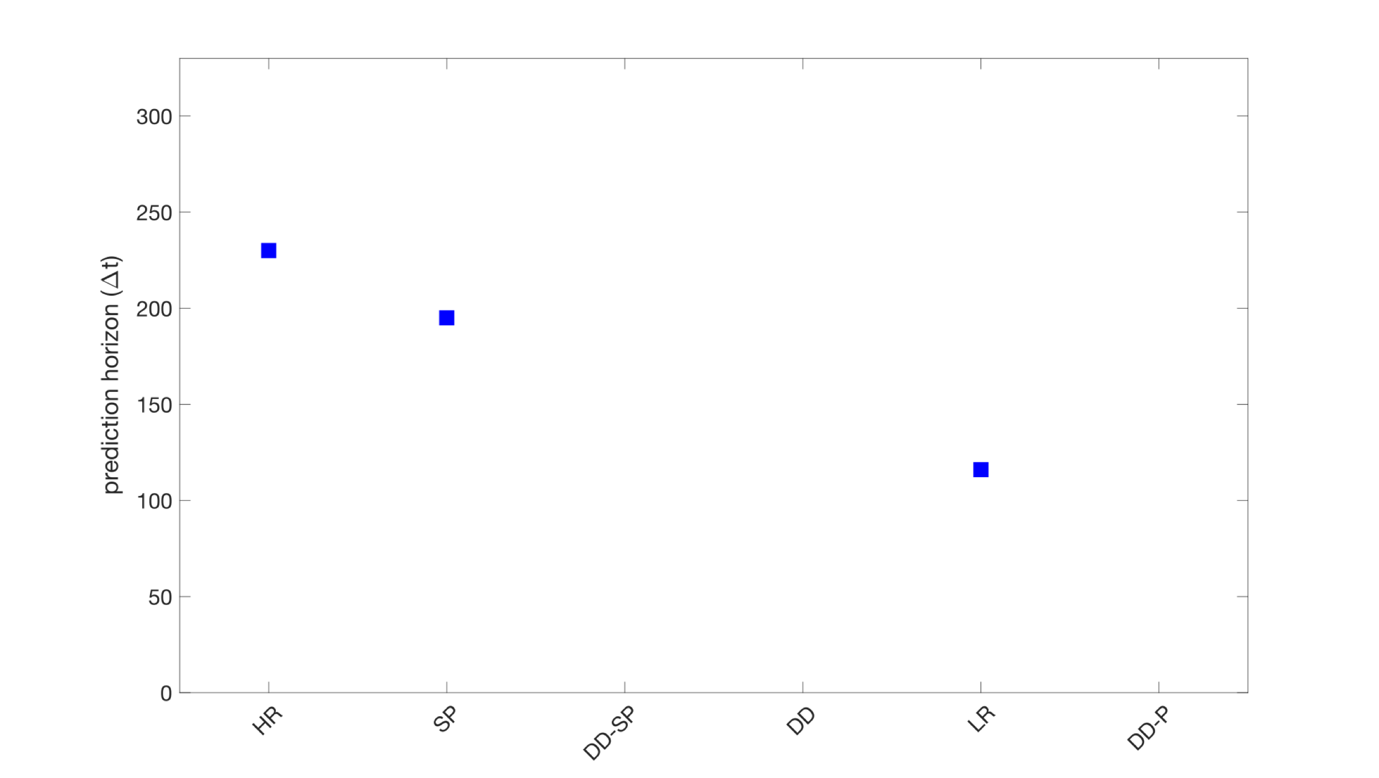
Predicting short-term spatio-temporal evolution
Computational cost (normalized)
123 111 1.4 0 1.4 1.4

Slide 12


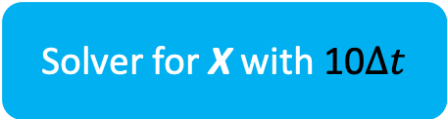


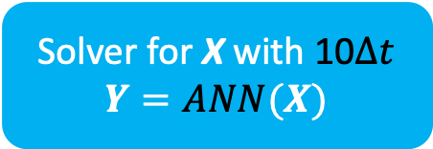

Data-driven
Parameterization
(DD-P)
Solver for X with 10$∆t$
$$Y=ANN(X)$$
$$\left[X(t)\right]$$
$$\left[X(t+10∆t)\right]$$
Normalized cost = 1.4
Solver for X with 10$∆t$
$$\left[X(t)\right]$$
$$\left[X(t+10∆t)\right]$$
Data-driven
super-parameterization
(DD-SP)
RNN for Y with $∆t$
Normalized cost = 1.4
Notes:
More scale separation issue

Slide 13
DD-SP
LR
DD-P
1 MTU = 200∆t = 4.5/λ = 7𝜏_{PC1}

Slide 14
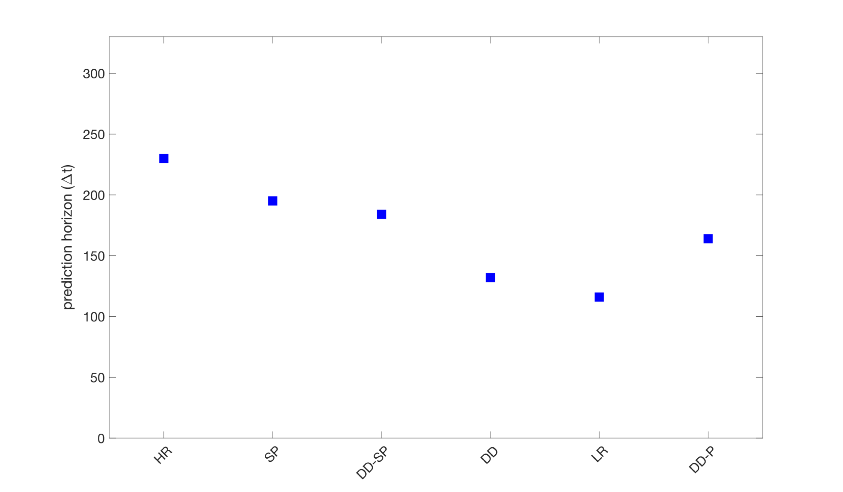
Predicting short-term spatio-temporal evolution
Computational cost (normalized)
123 111 1.4 0 1.4 1.4

Slide 15
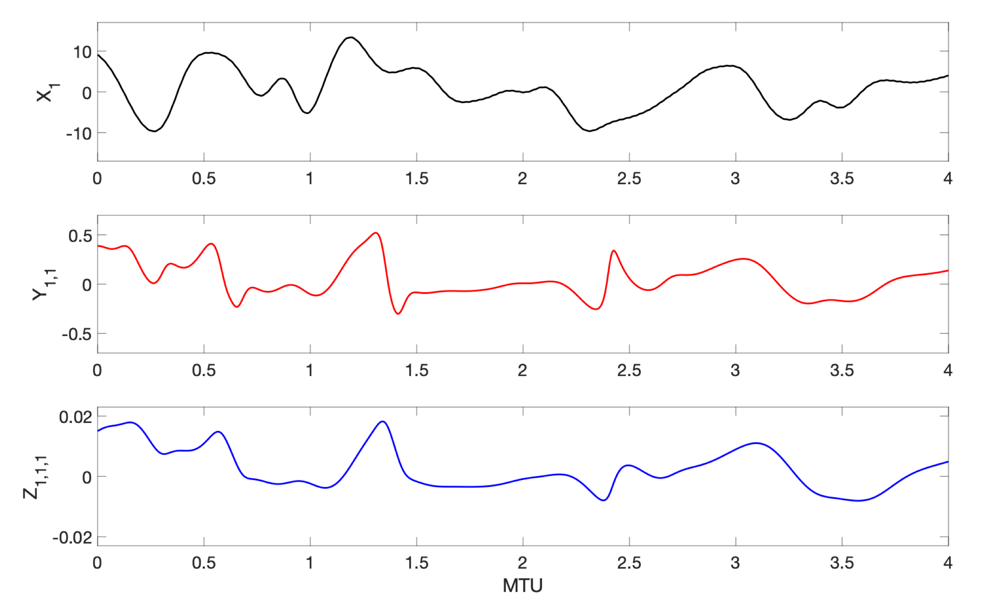
Y is in quasi-equilibrium with X.
Y=F(X) is justifed
Y is not in quasi-equilibrium with X. Y=F(X) is not justified
Notes:
Both panels together

Slide 16
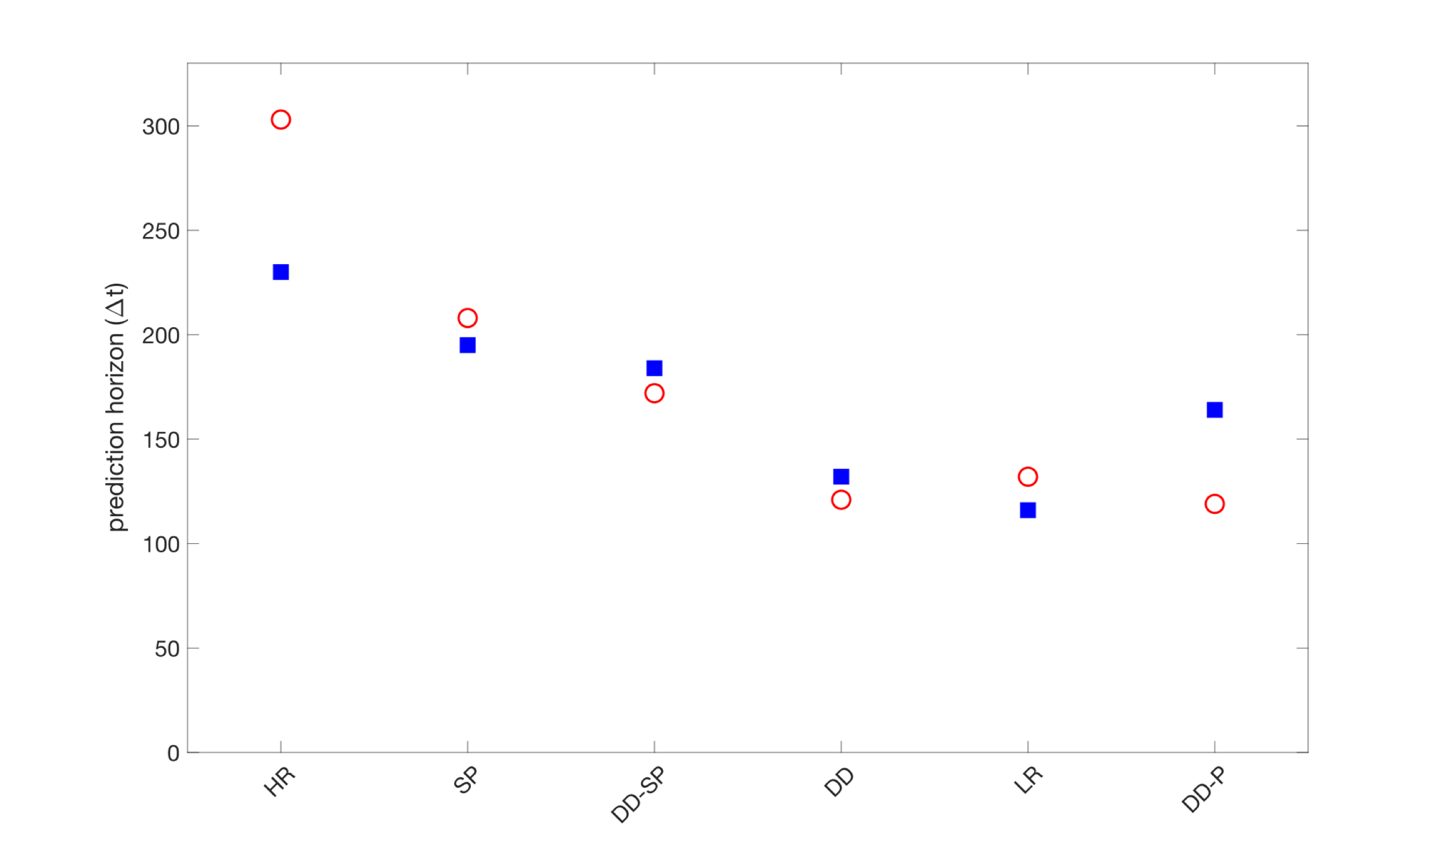
Predicting short-term spatio-temporal evolution
Equilibrium Case
Non-equilibrium Case
Computational cost (normalized)
123 111 1.4 0 1.4 1.4

Slide 17

Generalization to New Data
$$\frac{dX}{dt}=f\left(X,Y,p\right)$$
$$\frac{dY}{dt}=g(X,Y)$$
Generalization is not guaranteed by machine learning
Practical applications need models to generalize, e.g., climate change etc.
F=24
F=20

Slide 18
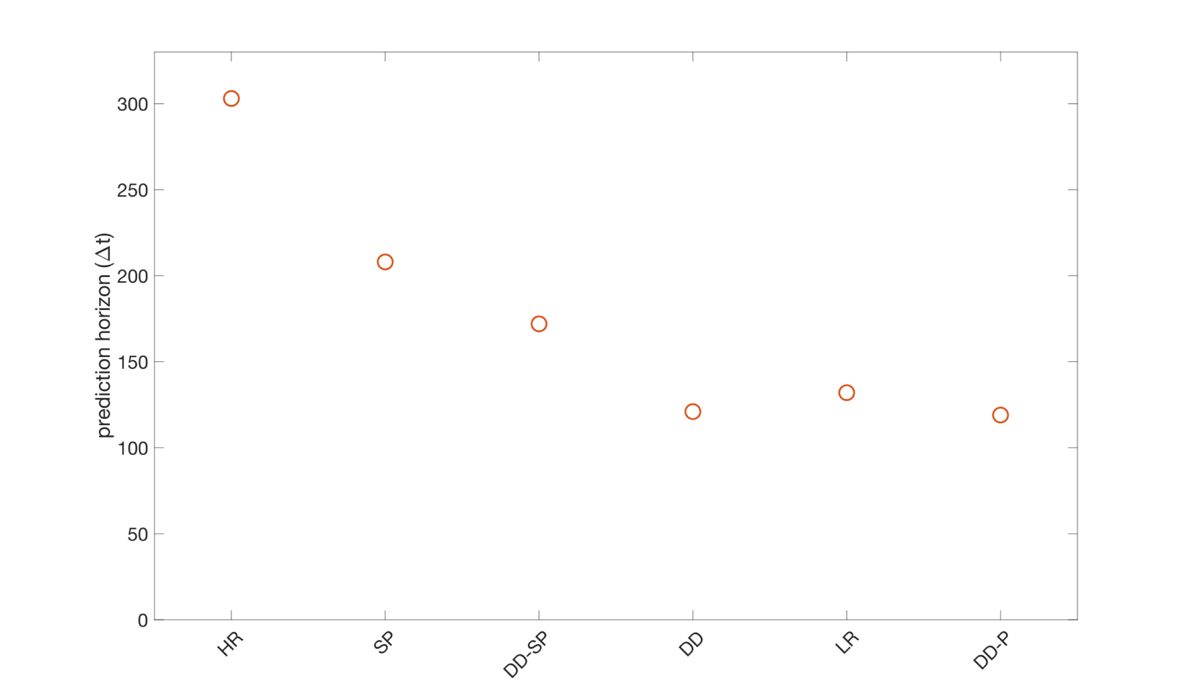
Generalization to New Data (Non-equilibrium Case)
Trained: F=20
Tested: F=20

Slide 19
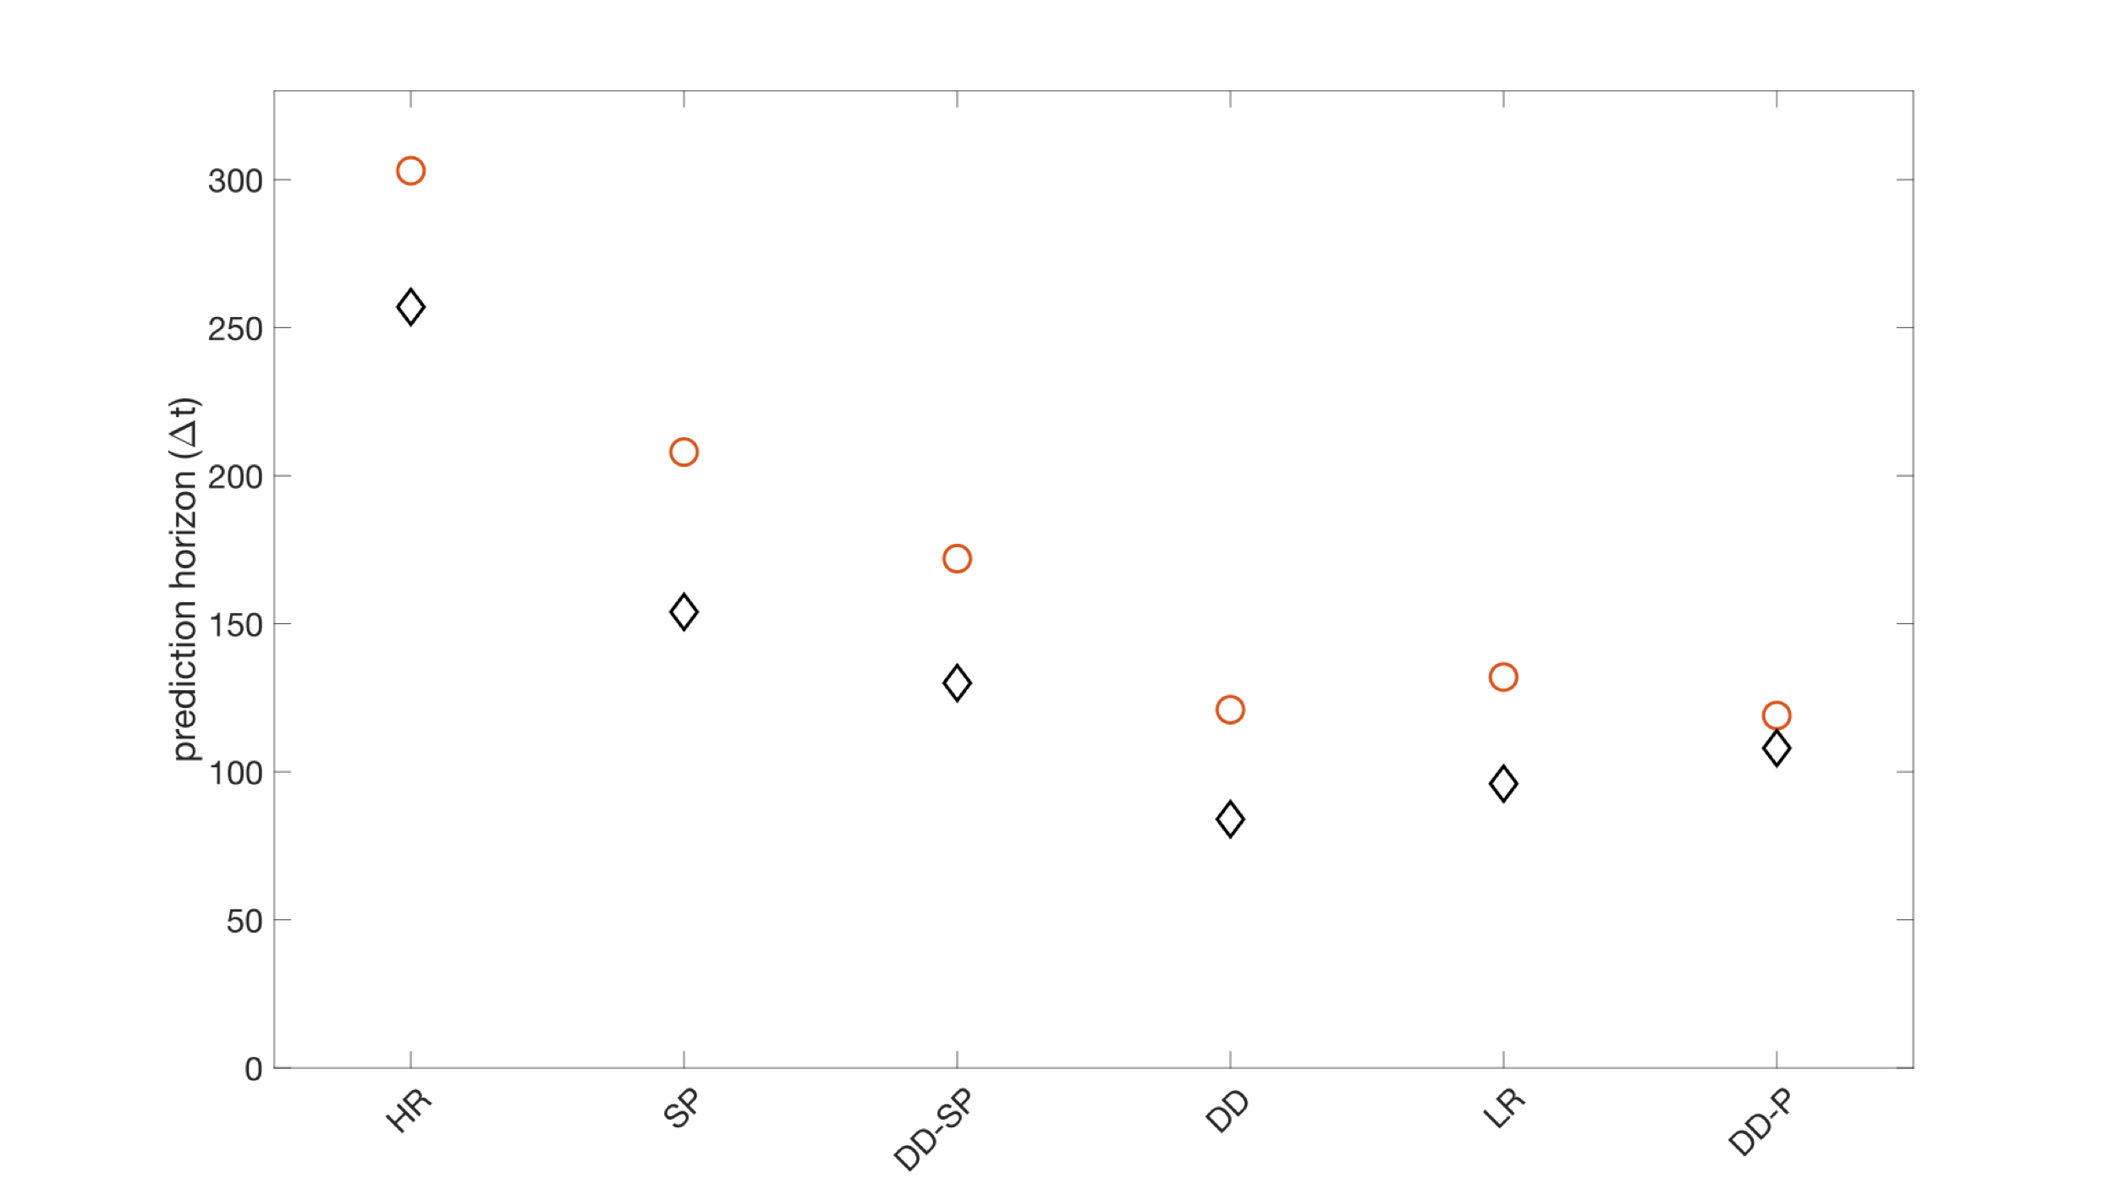
Generalization to New Data (Non-equilibrium Case)
Trained: F=24
Tested: F=24
Trained: F=20
Tested: F=20

Slide 20
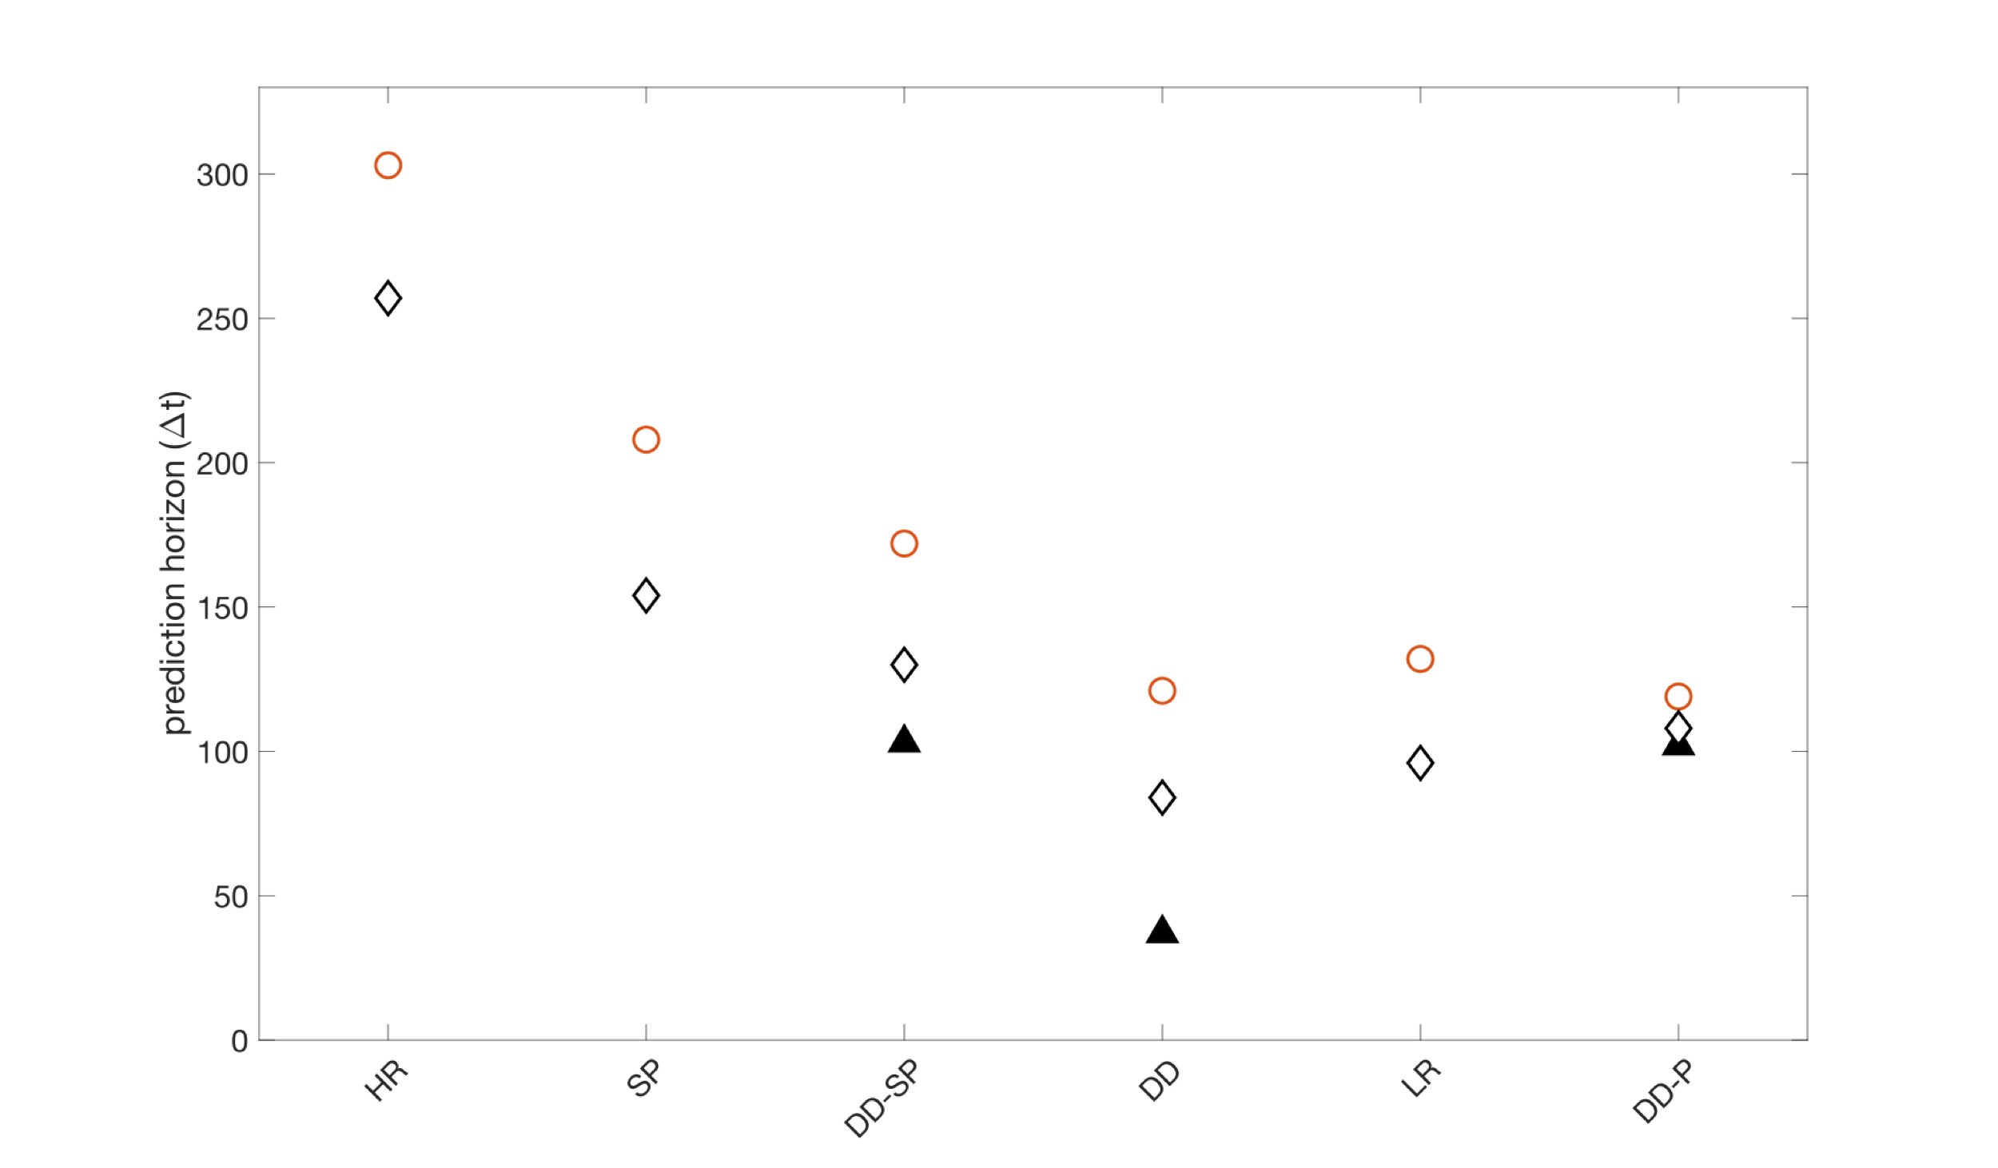
Generalization to New Data (Non-equilibrium Case)
Trained: F=24
Tested: F=24
Trained: F=20
Tested: F=20
Generalization gap too high when equilibrium is absent
Trained: F=20
Tested: F=24

Slide 21
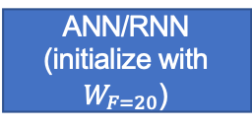
Transfer-learning
F=24
F=20
10K samples
1M samples
Train
Re-train
ANN/RNN (randomly initialized)
ANN/RNN (initialize with $W_{F=20}$)
Find weights $W_{F=20}$

Slide 22
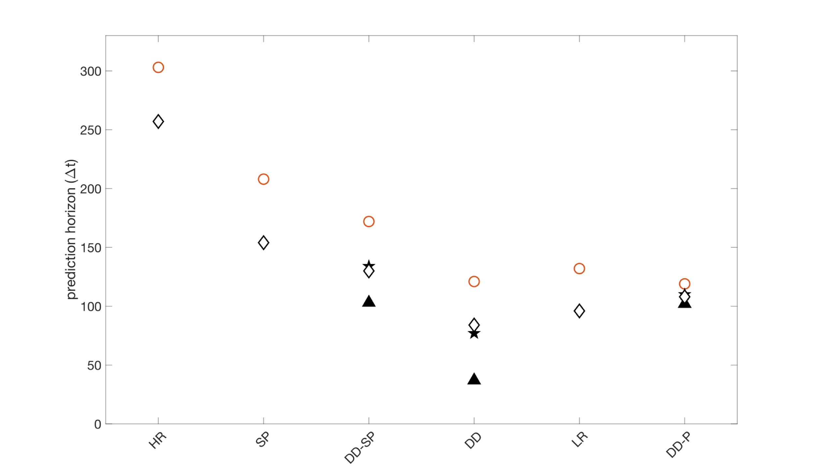
Trained: F=24
Tested: F=24
Trained: F=20
Tested: F=20
With
transfer-learning
Trained: F=20
Tested: F=24

Slide 23
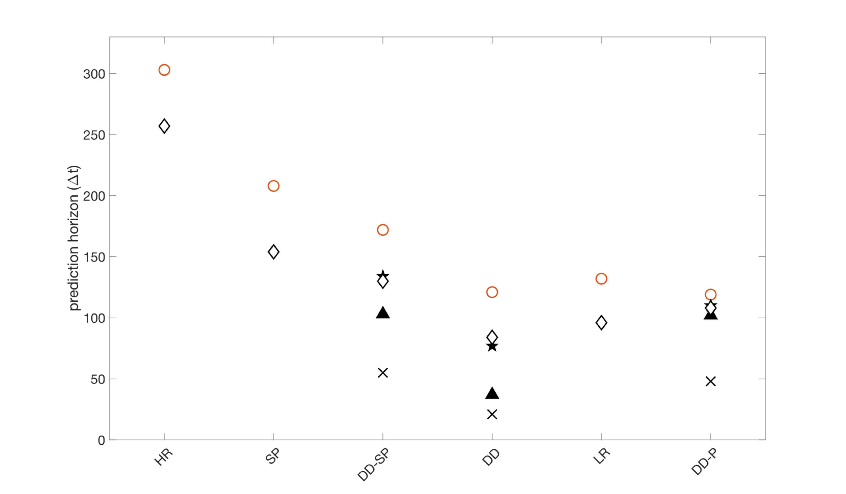
Trained: F=24
Tested: F=24
Trained: F=20
Tested: F=20
With
transfer-learning
Trained: F=20
Tested: F=24
With random initialization

Slide 24
Chattopadhyay, Subel, Hassanzadeh Data-driven super-parameterization using deep learning: Experimentation with multi-scale Lorenz 96 systems and transfer-learning, arXiv:2002.11167, Journal of Advances in Modeling Earth Systems, in revision.
Chattopadhyay, Subramaniam, Hassanzadeh Data-driven predictions of a multiscale Lorenz 96 chaotic system using machine-learning methods: reservoir computing, artificial neural network, and long short-term memory network, Non Linear Processes in Geophysics, 2020.
Chattopadhyay, Nabizadeh, Hassanzadeh, Analog Forecasting of Extreme‐Causing Weather Patterns Using Deep Learning, Journal of Advances in Modeling Earth Systems, 2020.
Chattopadhyay, Hassanzadeh, Pasha, Predicting clustered weather patterns: A test case for applications of convolutional neural networks to spatio-temporal climate data, Scientific Reports, 2020.
Chattopadhyay, Mustafa, Hassanzadeh, Kashinath, Deep spatial transformers for autoregressive data-driven forecasting of geophysical turbulence, EarthArxiv: 10.31223/osf.io/cqmb2, in review at the International Conference on Climate Informatics, Oxford UK.

Slide 25
Thank You

Slide 26
Back up

Slide 27




Challenges in Simulating Turbulence
DNS
LES
RANS
Resolved
$$E⁡(k)$$
RANS
Increasing computational cost
Physics
LES
DNS
$$log⁡(k)$$
$$k_{η}$$
Modeled

Slide 28
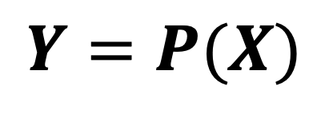
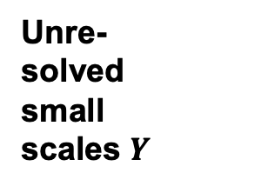




Subgrid-scale Models in Turbulence
RANS models (Kalitzin et al., JCP 2018)
Unre-
solved
small
scales $Y$
$$E⁡(k)$$
RANS
Smragonisky model (Smagorinsky, J. Mon. Weath. Rev, 1963 )
LES
Resolved large scales $X$
$$log⁡(k)$$
$$k_{η}$$
$$Y=P(X)$$
Semi-empirical
Ad-hoc
parameterization

