Slide 1



2nd NOAA Workshop on Leveraging AI in Environmental Sciences August 6, 2020
Recent Machine Learning Research at NCAR
Sue Ellen Haupt, Senior Scientist
Deputy Director, Research Applications Lab, NCAR
National Center for Atmospheric Research
NCAR is sponsored by the National Science Foundation under CA # 1852977.

Slide 2
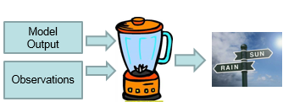
NCAR’s First Big AI Success: DICast®
Dynamic
Integrated
foreCast
System
DICast® In a Nutshell
Machine-Learning Post-processer of model data
  Create predictive relationships between model output, observations and desired forecast variables
Optimal Forecast Combiner
  Create best combination of inputs
Enables Decision Support
Uses Real-Time Data – IoT
Uses Large amounts of
Model Data
          Real time
          Historical for training

Slide 3
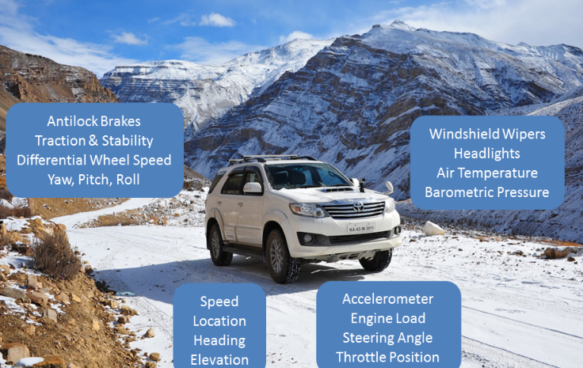
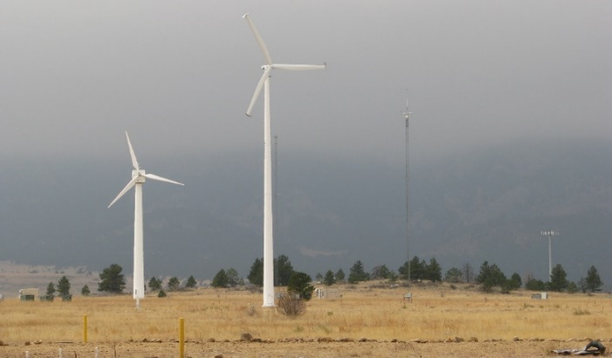


Evolution of DICast®
Originally developed for The Weather Channel (now The Weather Company - part of IBM) to produce public-oriented forecasts
Development started in 1999 in Research Applications Program
Used in many other projects as the ‘weather engine’
  Transportation (MDSS, Pikalert®, DIA, MSP)
  Solar Energy (DOE, Kuwait)
  Wind Energy (Xcel Energy, Kuwait)
  Agriculture (NASA)
  Commercial forecasting companies
    DTN/Schneider/Telvent/Meteorlogix/Kavouras
    Panasonic Weather Systems
    Global Weather Corp
    Skymet Weather Services of India
Jim Cowie
Seth Linden
Bill Petzke
Ishita Srivastava
Notes:
DICast was originally developed for The Weather Channel/Company in 1999.
NCAR and The Weather Company own the IP to DICast.
DICast’s applicability was clear from the beginning and it was used for the winter Maintenance Decision Support System as the weather engine.
It has also been used extensively in renewable energy projects.
Commercial weather providers also use DICast.
Most recently, we have contracted with Indian Skymet Weather Services to implement. Skymet’s goals are to improve the agricultural forecasts for farmers.

Slide 4
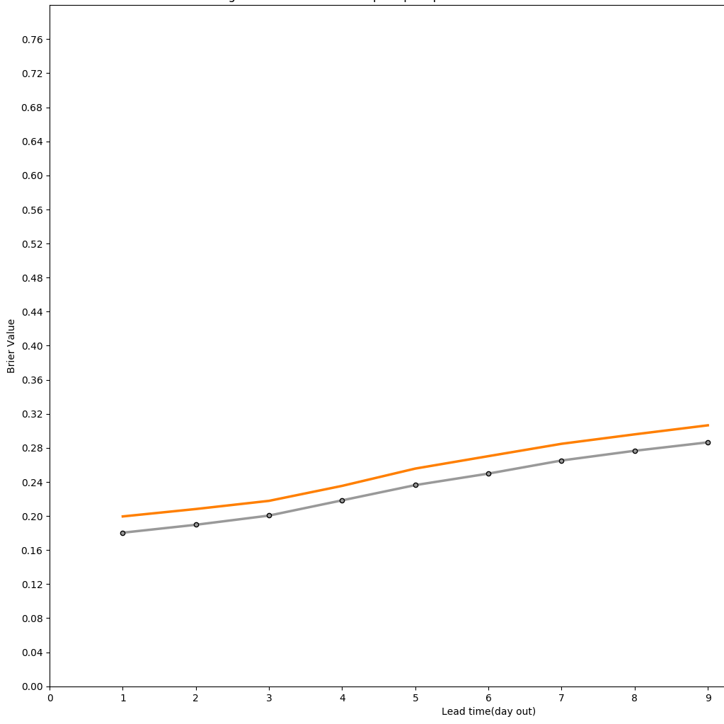
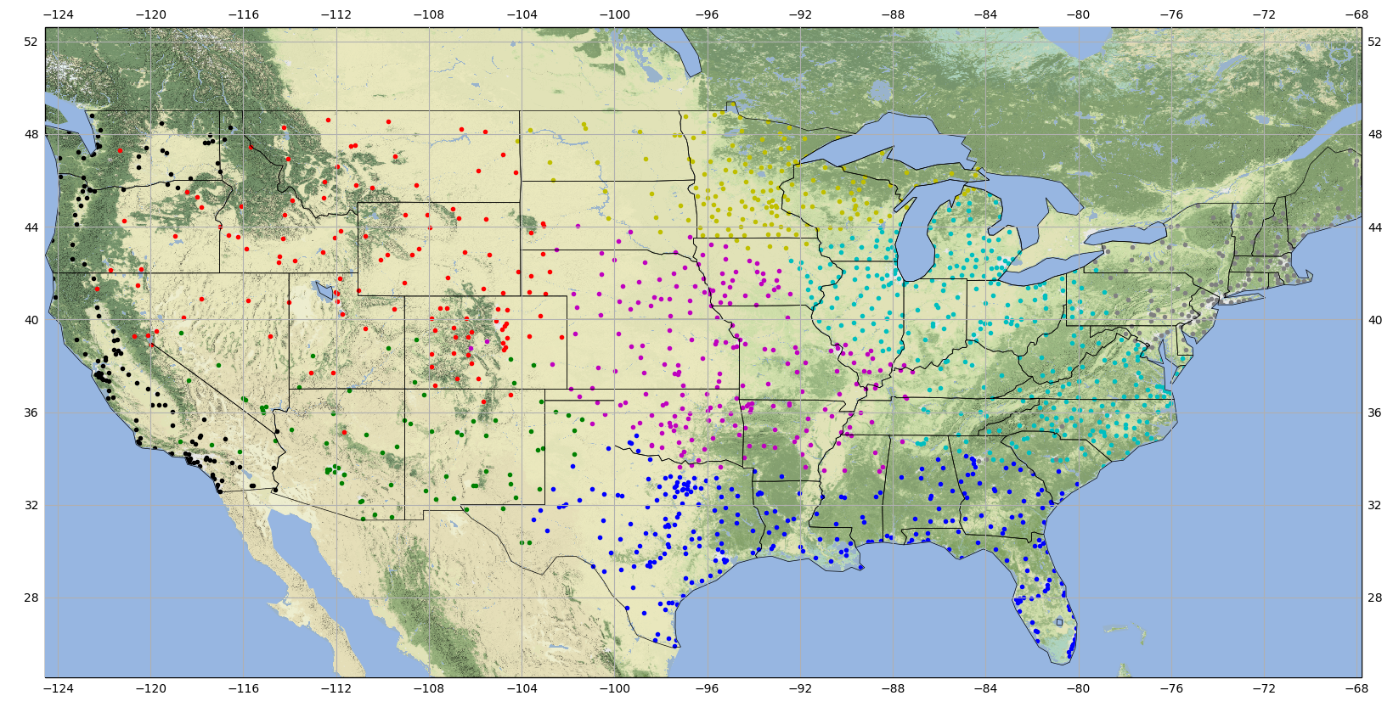
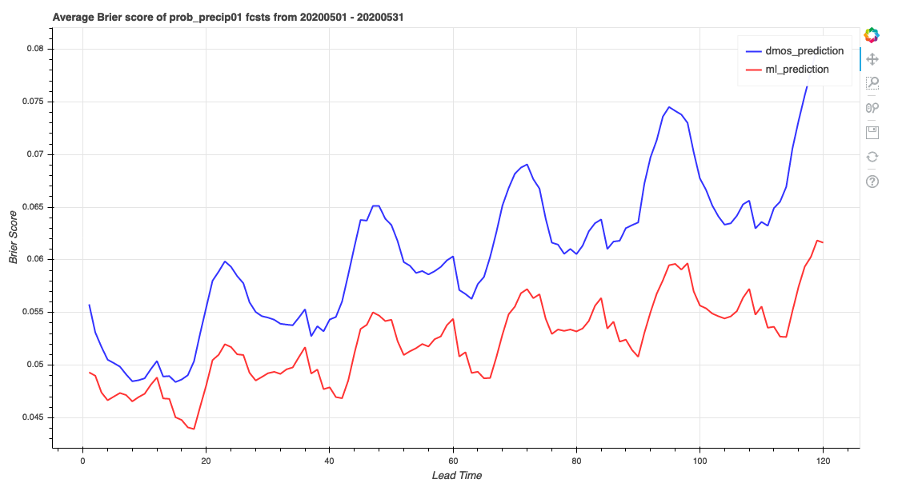
Recent DICast® Advances
GFS 12z 24-hr POP
Improve prediction of Probability of Precipitation with Machine Learning
Bias-corrected GFS
Gradient boosting
Brier Score
GFS 00Z – 1-hr POP
Clusters of climatologically similar METAR sites.
8 clusters based on GFS
Bias-corrected GFS
Gradient boosting
0 1 2 3 4 5 6 7 8 9
Lead time (day)
Brier Score
Gradient boosted regression trees improve upon multi-day POP forecasts
Bill Petzke
Jim Cowie
Ishita Srivastava
0 20 40 60 80 100 120
Lead time (hrs)

Slide 5
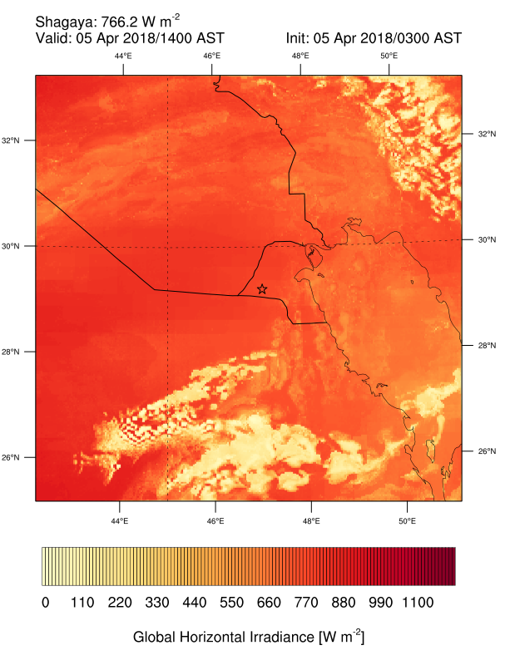
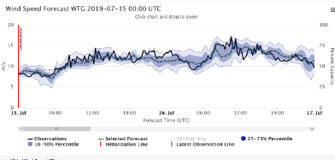
Kuwait Renewable Energy Prediction System (KREPS)
Probabilistic
Wind Power
Global Models
GFS, GEM (current)
ECMWF (future)
StatCast-Wind
(nowcasting)
Statistical
Verification
Meteorologist GUI
WRF Model Output
MAD-WRF & FDDA
(nowcasting)
Schaake Shuffle
Combine Wind &
Solar Power
Observations
Wind turbines, Meteosat, Wx stns
Operator GUI
Analog Ensemble System for Wind
Dynamic, Integrated Forecast (DICast®)
System
Analog Ensemble System for Solar
Regional Model
WRF-Solar-Wind
Observations
Pyranometers,
Meteosat, Wx stns
StatCast-Solar
(nowcasting)
Probabilistic
Solar Power
Statistical
Verification
Physical Model
AI Model
Sue Haupt Branko Kosovic
Gerry Wiener Jared Lee
Majed Al-Rasheedi Many others

Slide 6
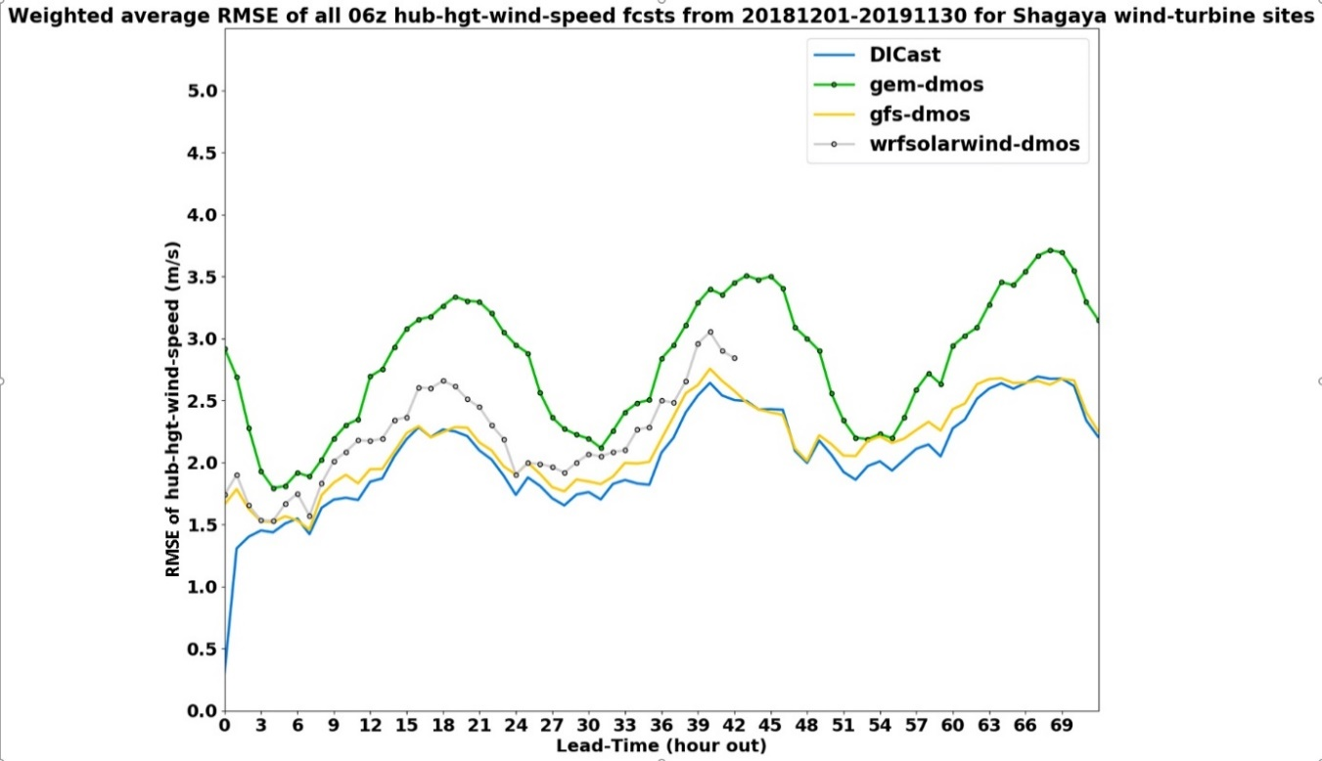
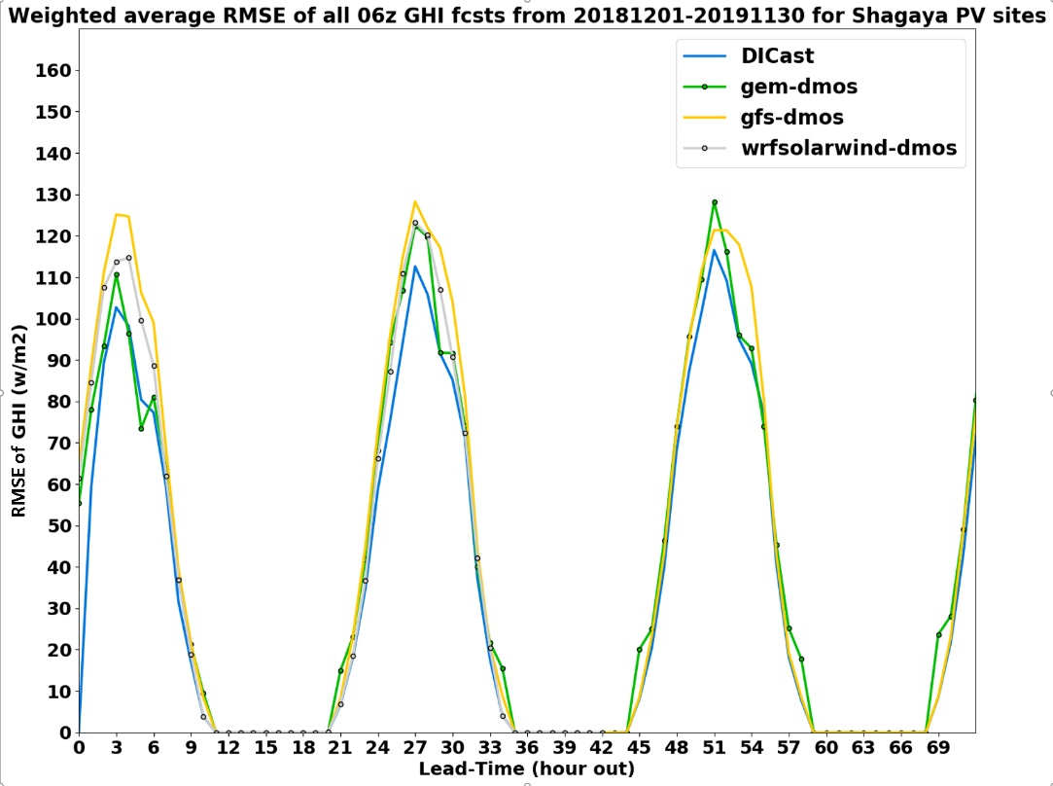
DICast® Preliminary Verification
Average RMSE of hub ht wind speed
1 Dec 2018–30 Nov 2019
Average RMSE of global horizontal irradiance
1 Dec 2018–30 Nov 2019; valid 06 UTC
Seth Linden
Tom Brummet

Slide 7

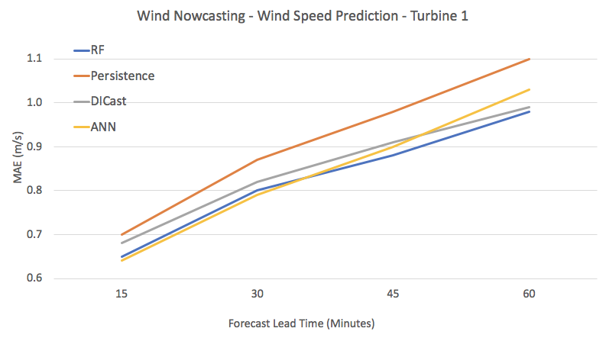
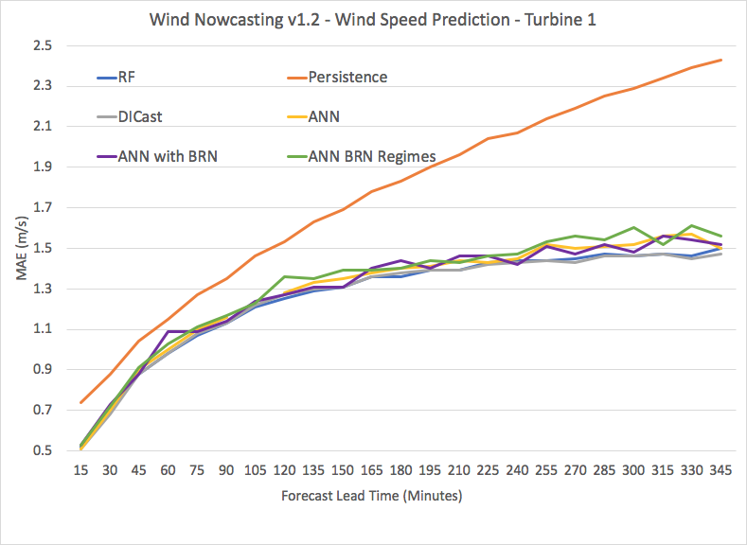
StatCast-Wind – Preliminary Results
StatCast Wind: Improvements over persistence for wind speed and power after 15-min (similar for all turbines), using either random forests (RF) or ANNs
Tyler McCandless
Ishita Srivastava

Slide 8

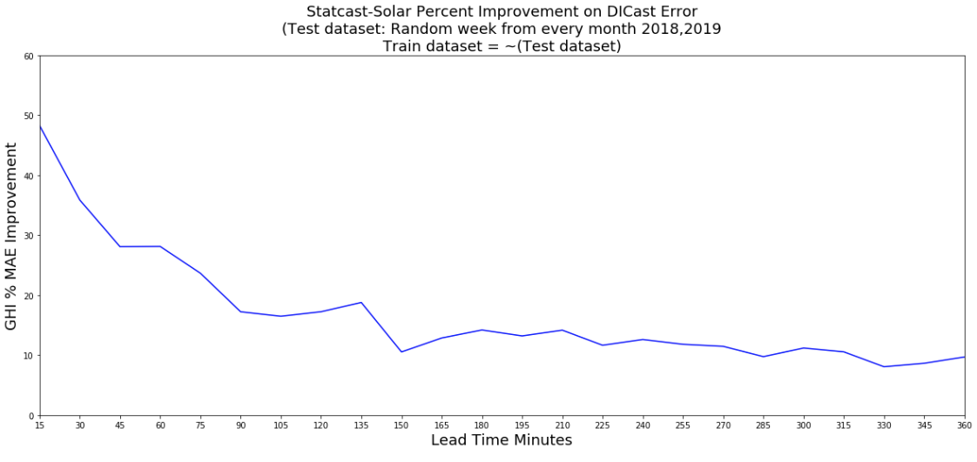
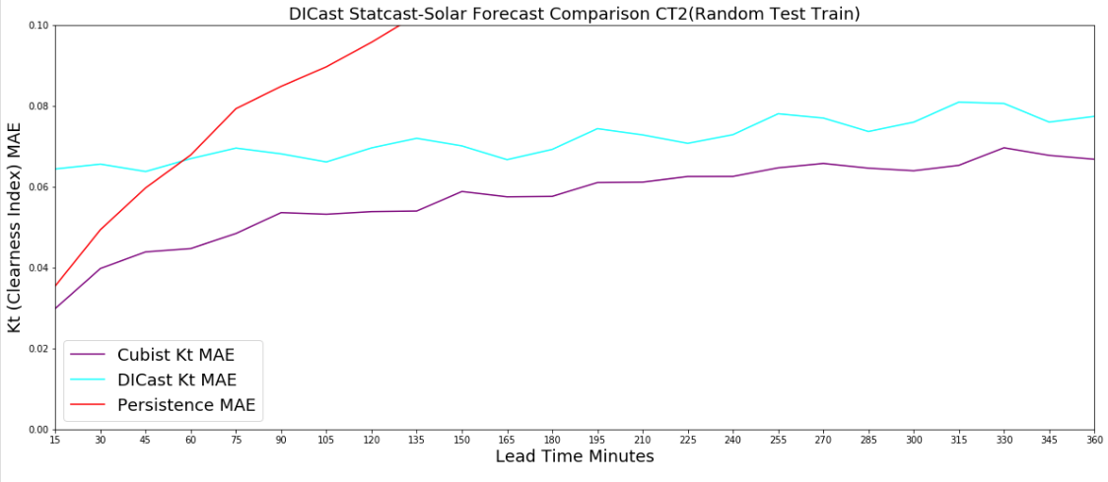
StatCast-Solar —Preliminary Results
  Initial Results
  Training data from 1 Sep 2018–30 June 2019
  StatCast-Solar can add value to DICast out to 6 hours
Comparison of the Cubist model to the DICast forecasts of Kt and smart persistence. The Cubist-based method performs best for all time periods from 15 min to 360 min compared to either DICast or smart persistence.
Percentage improvement of StatCast-Solar over DICast for all lead times from 15 min to 360 min.
Sue Dettling
Tyler McCandless
Tom Brummet
Sue Dettling
Notes:
Cubist performed better than Gradient Boosted Regression and Random Forest

Slide 9
Analog Ensemble (AnEn) Preliminary Results
Stefano Alessandrini
Tyler McCandless
AnEn + DICast (black) and DICast (red) for solar power (a) and wind power (b). The vertical bars represent the 5%–95% bootstrap intervals that are plotted every other lead time to reduce clutter. RMSE values are normalized by the nominal power of a single turbine (2 MW) or of a single PV plant (5 MW) and they are obtained by pooling data from all wind turbines or solar plants together.

Slide 10
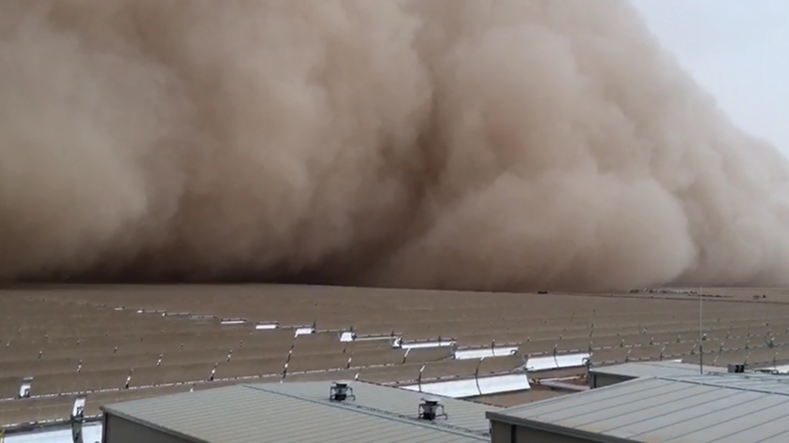
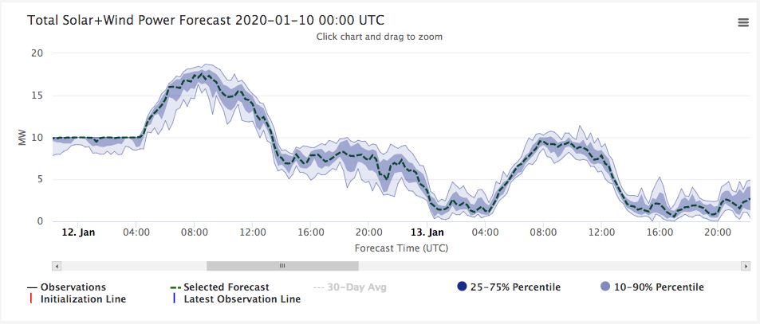
Display Probabilistic Power Output
Outputs from DICast+AnEn as displayed by the web display
Bill Petzke
Nhi Nguyen

Slide 11
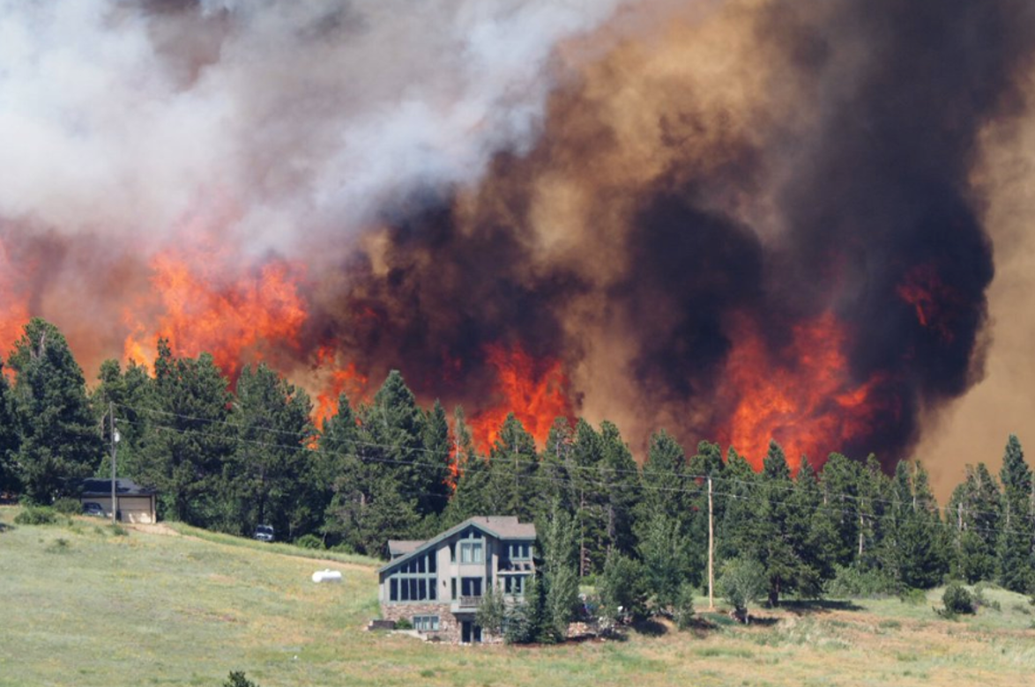
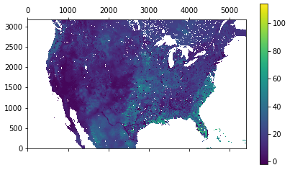
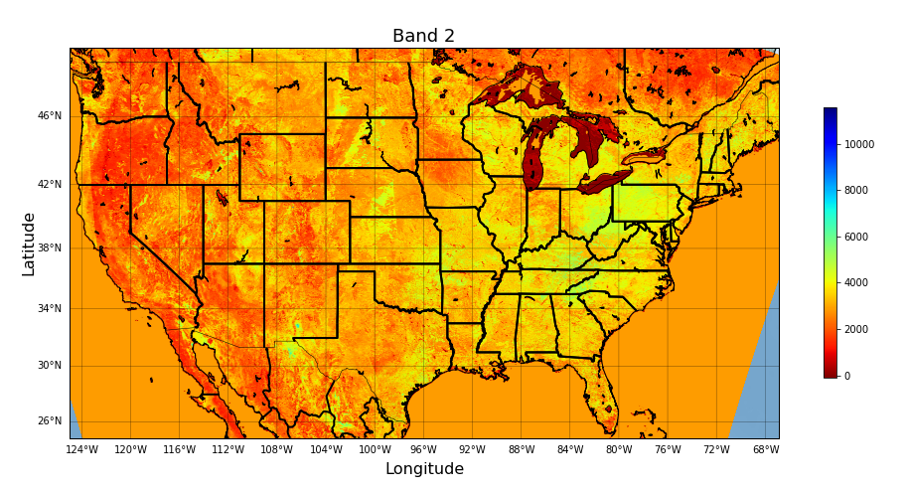
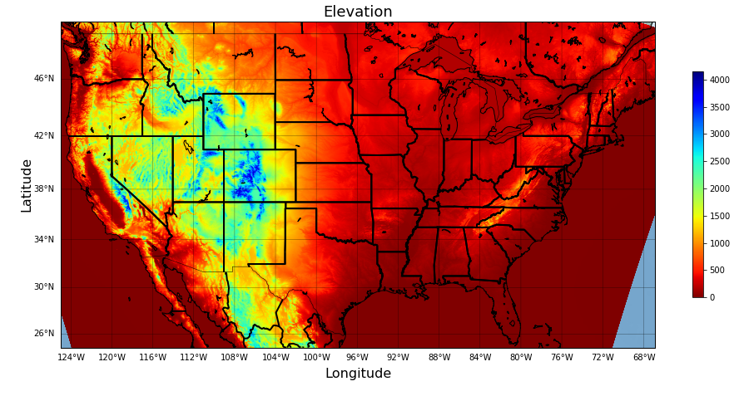
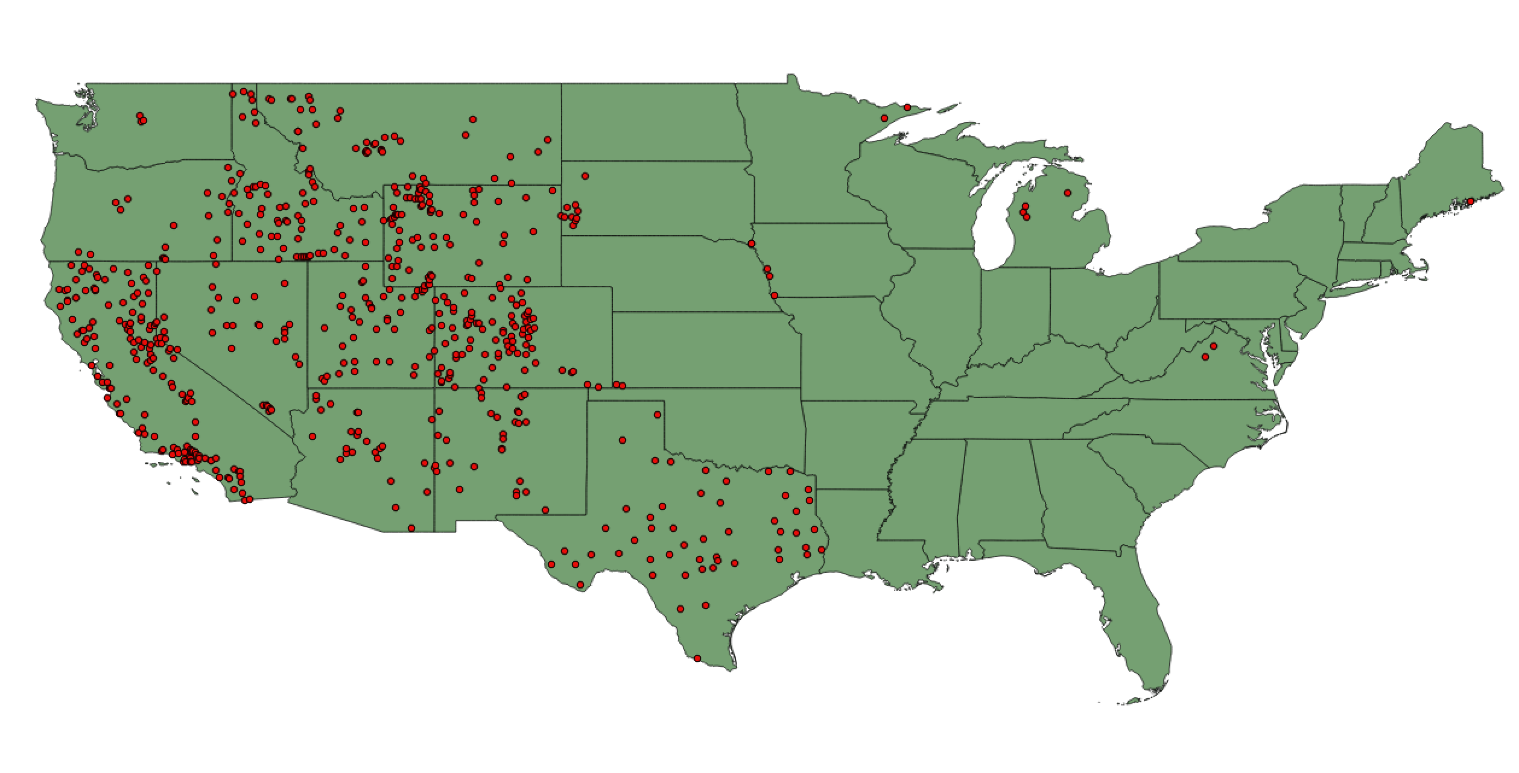
Fuel Moisture Content Prediction System
Satellite Derived Gridded Product
Goal: Create Gridded Product by using Artificial Intelligence to Learn Representative Relationships Between Satellite Data and Surface Observations
National Water Model
Accumulated Evapotranspiration, Land Use Category, Soil Moisture, Temperature
MODIS Satellite Data
Reflectance Bands 1-7
Machine Learning
Trained to Learn Relationships Between Predictors and FMC at Nearest Neighbor Grid Cells
Surface Characteristics
Elevation, East/West Slope, North/South Slope, Regions
Fuel Moisture Content
Live and Dead FMC
(Target Predictand)
Tyler McCandless
Branko Kosovic
Bill Petzke

Slide 12
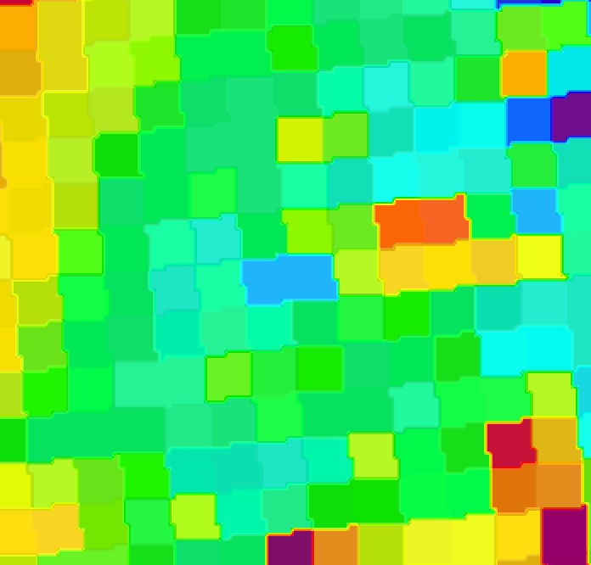
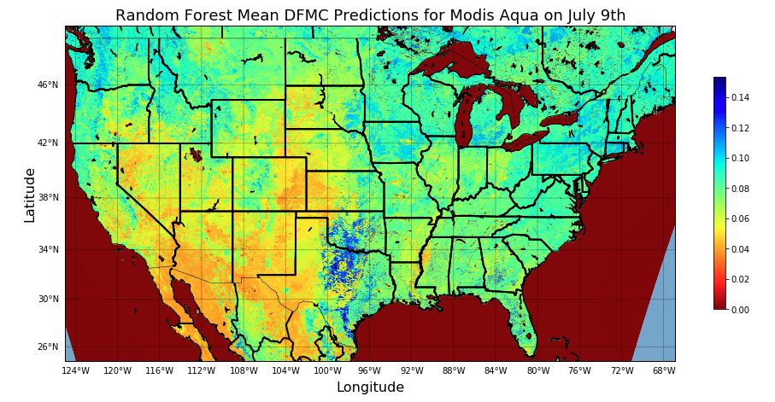
Fuel Moisture Content Prediction System
Fuel Moisture Content Prediction Errors
Random Forest (RF)
  1000 trees, 25 minimum samples per split,
  25 minimum samples per leaf
Artificial Neural Network (ANN)
Gradient Boosted Regression (GBR)
Multiple Linear Regression (MLR)
Dead Fuel Moisture Content
Live Fuel Moisture Content
DFMC Mean = 9.41%
DFMC Standard Deviation = 4.51%
LFMC Mean = 94.9%
LFMC Standard Deviation = 90.4%
 | Aqua | Terra
Method | Testing | Testing
MLR | 2.36% | 3.27%
ANN | 1.94% | 2.64%
GBR | 1.73% | 2.33%
RF | 1.56% | 2.14%
 | Aqua | Terra
Method | Testing | Testing
MLR | 30.37% | 30.39%
ANN | 28.58% | 27.76%
GBR | 23.87% | 23.56%
RF | 21.92% | 22.06%
Tyler McCandless
Branko Kosovic
Bill Petzke
Notes:
We use machine learning methodology to combine MODIS Aqua and Terra satellite observations, National Water Model output, and terrain data with surface observations and estimate dead and live fuel moisture content (FMC) over CONUS and produce daily a gridded, 1 km resolution, FMC map.

Slide 13
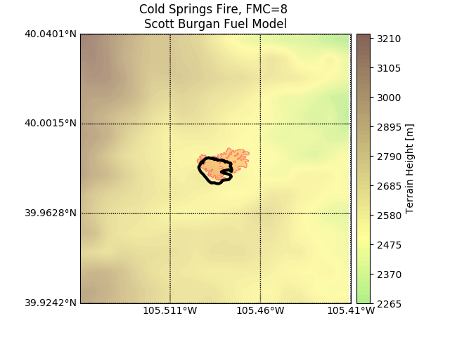
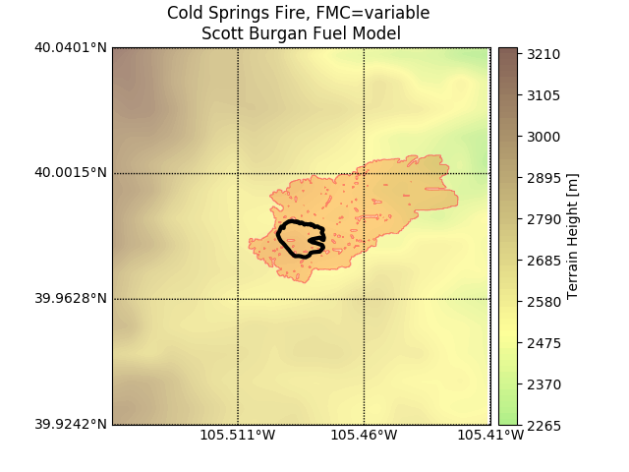
Fuel Moisture Content Prediction System
WRF-Fire Evaluation
Cold Springs fire simulated using constant Dead Fuel Moisture Content of 8% and machine learning predicted DFMC
Our NWP-based wildland fire prediction model tends to overestimate the rate of spread of fire due to lack of including fire suppression
Thus, it is positive to see burn area increase
Distribution of the estimated DFMC
Constant DFMC
ML-based DFMC - RF
Tyler McCandless
Branko Kosovic
Bill Petzke

Slide 14
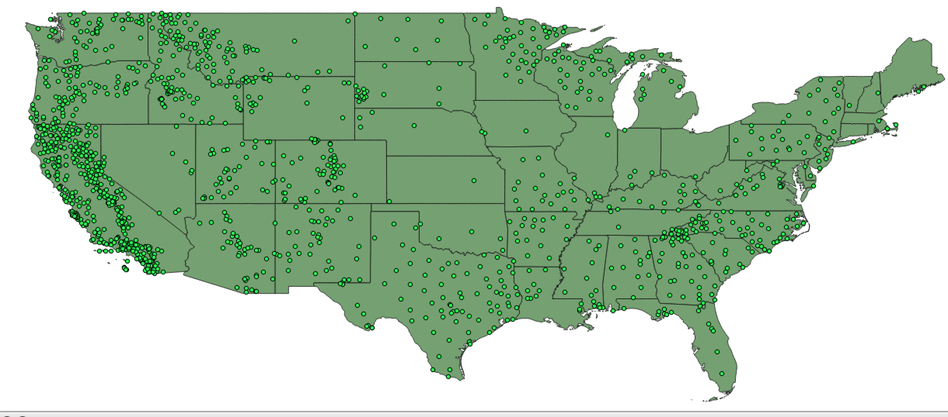
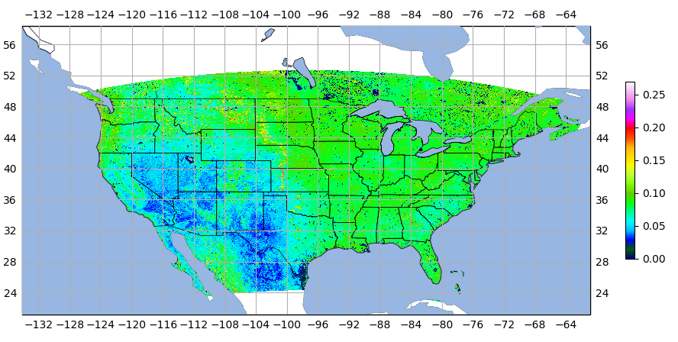
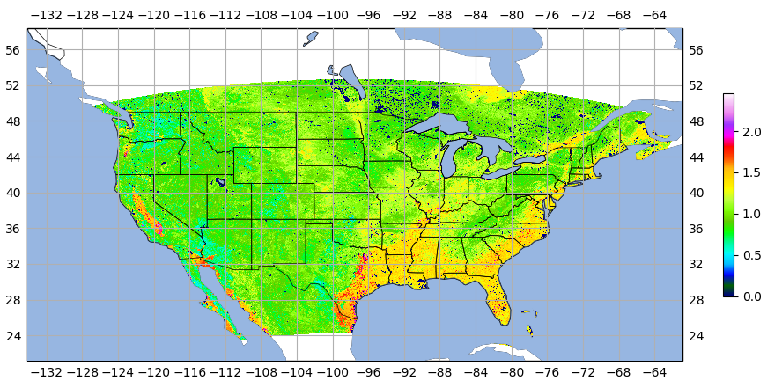
Daily CONUS 1-km Gridded Fuel Moisture Content Maps
Final Models
Final Gridded Product Provides More Realistic Representation of Fuel Moisture Content Across CONUS
DFMC Observation Sites
LFMC Observation Sites
Dead Fuel Moisture Content
Live Fuel Moisture Content
Gridded DFMC Predictions
Gridded LFMC Predictions
Tyler McCandless
Branko Kosovic
Bill Petzke
Fuel Moisture Content over CONUS
https://ral.ucar.edu/projects/improved-wildland-fire-spread-prediction (”Operations” tab for data)

Slide 15
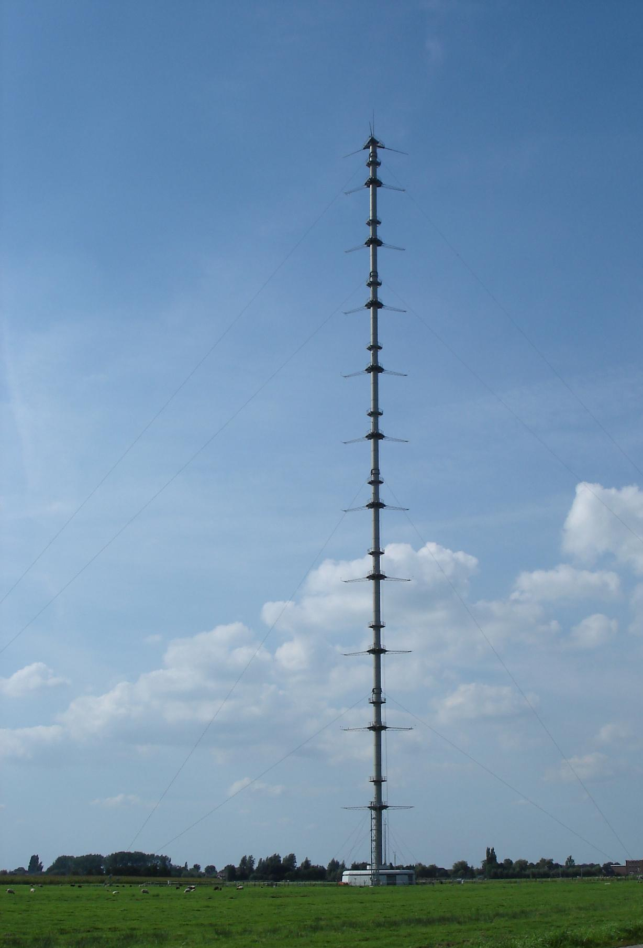
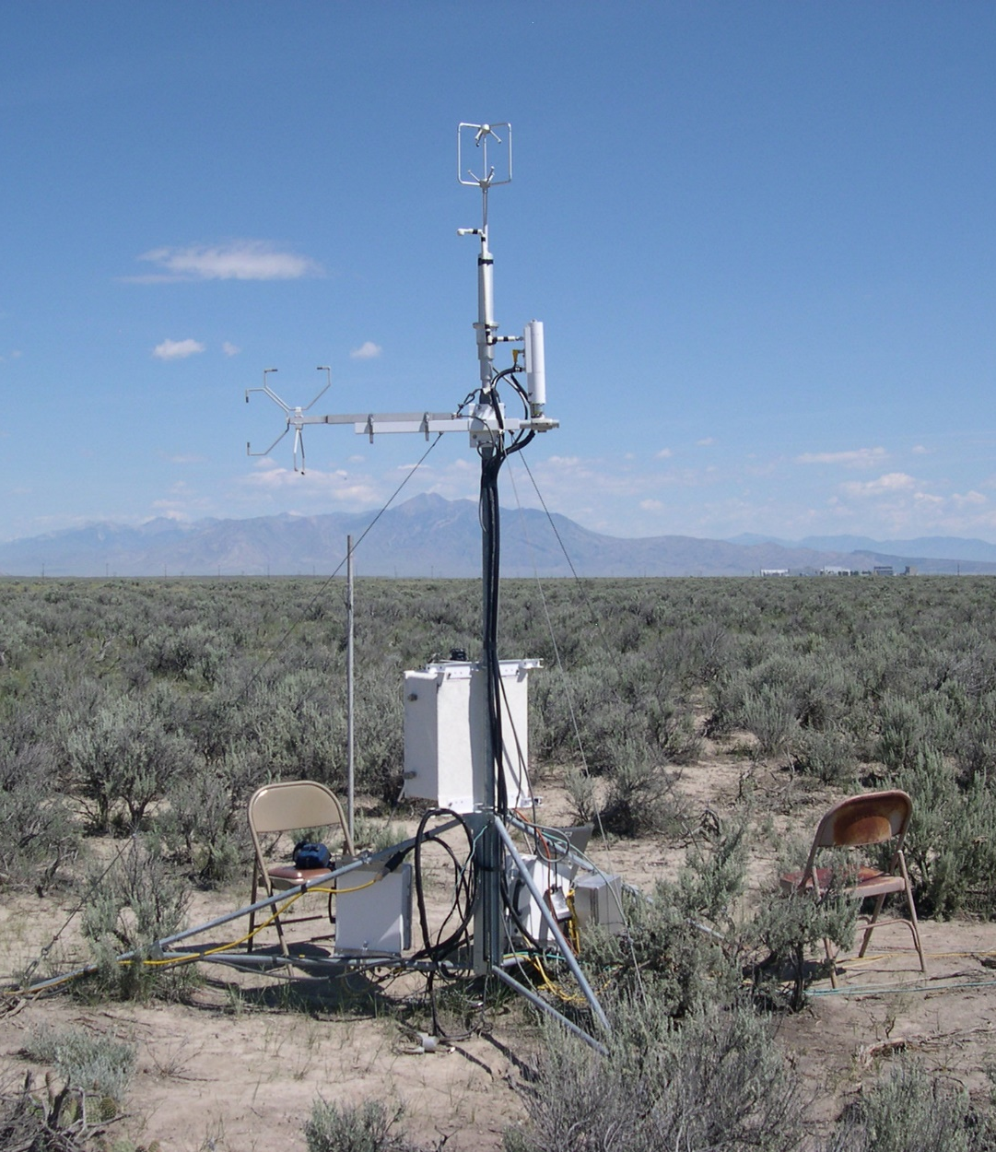
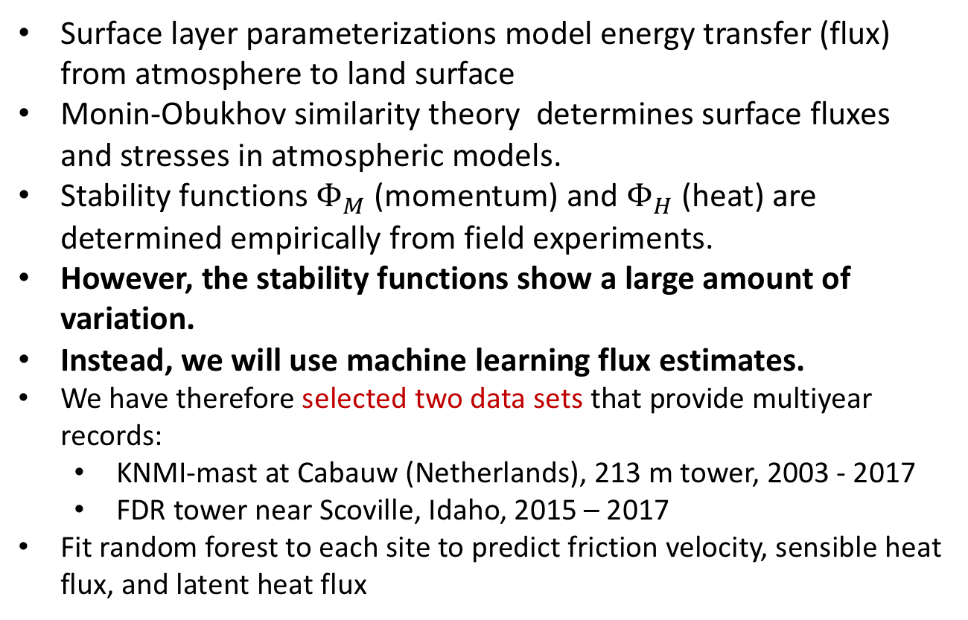
New Models: Machine Learning for
Surface Layer Parameterization
Surface layer parameterizations model energy transfer (flux) from atmosphere to land surface
Monin-Obukhov similarity theory determines surface fluxes and stresses in atmospheric models.
Stability functions $Φ_{M}$ (momentum) and $Φ_{H}$ (heat) are determined empirically from field experiments.
However, the stability functions show a large amount of variation.
Instead, we will use machine learning flux estimates.
We have therefore selected two data sets that provide multiyear records:
  KNMI-mast at Cabauw (Netherlands), 213 m tower, 2003 - 2017
  FDR tower near Scoville, Idaho, 2015 – 2017
Fit random forest to each site to predict friction velocity, sensible heat flux, and latent heat flux
https://nevada.usgs.gov/et/measured.htm
Cabauw
Idaho
McCandless, Gagne, Kosovic, Haupt

Slide 16
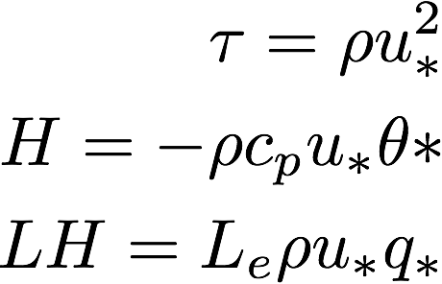
Input and Output Variables
Output equations
Input Variables | Heights (Idaho/Cabauw)
Potential Temperature Gradient (K) | Skin to 10 m, 15 m/20 m
Mixing Ratio Gradient (g kg⁻¹) | Skin to 10 m, 20 m
Wind Speed (m s⁻¹) | 10 m, 15 m/20 m
Bulk Richardson number | 10 m- 0 m
Moisture Availability (%) | 5 cm/3 cm
Solar Zenith Angle (degrees) | 0 m
Predictands
u*=Friction velocity
θ*=Temperature scale
q*=Moisture scale
ML Procedure
Train ML models on observations
Surface layer parameterization derives necessary outputs from ML predictions

Slide 17
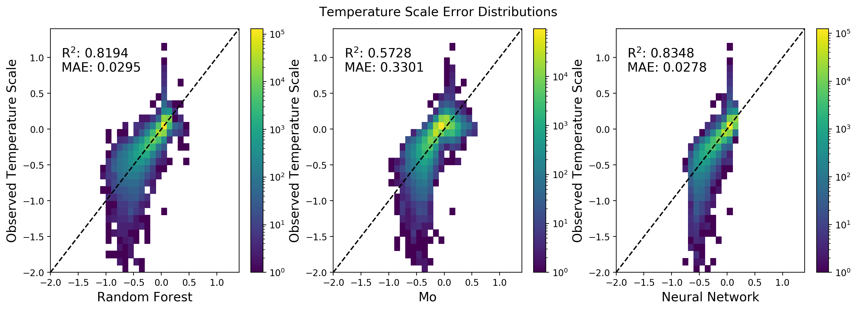
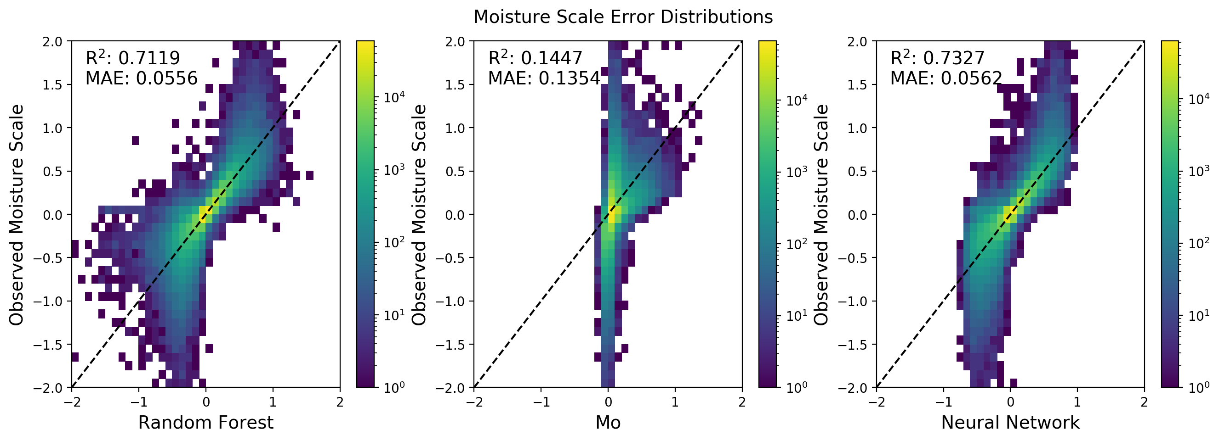
Random Forest and ANN Prediction of
Surface Layer Variables
Temperature Scale
Both Random Forest and Neural Networks consistently outpredict Monin-Obukov Similary Theory
Higher Correlation
Lower MAE
Moisture
Scale
McCandless, Gagne, Kosovic, Haupt
Random Forest M-O Neural Network

Slide 18
Cross-Testing ML Models
 | R² |  |  | MAE
Idaho Test Dataset | Friction Velocity | Temperature Scale | Moisture Scale | Friction Velocity | Temperature Scale | Moisture Scale
MO Similarity | 0.85 | 0.42 |  | 0.077 | 0.203
RF Trained on Idaho | 0.91 | 0.80 | 0.41 | 0.047 | 0.079 | 0.023
RF Trained on Cabauw | 0.88 | 0.76 | 0.22 | 0.094 | 0.139 | 0.284
 | R² |  |  | MAE
Cabauw Test Dataset | Friction Velocity | Temperature Scale | Moisture Scale | Friction Velocity | Temperature Scale | Moisture Scale
MO Similarity | 0.90 | 0.44 | 0.14 | 0.115 | 0.062 | 0.135
RF Trained on Cabauw | 0.93 | 0.82 | 0.73 | 0.031 | 0.030 | 0.055
RF Trained on Idaho | 0.90 | 0.77 | 0.49 | 0.074 | 0.049 | 0.112
Random Forest significantly outperforms Monin-Obukov Theory
True even when applied to site that is different than the one trained
Can be used as a model parameterization
McCandless, Gagne, Kosovic, Haupt – In preparation

Slide 19
Summary:
Machine Learning is advancing
applications of weather forecasting
  Post-processing
  Pre-processing for data needs
  Stand-alone short-range prediction
  Replacing physics
ML becoming a necessary component of modern weather forecasting systems
AI-Physics Blended System
Planned outcome: to advance applications of weather forecasting through a systems approach and machine learning
NCAR is sponsored by the National Science Foundation

Slide 20
Supplementary Slides

Slide 21


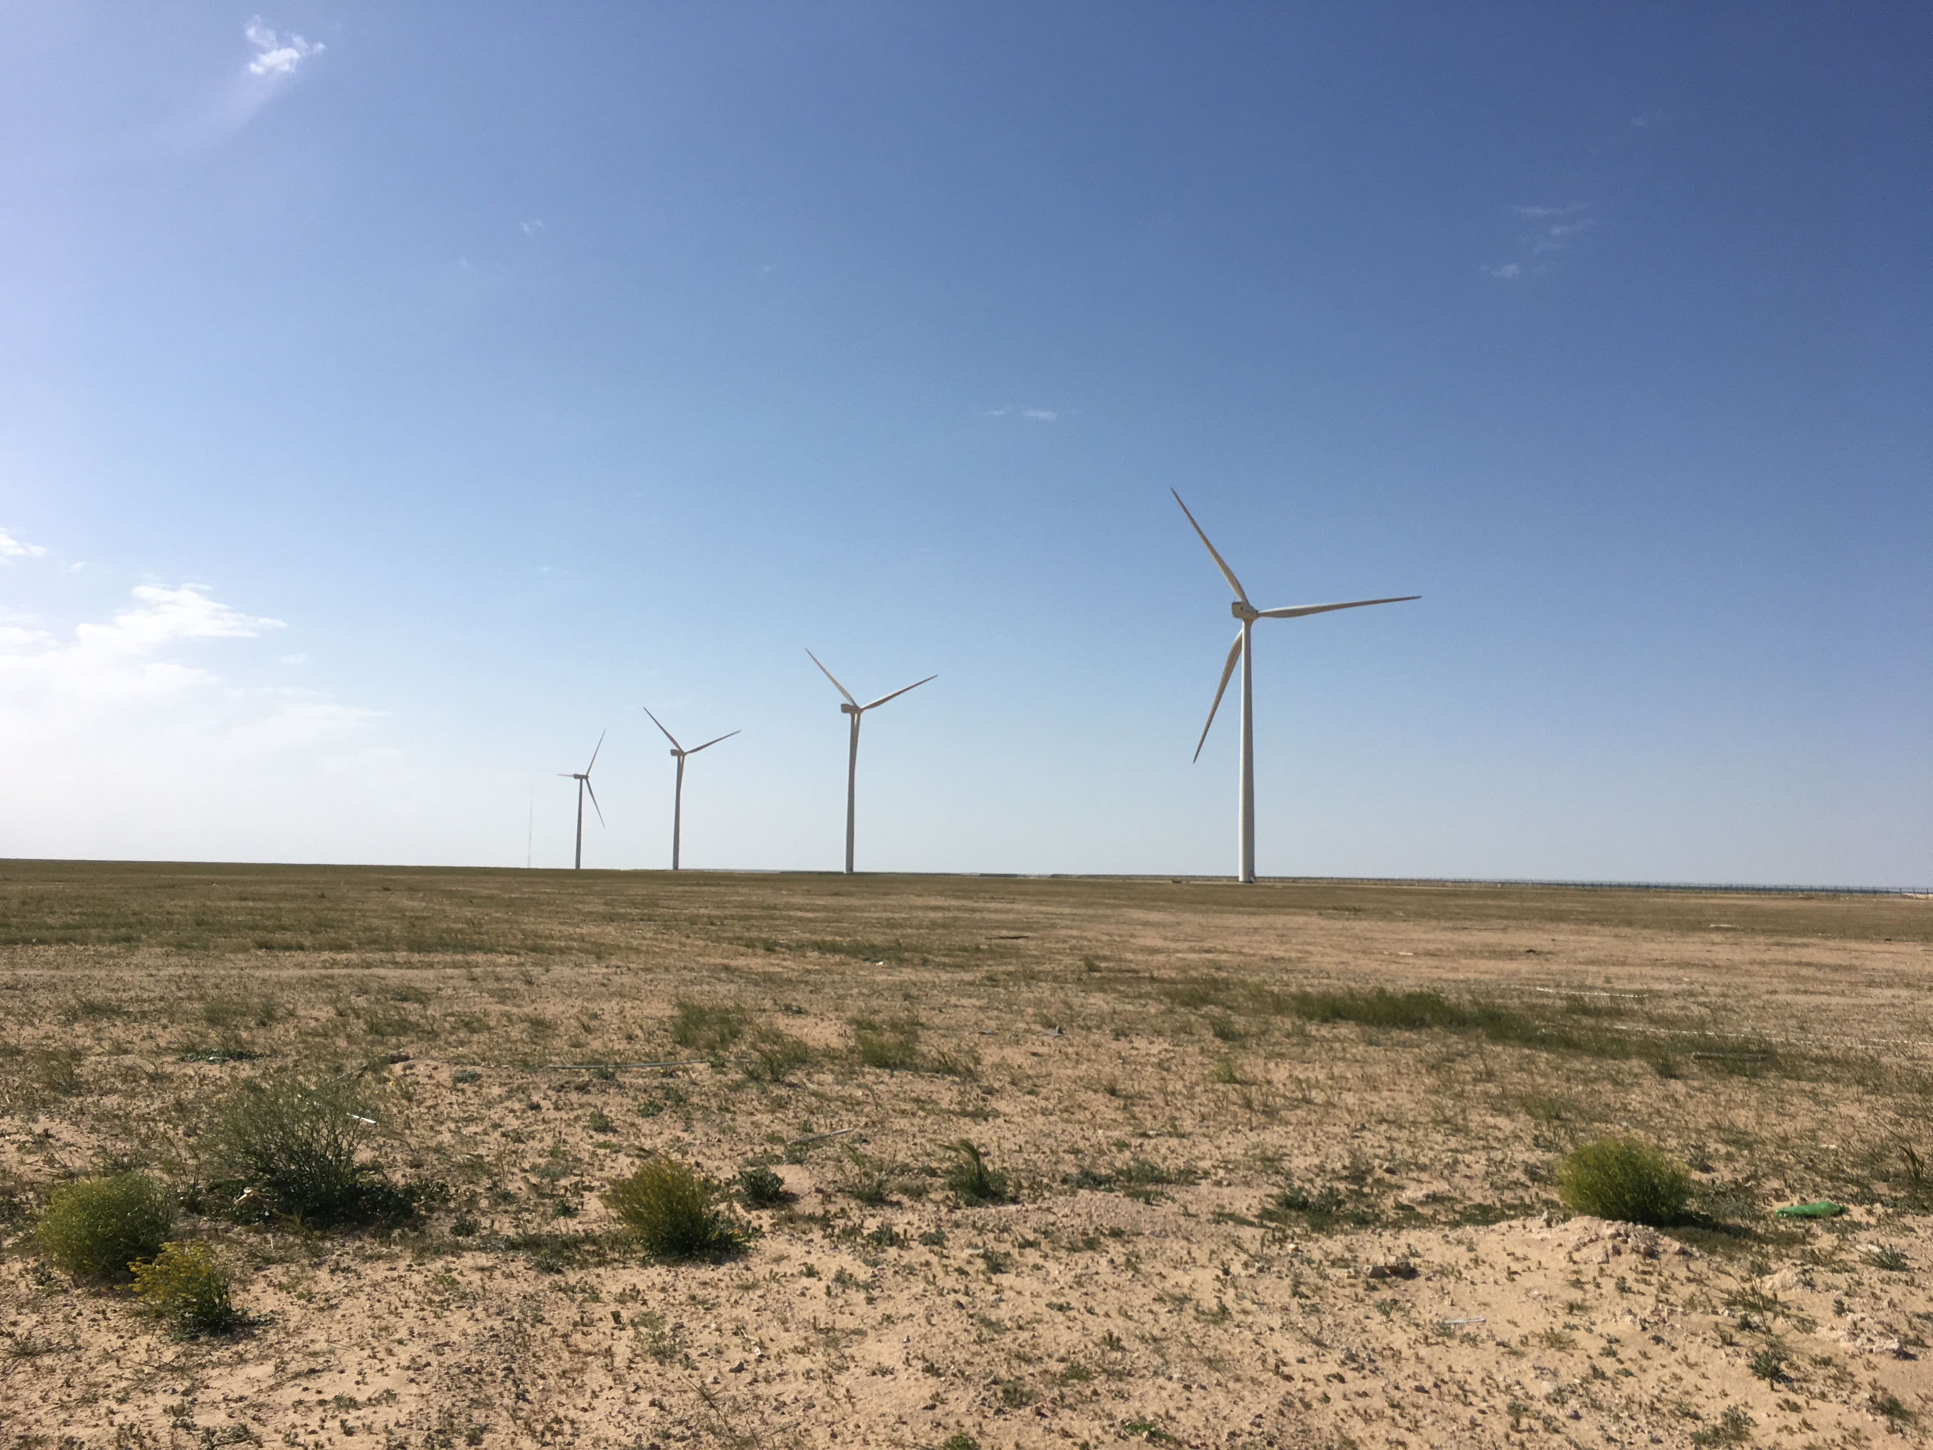


Forecasting System for Shagaya Renewable Energy Park in Kuwait
Phase 1 (complete):
  10 MW PV (May 2017)
  10 MW Wind (Jul 2017)
  50 MW CSP (Dec 2018)
Phase 2:
  TBD add’l PV/CSP
  TBD add’l wind
Phase 3:
  TBD
Total by 2030: ~4 GW
Kuwait goal of 15% RE generation by 2030

Slide 22
Ongoing developments: fuel moisture content
High sensitivity to the fuel moisture content (FMC) requires accurate estimate of FMC
FMC = 0.02
FMC = 0.08
FMC = 0.16
Cold Springs Fire

Slide 23
We use machine learning methodology to combine MODIS Aqua and Terra satellite observations, National Water Model output, and terrain data with surface observations and estimate dead and live fuel moisture content (FMC) over CONUS and produce daily a gridded, 1 km resolution, FMC map.
9 July 2016 – the day of Cold Spring Fire in Colorado

Slide 24
Weights assigned to predictors by machine learning model indicate their importance
Predictor importance for estimation of dead FMC
Variable (CONUS, Aqua) | Importance
Land Surface Temperature | 40%
Elevation | 15%
Soil Saturation All Layers | 8%
Accumulated Evapotranspiration | 7%
Band 5 | 4%
Band 7 | 4%
East West Slope | 4%
North South Slope | 4%
Band 1 | 2%
Band 2 | 2%
Band 3 | 2%
Land Use Category | 2%
East Region | 2%
Band 4 | 1%
Band 6 | 1%
Southwest Region | 1%
Northwest Region | 0%
Variable (CONUS, Terra) | Importance
Land Surface Temperature | 40%
Elevation | 15%
Soil Saturation All Layers | 7%
Accumulated Evapotranspiration | 7%
Band 7 | 5%
East Region | 4%
Band 2 | 3%
East West Slope | 3%
North South Slope | 3%
Band 1 | 2%
Band 3 | 2%
Band 5 | 2%
Band 6 | 2%
Band 4 | 1%
Land Use Category | 1%
Northwest Region | 1%
Southwest Region | 1%

Slide 25
Weights assigned to predictors by machine learning model indicate their importance
Predictor importance for estimation of live FMC
Variable (CONUS, Aqua) | Importance
Elevation | 22%
Soil Saturation All Layers | 19%
Accumulated Evapotranspiration | 9%
North-South Slope | 8%
East-West Slope | 7%
Land Surface Temperature | 7%
Band 2 | 6%
Band 7 | 6%
Land Use Category | 4%
Band 1 | 3%
Band 4 | 3%
Band 5 | 3%
Band 3 | 2%
Band 6 | 1%
Variable (CONUS, Terra) | Importance
Elevation | 22%
Soil Saturation All Layers | 17%
Accumulated Evapotranspiration | 11%
East-West Slope | 7%
Band 2 | 6%
Band 6 | 6%
Land Surface Temperature | 6%
North-South Slope | 5%
Land Use Category | 5%
Band 7 | 4%
Band 1 | 3%
Band 4 | 3%
Band 5 | 3%
Band 3 | 2%

