Slide 1
Combining data assimilation and machine learning for weather
forecasting
Alan Geer
European Centre for Medium-range Weather Forecasts
alan.geer@ecmwf.int
Thanks to: Massimo Bonavita, Sam Hatfield, Patricia de Rosnay, Peter Dueben

Slide 2
Data assimilation for numerical weather prediction: (NWP) Blending short forecasts and new observational data in a statistically optimal way
Long forecasts
Initial conditions
Data assimilation
Data assimilation
Data assimilation
Short forecast
Short forecast
Short forecast
Observations
Observations
Observations
Time
09 UTC
21 UTC
09 UTC
21 UTC

Slide 3
4D-Variational DA with a perfect model
Geophysical state
Background
model trajectory
Improved forecast
DA adjusts initial state to better fit observations
Analysis model trajectory
=
Observations
Time

Slide 4
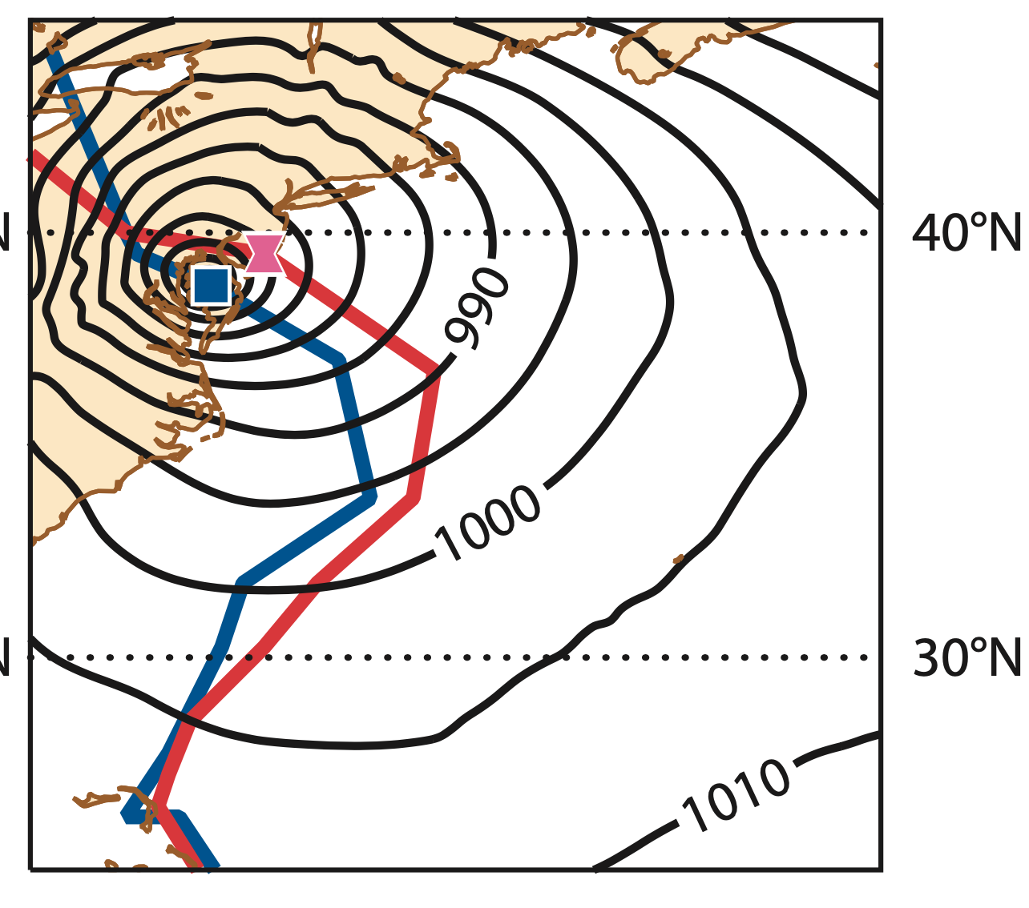
The perfect model assumption… valid?
Basic physical principles (e.g. conservation of momentum, mass and energy)
Complete system described in physical equations (e.g. Navier-Stokes)
Atmospheric/ocean dynamics
Global forecast model on 8km resolution
Up to 8 days forecast of Hurricane Sandy (2012)
Is predictability limited not by deficiencies in the forecast model by chaotic error growth (e.g. Lorenz, 1963)?
The deterministic prediction limit of 10 days for midlatitude weather could be increased to 15 days with more precise initial conditions (Zhang et al., 2019, doi:10.1175/JAS-D-18-0269.1)
Analysis track
5-day forecast
Evaluation of forecasts for Hurricane Sandy
Magnusson et al., (2013, https://doi.org/10.21957/b5nhw6qe1)

Slide 5
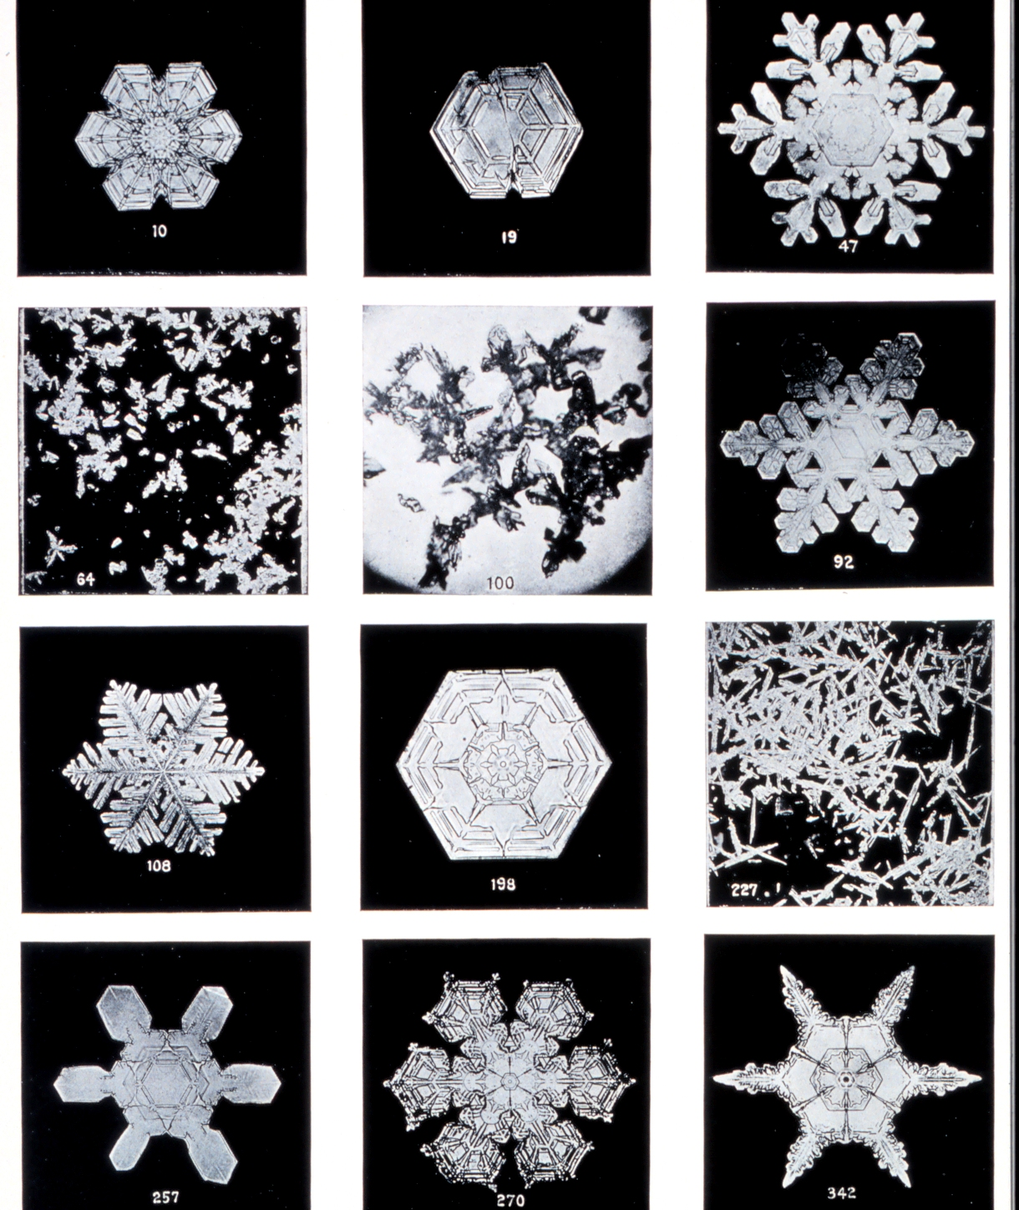
The perfect model assumption… questionable?
Within the fluid systems (atmosphere / ocean):
Truncation of model resolution and dynamical processes (e.g. 8 km currently) therefore needing parametrisations of diffusion, turbulence, gravity waves etc.
The water problem: phase changes
Cloud and preciptiation processes – microscopic scales
Sea-ice
Throughout the earth system – many processes or boundary conditions that are not modeled from physical first principles and/or are strongly heterogeneous in time and space
Biosphere, lithosphere, aerosols ...
Wilson Bentley (1902, http://www.photolib.noaa.gov)

Slide 6
Data-driven model learning - for new knowledge
No new knowledge gained
(but can help approximate subgrid aspects using higher-res models
Krasnopolsky et al. (2013, https://doi.org/10.1155/2013/485913),
Gentine et al. (2018, https://doi.org/10.1029/2018GL078202))
Model output?
Observations
Retrieval of temperature profile from satellite
Real observations
Satellite radiance
Measurement of 2m temperature in a screen
Disdrometer measurements at a field site
Problematic – see later (‘Null space’ filled by a-priori and many other issues – e.g. Clive Rodgers, ‘Inverse methods for atmospheric sounding’, 2000)
Normally used in NWP
Indirect measurement, ambiguous
Not fully representative of wider area
Technically difficult to incorporate
Not yet used in NWP

Slide 7
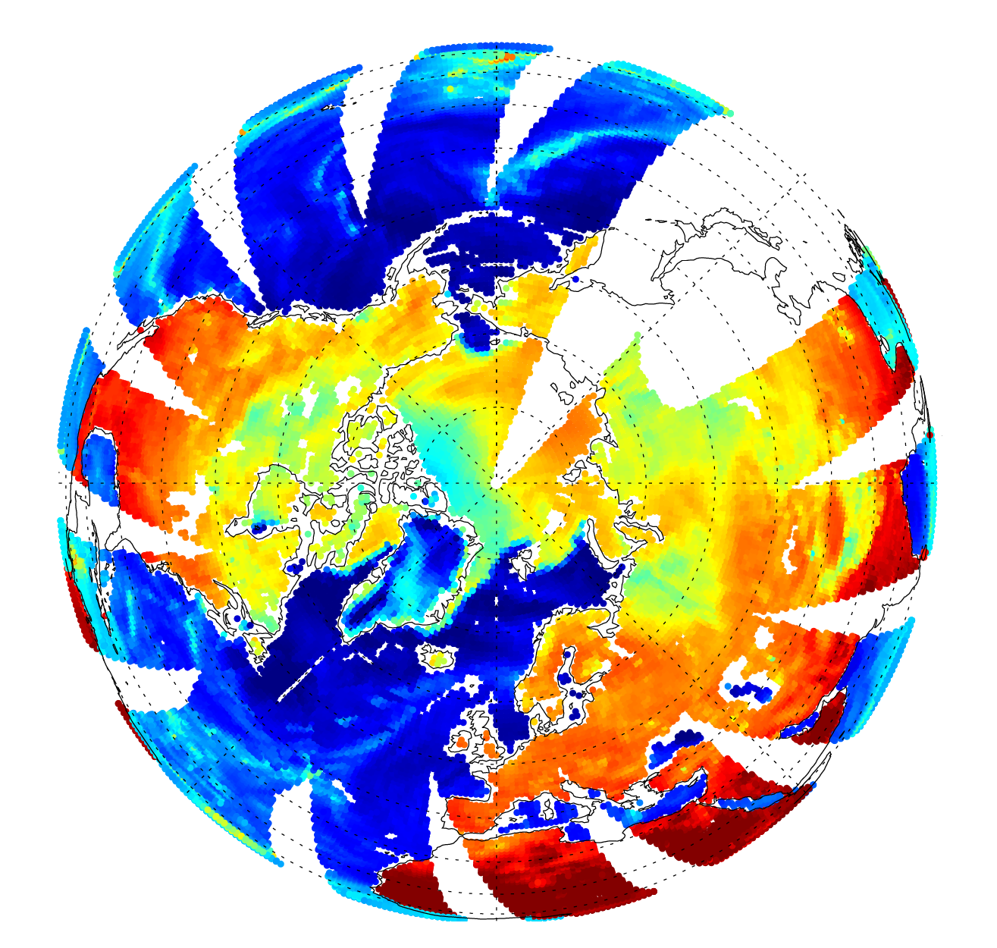
Satellite observations Geophysical variables
Atmospheric temperature, water vapour, wind, cloud, precipitation
Skin and substrate temperature and moisture
Ocean wind, waves, foam
Sea-ice
Snowpack
Ice
Vegetation
Soil
$$y=h\left(\begin{matrix}x_{1} \\ x_{2} \\ x_{3} \\ x_{4} \\ x_{5} \\ x_{…}\end{matrix}\right)$$
SSMIS F-17 channel 13 (19 GHz, v)
Microwave brightness temperatures
3rd December 2014

Slide 8
Satellite observations
Model parameters / equations
Gas spectroscopy
Approximations in scattering radiative transfer solver
Cloud and precipitation micro and macro-structure
Snow / ice grain size and structure
…..
$$y=h\left(\left[\begin{matrix}x_{1} \\ x_{2} \\ x_{3} \\ x_{4} \\ x_{5} \\ x_{…}\end{matrix}\right],\left[\begin{matrix}w_{1} \\ w_{2} \\ w_{3} \\ w_{4} \\ w_{5} \\ w_{…}\end{matrix}\right] \right)$$
SSMIS F-17 channel 13 (19 GHz, v)
Microwave brightness temperatures
3rd December 2014

Slide 9
The forward and inverse problem
Forward model
$$y=h(x,w)$$
Observations
Geophysical state
Model parameters
$$x,w=h^{−1} (y)$$
Inverse model
No unique solution: ill-posed
The best that observations can do is to provide a statistical improvement in our knowledge of x and w

Slide 10
The inverse problem solved by Bayes theorem
Observations
Geophysical state
Model parameters
Bayes theorem
$$P(x,w|y)=K (y, P\left(y|x,w\right),P(x,w))$$
Probabilistic equivalent of the forward model f()
Probability of x and w given y
Prior probability of x and w

Slide 11
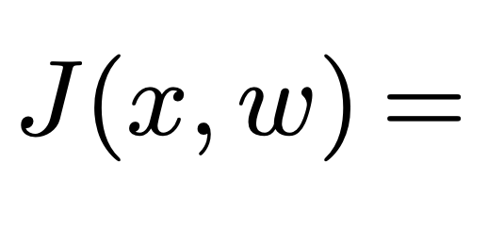
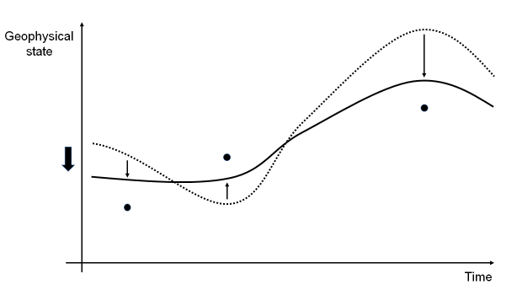
Cost / loss function equivalence of ML and variational DA
Assume Gaussian errors (error standard deviation $σ$)
and for clarity here simplify to scalar variables
and ignore any covariance between observation, model or state error
Basic loss function
Feature error?
Weights regularisation
ML
Loss function
DA
Cost function
Observation term
Prior knowledge of state
Prior knowledge of model

Slide 12
Bayesian equivalence of ML and DA
This diagram is a Bayesian network, so it can be translated directly into maths or code
Geer (2020)
https://doi.org/10.21957/7fyj2811r
Bocquet et al. (2020)
Abarbanel et al. (2018)
Hsieh and Tang (1998)
Goodfellow et al.. (2016)
https://arxiv.org/abs/2001.06270
https://doi.org/10.1162/neco_a_01094
https://doi.org/10.1175/1520-0477(1998)079%3C1855:ANNMTP%3E2.0.CO;2
https://www.deeplearningbook.org

Slide 13
Time evolution of state in data assimilation
Time-constant model (parameters)
Time evolving state
Observations

Slide 14
Inside an atmospheric model & data assimilation timestep
One model time-step

Slide 15
Learning an improved model of cloud physics (ML or DA)
We want to train a model against observations, but we cannot directly observe intermediate states $x_{1.1}$ and $x_{1.2}$ … or more precisely model tendencies …

Slide 16
Inside an atmospheric model
… so train the model inside the data assimilation system

Slide 17
Snow micro- and macro-physical parameter estimation for all-sky radiative transfer
Offline physical parameter search using cost function between ECMWF model and SSMIS observations
6-dimensions of parameters from RTTOV-SCATT radiative transfer modelling
Cost function is based on mapped mean and skewness, not the squared error (errors are highly non-Gaussian)
Cost function has multiple minima
Some aspects are quite ambiguous (e.g. snow mixing ratio versus particle shape)
Cost function at prior
At analysis (posterior)

Slide 18
Before going to full model learning: practical applications of ML within the data assimilation at ECMWF

Slide 19
Model error correction using ML – Bonavita and Laloyaux (2020, submitted to JAMES, https://www.essoar.org/doi/abs/10.1002/essoar.10503695.1)
Massimo’s talk: Session 7 – 10th Sept
$$x$$
$$y$$
One vertical model profile + additional parameters
One vertical profile of model error tendencies (trained on the data assimilation increments)
$$w$$

Slide 20
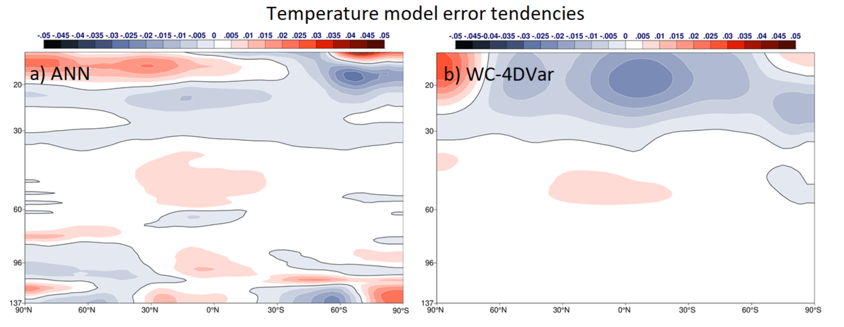
Model error correction using ML – Bonavita and Laloyaux (2020, submitted to JAMES, https://www.essoar.org/doi/abs/10.1002/essoar.10503695.1)
Massimo’s talk: Session 7 – 10th Sept
Offline ML – learn weights w of model for model error tendency
Weak-constraint 4D-Var, done online (w is a field of model error tendencies)
…

Slide 21
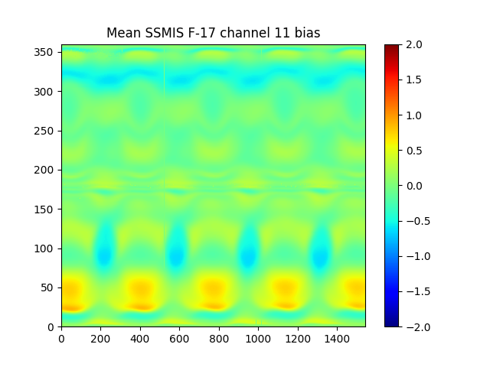
Satellite bias correction using ML
Application: SSMIS instrument solar-dependent calibration anomalies
Offline training of a bias model in observation space
Learn bias between observations and model as a function of satellite-solar orbital parameters.
Problems: many latent variables, orbit changes, model changes
Daily binned bias
Static NN model predicted
Orbit angle [deg]
Bias [K]
Training set: 360 days
Day
Day
Model upgrade

Slide 22
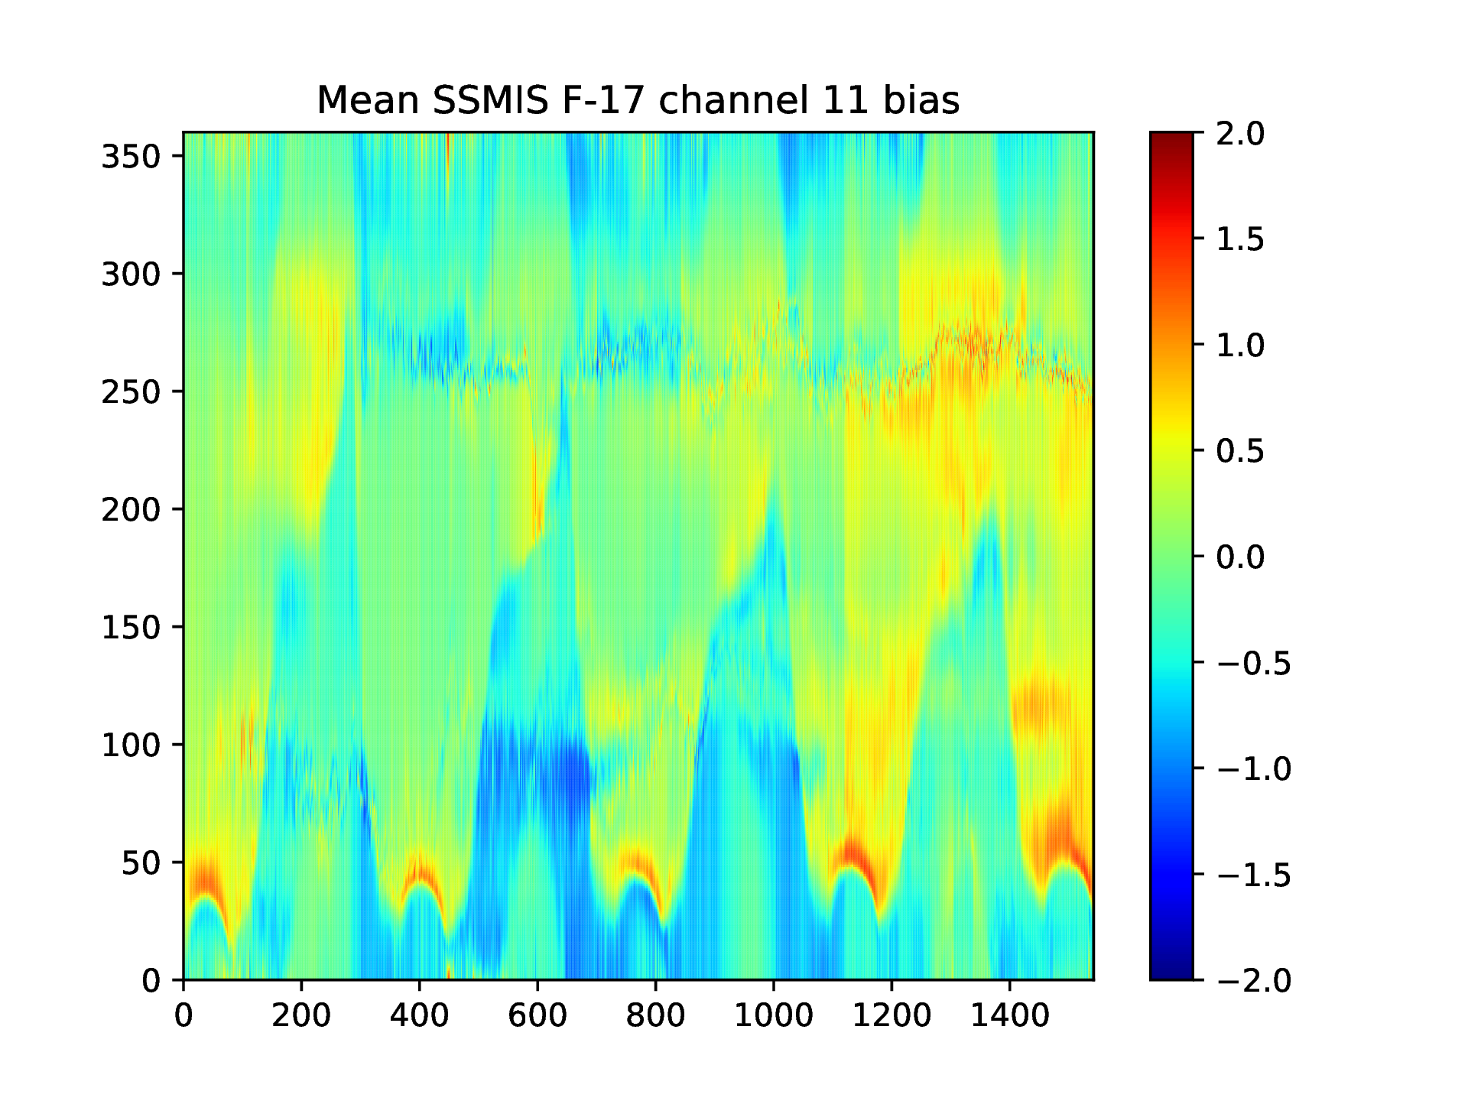
Satellite bias correction
Dynamic NN approach:
Re-train each day on yesterday’s biases
Learn bias as a function of orbit angle
This is essentially a nonlinear version of VarBC, which is a standard bias correction technique for DA
Daily binned bias
Dynamic NN model predicted
Orbit angle [deg]
Bias [K]
Day
Day

Slide 23
Automatic differentiation for variational DA tangent-linear and adjoint operators: Hatfield, Chantry et al. (ongoing work)
48h TL test of full IFS forecast model
Train a NN on IFS non-ographic gravity wave drag scheme (NOGWD)
Differentiate the NN via the chain rule to get:
TL (tangent-linear)
Adjoint (== back-propagation)
Use the NN TL and adjoint in the 4D-Var (but keep the physical nonlinear NOGWD scheme)
Succesful 2-month run of IFS cycling 4D-Var completed
NN for NOGWD
Standard IFS
Model level
$$ε=\left\langle \left|Hδx − h\left(x+δx\right)−h\left(x\right)\right|\right\rangle$$
Tangent linear model
Nonlinear model

Slide 24
Observation operators using ML
Soil moisture
Single hidden layer NN trained between SMOS observations and model soil moisture (H-TESSEL or IFS)
A version of this is used in the operational IFS
Fast radiative transfer models used as observation operators (e.g. RTTOV, CRTM) are already ‘ML’ – just using linear regression or heuristic model components
Train on physical reference models
Train directly between model background and observations
→ Use of deep neural networks as components within these applications is likely in the next few years – these areas will be explored:
sea-ice radiative transfer at microwave / sub-mm frequencies
ocean surface emissivity
Rodriguez-Fernandez, N., de Rosnay P., Albergel C., Richaume P., Aires F., Prigent C., Kerr Y.: "SMOS Neural Network Soil Moisture Data Assimilation in a Land Surface Model and Atmospheric Impact", Remote Sensing, 11(11), 1334, 2019 https://www.mdpi.com/2072-4292/11/11/1334

Slide 25
Many more possible applications of ML in DA not covered here…

Slide 26
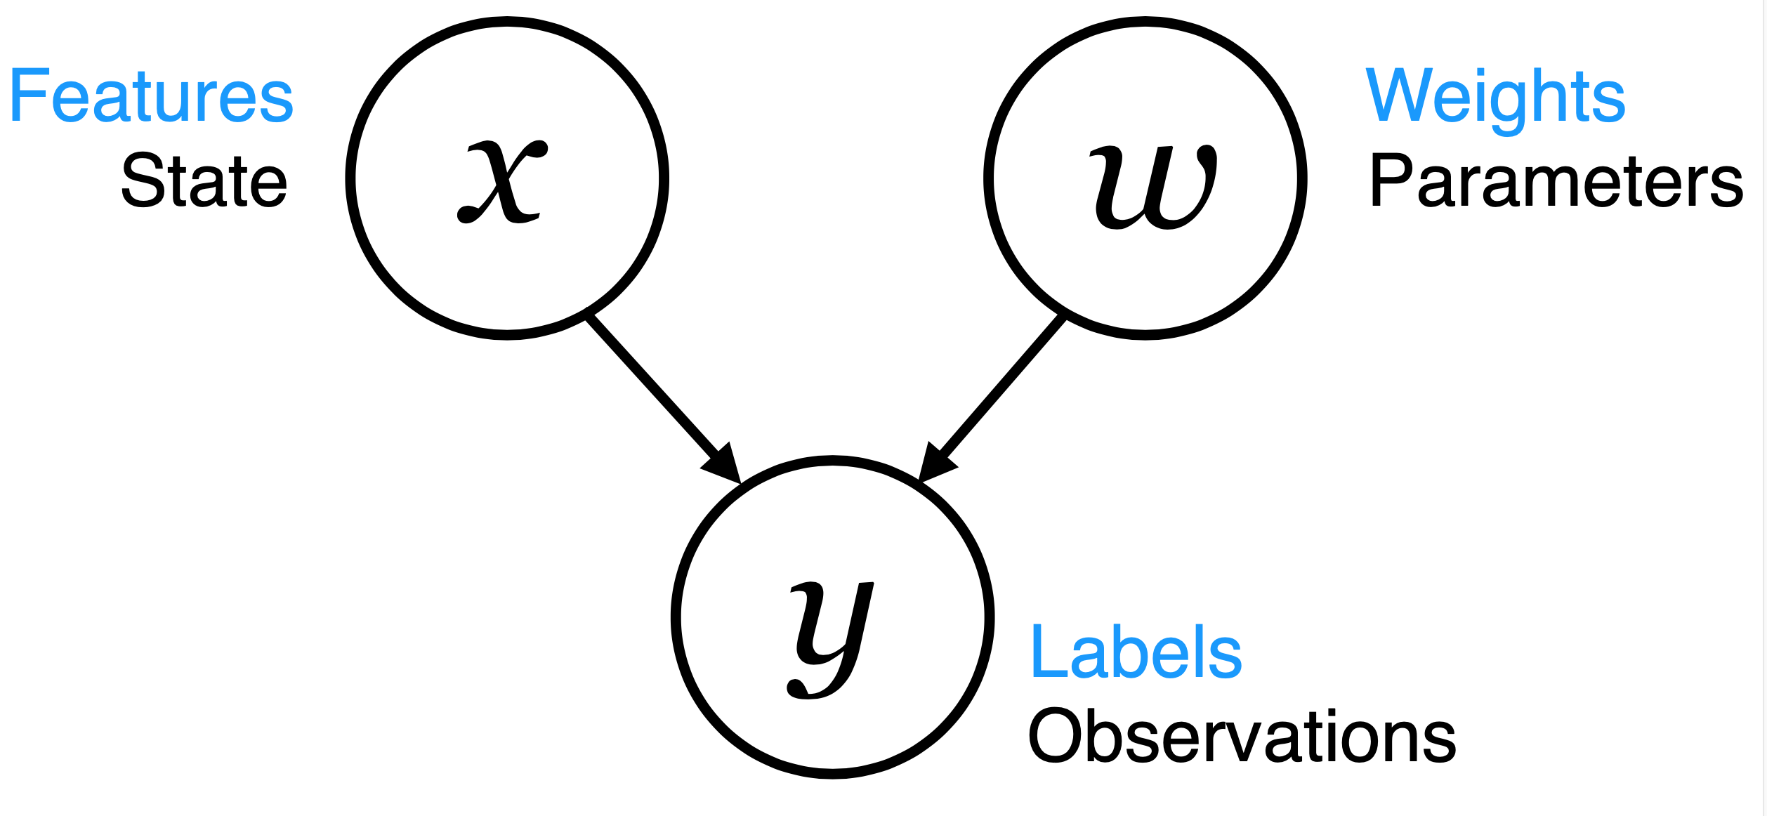
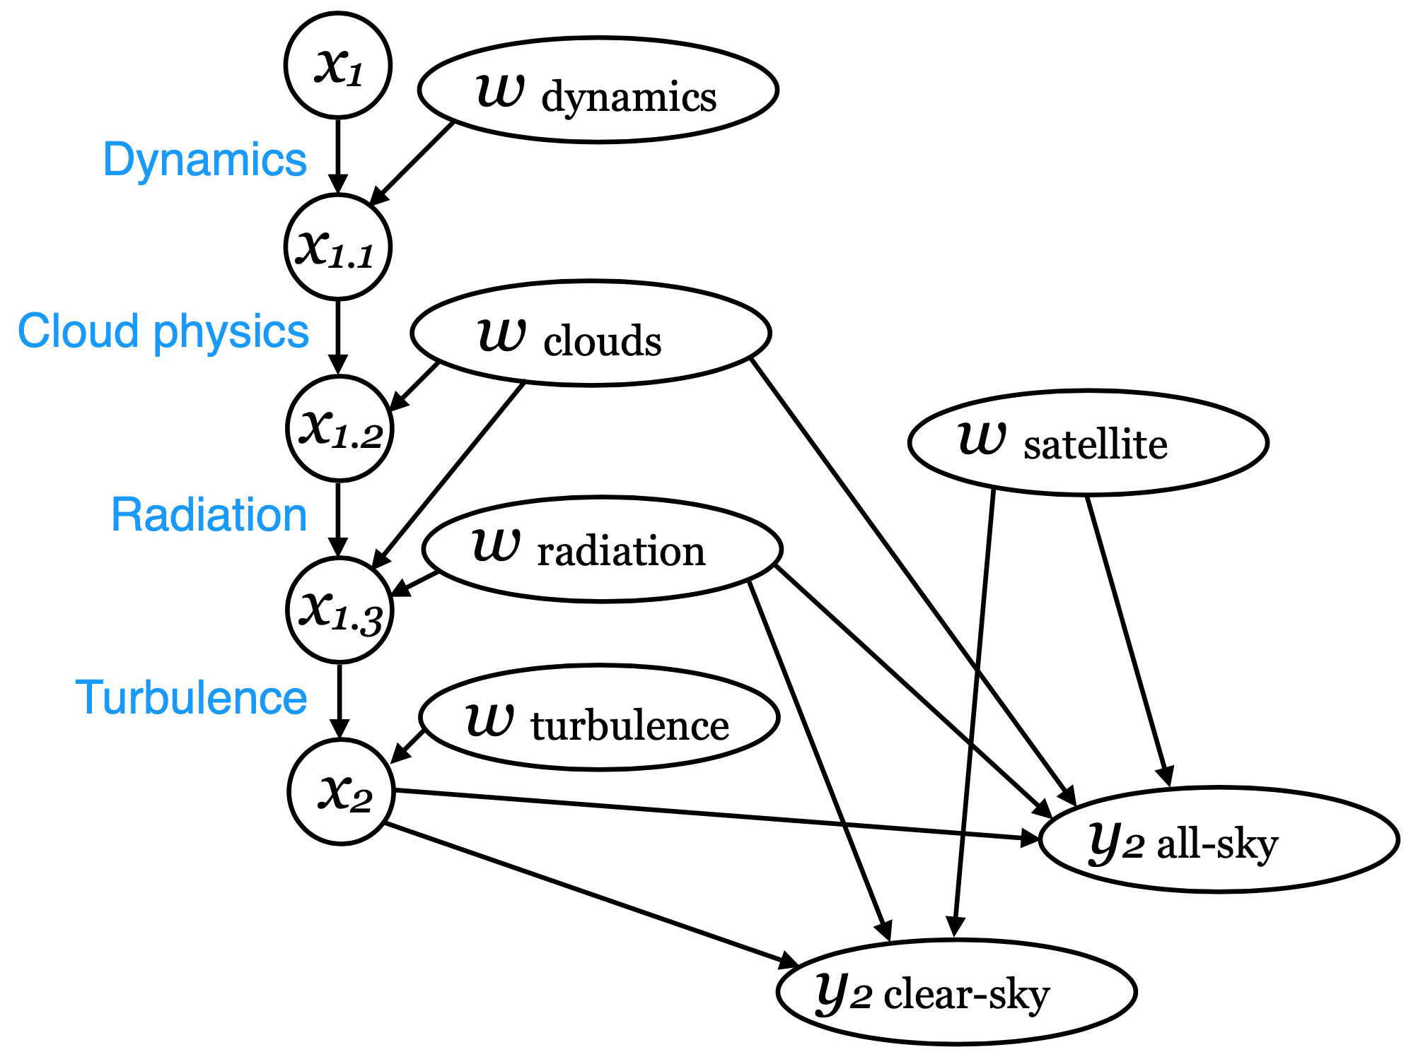
Summary: model learning directly from real observations
Data assimilation and machine learning are both rooted in Bayesian inverse methods
Do the ML inside the data assimilation system to make use of all available existing observations and physical constraints

Slide 27
Could DA techniques and the Bayesian approach help improve ML in earth sciences?
Can data normalisation be replaced with a more quantitative physical description of label and feature uncertainty?
In the same way DA quantifies observation and background error matrices
Use physical layers:
As an output layer, physical observation operators can move from gridded geophysical states to observation space
Physical constraint layers to take advantage of prior knowledge where it exists (e.g. known physical laws)

