Slide 1
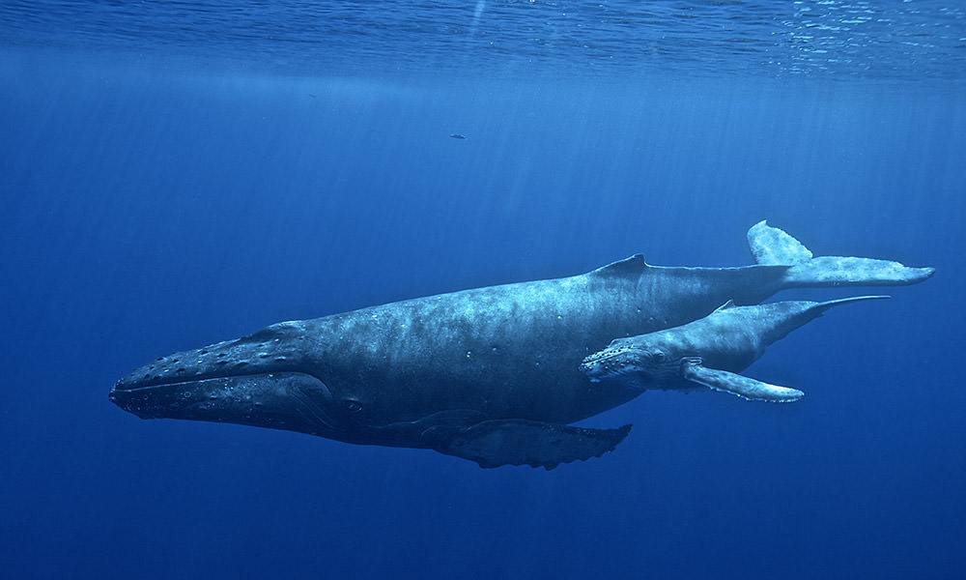
Artificial Intelligence and Deep Machine Learning for Passive Acoustic Monitoring at NOAA Fisheries
Ann Allen, PIFSC
ann.allen@noaa.gov
Manuel Castellote, AFSC
Shannon Rankin, SWFSC

Slide 2
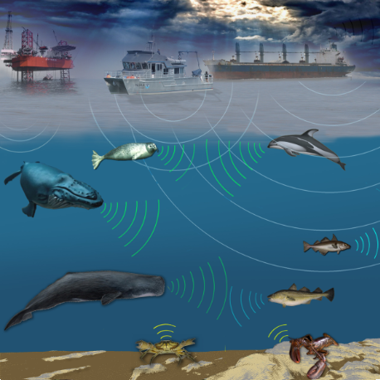
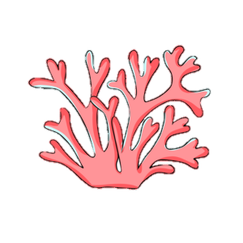
Sound in the Ocean
Sound travels great distances underwater
Wide variety of animals produce sound:
Cetaceans (whales and dolphins)
Commercially important fish species
Invertebrates on reef or benthic environments
Sound used for:
Communication
Prey finding
Competition
Van Parijs, et al. 2015. Mar Technol Soc J. 49 (2).

Slide 3
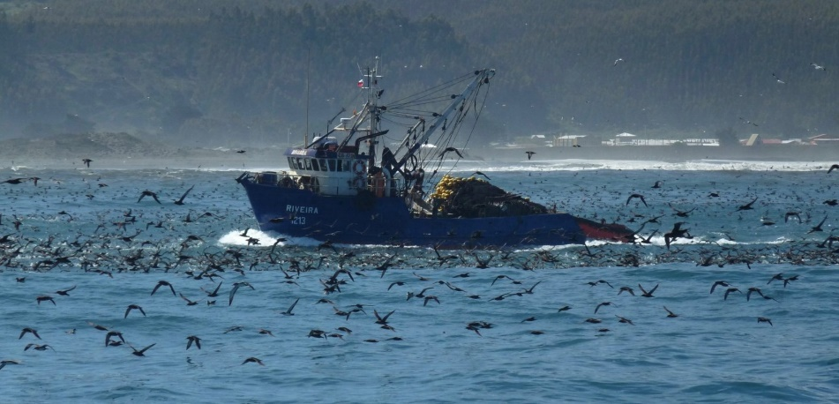
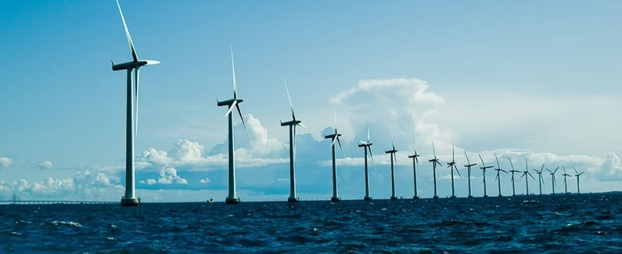
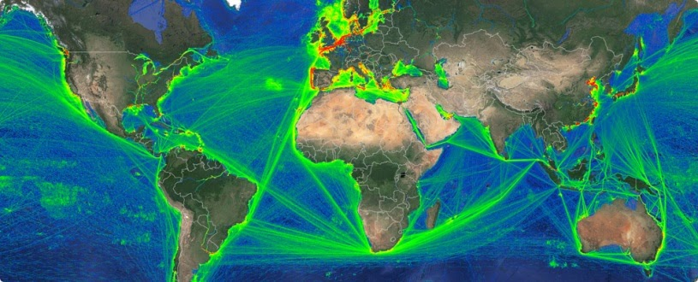
Passive Acoustic Monitoring
Passive Acoustic Monitoring (PAM): Listening to sounds produced in the ocean to understand where and when species occur
PAM can be used for:
Monitoring health and status: marine mammals, fish, coral reefs
Stock assessments for regulatory information
Mitigation: bycatch, anthropogenic noise

Slide 4
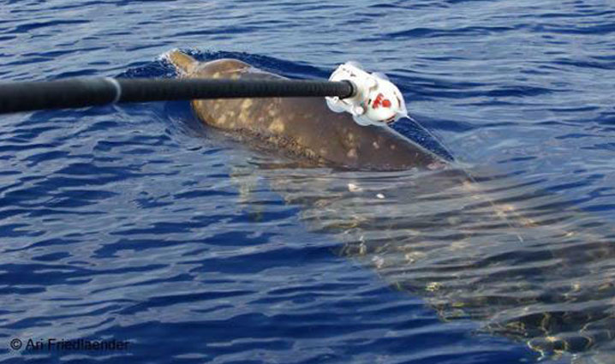
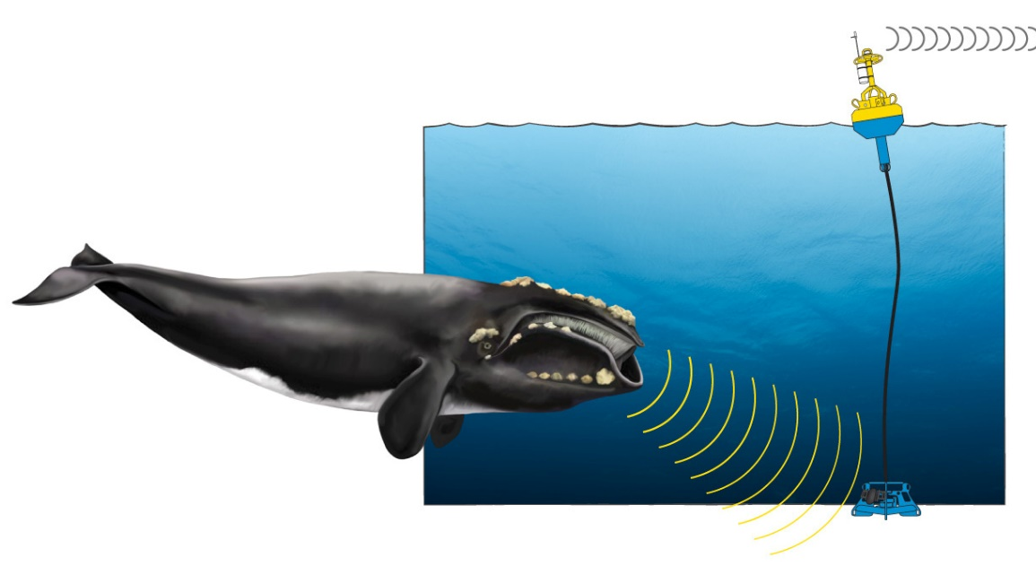
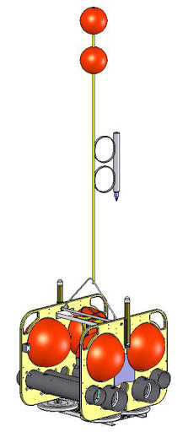
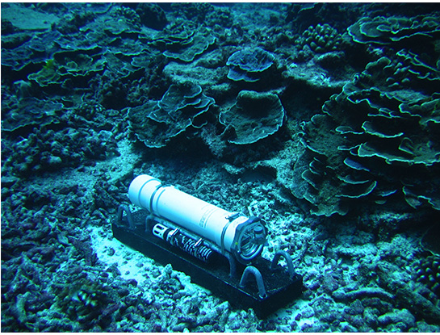
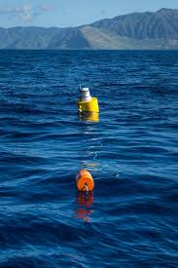
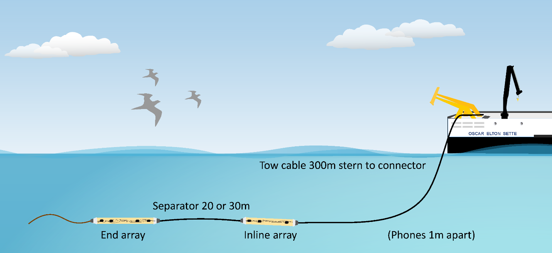
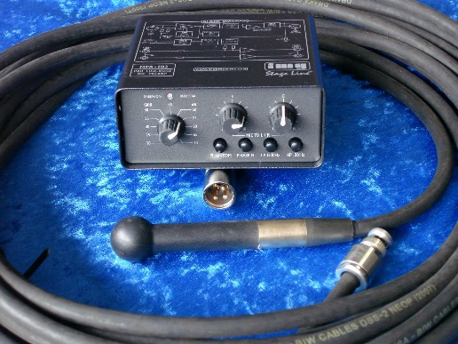
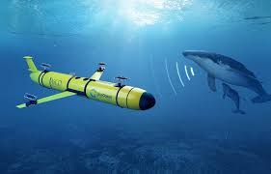
Passive Acoustic Monitoring
Widely used in cetacean monitoring
Increasing types of recording instruments, lengths of deployments, number of channels

Slide 5
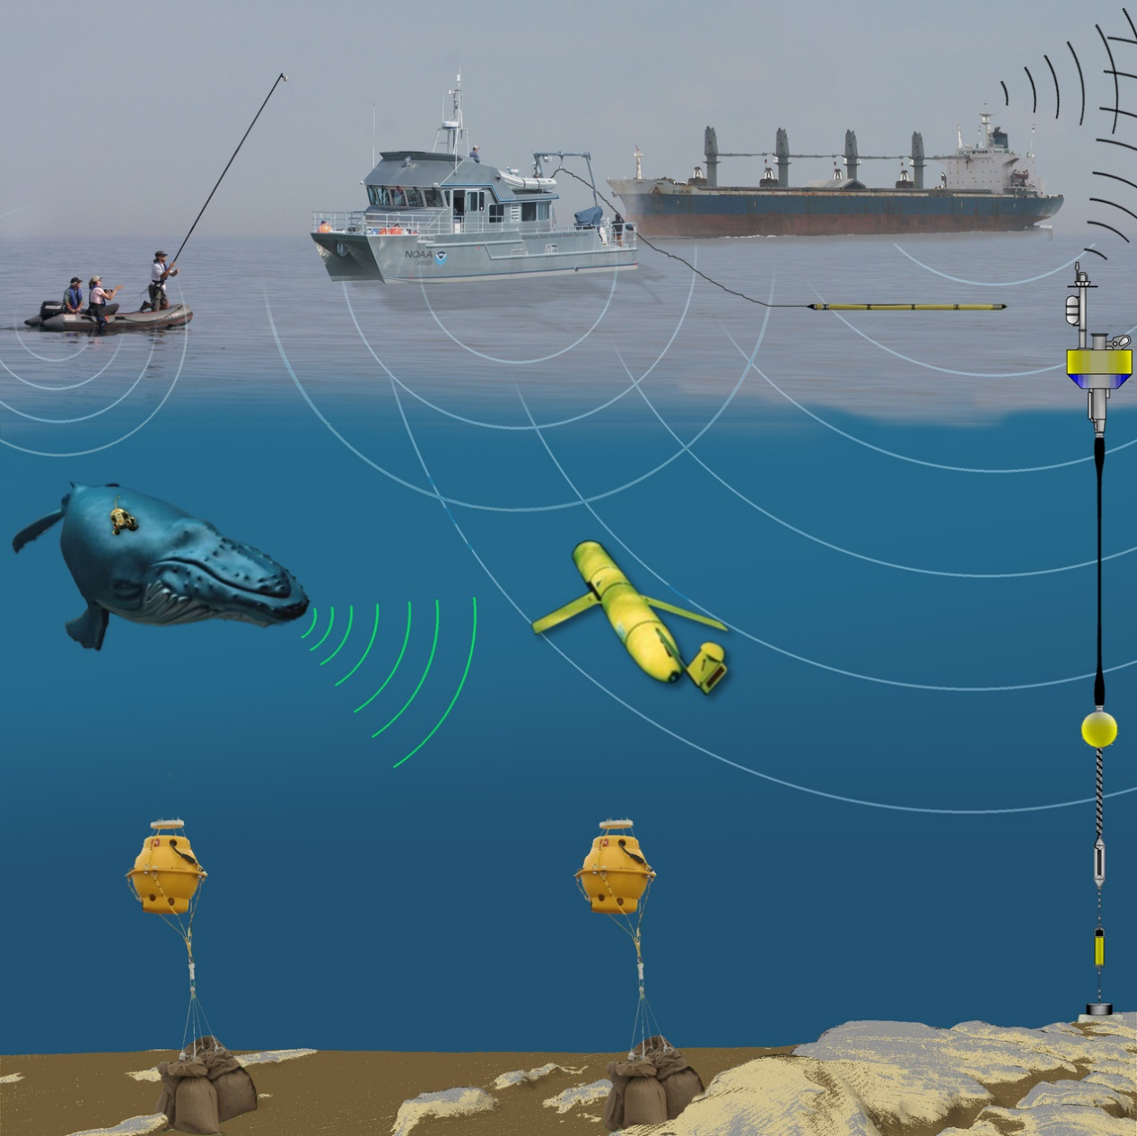
Passive Acoustic Monitoring
Now every NOAA Science center uses Passive Acoustic Monitoring
Integrated networks of PAM combining multiple recording platforms
Van Parijs, et al. 2015. Mar Technol Soc J. 49 (2).

Slide 6
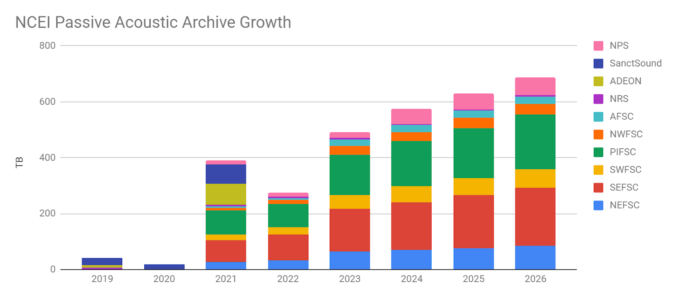
Large PAM Data Volumes
Increasing data volumes collected every year
NOAA has collected >1 Petabyte of passive acoustic data
Our ability to collect data are no longer the limitation. Now we are limited by our ability to access and analyze it efficiently!
Courtesy of Carrie Wall Bell, NCEI Boulder

Slide 7
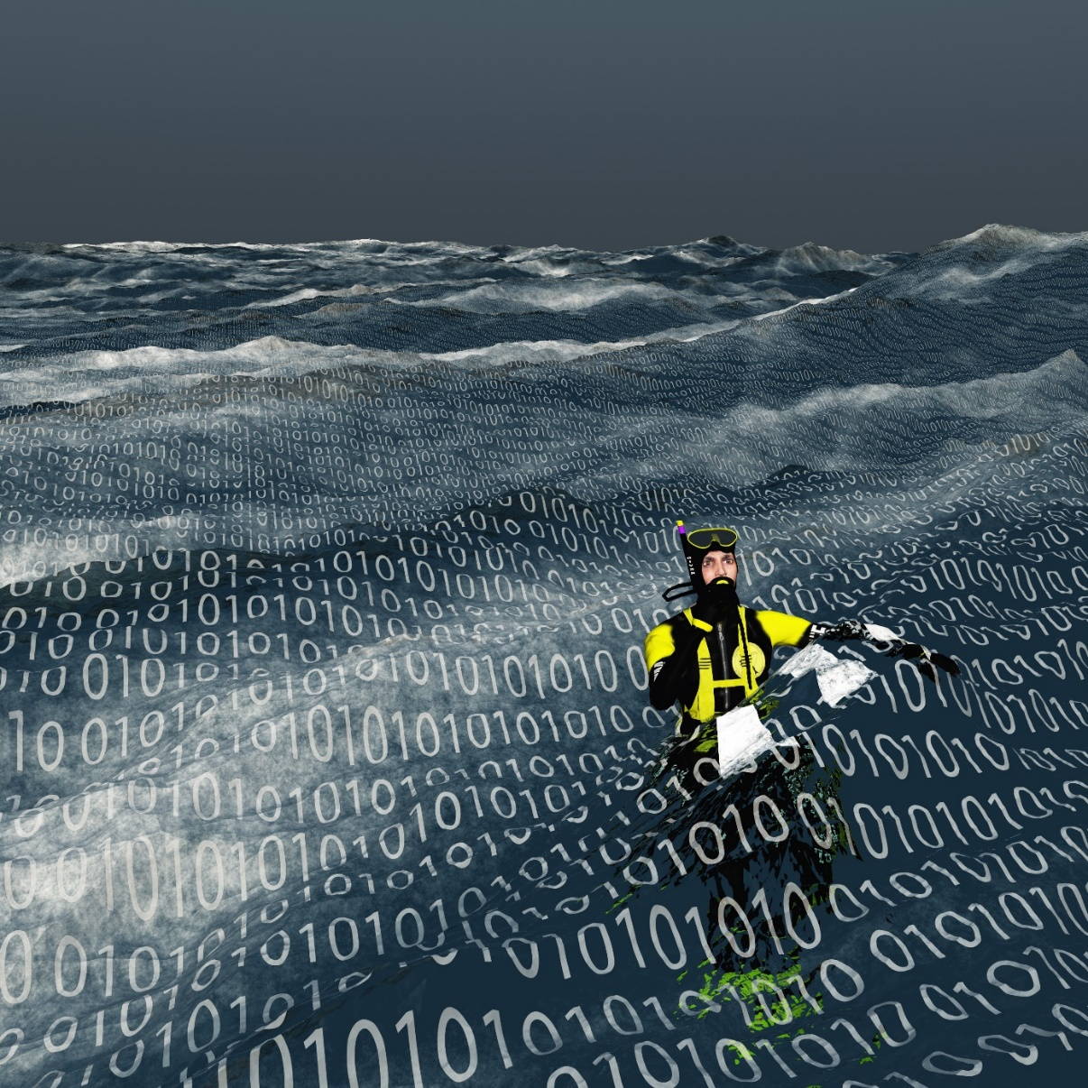
Large PAM Data Volumes
How do we avoid drowning in an ocean of data?
AI/ML

Slide 8
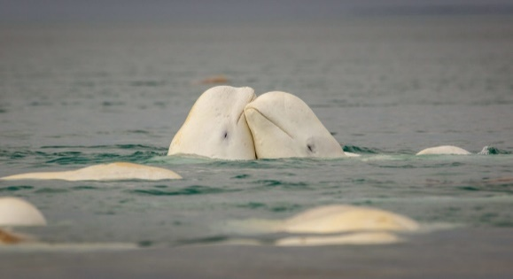
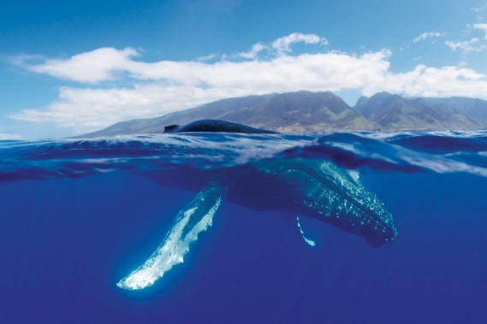
AI and Deep Machine Learning for PAM
<10 scientific papers using deep machine learning for cetacean passive acoustic monitoring
Two NOAA pilot PAM AI projects:
AFSC: Beluga whale acoustic signal classification
Partnership with Microsoft AI for Earth
PIFSC: Humpback whale song occurrence
Partnership with Google AI for Social Good

Slide 9
AI for Endangered Belugas
Most acoustic classification models use image recognition
Raw waveform
Spectrogram with label (e.g. humpback)

Slide 10
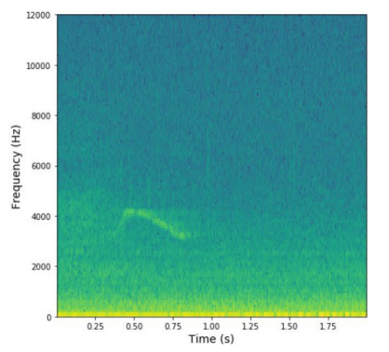
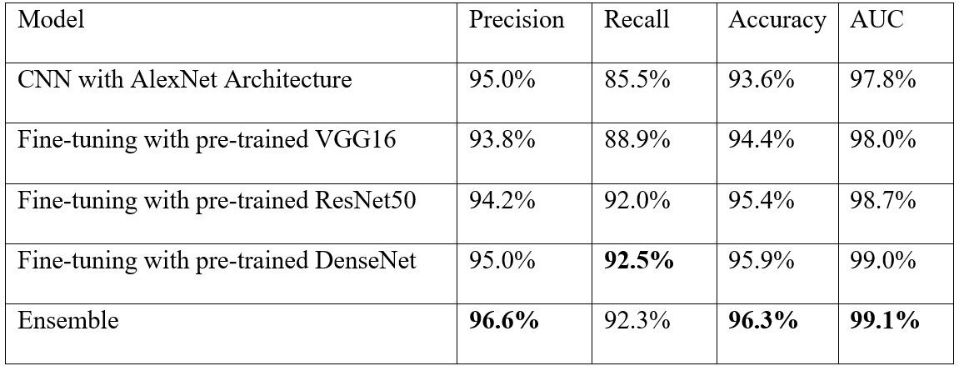
AI for Endangered Belugas
AFSC collaboration with Microsoft AI for Earth
Used ML to classify beluga vocalizations in acoustic data
Best performance was an ensemble model that weighted the output of 4 CNNs
Model open sourced on GitHub: https://github.com/microsoft/belugasounds

Slide 11
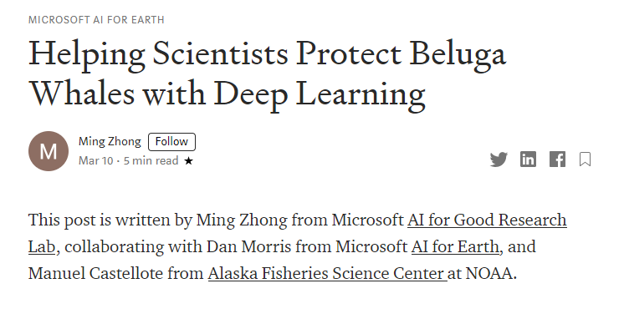
AI for Endangered Belugas
Full presentations:
October 22, 1:05 pm.
Improving Passive Acoustic Monitoring applications to the Endangered Cook Inlet Beluga Whale.
Ming Zhong (Microsoft)
October 29, 12:50 pm.
Shifting to AI for Passive Acoustic Monitoring of the Endangered Cook Inlet Beluga Whale.
Manuel Castellote (AFSC).

Slide 12
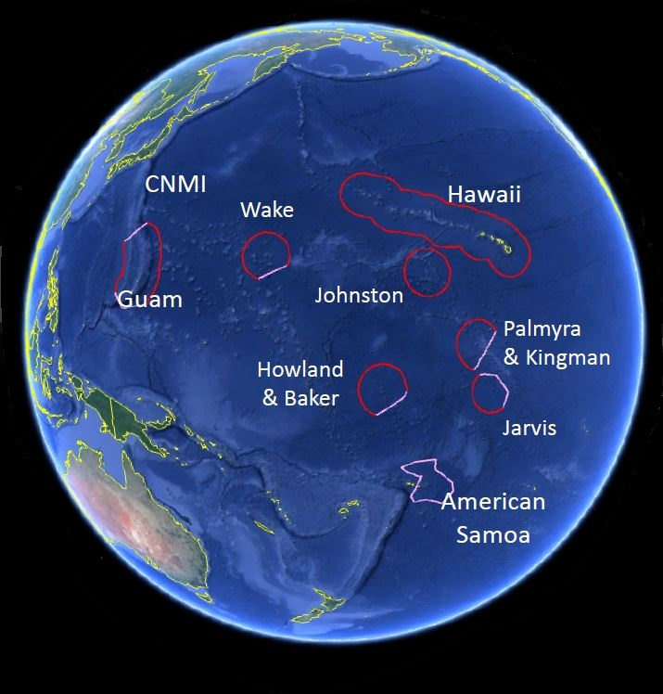
AI for Humpback Whales
NOAA Pacific Islands Study areas

Slide 13
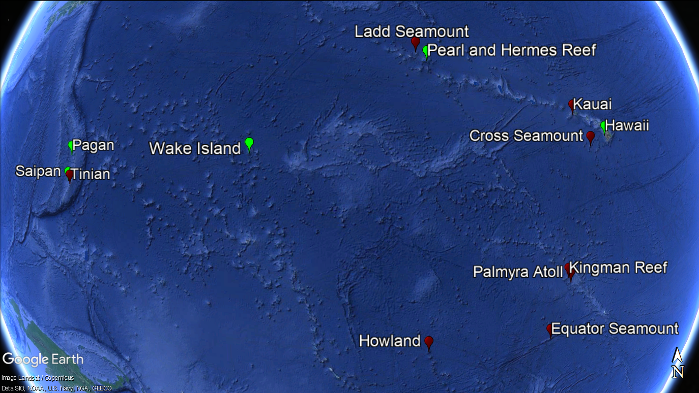
Pacific Islands Passive Acoustic Network (PIPAN)
13 recording sites starting in 2005
~180,000 hours of recordings
~300 Terabytes of data

Slide 14
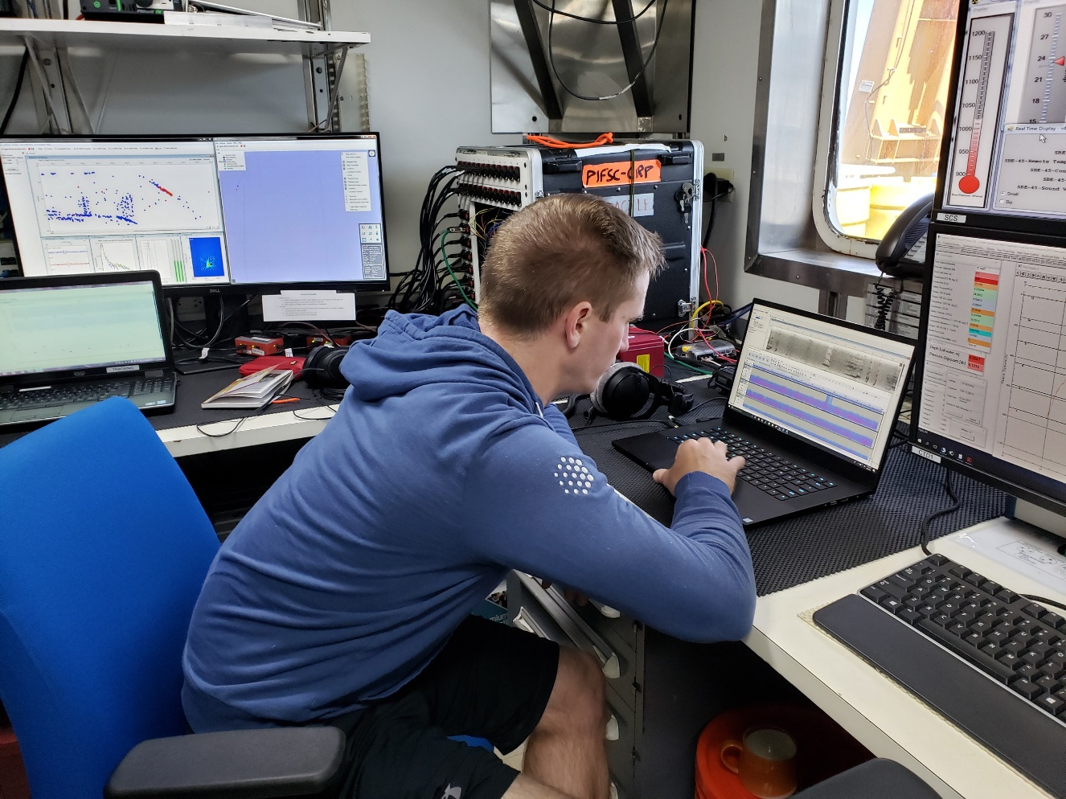

Slide 15
Humpback Song Deep Learning Model
Raw waveform
Spectrogram with label (e.g. humpback)
Convolutional neural network
Humpback whale singing!
Video Credit: www.3blue1brown.com
Image credit: Hawaiian Islands Humpback Whale National Marine Sanctuary/Jason Moore

Slide 16
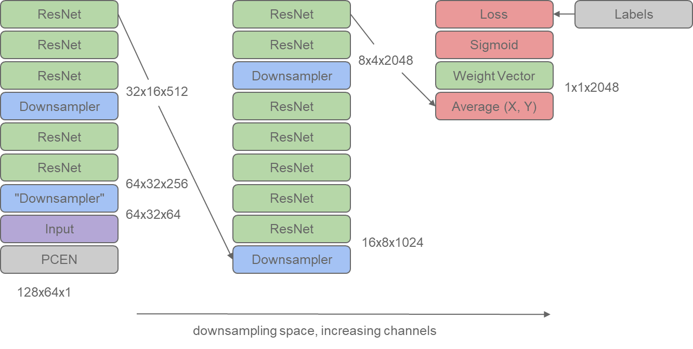
Convolutional Neural Network
Convolutional neural network
ResNet-50 model
Model modified from YouTube audio event detection
Only 0.04% of data labelled for training
Active learning procedure
.97 Average precision
.992 AUC-ROC

Slide 17
Convolutional Neural Network
Convolutional neural network
ResNet-50 model
Model modified from YouTube audio event detection
Only 0.04% of data labelled for training
Active learning procedure
.97 Average precision
.992 AUC-ROC
Blog with more detailed info

Slide 18
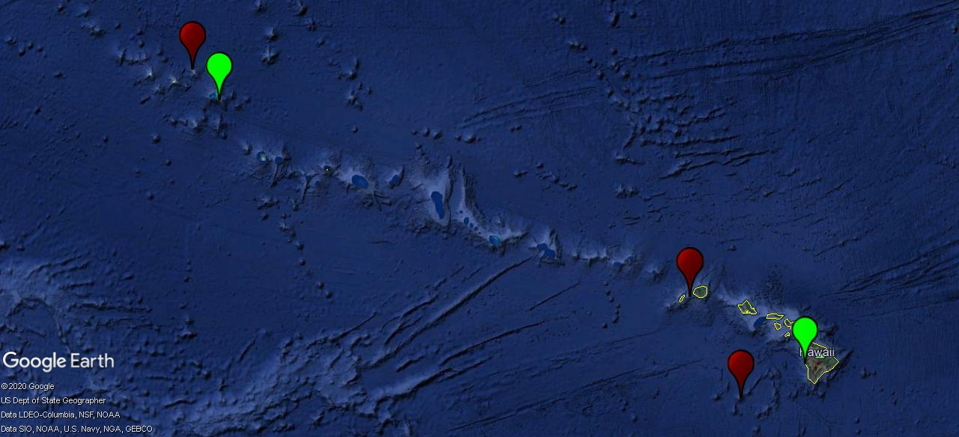
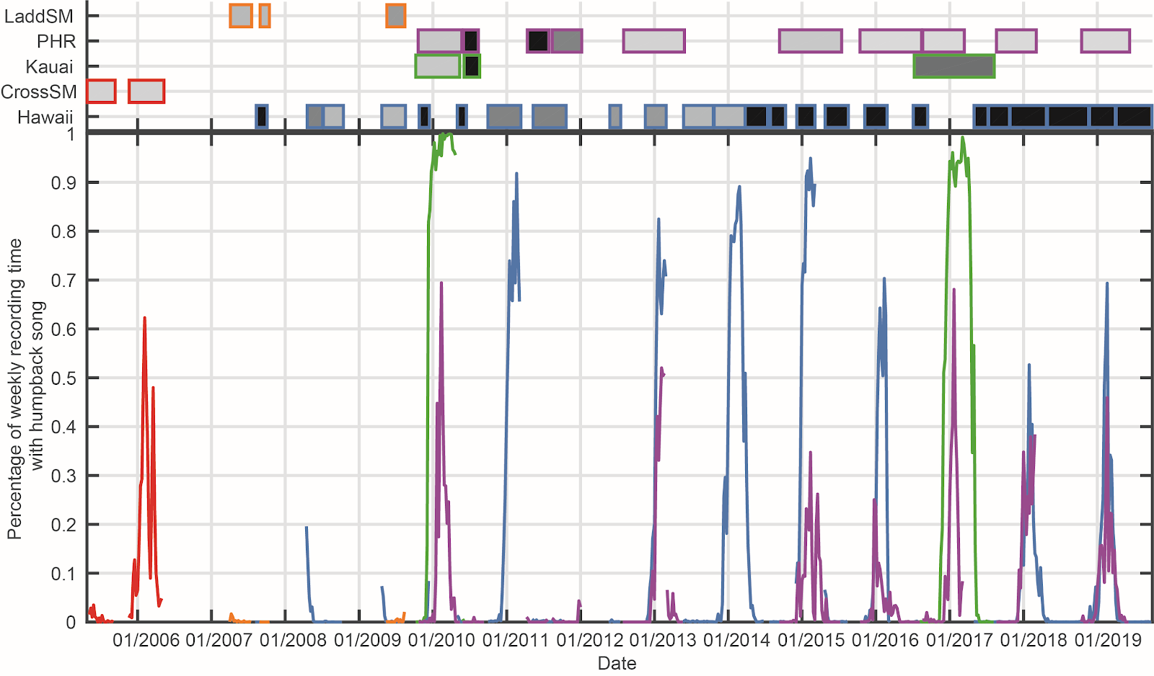
Occurrence analysis
Ladd SM
Pearl and Hermes Reef (PHR)
Kauai
Hawaii
Cross SM

Slide 19
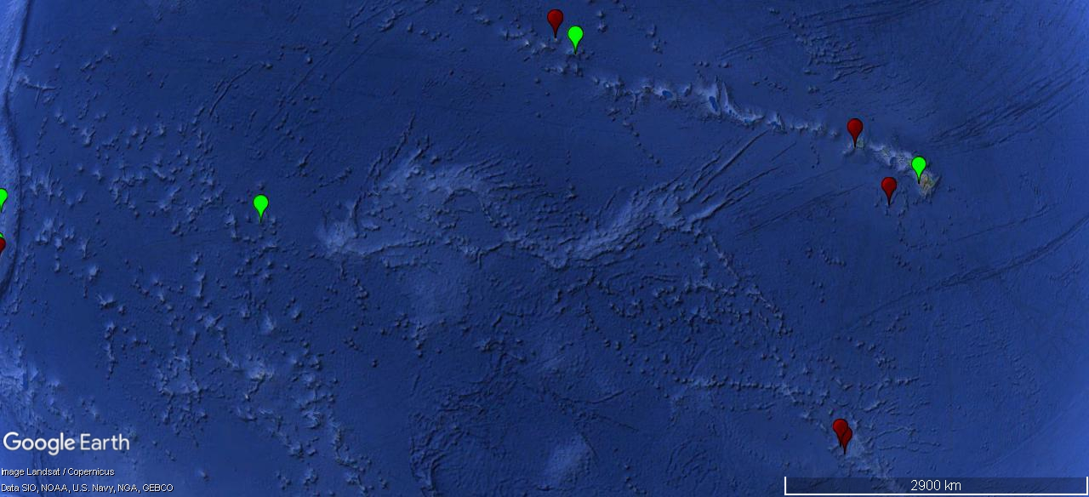
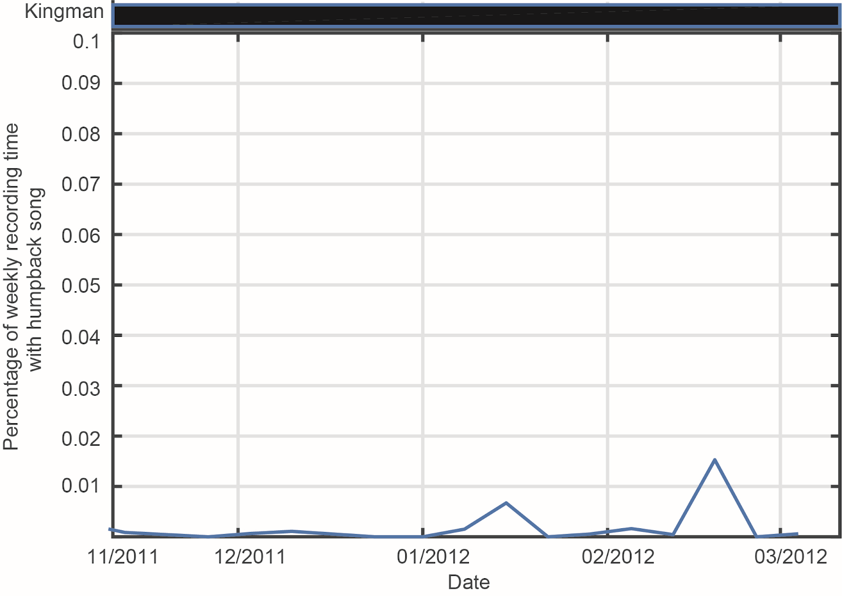
Discovery of novel singing location
Hawaiian Islands
Kingman Reef

Slide 20
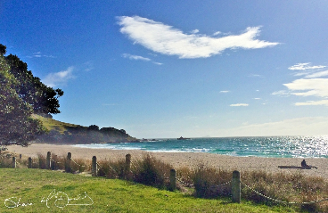
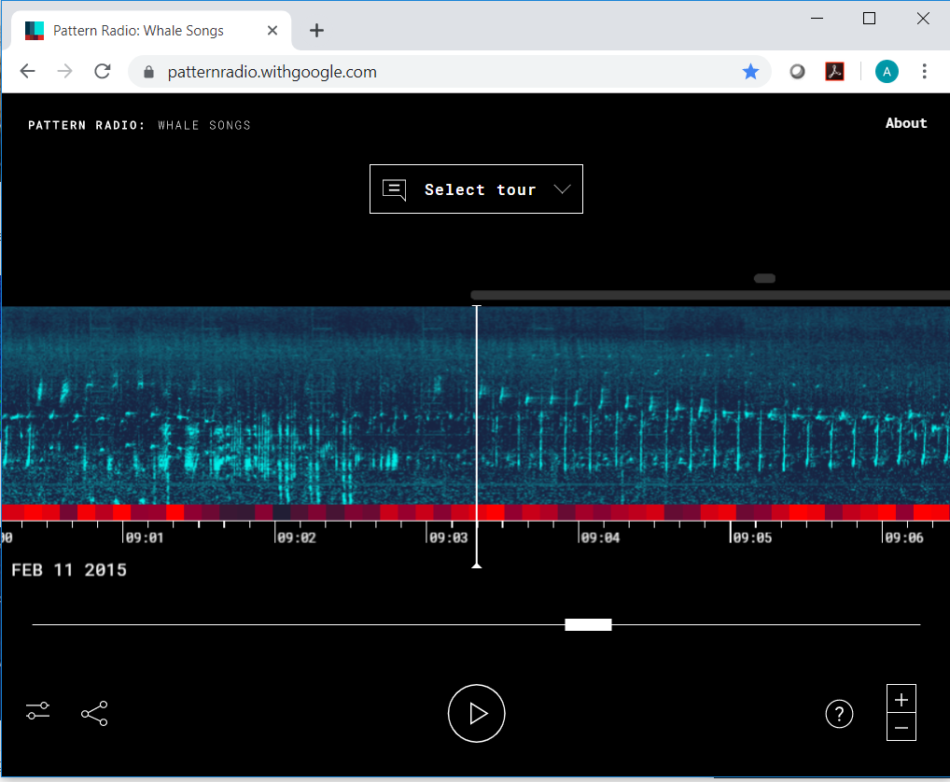
Public data access: whales in the cloud
Google Creative Labs: ~1 year of PIFSC HARP data hosted online with ML labels
Machine learning, cloud computing and cloud storage enables browsing at scale without full download
https://patternradio.withgoogle.com
Technical Details:

Slide 21
Public data access: whales in the cloud
Upcoming open source access to:
Entire 180,000 hours of audio data (~12TB)
All training labels
Full machine learning model
NOAA Big Data Project
~62 TB of NOAA acoustic data on Google Public Datasets Page
https://cloud.google.com/public-datasets
Courtesy of Carrie Wall Bell, NCEI Boulder

Slide 22
Public data access: whales in the cloud
Provides:
Global access to large datasets
Use of data beyond original collection purpose
Innovative marine ecosystem acoustic research
Large-scale, multi-year, and even cross-basin scale studies
Identification of data gaps or repeated surveys
Cloud computing: bring the processing to the data
https://cloud.google.com/public-datasets
Courtesy of Carrie Wall Bell, NCEI Boulder

Slide 23
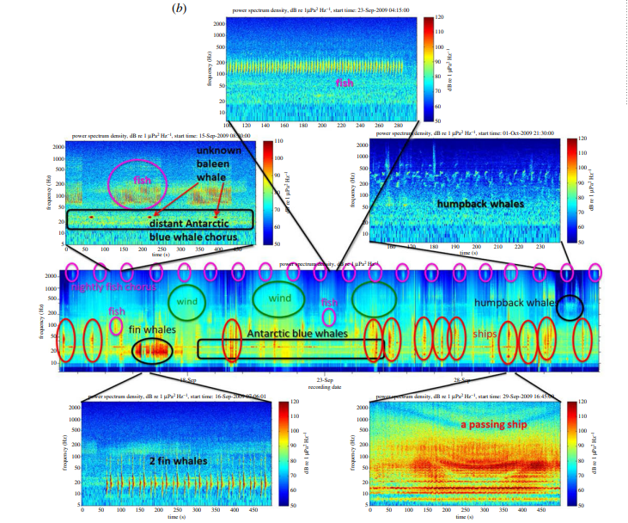
Public data access: whales in the cloud
Partnering with industry experts can very quickly advance scientific objectives
If we can combine machine learning labelling of data with cloud based public data access we can quickly advance scientific research through global data discovery and access
Mooney et al. 2020. R Soc Open Sci. 7: 201287

Slide 24
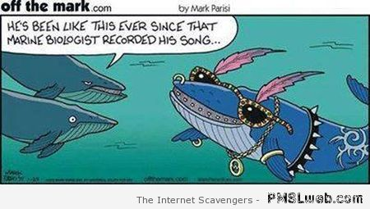
Questions?
Related Presentations:
October 22, 1:05 pm.
Improving Passive Acoustic Monitoring applications to the Endangered Cook Inlet Beluga Whale. Ming Zhong (Microsoft)
October 29, 12:50 pm.
Shifting to AI for Passive Acoustic Monitoring of the Endangered Cook Inlet Beluga Whale. Manuel Castellote (AFSC).
December 15, Poster Session.
Preparing for the Future: Development of an Open-Source Workflow for AI driven Acoustic Data Analysis. Shannon Rankin (SWFSC)
He’s been like this ever since that marine biologist recorded his song….
ann.allen@noaa.gov

