Slide 1
Cost Sensitive Loss Functions for Machine Learning
Richard Berk
Department of Statistics
Department of Criminology
University of Pennsylvania

Slide 2
The Take Home Message in 6 Parts
1. Some ML fitting/forecasting errors are worse than others.
Underestimates may be more or less costly than overestimates (e.g., number of humpback whales).
False positives may be more or less costly than false negatives. (e.g., presence or absence of humpback whales)
2. Standard loss functions used in ML neglect this cost asymmetry because the loss functions used are a straight jacket (e.g., convexity).
3. Forecasts can be misleading as a result, and decision makers can be misled (e.g., a false alarm for a hurricane storm surge).
4. Accuracy and uncertainty measures need to be reconsidered (e.g., MSE)
5. Measures of variable importance and plots of relationships can be misleading (e.g., even just importance rankings).
6. But we can alter some loss functions so that the relative costs of mistakes are more consistent decision-maker needs. Can be a game changer.

Slide 3
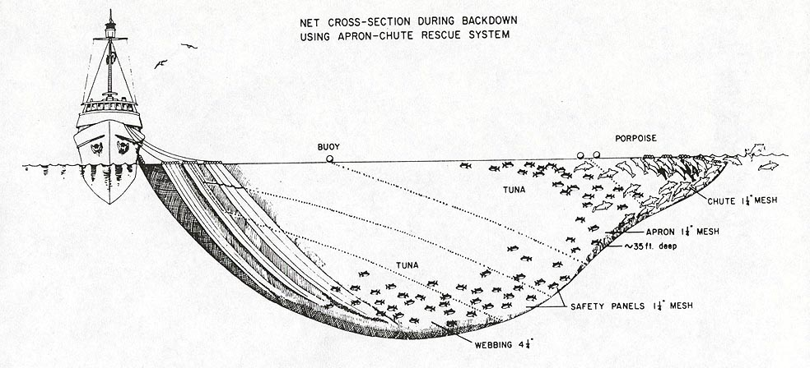
Some Mistakes Are Worse Than Others
Example: Impute Tuna Bycatch
Did the captain alter the data?

Slide 4
Kinds of Mistakes
Underestimate
Y
Numeric Error
Overestimate
X
Positives
Z
Classification Error
False Positive
False Negative
Negatives
X

Slide 5
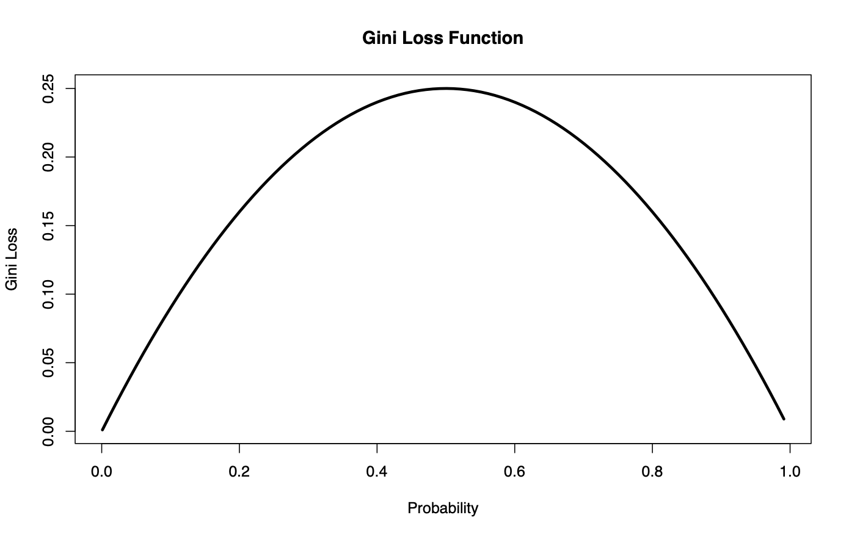
Classification Loss in CART
(e.g., False Positives v. False Negatives
Gini Loss
Bayes Error
Cross-Entropy - Deviance

Slide 6
Some Common Loss Metrics For Numeric Response Variables

Slide 7
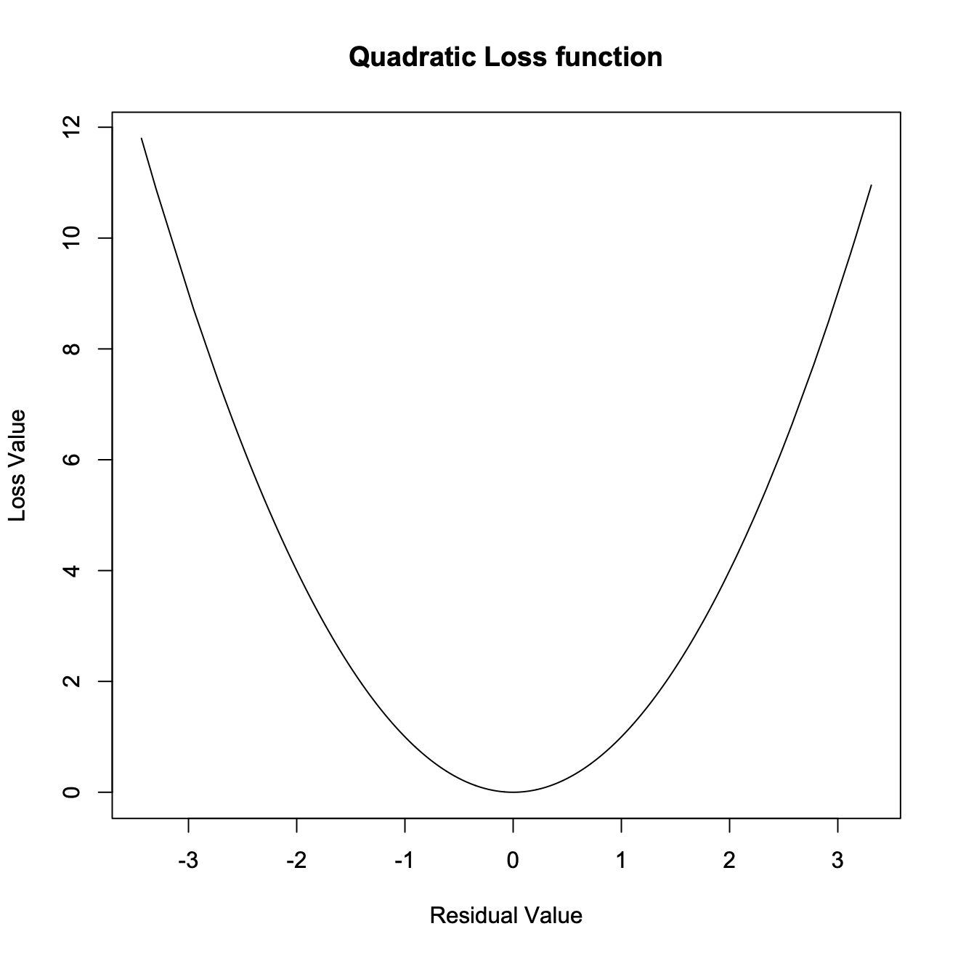
“Standard” Loss Function for Numeric Y
Overestimates
Underestimates

Slide 8
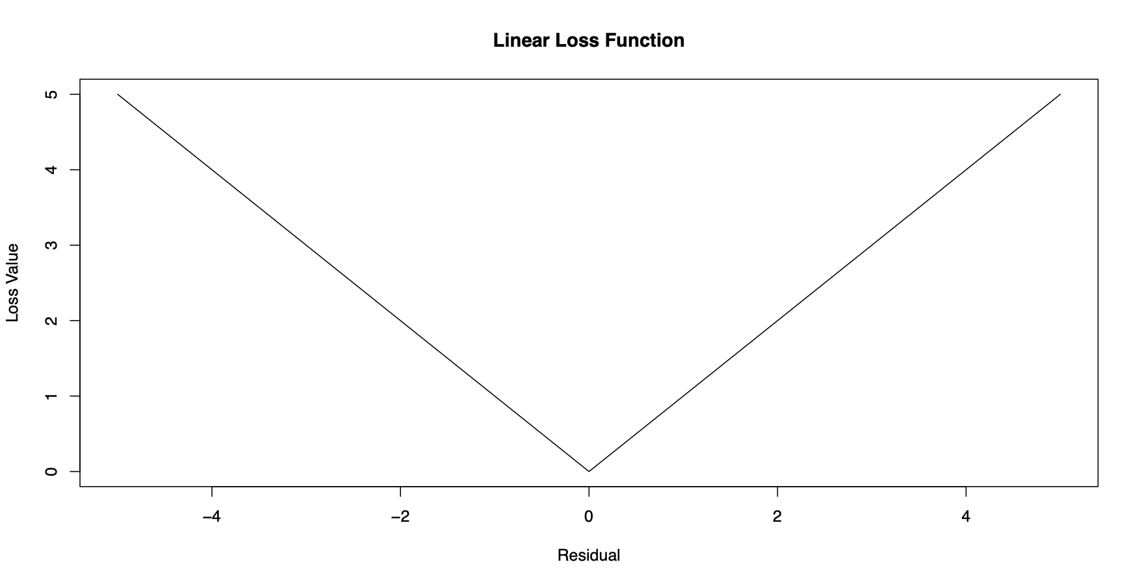
“Robust” Loss Function for Numeric Y
Overestimates
Underestimates

Slide 9
Three “Solutions”
For numeric Y: change the loss function (e.g., use quantile loss)
For categorical Y: change the classification rule (e.g., away for .50 threshold)
For categorical Y: change the prior (e.g., away from the empirical prior)
Stratified sampling (e.g., over-sample cases with more costly errors)
Weight the data (e.g., weight more heavily cases with more costly errors)

Slide 10
Default Costs Random Forest Confusion Table
 | No Bycatch Predicted | Bycatch Predicted | Missclassification Rate
No Bycatch reported | 30700 | 345 False Positives | 0.01
Bycatch Reported | 3190 False Negatives | 783 | 0.81
Forecasting Error | 0.09 | 0.31

Slide 11
2 to 1 Costs Ratio Random Forest Confusion Table
 | No Bycatch Predicted | Bycatch Predicted | Missclassification Rate
No Bycatch reported | 27544 | 3501 False Positives | 0.11
Bycatch Reported | 1733 False Negatives | 2195 | 0.44
Forecasting Error | 0.31 | 0.51

Slide 12
An Asymmetric Linear Loss Function for 𝛼 Less Then .50
high
Loss
low
-
0
+
Overestimates
Underestimates
Deviation Score

Slide 13
An Asymmetric Linear Loss Function for 𝛼 Greater Than .50
high
Loss
low
-
0
+
Overestimates
Underestimates
Deviation Score

Slide 14
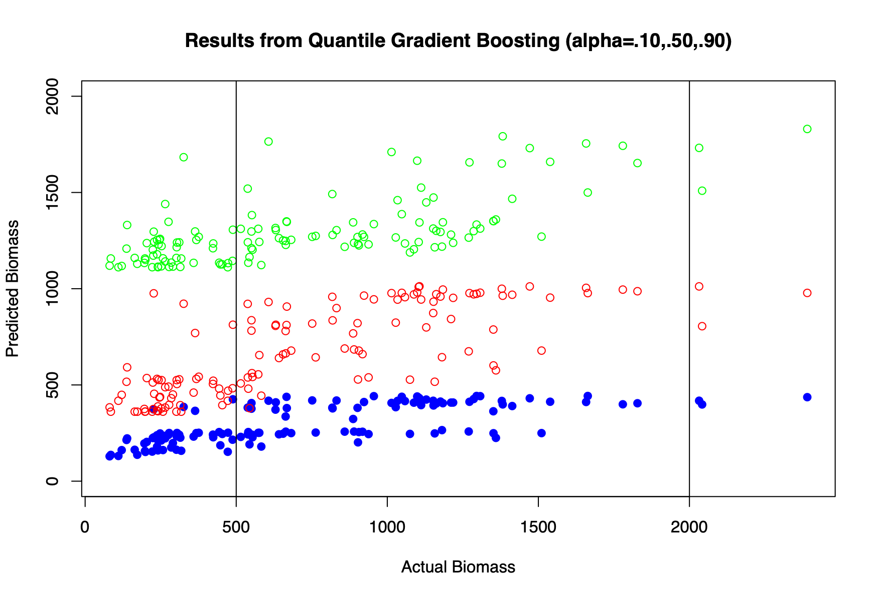
Quantile Gradient Boosting With Cost Ratios of 1 to 9, 1 to 1, and 9 to 1

Slide 15
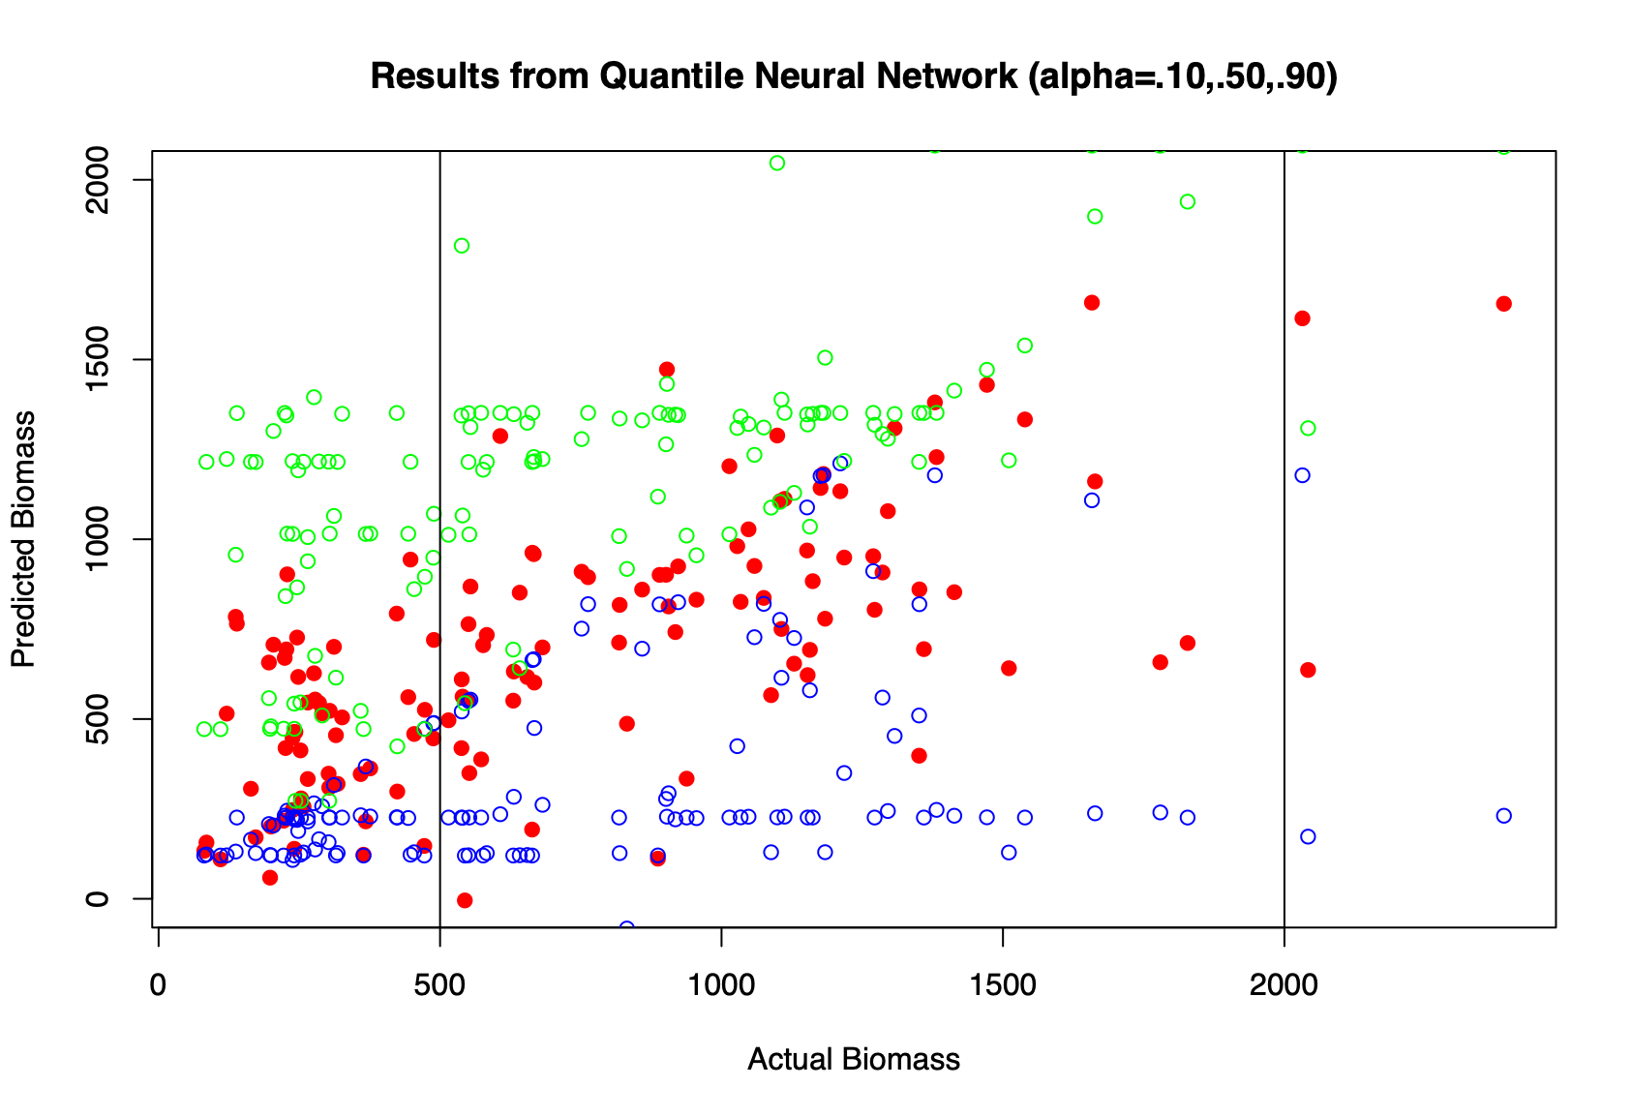
Quantile Neural Network With Cost Ratios of 1 to 9, 1 to 1, and 9 to 1

Slide 16
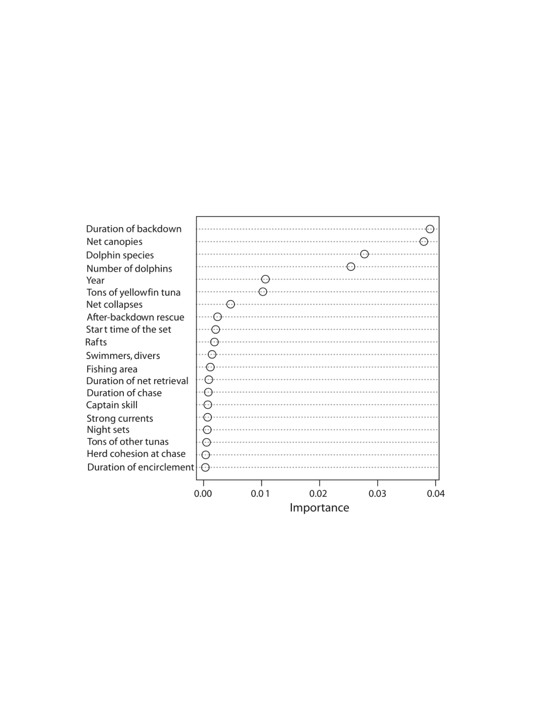
Variable Importance Using Reductions in Classification Accuracy
These will often change with different cost ratios

Slide 17
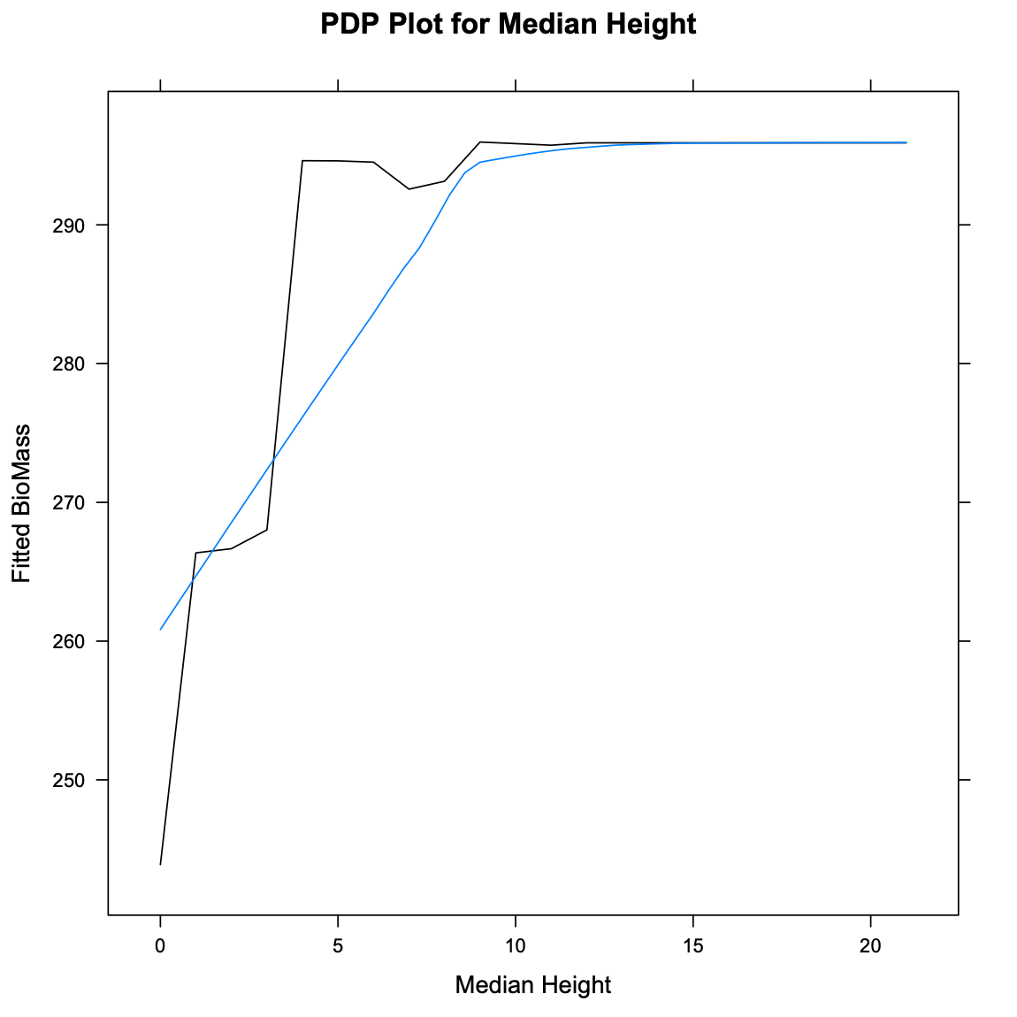
Partial Dependence Plots
These will often change with different costs for errors

Slide 18
DONE,
Thanks

