Slide 1
AI for Science @ Argonne
Ian Foster
Director, Data Science and Learning Division, Argonne National Laboratory
Professor of Computer Science, University of Chicago
foster@anl.gov
September 17, 2020

Slide 2
Why are we excited about “AI for science”?
Push
Step changes in AI/ML methods, notably deep neural networks
Major advances in areas like machine translation, speech recognition, image processing
New hardware specialized for deep neural networks
Pull
Exploding volumes of data due to new sensors and instrumentation exceed human capabilities
End of Moore’s Law puts hard problems out of reach
Growing complexity of science and engineering problems slowing rate of discovery
Notes:
Add “promising early results”

Slide 3
AI for Science @ Argonne targets both research and infrastructure
Applications
AI applications across science and engineering. Transformative approaches to simulation and experimental science.
AI software. Software infrastructure for managing data,
models, workflows etc., and for delivering AI capabilities
to 1000s of scientists and engineers.
Learning systems
Mathematics, algorithms; general AI, reinforcement learning, uncertainty quantification, explainability, etc.
Foundations
Advanced hardware to support AI. Evaluation of new architectures and systems; exploration of neuromorphic
and quantum as long term accelerators for AI.
Hardware

Slide 4
AI for Science @ Argonne targets both research and infrastructure
Applications
AI applications across science and engineering. Transformative approaches to simulation and experimental science.
AI software. Software infrastructure for managing data,
models, workflows etc., and for delivering AI capabilities
to 1000s of scientists and engineers.
Learning systems
Mathematics, algorithms; general AI, reinforcement learning, uncertainty quantification, explainability, etc.
Foundations
Advanced hardware to support AI. Evaluation of new architectures and systems; exploration of neuromorphic
and quantum as long term accelerators for AI.
Hardware

Slide 5
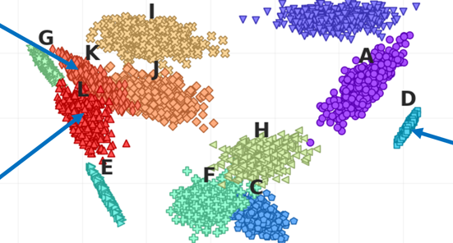
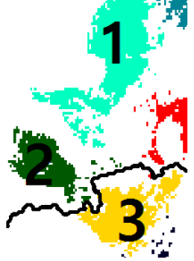
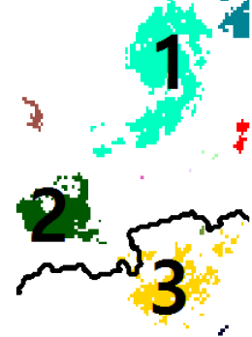
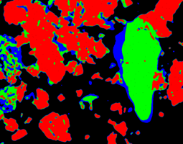
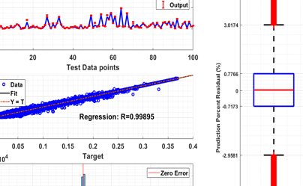
AI at Argonne: Dozens of applications projects
Reduced order modeling
of laser sintering
Materials & Design, 2018
Prediction of antimicrobial
resistance phenotypes
Scientific Reports, 2016, 2018
Identification and
tracking of storms
Journal of Climate, 2016
Defect-level prediction
in semiconductors
Chemistry & Materials, 2018
Learning for dynamic sampling
in spectroscopy
Ultramicroscopy, 2018
Vehicle energy
consumption prediction
Transportation Research, 2019

Slide 6
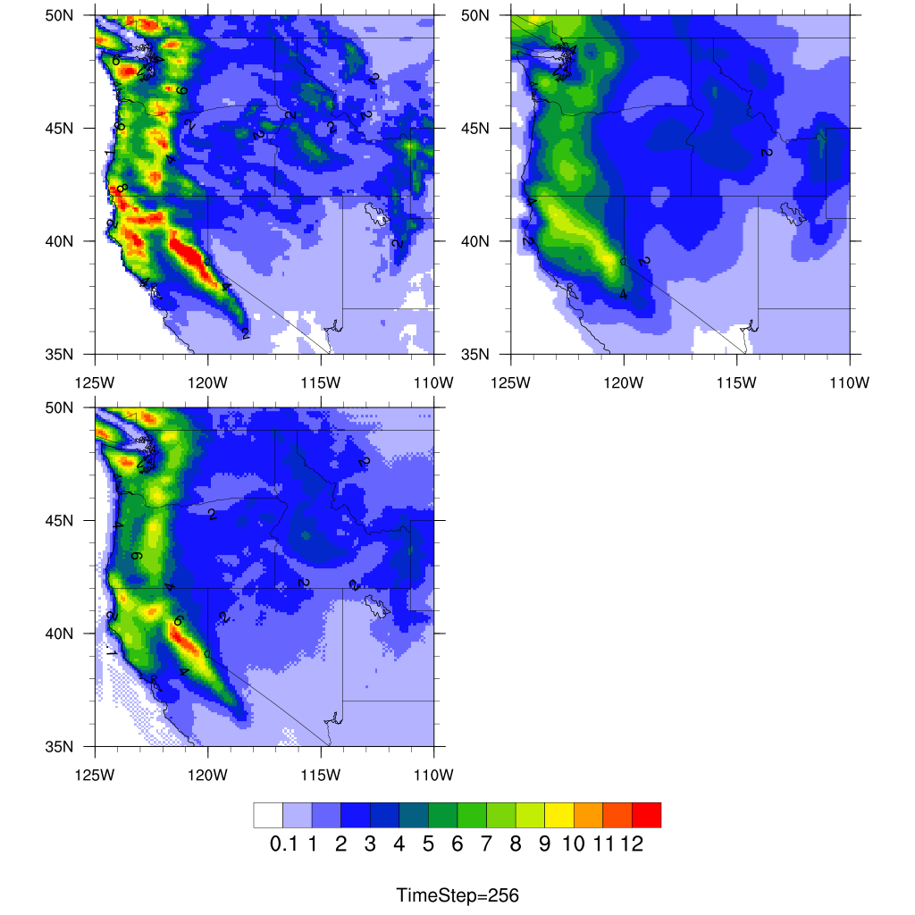
Deep Learning for Climate Downscaling
Problem: High resolution climate simulation results provide important input for other research fields, such as hydrological/urban modeling and risk assessment for critical infrastructures. However, high resolution simulation is computationally expensive. Can DL help downscaling of a coarse simulation?
Approach: Current studies use single image super-resolution (SR) technique which can generate many details, but there is no reference to tell whether those details are right or wrong, because the SR algorithm is developed
solely based on pairs of fine-resolution and upscaled results. Thus, the
results are not comparable to the observations, in fact it does not reduce model bias compared to the original coarse resolution dataset. We develop
a DL approach that directly learns data between a coarse resolution and a convective-permitting resolution.
Results: Our preliminary results (for precipitation) using 50km and 12km show that the downscaled 50km to 12km is closer to the original 12km and much better than the interpolated 50km to 12km (Figure on the right).
Impact: This approach can be implemented in WRF or any other earth
system model run at coarse resolution.
(a)
(b)
(a) original model simulated at 12km; (b) model simulated at 50km, and interpolated to 12km; (c) DL-downscaled to 12km by learning the relationship between 12km and 50km.
(c)
Zhengchun Liu, Jiali Wang, Kotamarthi Rao, Raj Kettimuthu
Notes:
Figure explanation. Compare with direct interpolation from 50km to 12km, DL downscaled one is much closer to real 12km and has more details like high precipitation events

Slide 7
ML Driven Probabilistic Forecasting (1/2)
Use ML to learn systematic model errors from past simulations and observations
ML encodes spatial-temporal discrepancies in a stochastic process
The stochastic process (ML prediction) is used to augment ensemble forecast simulations
ML provides a probabilistic “corrected” forecast:
Observations
prediction
Observations
past
ML learns discrepancies
ML corrects prediction
Probabilistic ML
Probabilistic ML
Model (NWP)
Model (NWP)
target
prediction
ML
param.
simulation/ NWP prediction
past
observation
past NWP
simulation
probabilistic
prediction
Emil Constantinescu & Julie Bessac
Notes:
Idea is that we learn simulation (weather forecast) errors by using ML (based on Gaussian Random Fields) and data from
1. NWP (numerical weather prediction) simulations
2. collected observations
We use the ML in predictive mode to correct forecasts (or projections).
Top diagram illustrates the points above.
The ML is outside the NWP model – we only postprocess the data; but use a space-time stochastic model (ML) that account for the evolution of model discrepancies.
Bottom formula represents the probabilistic function: future observation are conditioned on NWP forecasts and past observation-simulation data.
{ \rm ML} [\,p\left(\yobsfuture(t_{k+1:}) ,\,\theta_{\rm ML}\,| \ynwpfuture(t_{k+1:}),\yobspast(t_{1:k}), \ynwppast(t_{1:k})\right) \,] \leadsto p\left(\yobsfuture(t_{k+1:})\right)

Slide 8
ML Driven Probabilistic Forecasting (2/2)
Use the ML to compute the surface wind correction at the observation locations conditioned on the NWP forecast. Forecast is 24 hours ahead.
ML is calibrated once every 10 days, use ~90 space-time parameter variables
Surface wind speed forecast improvement [%] Jan 2012
The location with median improvement:
Observation (surface wind speed)
Numerical Weather Forecast (NWP) + ML
NWP
Time [days of Jan 2012]
Emil Constantinescu & Julie Bessac
Notes:
Illustration of the results when trying to correct surface winds. NWP = WRF; We use the framework in Midwest with the ground observations on the right panel. This is for the month of Jan 2012.
On average the forecast is improved up to 60% RMSE.
In time we show on the bottom the time series for the station with median performance (RMSE).
NWP in green is worse than NWP+ML in blue. Moreover, NWP+ML provides confidence intervals and the true observations (red) is inside the confidence interval.
J. Bessac, E.M. Constantinescu, and M. Anitescu, Stochastic simulation of predictive space-time scenarios of wind speed using observations and physical models, Annals of Applied Statistics, 2018
J. Hart, J. Bessac, and E.M. Constantinescu, Global sensitivity analysis for statistical model parameters, SIAM JUQ, 2020

Slide 9
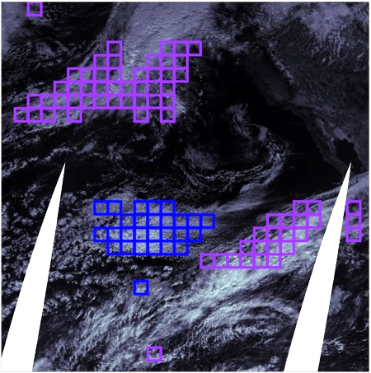
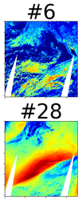
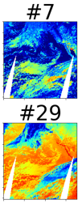
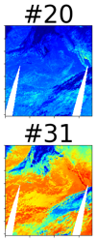
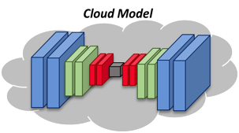
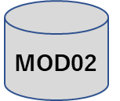
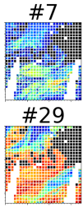
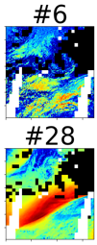

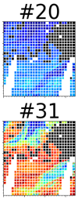
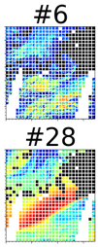
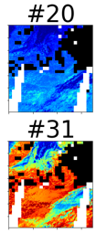

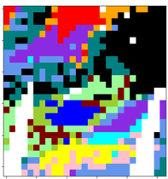
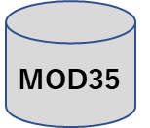
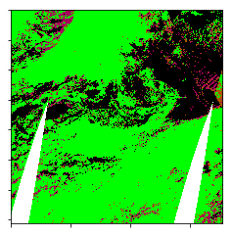
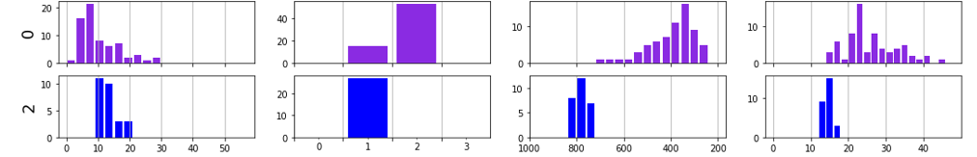
Autoencoders to discover cloud classes
Test – physical reasonableness
Raw visible image with clusters #0 & #2
MOD
02 x 35
=
Cloud Mask
Optical Thickness
Phase
Pressure
Effective Radius
Liquid
Ice
Takuya Kurihana, Liz Moyer, Rebecca Willett, Ian Foster

Slide 10
AI for Science @ Argonne targets both research and infrastructure
Applications
AI applications across science and engineering. Transformative approaches to simulation and experimental science.
AI software. Software infrastructure for managing data,
models, workflows etc., and for delivering AI capabilities
to 1,000s of scientists and engineers.
Learning systems
Mathematics, algorithms; general AI, reinforcement learning, uncertainty quantification, explainability, etc.
Foundations
Advanced hardware to support AI. Evaluation of new architectures and systems; exploration of neuromorphic
and quantum as long term accelerators for AI.
Hardware

Slide 11
Infrastructure for AI-enabled Science
Artificial Intelligence
Methods
Simulation codes
Computational results
Function memoization
…
Scientific instruments
Major user facilities
Laboratories
Automated labs
…
Data enhancement
Feature selection
System Software
Resource mgmt
Authen/Access
Model
creation
Data
QA/QC
Prog.
envs.
Languages
Models
Sensors
Environmental
Laboratories
Mobile
…
Model training
Industry, academia
New methods
Open source codes
AI accelerators
…
Data ingest
Data mgmt
Data
Agile
Infrastructure
Libraries
Accelerators
Runtime system
HPO
Compute
Portability
Inference
Operating system
UQ
Databases
Reference data
Experimental data
Computed properties
Scientific literature
…
Compilers
Workflow
Automation
Scientists, engineers
Expert input
Goal setting
…
Model
reduction
Surrogates
Active/
reinforcement learning

Slide 12

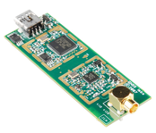

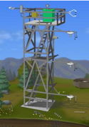
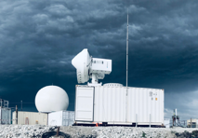
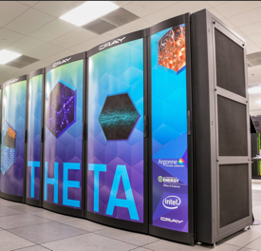
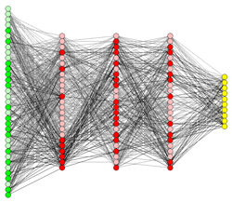
AI at the Edge
Sensors
LIDAR
Software
Defined
Radios
Powerful
Parallel Edge
Computing
Edge computing and deep learning with feedback for continuous improvement
Hyperspectral
Imaging
Facilities
HPC
Reduced, Compressed data
Actuators
New inference (model)
Adaptive steering
Servos
Deep Learning Training
Simulation / Forecast
Artificial Intelligence
Deep Learning Inference
Lightweight Training
Dynamic
adaptation
Source: Pete Beckman and Scott Collis, Argonne
Notes:
https://commons.wikimedia.org/wiki/File:HyperspectralCube.jpg
https://commons.wikimedia.org/wiki/File:DC_Motor.jpg
https://www.flickr.com/photos/sparkfun/8660319199/in/photostream/
12

Slide 13
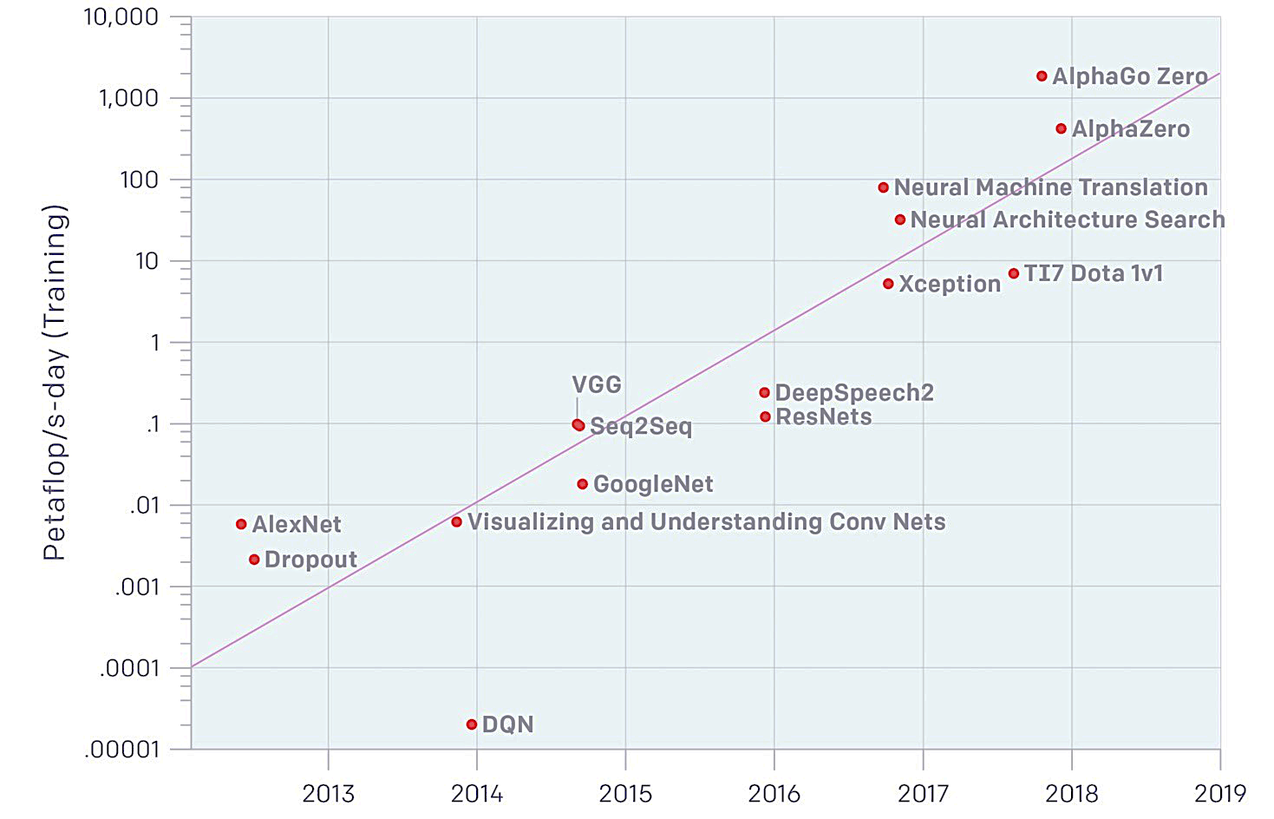
Deep learning uses massive computing
Exaflop/s-days used
to train:
AlexNet: 0.000007
(in 2012)
AlphaGo Zero: 2
(in 2017)
x 300,000 in 5.5 years
Source: DeepAI

Slide 14
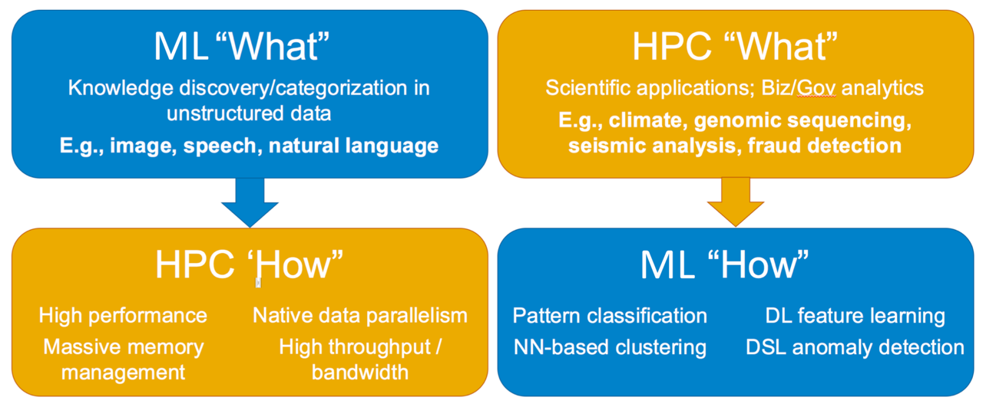
Relationships between AI/ML and HPC
HPC for ML
ML for HPC
Ack: Gadi Singer
HPC for AI/ML: HPC Technologies are applied to learning tasks to accelerate computation and/or solve larger problems
AI/ML for HPC: Learning Technologies are applied to HPC computations to improve their performance in some way, e.g., by choosing the next simulation(s) to perform

Slide 15
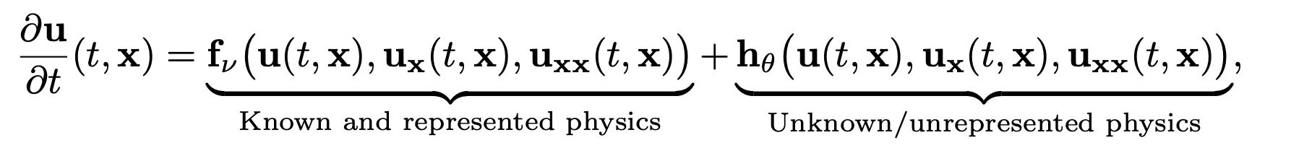
Some drivers for HPC + AI convergence
Simulation environments to drive deep reinforcement learning
  Autonomous vehicles, aircraft, robotics, marine, control systems, etc.
Deep Learning as surrogate models in simulations
  Molecular modeling, detectors, gravitational dynamics, CFD, climate, etc.
Augmenting PDE simulations with deep learning
  Enables learning new physics by combining simulation with exp data (CFD)
1911.09145v1.pdf
s41467-019-10827-4.pdf
PhysRevD.97.014021.pdf
1902.03701v1.pdf
sdata2017193.pdf
1910.07291.pdf
1912.06794v3.pdf
c6sc05720a.pdf
E5494.full.pdf

Slide 16
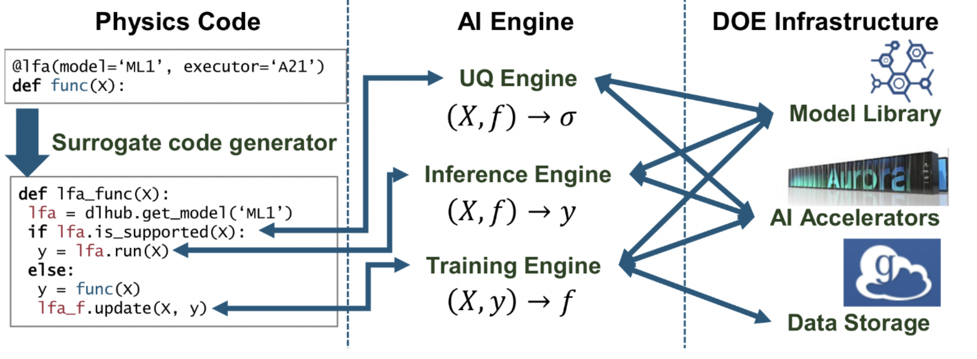
Robust Learned Function Accelerators (RLFAs)
Fluidity between simulations and learned models
Logan Ward, Ben Blaiszik, et al.
Notes:
Need an example

Slide 17
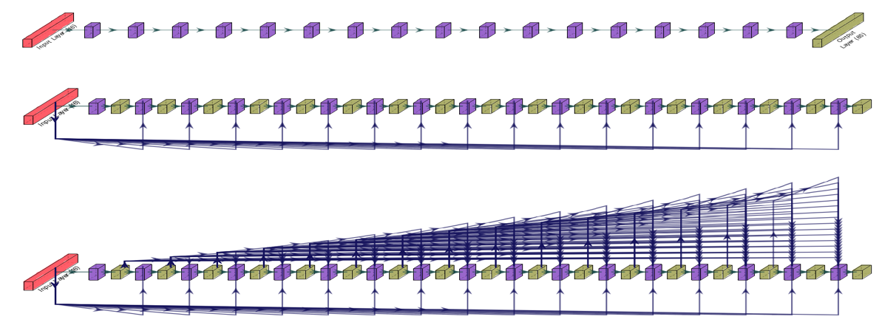
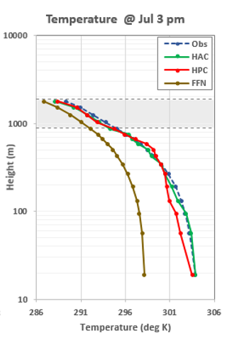
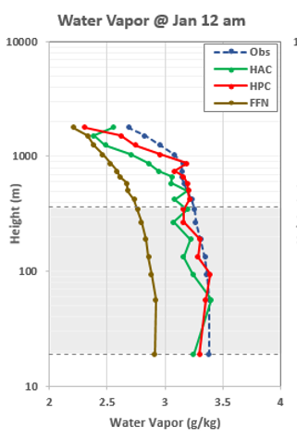
Building Process Modeling Emulators – Building Blocks of AI-Hybrid and Whole Model Emulators (Wang et al., GMD, 12,4261, 2019)
(a) FFN
Three DNN variants of DNN for emulating PBL physics. (a) Fully connected feed-forward neural network (FFN) with 17 hidden layers which only consider the near-surface variables as inputs, and one output layer. (b) Hierarchically connected network with previous layer only connection (HPC), with 17 output layers, each of them having five variables, and 17 hidden layers, each considering both near-surface variables and five output variables from previous output layer as inputs. (c) Hierarchically connected network with all previous layers connected (HAC); same as HPC, but each hidden layer also considers output variables from all previous output layers as inputs.
85 outputs: 5 x 17 WRF levels
(b) HPC
16 inputs: near-surface variables
(c) HAC
Temperature and water vapor mixing ratio from the observation and three DNN predictions in January and July of 2005 at 15:00 and 00:00 local time of Logan, Kansas.
The DNN method (HAC used here) developed at one single location (the star, Logan, Kansas) can transfer to adjacent locations. Contours are normalized RMSEs in percent (relative to observations) of HAC-predicted temperature and water vapor mixing ratio at midnight in Jan.

Slide 18
Globus services
globus.org
operated by UChicago for researchers worldwide

Slide 19
AI for Science @ Argonne targets both research and infrastructure
Applications
AI applications across science and engineering. Transformative approaches to simulation and experimental science.
AI software. Software infrastructure for managing data,
models, workflows etc., and for delivering AI capabilities
to 1,000s of scientists and engineers.
Learning systems
Mathematics, algorithms; general AI, reinforcement learning, uncertainty quantification, explainability, etc.
Foundations
Advanced hardware to support AI. Evaluation of new architectures and systems; exploration of neuromorphic
and quantum as long term accelerators for AI.
Hardware

Slide 20
Future directions in foundations
Leverage expertise in automatic differentiation, symbolic computing, and optimization to ensure that machine learning for science is forward looking, methods are robust and models interpretable
Many facets relevant to science
  Integration of symbolic computing with machine learning
  Prediction and inference of spatio-temporal processes
  Derivatives for training, sensitivity analysis, optimization, and UQ
  Rapid data analysis to reduce volume or identify features of interest
  Variety of new approaches to inference and UQ
  Identify and account for uncertainty in data sources and computations
Notes:
NOTE: This is a change from last year, whereby we had a capability focused on Data Analysis and Statistics. We added Automatic Differentiation to this area and redefined it as Foundations of ML, Data Analysis and Statistics to include the Foundations of ML in this area.
Top 2 figs are from Ulvestead, Menickelly, Wild, AIP2018 and show recovered screw dislocations based on nano-scale Bragg coherent diffractive imaging data obtained at APS.
Bottom fig is from Hanqi Guo and shows uncertainty of flow field.

Slide 21
AI for Science @ Argonne targets both research and infrastructure
Applications
AI applications across science and engineering. Transformative approaches to simulation and experimental science.
AI software. Software infrastructure for managing data,
models, workflows etc., and for delivering AI capabilities
to 1,000s of scientists and engineers.
Learning systems
Mathematics, algorithms; general AI, reinforcement learning, uncertainty quantification, explainability, etc.
Foundations
Advanced hardware to support AI. Evaluation of new architectures and systems; exploration of neuromorphic
and quantum as long term accelerators for AI.
Hardware

Slide 22
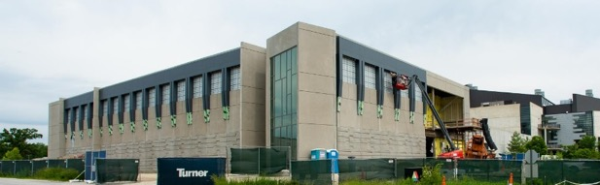




Aurora: HPC and AI
>> Exaops/s for AI
Architecture supports three types of computing
Large-scale Simulation (PDEs, traditional HPC)
Data Intensive Applications (scalable science pipelines)
Deep Learning and Emerging Science AI (training and inferencing)

Slide 23
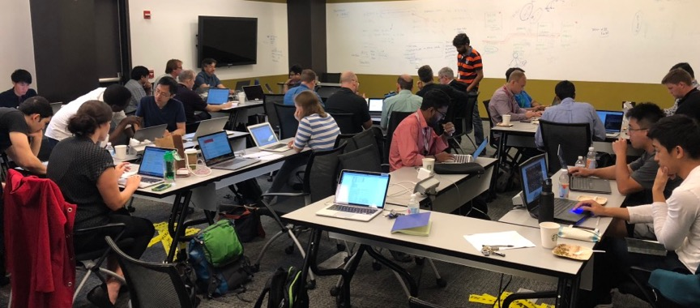
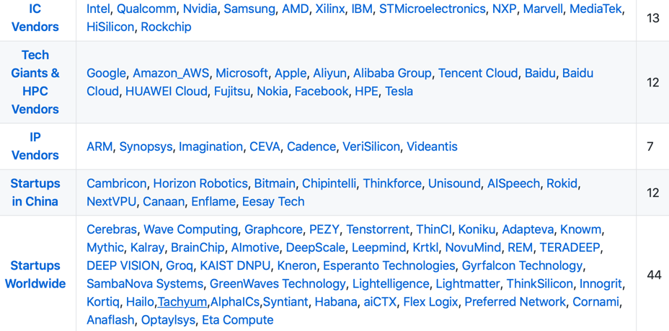
An AI accelerator testbed
Engaging the community to understand and improve specialized AI hardware for science
Dozens of proposed AI accelerators promise
10x - 1000x acceleration for AI workloads. AI testbed will:
  Provide an open and unbiased environment for
  evaluation of AI accelerator technologies
  Disseminate information about use cases, software, performance on test problems
  Support collaborations with AI technology developers, academics, commercial AI, DOE labs
Staged evaluation enables identification
of most promising systems for science
Device
Subrack
Rack
https://github.com/basicmi/AI-Chip

Slide 24
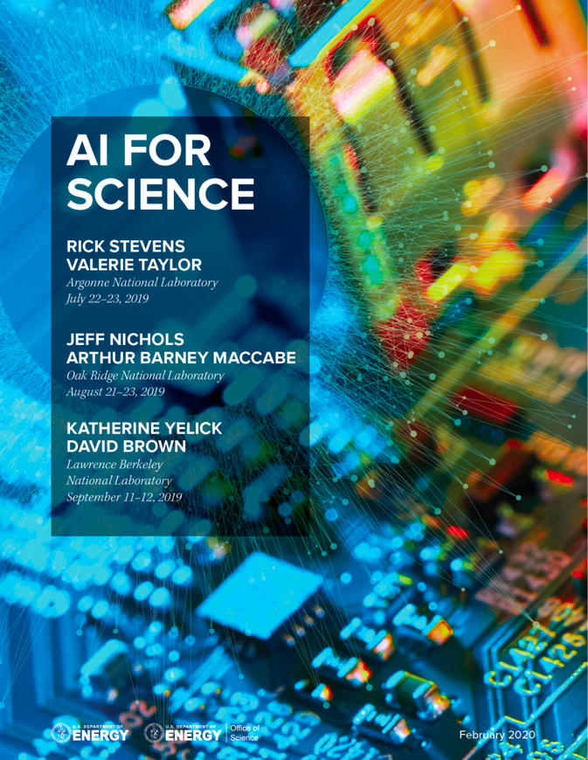
DOE’s AI for Science Townhalls
Organized by Argonne, Oak Ridge and Berkeley with participation from all DOE labs
Four “Townhalls” held during 2019 to get input from the DOE community on opportunities and requirements for the next 5-10 years in computing with a focus on convergence between HPC and AI
Applications in science, energy and technology
Software, math and methods, hardware, data management, computing facilities, infrastructure, integration with experimental facilities, etc.
~300 people per meeting
Produced a report to guide strategic planning at Labs and DOE
https://www.anl.gov/ai-for-science-report

Slide 25
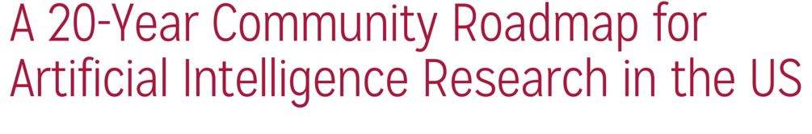

I have covered just a few of the many activities underway at Argonne on AI in science
We welcome collaboration in applications, learning systems, foundations, and hardware
Ian Foster
foster@anl.gov
http://bit.ly/2JK8OZ9

