Slide 1


The Artificial Intelligence for Earth System Science Hackathon:
Challenges and Lessons Learned
David John Gagne
NCAR, Boulder, CO

Slide 2
Acknowledgements
Organizing Committee
Sponsors
Taysia Peterson
David John Gagne
Karthik Kashinath
Rich Loft
UCAR President’s Council
Vaisala: Eric Grimit
Amazon Web Services: Zac Flamig
NCAR Machine Learning Data Commons Reinvestment Project
Hackathon Development Team
Livestream and Slido Team
Aaron Bansemer
Matt Hayman
Siyuan Wang
Alma Hodzic
Andrew Gettelman
Chih-Chieh (Jack) Chen
Natasha Flyer
Charlie Becker
Gabrielle Gantos
Keely Lawrence
Gunther Wallach
Ankur Mahesh
Bill Petzke
Paul Martinez
Bret Batterman
Mary Andreski
Lisa Larson
Gail Rutledge

Slide 3
Speaker Acknowledgements
Monday
9:10: David John Gagne
10:20: Dorit Hammerling
11:30: Ryan Lagerquist
Thursday
9:00: Amy McGovern
10:10: Imme Ebert-Uphoff
11:20: Mike Pritchard
Tuesday
9:00: Karthik Kashinath
10:10: Chaopeng Shen
11:20: David Hall
Friday
9:00: Mustafa Mustafa
10:10: Pierre Gentine
11:20: Claire Monteleoni
Wednesday
9:00: Sue Ellen Haupt
10:10: Jebb Stewart
11:20: Katie Dagon
*All times US Mountain Daylight Time

Slide 4
Motivation
Interest in AI/ML for weather and climate problems is growing rapidly
Earth System Science practitioners need help getting started with ML
Not enough trained ML-ESS experts to work with everyone
Solution: Host a summer school and hackathon!
Invite AI-ESS experts to lecture about different aspects of AI and ESS
Create training materials and domain-focused challenge problems

Slide 5
Hackathon Goals
Give participants machine learning experience with realistic ESS data and problems
Provide them with sufficient computational resources to train more complex models
Work collaboratively with a new team with diverse backgrounds
Originally planned to be in person at Mesa Lab, but COVID happened
Virtual hackathon allowed greatly expanded participation (80->200)

Slide 6
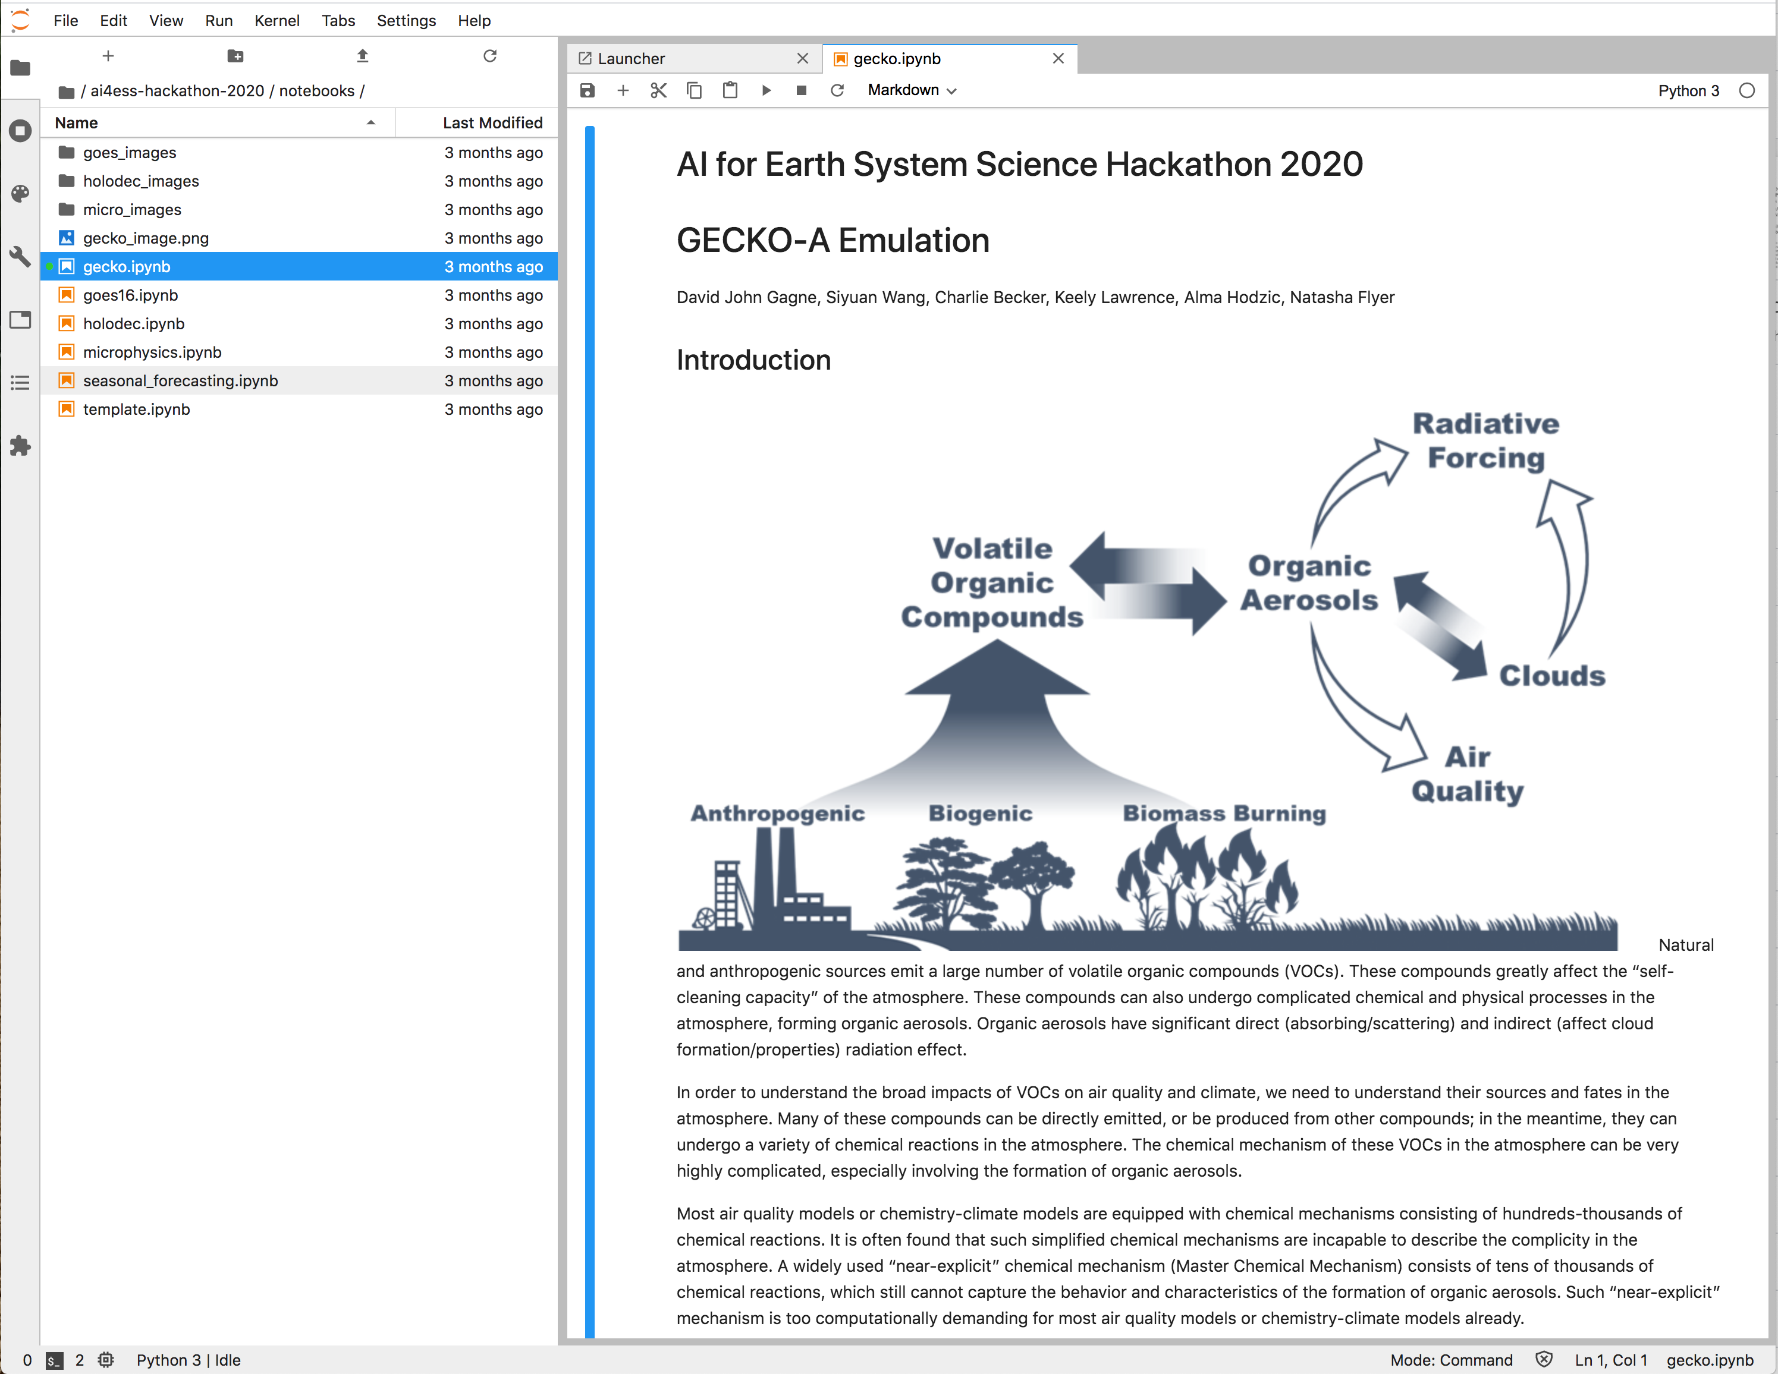
Hackathon Software Platform
User Interface
Jupyterlab in web browser after logging in with Google credentials.
Jupyterlab is preinstalled with full python data science environment and access to a GPU.
User can save data in virtual machine that persists over lifetime of hackathon.
Users can also run challenge problems through Google Colab notebooks
Team Setup
Users communicate with other team members through Slack
Teams of 5 were assigned randomly from the registration info.
Scheduled hackathon period from 2 to 6 PM Mountain Time each day

Slide 7
Hackathon Cloud Infrastructure
Google Authentication
Jupyterhub
Kubernetes
AWS EKS
AWS VM 1
Docker
AWS S3
Anaconda
AWS VM 2
NVIDIA K80
From xkcd.com

Slide 8
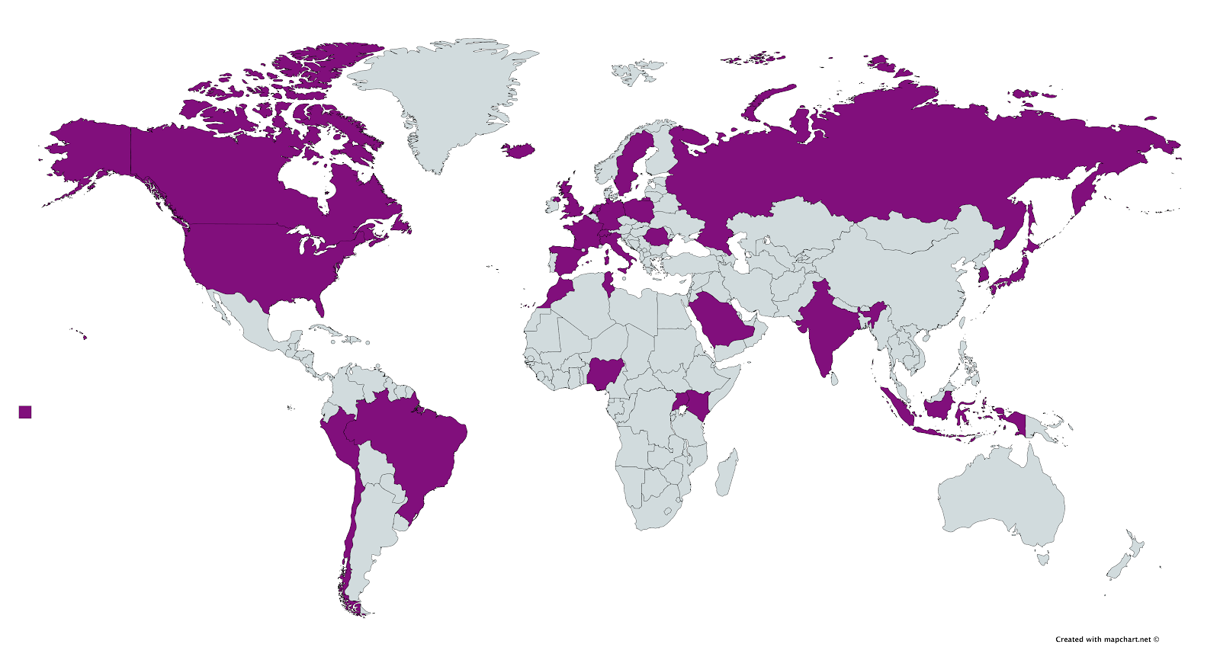
Hackathon Participants
Over 250 initial participants from 5 continents
~150 participate throughout the week
72 teams
Over 33K Slack Messages
~$36K in AWS for Earth compute credits used

Slide 9
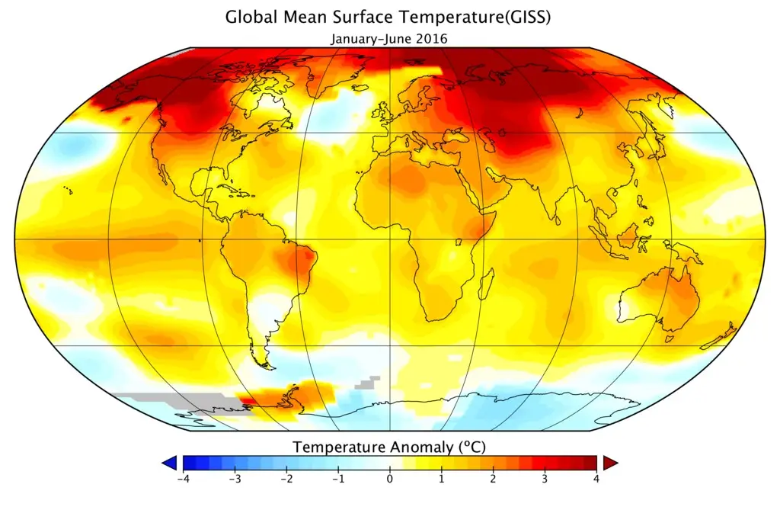
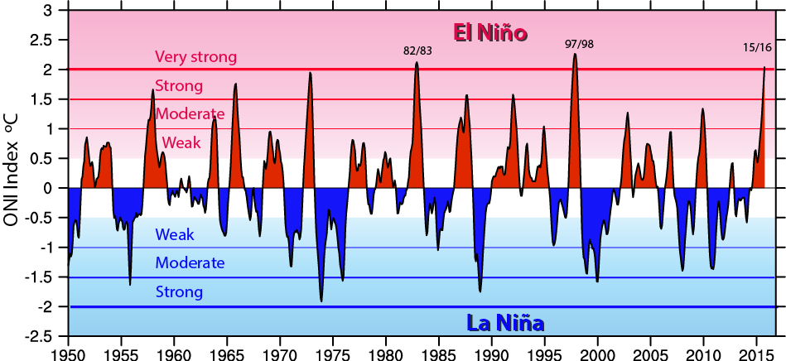
Challenge Problem: ENSO (Ankur Mahesh)
Predictor Data: surface temperature
El Niño is a cycle of warm and cold temperatures in the equatorial Pacific that affects seasonal weather
It is measured by the Niño3.4 Index: rolling 3-month average of sea surface temperatures in the equatorial Pacific
We will forecast El Niño 1-6 months ahead of time with machine learning
How do we learn effectively from using the variety of data sources and machine learning models?
How does predictability of El Niño compare to that of land temperatures?
Target Data:

Slide 10
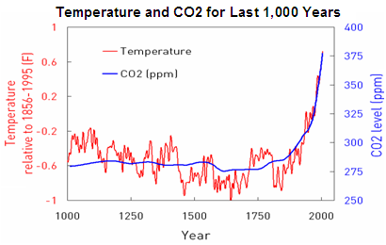
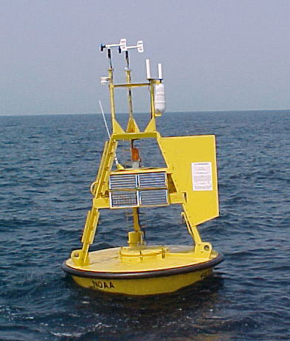
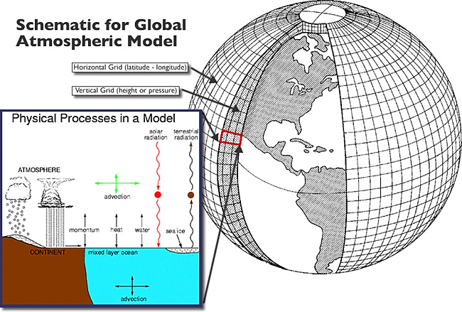
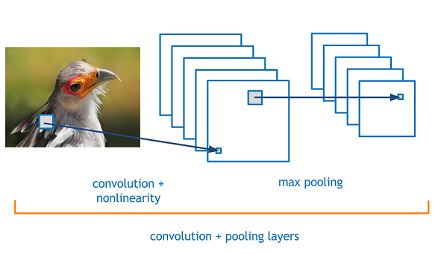
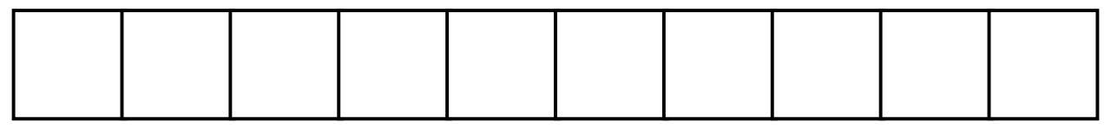
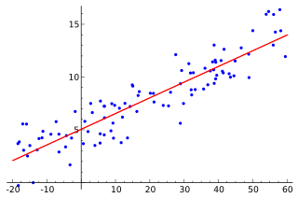
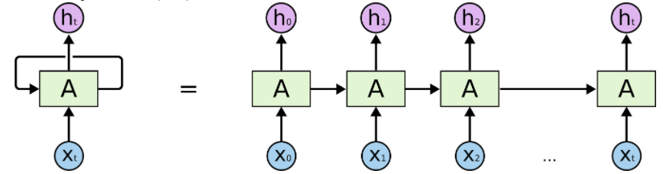
Most Common Questions
What considerations go into making a train/ test split?
Anthropogenic warming trend
Autocorrelation between consecutive months
Climate models offer another source of training data
More uncertainty with observations pre-1979
Which machine learning models leverage the spatial nature of the input?
The input is a global grid: latitude by longitude
Convolutional neural networks use this spatial organization of grid cells
Other ML methods treat each grid cell independently
CNN
Linear Regression
How can I define a custom neural network architecture? How can I learn from time series?
PyTorch requirement: you need to know the size of the extracted features from the convolutional layers in order to define the fully connected layers

Slide 11
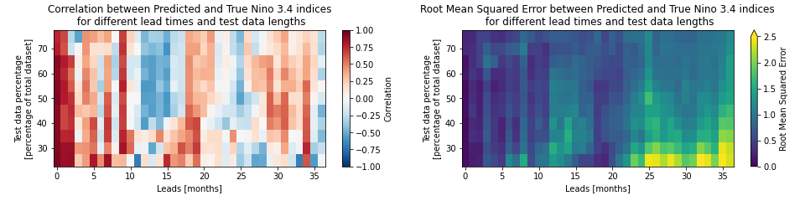

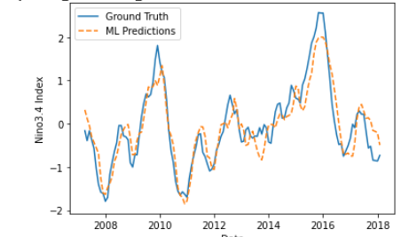

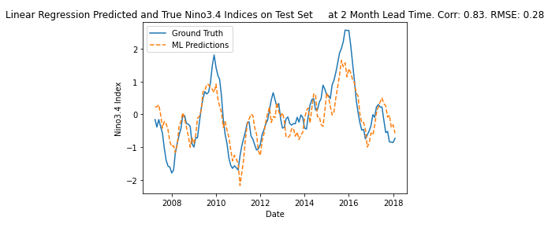
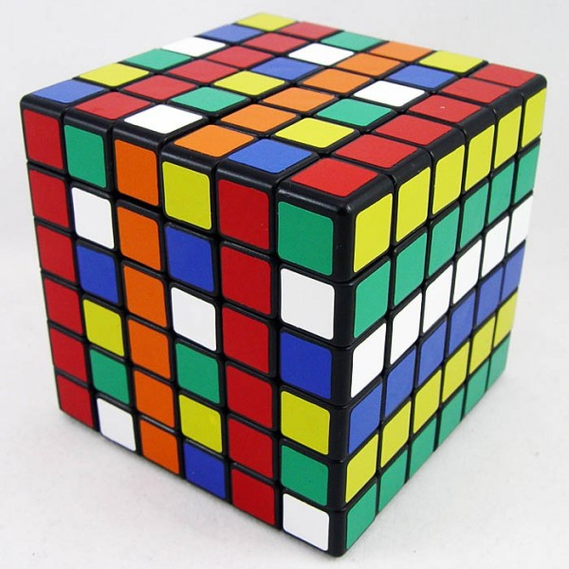
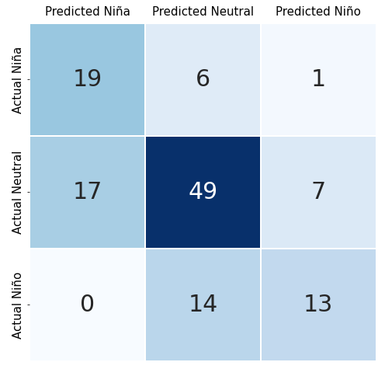
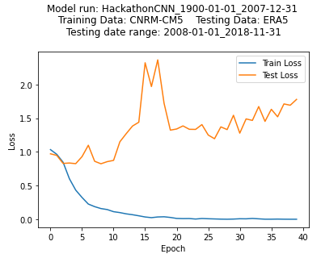
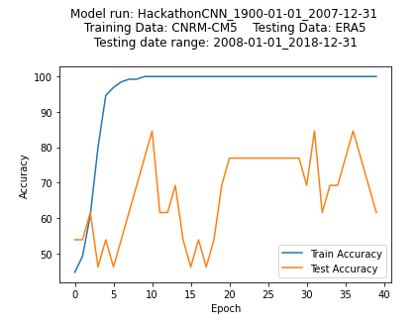
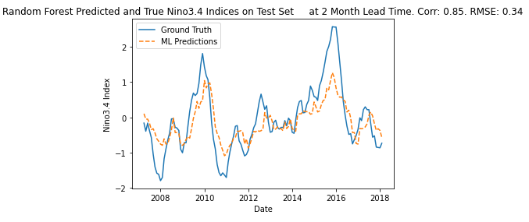
Team # 72: El Niño
Exploring the Model ZOO
Convoluted Neural Network (CNN)
Linear Regression
🌲
CNN modified to multiclass classification
🌲
🌲
🌲
🌲
🌳
🌳
*Preliminary Results - subject to change
Random forest
* caveat: training periods may vary among the figures illustrating different methods, as it was a collective effort to assemble figures
** Images come from a google search - need proper attribution

Slide 12
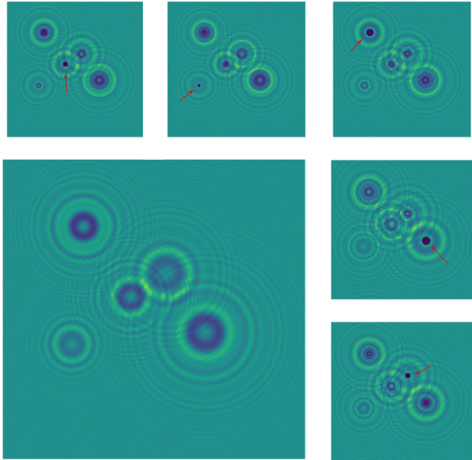
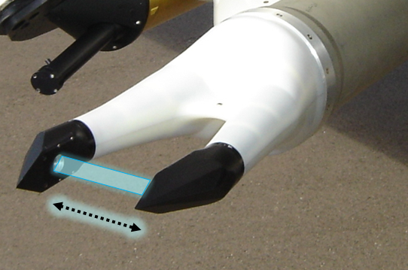
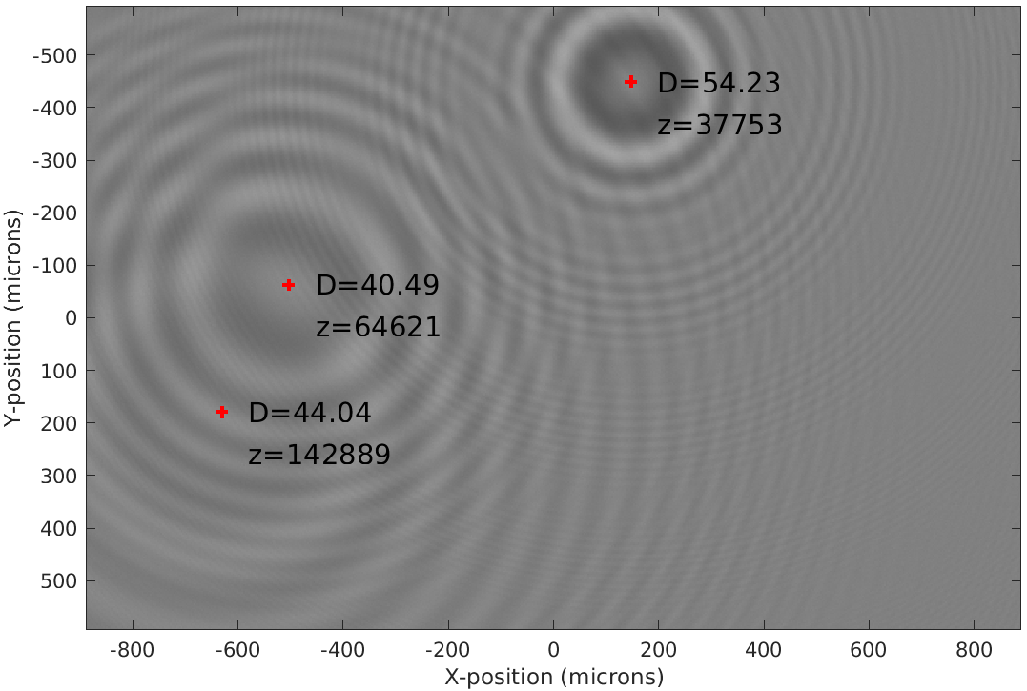
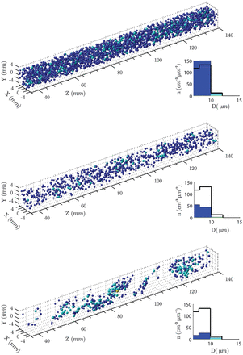
HOLODEC Machine Learning Challenge Problem
Matt Hayman, Aaron Bansemer, David John Gagne, Gabrielle Gantos, Gunther Wallach, Natasha Flyer
Holographic Detector for Clouds (HOLODEC)
Airborne instrument that measures liquid droplets and ice crystals in natural clouds
Simultaneously measures all particles in 13 cm³ volume leading to 1000+ particles per hologram
Refocusing performed on individual particles to return the 3-D position of the particle (x, y, z) as well as the size (d) and shape (2 million core hours per project)
Can ML reduce core hours?
Synthetic data using simplified holograms
  Circular droplets only (no ice)
  Synthetic grayscale hologram images
  X,Y,Z-position and Diameter of each particle
Training (15,000) and validation sets for 1 and 3 particles per 2-D hologram image
Goal: learn X,Y,Z-position and D of each particle
Beals et al. 2015

Slide 13
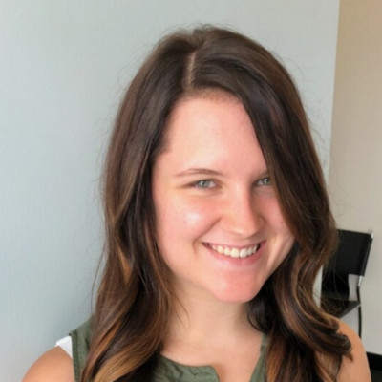
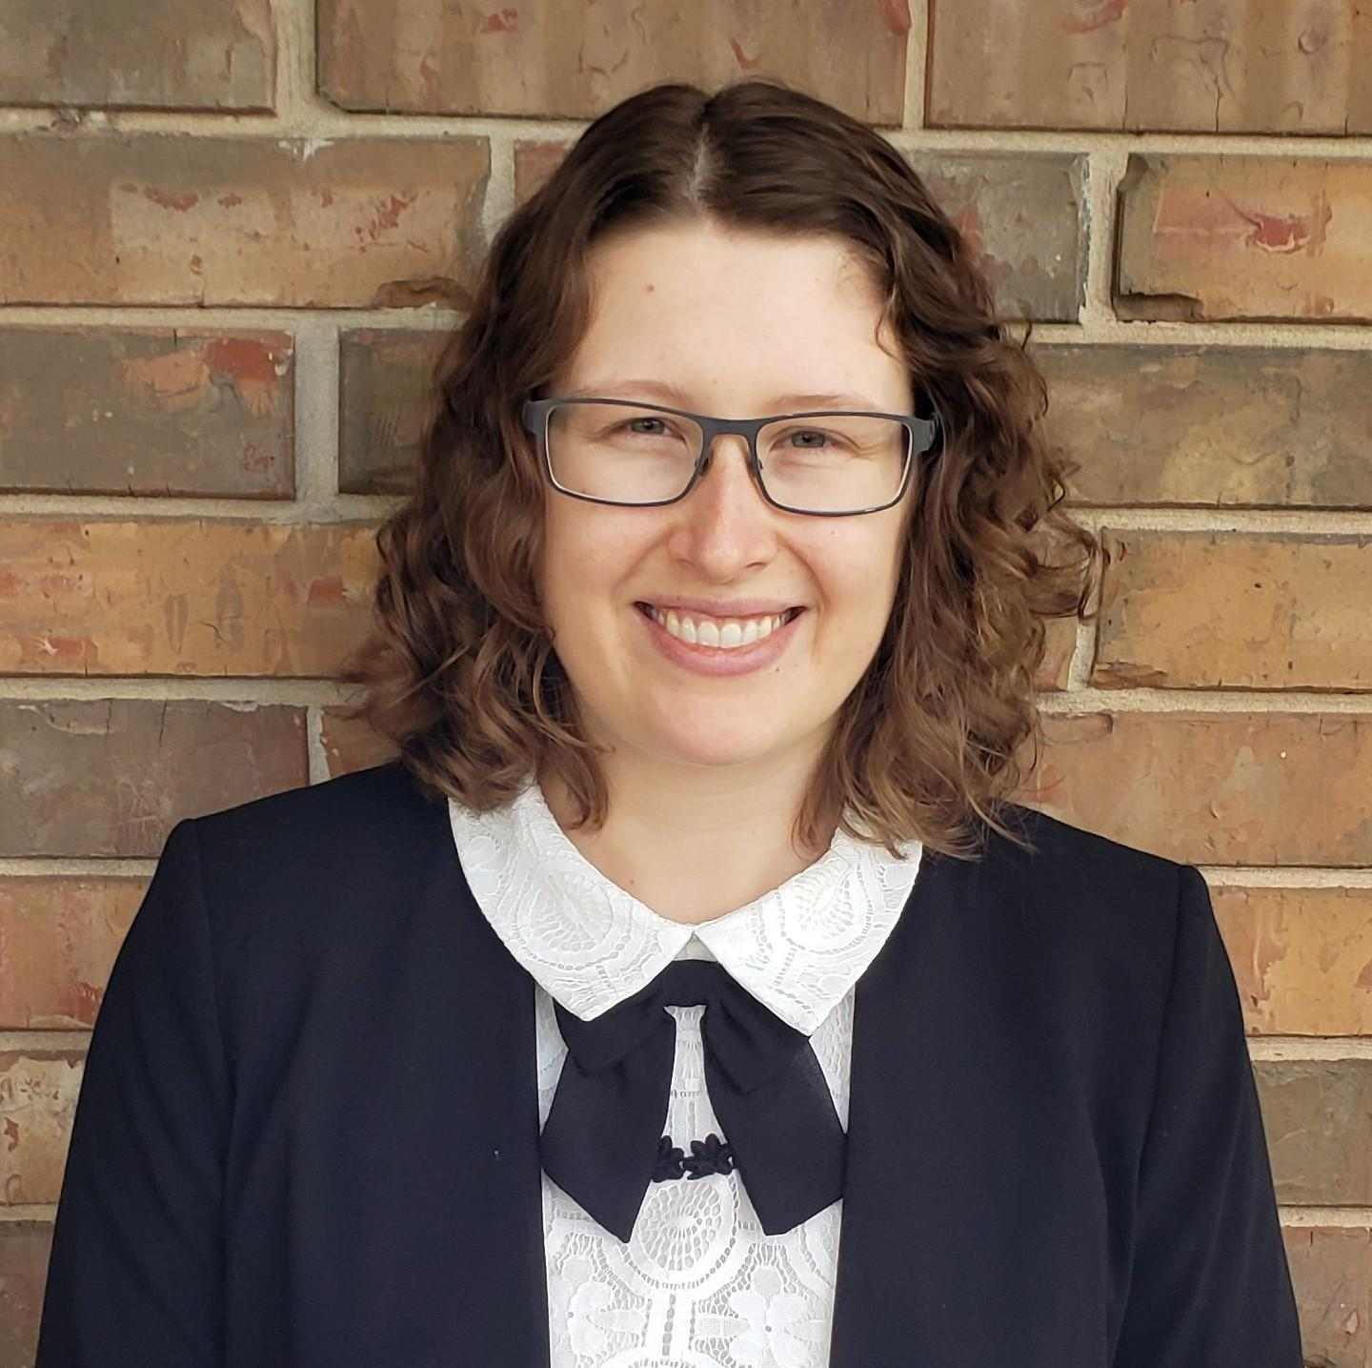
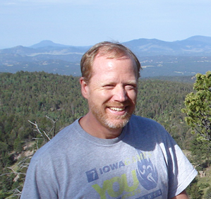

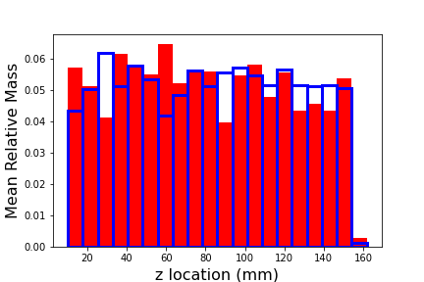
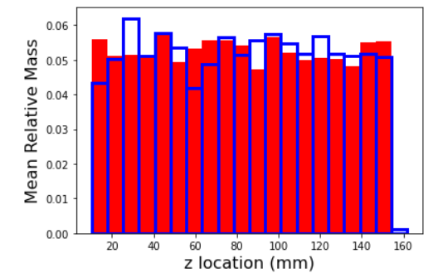
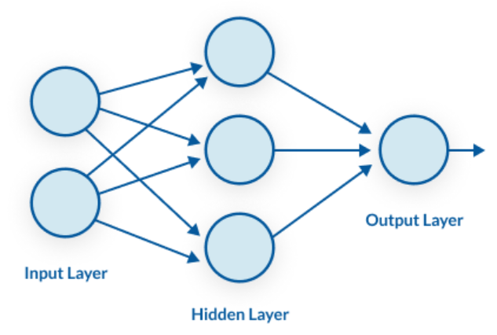

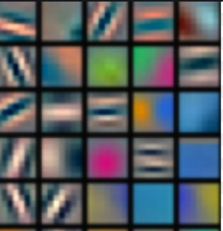
Team 26: Holodec
Team members:
Abigail Whiteside, Burkely Gallo, David Jahn, Sitian Xiong
3-particle model goal: Predict mean relative mass by distance from camera
Optimize Method | RPSS
Baseline Model | -0.234
Double dense layer nodes: [64,32] to [128,64] | -0.310
Halve dense layer nodes: [64,32] to [32,16] | 0.009
Batch size increase from 128 to 264 | -0.006
Filter change from [16,24,32] to [4,6,10] and batch size increase from 128 to 264 | 0.011
Change filters: [16, 24, 32] to [8, 16, 24, 32] | 0.000
Baseline
RPSS = -0.234
Best fit
RPSS = 0.011
Blue boxes: mean relative mass distribution along z from validation set;
Red boxes: mean relative mass distribution along z from prediction;
Notes:
Image (icon) source:
MLP icon https://stats.stackexchange.com/questions/362988/in-cnn-do-we-have-learn-kernel-values-at-every-convolution-layer
Kernel icon https://missinglink.ai/guides/neural-network-concepts/perceptrons-and-multi-layer-perceptrons-the-artificial-neuron-at-the-core-of-deep-learning/

Slide 14
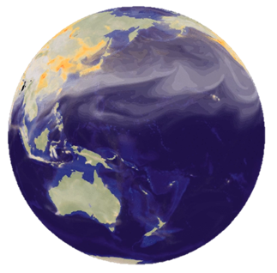
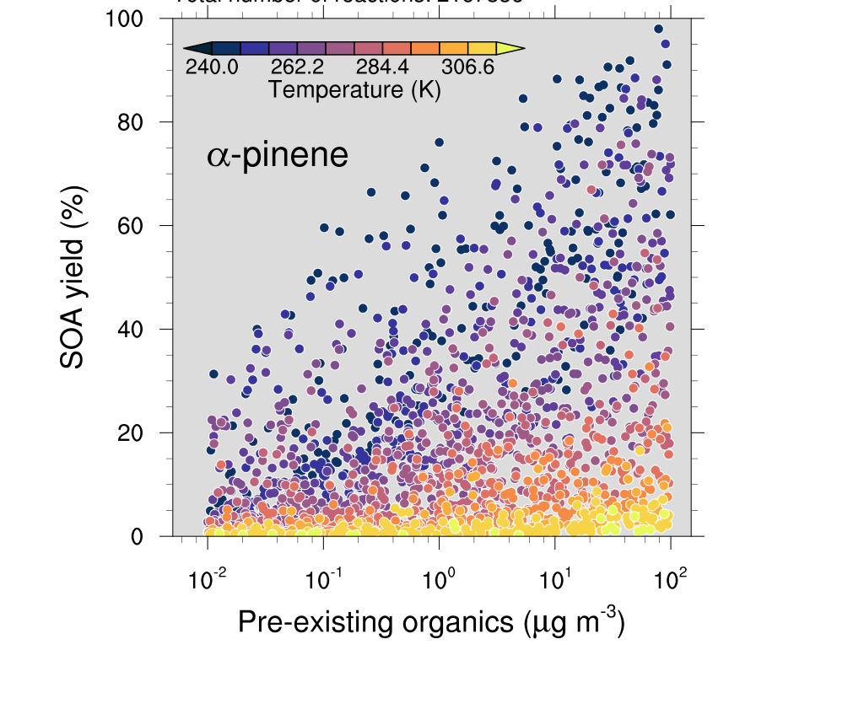
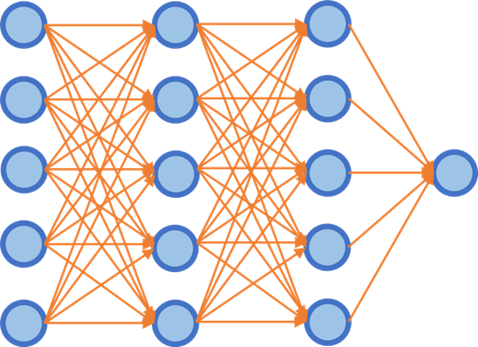
GECKO-A Challenge: Build An Emulator For 3-D Models?
GECKO-A Training Library Machine-Learning Emulator 3-D Models
Many inspiring applications out there: machine-learning emulators using explicit/process-level models, and implementing the trained emulators into large-scale models. Such explicit/process-level models are otherwise too expensive for large-scale models.
The goal of this project is to train the machine learning emulator using the “library” generated by the hyper-explicit chemical mechanism, GECKO-A.

Slide 15
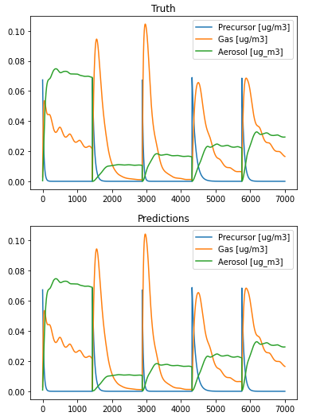
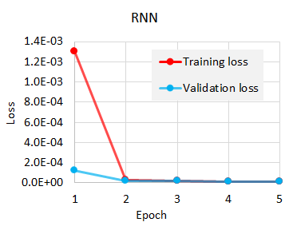
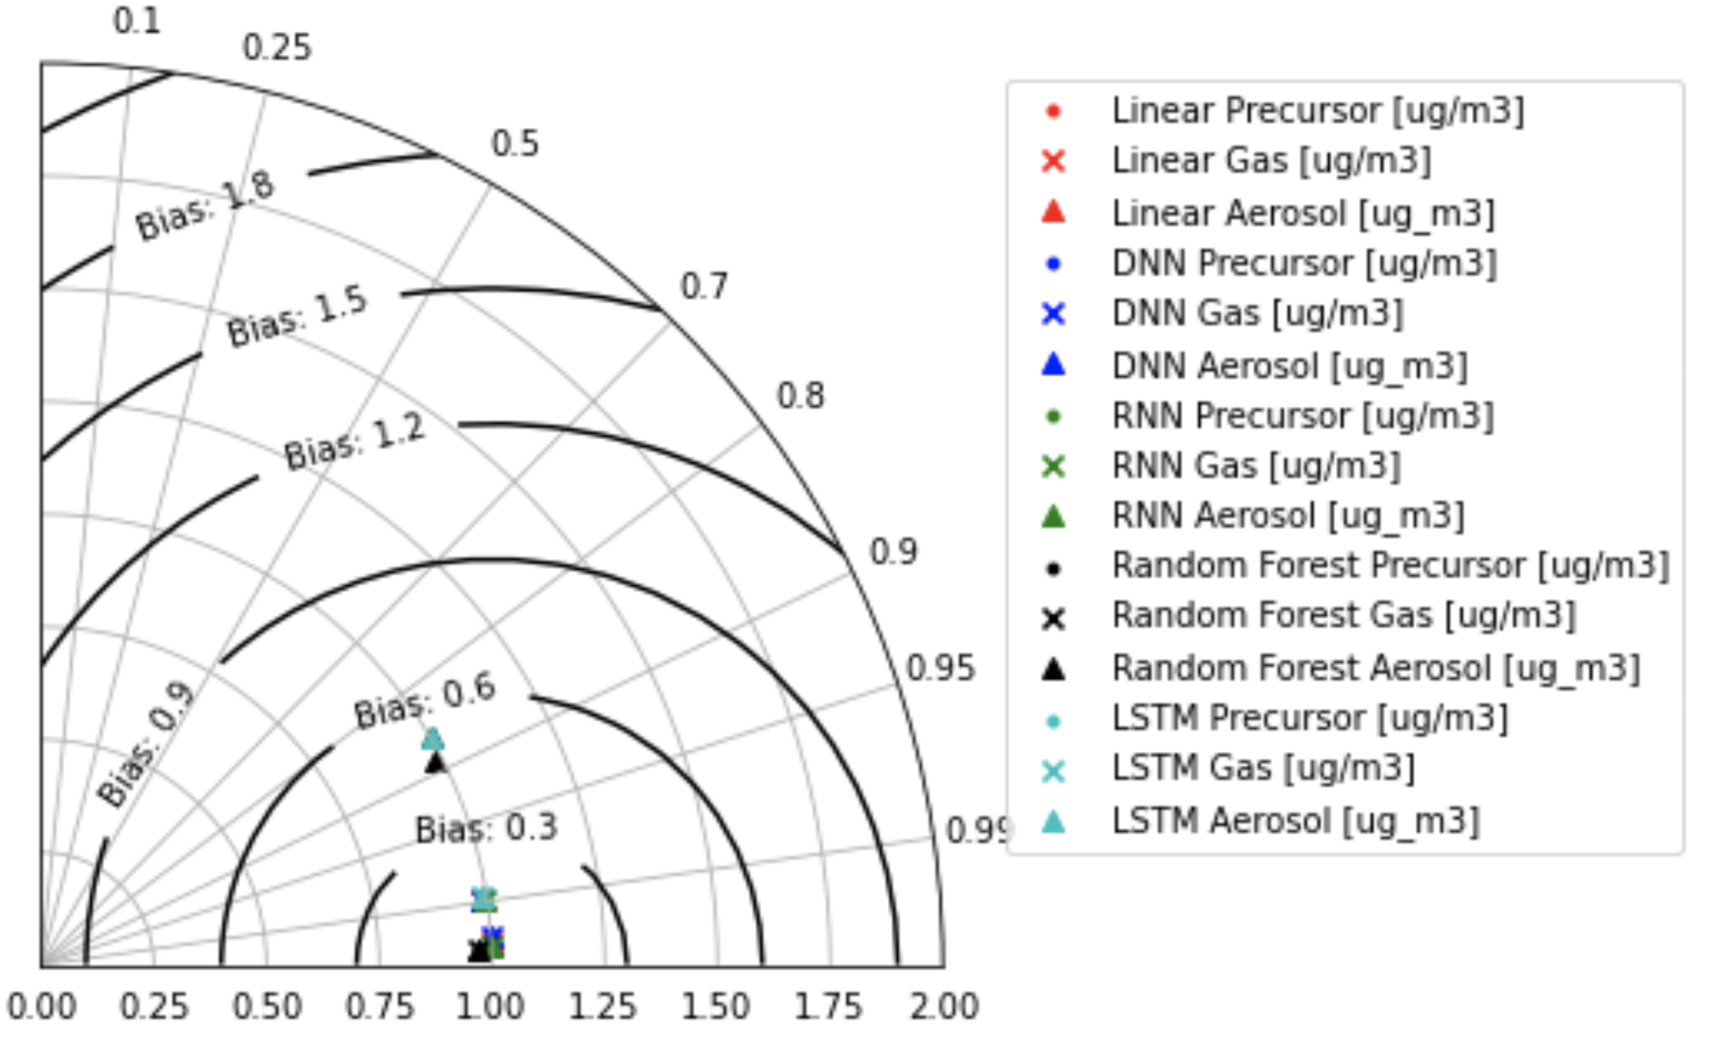
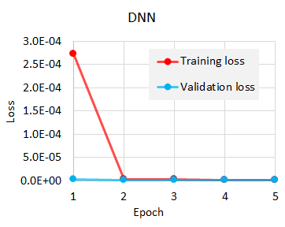
Team 17: GECKO
The model prediction shows good agreement with validation data
All of the models we tried produce similar result
Lessons learned from Hackathon:
● Fanciest tools are not always the best
● Data preparation (pipeline scaling) is really important
● Even with non-Gaussian transformation(MinMax transform), the result was good
● Precision is as important as accuracy. You can’t improve one without the other (RMSE, MAE)
Challenges: spin-up time

Slide 16
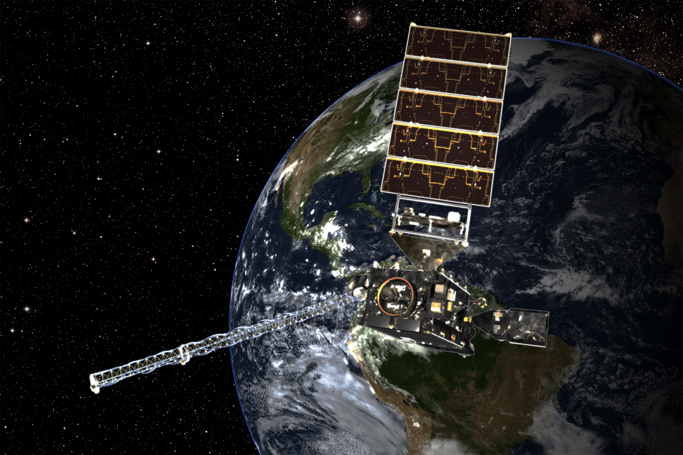
GOES Machine Learning Challenge Problem
David John Gagne, Gunther Wallach, Charlie Becker, Bill Petzke
The Geostationary Operational Environmental Satellite 16 (GOES-16) is a weather satellite that orbits the Earth
It can provide a hemispheric, multispectral view of cloud patterns at high space and time resolution through its Advanced Baseline Imager (ABI) camera.
The satellite holds the Geostationary Lightning Mapper (GLM) instrument that records lightning flashes across the hemispheric view of the satellite

Slide 17
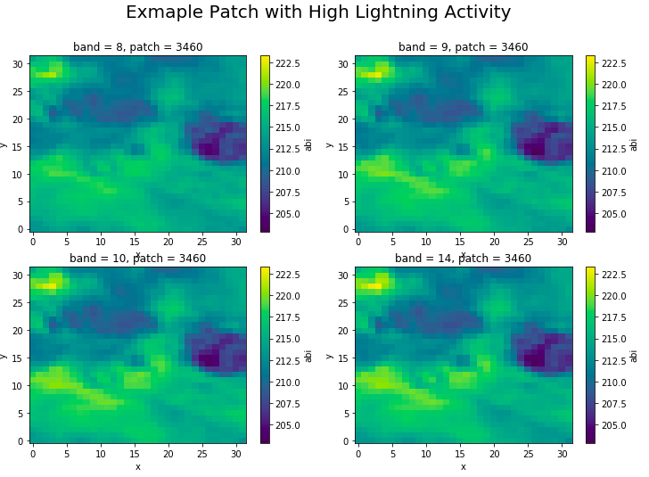
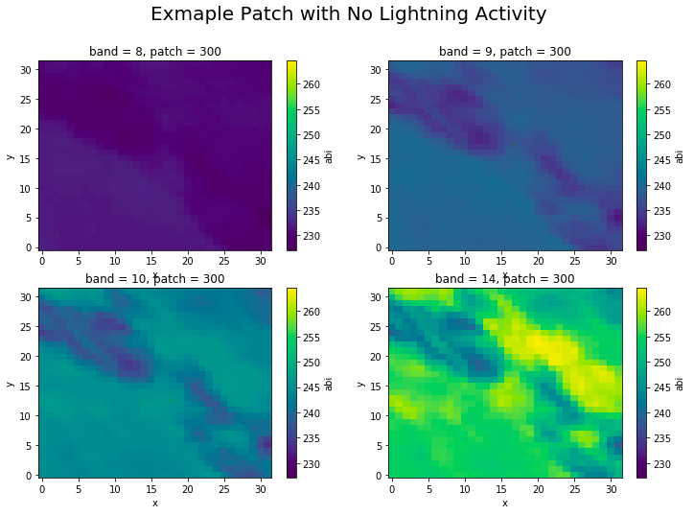
Example Patch Data
Convolutional Neural Networks (CNNs) work well to capture spatial structural differences.
Residual Networks can be used to increase the effectiveness of the depth of the NN.

Slide 18
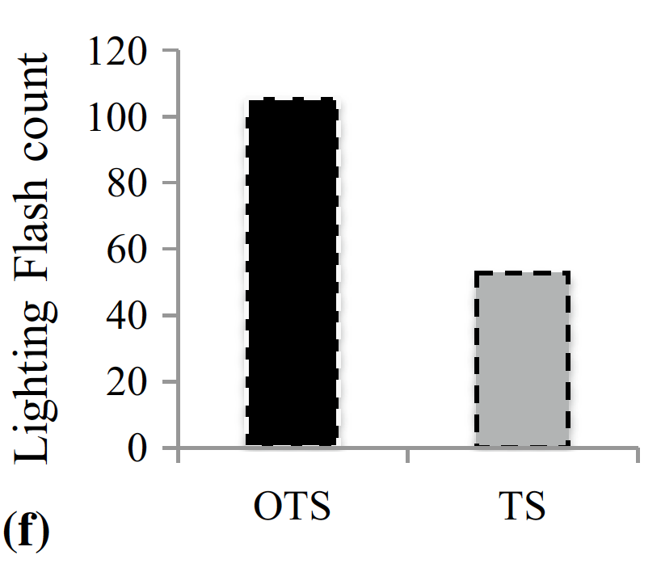
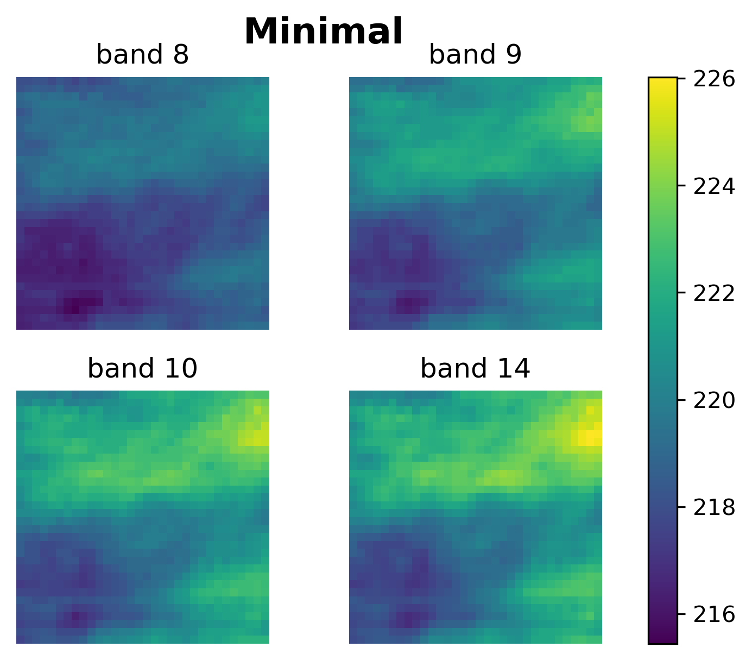
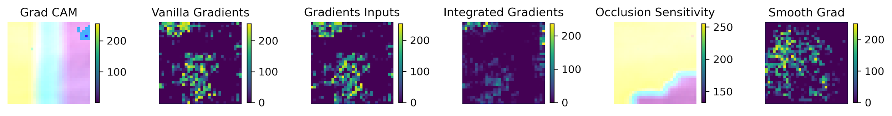
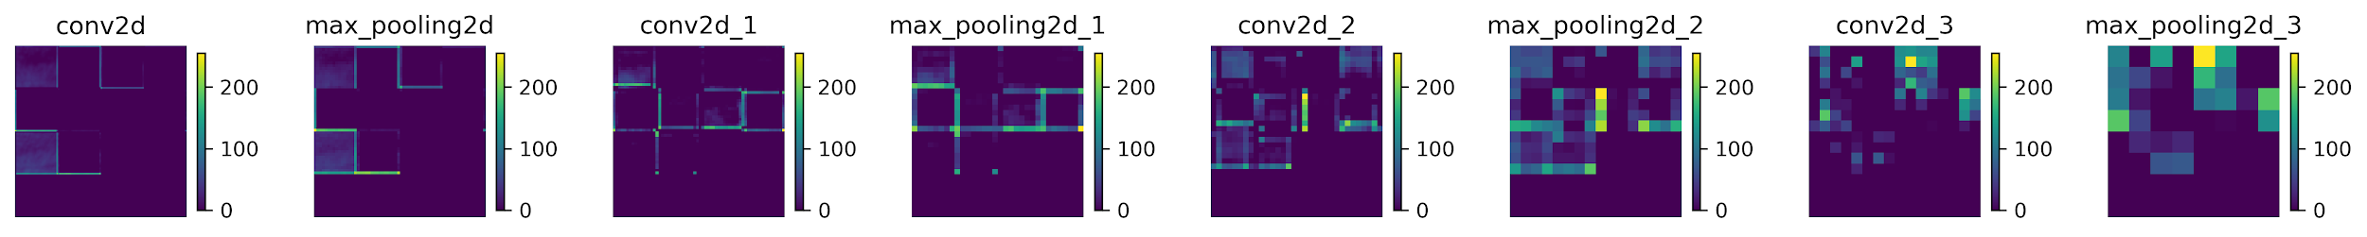
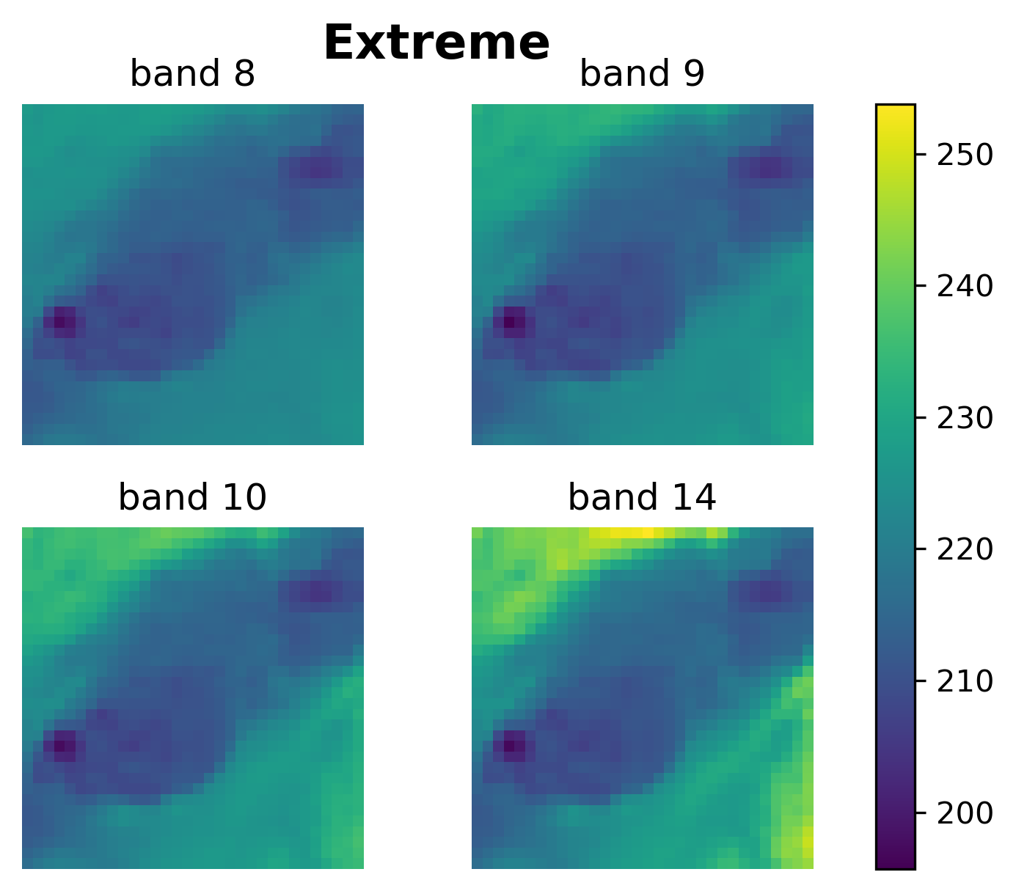
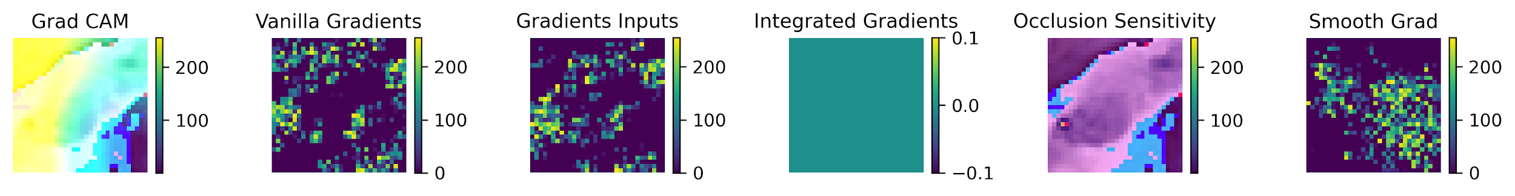
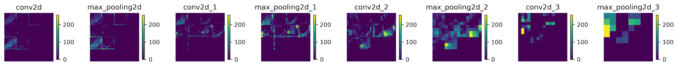
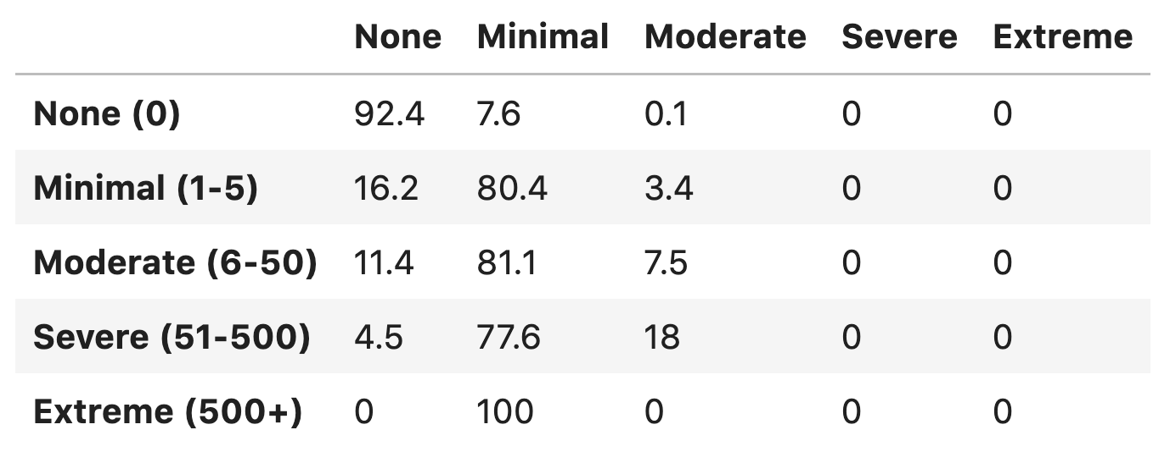
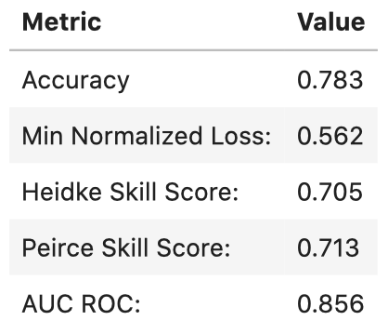
Team 53: GOES Challenge
Figure 4., Chaudhuri et al. 2020
Layer Activations
Divided data into 5 categories representing storm severity
Investigated misclassification of Extreme and Minimal events
Extreme event occlusion sensitivity picks up on overshooting top
  Often associated with intense convection (Figure 4.)
Challenges encountered:
  Experienced overfitting on training data
  Difficulty managing class imbalances

Slide 19
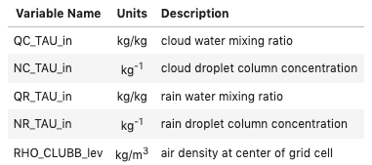




Machine Learning the Warm Rain Process
Bin Microphysics Neural Network Emulator
The warm rain formation process is critical for weather and climate prediction.
Simply parameterized in large scale models with bulk microphysics but more detailed treatments computationally expensive
Can NN Emulator reduce costs for similar performance?
Proposed input variables
Proposed output variables
Bulk: Efficient, but approximates interactions between drop sizes
Bin: Explicit interactions between sizes closer to physical equations, but too computationally expensive to calculate processes

Slide 20


Team 59
Metrics of models for test sample:
Main conclusions:
A CNN based model can emulate the behavior of a model on incomplete data, but the accuracy of the model is not very high at the moment (MAE for qrtend_TAU - 0.36, RMSE - 0.66);
The most accurate model was Random Forest with mean absolute error 0.06 in the test sample.
Linear Regression | qrtend_TAU | nrtend_TAU | nctend_TAU
MAE | 0.43 | 0.51 | 0.50
RMSE | 0.61 | 0.72 | 0.68
Decision Tree | qrtend_TAU | nrtend_TAU | nctend_TAU
MAE | 0.06 | 0.09 | 0.04
RMSE | 0.24 | 0.27 | 0.17
Random Forest | qrtend_TAU | nrtend_TAU | nctend_TAU
MAE | 0.06 | 0.08 | 0.04
RMSE | 0.18 | 0.20 | 0.13
Dense Neural Network | qrtend_TAU | nrtend_TAU | nctend_TAU
MAE | 0.36 | 0.43 | 0.22
RMSE | 0.66 | 0.7 | 0.66

Slide 21
Administration Challenges
Setting up Jupyterhub and Kubernetes on AWS
  Lots of trial and error in the last week
  Could not get autoscaling to work
Code and VM bugs/failures
  Users discovered coding bugs and needed more libraries/extensions in Python environment
  Using more RAM than available crashes the VM instead of going to swap
Slack communication
  Too many notifications turned on by default for admins
  Receiving questions through mix of official channels and PMs
  Could have used more people helping answer team questions
Team management
  People dropped out throughout the week
  Some people requested transfers to different teams/problems

Slide 22
Participant Feedback
Positive
Negative
Appreciated non-competitive feel
Learned a lot
Good collaborations on active teams
Most thought being on teams improved their experience
Virtual format greatly increased diversity of participation
Huge learning curve for beginners
Needed more documentation
Problems not well defined
Software bugs
Time zone issues
Team members dropping out/not communicating
Beginner team members feeling like they hindered others

Slide 23
Tough Dilemmas for Hackathons
Producing challenges that appeal to vast swath of ESS community vs. limited time and resources
Encouraging open-ended exploration vs. completing defined tasks
Designing problems to focus on ML tasks beyond model selection and hyperparameter tuning vs. having participants deal with raw data
Providing extensive feedback for each team vs. hackathon leaders getting rest in the evening
ML beginners may get most impact from hackathon vs. a week-long hackathon is an extremely steep learning curve for a beginner

Slide 24
Lessons Learned
Have fewer, more robustly tested and documented challenge problems
Create challenge problems targeted at different experience levels
Have synchronous work periods targeted at different time zones
Satellite admin sites to support different time zones
Provide clearer guidance up front about tasks, goals, best practices, and expectations
Provide regular feedback on team submissions
Charge a registration fee to incentivize participation
Hackathon notebooks: https://github.com/NCAR/ai4ess-hackathon-2020

