Slide 1
Improving CFS Precipitation and 2m Temperature Anomaly Outlooks from Week-1 to Week-6 with Machine Learning
Yun Fan¹, Vladimir Krasnopolsky², Huug van den Dool¹, Peitao Peng¹, Jon Gottschalck¹ and David DeWitt¹
¹Climate Prediction Center ² Environmental Modeling Center NOAA Center for Weather and Climate Prediction
NOAA 2nd AI Workshop, Oct. 29, 2020

Slide 2
Outline
Motivation
NN Basic
Preliminary Results
Summary

Slide 3
Motivation
Demand for S2S P & T2m Fcst Steadily Increasing
Problem: Low Forecast Skill
Post-Processing:
Data Sets
{ ( f₁,f₂, ….., f_{n} )_{p}, O_{p} }_{p=1,2,……N}
Where
f₁,f₂, ….., f_{n} -- predictors: 1999-2019 daily BC CFSv2 Week 1-6 P & T2m fcsts, ……
O_{p} -- predictands: 1999-2019 daily Week 1-6 P & T2m Obs
Mapping: O = M(F)
Traditional method: MLR -- MOS
Can AI or Machine Learning beat BC CFS?
Notes:
Main goal this work is focus on can AI/ML further improve beat BC CFS, if yes, by how much and how far (from Week 1 to Week 6)?

Slide 4
Big Data!!!
Output Layer
Input Layer
Y₁
X₁
t₁
Predictors
Predictands
X_{i}
t_{j}
Y_{q}
t_{k}
X_{n}
Hidden Layer
Y_{m}
Non-linear impact
$E= \frac{1}{N}\sum_{i=1}^{N}{{\left[Z_{i}−NN(X_{i})\right]}^{2}}$
Pattern relationship
Co-variability
Notes:
Increase complexity or nonlinearity by increasing # of neuron

Slide 5
8 Years Cross-Validation
Training
2012 Testing
Training
Training
2013 Testing
Training
Training
2014 Testing
Training
NNv
Training
2019 Testing
1999 – 2019 daily Week 1-6 forecasts = 6 x 7670 daily samples over North America
Training
NNd

Slide 6
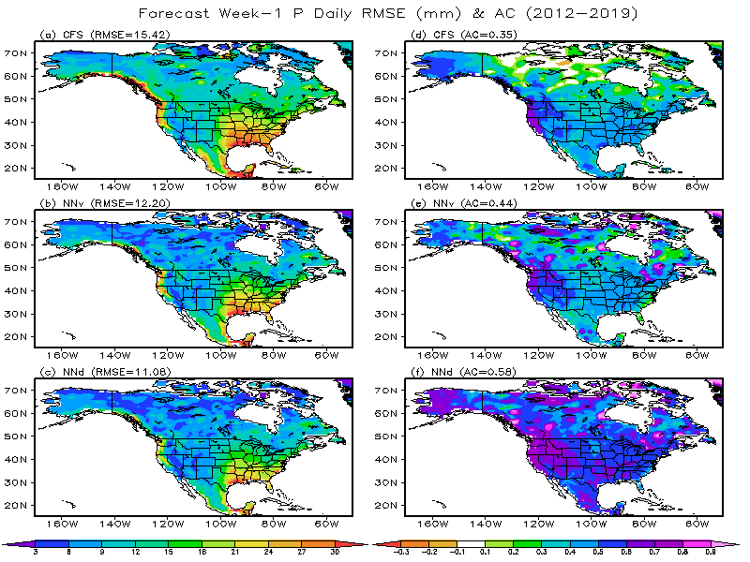
CFS: Bias corrected
NNv: Yearly Cross-Validation
NNd: Dependent Fcst
Notes:
1. Overall Improvement, but most noticeable in higher latitude
2. Improvement: NNv-26%, NNd-66%

Slide 7
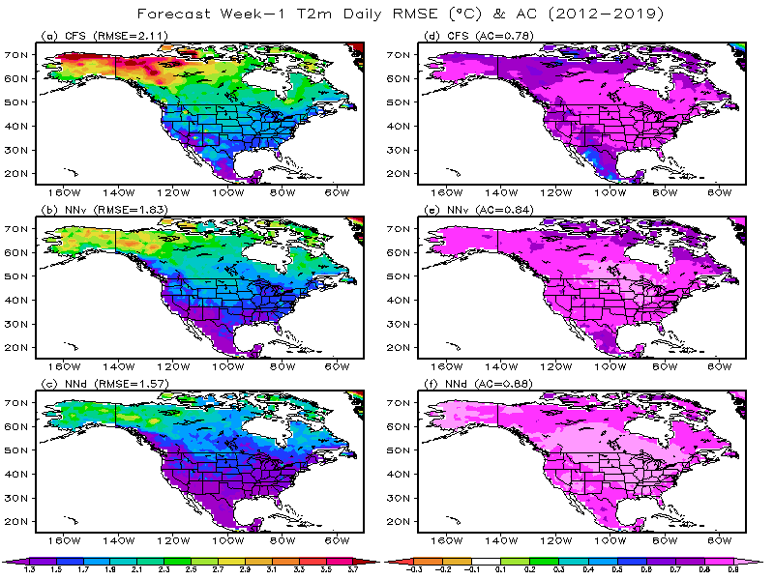
CFS: Bias corrected
NNv: Yearly Cross-Validation
NNd: Dependent Fcst
Notes:
Same as Prcp, overall Improvement, but most noticeable in higher latitude

Slide 8
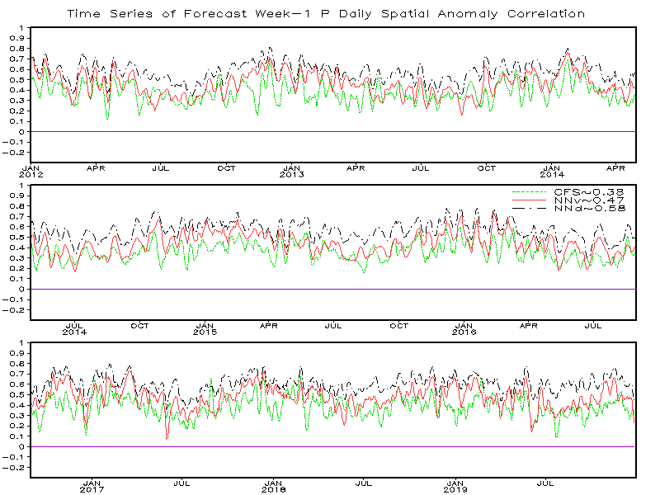
North American Domain
CFS: Bias Corrected
NNv: Yearly Cross-Validation
NNd: Dependent: 2012-2019
Notes:
Yearly (2012, 2013, 2014, 2015, 2016, 2017, 2018 and 2019) verifications:
withhold yearly data (e.g. 2012: total 366 days) from 21 year sample pool 1999-2019 (total 7670 days),
in other words: testing sample 2012, training sample 2013-2019

Slide 9
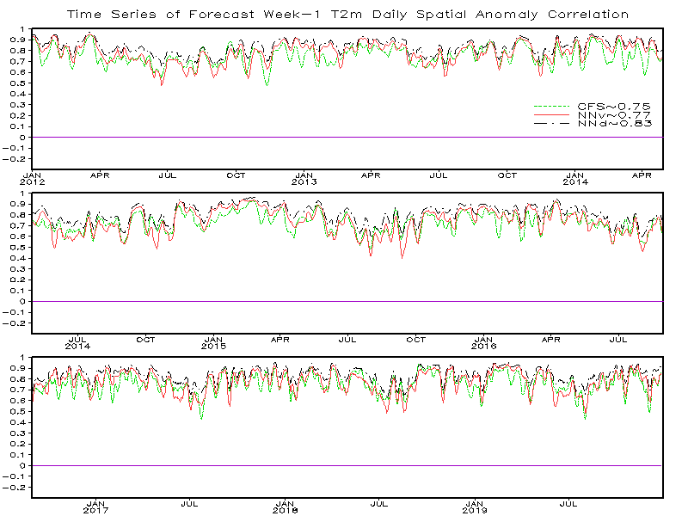
North American Domain
CFS: Bias Corrected
NNv: Yearly Cross-Validation
NNd: Dependent: 2012-2019
Notes:
Yearly (2012, 2013, 2014, 2015, 2016, 2017, 2018 and 2019) verifications:
withhold yearly data (e.g. 2012: total 366 days) from 21 year sample pool 1999-2019 (total 7670 days),
in other words: testing sample 2012, training sample 2013-2019

Slide 10
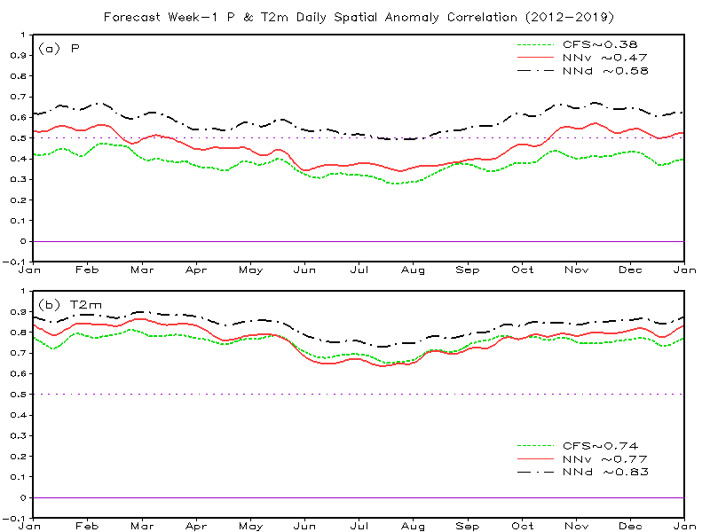
North American Domain
CFS: Bias Corrected
NNv: Yearly Cross-Validation
NNd: Dependent: 2012-2019
Notes:
1. Both CFS and NN for Prcp and T2m have better AC in cool seasons, while T2m have much better AC.
2. Overall, Prcp improvement (all seasons) is better than T2m improvement (better in cool seasons and worse in warm seasons)
3. Average NN Prcp AC can beat 0.5

Slide 11
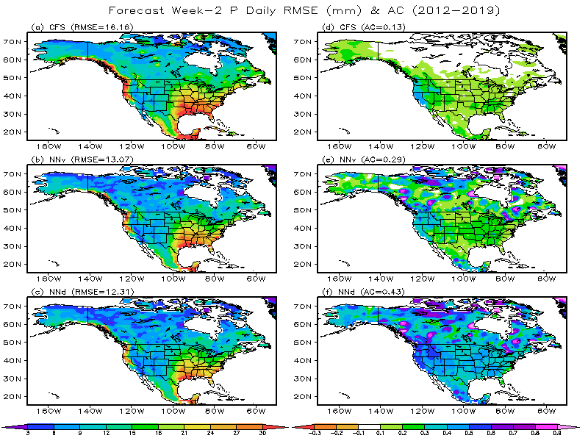
CFS: Bias corrected
NNv: Yearly Cross-Validation
NNd: Dependent Fcst
Notes:
1. Overall Improvement, but most noticeable in higher latitude
2. Yearly (2012, 2013, 2014, 2015, 2016, 2017, 2018 and 2019) verifications:
withhold yearly data (e.g. 2012: total 366 days) from 21 year sample pool 1999-2019 (total 7670 days),
in other words: testing 2012, training 2013-2019

Slide 12
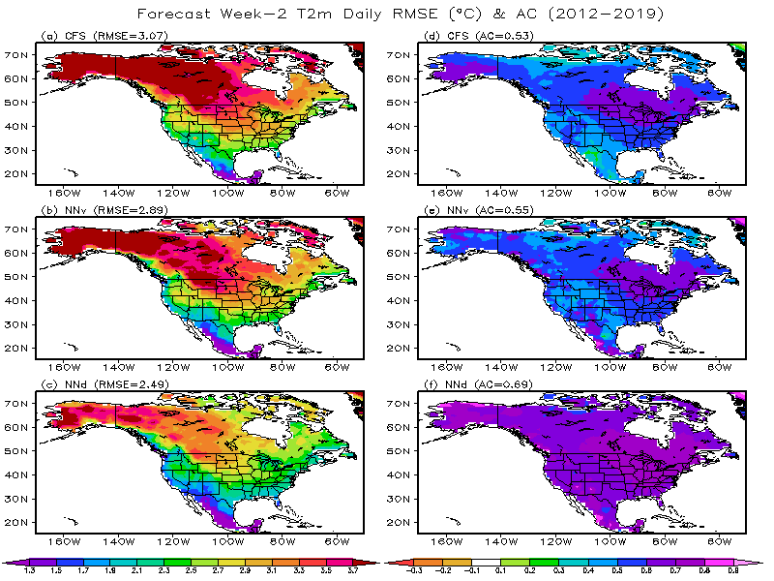
CFS: Bias corrected
NNv: Yearly Cross-Validation
NNd: Dependent Fcst
Notes:
1. Overall Improvement, but most noticeable in higher latitude
2. Yearly (2012, 2013, 2014, 2015, 2016, 2017, 2018 and 2019) verifications:
withhold yearly data (e.g. 2012: total 366 days) from 21 year sample pool 1999-2019 (total 7670 days),
in other words: testing 2012, training 2013-2019

Slide 13
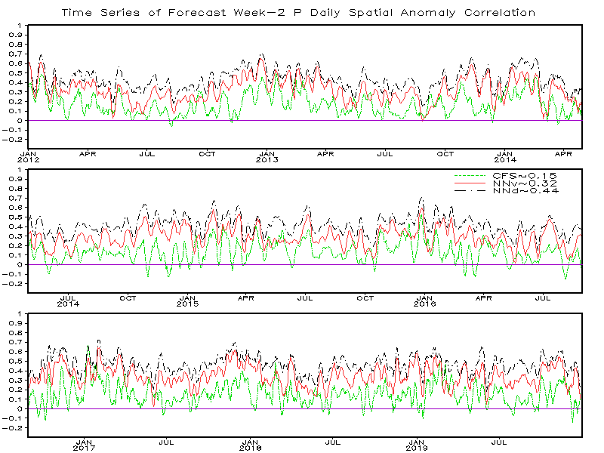
North American Domain
CFS: Bias Corrected
NNv: Yearly Cross-Validation
NNd: Dependent: 2012-2019
Notes:
Yearly (2012, 2013, 2014, 2015, 2016, 2017, 2018 and 2019) verifications:
withhold yearly data (e.g. 2012: total 366 days) from 21 year sample pool 1999-2019 (total 7670 days),
in other words: testing sample 2012, training sample 2013-2019

Slide 14
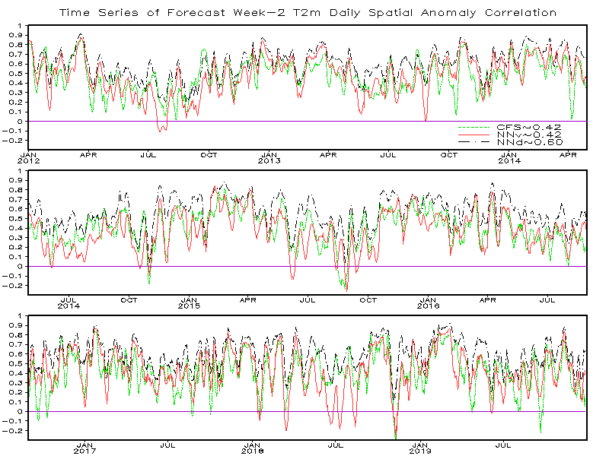
North American Domain
CFS: Bias Corrected
NNv: Yearly Cross-Validation
NNd: Dependent: 2012-2019
Notes:
Yearly (2012, 2013, 2014, 2015, 2016, 2017, 2018 and 2019) verifications:
withhold yearly data (e.g. 2012: total 366 days) from 21 year sample pool 1999-2019 (total 7670 days),
in other words: testing sample 2012, training sample 2013-2019

Slide 15
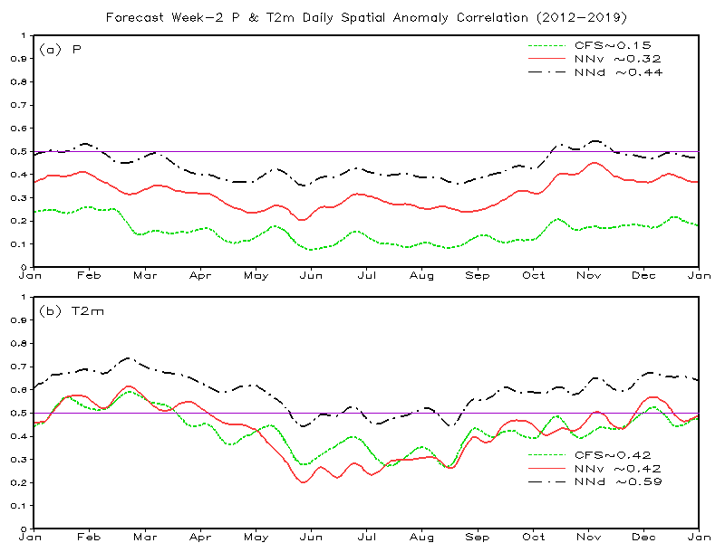
North American Domain
CFS: Bias Corrected
NNv: Yearly Cross-Validation
NNd: Dependent: 2012-2019

Slide 16
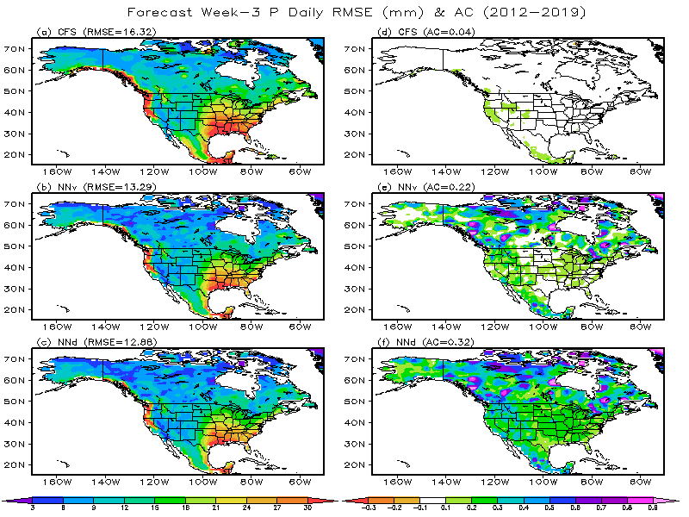
CFS: Bias corrected
NNv: Yearly Cross-Validation
NNd: Dependent Fcst
Notes:
1. Overall Improvement, but most noticeable in higher latitude
2. Yearly (2012, 2013, 2014, 2015, 2016, 2017, 2018 and 2019) verifications:
withhold yearly data (e.g. 2012: total 366 days) from 21 year sample pool 1999-2019 (total 7670 days),
in other words: testing 2012, training 2013-2019

Slide 17
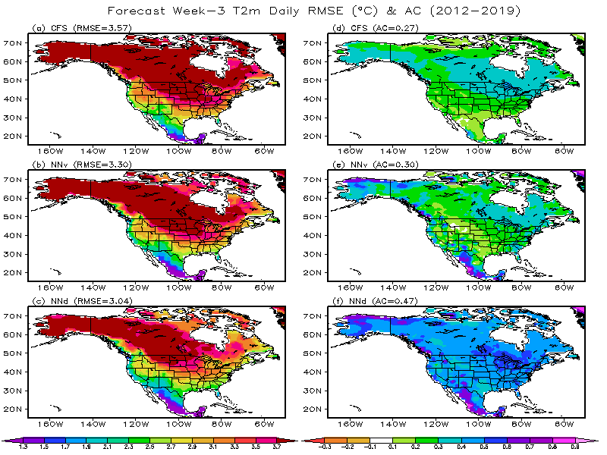
CFS: Bias corrected
NNv: Yearly Cross-Validation
NNd: Dependent Fcst
Notes:
1. Overall Improvement, but most noticeable in higher latitude
2. Yearly (2012, 2013, 2014, 2015, 2016, 2017, 2018 and 2019) verifications:
withhold yearly data (e.g. 2012: total 366 days) from 21 year sample pool 1999-2019 (total 7670 days),
in other words: testing 2012, training 2013-2019

Slide 18
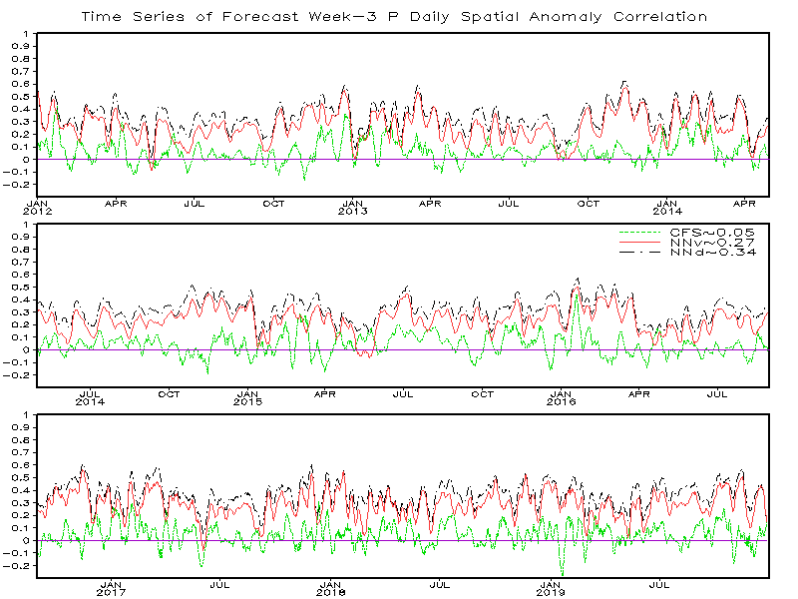
North American Domain
CFS: Bias Corrected
NNv: Yearly Cross-Validation
NNd: Dependent: 2012-2019
Notes:
Yearly (2012, 2013, 2014, 2015, 2016, 2017, 2018 and 2019) verifications:
withhold yearly data (e.g. 2012: total 366 days) from 21 year sample pool 1999-2019 (total 7670 days),
in other words: testing sample 2012, training sample 2013-2019

Slide 19
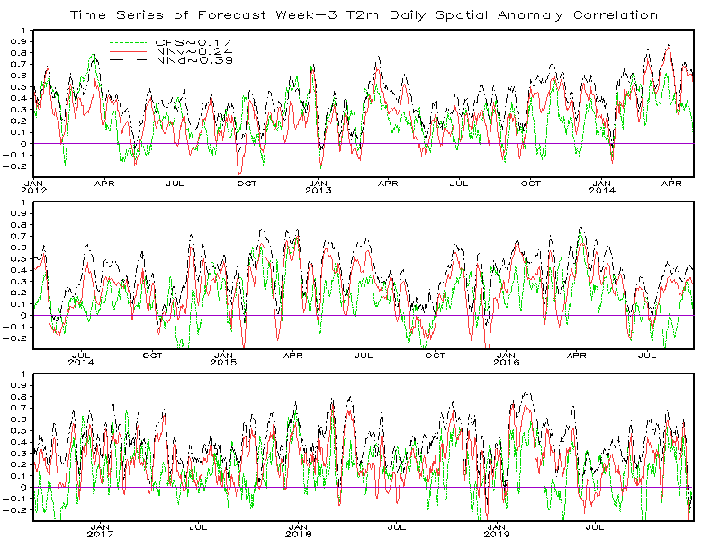
North American Domain
CFS: Bias Corrected
NNv: Yearly Cross-Validation
NNd: Dependent: 2012-2019
Notes:
Yearly (2012, 2013, 2014, 2015, 2016, 2017, 2018 and 2019) verifications:
withhold yearly data (e.g. 2012: total 366 days) from 21 year sample pool 1999-2019 (total 7670 days),
in other words: testing sample 2012, training sample 2013-2019

Slide 20
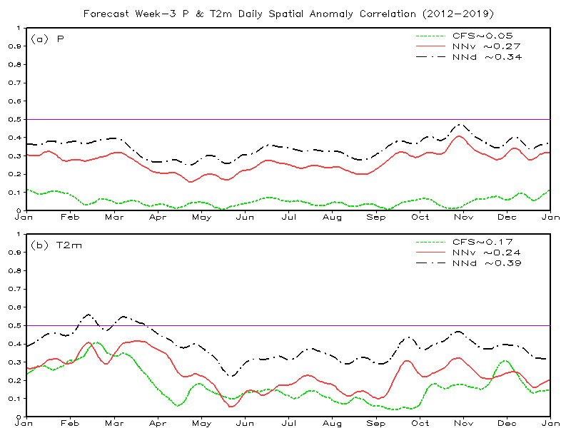
North American Domain
CFS: Bias Corrected
NNv: Yearly Cross-Validation
NNd: Dependent: 2012-2019

Slide 21
CFS: Bias corrected
NNv: Yearly Cross-Validation
NNd: Dependent Fcst
Notes:
1. Overall Improvement, but most noticeable in higher latitude
2. Yearly (2012, 2013, 2014, 2015, 2016, 2017, 2018 and 2019) verifications:
withhold yearly data (e.g. 2012: total 366 days) from 21 year sample pool 1999-2019 (total 7670 days),
in other words: testing 2012, training 2013-2019

Slide 22
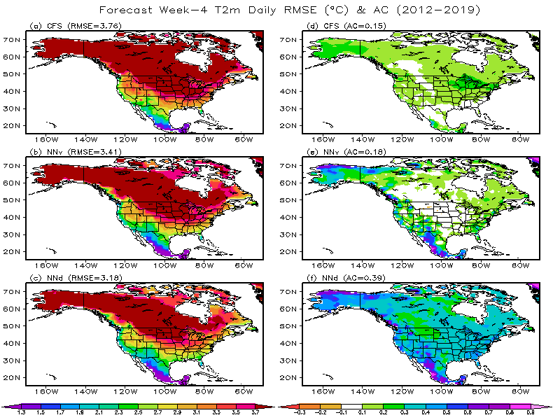
CFS: Bias corrected
NNv: Yearly Cross-Validation
NNd: Dependent Fcst
Notes:
1. Overall Improvement, but most noticeable in higher latitude
2. Yearly (2012, 2013, 2014, 2015, 2016, 2017, 2018 and 2019) verifications:
withhold yearly data (e.g. 2012: total 366 days) from 21 year sample pool 1999-2019 (total 7670 days),
in other words: testing 2012, training 2013-2019

Slide 23
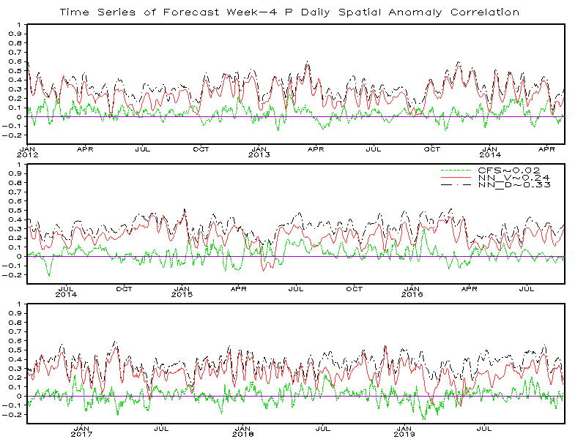
North American Domain
CFS: Bias Corrected
NNv: Yearly Cross-Validation
NNd: Dependent: 2012-2019
Notes:
Yearly (2012, 2013, 2014, 2015, 2016, 2017, 2018 and 2019) verifications:
withhold yearly data (e.g. 2012: total 366 days) from 21 year sample pool 1999-2019 (total 7670 days),
in other words: testing sample 2012, training sample 2013-2019

Slide 24
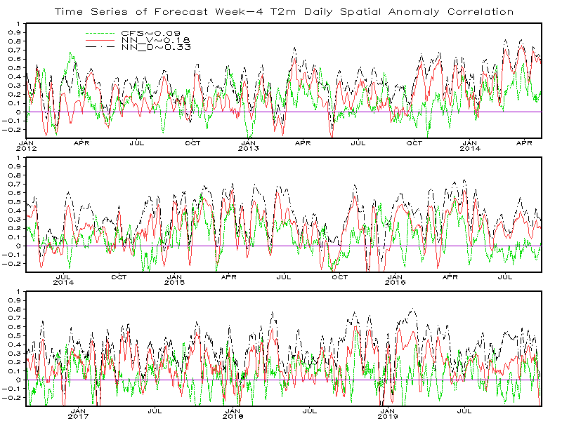
North American Domain
CFS: Bias Corrected
NNv: Yearly Cross-Validation
NNd: Dependent: 2012-2019
Notes:
Yearly (2012, 2013, 2014, 2015, 2016, 2017, 2018 and 2019) verifications:
withhold yearly data (e.g. 2012: total 366 days) from 21 year sample pool 1999-2019 (total 7670 days),
in other words: testing sample 2012, training sample 2013-2019

Slide 25
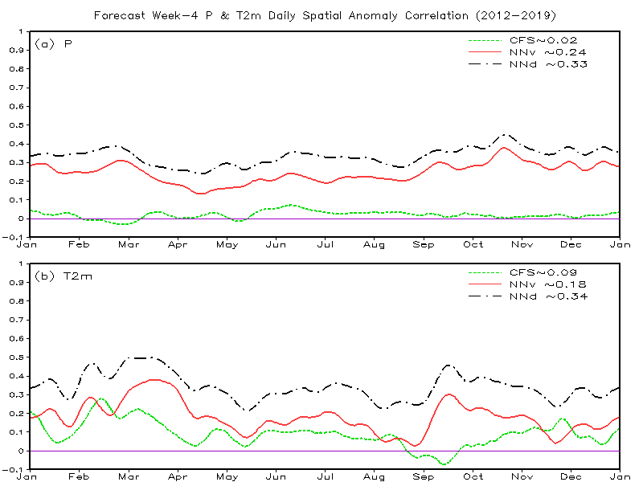
North American Domain
CFS: Bias Corrected
NNv: Yearly Cross-Validation
NNd: Dependent: 2012-2019

Slide 26
CFS: Bias corrected
NNv: Yearly Cross-Validation
NNd: Dependent Fcst
Notes:
1. Overall Improvement, but most noticeable in higher latitude
2. Yearly (2012, 2013, 2014, 2015, 2016, 2017, 2018 and 2019) verifications:
withhold yearly data (e.g. 2012: total 366 days) from 21 year sample pool 1999-2019 (total 7670 days),
in other words: testing 2012, training 2013-2019

Slide 27
CFS: Bias corrected
NNv: Yearly Cross-Validation
NNd: Dependent Fcst
Notes:
1. Overall Improvement, but most noticeable in higher latitude
2. Yearly (2012, 2013, 2014, 2015, 2016, 2017, 2018 and 2019) verifications:
withhold yearly data (e.g. 2012: total 366 days) from 21 year sample pool 1999-2019 (total 7670 days),
in other words: testing 2012, training 2013-2019

Slide 28
North American Domain
CFS: Bias Corrected
NNv: Yearly Cross-Validation
NNd: Dependent: 2012-2019

Slide 29
North American Domain
CFS: Bias Corrected
NNv: Yearly Cross-Validation
NNd: Dependent: 2012-2019

Slide 30
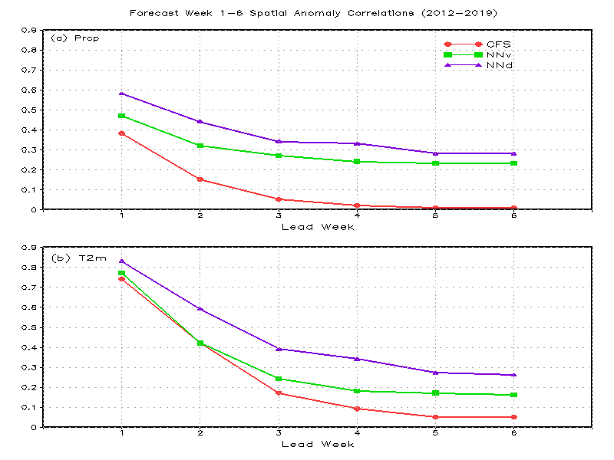
North American Domain
CFS: Bias Corrected
NNv: Yearly Cross-Validation
NNd: Dependent: 2012-2019

Slide 31
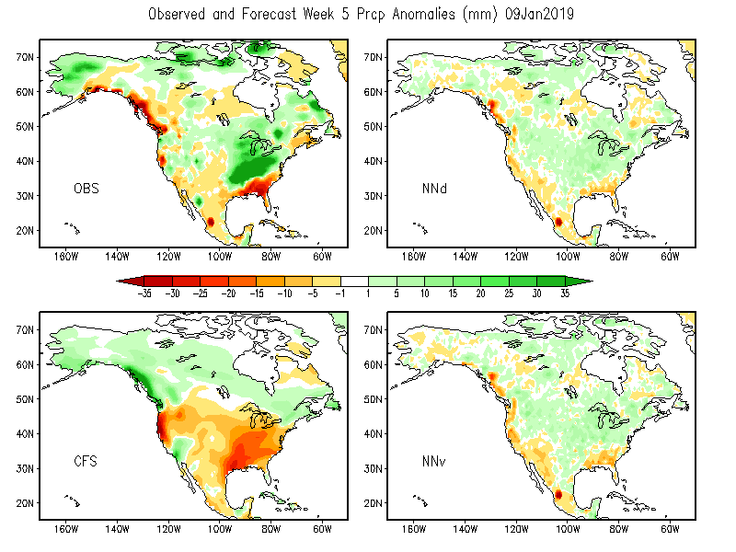
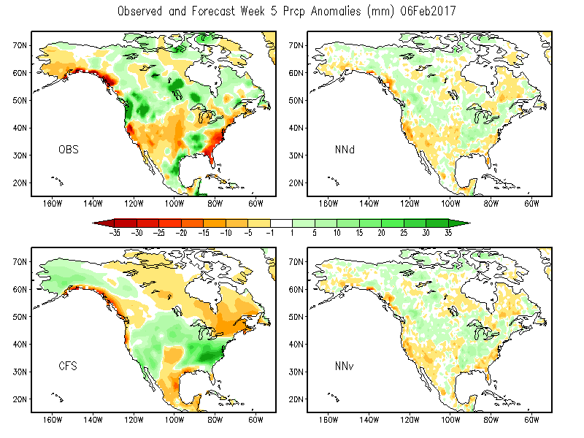
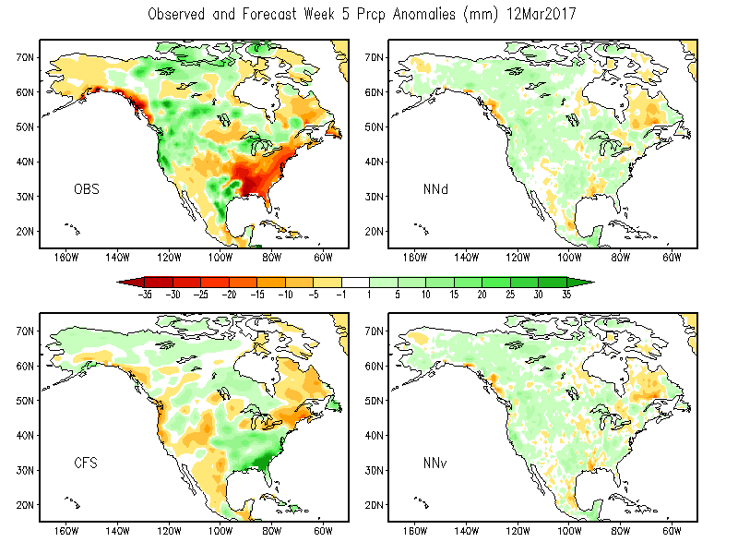
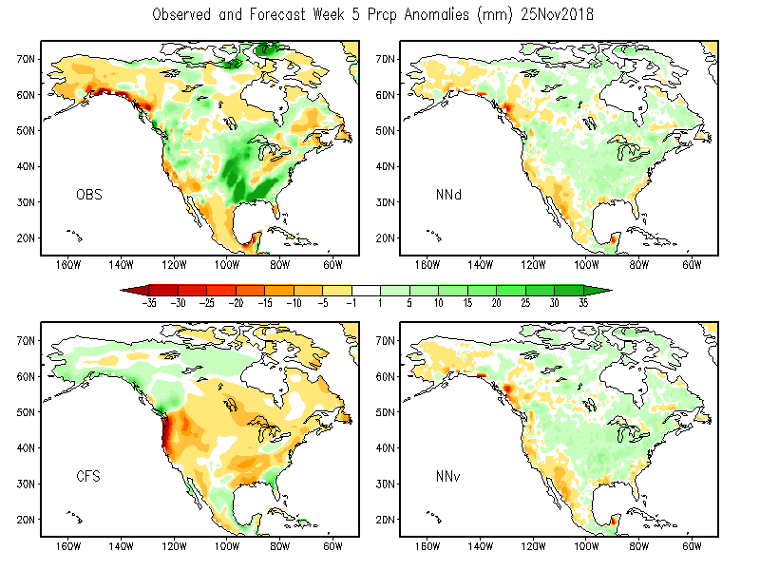
Week 5 Prcp Forecasts

Slide 32
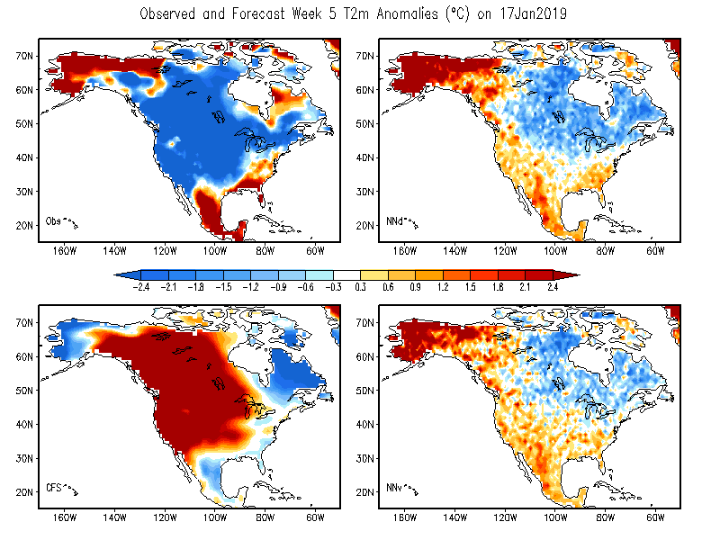
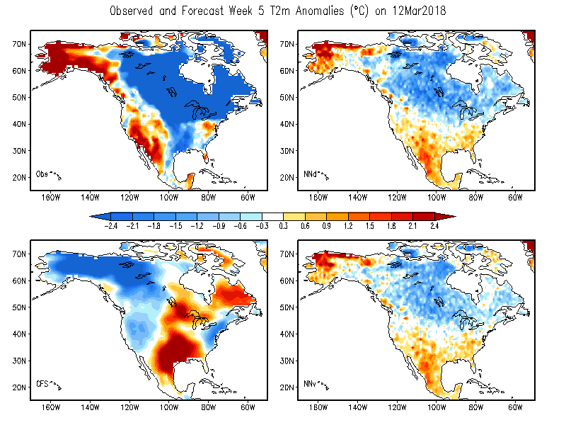
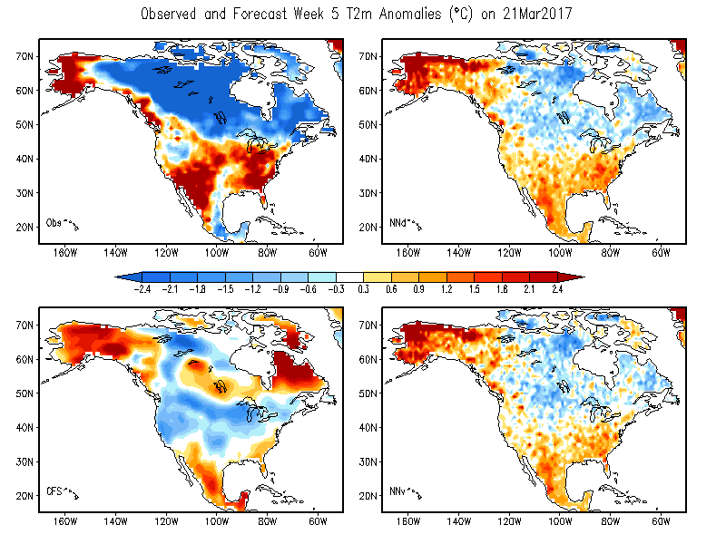
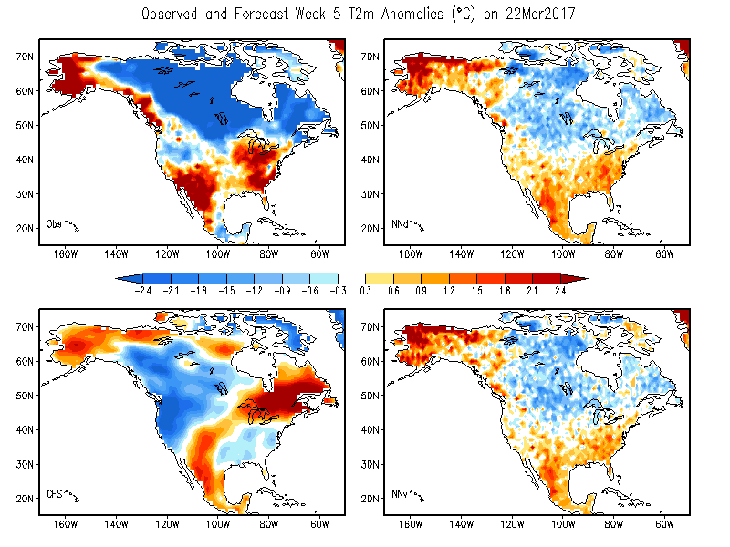
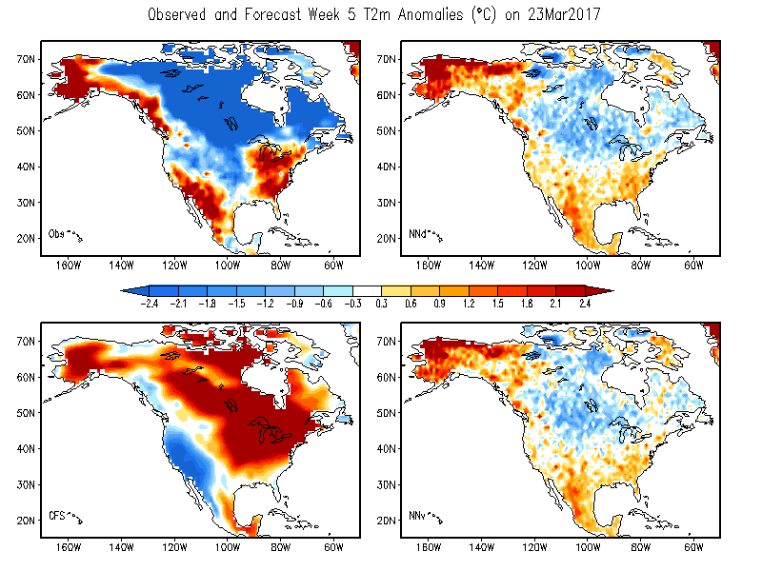
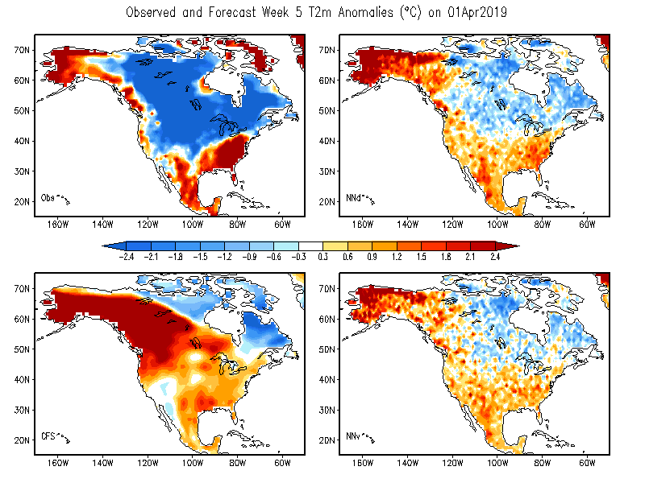
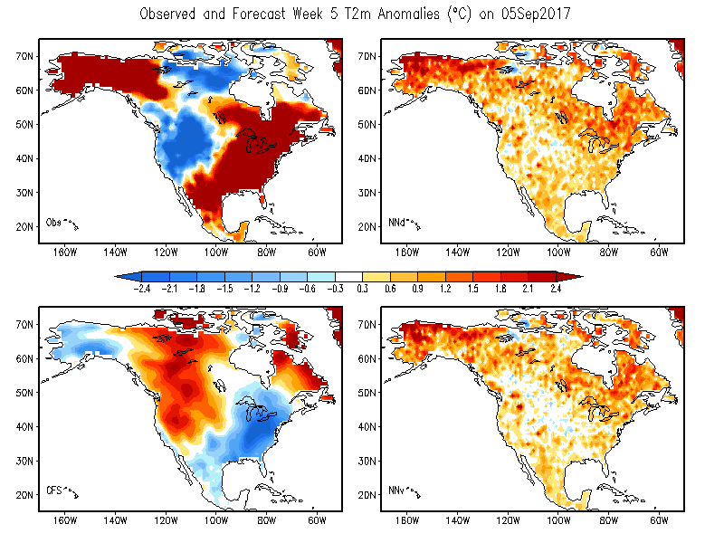
Week 5 T2m Forecasts

Slide 33
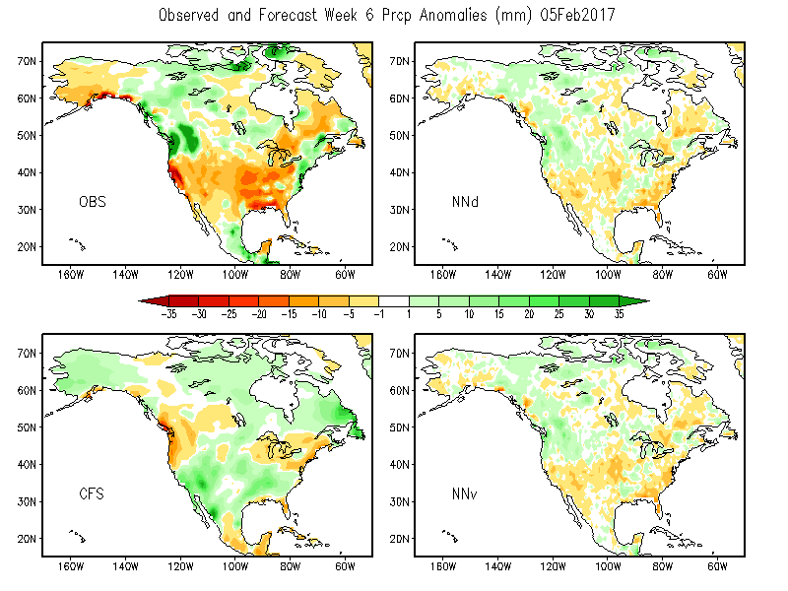
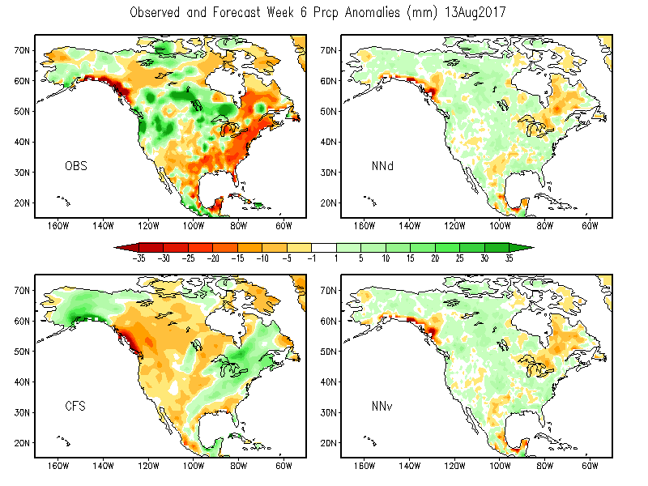
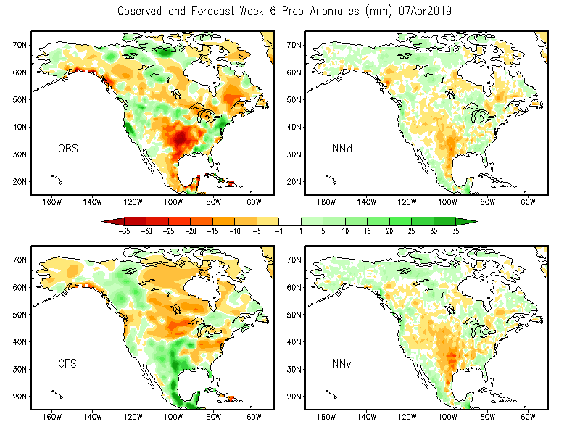
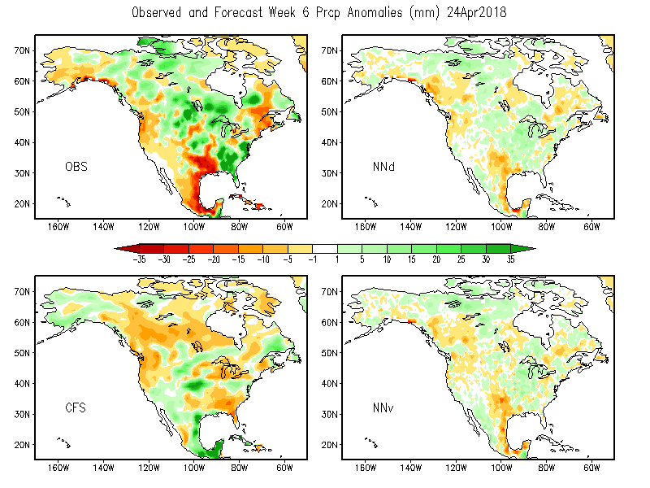
Week 6 Prcp Forecasts

Slide 34
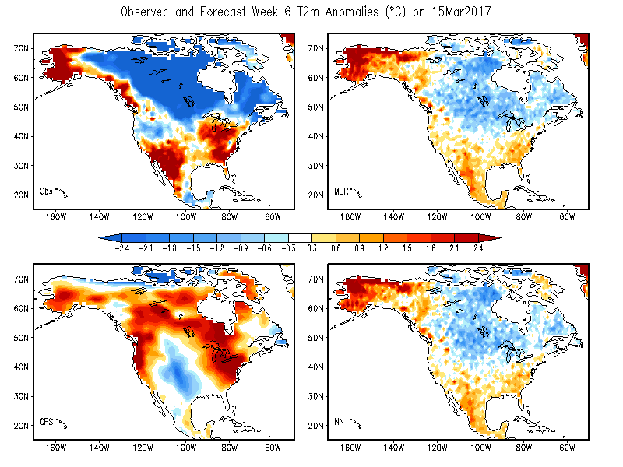
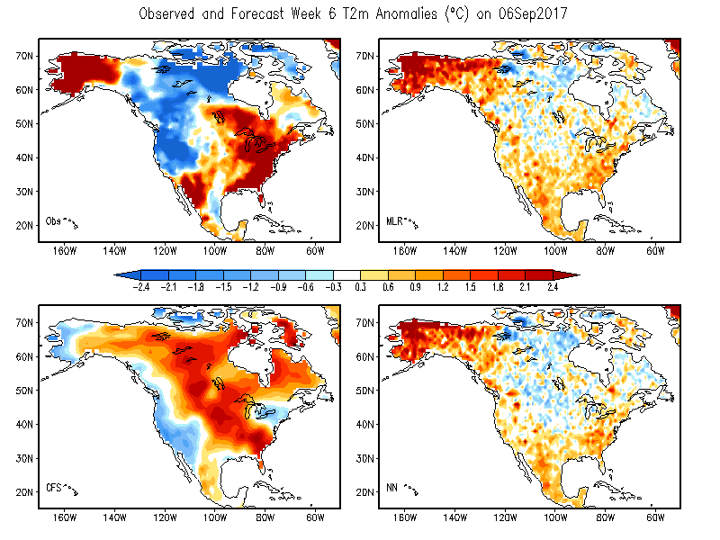
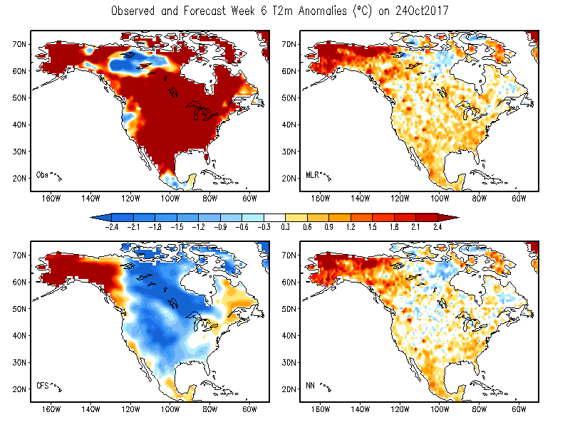
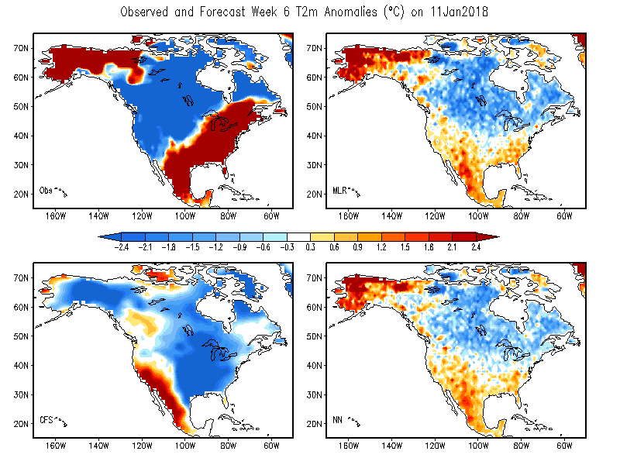
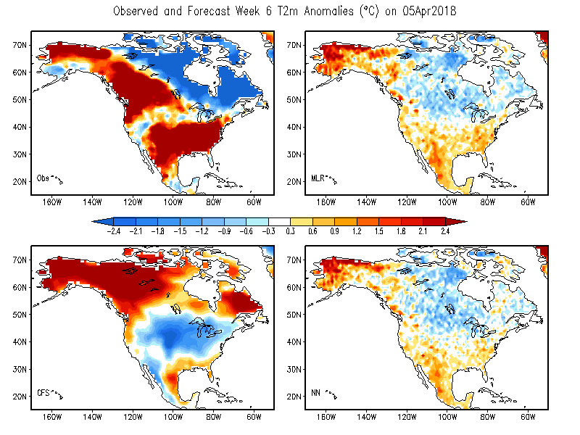
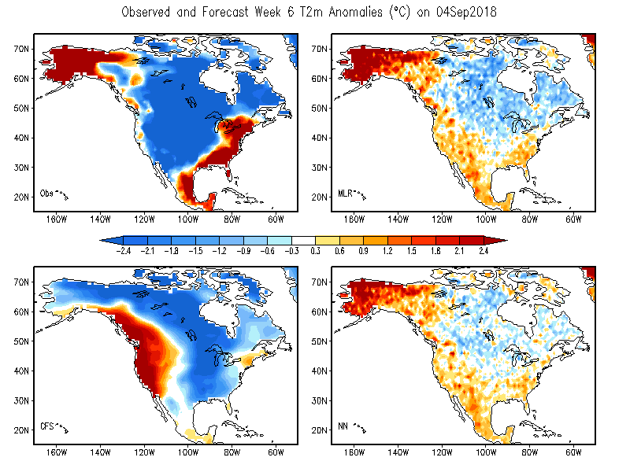
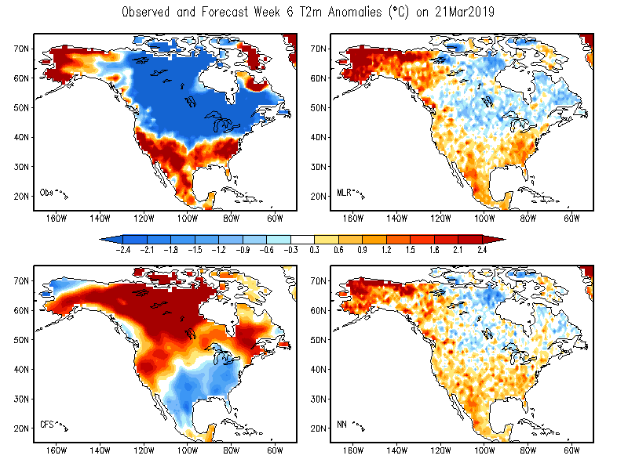
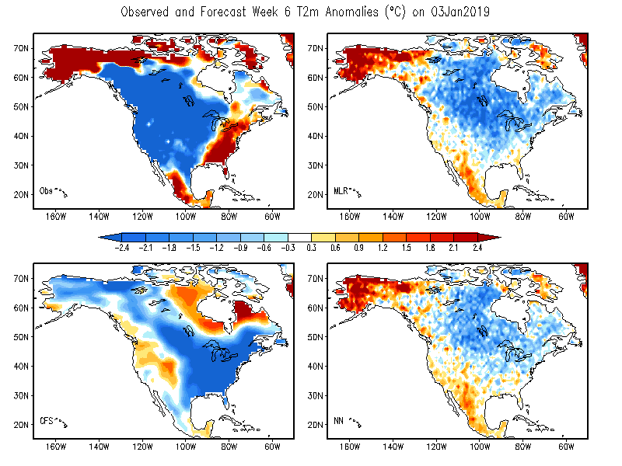
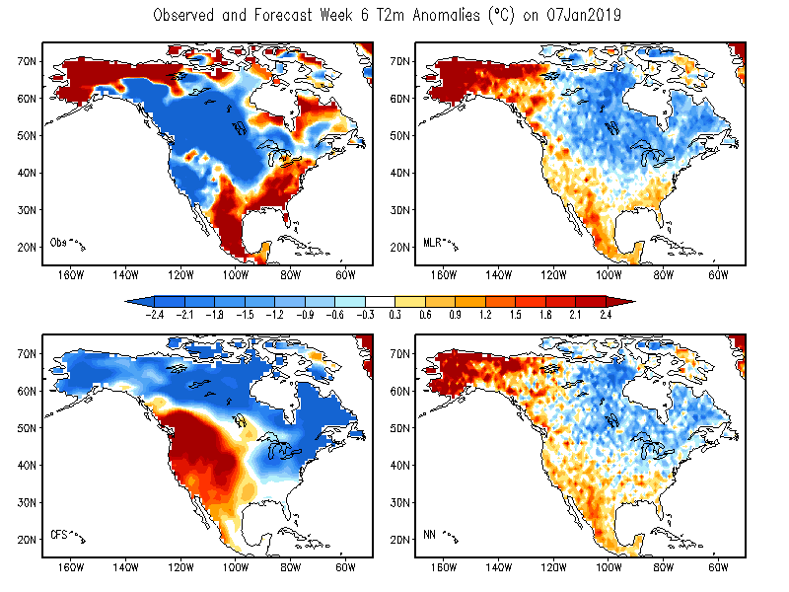
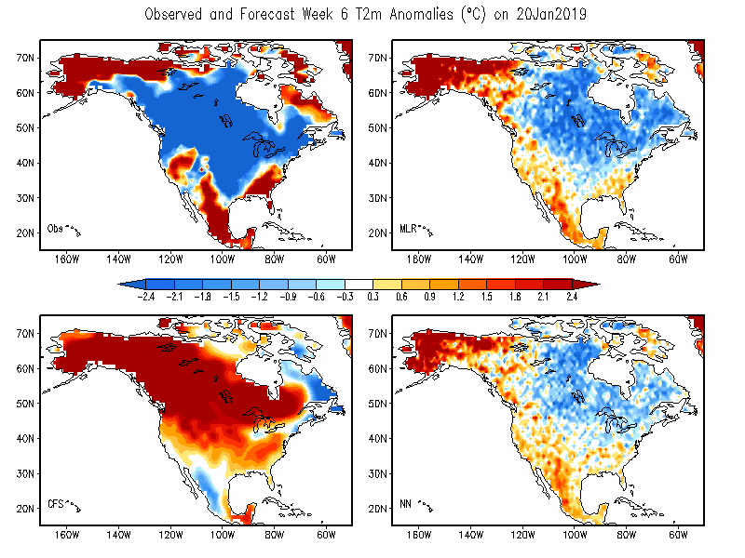
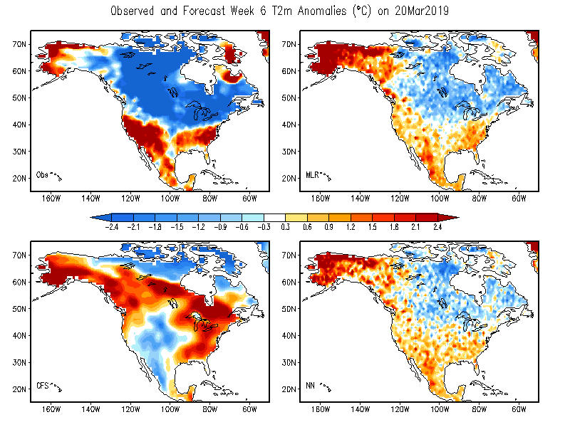
Week 6 2m Temperature Forecasts

Slide 35
Summary
NN advantages
Flexible nonlinear tool & Easy to handle BIG DATA
Unique & beneficial NN architectures: account for
Non-Linear Impact, Pattern Relationship, Co-Variability
NN Significantly Improves CFS Week 1-6 P & T2m Fcsts
more sophisticated info hidden behind multiple dimensional big data
can be extracted by NN
NN can perform more complicated corrections
by reversing incorrect forecast patterns, hardly done by traditional MLR
5. Forecast skills in Week 3-6 ranges have similar trend

