Slide 1




2
0
2
0
Alpha
Weather
NIMS R&D Strategy for AlphaWeather
KMA/NIMS-AIWFR Team
Hyesook Lee

Slide 2


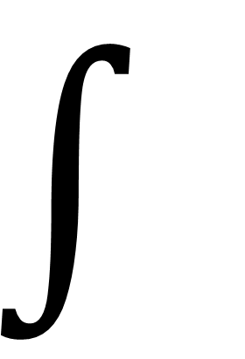
$$∫$$
Since Aug. 2019
Public
d
ARTIFICIALLY
SMART PARTNER
AlphaWeather
·
evelopment
Forecaster

Slide 3
Background
How to Approach
Future Plan

Slide 4

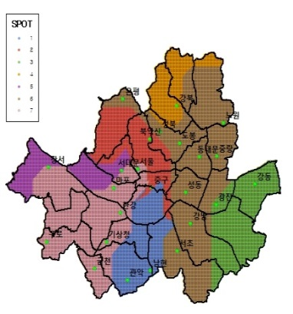
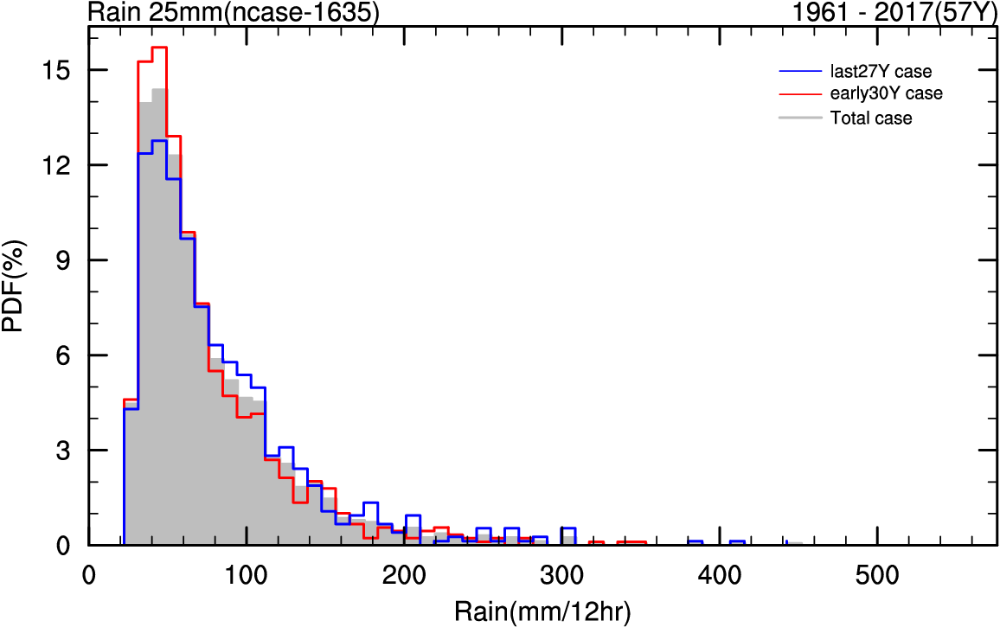
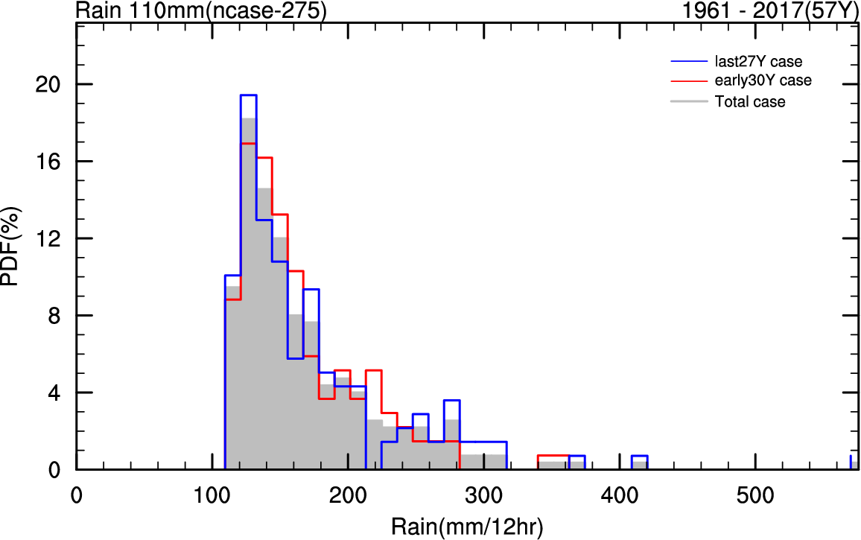
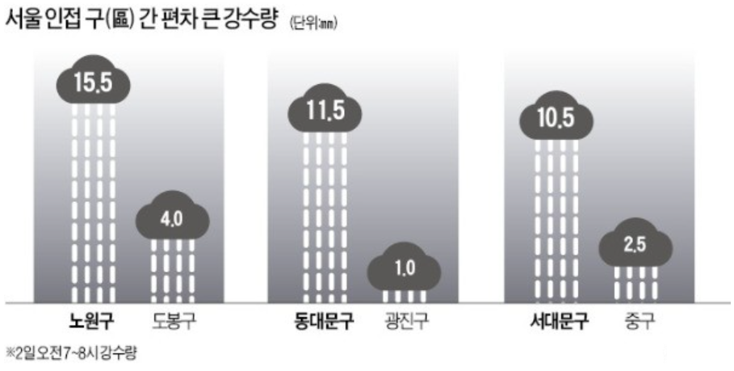
Background New Weather Extremes
When ?
Where ?
How much?
①
②
③
①
③
②
* Rain Rate (mm/hr) July 2nd of 2018 07:00-08:00
2020 NOAA AI Workshop

Slide 5
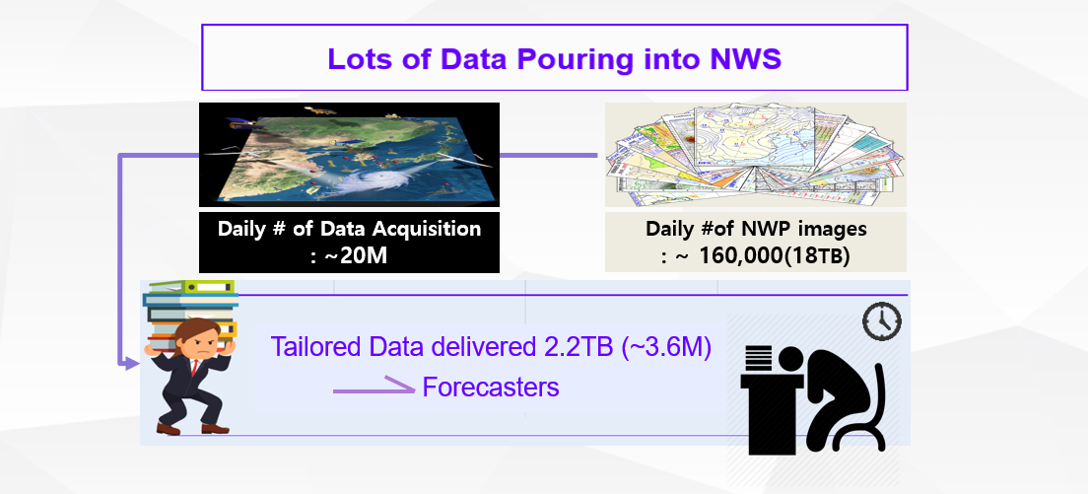
Background Data Extremes
2020 NOAA AI Workshop

Slide 6

Background Click Extremes
For Extreme daily temperature
6
기본 온도 페이지
두 번 클릭
1
로그인 클릭
2
SSO 페이지
COMIS 클릭
3
8
7
4
극값 클릭
지상 클릭
5
다른 요소 검색 시
2020 NOAA AI Workshop

Slide 7

WHY AlphaWeather
Forecasting Accuracy
Consumer Perception of Accuracy
Climate Crisis
Consumer Request
Data
Model
Extreme Weather
Weather Forecaster
Weather Forecast
2020 NOAA AI Workshop

Slide 8
WHY AlphaWeather
Load × distance from the point
Weather Forecaster
Leveraging AI to support forecaster
2020 NOAA AI Workshop

Slide 9
WHY AlphaWeather
Forecasting Accuracy
Consumer Perception of Accuracy
Service I/F ?
Data
Model
Deliver right time, right data
integrated Searching
integrated Analysis
Extreme Weather
Weather Forecast
Weather Forecaster
Leveraging AI
2020 NOAA AI Workshop

Slide 10
How to Approach IN BRIEF
Strategy 1. Enhancement
Strategy 2. Automation – Assistant Agent
Strategy 3. Data – Skip for today
  What : Precipitation Forecasting [‘21-’24]
  How to : ① Replacement of NWP Physics (Radiation, MP)
  ② Post-processing & Recommendation
  ③ Precipitation forecasting using Radar/Satellite/Rain Gauge
AI +
  What : Search / Watch [‘21-’24]
  How to : ① Web-pages, Met-DB
  ② Similar cases/images of severe weather
  ③ NLP, NLQ, Multi-turn dialog/Information retrieval Agents
  What : Search / Watch [‘21-’24]
  How to : ① Web-pages, Met-DB
  ② Similar cases/images of severe weather
  ③ NLP, NLQ, Multi-turn dialog/Information retrieval Agents
  What : Training Data Set [‘21-’24]
  How to : ① Data QC, Gap-filling
  ② Data Pre-processing / Build Training set
2020 NOAA AI Workshop

Slide 11
How to Approach Strategy 1. Enhancement
Replacement of NWP Physics – Emulating Radiation/ MP Parameterization
  Joint Research btw. NOAA/EMC (Dr. Krasnopolsky, Dr. Belochitski, Dr. Sun, Dr. Tallapragada)
  and KMA/NIMS (Dr. Song, Dr. Roh, Dr. Sun, Dr. Lee)
  Base model : (‘19-’21) KMA operational short-range forecast model (KLAPS)
  (’21-’24) KMA operational forecast model (KIM/KIM-meso)
  Physics Scheme : (Radiation) RRTMG-K※, (MP) WDM7
  ※ Roh, S. and H.-J. Song (2020) GRL, Evaluation of NN Emulations for Radiation Parameterization (accepted)
  Plan : ① To improve accuragy and long-term stability
  ② Multi-MP Application including emulators for physical parameterizaiton
  ③ To improve bulk MP using bin MP emulation
2020 NOAA AI Workshop

Slide 12
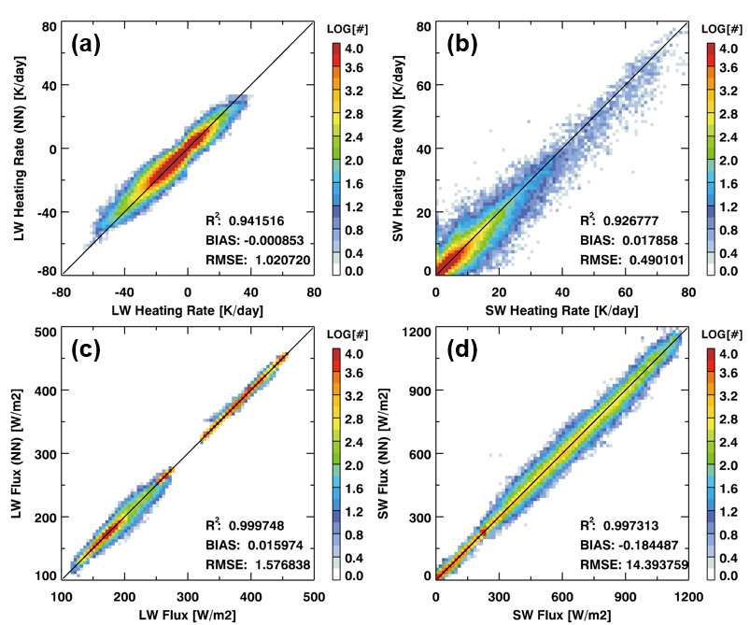
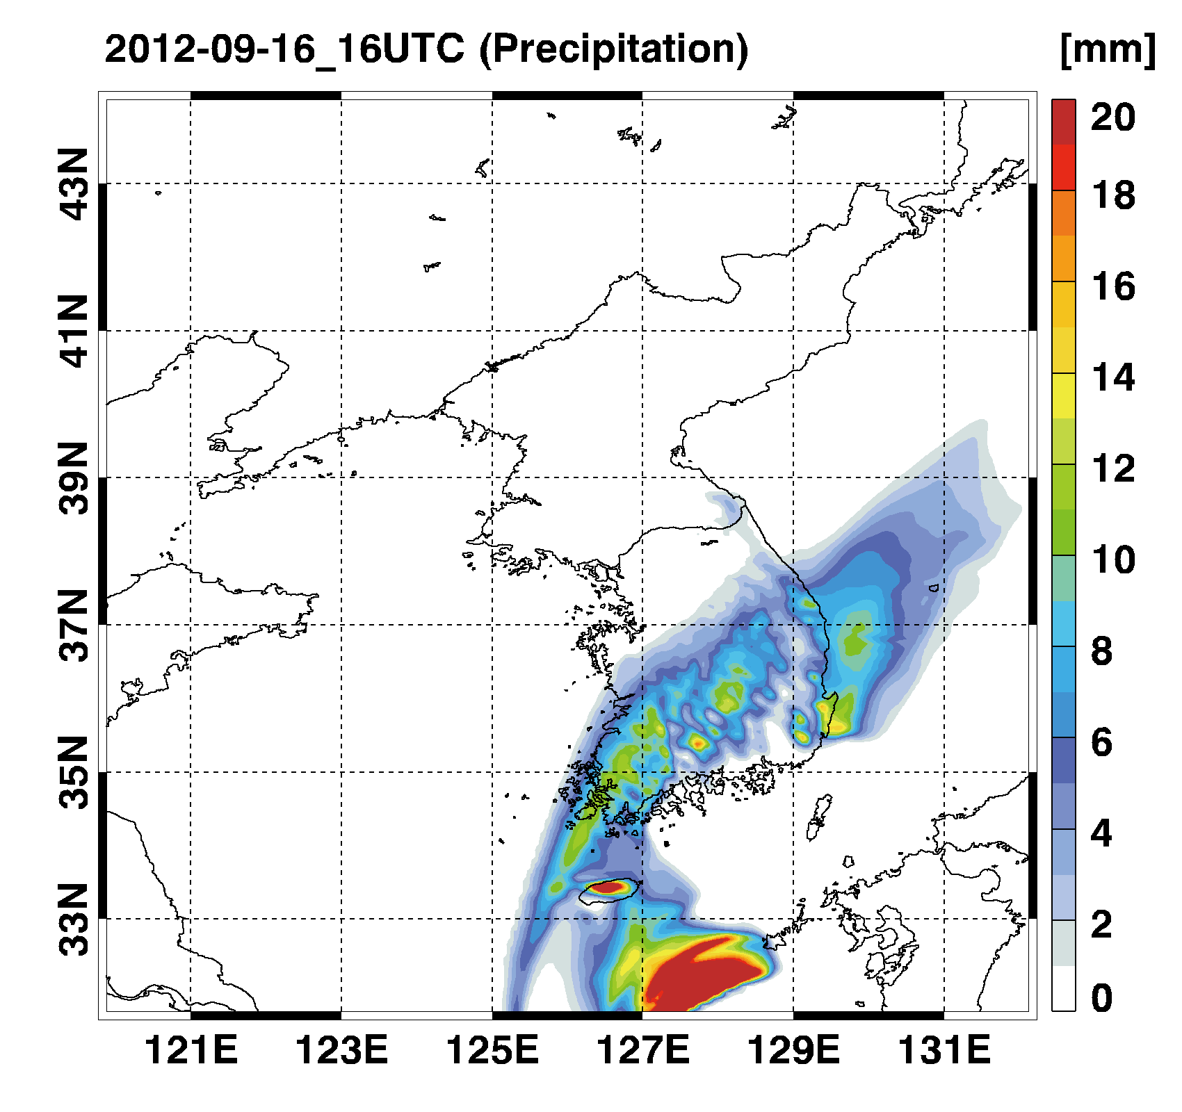
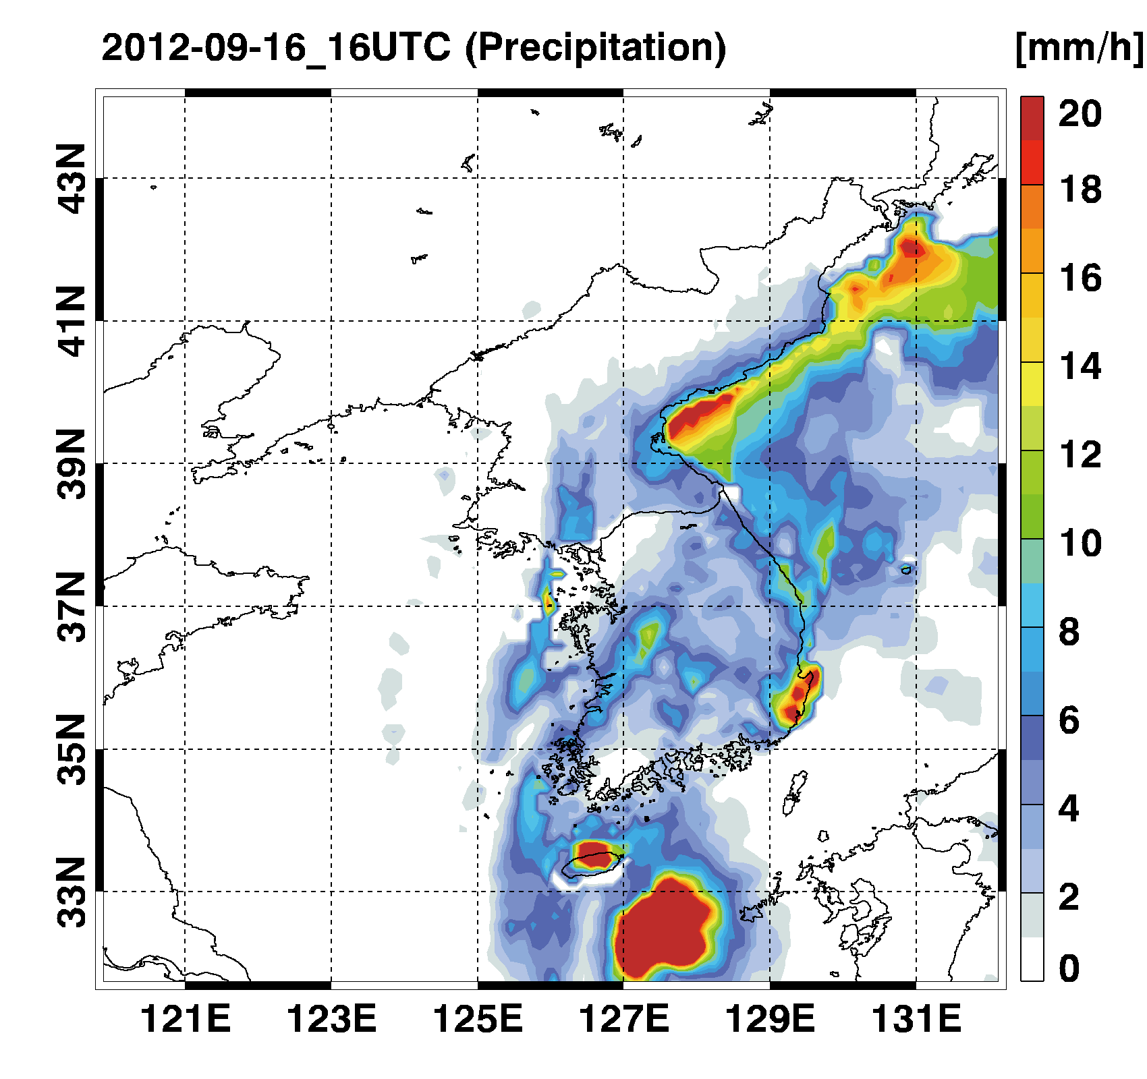
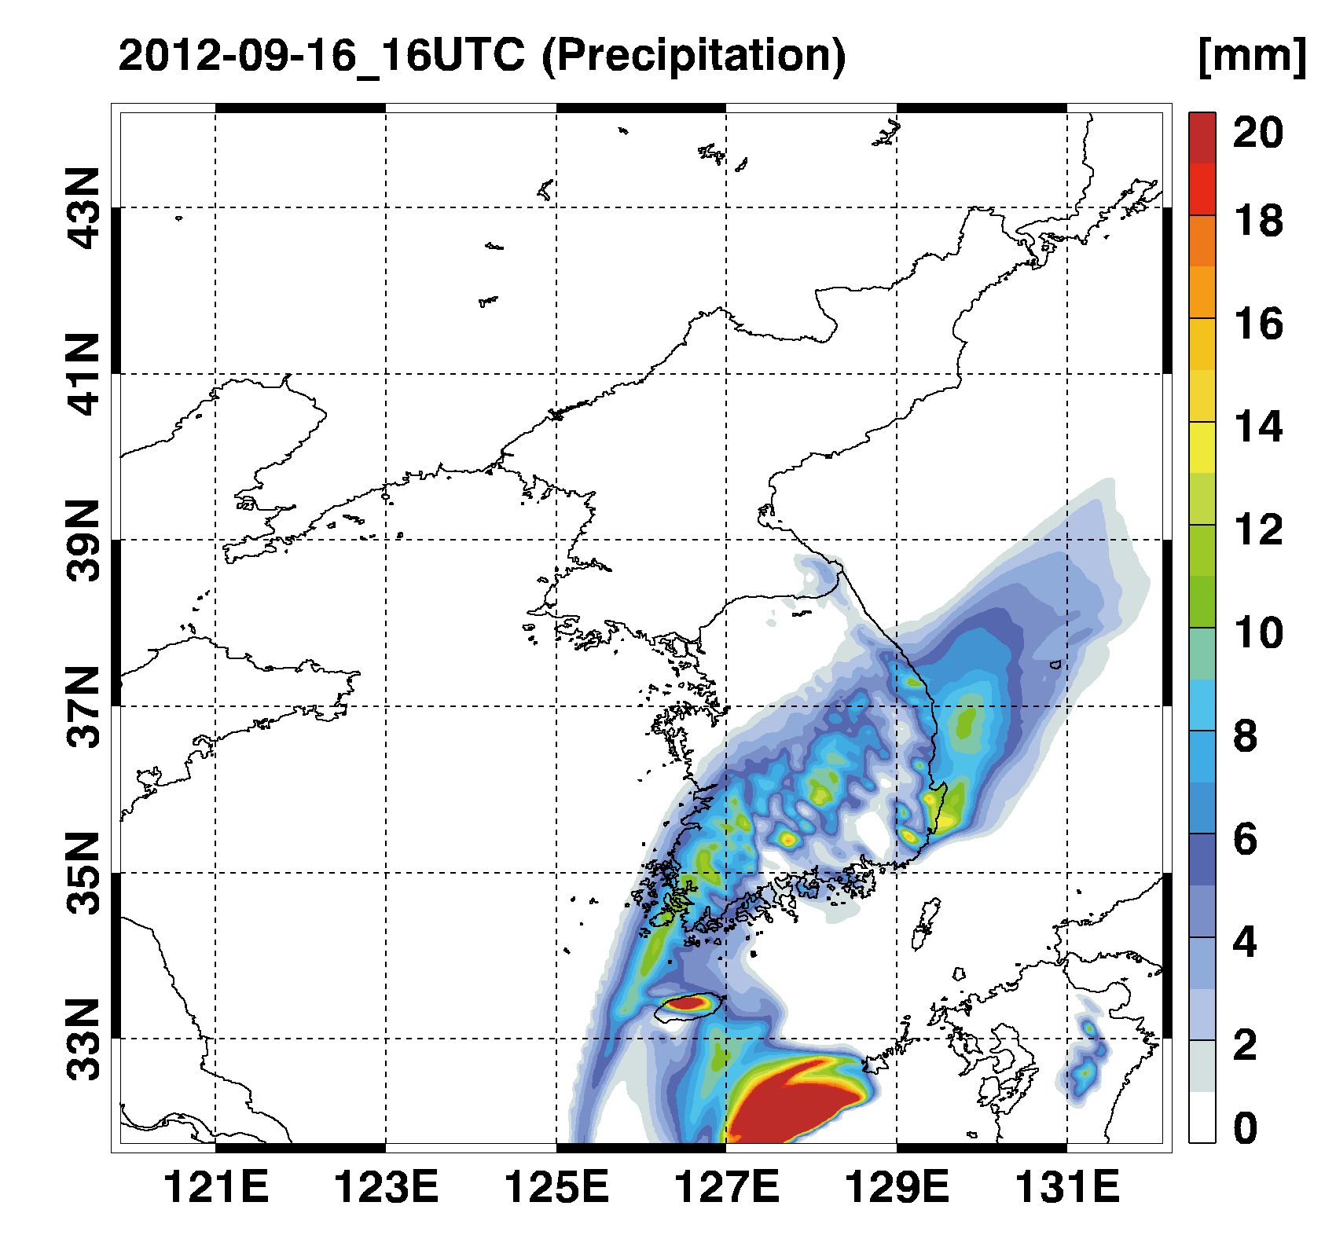
How to Approach Strategy 1. Enhancement
Replacement of NWP Physics – Emulating Radiation Parameterization
Control
Observation
NN
2020 NOAA AI Workshop

Slide 13
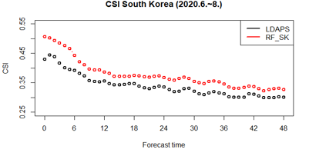
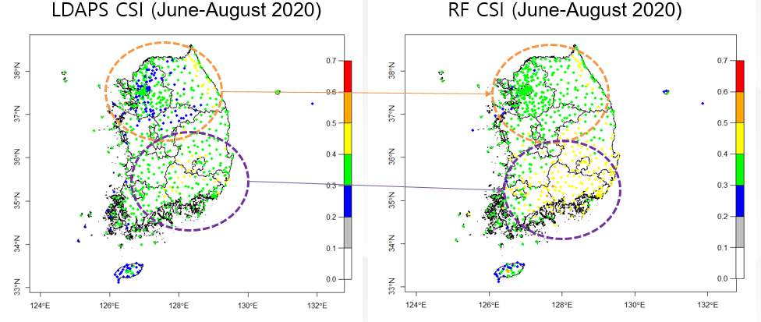
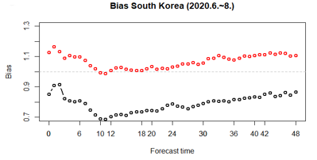

How to Approach Strategy 1. Enhancement
  Post-processing & Recommendation
  Correct the precipitation from (’19-’21) LDAPS
  Recommend the best output from (‘21-’24) GDAPS, KIM, ECMWF
11 % $↑$
2020 NOAA AI Workshop

Slide 14
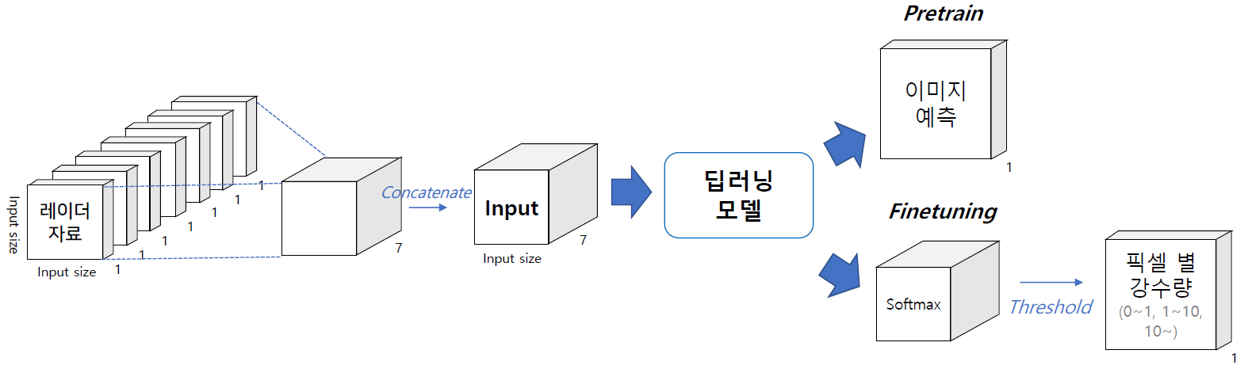
Current Status Strategy 1. Enhancement
  Precipitation forecasting using Radar/Satellite/Ground Observation
Radar
data
U-Net
F1 | Focal Loss |  |  | New Loss Function
 | <1㎜ | ≥1㎜ | ≥10㎜ | <1㎜ | ≥1㎜ | ≥10㎜
1hr | 0.979 | 0.782 | 0.587 | 0.977 | 0.772 | 0.558
2hr | 0.974 | 0.711 | 0.319 | 0.966 | 0.692 | 0.398
3hr | 0.969 | 0.639 | 0.242 | 0.962 | 0.642 | 0.315
4hr | 0.965 | 0.582 | 0.193 | 0.954 | 0.595 | 0.265
5hr | 0.962 | 0.535 | 0.151 | 0.955 | 0.570 | 0.206
6hr | 0.961 | 0.492 | 0.087 | 0.958 | 0.519 | 0.121

Slide 15
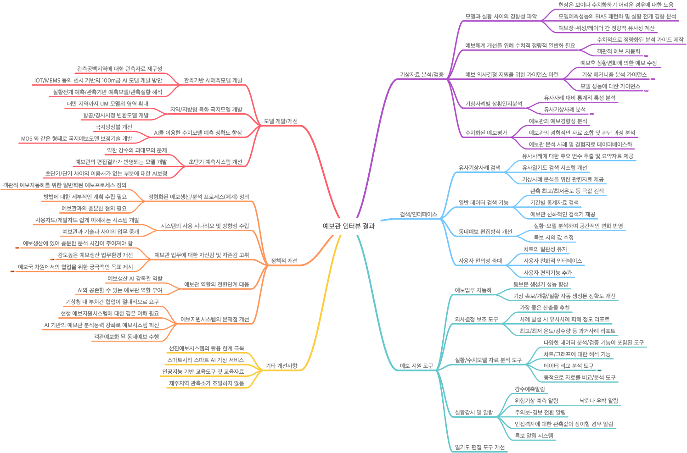
How to Approach Strategy 2. Automation
Search/Watch
NLQ (Forcasters’ Language to Query) based Information Search Agents
Requirements from Forecasters (2020.2.~3.)
2020 NOAA AI Workshop

Slide 16

How to Approach Strategy 2. Automation
Search/Watch (’20.9.)
기상-AI 검색기
Keyword
  Voice/Text Toggle
“Search”

Slide 17

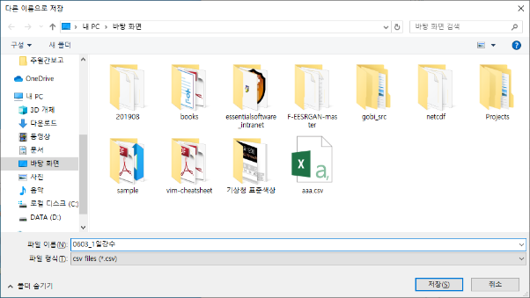
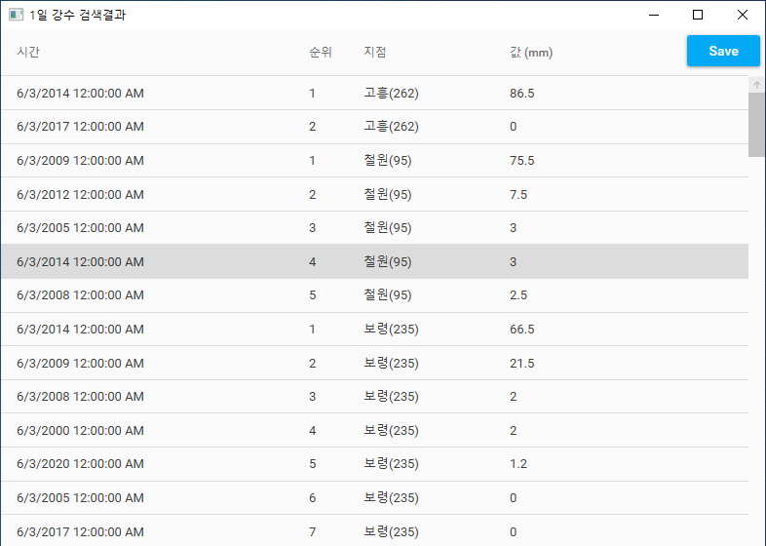
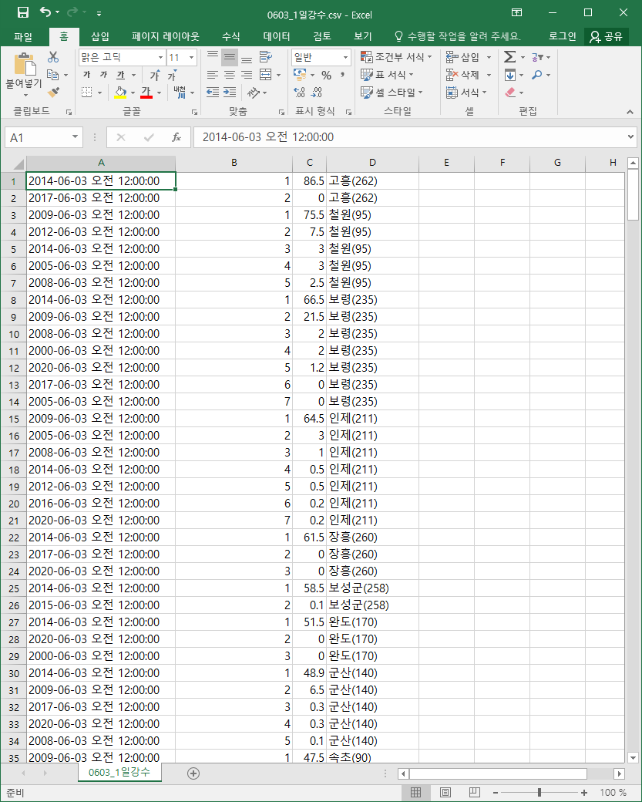
How to Approach Strategy 2. Automation
Search/Watch
1. Search/Retrieve Information
3. Save into file
기상-AI 검색기
Typo corrected!
2. Results
2020 NOAA AI Workshop

Slide 18
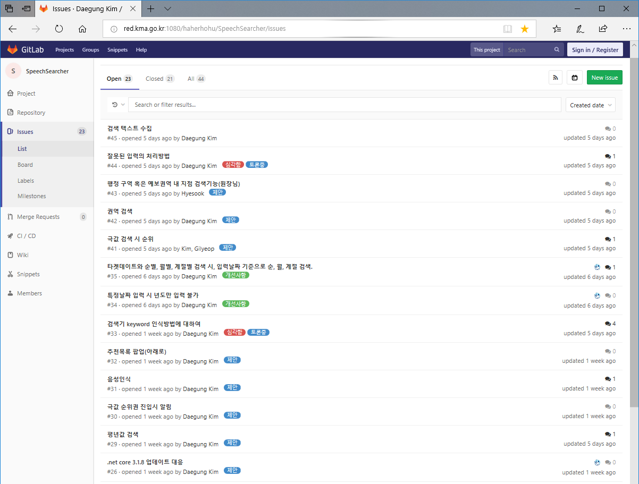
How to Approach Strategy 2. Automation
Search/Watch
Requirements from Forecasters collected in near-real time

Slide 19
How to Approach Strategy 2. Automation
Plan for Information Search/Retrieval Agents
1
Enhance Search/Retrieval funtion
AI NLP
AI Search (Web-pages, DB)
Accuracy
Multi-turn Dialog
Language Model
Data Aquisition
Recommendation model
2
Expand Search Scope
‘21
Cross DB Search
Link to External System
Link to Internal DB
‘23
3
Enhance Performance
‘24
Accuracy
Speed
2020 NOAA AI Workshop

Slide 20
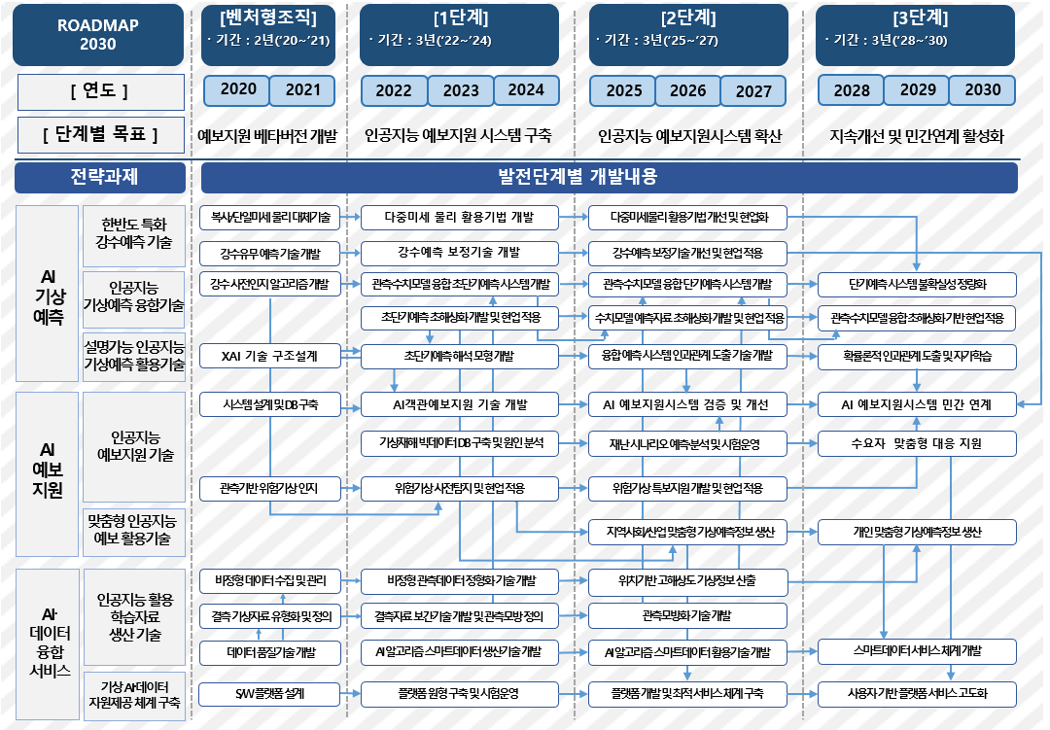
Future Plan (2030)
Strategy 1. Enhancement
Strategy 2. Automation
Strategy 3. Data Value

Slide 21
Future Plan (2030)
Phase 1. ‘21-’24 (30M in USD)
Phase 2. ‘25-’27
Phase 3 ‘28-’30
  Build AI system for Forecasters
  : from Labor intensive system to Technology centered system
  Secure the leading time for heavy rainfall
  Build AI system for Targeted service
  : Tailored information by region/industry
  Secure the leading time for severe weather
  Build AI system for the Public
  : Tailored information by person
2020 NOAA AI Workshop

Slide 22

Thank You !

