Slide 1
Applying satellite observations of tropical cyclone internal structures to rapid intensification forecast with machine learning
Hui Su¹, Longtao Wu¹, Raksha Pai², Alex Liu³, Peyman Tavallali¹, Albert J. Zhai⁴,
Jonathan H. Jiang¹, Mark DeMaria⁵
¹Jet Propulsion Laboratory, California Institute of Technology, Pasadena, CA, 91109
²IBM Analytics Services
³RMDS Lab
⁴Dept. of Computing and Mathematical Sciences, California Institute of Technology
⁵National Hurricane Center, Miami, FL
NOAA AI workshop, November 5, 2020
Notes:
Strong winds from hurricanes, and flooding from storm surges and heavy rain, inflict losses on various sectors of the economy.
https://www.ncdc.noaa.gov/billions/summary-stats/US/1980-2020

Slide 2


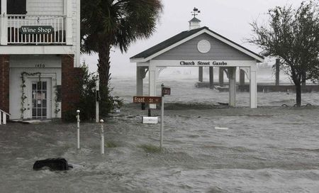
Motivation
Strong winds from hurricanes, and flooding from storm surge and heavy rain, cause losses on various sectors of the economy.
In US, hurricane loss averages $24 billion annually from 1980 to 2019 (in 2019 dollars, inflation adjusted), about 54% of the cost of all major disasters including droughts, wildfires and other severe storms.
National Hurricane Center (NHC) tropical cyclone (TC) intensity forecast skills have not shown much improvement in the last few decades, while the TC track errors have declined steadily.
Storms that undergo rapid intensification (RI, defined as hurricane maximum sustained wind speed change greater than 30 knots within 24 hours) are associated with the highest forecast errors and larger economic losses. About 80% of major hurricanes in the Atlantic basin experienced RI.
The NHC's probability of detection (POD) for RI in the Atlantic basin is < 40% (Kaplan et al. 2015).
Notes:
Strong winds from hurricanes, and flooding from storm surges and heavy rain, inflict losses on various sectors of the economy.
https://www.ncdc.noaa.gov/billions/summary-stats/US/1980-2020

Slide 3
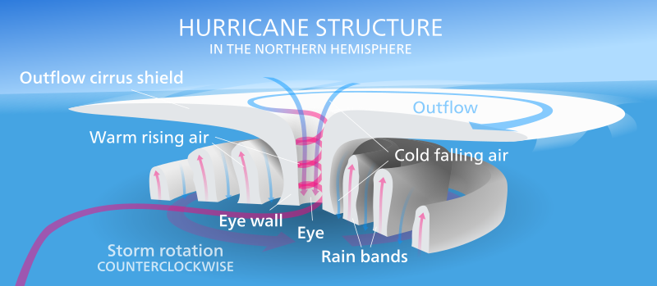
Factors Controlling Hurricane Intensification
Warm sea surface temperature
Weak vertical wind shear
Moist environment
Strong symmetric convection
Intense convective bursts
Cold outflow temperature
Notes:
https://earthobservatory.nasa.gov/images/91130/a-closer-look-at-rapidly-intensifying-hurricanes
Warm SST 86 degrees Fahrenheit, 30degree in celsius

Slide 4
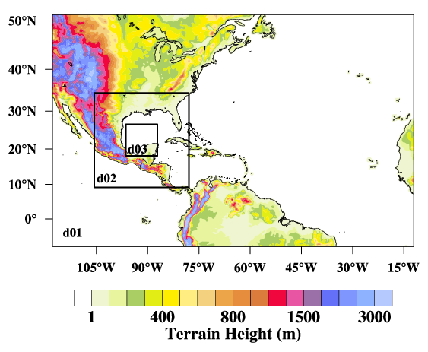
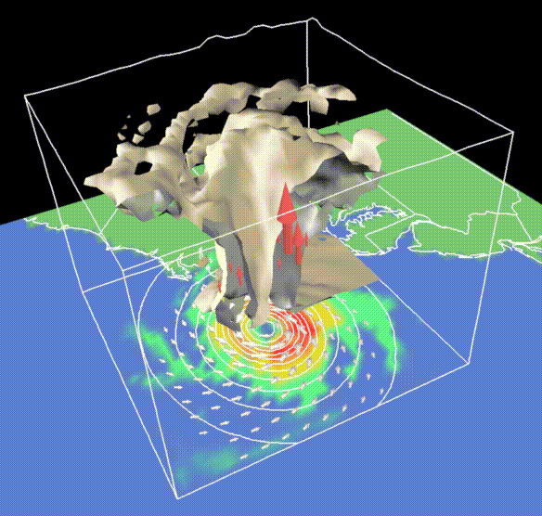
Hurricane Forecast Models
Numerical models

Slide 5
Statistical Forecast Models
Predictors
Predictands

Slide 6
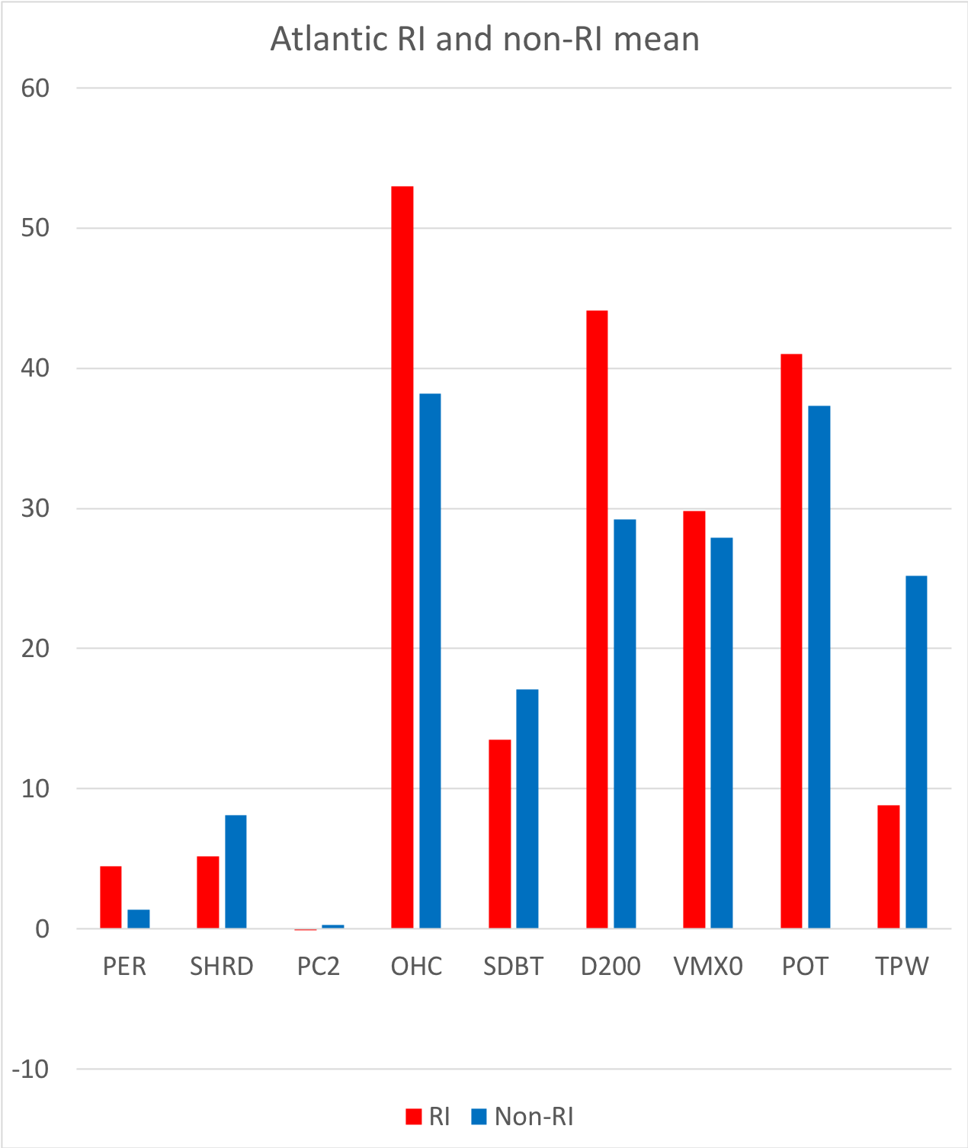
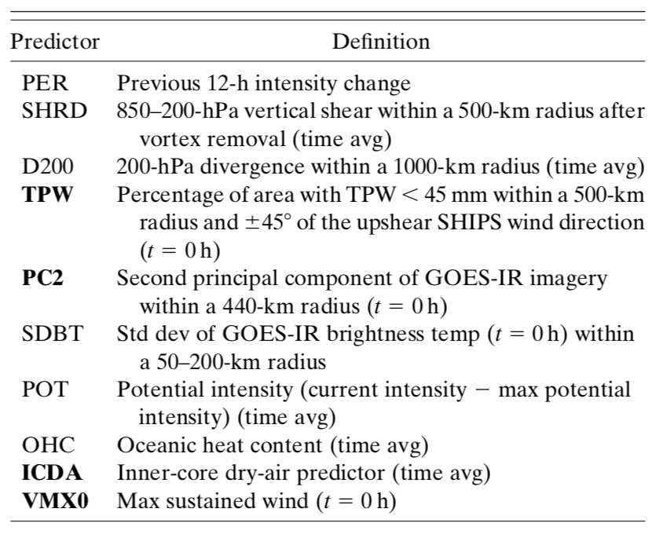
Statistical Hurricane Intensity Prediction Scheme (SHIPS)
Predictors for RI
Kaplan et al. (2015, Weather and Forecasting)

Slide 7
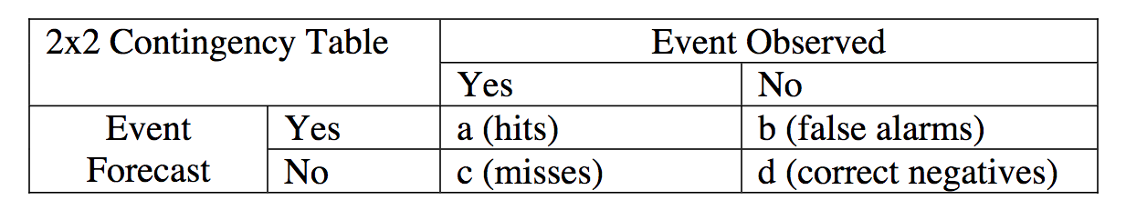
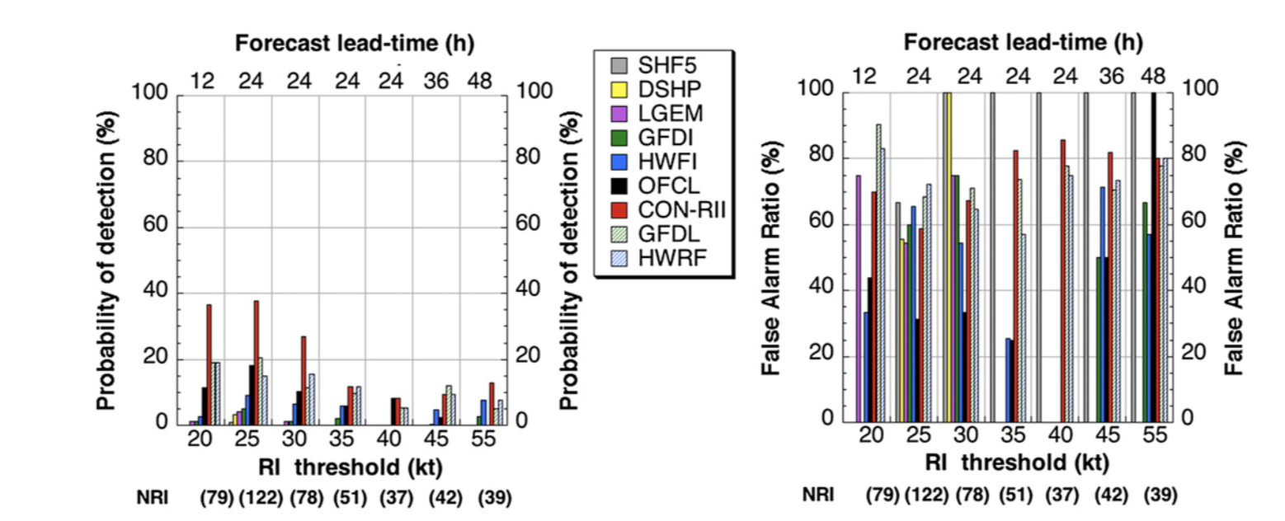
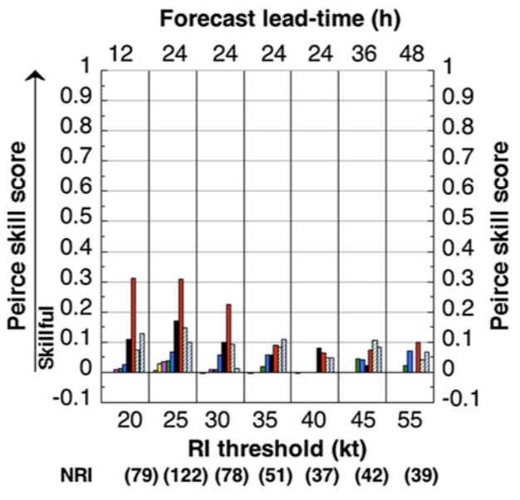
Current NHC RI Forecast Skills
Probability Of Detection (POD)
False Alarm Ratio (FAR)
Peirce Skill Score (PSS)
PSS
POD
FAR
Kaplan et al. (2015, Weather and Forecasting)

Slide 8
Path to Improve RI Forecast
Predictors
Predictands

Slide 9
New Predictors for RI
Our analysis of NASA satellite observations identifies several new predictors for TC intensity change, including inner core precipitation structure, ice water content, and outflow temperature
TC Intensification Rate
Sample size for TRMM data (1998-2014)
TC Intensity

Slide 10
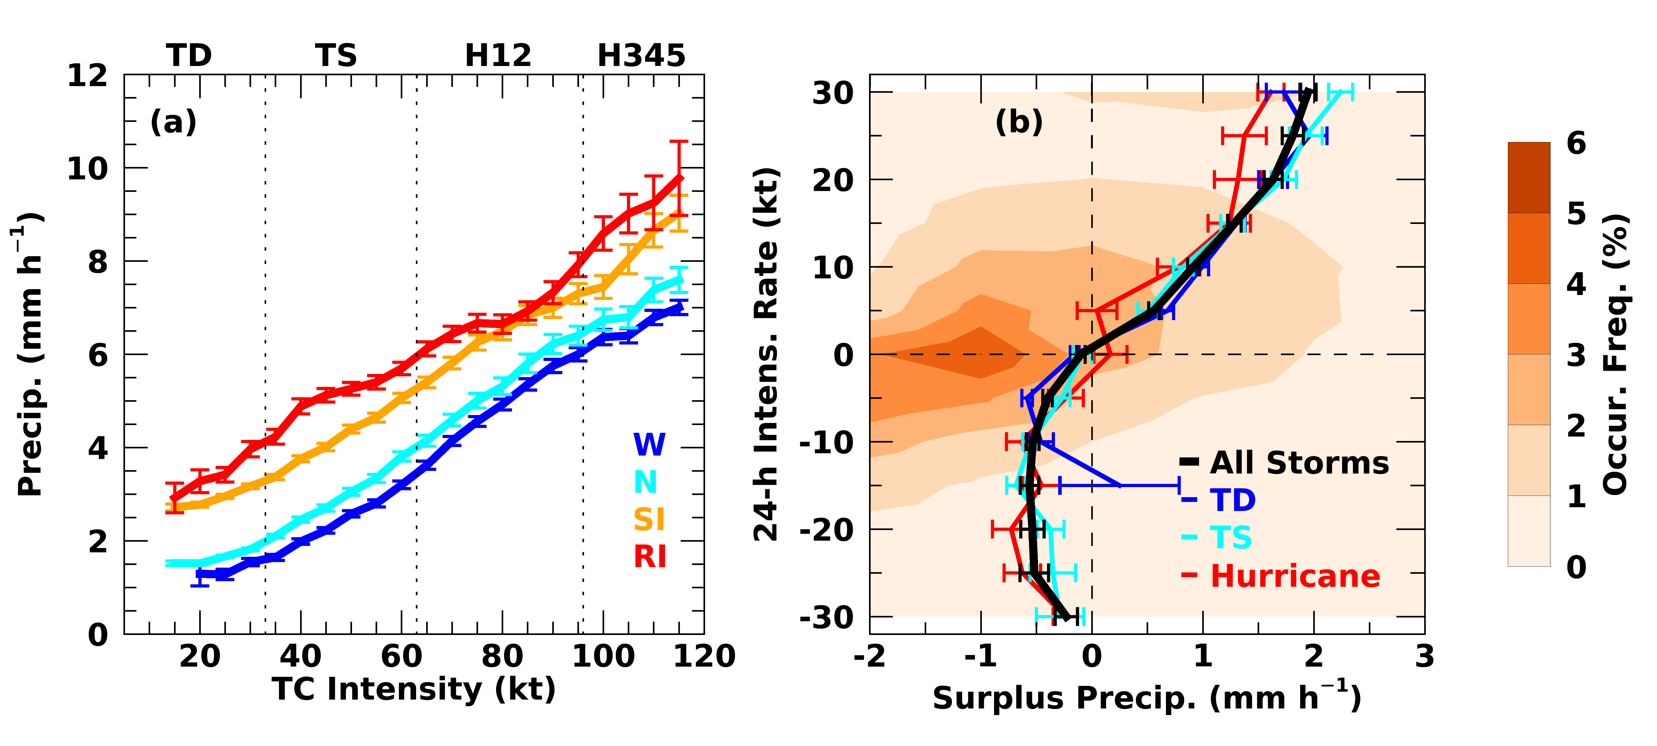

Surplus Inner-Precipitation
Surplus Precipitation
$S=P−P_{N}$
Su et al. (2020, GRL)

Slide 11
CloudSat Ice Water Content
TC Intensification Rate
TC Intensity

Slide 12
MERRA-2 Ice Water Path (IWP)
TC Intensification Rate
0-100 km
TC Intensity

Slide 13
Aura MLS Outflow Temperature
TC Intensification Rate
0-200 km
TC Intensity

Slide 14
MERRA-2 Precipitable Water Vapor
TC Intensification Rate
0-300 km
TC Intensity
Notes:
PWV within 300 km

Slide 15
MERRA-2 Liquid Water Path (LWP)
TC Intensification Rate
0-100 km
TC Intensity
CloudSat LWP does not show similar relation.

Slide 16

Exploration with IBM Watson Studio
We use the IBM Watson Studio to facilitate the machine learning model building and analysis.
NOAA-NHC
(in-kind)
IBM
(in-kind)
NASA-JPL
Prepare Data
Build ML Models
Deploy Models
Visualize Results
IBM Watson Studio: Evaluation of end-to-end ML workflow
Notes:
We launched a three-way collaboration between JPL, IBM and NOAA. IBM and NOAA provided in-kind support.

Slide 17
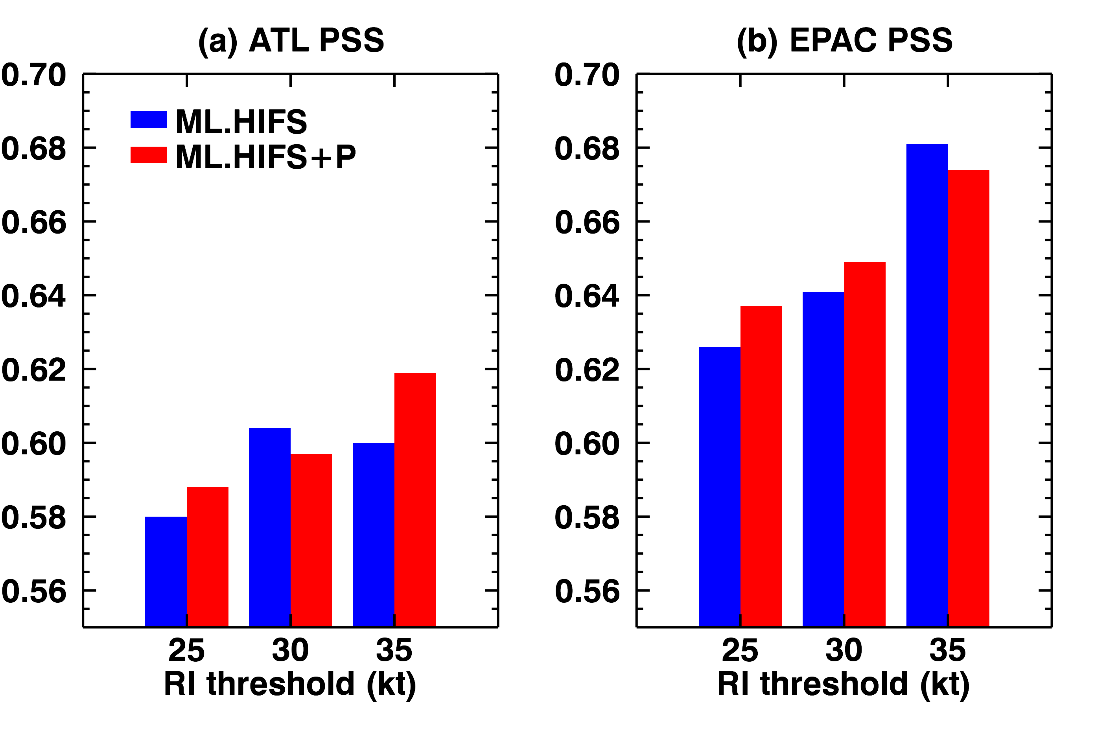
Training ML Models with the SHIPS and New Predictors
ATL
Training: 2680 total cases from 1998-2008
EPAC
Training: 2428 total cases from 1998-2008
Kaplan et al. (2015, Weather and Forecasting)

Slide 18
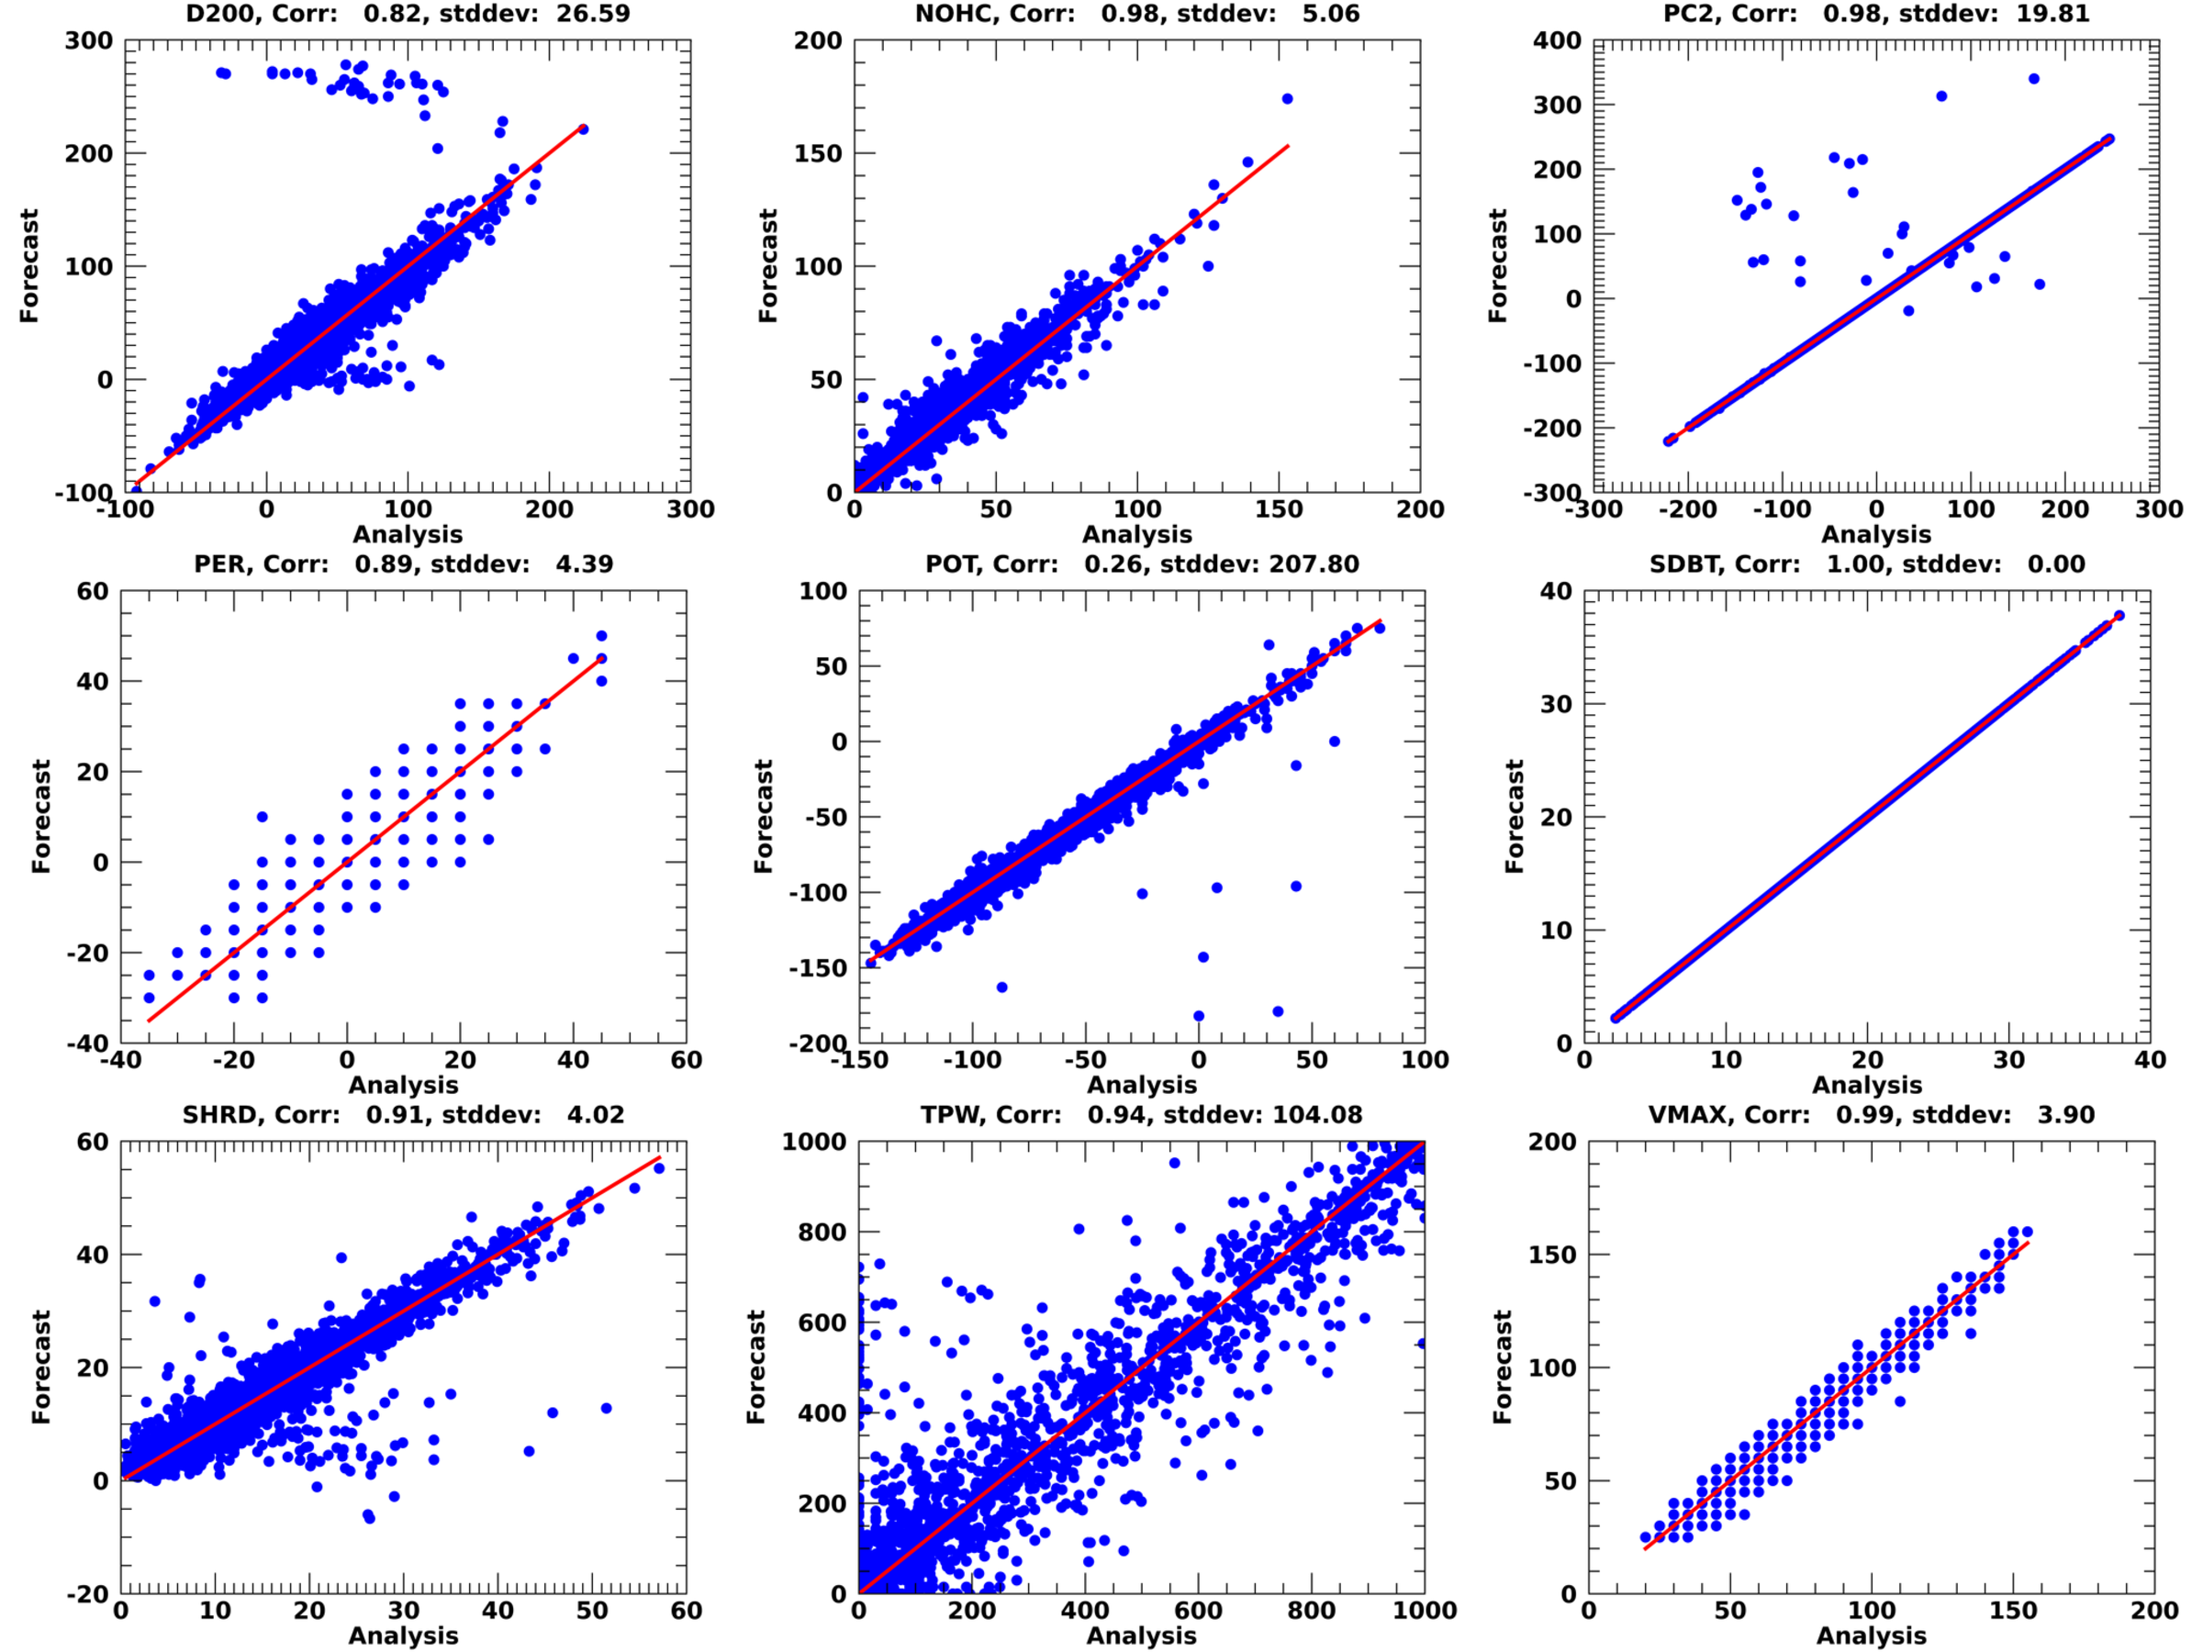
Challenges in Operational Forecast

Slide 19
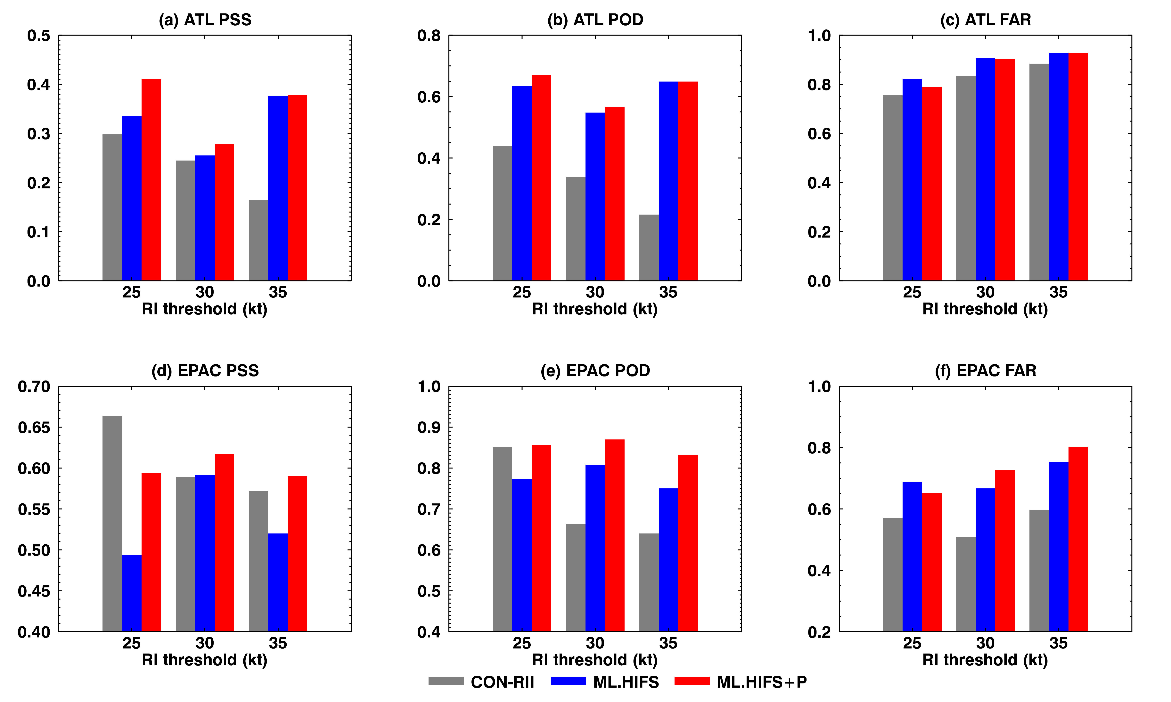
Improved RI Forecast with ML
ATL
  Training: 2680 total cases from 1998-2008
  Test: 1228 total cases from 2009-2014
EPAC
  Training: 2428 total cases from 1998-2008
  Test: 1349 total cases from 2009-2014

Slide 20
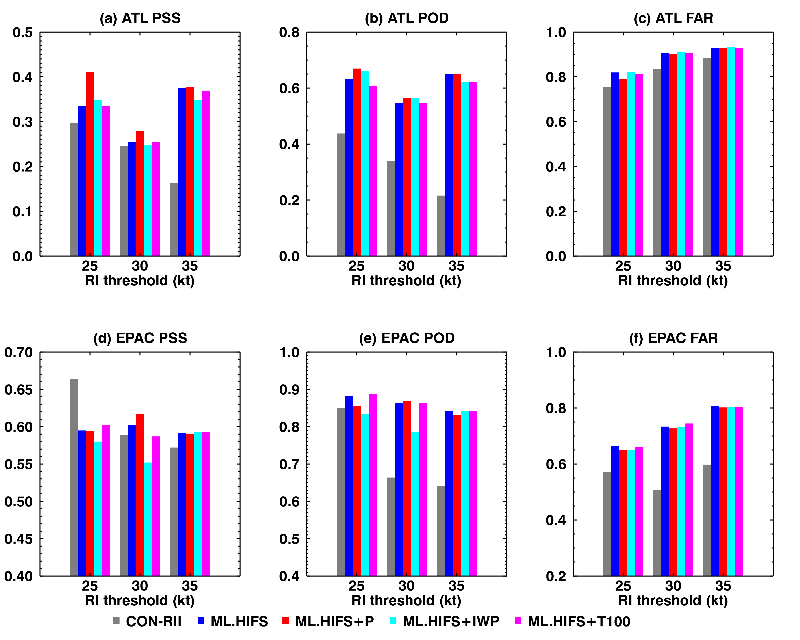
Sensitivity to Different Predictors

Slide 21
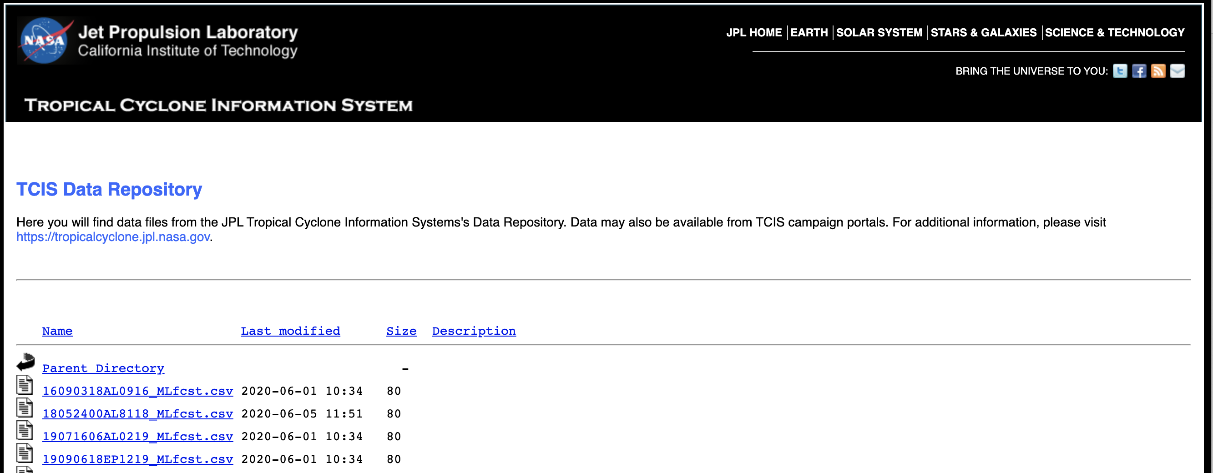
Realtime Forecast System https://tcis.jpl.nasa.gov/data/ships/

Slide 22
Summary
Tropical cyclone intensity change is approximately linearly correlated with surplus inner-core precipitation, ice water path and outflow temperature above a threshold value.
The threshold value can be determined from neutral TCs of nearly constant intensity and it varies approximately linearly with TC intensity.
The JPL-ML model significantly outperforms the NHC operational RI consensus forecast. Our probability of detection for RI in the Atlantic Basin is 40%, 60% and 200% higher than the NHC operational model while the false alarm ratio is only 4%, 7% and 6% higher for 25-, 30- and 35-kt RI thresholds, respectively.
Su, H., Wu, L., Jiang, J. H., Pai, R., Liu, A., Zhai, A. J., et al., Applying satellite observations of tropical cyclone internal structures to rapid intensification forecast with machine learning. Geophysical Research Letters, 47, e2020GL089102, http://dx.doi.org/10.1029/2020GL089102, 2020.
NASA press release: https://www.jpl.nasa.gov/news/news.php?feature=7738.

