Slide 1
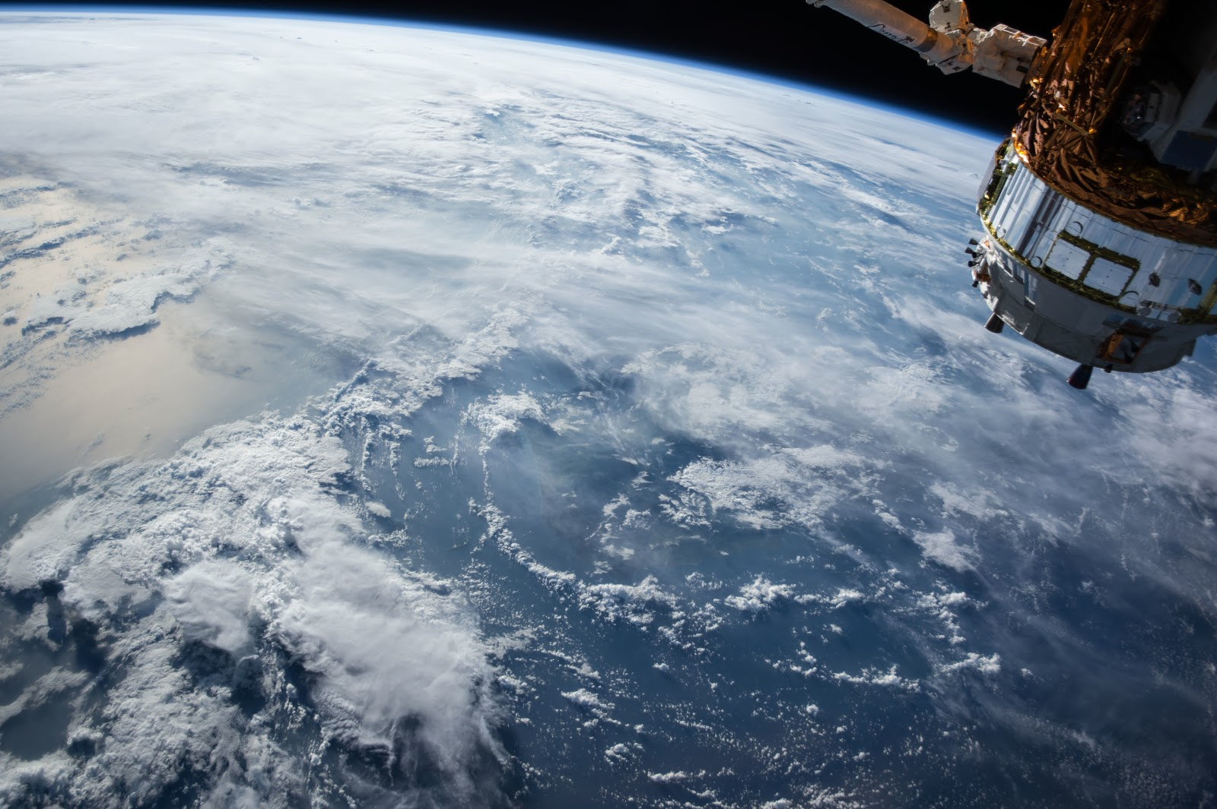
Counting Belugas from Space: Can we use VHR satellite imagery to accurately assess the critically endangered beluga whale population in Cook Inlet, Alaska?
Kimberly Goetz¹, Christin Khan², Erin Murnane³, Christina Neverez³, Michelle LaRue⁴, Rose Foster⁴, Manolo Castellote⁵, Paul Wade¹, Kim Shelden¹, Christy Sims⁵
¹NOAA/NMFS/AFSC/MML, Washington, USA
²NOAA, NMFS/NEFSC, Maine, USA
³U.S. Naval Research Laboratory, Space Systems Development Division
⁴Univeristy of Canterbury, Christchurch, New Zealand
⁵Joint Institute for the Study of the Atmosphere and Ocean, Washington, USA
Notes:
Good morning, or afternoon depending on where you are. My name is Kim Goetz from the AFSC and Today I’m going to talk to you about the feasibility of using VHR satellite imagery to assess the critically endangered Cook Inlet beluga whale. This will be less of a technical talk and more of and overview of the progress we have made towards using this technology to detect cetaceans such as beluga whales and the future dirction of this work.

Slide 2
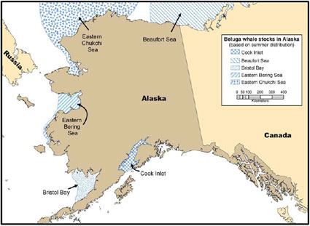
Cook Inlet Beluga
Canada
Notes:
I am going to start by giving you a little background about the Cook Inlet beluga whale.
There are 5 populations of belugas in Alaska The population we are going to focus on today is the Cook Inlet beluga (red box)

Slide 3
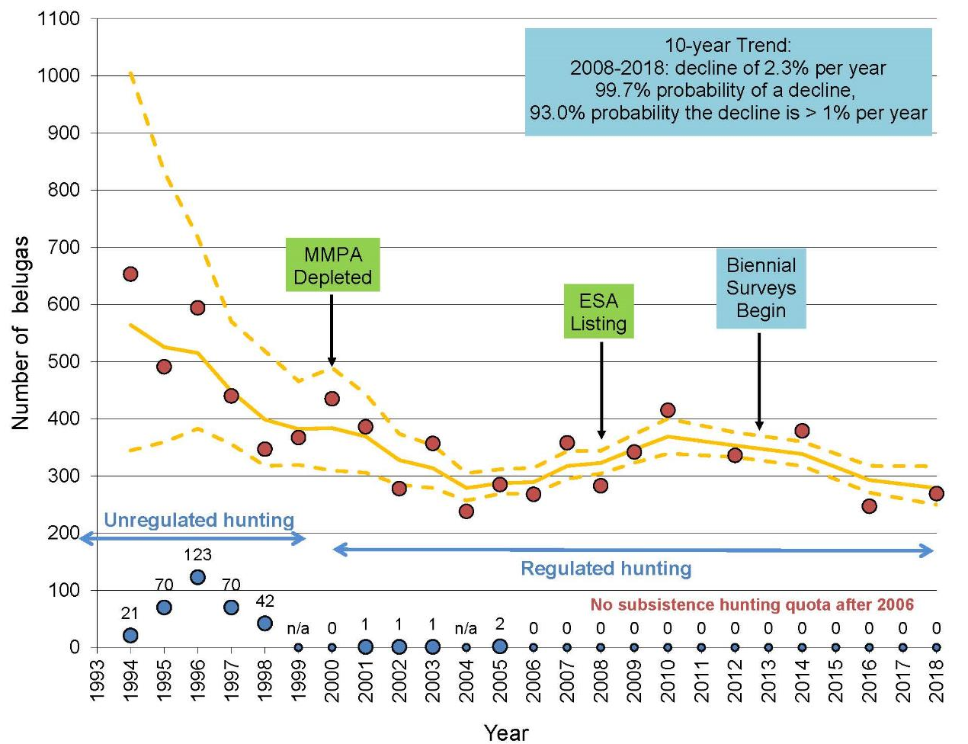
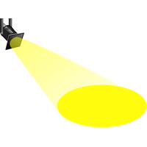
Cook Inlet Beluga
Population declining:
~1300 in 1979 to <300 today
ENDANGERED
SIS
Notes:
This graph shows the population trend since 1993
Between 1994 – 1998, the population declined by 50% primarily due to unregulated hunting. However, after this stopped in the late 90s, the population has failed to recover
In total, the population has declined from ~1300 in the 70s (caulking – 1979) to <300 animals today and was listed as endangered under the ESA in 2008.
In 2016 NMFS included the Cook Inlet beluga whale as one of eight Species in the Spotlight (SIS), species at high risk needing immediate, targeted efforts to stabilize their population and prevent extinction.

Slide 4
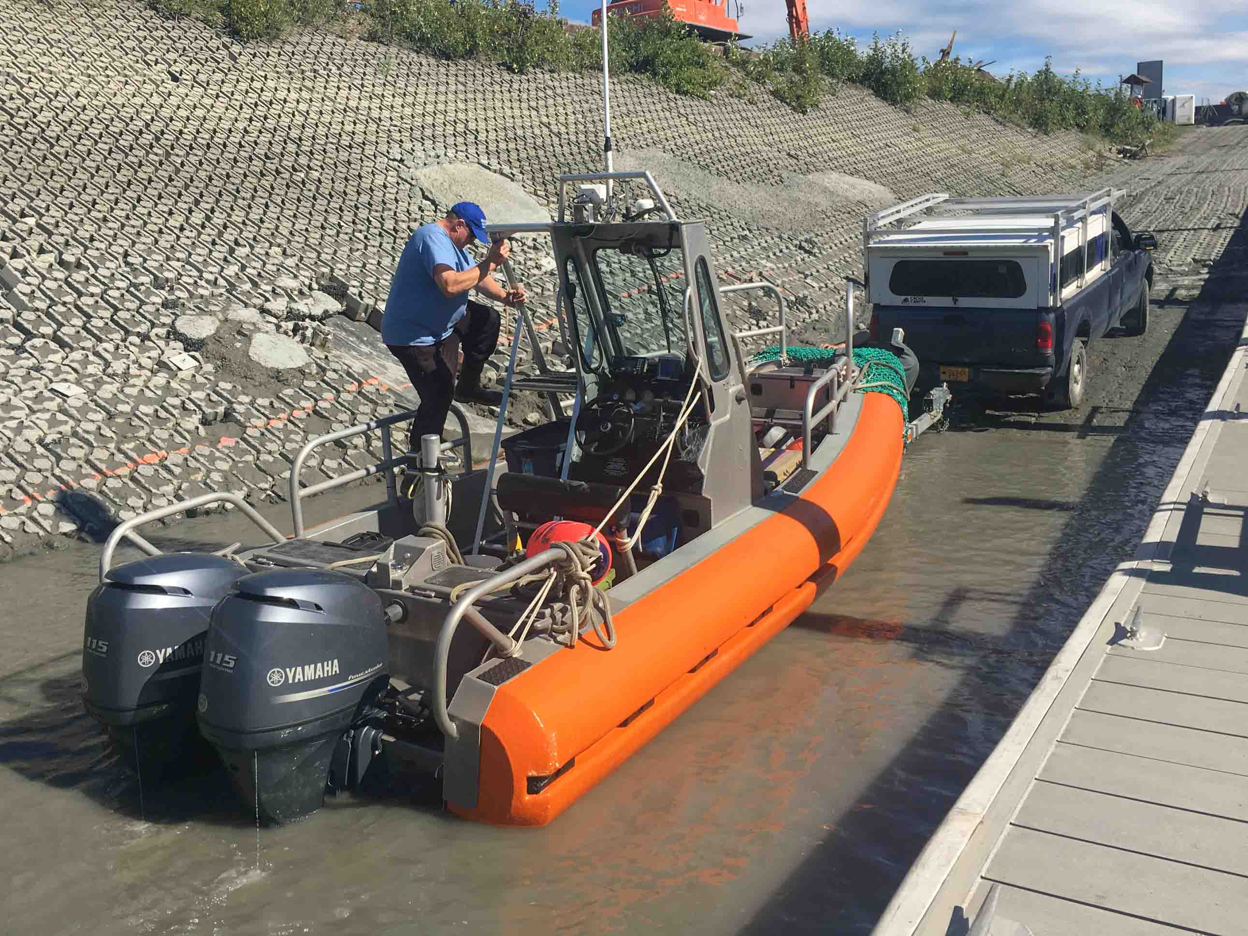
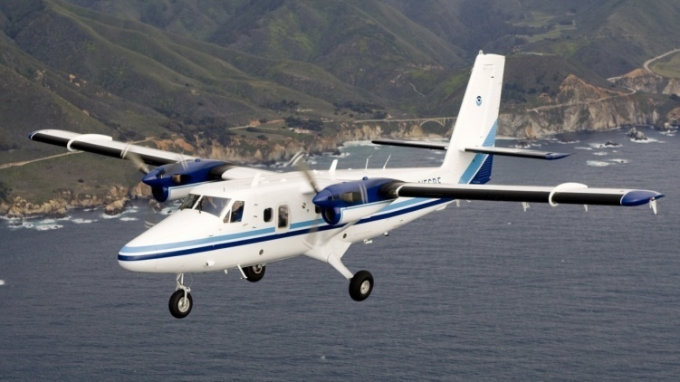
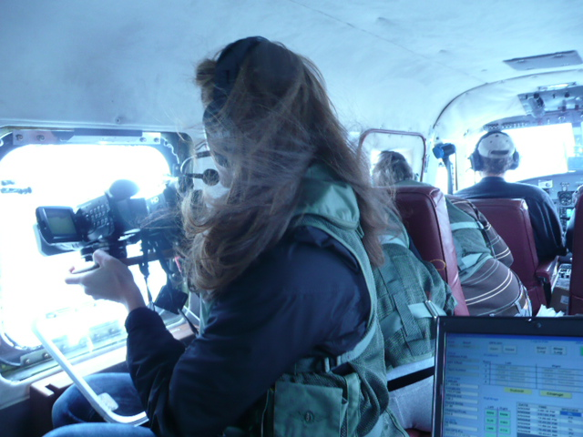
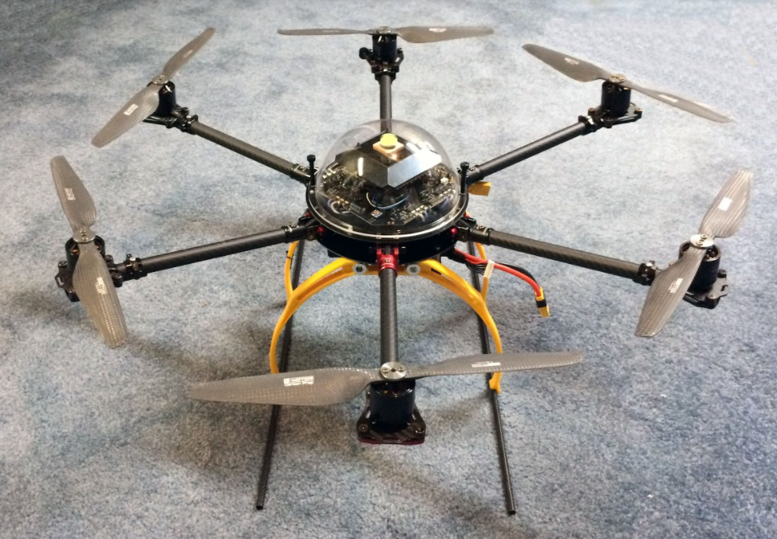
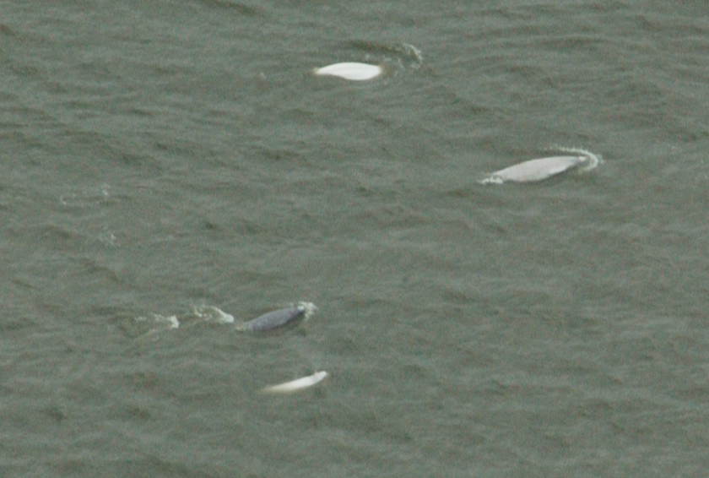
Monitoring – Surveys
Notes:
To monitor the population
AFSC has been conducted aerial surveys since 1993 to calculate new abundance estimates and trends and
since 2017, we have been using Unmanned Aircraft to collect data that will address action items listed in the SIS Action Plan.

Slide 5
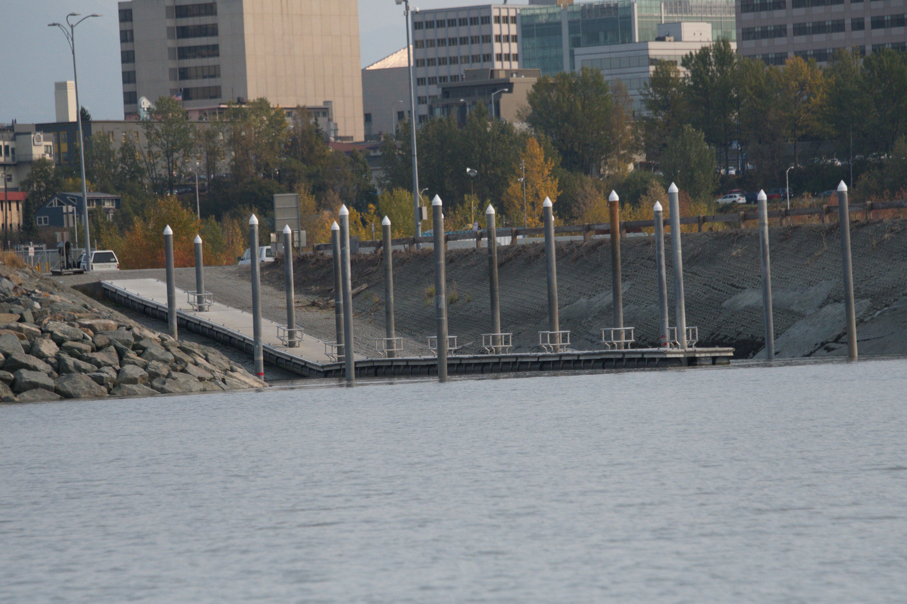
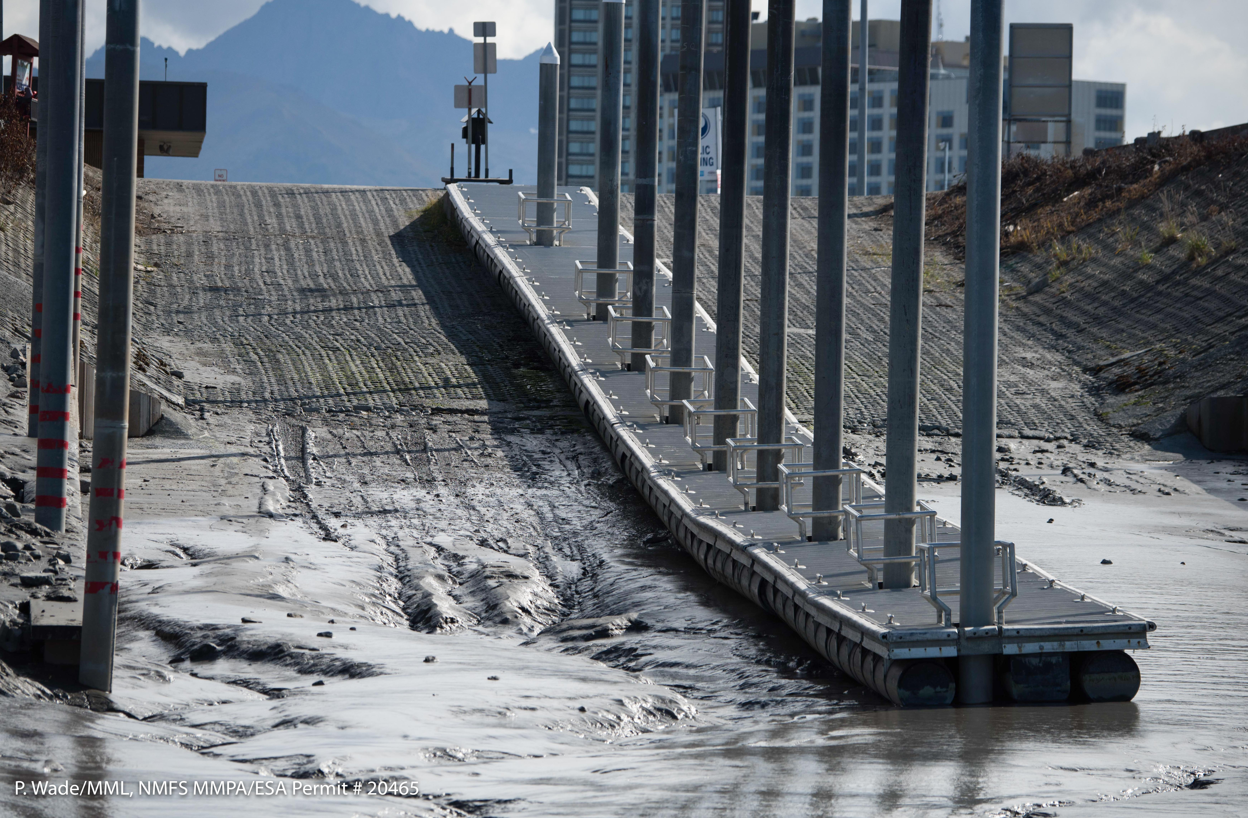
Monitoring - Challenges
Risk
Cost
Weather
Large area of interest
Are there other innovative methods that can be used to improve our ability to monitor CI belugas?
Notes:
There are several challenges associated with boat/aerial based monitoring. For one, this is a very dynamic environment with 30 ft tide cycles which can be seen in the images here.
Once we get our boat launched on high tide (top), the tide keeps going out, and the boat dock goes dry and we can’t return to shore for at least 6 hours,. So everything we do is timed with the tides and weather.
Aerial surveys are also costly and logistically difficult given the expanse of Cook Inlet and the need to survey coastlines, bays, rivers, and offshore regions, and timing surveys with animal behavior relative to the dynamic tidal cycle and weather.
With all these challenges in mind, we often ask the question - Are there other innovative methods that can be used to improve/supplement our ability to monitor CI belugas – for example – times of COVID when we can’t to field work.

Slide 6
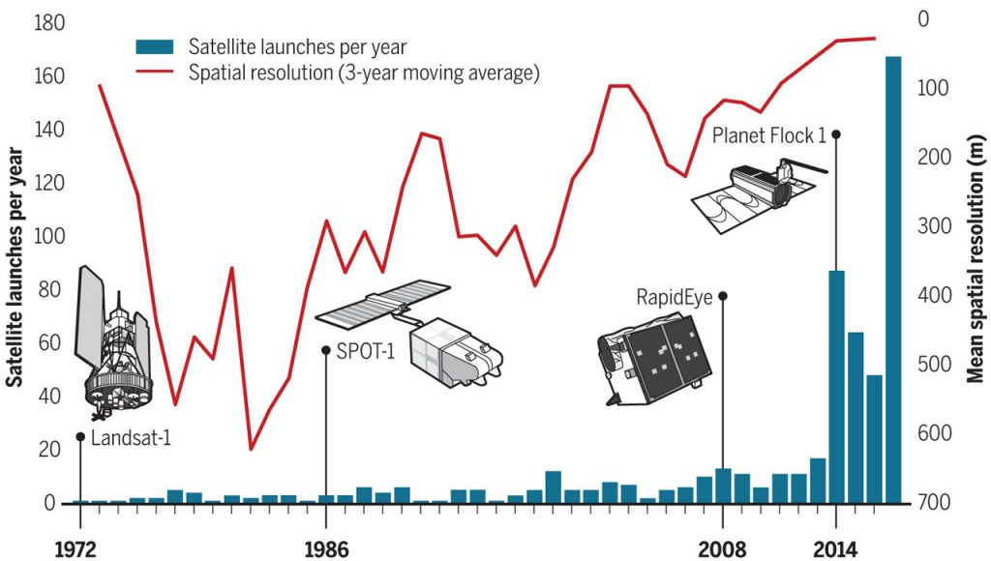
Satellite Imagery
Notes:
Now I’m going to switch gears and provide some background on satellite imagery.
Both the resolution and revisit rates of satellite imagery have increased over the years.
This graph shows the 488 earth observation satellites launched since 1972 by commercial and government providers (excluding military) (blue bars) and how the resolution has drastically increased over the years (red line).
Medium to low (1–60 m) spatial resolution space borne remote sensing data have been used for indirect animal surveys by identifying some ‘sign’ that indicates that animals have been in the area, such as fecal counts, since the early 1980s.

Slide 7
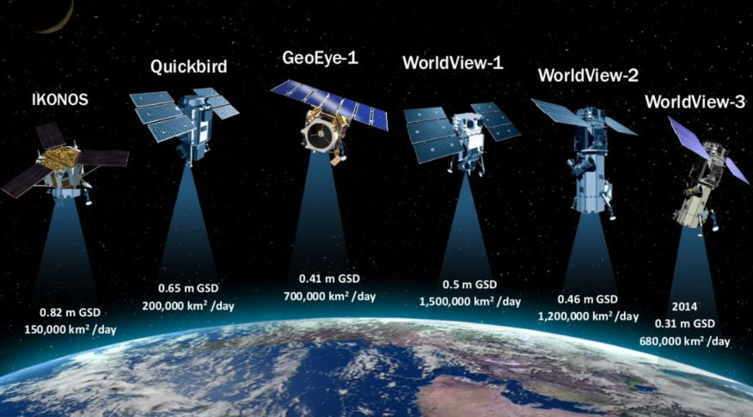
Satellite Imagery
Notes:
The world of satellite imagery was basically revolutionized by Maxar’s electro-orbiting constellation of satellites.
IKONOS and Quick bird are not currently active but images are available in the archive
However, GE, WV1,2, and 3 are currently on orbit, collecting more than 3 million square kilometers of imagery each day
Due to its high spatial resolution, broad spatial coverage, and cost-effectivness, commercial satellite imagery is rapidly becoming a key component of biological monitoring.
Detection of marine mammals from satellite imagery was not possible until the launch of the IKONOS satellite in 1999
Imagery has a resolution of 1 m in the panchromatic

Slide 8
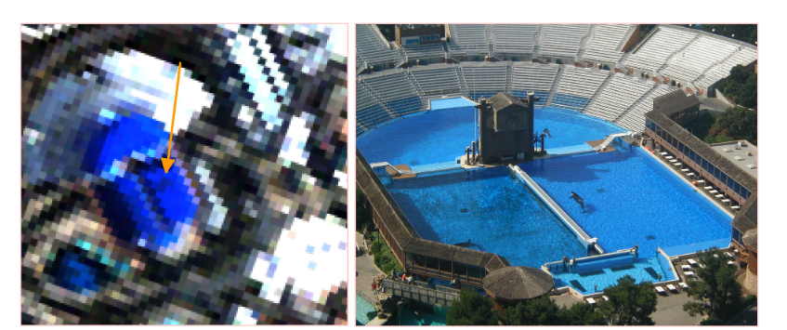
Satellite Imagery - ikonos
Notes:
Early work by Abileah et al demonstrated the initial proof of concept for detecting whales from space using IKONOS imagery to detect captive Orca whales and wild humpback whales in Hawaii.
This figure shows a satellite image of captive orcas in the Shamu amphitheater, SeaWorld, San Diego; Right: similar view from a photograph taken overhead

Slide 9
Satellite Imagery
Notes:
In recent years, sub-meter very-high-resolution imagery from commercial satellites,, have been used to directly identify large-sized individual animals.
Early groundbreaking work has been done on penguins and seals in Antarctica by Fretwell 2012 and LaRue 2011 using a combination of different VHR satellite imagery.

Slide 10
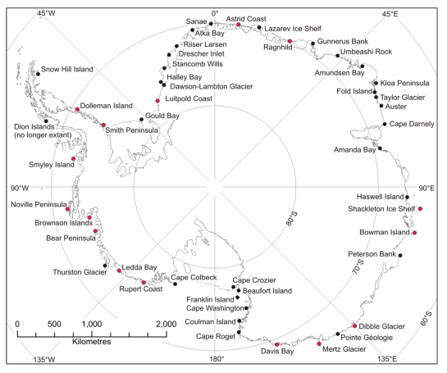
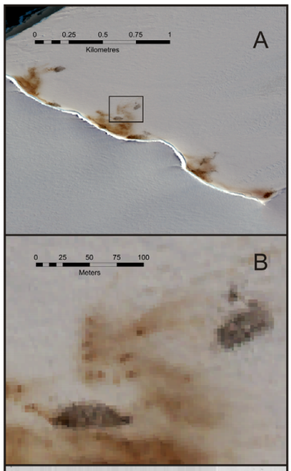
Satellite Imagery - Quickbird
Notes:
For example, using a combo imagery from IKONOS, Quickbird, and WV2, Fretwell et al 2012 was able to estimate the population of emperor penguins all around Antarctica using a single synoptic survey (left). The image on the right shows that you can differentiate between guano stains and actual birds.
In fact, they found four new colonies and confirmed the location of three previously suspected sites .
Estimate of 238,000 breeding pairs
This work now provides a comprehensive estimate of the total breeding population that can be used in future population models and will provide a baseline for long-term research.
These types of studies are really important as there is a growing consensus that spp such as the emperor penguin will be affected by changing climate, a driver thought to be critical to their future survival.

Slide 11
Satellite Imagery – WorldView-2
Notes:
Then in 2014, Fretwell et al used a WorldView-2 satellite image with 50 cm panchromatic resolution to identify and count Southern right whales off Argentina (image on this slide).
To detect whales, they were able to use a basic thresholding technique of the panchromatic and coastal band but concluded that it was “unlikely that different baleen species could be differentiated with the resolution of currently available satellite data.” One of the reasons this study was useful is because, right whales are the only large whale in this area at the time.

Slide 12
Satellite Imagery – WorldView-3
Notes:
The launching of Maxar’s WorldView-3 satellite in 2014 which has a resolution of 31 cm the panchromatic band has drastically increased our ability to differentiate specie and even classify behavior.

Slide 13
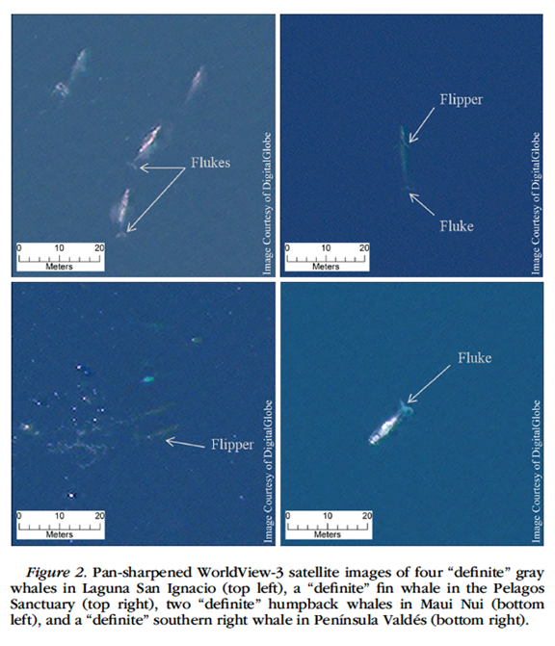
Satellite Imagery – WorldView-3
Gray whale
Fin whale
Guirado et al. 2019
Cubaynes et al. 2018
Humpback whale
Southern right
whale
Notes:
Two examples
In 2018, Hannah Cubaynes et al (left) manually detected four species of whales (fin, humpback, southern right, and gray whales) with pan-sharpened images. Now it is possible to clearly see details such as fins and flukes.
Guirado et al 2019 (right) was able to examine whale behaviors and found that a higher detectability was obtained for whales that were classified as blowing, breaching, peduncle, and logging. The lowest detectability occurred for submerged and spy hopping behaviors.

Slide 14
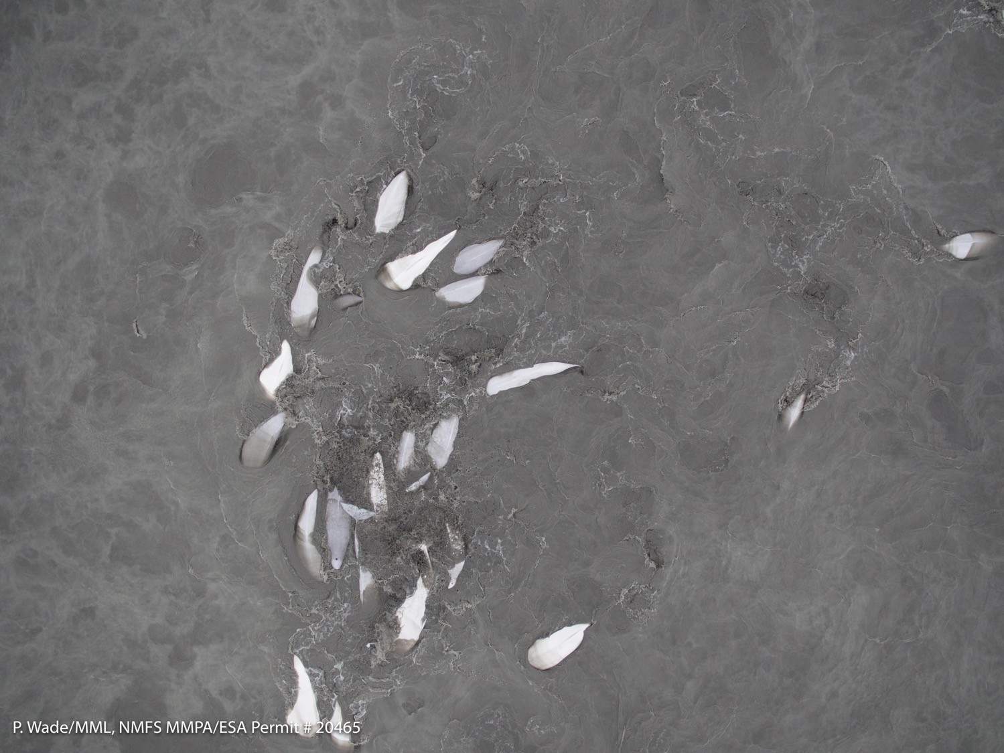
Satellite Imagery – Beluga Whales
Can we use VHR imagery to detect smaller cetaceans, like beluga?
Somerset Is.
Cook Inlet
Humpback whale
Southern right
whale
Notes:
While we have seen that large whales can successfully be detected in VHR imagery, we still don’t know how useful this imagery is for detecting smaller cetaceans
Detecting target species or objects can be difficult if they are too cryptically-colored or if they are too small to be identified with a reasonable amount of certainty.
Luckily for us, there is strong contrast between the white body of adult animals and the gray-brown muddy waters of their surrounding environment which makes the CIB population ideal for examining the utility of using VHR satellite imagery to detect animal presence. As such, we are currently examining existing and recently tasked VHR satellite imagery to determine if belugas can be detected.
Here I am going to show a couple examples of images where belugas have been detected

Slide 15
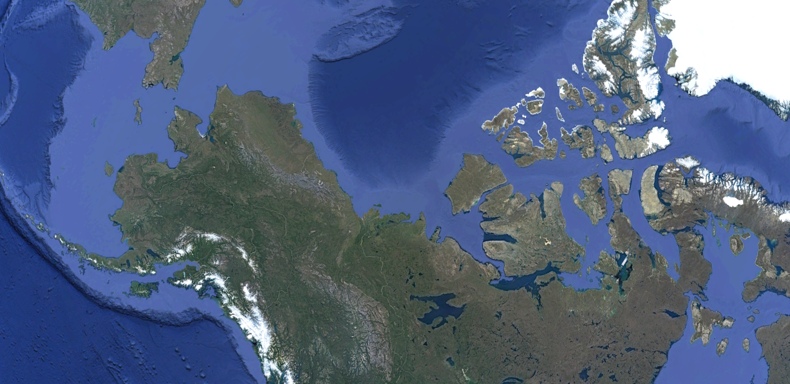
Satellite Imagery – Beluga whales
Somerset Is.
Notes:
The first example is from belugas in Canadian waters.

Slide 16
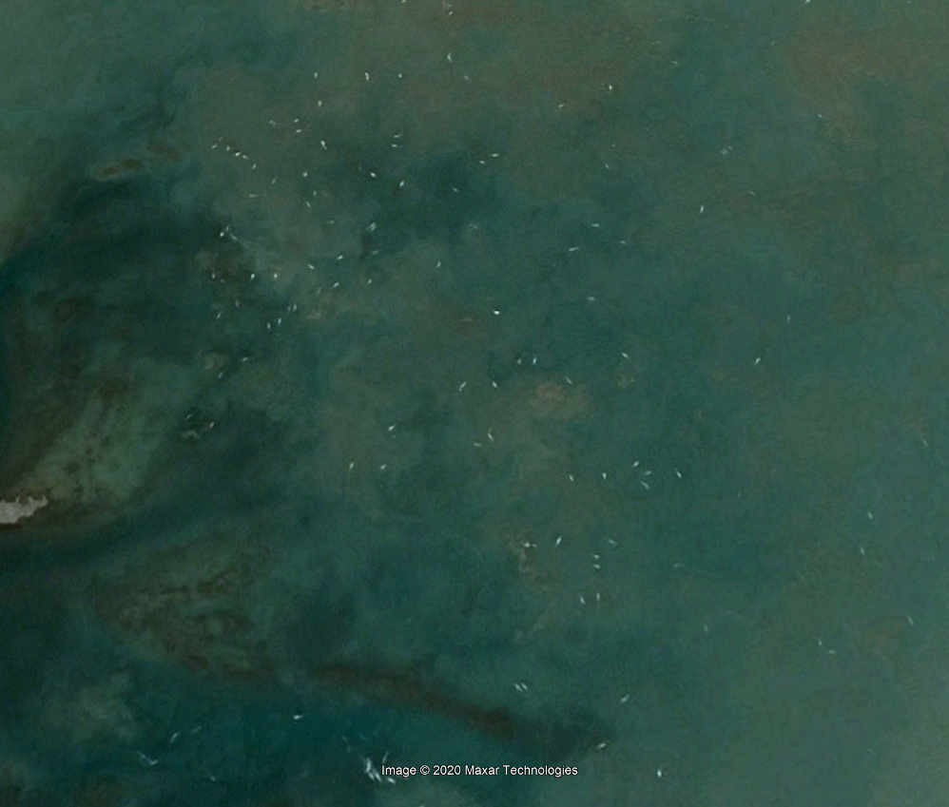
Satellite Imagery – Beluga Whales
Notes:
So based on this image, we are optimistic that CIB can be successfully detected – esp because this is lower resolution than the worldview 3 images that are now being collected.

Slide 17
Satellite Imagery – Cook Inlet Beluga
What about CI beluga?
Tasking since May
20 GeoEye
36 WorldView-2
12 WorldView-3
?
Notes:
Now, what about the CI beluga?
Downloaded existing archived data and started tasking new imagery in May 2020 – collected over 60 images. However I should mention that this number includes duplicate images taken within a few seconds of each other, images with high cloud cover, etc
We are struggling to go through the images (time and resources). I have personally been able to scan through the photos in a very cursory basis but not in any systematic level which is really wat we need.

Slide 18
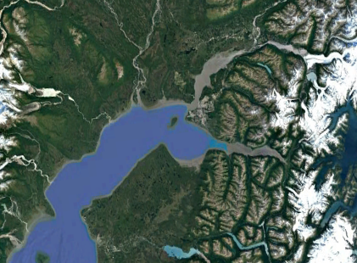
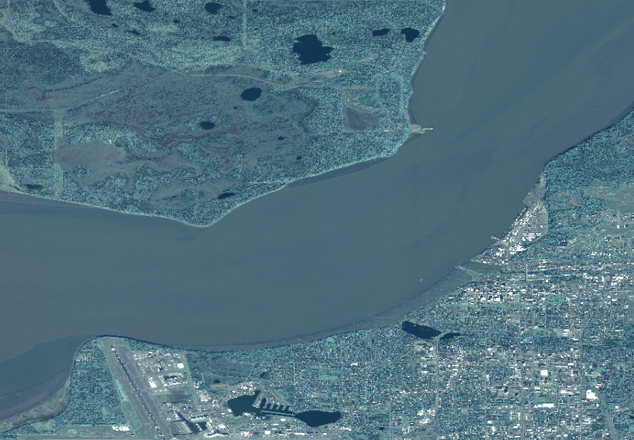
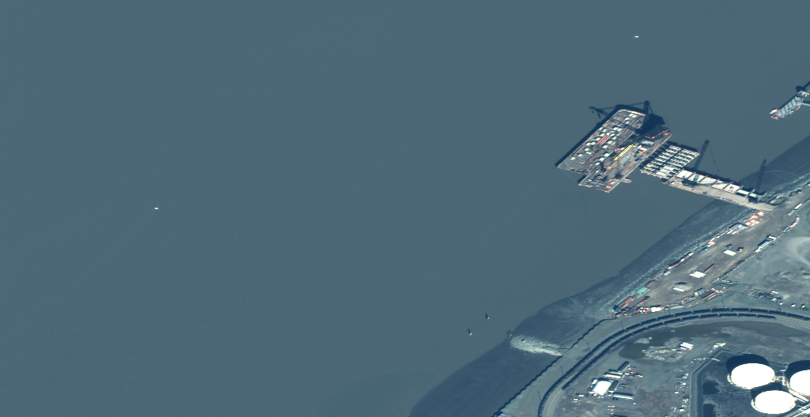
Satellite Imagery – Cook Inlet Beluga

Slide 19
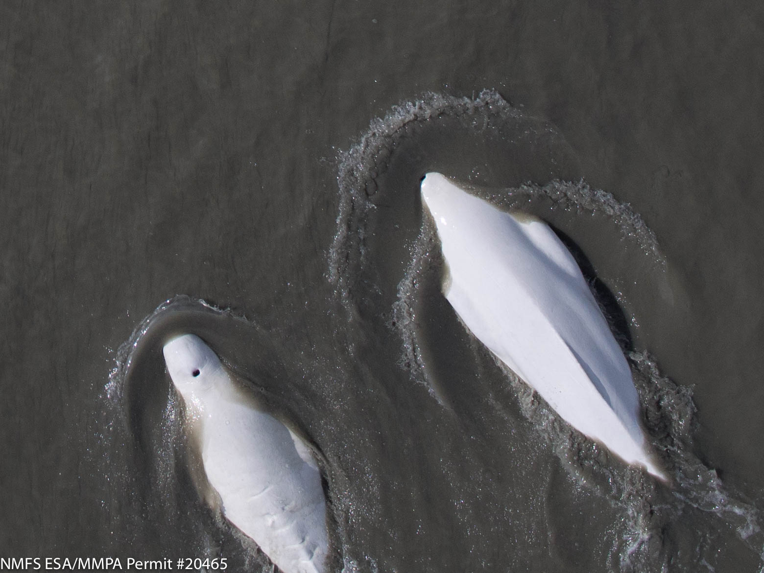
Satellite Imagery – Cook Inlet Beluga
Notes:
I know this is not as exciting as the image from Canada but given that the entire population is less than 300 animals we expect to find less animals per image. I have no doubt that we can find 50-100 animals in an image if its collected at the right time and place. In fact, its possible we already have the image but have not had a chance to go through them yet.

Slide 20
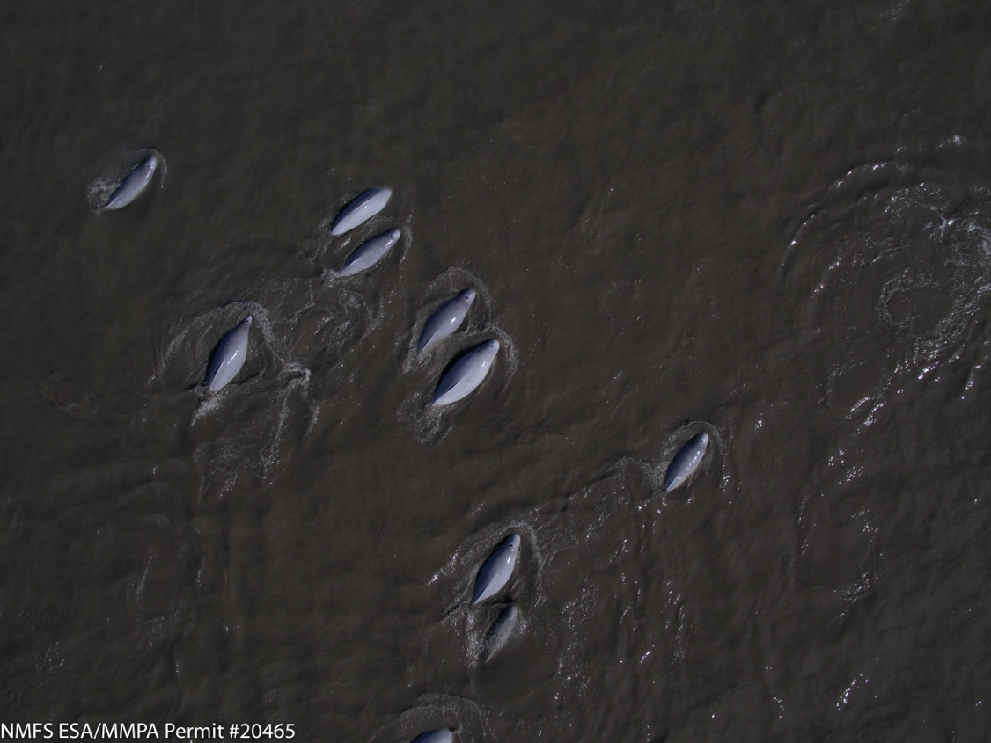
Satellite Imagery – Cook Inlet Beluga
Can we use VHR satellite imagery to monitor the endangered Cook Inlet beluga whale?
Appears likely, but….
Notes:
So just to get back to the question posed in the title of this talk: “can we use VHR sat imagery to monitor the endangered beluga in Cook Inlet Alaska?
Very probably, but we are still far from replacing other survey modalities, Satellite imagery has promise to improve current survey methodology for detecting whales, increase the temporal resolution of surveys, minimize human risk, and increase the rate of data acquisition.
But we still have a long way to go which Ill explain towards the end of this talk

Slide 21
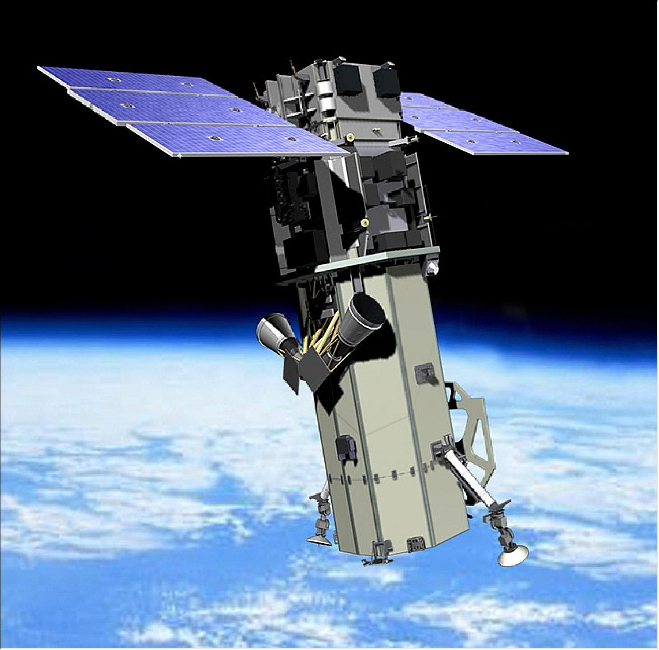
Future Goals and Progress
MONITORING WHALES FROM SPACE USING AI
Notes:
This brings me to our ultimate goal - to leverage AI to detect whales form VHR sat imagery on an operational scale
To date, applications to use satellite imagery to detect whales have been mostly academic on a small scale.
These studies often use manual methods such as Cubanyes study - took about 3 hours and 20 minutes for 100 km² which is clearly not sustainable for detecting whales at an operational level
We are hoping to combine Machine learning algorithms with an automated workflow to process satellite imagery, detect objects of interest and classify species using deep learning approaches. The ultimate goal is to augment data collection from aerial and vessel surveys to generate abundance estimates.

Slide 22
Future Goals and Progress
CNN
Correctly classified 100% of tiles with whales and 94% of tiles containing only water
Notes:
As you all know, there has been great advancements in the world of machine learning over the last few years
There has have been a couple seminal papers in using AI to detect whales in satellite imagery
In one example, Borowicz et al 2019 used convolutional neural networks (CNN) to detect whales. The best model correctly classified 100% of tiles with whales (but did not discriminate between different species), and 94% of tiles containing only water.
This is an exciting development because obviously machine learning algorithms are a precursor to an operational system

Slide 23
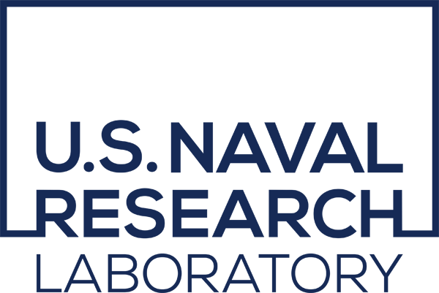
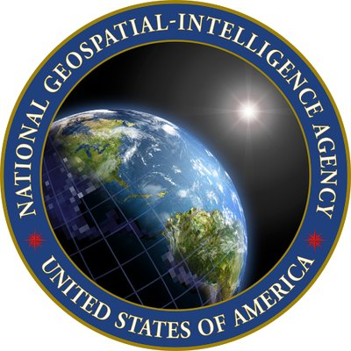
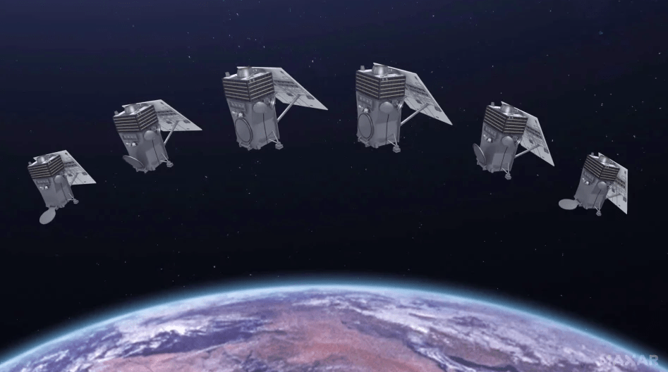
Future Goals and Progress
MONITORING WHALES FROM SPACE USING AI
Enhanced View Contract
2021 Next-gen WorldView Legion satellites
Machine Learning
Notes:
Momentum for using satellite imagery for marine mammal monitoring continues to grow and this new initiative brings together an extraordinary coalition of organizations to tackle the challenge of designing a large-scale operational platform to detect whales from space-orbiting satellites.
Essentially we want worldwide coverage of the highest resolution commercially available satellite imagery at an affordable price - how hard can that be?
Address worldwide coverage: Maxar is on schedule to launch its next-generation WorldView Legion satellites in 2021. The new constellation has the ability to capture 5 million sq km a day (~3% of the earth), at 29 cm resolution with a revisit rate up to 15 times a day.
As far as the Affordable price: NOAA has access to limited amounts of imagery through Enhanced View contract with the National Reconnaissance Office“
Which recently took over buying imagery from the National Geospatial Agency
And finally, none of this would be possible without advancements in AI/machine learning And cloud based platforms such as Maxar’s Geospatial Big Data (GBDX) platform which allows the storage of and access to WorldView-3 on Amazon Web Services (AWS) and allows the ability process machine learning algorithms without ever having to download and visually inspect the imagery.

Slide 24
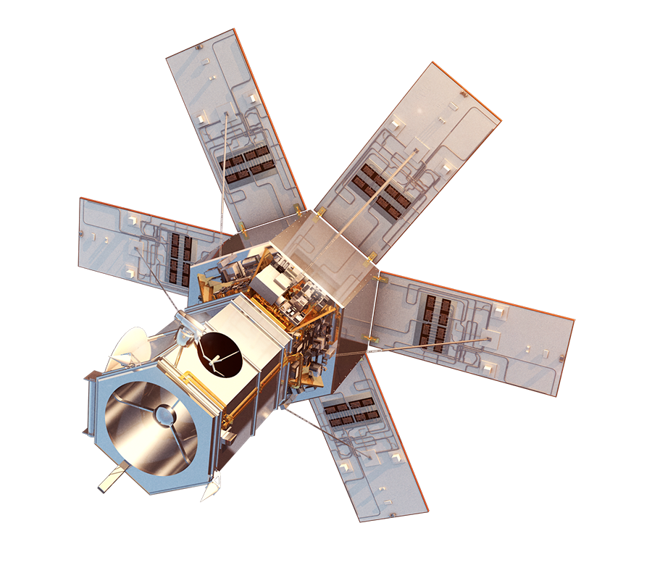
Future Goals and Progress
MONITORING WHALES FROM SPACE USING AI
Case studies
CIB
North Atlantic Right Whale
Arctic Bowhead whale
Western North Pacific gray whale
Steps
Image library
Annotated dataset
Algorithm development
Operational platform
Notes:
As we begin to move towards this big picture vision of leveraging Artificial Intelligence and VHR Imagery to Monitor Whales from Space , there are several high profile species that would make good test cases such as the Cook Inlet beluga whale, the North Atlantic right whale, the bowhead whale, and the gray whale.
There are several steps before we can reach our ultimate goal –
Once a library of high-resolution satellite imagery has been collected and prepared, the images will need to be annotated to identify targets of interest. Image annotation can be done via manual inspection of the imagery and/or via active learning
The resulting clean annotated data set (hundreds to thousands of detections per species) will be used as a training dataset for the development of more sophisticated deep machine learning algorithms in collaborations with others such as Microsoft.
Once we have a machine learning algorithm(s) of sufficiently high accuracy, then we can deploy into an operational system that detects whales and shares that information with stakeholders. Ultimately this whole system could be expanded to include other species/regions at tremendous benefit to marine mammal science and conservation efforts.

Slide 25
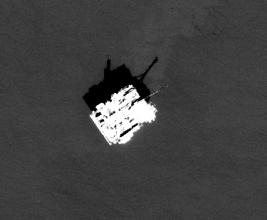
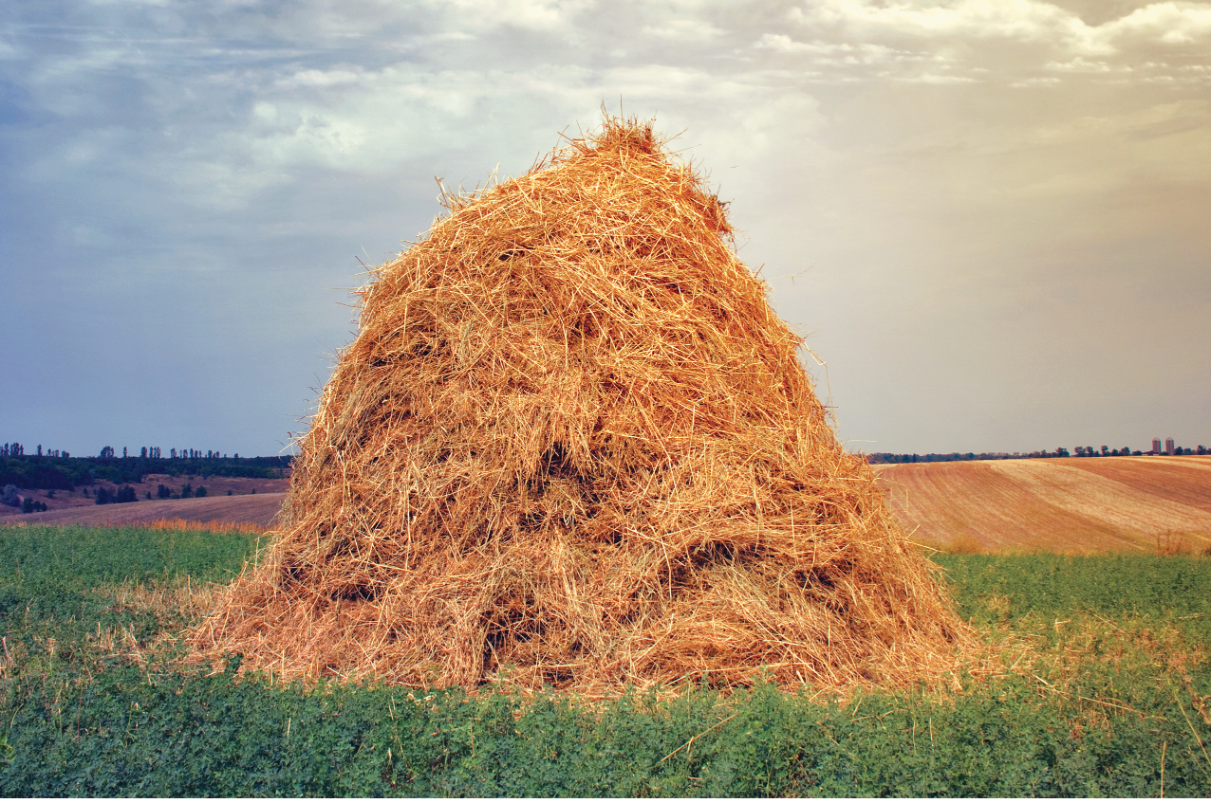
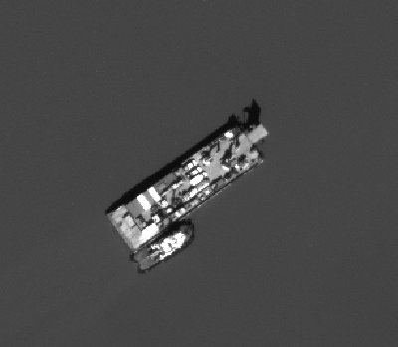
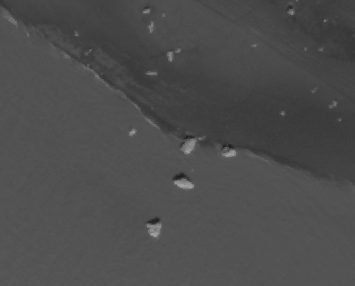
Progress and Challenges
Plane
Existing imagery
Cloud cover/ Sea state
Tasking
Size of AOI
Frequency
Priority
Image products
Projections
Pansharpening
Orthorectification
Small sample size
Object detection
?
Oil Platform
Barge
Rocks
Notes:
So while we have made progress there have also been many challenges - I have a question next to these because we are always interested in hearing feedback from folks in this audience that might have experience with these topics. So please feel free to contact me later.
Myth: existing imagery
Cloud Cover - some machine learning experts have indicated that we can likely eventually resolve the issue with thin cloud cover; but thick cover will continue to present a challenge; at least in the early stages, we will be limited by cloud cover.
Sea State - it is unknown if whitecaps will hinder whale detection
Tasking not intuitive
Limitations to are area being tasked (1,000 sq) which is not ideal for large open ocean areas
If you are lucky you might be able to get an image every three days (which is pretty much the most that can be requested)
We are taking advantage of the Enhanced View contract to access imagery – as a result we are low priority compared to paying customers
We are still figuring out which imagery product should we use? Pan sharpening, orthorectification, and projection are all important considerations.
Deep learning will require a large annotated dataset which we currently don’t have.
We are currently collaborating with folks at the NRL to apply an early active learning approach (spectral angle mapping or SAM) to identify objects using spectral signatures which will help us build up an annotated library so that we can share with additional collaborators to explore machine learning approaches.
After evaluating the SAM approach, the NRL folks discovered a better approach involves knowing more about other objects in the image which is represented by this hay analogy.
When most folks are given a stack of hay and asked to find a needle, they will look for needle-like objects. I know a needle is silver, pointy, shiny and thin. This is a tedious but effective approach. This is what we were doing with SAM: you have a feature vector that represents a whale spectrally and use that to find things that look like that feature vector.
However, a better approach is getting rid of all hay, and see what’s left. In order to get rid of hay, you must have a definite understanding of what hay looks like. This is the basis of anomaly detection: get rid of all the things that are uninteresting and report back anomalous things. So in terms of our satellite imagery, we want to remove objects such as planes, barges, rocks etc that are also visible in the earlier image I showed you that Cook Inlet belugas. This means you must thoroughly understand what water, vessel, land, and rock pixels look like. NRL is currently exploring a tool that has the ability to do this. to be continued…

Slide 26
Progress and Challenges
Notes:
As we have embarked on this journey, we realized that there are a lot of challenges to work through.
So while we naively thought our path would look like this – it is quickly turning into this
Using VHR imagery to determine whale density is still in its infancy and due to platform limitations, images are still not high quality enough for individual photo-id, to detect entanglements or asses health
With the ability to rapidly and automatically detect whales in satellite imagery, boat or aerial surveys become valuable as ground-truthing rather than as the sole source of data on whale abundance and distribution.
It is clear that satellite imagery has tremendous potential to augment these other platforms, particularly as a non-invasive means of surveying hard to reach locations.

Slide 27
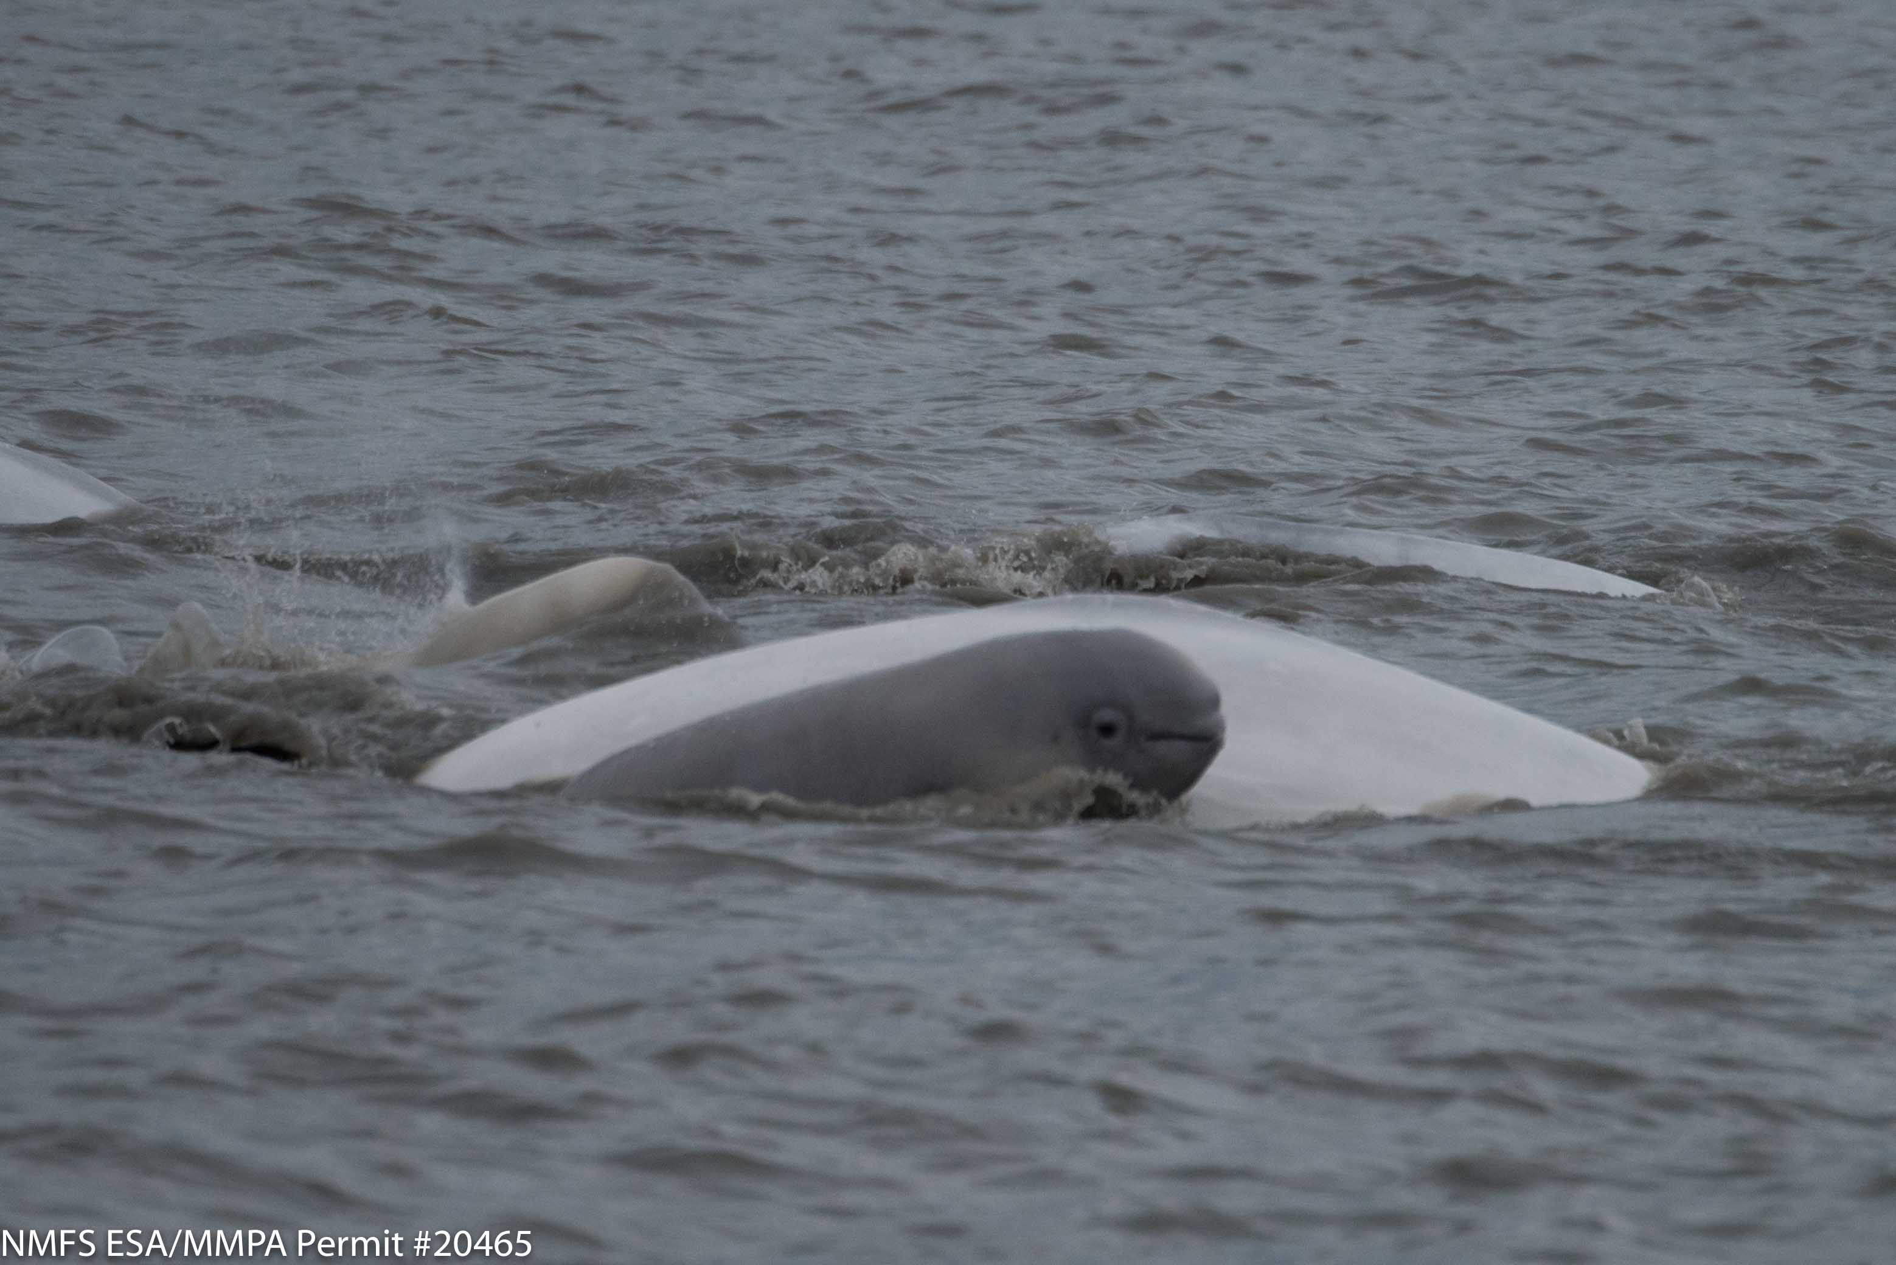
Questions?
Quick Plug…
Christin Khan, NEFSC
February 11
_______________
Automate the Identification of Right Whales using Deep Learning
Stay Tuned……..
kim.goetz@noaa.gov
Notes:
Ok, Id like to take any questions – but want to put in a quick plug for a talk on Feb 11, by my collaborator Christin Khan who will be able to give a bit more of an update on the progress we have achieved in addition to speaking aobut her other projects.
Christin Khan
Automate the Identification of Right Whales using Deep Learning

