Slide 1
Using Neural Networks as Model Physics Components in Numerical Weather Prediction
V. Krasnopolsky¹ and A. Belochitski²
¹NWS/NCEP/EMC, ²IMSG at NCEP/EMC
Vladimir.Krasnopolsky@noaa.gov
Alexei.A.Belochitski@noaa.gov
2-nd NOAA AI Workshop, Dec 3, 2020

Slide 2
Outline
NN emulation for Full Suite of Model Physics
Stability and Robustness
Conclusions

Slide 3
GFS v.16 Structure
NN
506 Inputs
304 Outputs
250 Hidden Neurons in one hidden layer
3 times faster
GFS
Atmospheric Physics
RRTMG LW Radiation,
RRTMG SW Radiation,
Planetary BL,
Orographic and convective
gravity wave drag,
Deep convection,
Shallow convection,
Microphysics,
CO2(t), trace gases,
Aerosols (tropo- and stratospheric),
O3 and H2O photochemistry
Dycore
U
V
T
Sh
Suite of Model Physics
Clw
O₃
Noah Land Model
Training: Data simulated by 23 10-day GFS v.16 C96L64 forecasts, uniformly covering entire 2018

Slide 4
NN Inputs and Outputs
NN Input | NN Input # | Layers | NN Input | NN Input # | Layers
$$\cos{\frac{2∙π×day}{366}}$$ | 1 | - | Surface Pressure | 137 | -
$$\sin{\frac{2∙π×day}{366}}$$ | 2 | - | U-wind | 138 : 201 | 1 : 64
$$\cos{\frac{2∙π×month}{366}}$$ | 3 | - | V-wind | 202 : 265 | 1 : 64
$$\sin{\frac{2∙π×month}{366}}$$ | 4 | - | Vertical velocity | 266 : 329 | 1 : 64
Latitude | 5 | - | Temperature | 330 : 393 | 1 : 64
cos(Longitude) | 6 | - | Specific humidity | 394 : 430 | 1 : 37
sin(Longitude) | 7 | - | Total cond. mix. ratio | 431 : 473 | 1 : 43
cos(Zenith Angle) | 8 | - | Ozone mixing ratio | 474 : 505 | 33 : 64
Layer geop. height | 9 : 72 | 1 : 64 | Solar constant | 506 | -
Layer pressure | 73 : 136 | 1 : 64
NN Output | NN Output # | Layers | NN Output | NN Output # | Layers
U-wind increment | 1 : 64 | 1 : 64 | Specific humidity incr. | 193 : 229 | 1: 37
V-wind increment | 65 : 128 | 1 : 64 | Total cond. m. r. incr. | 230 : 272 | 1 : 43
Temperature incr. | 129 : 192 | 1 : 64 | Ozone mix ratio incr. | 273 : 304 | 33 : 64

Slide 5
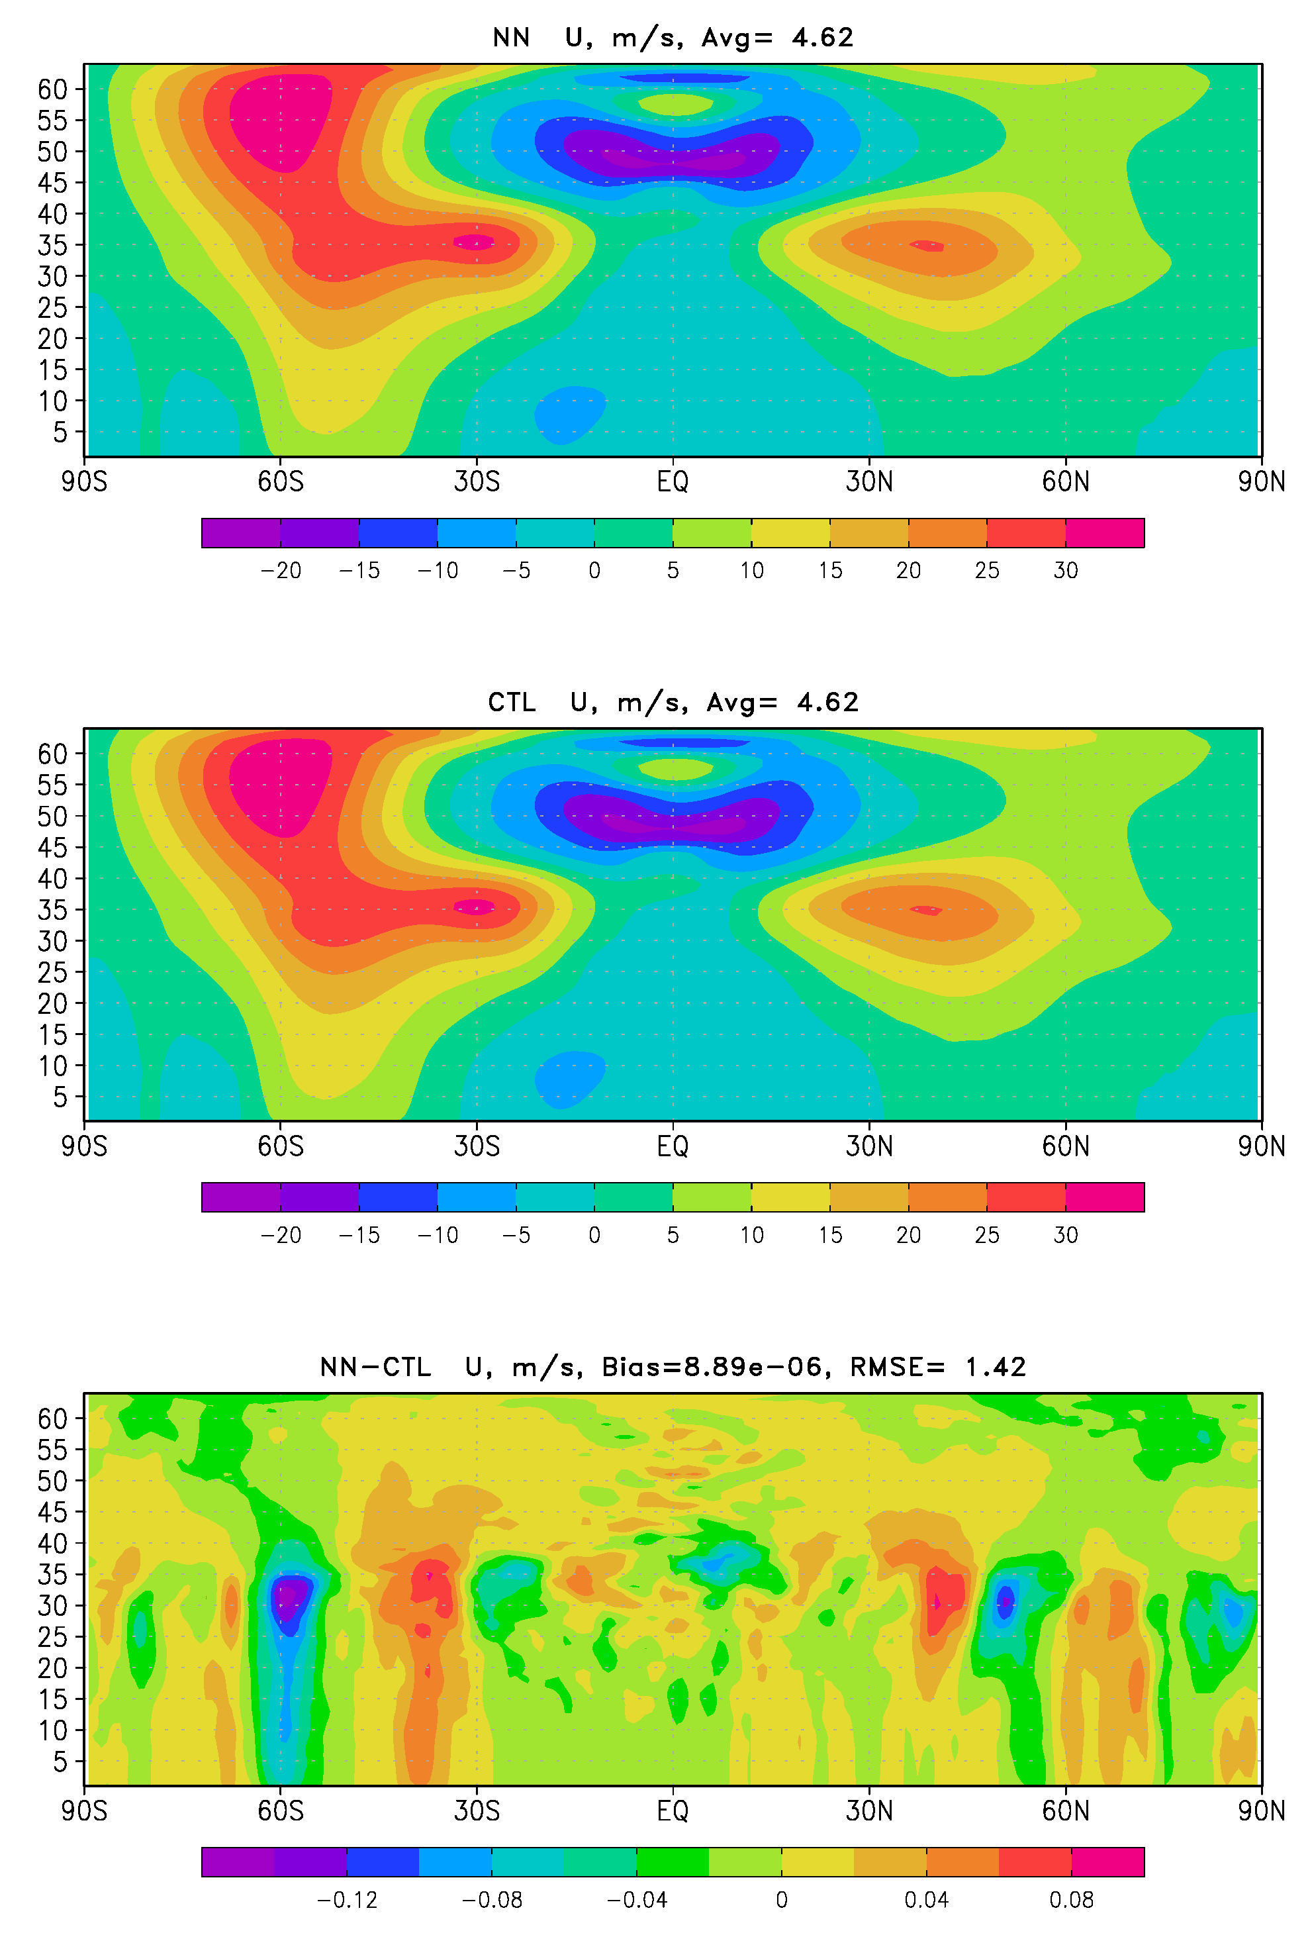
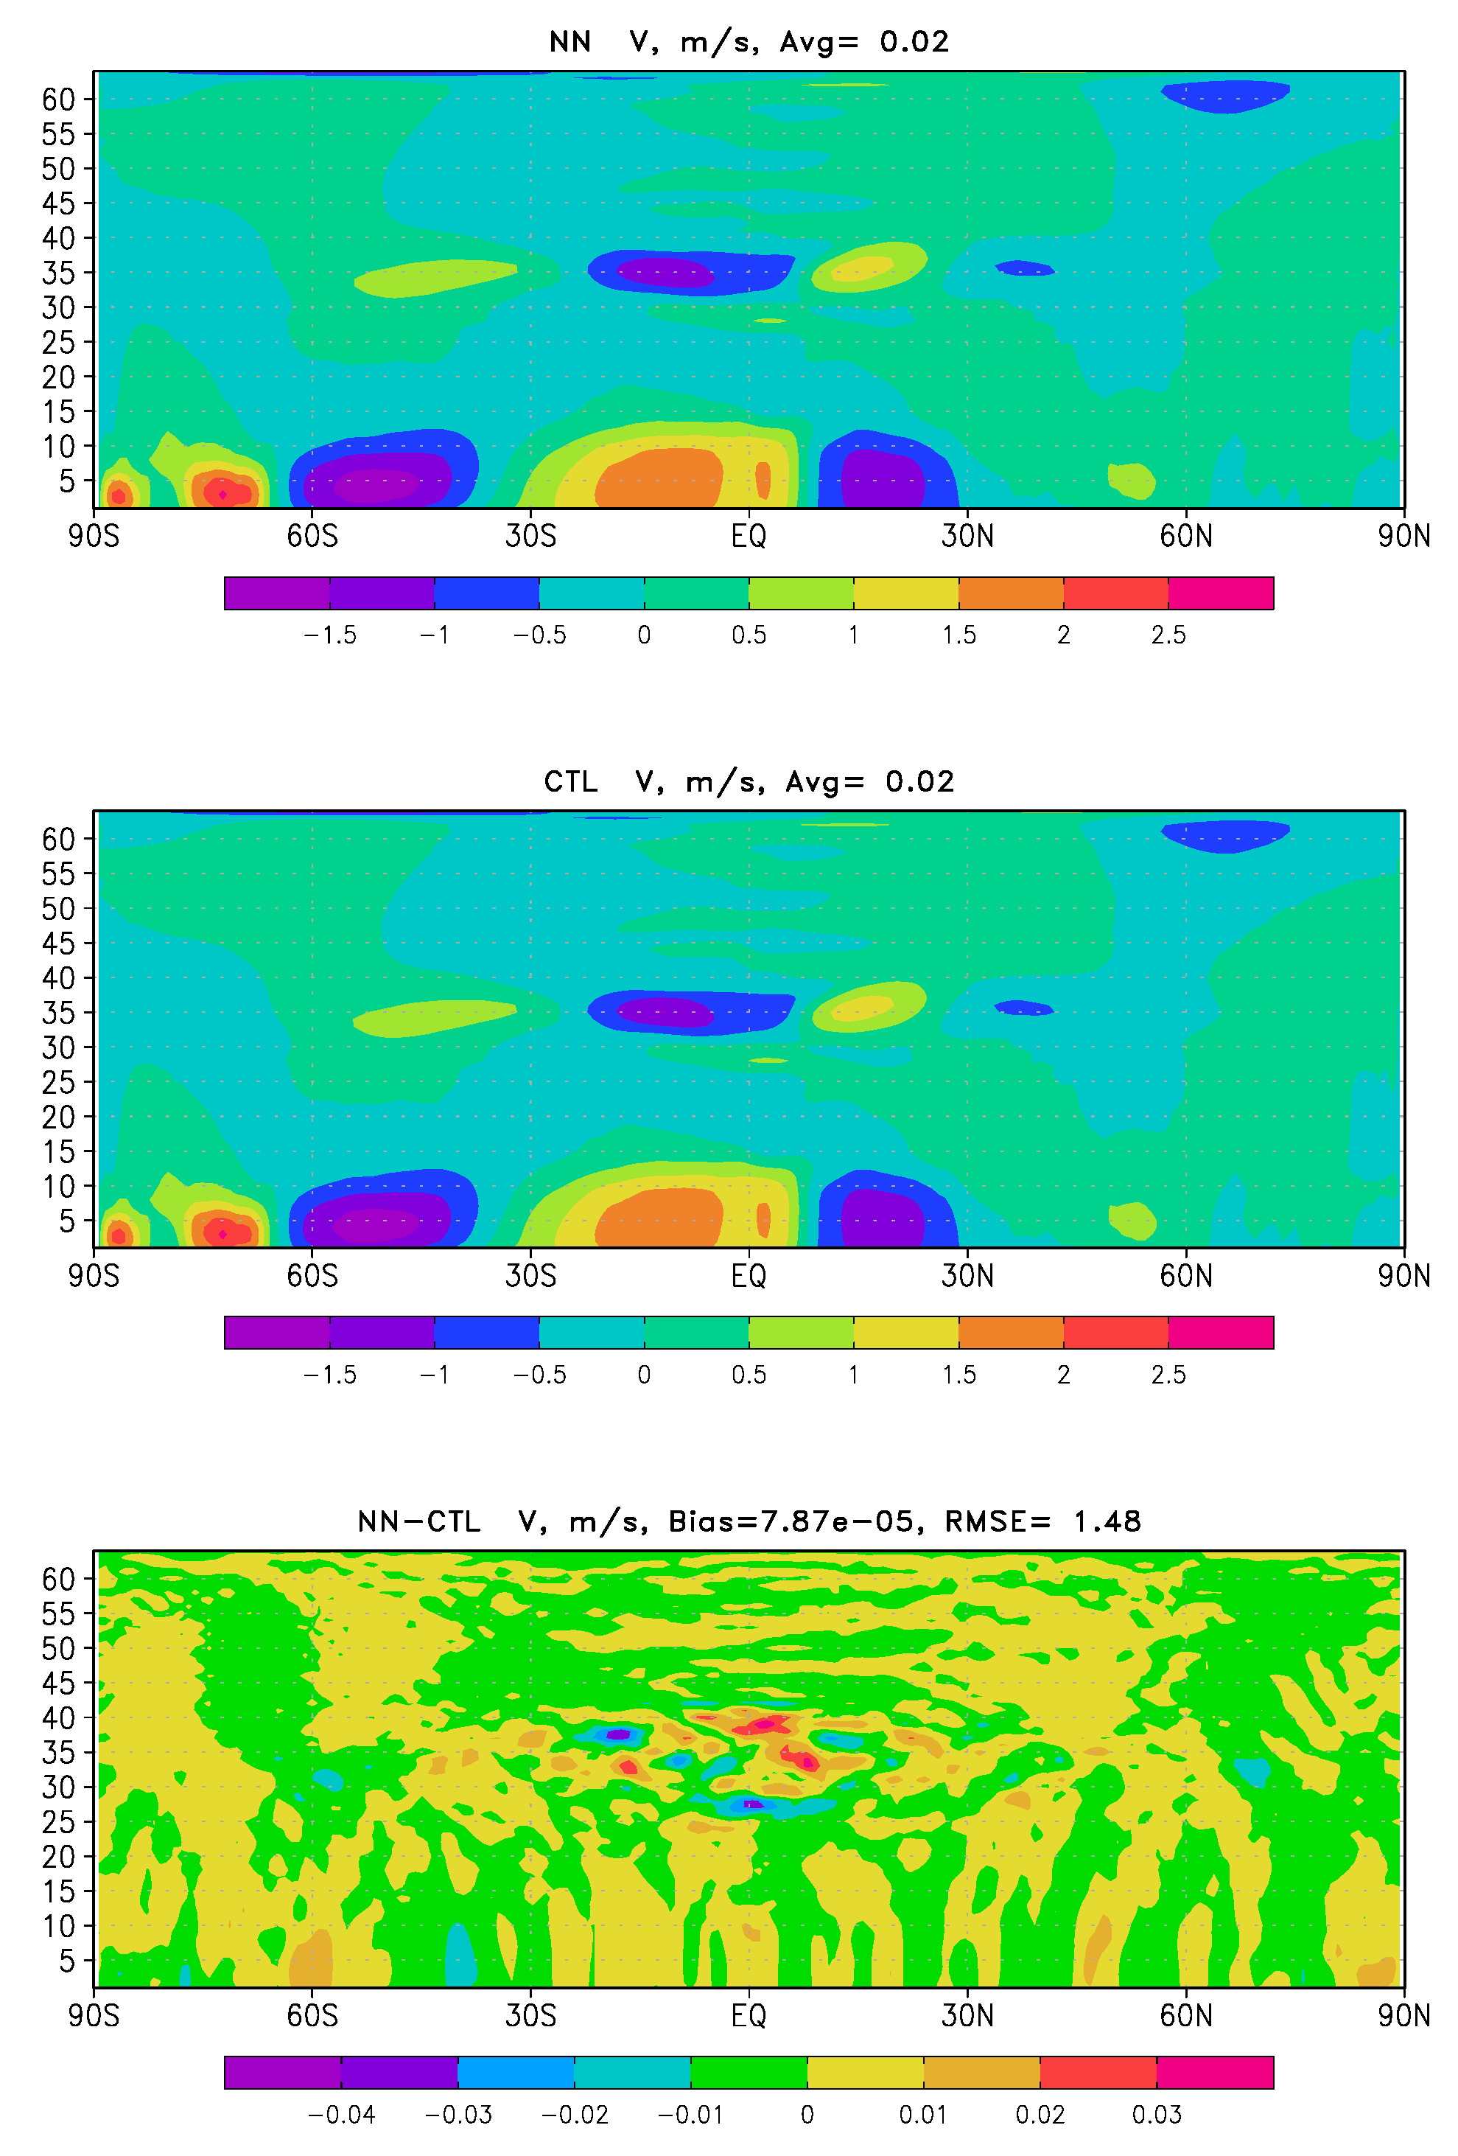
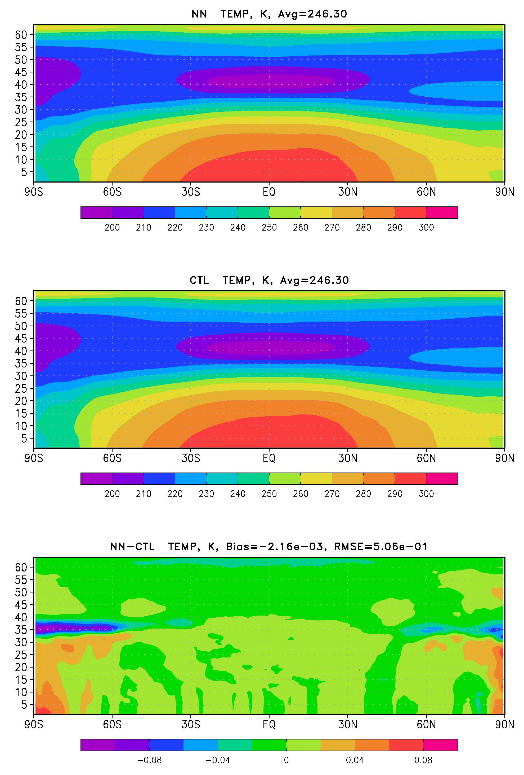
24 10-day forecasts (zonal means) - 1
Bias = 9.10⁻⁶ m/s
Bias = 8.10⁻⁵ m/s
Bias = -2.10⁻³ K

Slide 6
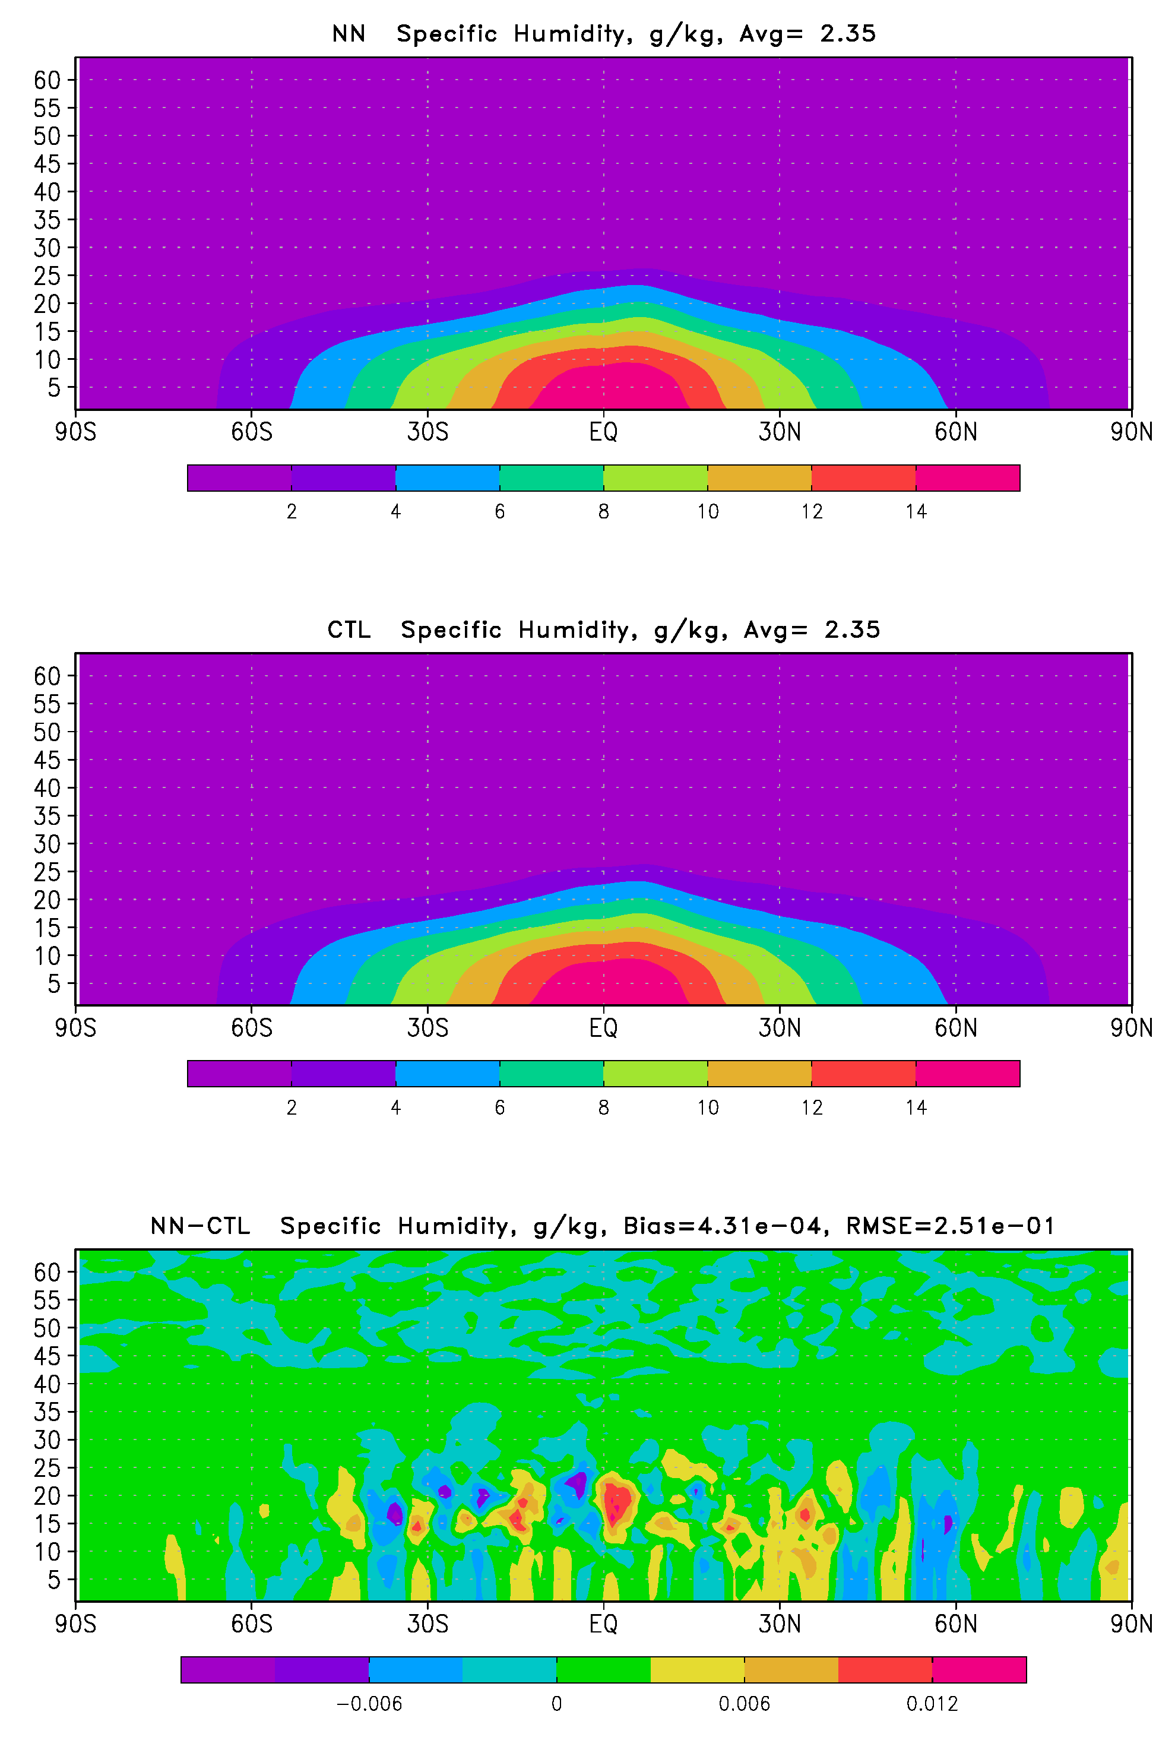
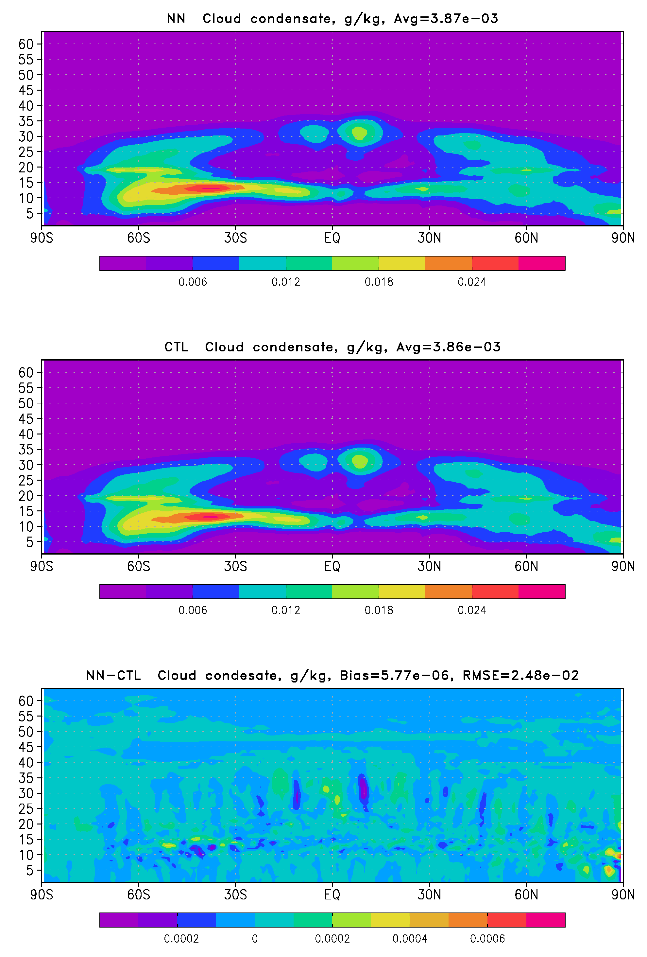
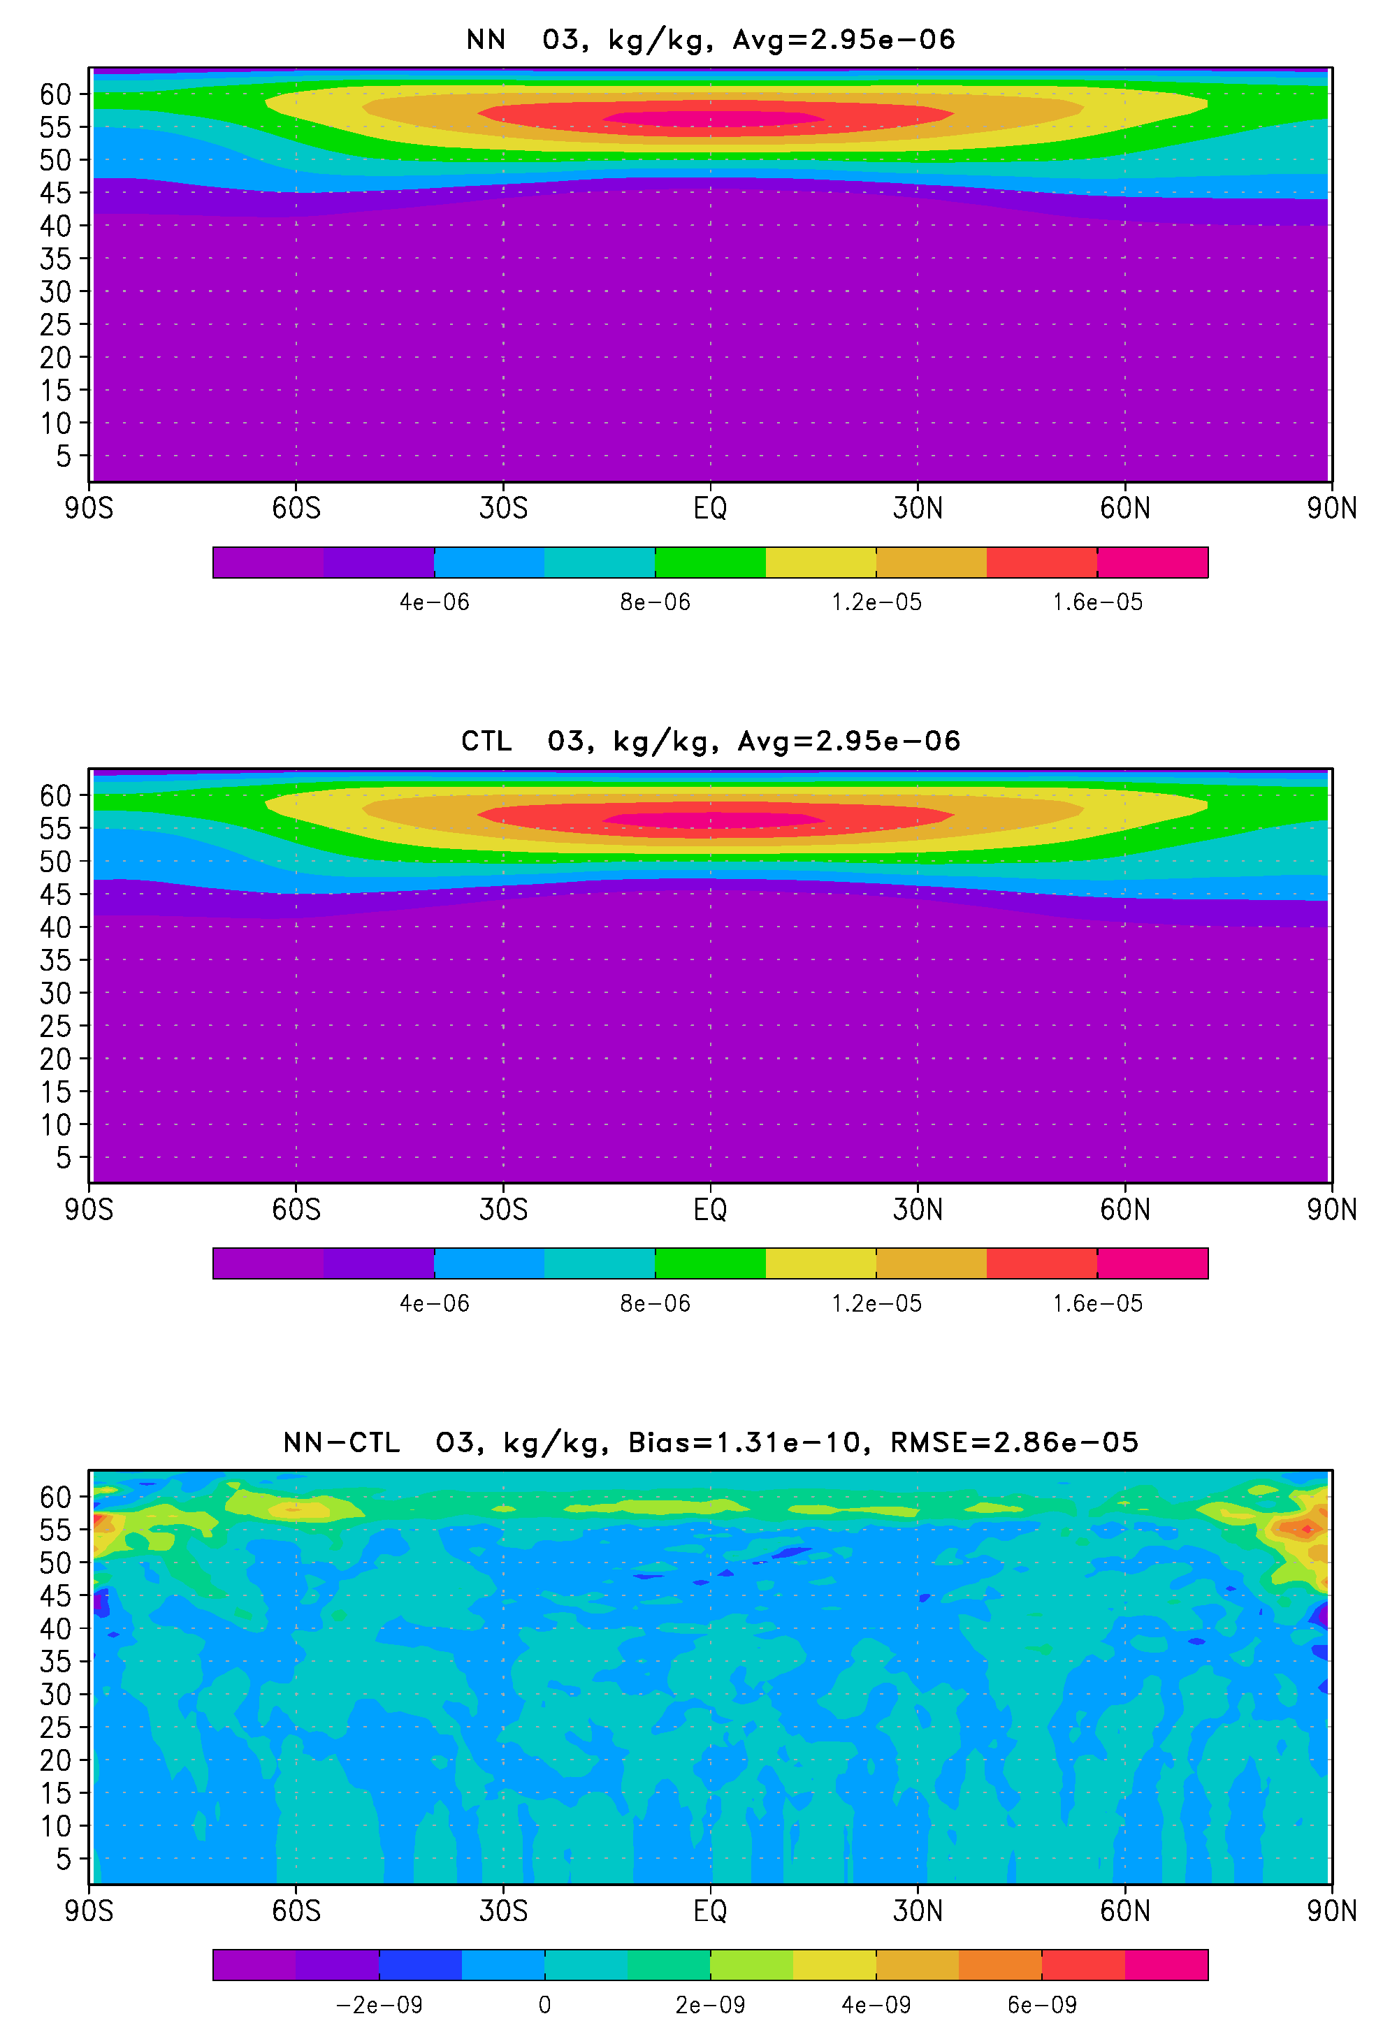
24 10-day forecasts (zonal means) - 2
Bias = 4.10⁻⁴ g/kg
Bias = 6.10⁻⁶ g/kg
Bias = 1.10⁻¹⁰ g/kg

Slide 7
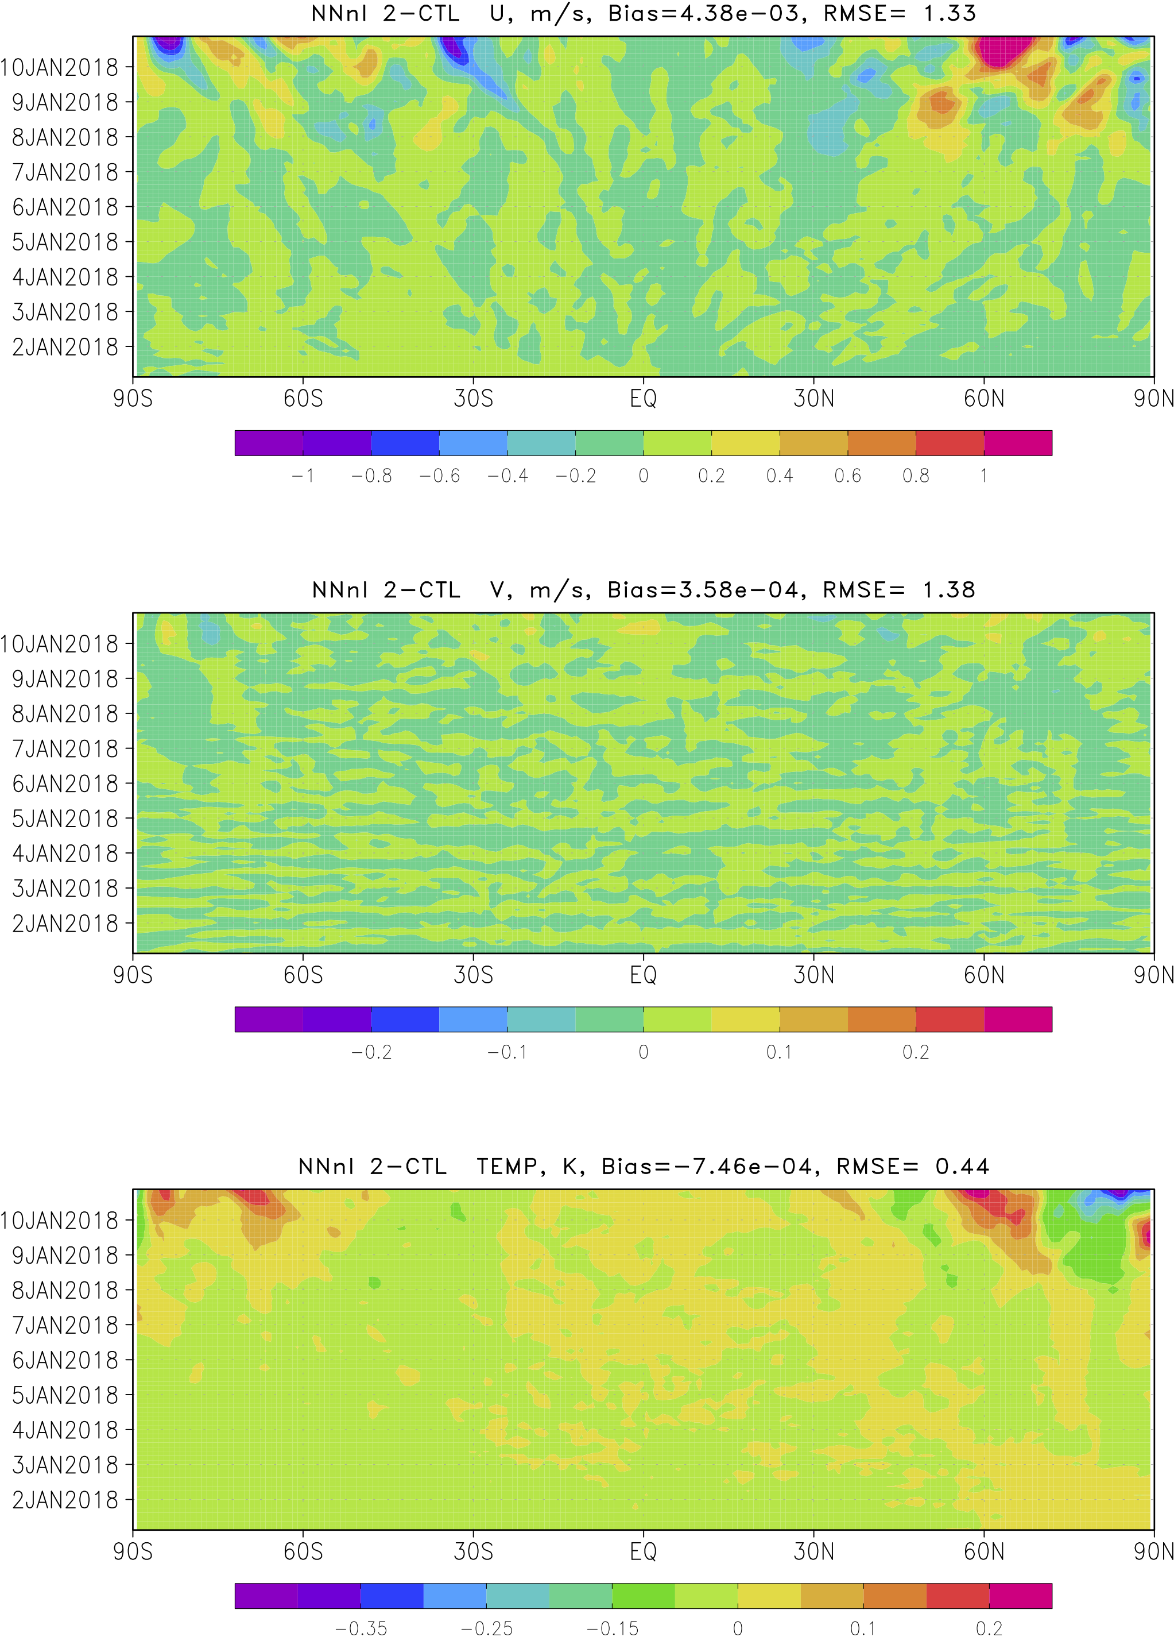
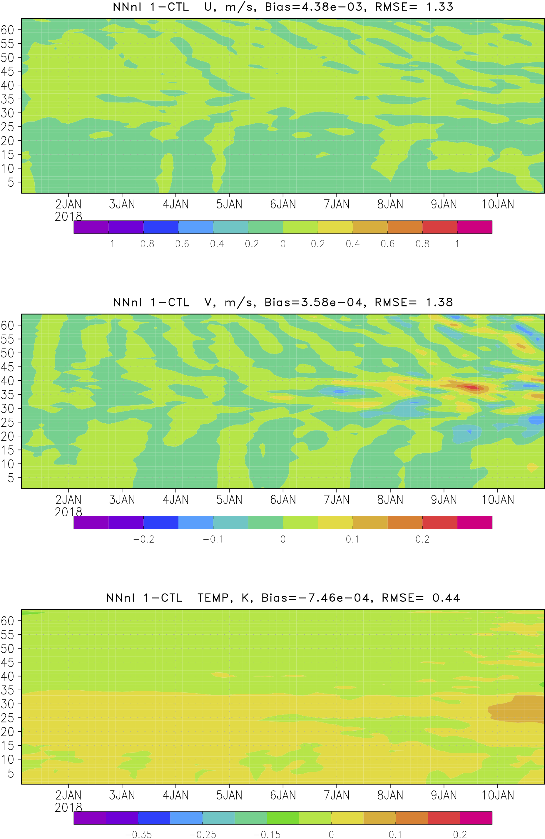
Evolution of Biases with Time
Forecast time
Forecast time

Slide 8
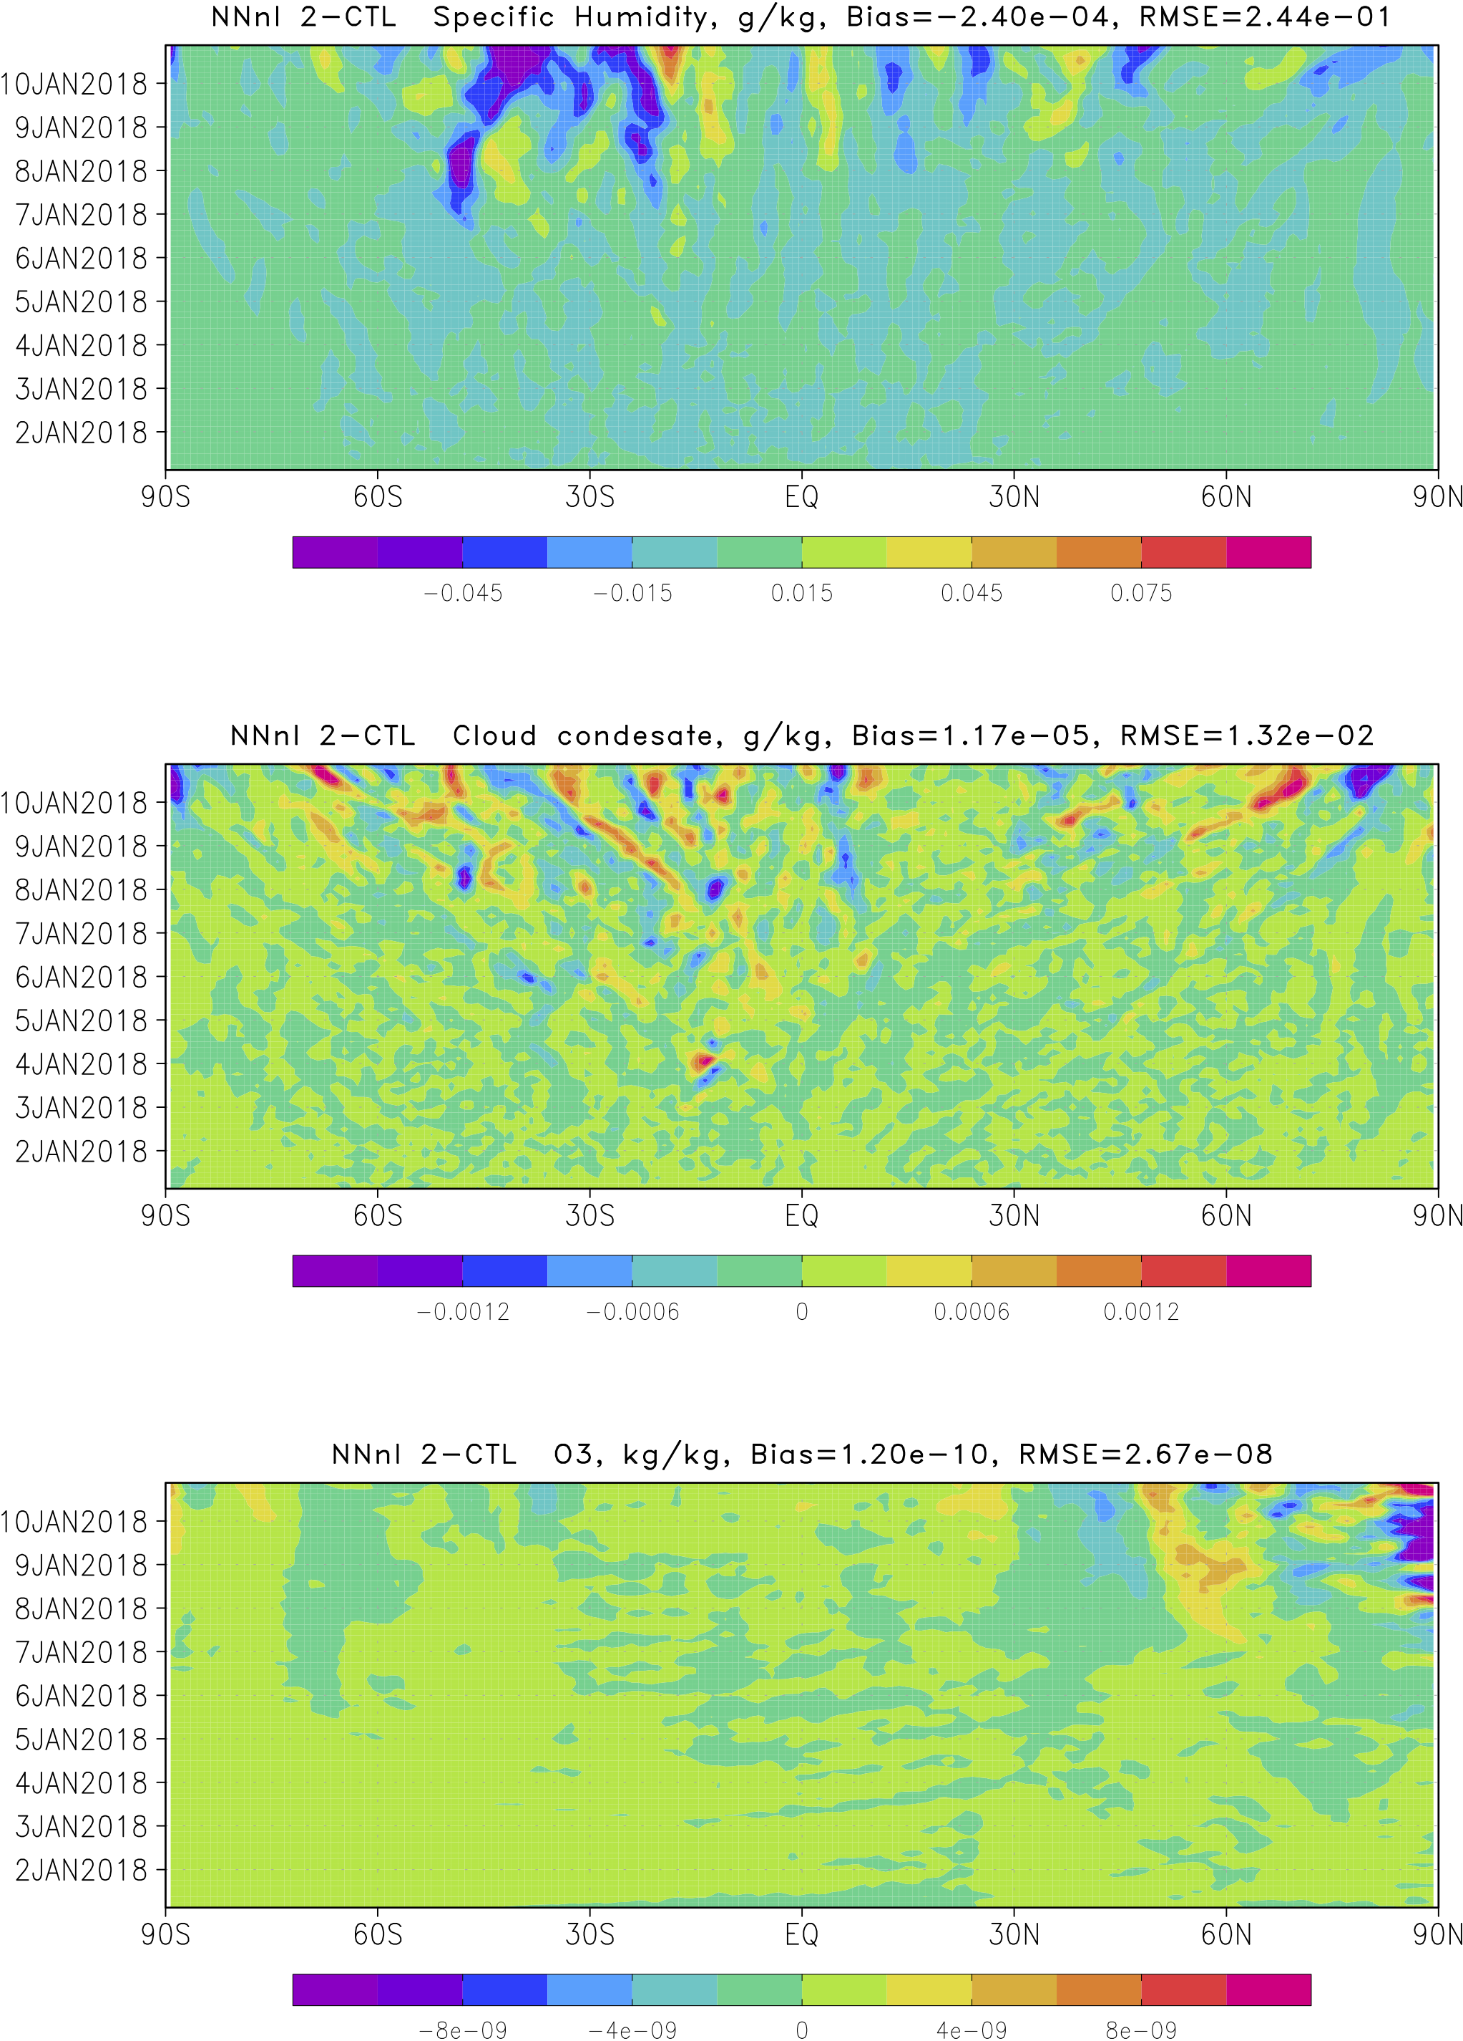
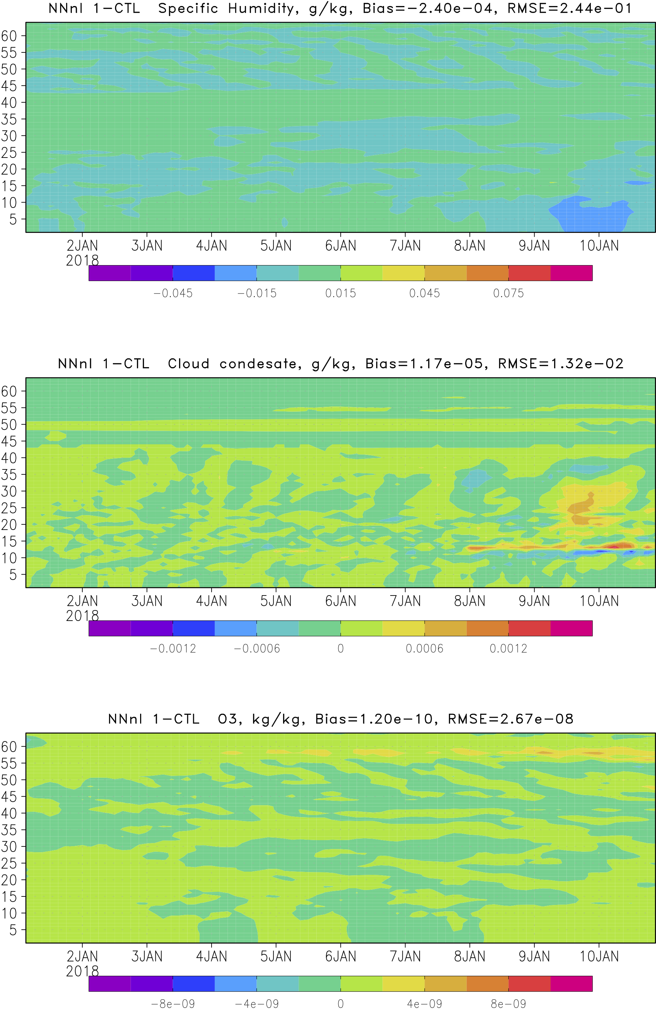
Evolution of Biases with Time
Forecast time
Forecast time

Slide 9
Validation of NN Model Physics
24 10-day forecasts over 2018, no signs of instability
Control run is reproduced with high accuracy
One-year continuous NN run, no signs of instability
Run NN in GFS C384L64 (trained on C96L64), no signs of instability

Slide 10
NN Stability
General issues
Model physics and individual parameterizations are mappings
$$Y=M\left(X\right); X∈ ℜ^{n}, and Y∈ ℜ^{m}$$
SNNs are generic & universal tool for approximating continuous and almost continuous mappings (Hornik 1991, 1993, Vapnik 2019)

Slide 11
NN Complexity and Nonlinearity
Complexity and nonlinearity of approximating/emulating NN should not exceed the complexity and nonlinearity of the mapping to be approximated
SNN vs. DNN
SNN complexity => $ℂ_{s}=k⋅\left(n+m+1\right)+m$
DNN complexity => $ℂ_{D}=\sum_{i = 0}^{K}{k_{i+1}(k_{i}+1)}$
SNN nonlinearity => $y_{j}=b_{j}^{}+\sum_{i=1}^{k}{a_{ji}^{}∙φ_{i} }, j=1, ⋯, M$
DNN nonlinearity => $y_{j}\sim φ_{1}\left(φ_{2}\left(φ_{3}\left(⋯\right)\right)\right), j=1, ⋯, M$
DNN: complexity and nonlinearity increase very quickly with adding new hidden layers
It is more difficult to control complexity and nonlinearity (overfitting and generalization) of DNN

Slide 12
Activation Function (AF)
Choice of activation function may affect stability of NN
If use of AFs that are not continuously differentiable (e.g., ReLU):
May cause problems with gradient-based optimization
Your NN emulation is not continuously differentiable
When the range of the AF is finite, gradient-based training methods tend to be more stable
When AF approximates identity near the origin, i.e.,
$φ\left(0\right)=0, φ^{′}\left(0\right)=1, and{ φ}^{′} is continuous at 0$, weights are recommended to be initialized with small random values.
Old fashioned sigmoid and tanh fulfill all these conditions

Slide 13
Training Set (TS)
TS preparation may affect stability of NN
Amount of data:
$ℂ_{D}$ > $ℂ_{s}$, therefore $N_{D}$ > $N_{s}$
$N_{D}$ > $ℂ_{D}$ and $N_{s}$ > $ℂ_{s}$
Representativeness of data:
Annual cycle
Diurnal cycle
Extreme events
Data preprocessing:
Proper sampling (e.g., polar areas are overrepresented in lat x lon grid)
Proper purging and normalization of inputs and outputs (e.g., removing constants)

Slide 14
Additional issues that may lead to NN instability
When learn a new NN parameterization for GCM from the data simulated by higher resolution model (e.g., CRM)
Projecting: removing CRM variables that are not present in GCM
Projecting introduces stochasticity in the training set
ML/NN parameterization/mapping becomes stochastic and should be treated as such; otherwise NN may become unstable

Slide 15
Conclusions
NN, when properly trained, provides an accurate and stable emulation of the full suite of the model physics in a state-of-the-art GFS
Transfer of knowledge should be performed accurately to produce stable NNs:
DNNs are sensitive tools, require careful use
Choice of activation function may affect NN stability
Preparation of data sets is important for NN stability
Stochasticity should be treated properly

