Slide 1


A Storm Event Imagery Dataset for Deep Learning Applications in Radar and Satellite Meteorology
Mark S. Veillette
MIT Lincoln Laboratory
mark.veillette@ll.mit.edu
Siddharth Samsi
MIT Lincoln Laboratory
sid@ll.mit.edu
The 2nd NOAA Workshop on Leveraging AI in Environmental Sciences
17 December 2020

Slide 2
Acknowledgement
Research was sponsored by the United States Air Force Research Laboratory and the United States Air Force Artificial Intelligence Accelerator and was accomplished under Cooperative Agreement Number FA8750-19-2-1000. The views and conclusions contained in this document are those of the authors and should not be interpreted as representing the official policies, either expressed or implied, of the United States Air Force or the U.S. Government. The U.S. Government is authorized to reproduce and distribute reprints for Government purposes notwithstanding any copyright notation herein.

Slide 3
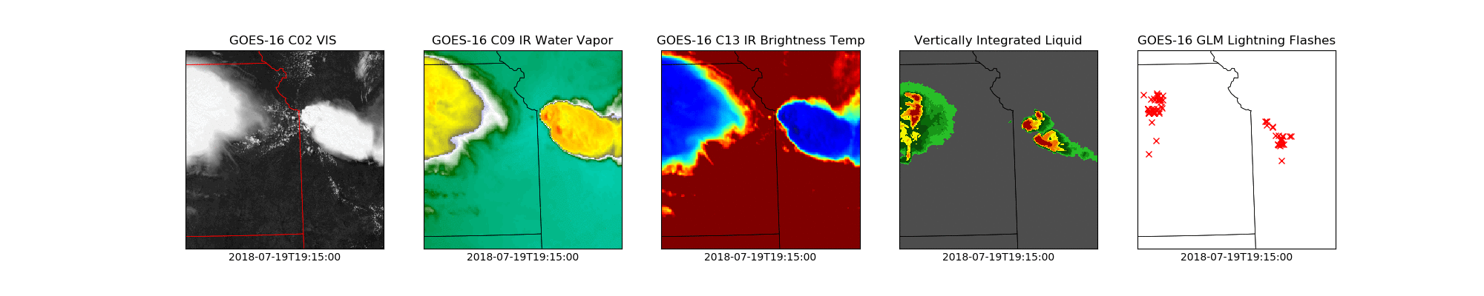
Overview
This talk introduces a new benchmark dataset for AI applications in radar and satellite meteorology, the Storm Event Imagery (SEVIR) Dataset
Public challenge problems are being constructed that illustrate applications of SEVIR
Download: https://registry.opendata.aws/sevir/
Tutorial: https://nbviewer.jupyter.org/github/MIT-AI-Accelerator/eie-sevir/blob/master/examples/SEVIR_Tutorial.ipynb
SEVIR Challenges (BETA): https://sevir.mit.edu
Sample SEVIR Event

Slide 4
Outline
Motivation
Dataset description
Applications of SEVIR

Slide 5
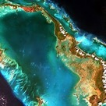
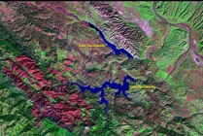
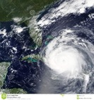
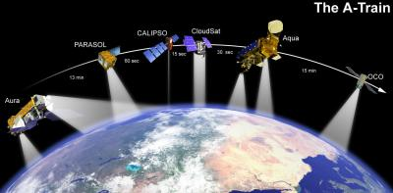
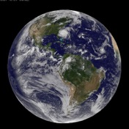
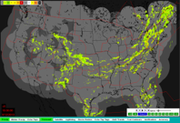
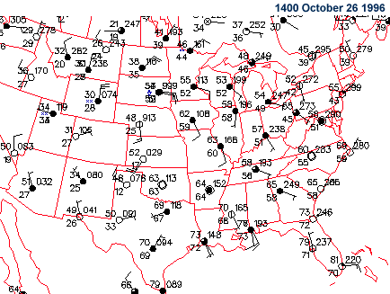
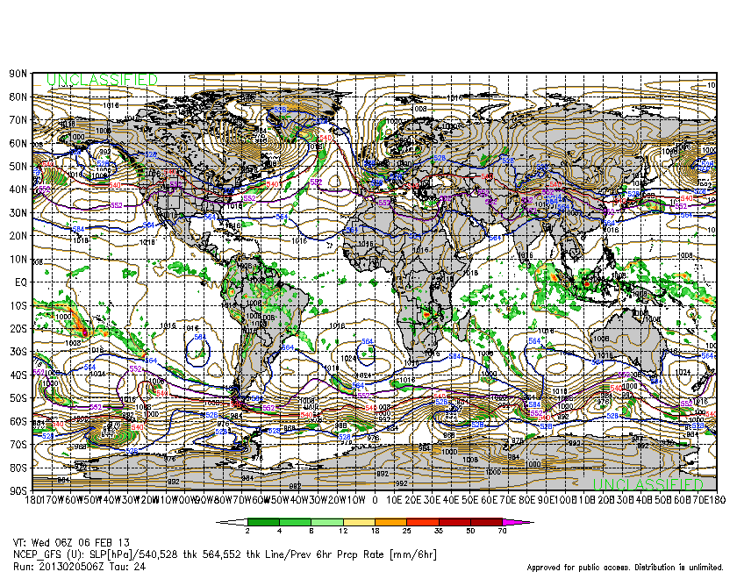
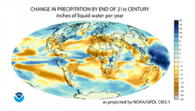
Earth Systems Data
Sentinel
LandSat
MODIS
Weather Satellites
Radar
Land & Ocean Observations
Numerical Weather & Climate Models
The deluge of earth systems data is a blessing and a curse
Good: Easy access to massive amounts of data creates opportunities for AI research
Bad: The shear size and complexity of the data creates barriers to entry

Slide 6











Benchmark Datasets in Environmental Science
Benchmark Datasets
Data Curation
MNIST
CIFAR 10
Imagenet
celebA
ML
Readiness
Unstructured
Unorganized
Unlabeled
Too Small
Not Diverse
Non-Tabular structure
Uncommon or proprietary formats
Complex
Too big
Difficult to obtain
Tabular/Tensors
Standard Formats
Labeled
Sized for GPUs
Freely Available
Advances in ML for Environmental science can be accelerated through high-quality benchmark datasets

Slide 7
AI Challenges
AI Challenge Components
Problem
Identify a problem that can be solved using data
e.g,
Short-term forecasting
Synthetic weather radar
Data assimilation
Datasets
Identify datasets that can be used to build solutions to this problems
e.g.,
GALWEM model
GOES satellite
NEXRAD radar
Data Curation
Convert raw data into training/testing datasets that are compatible with ML algorithms
e.g.,
SEVIR
ML Algorithms
Models that learn automatically from curated datasets
e.g.,
CNNs
GANs,
Physics-informed models
Metrics
Measures of model performance on held-out data that wasn’t used during training
e.g.
Pixel-wise similarity (POD, FAR, CSI)
Perceptual similarity (SSIM, LPIPs)
Clear mathematical statement of a problem
Identification of relevant datasets or proxy datasets
Training and testing datasets suitable for target ML problem
Baseline models that reflect state-of-the-art
Useful metrics that reflect future improvement
AIA challenge deliverables
An AI Challenge is a compact representation of a capability that can be easily shared, reproduced and improved

Slide 8
Recent Benchmark Datasets and Challenges for Weather
WeatherBench: Weather forecasting
  Stephan Rasp, Peter D. Dueben, Sebastian Scher, Jonathan A. Weyn, Soukayna Mouatadid, and Nils Thuerey, 2020. WeatherBench: A benchmark dataset for data-driven weather forecasting.
  Challenge: https://github.com/pangeo-data/WeatherBench
RainBench: Precipitation Forecasting
  Catherine Tong, Christian Schroeder de Witt, Valentina Zantedeschi, Daniele De Martini, Freddie Kalaitzis, Matthew Chantry, Duncan Watson-Parris, Piotr Biliński 2020. RainBench: Enabling Data-Driven Precipitation Forecasting on a Global Scale
TAASRAD19: Weather radar reflectivity
  Franch, Gabriele, et al. "TAASRAD19, a high-resolution weather radar reflectivity dataset for precipitation nowcasting." Scientific Data 7.1 (2020): 1-13.
Our Contribution: High resolution Storm Event Imagery (SEVIR) Dataset
  Veillette, Mark, Siddharth Samsi, and Chris Mattioli. "SEVIR: A Storm Event Imagery Dataset for Deep Learning Applications in Radar and Satellite Meteorology." Advances in Neural Information Processing Systems 33 (2020).
  Challenge: https://sevir.mit.edu

Slide 9
Outline
Motivation
Dataset description
Applications of SEVIR

Slide 10

Storm EVent ImageRy (SEVIR) Dataset
SEVIR is a dataset of spatially and temporally aligned image sequences depicting weather events
Each sequence, or “event” in SEVIR contains a 384 km x 384 km region spanning a 4 hours and containing one of more of the following:
  Digital Vertically Integrated Liquid (VIL) extracted from the NextGen Weather Processor archives
  GOES-16 0.64 $μ$m Visible (C02), 6.9 $μ$m Infrared (C09) and 10.7 $μ$m Infrared (C13) imagery
  GOES-16 Geostationary Lightning Mapper flashes
Sample SEVIR “Event”
Total Dataset Size: ~1 TB

Slide 11
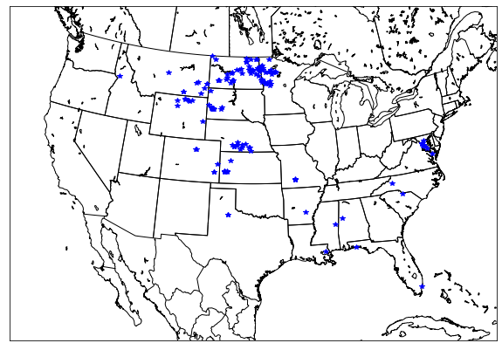
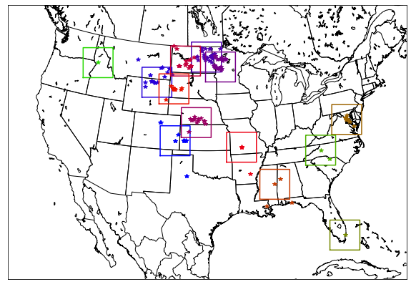
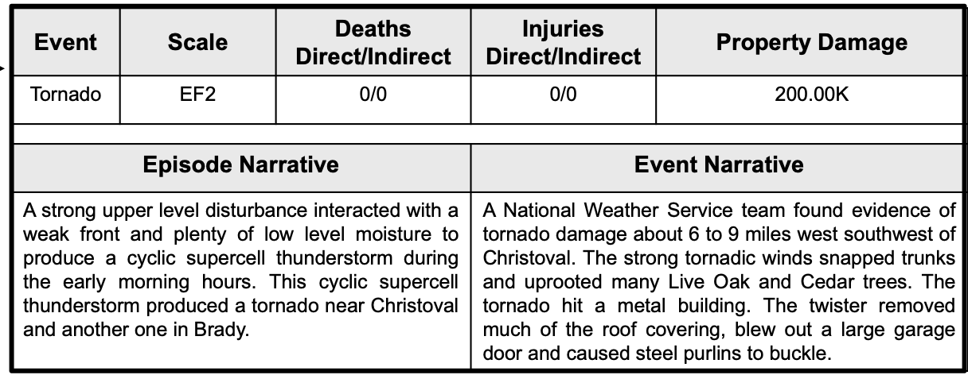
SEVIR Event Selection
SEVIR Events were chosen in one of two ways:
  Based on events in NOAA’s National Centers for Environmental Information (NCEI) Storm Event Database (https://www.ncdc.noaa.gov/stormevents/)
  Or, randomly chosen in areas of NEXRAD coverage over CONUS
Example Storm Event Selection (July 8th 2019)
Sample NOAA Database Entry
Relevant Storm Reports on 7/8/2019
Clustered Storm Reports, with Frame Outline

Slide 12
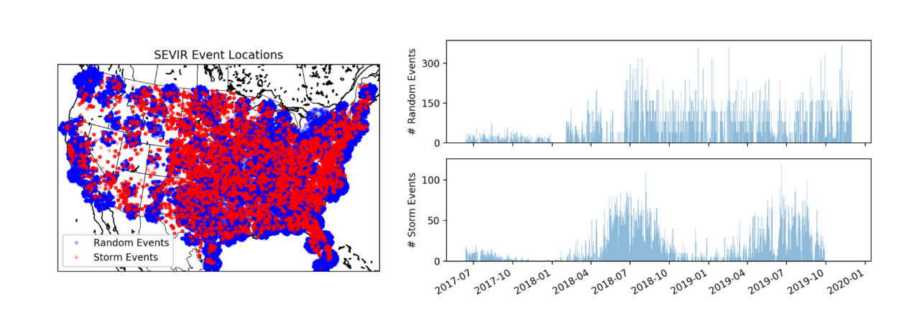
SEVIR Event Details
(as of Dec 2020)

Slide 13
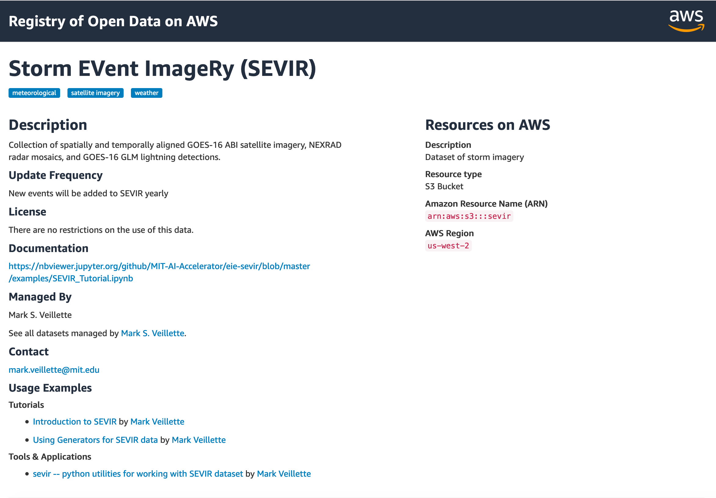
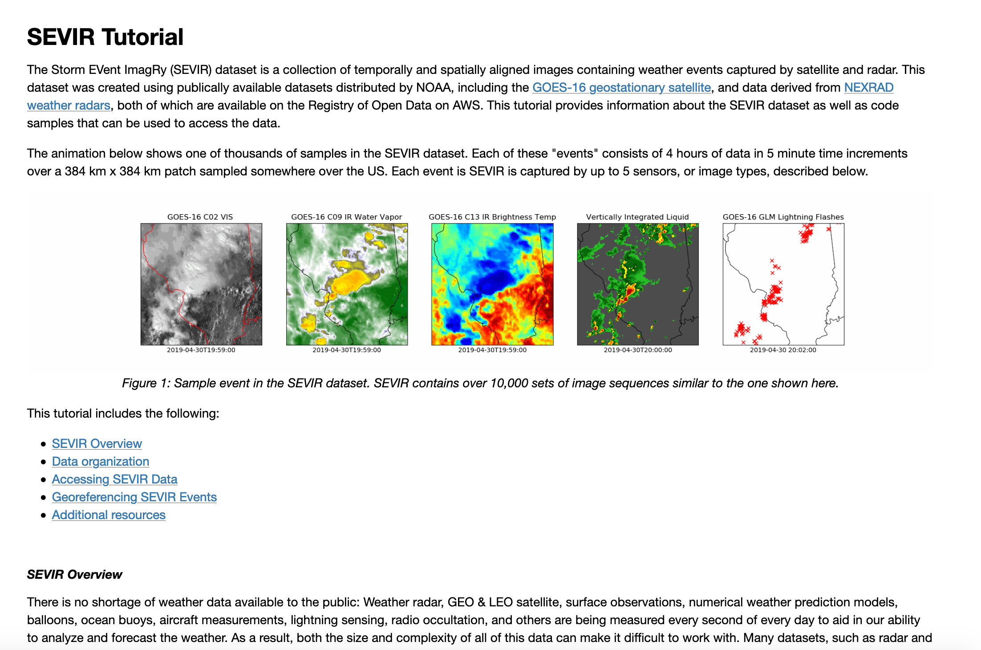
Obtaining and Working with SEVIR
SEVIR can be downloaded from AWS S3
  https://registry.opendata.aws/sevir/
  Full dataset is around 1TB in size, but smaller subsets can be downloaded
Online tutorials provide details and sample code for accessing the data
  https://registry.opendata.aws/sevir/
  https://nbviewer.jupyter.org/github/MIT-AI-Accelerator/eie-sevir/blob/master/examples/SEVIR_Tutorial.ipynb

Slide 14
Outline
Motivation
Dataset description
Applications of SEVIR

Slide 15
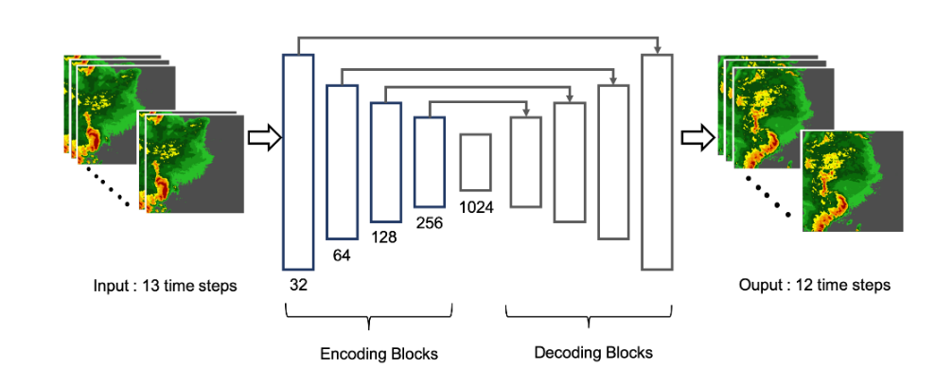
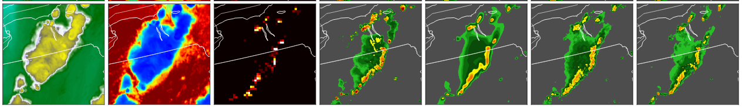
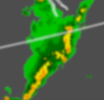
Example SEVIR Challenge Tasks
Future Prediction
Image-to-Image Translation
Inputs: Satellite + Lightning
Output: Radar
Inputs: Past N frames
Outputs: Future M frames
Generate short-term weather forecasts (a.k.a. nowcasts)
Estimate missing image type from known image types
Unsupervised Optical Flow
Super-Resolution
Inputs: N frames
Output: Flow field
Input: Down-Sampled data
Output: Image at original resolution
Estimate wind speed & direction from satellite imagery
Enhance visualization of low-resolution weather imagery
Notes:
.

Slide 16
Radar Nowcasting Benchmark
Problem setup
Model Inputs : One hour of radar & satellite imagery at 5 minute increments
t=-60
t=-55
t=0
Model Outputs : Next hour of weather data at 5 minute increments
t=5
t=60

Slide 17
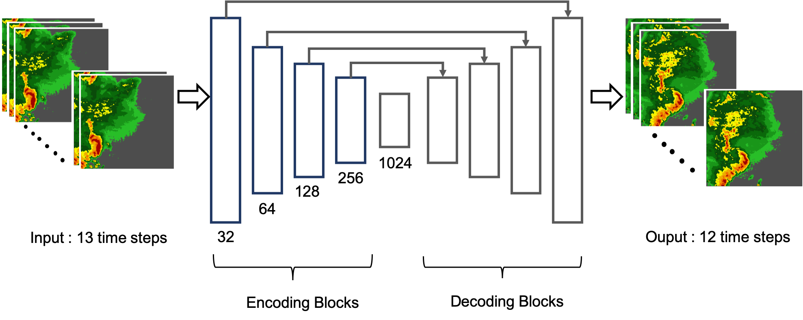
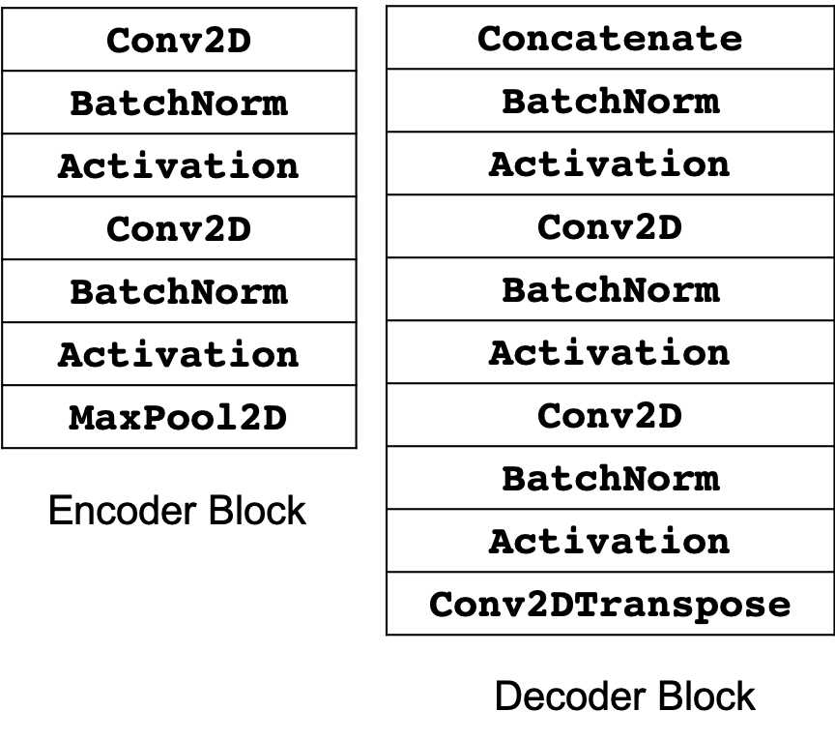
Radar Nowcasting Benchmark
Model Specification

Slide 18
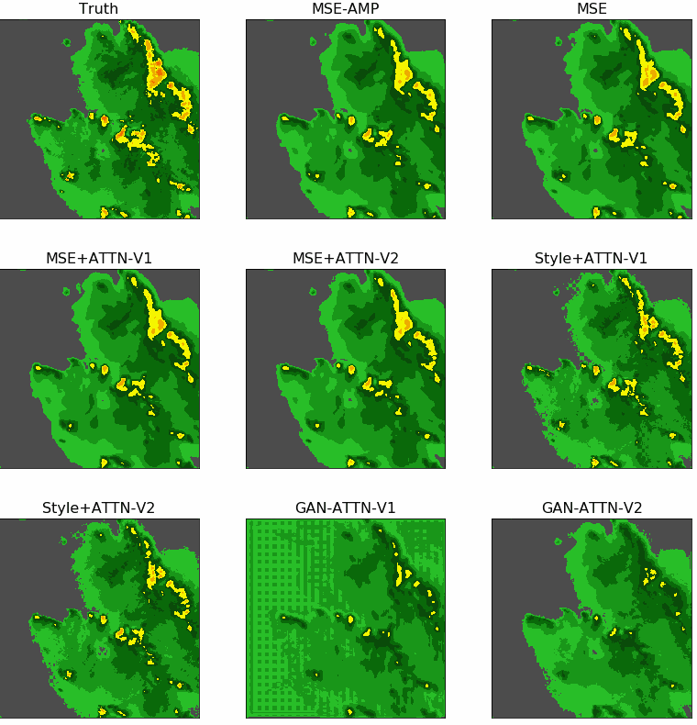
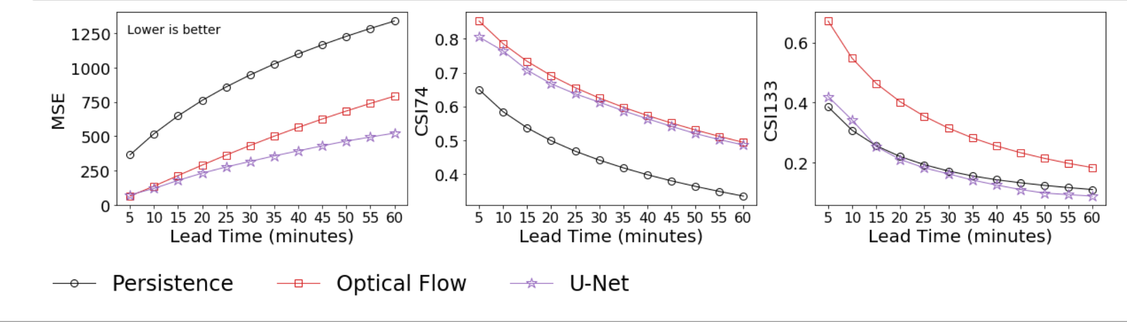
Radar Nowcasting Benchmarks
Target
U-Net Result
Baseline Scores
Lower is Better
Higher is Better
Higher is Better

Slide 19
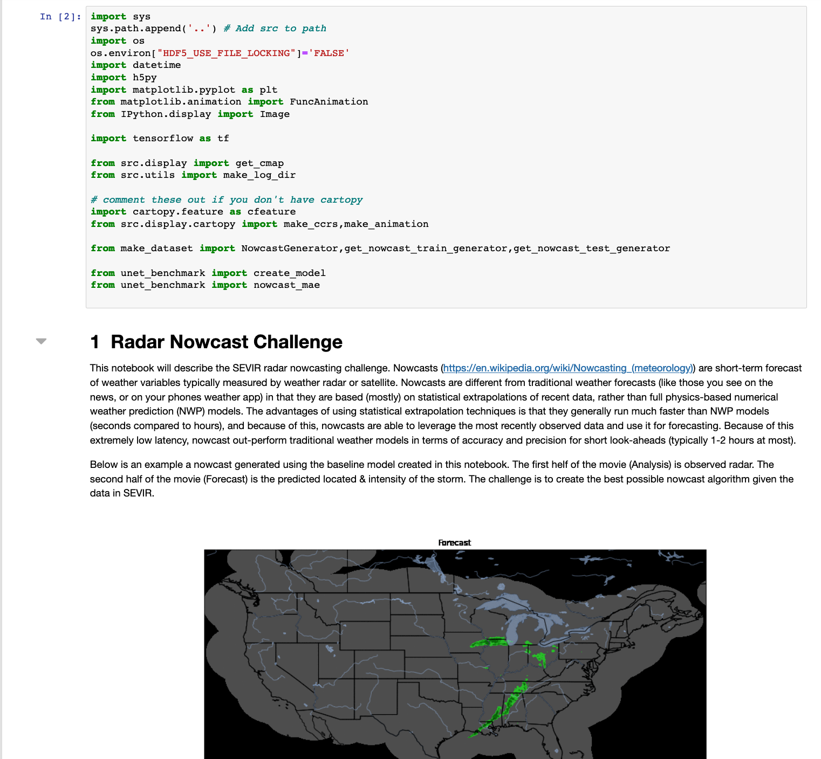
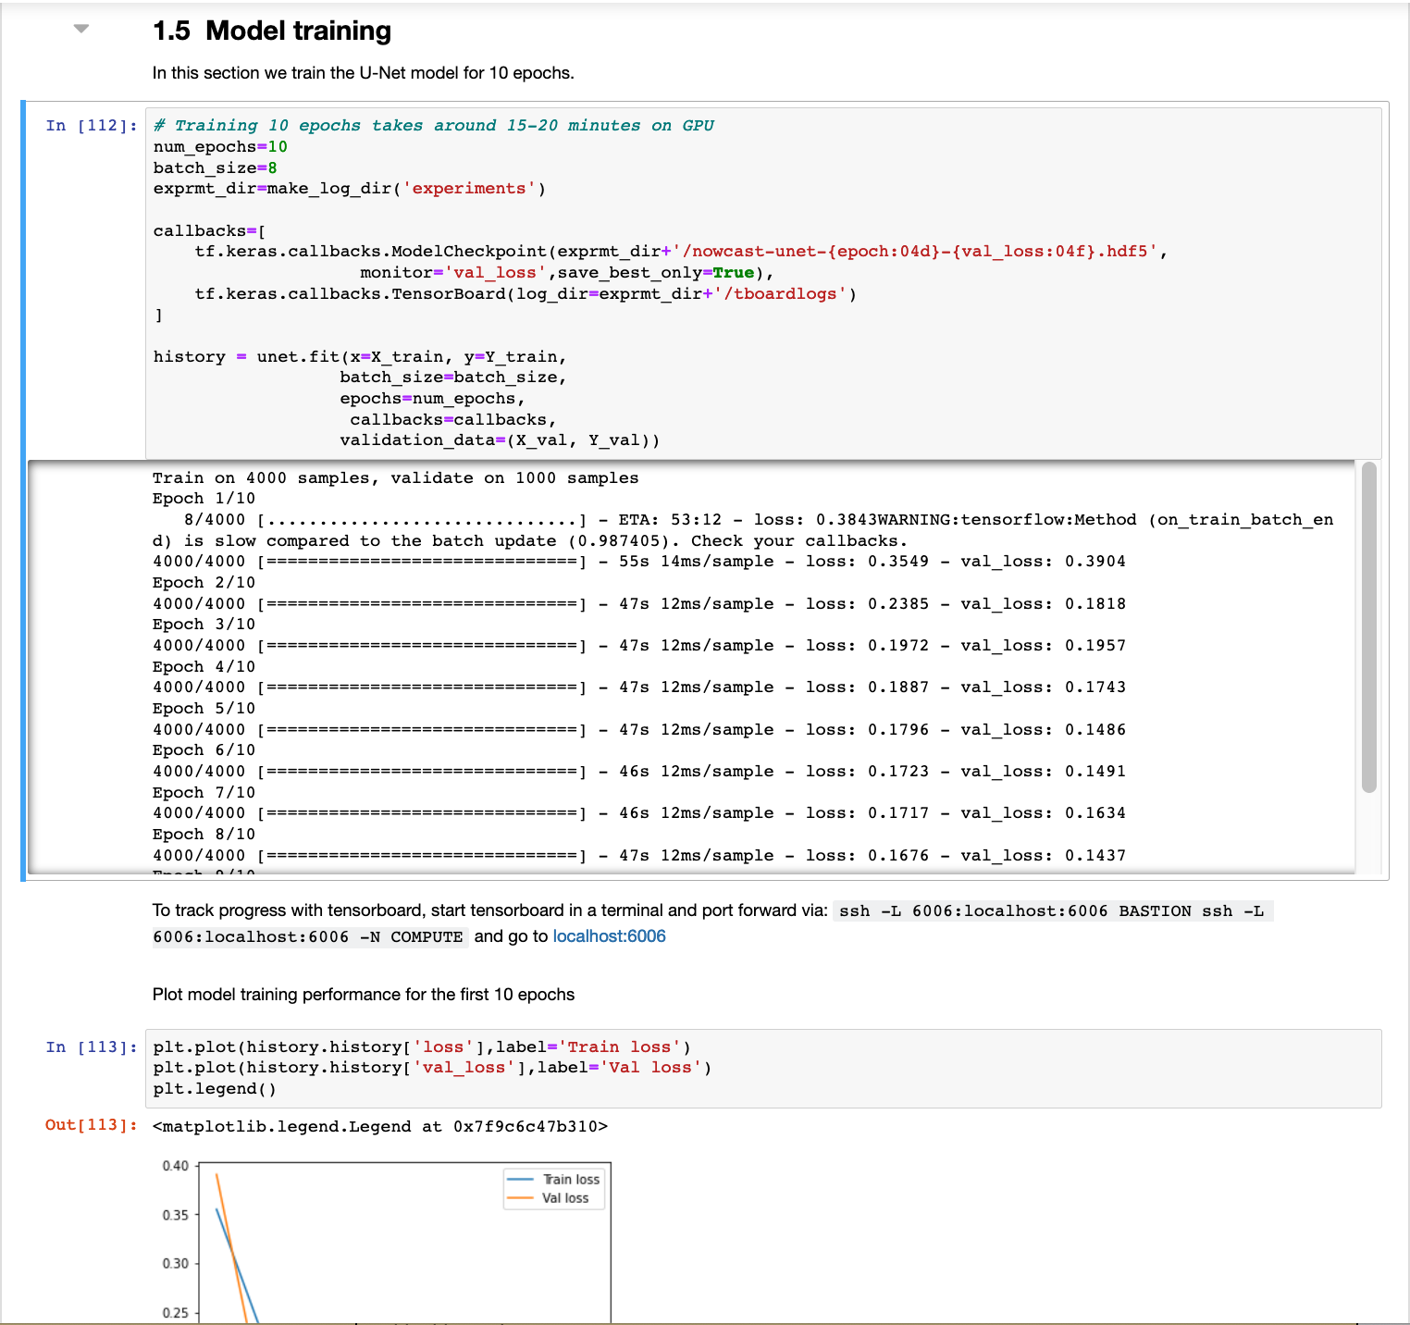
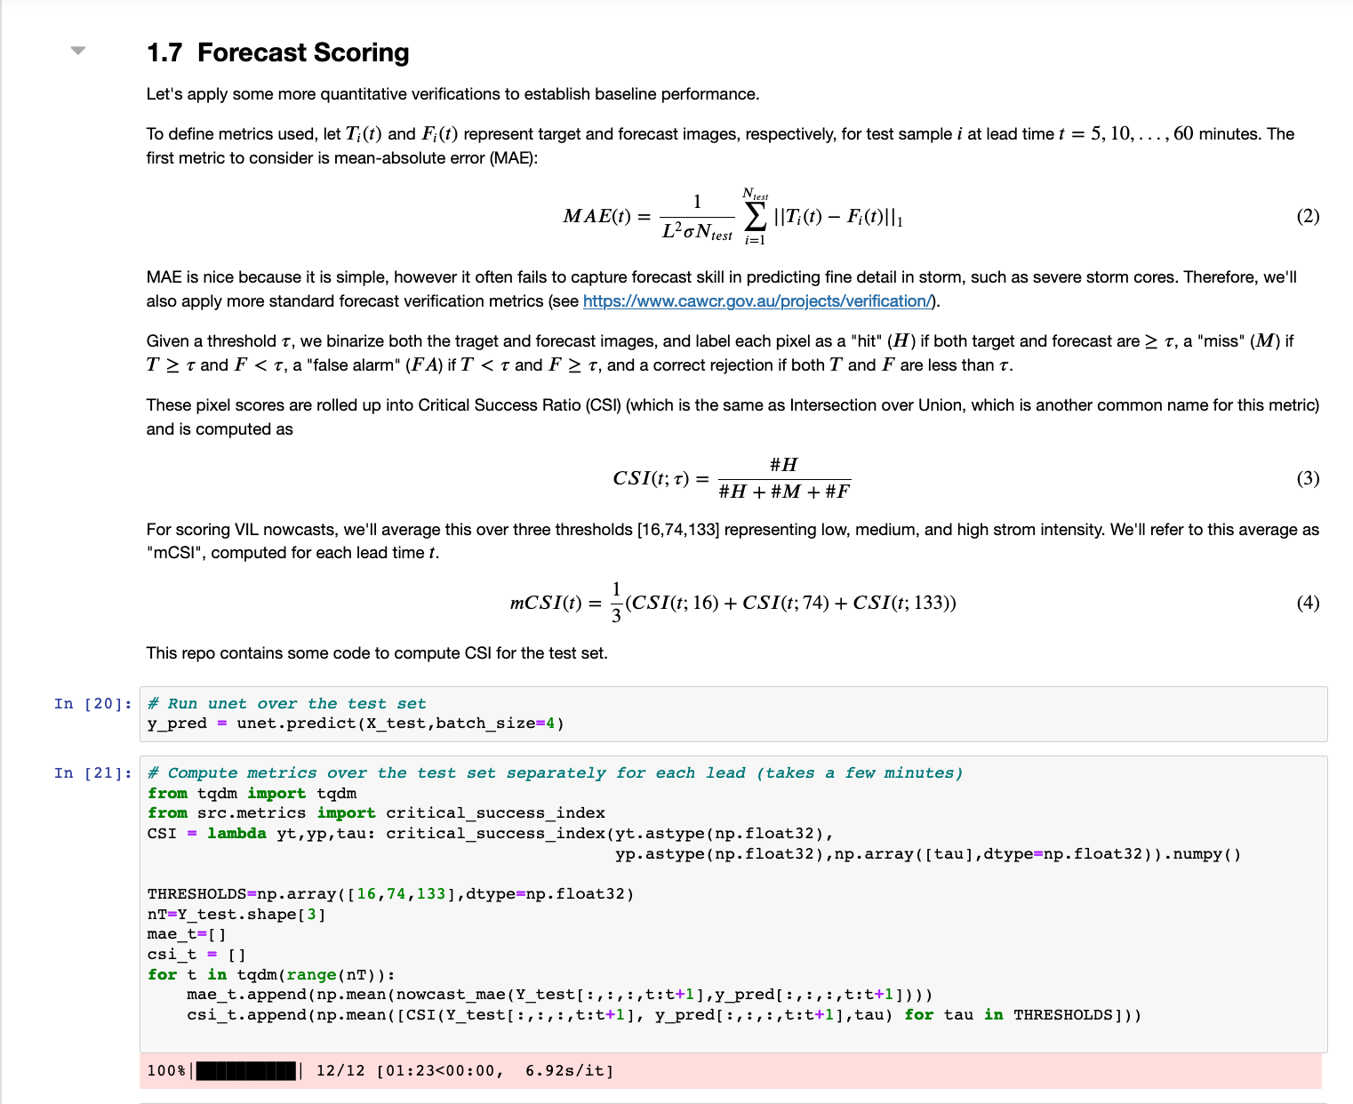
SEVIR Nowcasting Challenge
A public challenge centered around nowcasting and other tasks is under construction
Challenges will be managed through website https://sevir.mit.edu/ containing
  Statements of challenge problems
  Baseline models
  Descriptions of evaluation metrics
(Challenge Notebook BETA)

Slide 20
Example SEVIR Challenge Tasks
Future Prediction
Image-to-Image Translation
Inputs: Satellite + Lightning
Output: Radar
Inputs: Past N frames
Outputs: Future M frames
Generate short-term weather forecasts (a.k.a. nowcasts)
Estimate missing image type from known image types
Unsupervised Optical Flow
Super-Resolution
Inputs: N frames
Output: Flow field
Input: Down-Sampled data
Output: Image at original resolution
Estimate wind speed & direction from satellite imagery
Enhance visualization of low-resolution weather imagery

Slide 21
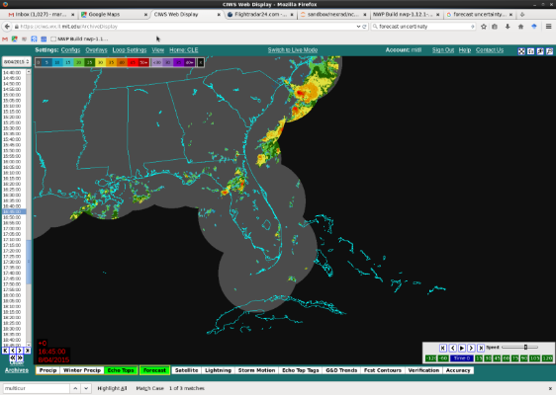
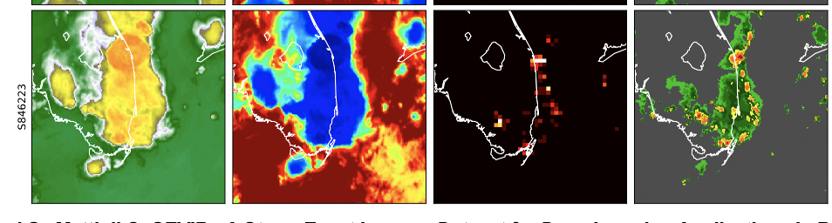
Synthetic Weather Radar
Many areas of the world lack ground-based weather radar required for tactical decision making in the presence of severe weather
Radar VIL can be estimated from other image modalities in SEVIR by applying image-to-image translation methods (e.g. CNNs)
No
Radar
Limited coverage of ground based radar
Synthetic Weather Radar Problem Setup
IR Satellite Imagery
Lightning
Radar VIL

Slide 22
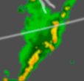
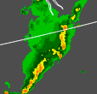

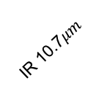

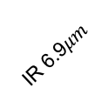
Synthetic Weather Radar
Experimental Setup
An image-to-image model was developed to transform three satellite-based image modalities in SEVIR (ir069, ir107, lght) to the radar modality (vil)
A U-Net architecture was used for the generator with two loss components
  L1 reconstruction loss: $L_{recon}\left(x,y\right)={\left\|G(x)−y\right\|}_{1}$
  Conditional GAN loss: $L_{cGAN}\left(X,Y,\hat{Y}\right)=E_{x,y}\left[D\left(x,y\right)\right]+E_{x}[1−D\left(x,G\left(x\right)\right)]$
Satellite & Lightning Inputs
Synthetic Radar Output
Loss function
${λ L}_{cGAN}+ L_{recon}$
IR 6.9$μm$
IR 10.7$μm$
Radar Truth
Total Lightning
[1] Veillette, M., Samsi S., Mattioli, C., SEVIR : A Storm Event Imagery Dataset for Deep Learning Applications in Radar and Satellite Meteorology, accepted to NeurIPS 2020

Slide 23
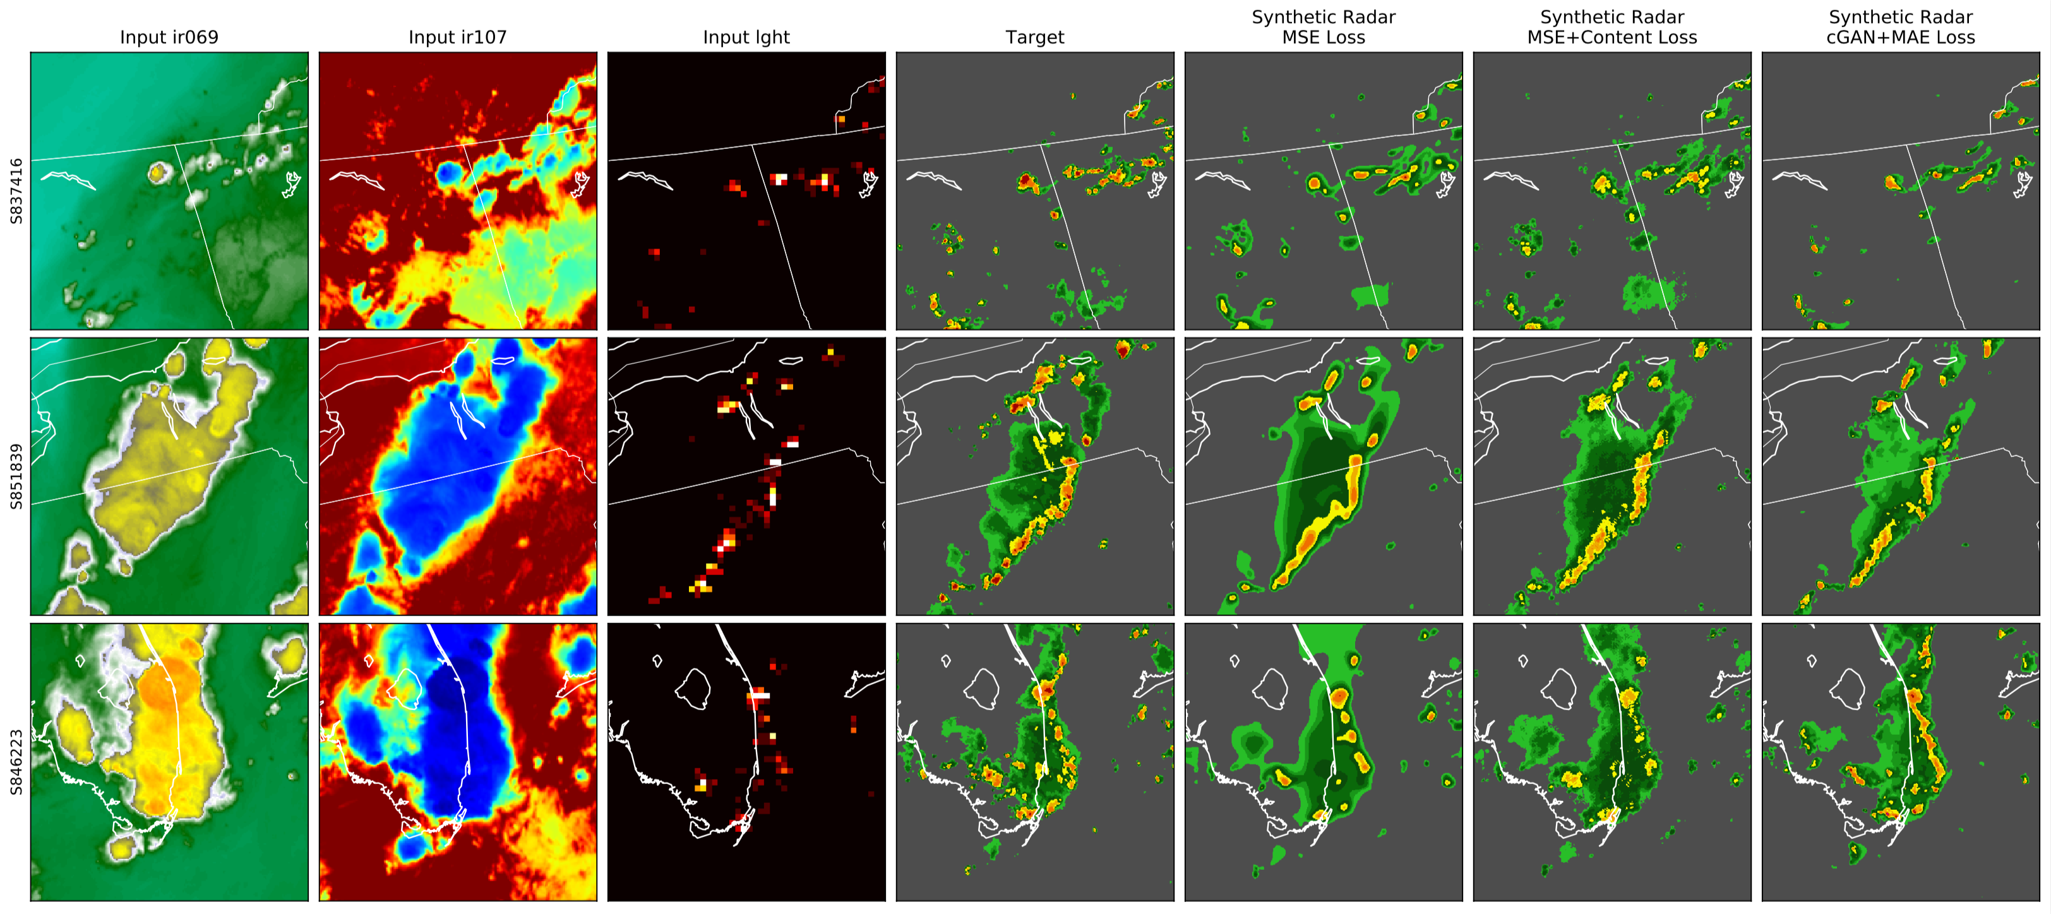


Synthetic Weather Radar Results
Qualitative Evaluation
Reconstruction only
$$λ=0$$
Conditional GAN
$$λ>0$$
Target
Inputs
IR Satellite
Lightning
Synthetic Radar
Actual Radar
Conditional GAN appears to improve visual similarity,
But is it a better result?

Slide 24
Synthetic Weather Radar Results
Quantitative Evaluation on Test Set
Pixel-wise Performance Metrics
Visual Similarity Metrics
Metric | Reconstruction Only | Conditional GAN
MAE (lower is better) | 10.93 | 12.69
MSE (lower is better) | 466.64 | 738.41
POD (Recall) (higher is better) | 0.4994 | 0.3176
CSI (IoU) (higher is better) | 0.4273 | 0.2803
Metric | Reconstruction Only | Conditional GAN
LPIPS (Lower is better) | 0.3934 | 0.3498
Better
Better
GANS successfully added visual realism, but have yet to improve pixel-wise skill
LPIPS = Learned Perceptual Image Patch Similarity (LPIPS)
Richard Zhang, Phillip Isola, Alexei A. Efros, Eli Shechtman, Oliver Wang. The Unreasonable Effectiveness of Deep Features as a Perceptual Metric In CVPR, 2018.

Slide 25
Conclusion
SEVIR is a ~1TB dataset containing spatially and temporally aligned weather imagery across multiple sensing types
  IR & VIS satellite, radar & lightning sensing
  Dataset available on AWS
A number of problems can be studied using this dataset
  Applied: short-term forecasting, image-to-image translation, optical flow, super-resolution
  Fundamental Research : Robustness, few-shot techniques, interpretability
A public nowcasting challenge is planned for early 2021, and will be managed through https://sevir.mit.edu/
  https://registry.opendata.aws/sevir/

