Slide 1
Using Deep Learning to Generate Synthetic Radar Fields from GOES ABI and GLM
Kyle Hilburn (Kyle.Hilburn@colostate.edu)
Cooperative Institute for Research in the Atmosphere (CIRA)
2nd NOAA Workshop on Leveraging AI in Environmental Sciences
January 07, 2021
Earlier presentations will be cited as:
Kyle Hilburn 20210107
List of Acronyms and Abbreviations
ABI Advanced Baseline Imager
CONUS Continental United States
DA Data Assimilation
ERF Effective Receptive Field
FAR False Alarm Rate
GLM Geostationary Lightning Mapper
GOES Geostationary Operational Environmental Satellite
GREMLIN GOES Radar Estimation via Machine Learning to Inform NWP
HPC High Performance Computing
HRRR High Resolution Rapid Refresh
LRP Layer-wise Relevance Propagation
ML Machine Learning
MRMS Multi-Radar Multi-Sensor System
NN Neural Network
NWP Numerical Weather Prediction
POD Probability of Detection
RAP Rapid Refresh
REFC Composite reflectivity (vertical maximum)
RF Receptive Field
TRF Theoretical Receptive Field
VIL Vertically Integrated Liquid

Slide 2
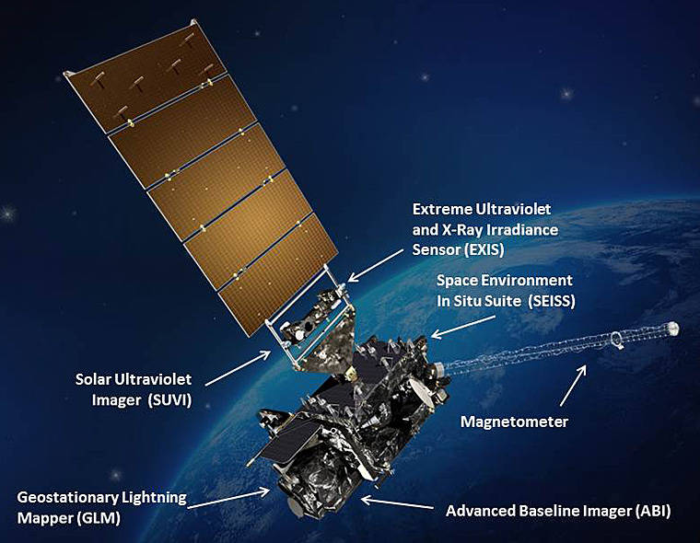
Motivation
Well described by Sid Boukabara 20200730:
  Increasing volume of observations
  Increasing diversity of data sources
  Higher spatial resolution in NWP models
  Faster temporal refresh frequency
  Ensemble modeling systems
  Coupled modeling systems
  Constraints: Budget, HPC, and time during the operational production cycle
Specifically of interest,
  GOES data have long been used by human forecasters for situational awareness
  But have limited usage in NWP, especially for cloudy and precipitating scenes
GOES-R Series opportunities:
  3x greater spectral resolution
  4x greater spatial resolution
  5x greater temporal resolution
  Lightning mapping
GOES-R Satellite
Image credit: NASA
https://www.nasa.gov/content/goes-r/index.html

Slide 3
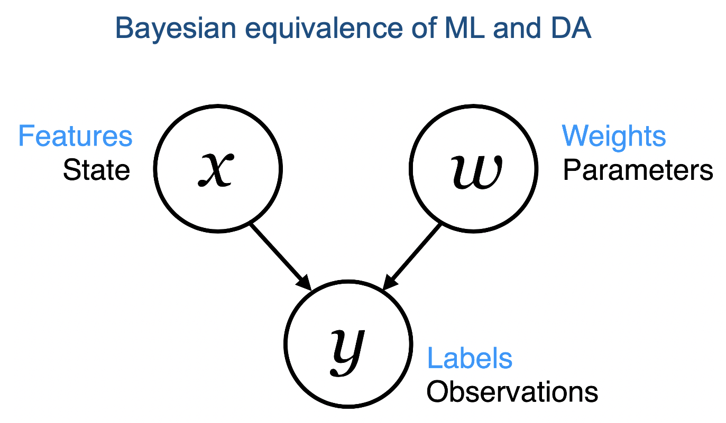
Why Machine Learning?
Current dynamical NWP models are very powerful tools
  Hard for ML to compete (Peter Dueben 20200730)
But this is not an either/or proposition
  Alan Geer 20200827 showed the equivalence of ML and DA
Convolutional NNs make use of spatial information
  Spatial information is not currently used by DA systems
  Can add value where models are uncertain or costly to run
  Areas of precipitation are especially problematic for DA
Variational DA directly increments the control variables
  For example, pressure, temperature, humidity, and wind
  The idea here is to use ML as an observation operator
  Target RAP/HRRR, uses radar for latent heating initialization
Adapted from Geer 20200827

Slide 4
Interpreting What Is Learned
Convolutional neural networks are very powerful tools for encoding and decoding spatial patterns
  Learning statistical relationships, not physical ones
How do we know what was learned and whether it is trustworthy?
  Explainable AI tools (Amy McGovern 20200910)
  Imme Ebert-Uphoff 20200917 reviewed tools that we found particularly helpful with GREMLIN:
    Ablation studies
    Layer-wise relevance propagation (LRP)
    Synthetic input studies
  Process is very similar to the scientific method
ML Interpretation Process
Question
Hypothesis
Analysis
Interpretation
Experiment
Testing

Slide 5
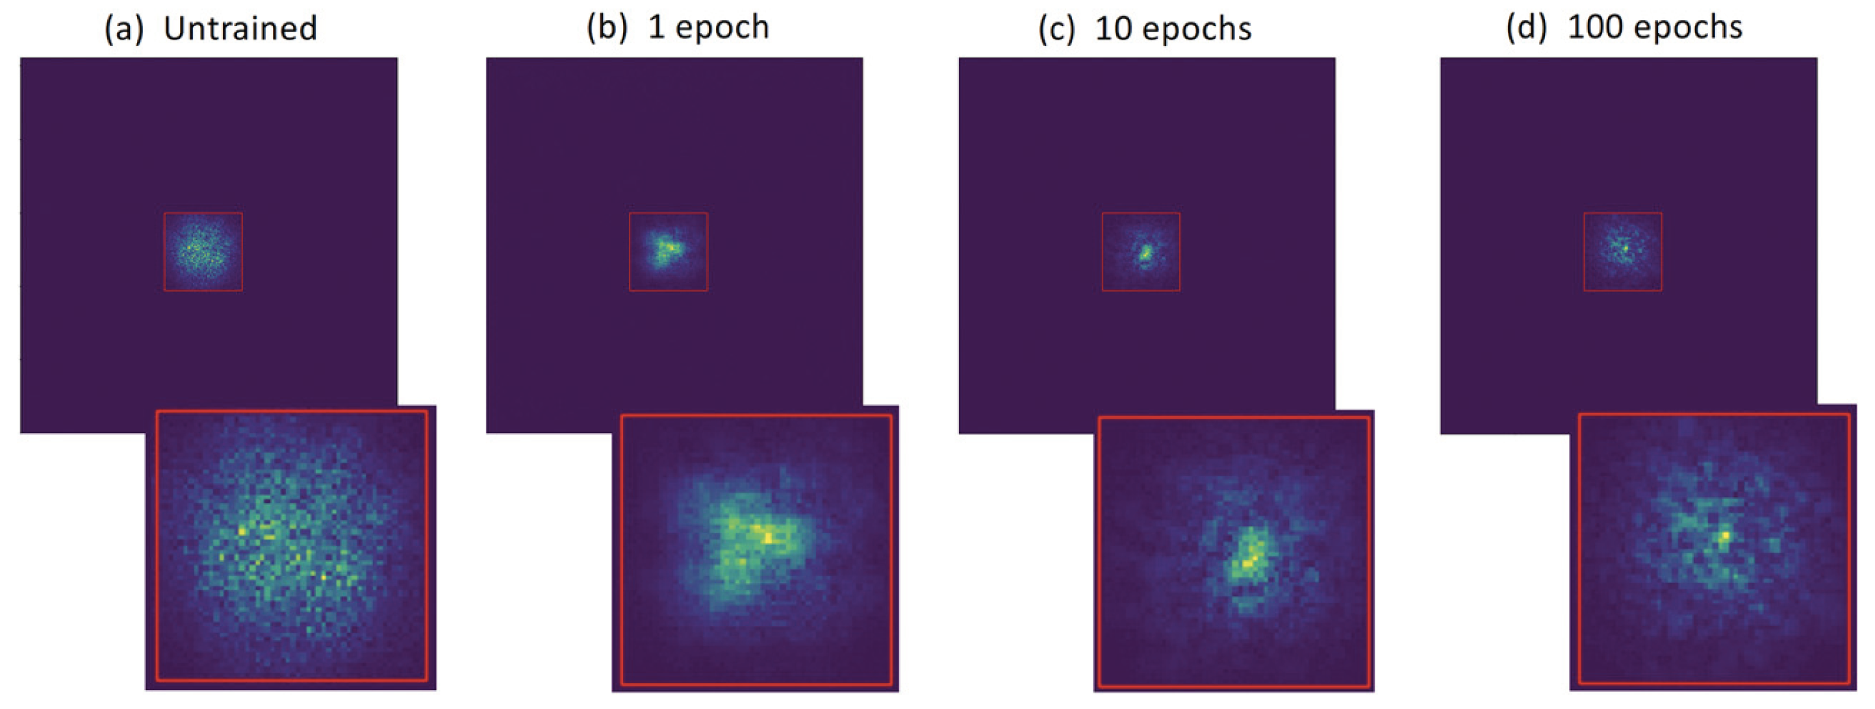
Receptive Fields
The receptive field RF is the size of the region in the input image that produces a feature in the output image
  Similarity with radius of influence in DA
The theoretical receptive field TRF (red boxes) can be calculated from network architecture alone using closed-form expression that depends on kernel sizes and strides (Araujo et al. 2019)
The effective receptive field ERF is a heatmap showing the importance of each input pixel on a particular output pixel
  SmoothGrad algorithm (Smilkov et al. 2017)
  ERF changes during training
  Output represents one sample from a distribution
Hilburn, K. A., I. Ebert-Uphoff, and S. D. Miller, 2020: Development and interpretation of a neural network-based synthetic radar reflectivity estimator using GOES-R satellite observations. J. Appl. Meteor. Climatol., https://doi.org/10.1175/JAMC-D-20-0084.1.

Slide 6
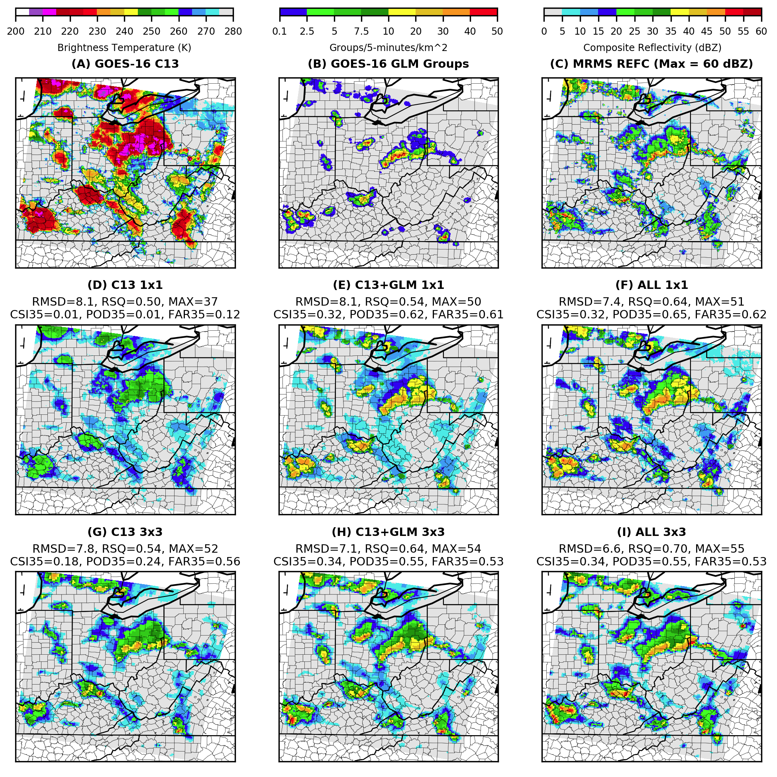
Importance of Spatial Context
Convolutional approaches use spatial information
  No spatial information: Panel D
  With spatial information: Panel G
  Truth: Panel C
Spatial information is particularly valuable in cloudy and precipitating scenes where information content of radiances in individual pixels saturates
Machine learning provides convenient framework for fusing radiances and lightning
  Panels H and I
Some of the skill provided by lightning can be reproduced by ABI spatial information
  Panel D vs G, compared with Panel D vs E
  John Cintineo 20200929: lightning prediction offshore
Infrared
Lightning
Radar
No spatial context
No spatial context, with Lightning
Hilburn, K. A., I. Ebert-Uphoff, and S. D. Miller, 2020: Development and interpretation of a neural network-based synthetic radar reflectivity estimator using GOES-R satellite observations. J. Appl. Meteor. Climatol., https://doi.org/10.1175/JAMC-D-20-0084.1.
With spatial context
With spatial context, with Lightning

Slide 7
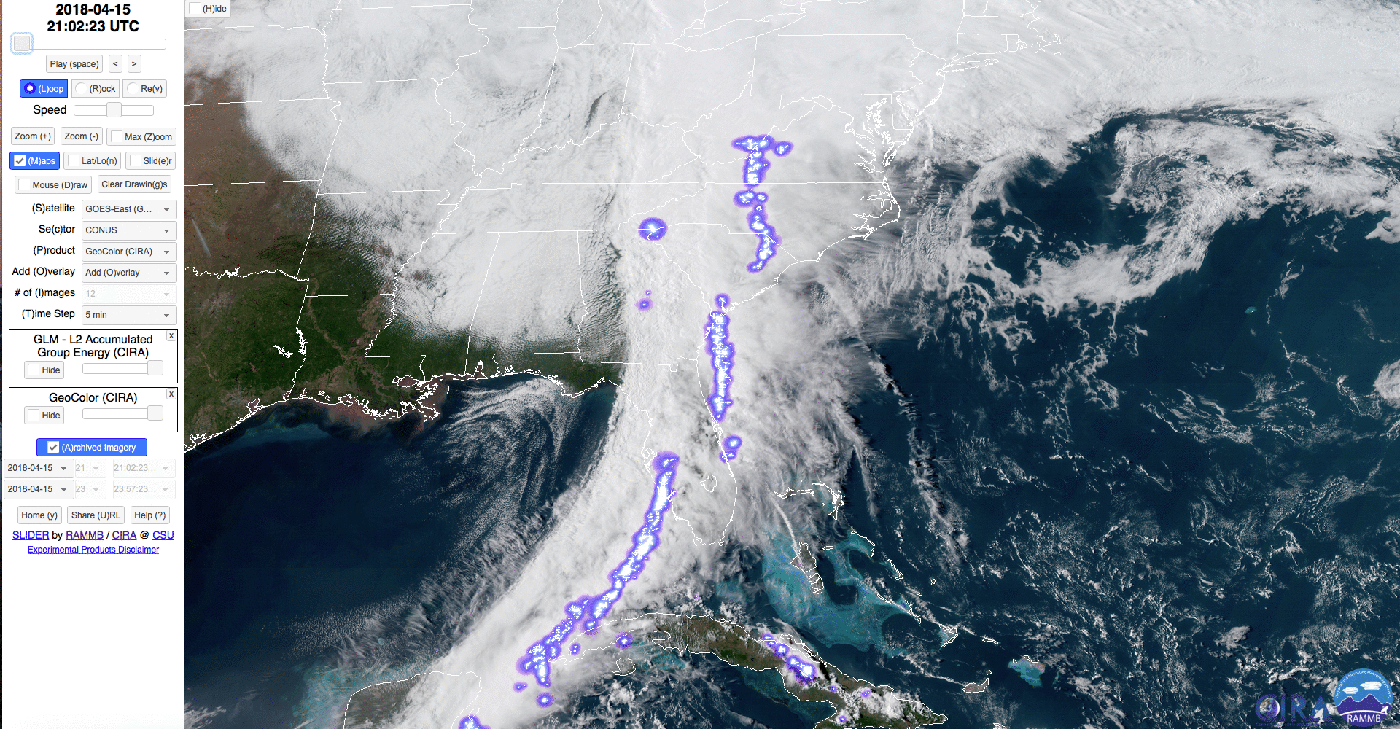
Value of Lightning Mapping
Loop shows GLM Group Energy Density overlaid on ABI GeoColor
  Spatial patterns of GLM Groups are better correlated with radar reflectivity than GLM Flashes, which can be sparse due to additional level of clustering
Lightning has great value for locating convective cores, and delineating stratiform areas
  Ice water path above the lightning can obscure the optical signal and lower detection efficiency in very intense thunderstorms (Rutledge et al. 2020)
  But LRP shows that GREMLIN responds to occurrence of lightning more than the strength of the signal
Lightning is especially valuable at night when no visible reflectances are available from ABI
Strong physical relationships between updrafts (W), radar reflectivity (Z), and lightning flash rate (F)
  Z ~ W¹²
  F ~ W⁵ (continental)
At risk of losing GLM on next generation of GOES
https://rammb-slider.cira.colostate.edu

Slide 8
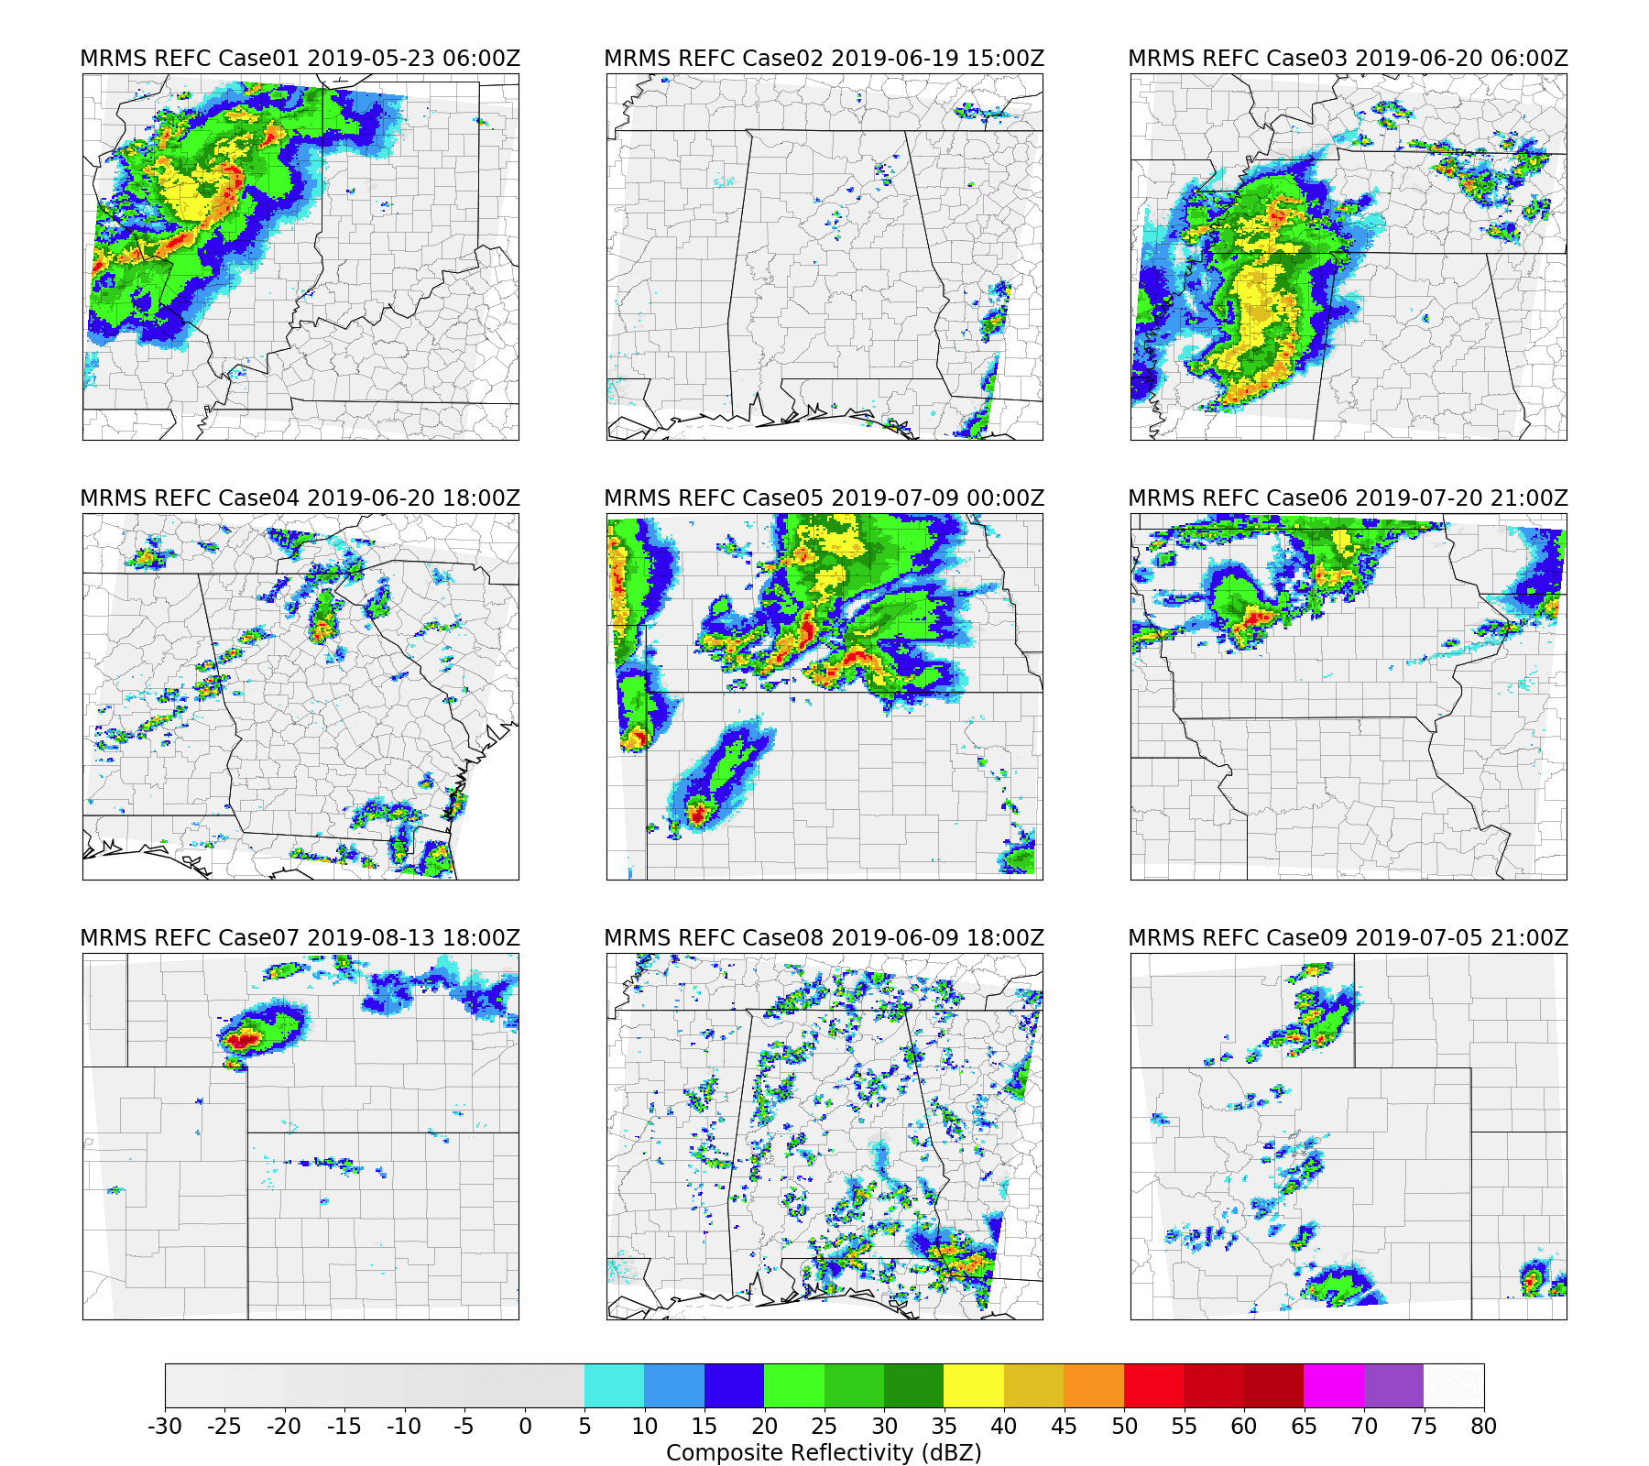
Datasets
These datasets combine GOES (2 km) and MRMS (1 km) data on the HRRR CONUS grid (3x3 km)
My focus has been on composite reflectivity
  Mark Veillette 20201217 showed results for VIL
  Eric Goldenstern (CSU Atmos) evaluating precipitation
Dataset | Number of Images | Image Size | Reference
CONUS1 | 225 | 256 x 256 | Hilburn et al. (2019) Joint Satellite Conference
CONUS2 | 1,800 | 256 x 256 | Hilburn et al. (2020) J. Appl. Meteor. Climatol.
CONUS3 | 63,850 | 1799 x 1059 | Lee et al. (2020) Fall AGU
We are building increasingly complex models with a hierarchy of increasingly large datasets encompassing more phenomena
Thanks to Alex Libardoni (CIRA) for help with CONUS1

Slide 9
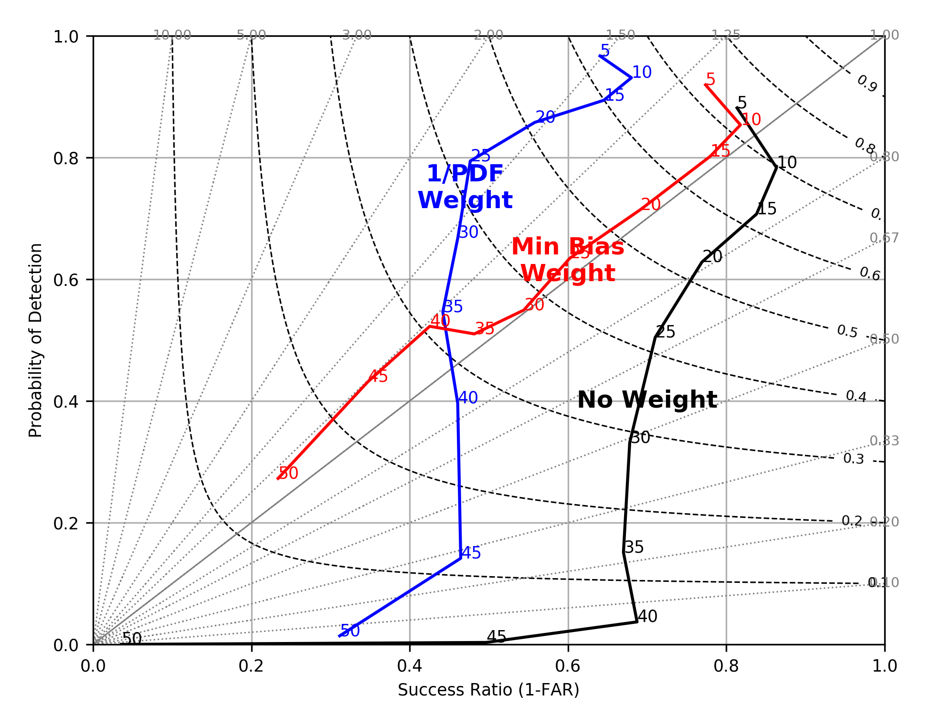
Loss Functions and Metrics
Performance Diagram for 5-50 dBZ Thresholds
The most realistic looking images come from minimum categorical bias (really 1-bias) by balancing over-prediction and under-prediction across the range of values
  This metric is not differentiable
  POD-FAR tradeoff depends on application
A performance diagram was used to ensure that GREMLIN provides good estimates across all reflectivity values
  Selection from ensemble of trained models
  Random seed can have impact on POD-FAR characteristics, even after very long training
The GREMLIN model was trained using a weighted loss function to put more emphasis on the relatively infrequent higher reflectivity values
  Testing with other loss functions suggests that double-penalty problem is contributing factor to lower skill at higher reflectivity
Hilburn, K. A., I. Ebert-Uphoff, and S. D. Miller, 2020: Development and interpretation of a neural network-based synthetic radar reflectivity estimator using GOES-R satellite observations. J. Appl. Meteor. Climatol., https://doi.org/10.1175/JAMC-D-20-0084.1.

Slide 10
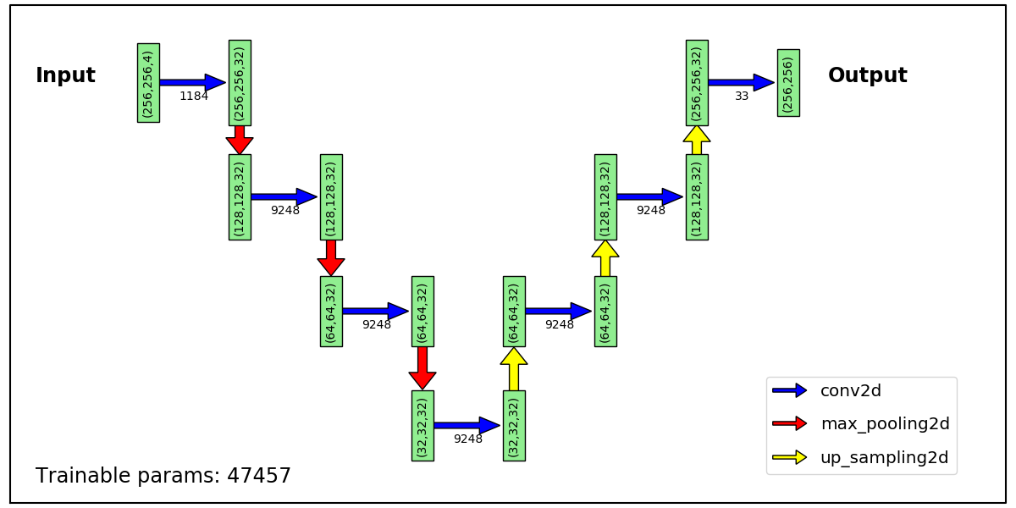
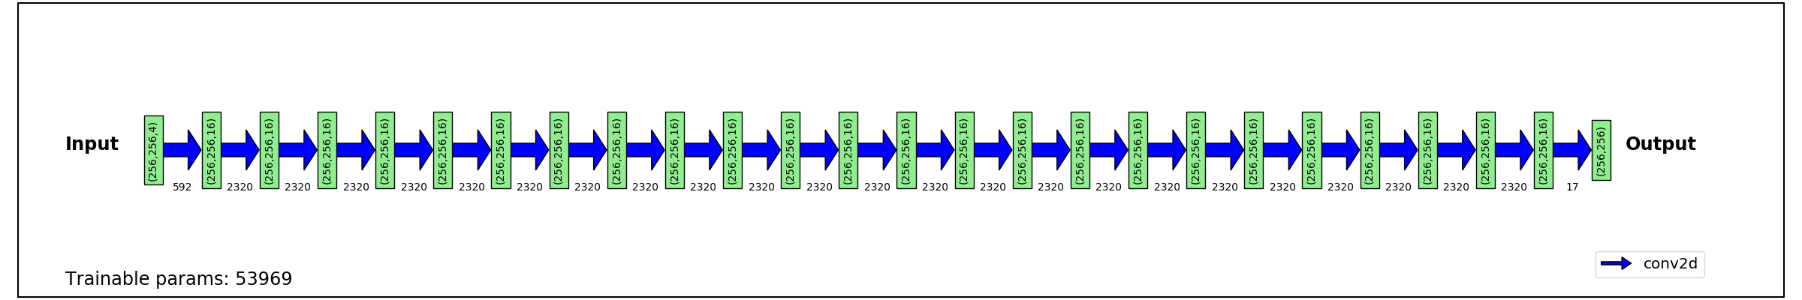
Model Architectures
Let’s compare two architectures designed deliberately
Top: GREMLIN V1 architecture
  GOES Radar Estimation via Machine Learning to Inform NWP
  Sequential encoder-decode structure with 3 blocks
  Total of 6 convo layers, 32 filters per layer
  Pooling and upsampling layers have no trainable parameters
  TRF = 50 pixels
  Trainable parameters = 47,457
Bottom: GREMLIN alternative – Convo Stack
  Total of 24 Conv2D layers, 16 filters per layer
  Both have linear final layer with 1 filter
  No artifacts from pooling and upsampling
  TRF = 49 pixels
  Trainable parameters = 53,969
  This requires 3x more memory and 3x longer to train
I expect these two architectures, with same TRF and number of parameters, should have similar performance versus MRMS
GREMLIN
Convo Stack

Slide 11
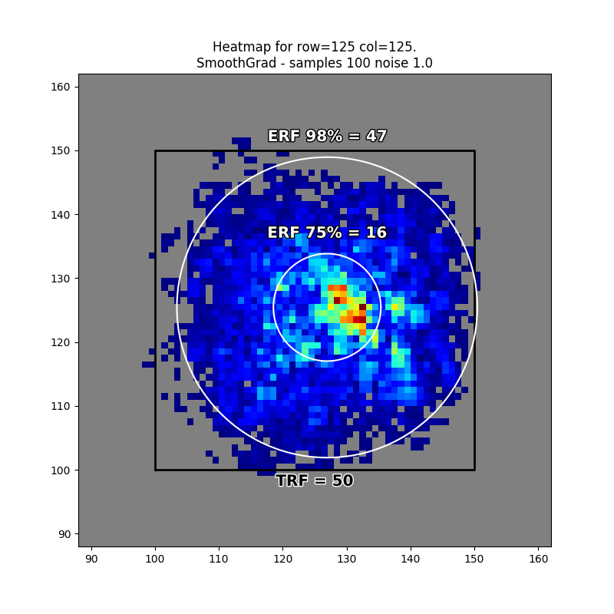
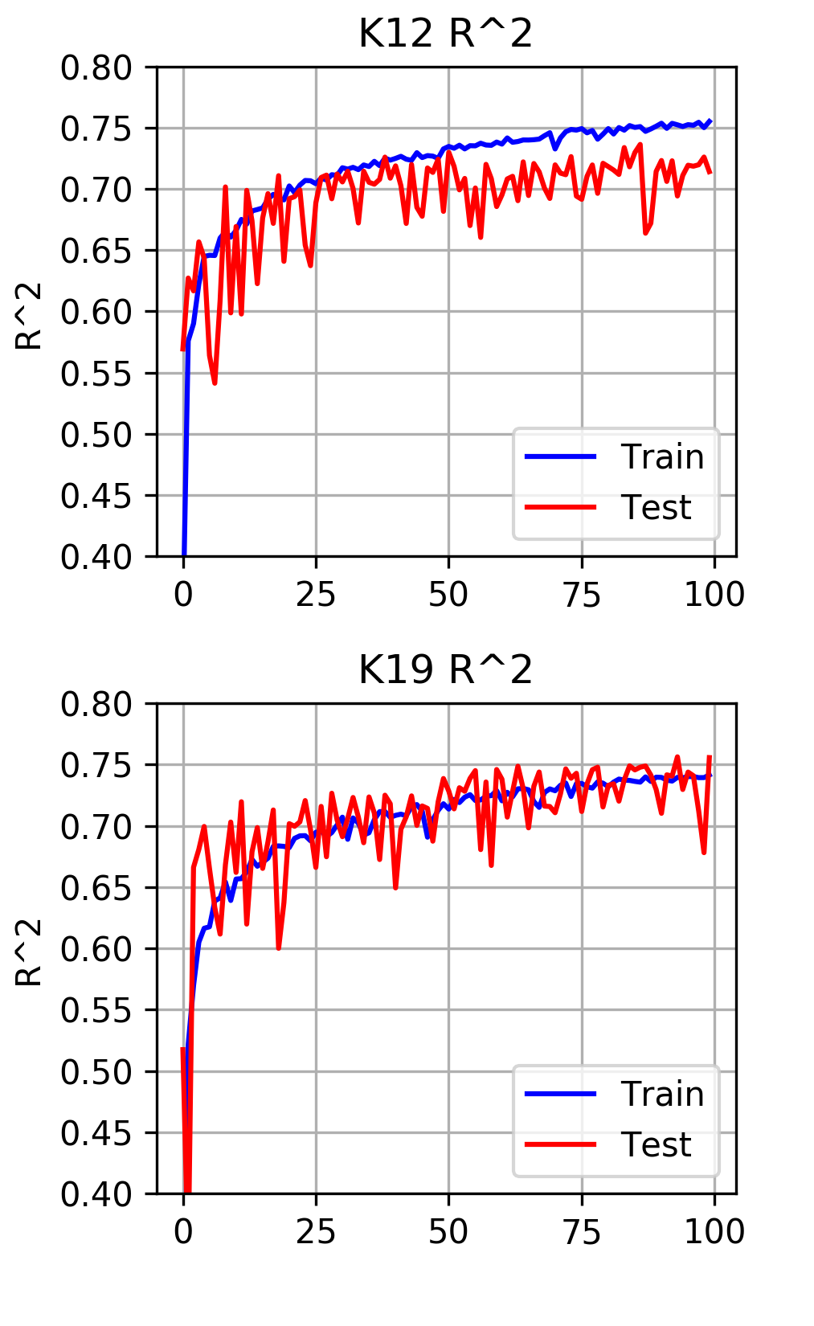
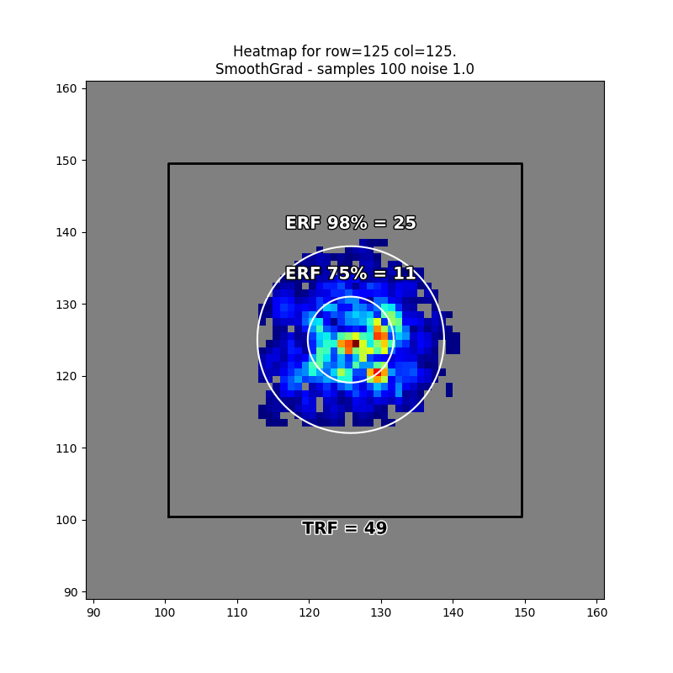
Receptive Fields and Overfitting
GREMLIN (top) has 98% ERF closely matching the TRF
  Began overfitting around 50 epochs
  Small offset for ERF centroid: effect of vertical wind shear
Convo stack (bottom) has a much smaller 98% ERF, despite having similar TRF
  Continued learning generalizable information
  However, R² from test dataset are nosier during training
The areas that are most strongly weighted (75% ERF) are roughly same size
Does the smaller ERF for the convo stack keep if from getting distracted by features farther away, resulting in less overfitting?
So, exactly how much spatial context is needed?
  These results are for convection (meso gamma-alpha)
GREMLIN
GREMLIN
Convo Stack
Convo Stack
Scale | Length (km)
Micro | < 1 km
Meso-gamma | 1-10
Meso-beta | 10-100
Meso-alpha | 100-1,000
Synoptic | 1,000-10,000
Planetary | 10,000-40,000
ERF
TRF
Epoch

Slide 12
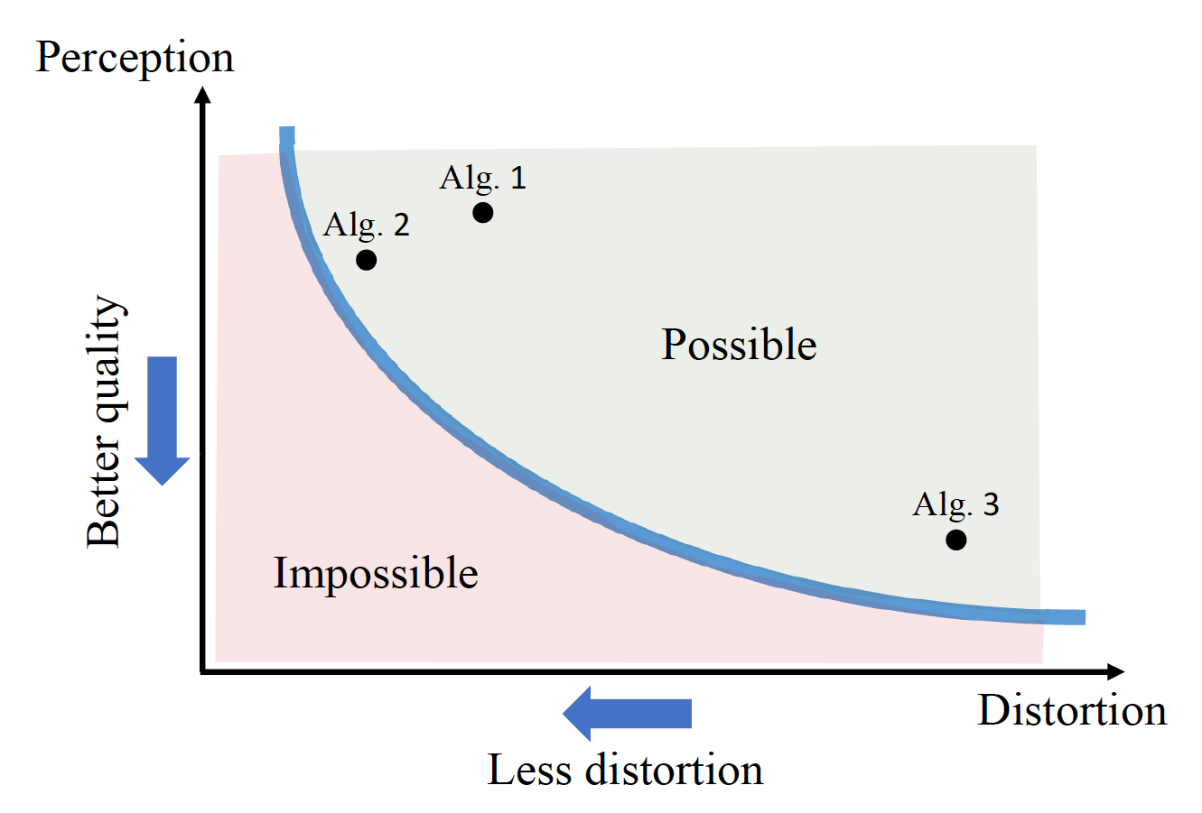
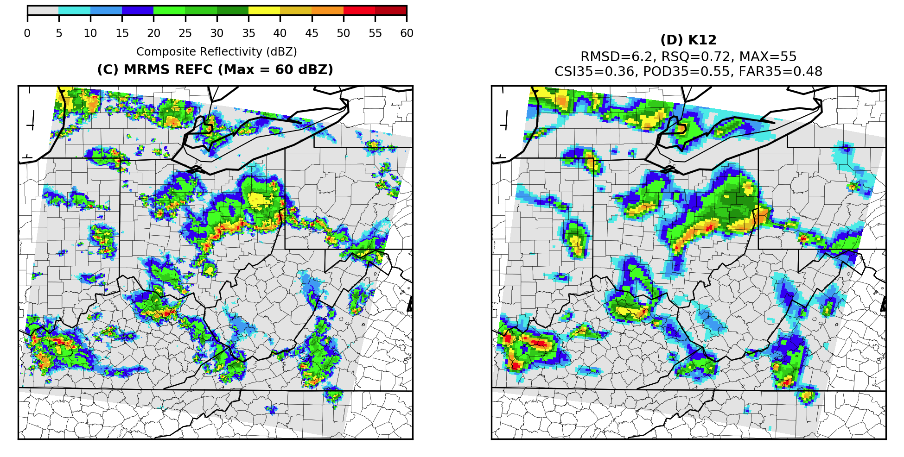
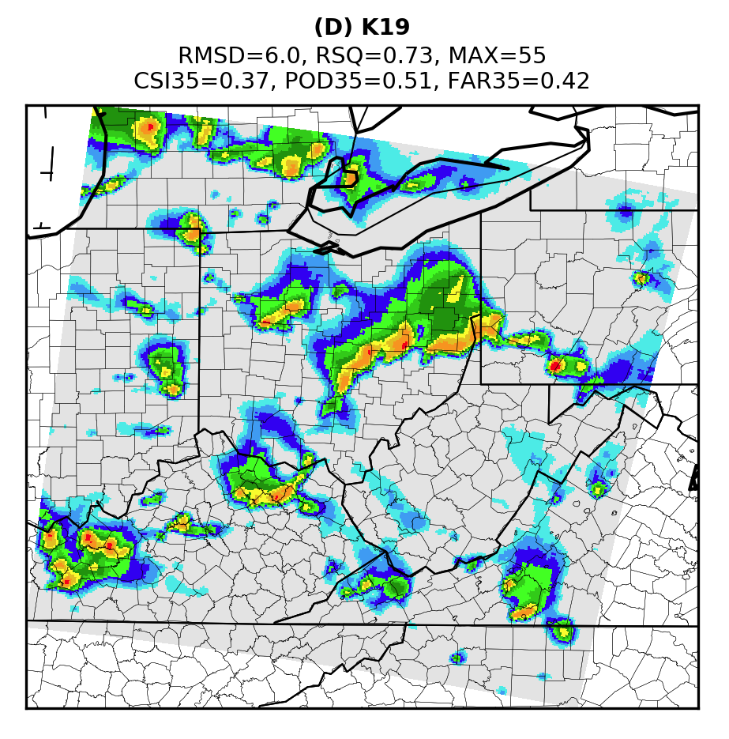
Perception-Distortion Tradeoff
CNN outputs tend to be blurry
  Architecture choices can improve this (example below)
  Is there a limit to the improvement?
Perception-Distortion tradeoff (Blau and Michaeli 2018)
  Images that look sharp and realistic (better perception) but are less accurate
  Images that look blurry but are more accurate (less distortion)
An analogy is the difference between an ensemble mean solution versus one deterministic realization
Negin Hayatbini 20200929 used a conditional generative adversarial network (cGAN) for precipitation estimates from GOES
Additional constraints in the loss function can reduce solution space
Adapted from
Yochai Blau and Tomer Michaeli
(2018 CVPR)
MRMS
GREMLIN
Convo Stack

Slide 13
Strategies Learned
Layer-wise relevance propagation (LRP, Bach et al. 2015) was the most useful attribution method for GREMLIN
  Imme Ebert-Uphoff 20200917 showed that saliency only found the strongest strategy (lightning)
Strong radar echoes are located on the cold side of sharp brightness temperature gradients and often associated with lightning
  Note that LRP gives information for a particular pixel
Additional experiments, setting lightning to zero everywhere, showed that the network changes where and how it looks at ABI based on occurrence of lightning from GLM
  Note that feature importance from LRP has sensitivity to scaling of inputs
Adapted from Ebert-Uphoff 20200917

Slide 14
Summary and Conclusions
Spatial context provides valuable information, especially in cloudy/precipitating scenes
Spatial information is not used by data assimilation systems
Explainable AI tools reveal what a neural network has learned
The receptive field quantifies the size of the spatial context
The loss function design is critical to what the network learns
Additional constraints in the loss function show promise for improving perceptual quality
GOES ABI
No Spatial Context
With Spatial Context
MRMS Truth

Slide 15
Acknowledgements
This work is supported by the NOAA GOES-R Program under grant NA19OAR4320073
Thank you to NOAA RDHPCS for access to the Fine Grain Architecture System on Hera
Thank you to Imme Ebert-Uphoff (CSU) for asking insightful questions that helped shape this research

