Slide 1
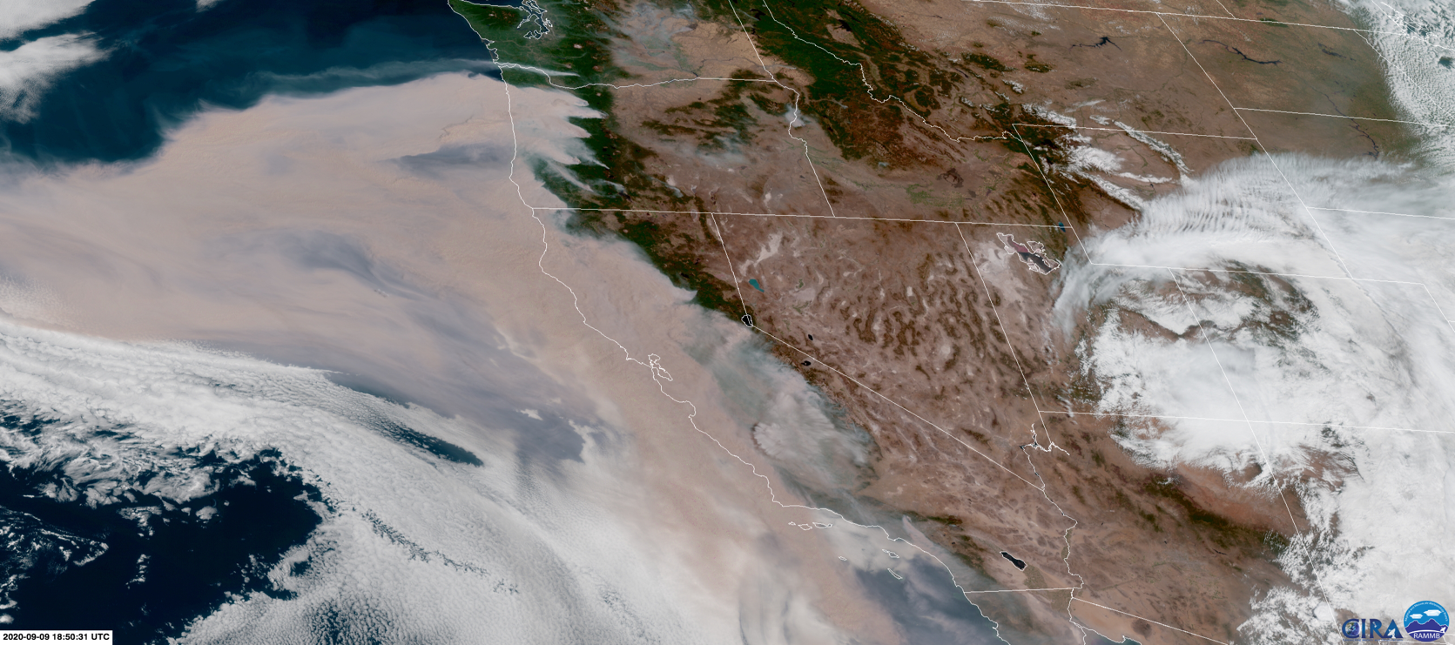
Deriving Fire Radiative Power from Numerical Weather Models and Satellites using Machine Learning Methods NOAA AI Workshop on Leveraging AI in Environmental Sciences Jan 28th 2021
Christina Kumler
CIRES/NOAA/GSL
Christina.E.Kumler@noaa.gov
Ravan Ahmadov
CIRES/NOAA/GSL
Jebb Stewart
NOAA/GSL

Slide 2
Motivation:
Background, Existing Methods, and Data

Slide 3
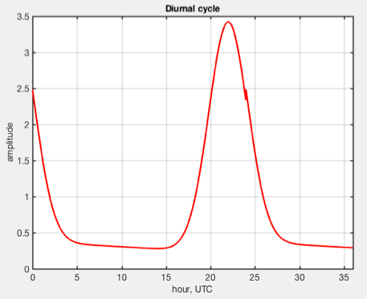
Motivation:
Fires are important to understand.
Wildfires are often unpredictable, costly, and deadly.
Fire-weather can fuel major fire growth or breed new ones; fast growth that satellites may or may not detect.
Smoke from wildfires is a challenge.
Major health concerns.
Solar and irradiance issues.
Smoke and aerosols important in forecasts.
Current measurements and modeling of Fire Radiative Power (FRP) benefit improvement.
For instance, HRRR Smoke and aerosols currently using a persistence model without any meteorological information.

Slide 4
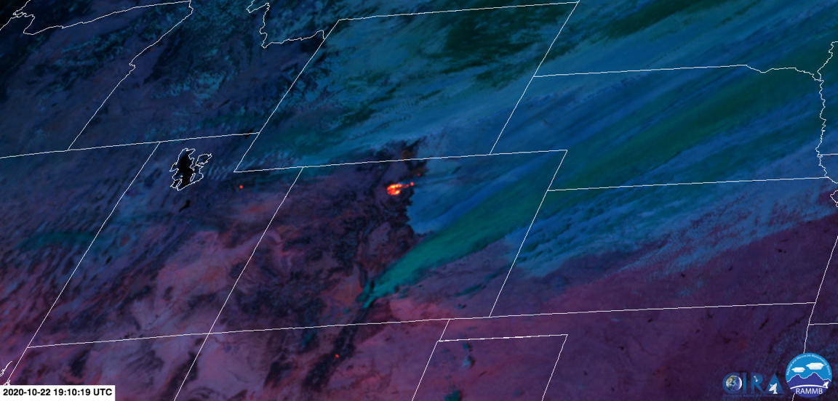
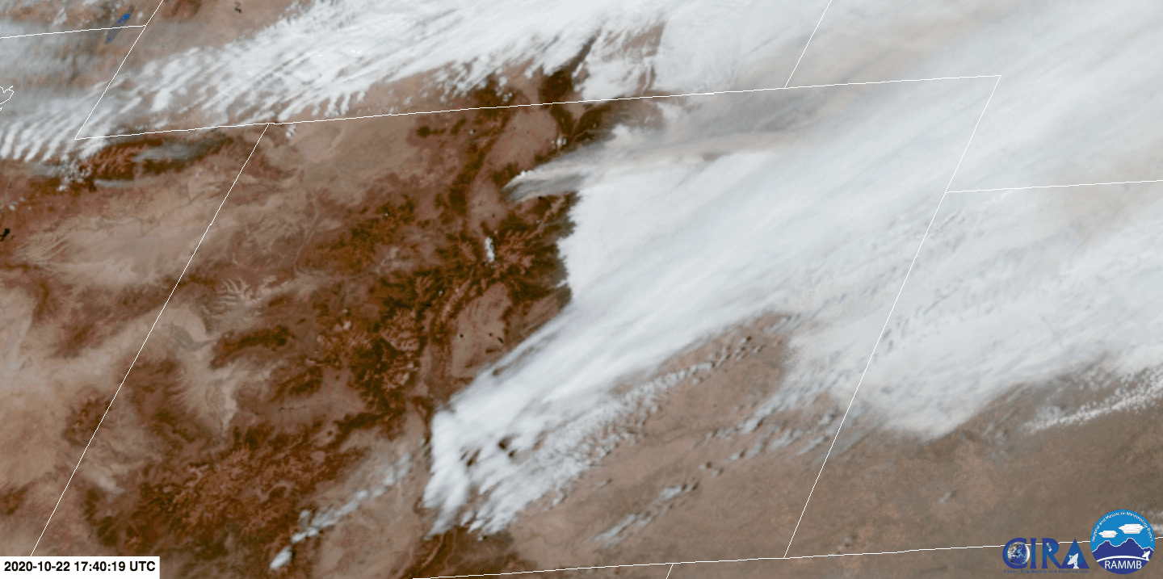
Motivation (continued):
Polar and geostationary satellites generate terabytes of data every day.
The caveat is that FRP derivations vary between satellites and have imperfections.
Some measurements aren’t actually fire measurements.
Some measurements are blocked by fire smoke and/or clouds.
This work addresses that there are issues in certain FRP measurements and combats this with only using FRP points that have at least an additional hour of existence.
Reduces non-wildfire and flare or error measurements.
Particularly interested in wildfires.

Slide 5
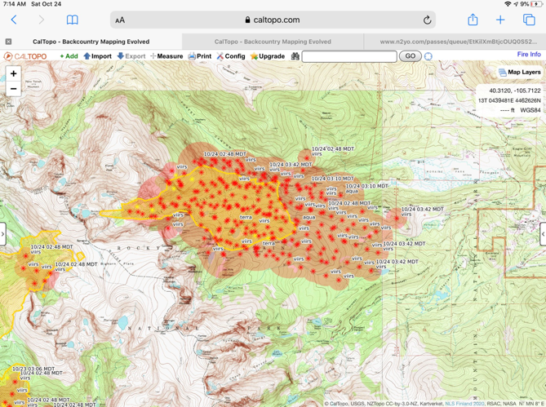
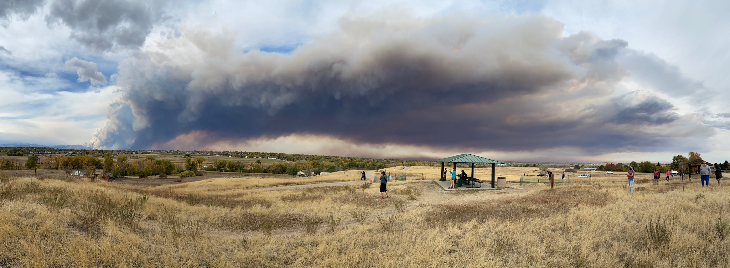
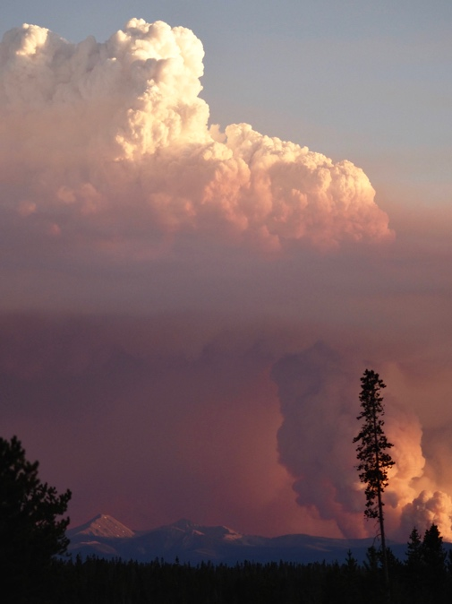
Image of bedroom in San Francisco during wildfire smoke event 2020 (Photo by friend, Shweta)
Polar orbiter detections of East Troublesome Fire, Colorado 2020
Photo of Cal-Wood Fire’s rapid growth and smoke spread, Colorado 2020
Photo of Cameron Peak Fire smoke event, sites reporting 200-400 AQI during image capture, Colorado 2020
Photo of Williams Fork Fire Pyro-cumulous at sunset, Colorado 2020

Slide 6
Machine Learning for FRP
Data Analysis and Machine Learning

Slide 7
Machine Learning for FRP:
Use Machine Learning (ML) to derive RAP gridded current-hour and next-hour FRP with inputs from:
FRP GOES 2018 satellite measurements.
HRRR or RAP weather model outputs.
Temperature, wind, relative humidity.
HRRR next-hour FRP forecast by method in current use.
Different types of ML were experimented with and selected the Random Forest (RF) model to pursue.
If a simpler method works as well or better, use it!
Easier to deduce variable input importance.
Slightly more transparent “black-box” method.

Slide 8
Machine Learning for FRP:
Want to gather information and importance on current-hour and next-hour FRP values from current weather and previous satellite data inputs
Isolate wildfires:
Experiments on entire CONUS domain as well as cases west of -105 longitude
FRP must have persisted in same grid for 2 hours
Realize this might still capture short-lived controlled fires
Might exclude wildfires whose FRP measurements were blocked in the next hour

Slide 9
Machine Learning for FRP (continued):
Input Variable Analysis
Figure 2. Those FRP values in Figure 1 exceeding 1000
Figure 1. FRP values from GOES 2018 data on the RAP domain that have a next-hour measured FRP (FRP_1)

Slide 10
Machine Learning for FRP (continued):
Input Variable Analysis: Comparing Weather to FRP values – Relative Humidity
Figure 3. ﻿9,977 points- Western states FRP values from GOES that have a consecutive FRP next-hour value averaged hourly on the RAP domain against HRRR model relative humidity.
Figure 4. ﻿5,634 points- Western states only grassland and forest FRP values from GOES that have a consecutive FRP next-hour value averaged hourly on the RAP domain against HRRR model relative humidity.
Figure 1. ﻿24,092 points - All CONUS FRP values from GOES averaged hourly on the RAP domain against HRRR model relative humidity.
Figure 2. 13,231 points - CONUS FRP values from GOES that have a consecutive FRP next-hour value averaged hourly on the RAP domain against HRRR model relative humidity.

Slide 11
Machine Learning for FRP (continued):
Input Variable Analysis: Case Study - West of 105 Longitude
Plot to the left shows the distribution of western states, or two time zones worth, FRP values at the UTC time of day. There is a noticeable diurnal cycle to FRP intensity, as the current method for approximating future FRP. Therefore, the hour was included in training the RF model.

Slide 12
Machine Learning for FRP (continued):
Input Variable Analysis: Case Study - West of 105 Longitude
Figure 1. Western states FRP values from GOES that have a consecutive FRP next-hour value averaged hourly on the RAP domain against HRRR model 10m temperature.
Figure 2. Western states FRP values from GOES that have a consecutive FRP next-hour value averaged hourly on the RAP domain against HRRR model 10m wind vector.

Slide 13
Machine Learning for FRP (continued):
The Random Forest model
Specify the number of trees, ensembles, and depth to create a forest that gets a prediction from each tree and selects the best option by “voting.”
This example for FRP is a single sample tree from a RF with 10 trees and a maximum depth of 3.

Slide 14
Machine Learning for FRP (continued):
Results from RF model to predict RAP-gridded FRP at current hour
Model Inputs: 24_hour_FRP_avg, latitude, longitude, hour of day (UTC), 2m temperature, surface relative humidity, wind_vector (wind speed from 10m u-wind and 10m v-wind), and vegetation.
Model Output: RAP-gridded current FRP value.
There were 1000 trees and 42 ensembles.
﻿Mean Absolute Error for FRP: 224.92

Slide 15
Machine Learning for FRP (continued):
Results from RF model to predict RAP-gridded FRP at current hour
Model Inputs: latitude, longitude, hour of day (UTC), 2m temperature, surface relative humidity, wind_vector (wind speed from 10m u-wind and 10m v-wind), and vegetation.
Model Output: RAP-gridded current FRP value.
There were 1000 trees and 42 ensembles.
﻿Mean Absolute Error for FRP: 294.02

Slide 16
Machine Learning for FRP (continued):
Current results from a RF model built with GOES 2018 FRP data and HRRR weather model data projected onto RAP-domain where next hour FRP exists (this eliminated short-lived, likely controlled fires).
There were 1000 trees and 42 ensembles.
Model Inputs:
FRP (satellite FRP averaged for current hour)
24_hour_FRP_avg (all FRP’s averaged over past 24 hours)
Latitude and longitude
Hour of day (UTC)
2m temperature (K)
Surface Relative Humidity
Wind_vector (Wind Speed derived from 10m u-wind and 10m v-wind)
HRRR_estimated_FRP_1 (one hour HRRR predicted FRP in future)
vegetation* *vegetation was tested but then dropped as it did not improve model performance
Model Output:
RAP-gridded next-hour FRP value.

Slide 17
Machine Learning for FRP (continued):
Model Analysis
Western USA RF 2018 Model:
Training Features Shape: (6983, 9)
Testing Features Shape: (2994, 9)
Variable: FRP Importance: 0.53
Variable: lat Importance: 0.07
Variable: temp Importance: 0.07
Variable: lon Importance: 0.06
Variable: wind_vector Importance: 0.06
Variable: climo_FRP_1 Importance: 0.06
Variable: FRP_24hr Importance: 0.06
Variable: RH Importance: 0.05
Variable: hour Importance: 0.03
Mean Absolute Error for FRP: 232.7
Mean Absolute Error for FRP HRRR Gaussian Curve: 443.46
In the future, we will remove the current hour FRP, since there will likely be a lag in between satellite measurements. We will keep the rolling 24-hour average FRP in addition to adding the previous-day FRP average (or 24 hours from the day before).
--> Trained model like this produces mean absolute error of ﻿269.02 and the highest importance was the 24-hour average at 0.36 followed by increased importance of HRRR’s persistence guess (climo_FRP_1)

Slide 18
Machine Learning for FRP (continued):
RF CONUS and Western Model Analysis
CONUS RF 2018 Model:
Training Features Shape: (9261, 9)
Testing Features Shape: (3970, 9)
Mean Absolute Error for FRP: 198.18
Mean Absolute Error for FRP HRRR Gaussian Curve: 396.38
Western USA RF 2018 Model:
Training Features Shape: (6983, 9)
Testing Features Shape: (2994, 9)
Mean Absolute Error for FRP: 232.7
Mean Absolute Error for FRP HRRR Gaussian Curve: 443.46

Slide 19
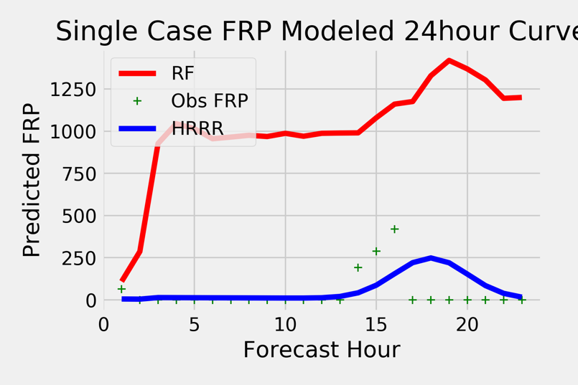
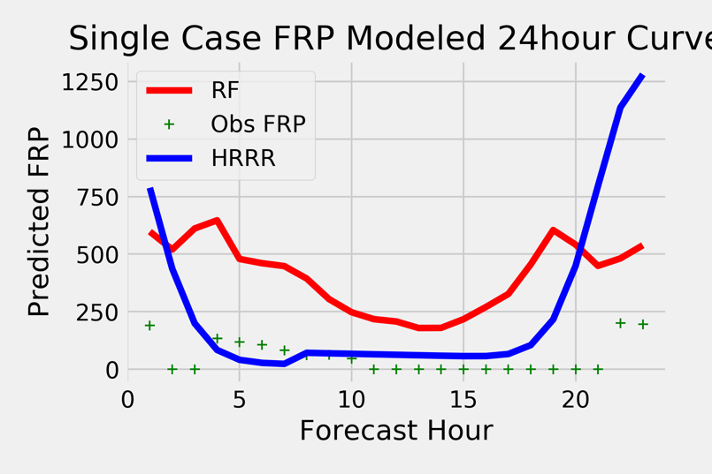
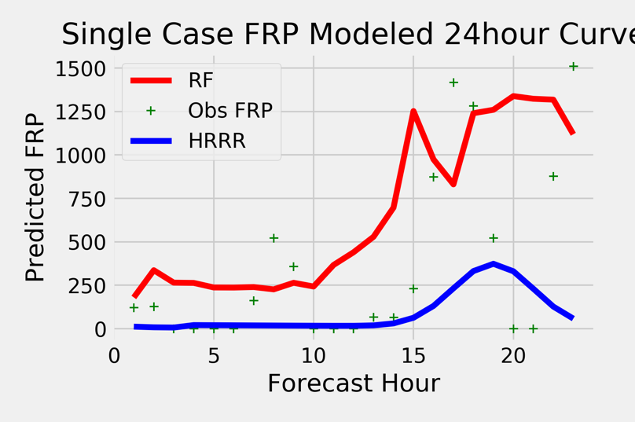
Machine Learning for FRP (continued):
Model Analysis: Case Study 24 “Forecast” -- West of 105 Longitude
Plots to left show four examples of mapping a 24-hour FRP curve using the west-trained RF to forecast FRP_1. The model trained to approximate the next-hour FRP value given inputs listed before, but certain variables are updated per each iteration:
Hour of day input
HRRR_estimated_FRP_1 (from initial 24hour averaged FRP grid value; not updated from new FRP input)
Weather variables when available (due to processing, every-hour updates are not yet used but the plan is to update this)

Slide 20
Machine Learning for FRP (continued):
Model Analysis
Plots above show RF models run for both entire CONUS and Western states. For the first 2 hours of forecast, the RF models perform substantially better than current methods. However, as seen in examples on previous slide, they are much less good with longer-term forecasts where a bounded persistence-like model will generally provide better forecasts.

Slide 21
Future RF Additions and Models:
Where to next?

Slide 22
Future RF Additions and Models:
Future additional inputs into the RF model:
Polar orbiter satellite information.
Averaged to HRRR and/or RAP domain.
Fire Fuel.
Revisit adding differences to the inputs.
Difference between next- and current- hour model-predicted FRP.
Difference between previous- and current FRP averaged grid value.
Additional training and validation years 2019 and 2020.
Precipitation.
Either from averaged radar reflectivity or measured rain/snow fall total.
Future model analysis:
More rigorous analysis and parameter tuning of RF performance.
Particularly, it’s trick to distinguish when FRP is truly zero or looks like zero because of hour blocking/lack of measurements.
Isolated case studies by vegetation type, weather, location, etc.

Slide 23
Thank you!
Questions: Christina.E.Kumler@noaa.gov

