Slide 1
How NOAA Fisheries Leveraged Competitions and Collaboration
to Automate the Identification
of Right Whales using Deep Learning
Notes:
Hi there. I’d like to give you a brief overview of how we used a Citizen Science competition combined with extensive public and private partnerships to achieve the ambitious goal of automating right whale photo identification with deep learning.
I’ll also touch on our exciting new project to detect whales with space orbiting satellites!

Slide 2
Jason Holmberg, Jason Parham, Drew Blount
Timothy White
Christin Khan
Kimberly Goetz
David Weller
Trevor Joyce
Paul Wade
Erin Murnane
Christina Nevarez
Philip Hamilton
Heather Pettis
Will Rayment
Steve Dawson
Dave Johnston
Marek Cygan
Marcin Mucha
Robert Bogucki and Maciej Klimek
Vicky Rowntree
Claire Charlton
Karina Groch
Els Vermeulen
Notes:
So - my name is Christin Khan and I’m with NOAA Fisheries at the Northeast Fisheries Science Center in Woods Hole but this work has been a monumental undertaking with researchers and data scientists around the world

Slide 3
RIGHT WHALES
<400
Notes:
As you may know --- there are less than 400 North Atlantic right whales alive today and they are in a dangerous decline

Slide 4
AERIAL SURVEYS
Notes:
We fly aerial surveys to monitor their abundance and distribution

Slide 5
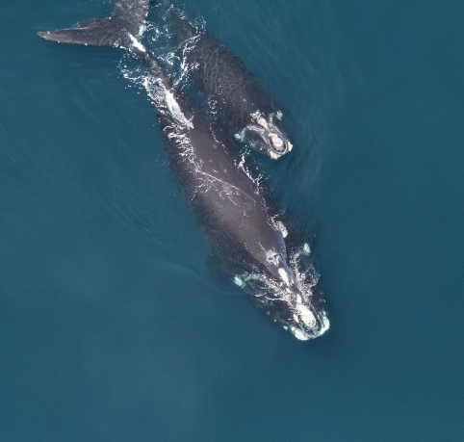
PHOTO IDENTIFICATION
Notes:
The photographs we take on these surveys are matched to the North Atlantic Right Whale Catalog and form the basis for mark-recapture estimates of abundance along with many other important research efforts

Slide 6
Sometimes easy…
Notes:
Sometimes identifying whales is super easy and there are individuals we can recognize even from the air a mile away, like Ruffian, who has very distinctive scar patterns.
But for whales with very generic callosities, bad photographs, limited sighting records, well…

Slide 7
Sometimes not…
Notes:
Sometimes it can be pretty frustrating…

Slide 8
Notes:
One such day… I took a break and checked Facebook…

Slide 9
Want to tag yourself?
Notes:
I was immediately greeted by the suggestion that I might want to tag myself
Well… this got the gears churning as I thought with exasperation – “no! I don’t want to tag myself but can you help me with this whale!?”

Slide 10
Notes:
After bouncing the idea around for awhile, a colleague suggested a Kaggle competition for algorithm development

Slide 11
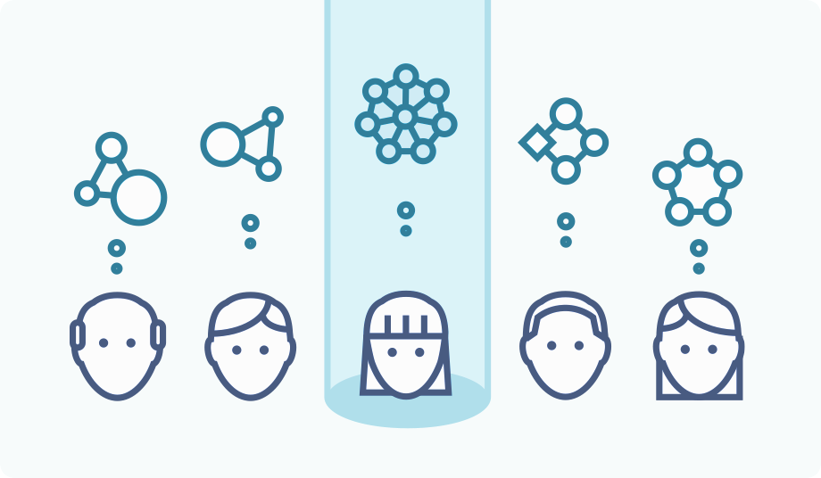
KAGGLE COMPETION
Notes:
Now, I imagine by now you are all familiar with the concept of a data science competition where citizen scientists from around the world compete to help solve your problem… back in 2015, the idea was fairly new to me and I was stunned by ease of harnessing such a high quality talent pool to tackle such a challenging problem

Slide 12
364 teams CNNs 87% code
Notes:
364 teams of data scientists participated
It became clear that the best solutions were based on convolutional neural networks, which is not something that I knew before the competition
We achieved a percent correct classification score of 87% top-1 accuracy !!!
And we received the source code on GitHub

Slide 13
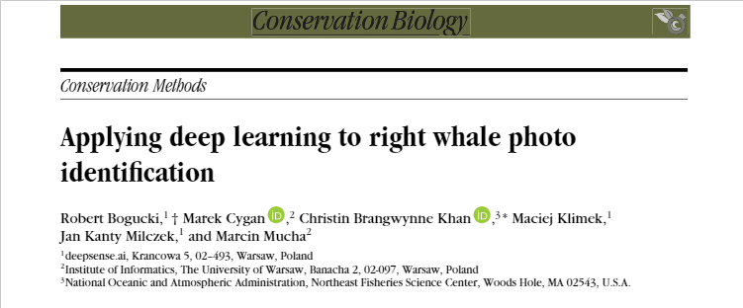
PUBLICATION
Notes:
I went on to collaborate with the winning team Deepsense.ai to publish the results of their deep learning approach in 2018
We hoped to encourage others to consider the use of computer vision for conservation

Slide 14
Challenges
Notes:
But going from the success of a technical solution to the user friendly interface that I needed turned out to be a much bigger challenge than I had anticipated, and it took awhile to both figure out and fund the ideal solution…

Slide 15
Notes:
Eventually I found success by collaborating with the team from Wild Me – the developers of Flukebook. Turns out that I didn’t have to re-invent the wheel and they had already laid a lot of the groundwork on a user friendly platform built for applying AI to photo identification. The system was originally designed for whale sharks but has since expanded to include many other species.

Slide 16
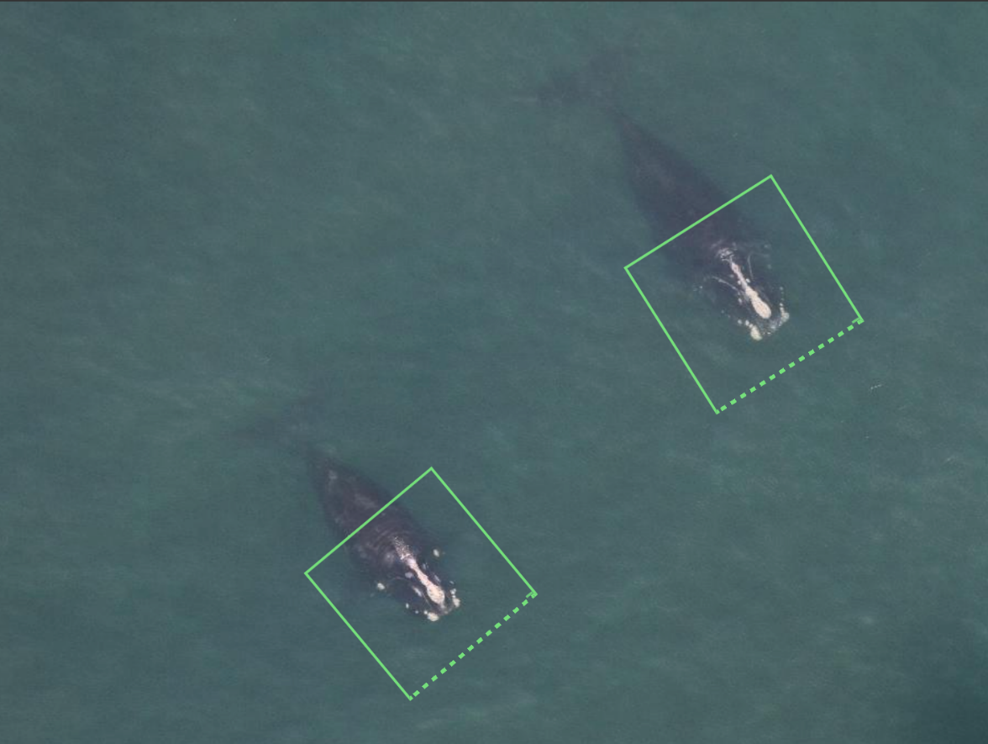
Notes:
Even though Wild Me had their own existing algorithms, they were willing to collaborate and incorporate this new deep learning algorithm for right whales into their code base, and the team from Deepsense.ai was willing to provide technical support to assist during their first attempt at retraining the algorithm. The best of both worlds!
The system went live for North Atlantic right whales in 2019

Slide 17
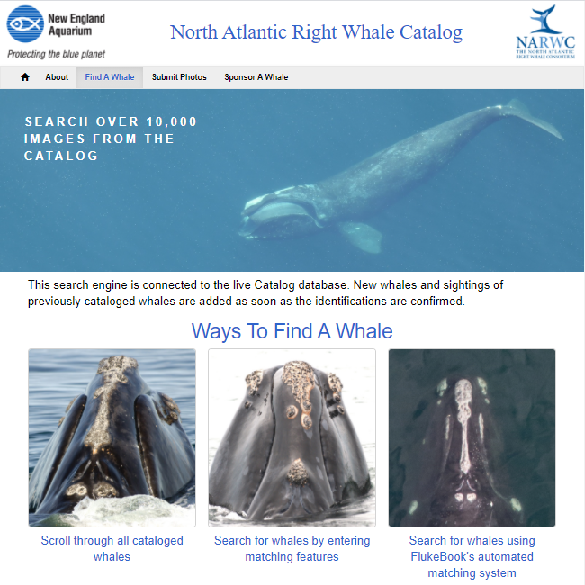
Notes:
The New England Aquarium was engaged as an important partner in this effort and we found a way to seamlessly integrate the new AI system through the existing North Atlantic Right Whale Catalog website

Slide 18
SOUTHERN RIGHT WHALES
Notes:
North Atlantic right whales are morphologically similar to the Southern right whale, and while I was initially a bit daunted by the challenge of incorporating these other photo catalogs, the benefits to the research community were too great to ignore, so in 2020 we expanded the system to include catalogs from South Africa, New Zealand, Australia, Argentina, Brazil, and Chile.
As expected, accuracy for the Southern right whales was considerably lower at only 26% top-1 accuracy (compared to 61.3% for the operational system in the North Atlantic).

Slide 19
VESSEL PHOTOS
Notes:
This past October 2020, machine learning was completed to expand the capacity of the system to recognize whales from lateral vessel-based photographs.
Wild Me has achieved some impressive results on these challenging images with background subtraction and a state-of-the-art machine learning algorithm named “PIE” for Pose Invariant Embeddings. This novel approach is achieving 55% top-1 accuracy and 80% top-5 accuracy on a database of around 3600 left side head images.
This work to be able to match whales based on multiple features and from multiple perspectives is really pushing the boundary on what is possible in automated wildlife identification

Slide 20
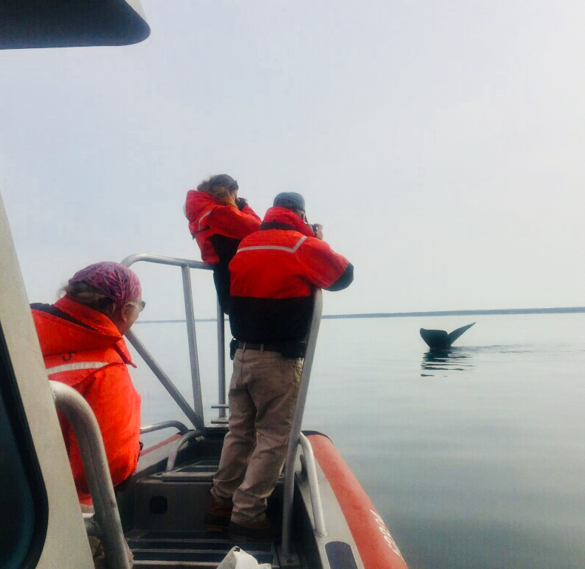
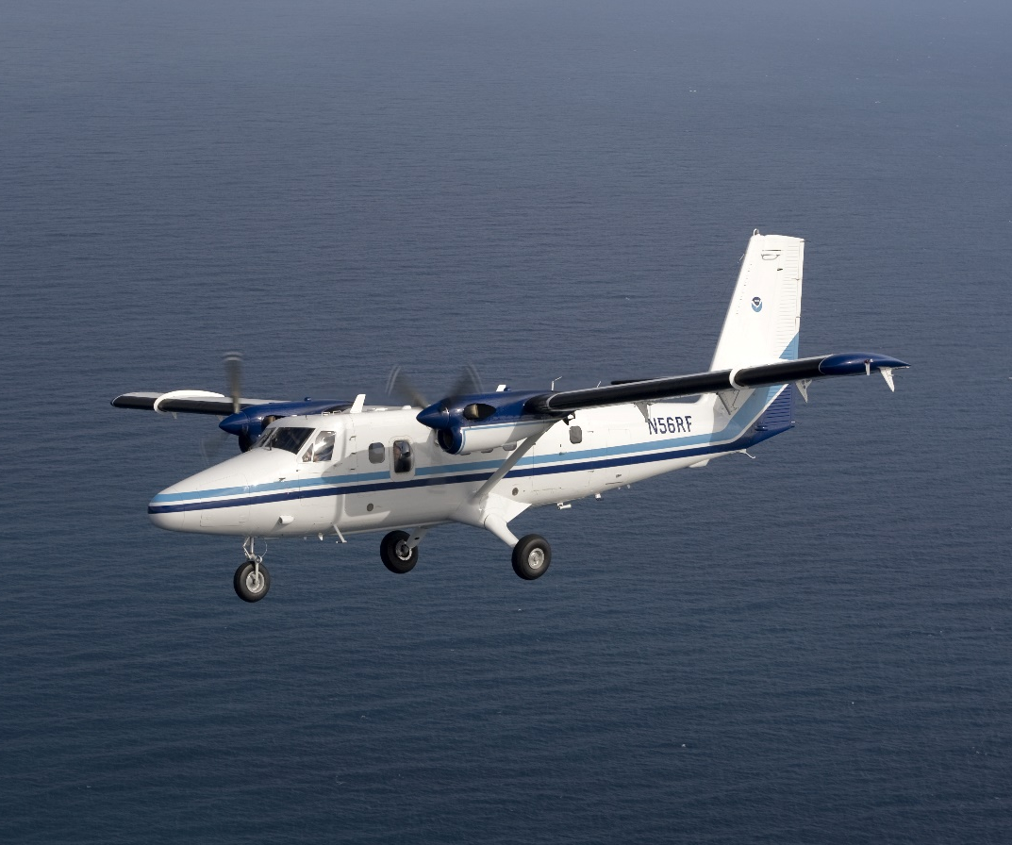
Notes:
So… while there is still lots of room for improvement in the system, we now have an operational AI based workflow for the detection of right whale from both aircraft and vessel photos!

Slide 21
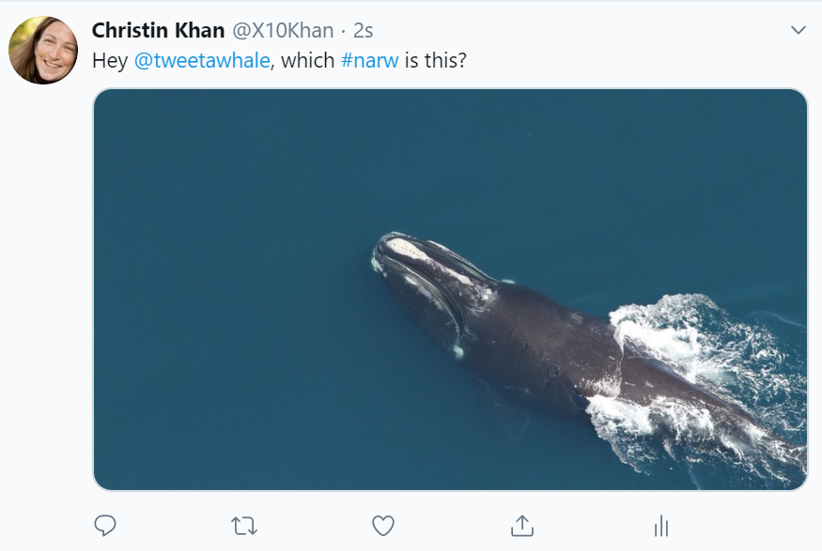
Notes:
And we are even beta testing a system where a photo can be quickly submitted and ID’d using Twitter!

Slide 22
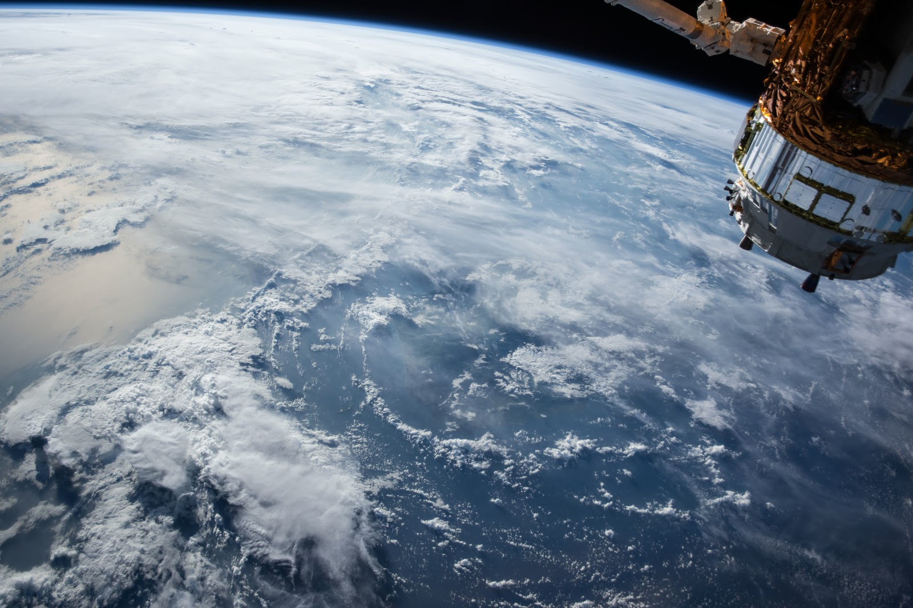
SATELLITE
Notes:
And now on to a slightly different topic – a new collaboration with Kim Goetz at the Alaska Fisheries Science Center along with colleagues from the Naval Research Laboratory and the Bureau of Ocean Energy Management….
We are exploring the feasibility of creating an operational whale detection system using satellite imagery. You may have heard Kim Goetz’s talk on this project earlier in the workshop.

Slide 23
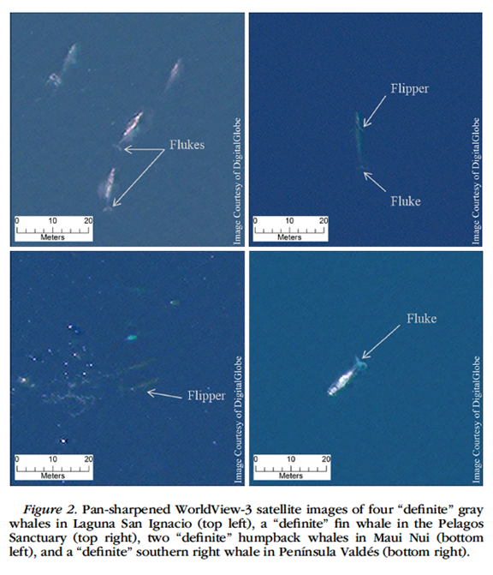
PROOF OF CONCEPT
Notes:
Satellite detection of whales has been demonstrated as a proof of concept by several recent publications, most notably this recent work by Dr. Hannah Cubaynes in 2018 which demonstrated the detection of four different species of whales (fin, humpback, right, and gray) from Maxar’s WorldView-3 imagery with 31 cm panchromatic resolution.

Slide 24
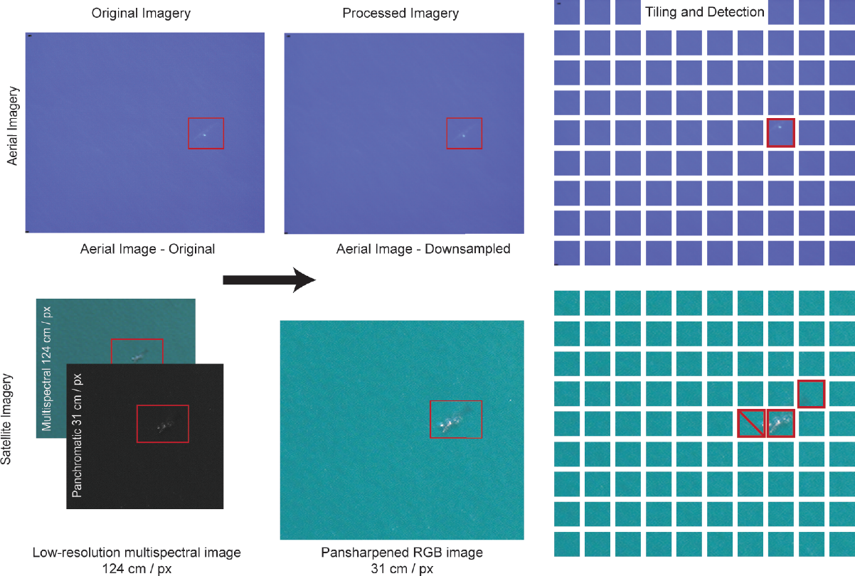
FIRST CNN APPROACH
Notes:
The 2019 paper by Borowicz et al showed the ability to detect whales using convolutional neural networks (CNN) using standard ResNet and DenseNet architecture on downsampled aerial images of minke whales and then tested on WorldView-3 imagery.
This is an exciting development because obviously machine learning algorithms are a precursor to an operational system

Slide 25
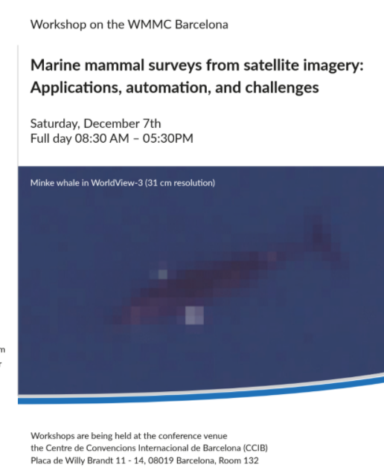
MOMENTUM
Notes:
So… all of this seminal research has been building up over the years into something that is beginning to look like we could take it out of academia and into production. At the last marine mammal conference in Barcelona there was a workshop on the detection of marine mammals from very high resolution satellite imagery and the room was a buzz with the possibilities that this holds for understanding worldwide marine mammal distribution and abundance some day.

Slide 26
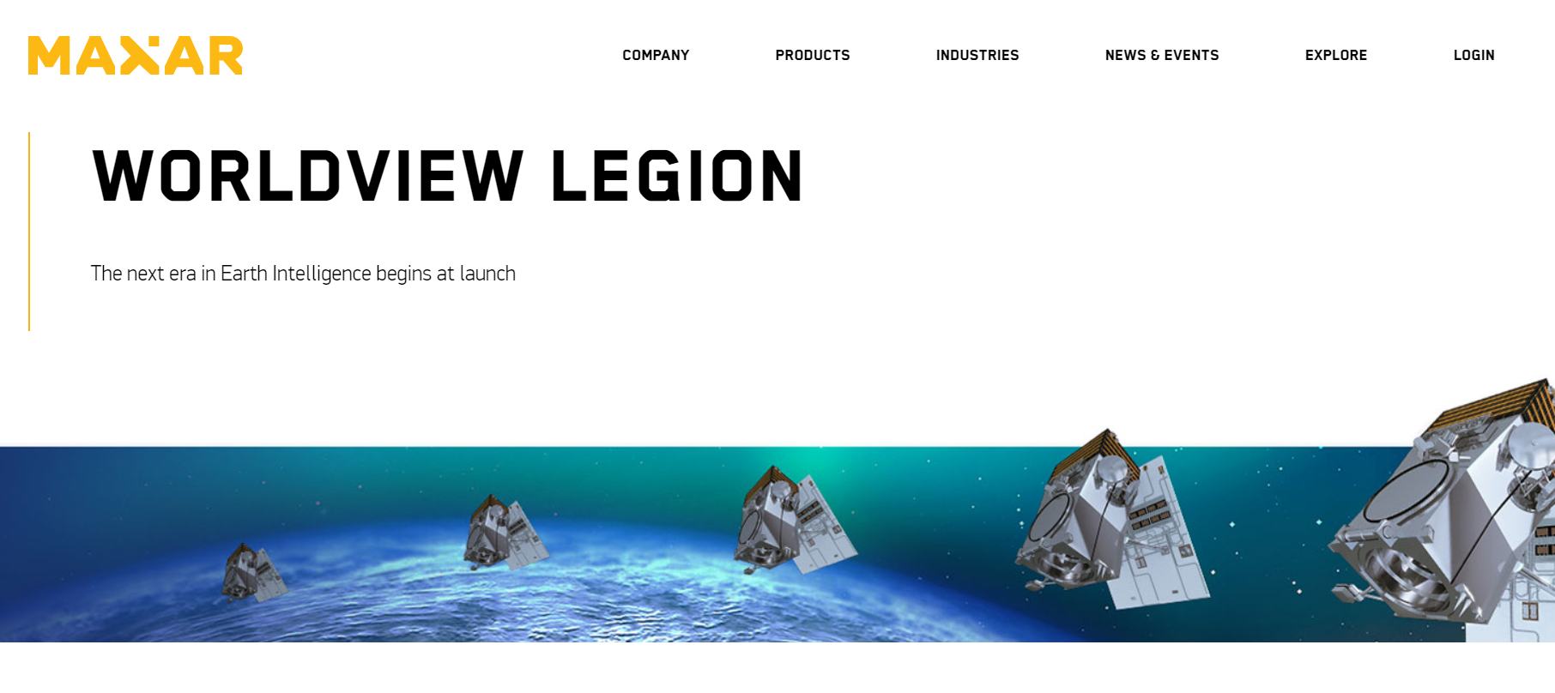
Notes:
There are also two big developments with the satellite company Maxar that really caught my attention – one is the WorldView legion program which launches next year and will have a revisit rate of up to 15 times per day and the capacity to collect data over open water at the same 30 cm resolution as WorldView-3
Truly impressive scale of image collection on the horizon

Slide 27
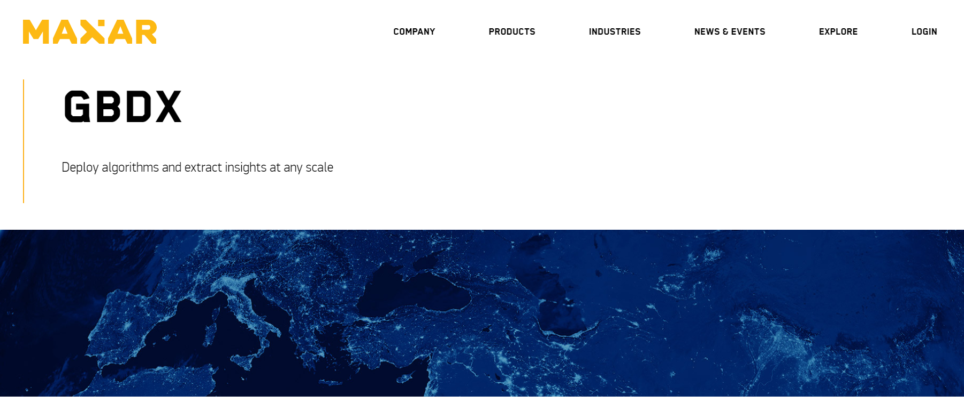
Notes:
The other infrastructure in place to support the operational usage of very high resolution satellite imagery is their Geospatial Big Data (GBDX) platform which is a cloud data storage interface where you can access WorldView-3 imagery stored in the cloud on Amazon Web Services (AWS) and process machine learning algorithms using Docker without ever having to download and visually inspect the imagery. Accessing data in the cloud would alleviate the time and burden of downloading large image files.

Slide 28
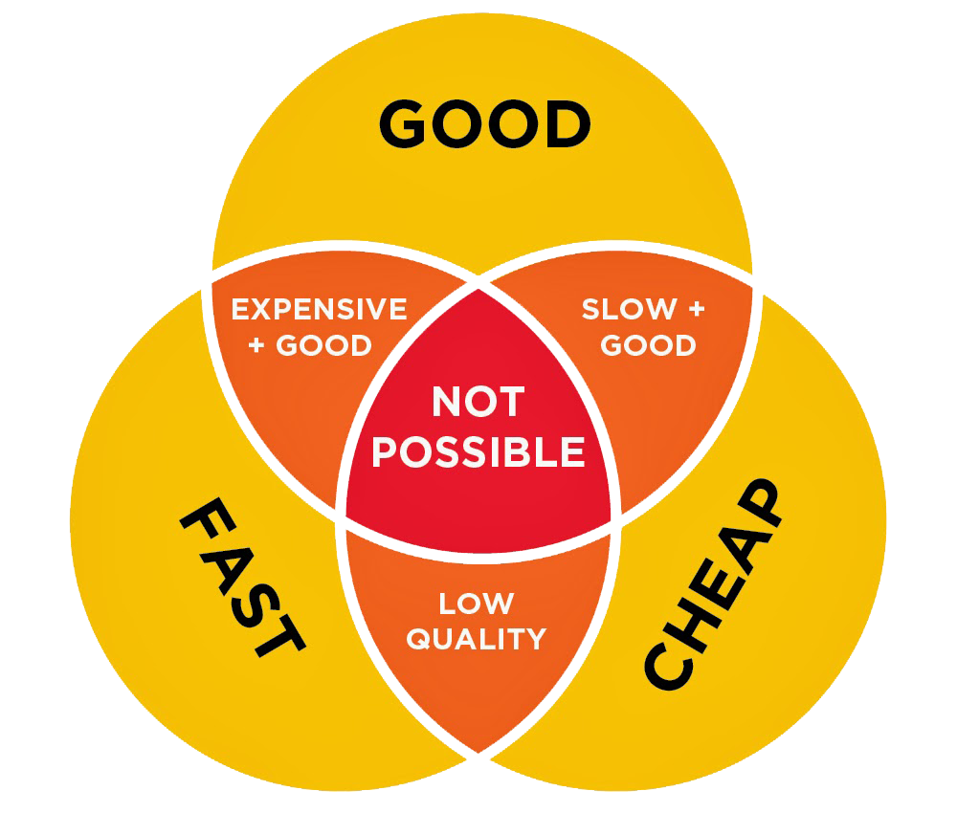
ACCESS TO IMAGERY
Notes:
Now… while these developments have been ramping up in recent years and becoming ever more tempting… access to the imagery at large scales has been a significant obstacle to progress.
We basically want worldwide coverage of the highest resolution commercially available satellite imagery at an affordable price – and no surprise – this isn’t possible yet

Slide 29
SATELLITE TASKING
Notes:
However, we have found a mechanism in collaboration with BOEM, USGS, and the National Geospatial-Intelligence Agency to acquire some imagery at a meaningful scale
Very high resolution satellite imagery from WorldView-2 and WorldView-3 satellites have been tasked over seasonal aggregations of North Atlantic right whales and the Cook Inlet beluga and work has begun on automating the workflow in collaboration with NRL with a variety of Python scripts to query Maxar’s imagery database, address sun glint phenomena and band offset , tile, and detect objects of interest via spectral statistics.

Slide 30
CHALLENGES AHEAD
Notes:
There are significant obstacles ahead and it remains to be seen whether or not satellite imagery can truly be used operationally for whale detection but we are poised to make some big progress on this initiative in 2021…

Slide 31
christin.khan@noaa.gov
Notes:
I’m happy to chat further about either of these project if you’d like to shoot me an email

