Slide 1
The NESDIS Cloud Framework
A Common, Data-Agnostic Cloud Computing Solution
28 February 2020
Satellite and Information Service
Kathryn Shontz
NOAA Office of System Architecture and Advance Planning

Slide 2
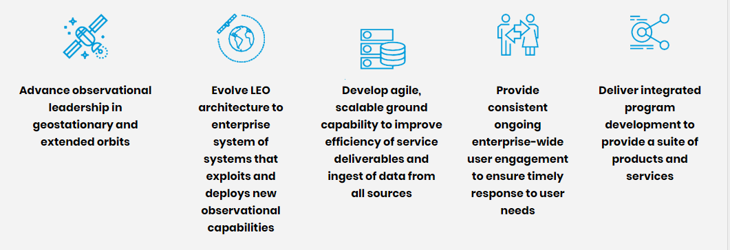
NESDIS Strategic Objectives
The next generation ground service capability will need to scale to accommodate ever increasing data source volumes and be flexible enough to bring in any type of data
Lean into innovation solutions by asking: Why not the commercial cloud?

Slide 3
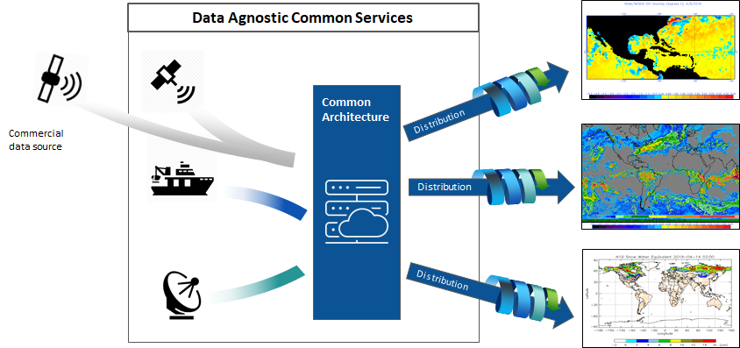
The NESDIS Cloud Vision
Centralize all NESDIS data holdings and bring the processing to the data

Slide 4
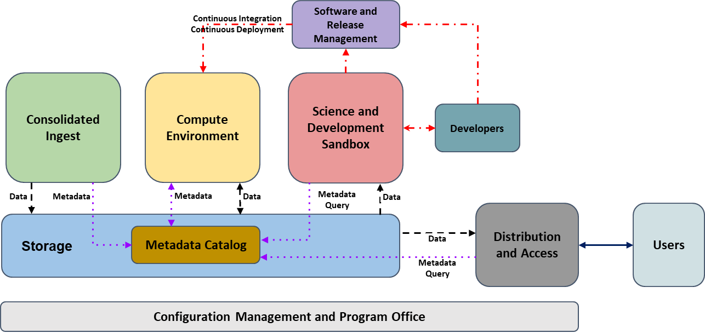
NESDIS Cloud Framework Architecture
Framework - Enables a set of services to work together to deliver mission value
Service - How to meet the core NESDIS IT functions
Tool - Cloud software application(s) used to implement the service
Data

Slide 5
Cloud Framework Use Case – Secure Data Ingest Workflow
This depicts how to leverage a common ingest service securely to bring in non-NOAA partner data
Software and Release Management
Continuous Integration
Continuous Deployment
Consolidated Ingest
Compute Environment
Science and Development Sandbox
Data
Developers
Data
Data
Results
Data
Distribution and Access
Users
Storage
Metadata Catalog
Data
Configuration Management and Program Office
Notes:
Operational Secure Ingest Service (OSIS) Implementation

Slide 6
Cloud Framework Use Case – Satellite Data Processing Workflow
This represents a nominal workflow of operational ingest, processing, and distribution of low-latency satellite data
Software and Release Management
Continuous Integration
Continuous Deployment
Consolidated Ingest
Compute Environment
Science and Development Sandbox
Data
Developers
Data
Metadata
Data
Results
Metadata Query
Data
Metadata
Distribution and Access
Users
Storage
Metadata Catalog
Data
Metadata Query
Configuration Management and Program Office

Slide 7
Cloud Framework Use Case – Science Development Workflow
Software and Release Management
This workflow shows how a NESDIS Developer creates a scientific algorithm
Continuous Integration
Continuous Deployment
Consolidated Ingest
Compute Environment
Science and Development Sandbox
Developers
Data
Metadata
Metadata
Data
Metadata Query
Data
Distribution and Access
Users
Storage
Metadata Catalog
Data
Metadata Query
Configuration Management and Program Office

Slide 8
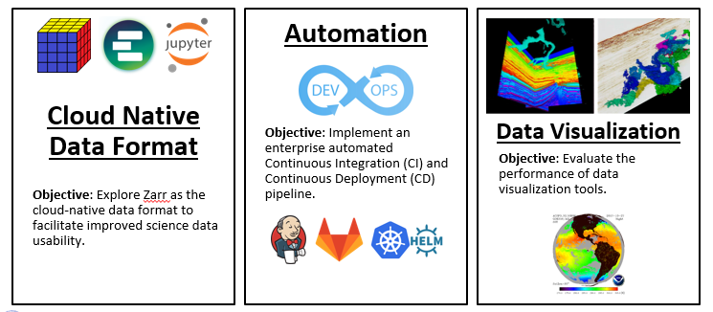
Future NESDIS Cloud Development

Slide 9
NESDIS Cloud Transformation Roadmap
We are here today!
NESDIS demonstrated that there is an advantage to bringing the processing to the data through a lean-in approach to innovation
Adoption of an enterprise cloud framework fundamentally alters the business and processes we use today, so we are tackling that head on with a dedicated change management team

Slide 10
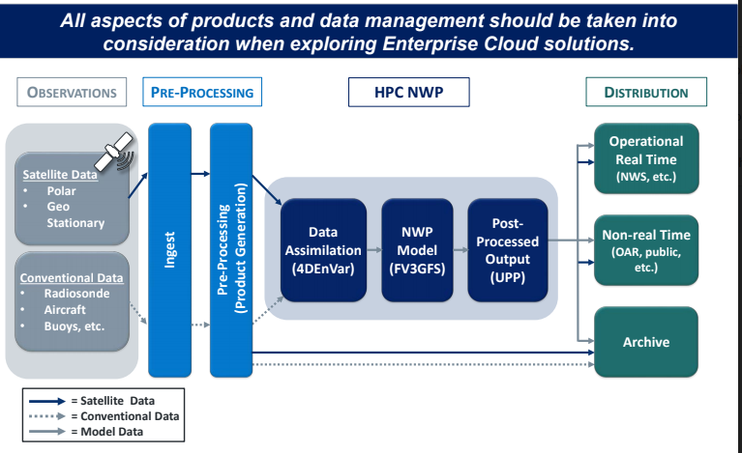
A NESDIS Solution for All of NOAA
NESDIS Cloud Framework
NESDIS developed the Cloud Framework from High Performance Computing (HPC) Industry best practices
Working with OAR to test viability of the NESDIS Cloud Framework for Numerical Weather Prediction

Slide 11
A Better Infrastructure Future
Secure – FISMA-compliant FedRAMP Moderate Cloud supports all Cloud Framework Services, tailoring controls to High in applicable areas
Fault-Tolerant – redundant and highly available services provide robust applications
Scalable – capacity to accommodate all current and future workloads
Data Agnostic – enable any data type and workflow within the framework
Decoupled – services are independent of each other and are interchangeable
Cloud Agnostic – workloads and services run in any cloud service provider
Resources On-Demand – rapid provisioning of cloud framework services based on business needs
Agile – support faster transition to operations with DevOps

