Slide 1
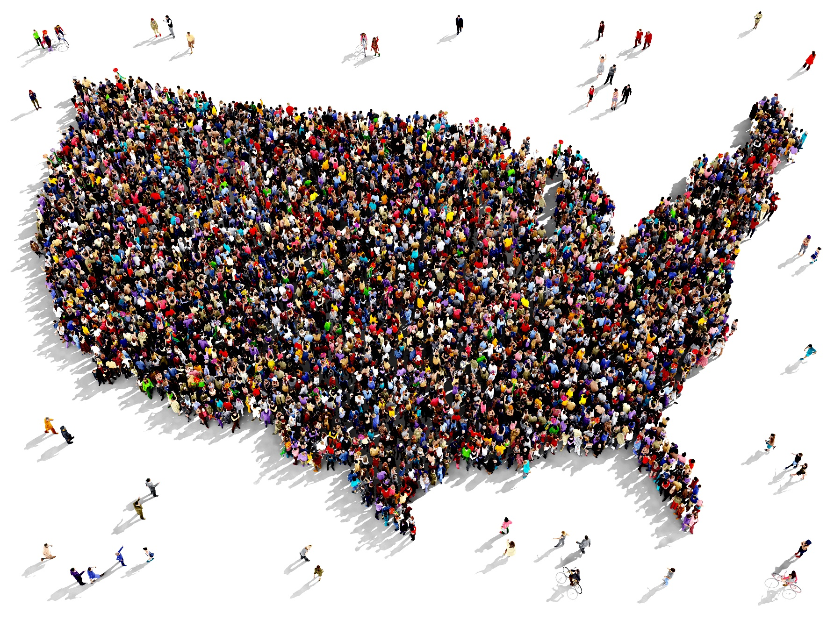
User-Driven Innovation
Renata Lana, NESDIS
renata.lana@noaa.gov
Notes:
https://www.shutterstock.com/image-illustration/large-group-people-seen-above-gathered-286867178

Slide 2
What is Innovation?

Slide 3
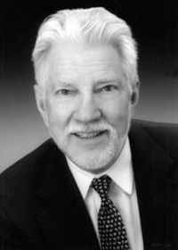
Innovation is . . . technological invention used and adopted
“The adoption of a new idea almost always entails the sale of a new product.”
(1962, Sociologist E.M. Rogers)
Notes:
Sociologists were the first to adopt the concept and terminology of “innovation.” They used it to describe the changes in material culture, patent law, and technology that they were seeing in the 1960s. “Innovation” was distinguished from “invention,” by the act of diffusion---that is, something that is used and adopted. In order to be “innovation,” in other words, something has to be adopted, otherwise, it’s “invention.”

Slide 4
Notes:
In 1969, Sumner Meyers, professor of Mathematics at the University of Michigan and Donald Marquis, a psychologist and Professor at the MIT Sloan School of Management, published a study, funded through the National Academy of Sciences, looking at factors underlying successful innovation selected firms.
What else is happening at MIT at this time? NASA is funding MIT to the tune of hundreds of millions of dollars starting in 1961 with the development of the Apollo program (NASA was planning the Apollo project in the early 1960s, one of the greatest technical challenges was the problem of navigating a spacecraft from Earth to the moon. From 1961 to 2000, MIT received a total of $794 million in NASA funding. Draper Laboratory received an additional $248 million from NASA since its divestment from MIT in 1973.
They are also funding MIT’s Sloan School of Management to identify how innovation worked and could be reproduced.
Meyers and Marquis built on the emerging definition that Rogers had articulated in 1961 that innovation was a technology that was used and diffused. They added the notion that need was a necessary driver of innovation.

Slide 5
What are user “needs,” and how do you identify those?

Slide 6
Needs ≠ Requests ≠ Requirements
“This year we will sell about one million quarter-inch drill bits. Our customers do not need quarter-inch drill bits. Our customers need quarter-inch holes.”
(Director of Marketing, Electric tool maker.)
Notes:
Why is this important? Because when you start with the need rather than a request (for a drill bit, say) than the possibilities for solving the problem from a technical perspect increase exponentially. You open up your thinking to many different ways of potentially solving the problem.

Slide 7
Asking Users What They Need Doesn’t Work
They don’t know what’s possible. Or . . .
They will only share with you what they think you can take care of. Or . . .
Users tend to think of “features”, not needs. Or . . .
They will tell you everything you can do for them, but what they ask for may be way down in their list of what is really important to them.
Notes:
They don’t think like you. They don’t know what language will be useful to you. You have to get them to explain what they are trying to accomplish without filtering themselves.
They don’t know what’s possible. As Henry Ford put it, “If I had asked the public what they wanted, they would have said a faster horse.“

Slide 8
What’s the real need?
Request: “We need a way to reduce wrinkles”
Need: We need a way for wrinkles not to be seen
Notes:
Uncovering a need requires a process of translation. Users don’t know how to communicate their needs to you in the language you use to develop. You can’t lead them.

Slide 9
How do we uncover needs?
How could users do their job faster, with less variability, or more efficiently?
How are our users modifying our existing products or creating workarounds?
How does the user react to the initial prototype?
What drivers will emerge when current drivers are satisfied?
How will the future affect users? (trends, tech forecasting, scenarios, etc.)
Observe our users, observe the environment, and ask the right questions.
Notes:
Harley Davidson; Mike Pavolonis---aviation talk---remember the issue of data overload.

Slide 10
Which of these strategies does NOAA use to identify user needs?
User interviews
Diary studies
Persona building
Task analysis
Journey mapping
Pluralistic walkthrough
Card sorting
Social media monitoring
Forum post analysis
Benchmark testing
Search-log analysis
Ethnographic research
Longitudinal studies
Online surveys
First-click testing
Heuristic evaluations
Scenario-based tabletop exercises
Observational field studies
Notes:
If you don’t recognize this terminology you are not alone. NOAA has invested in a rich and sophisticated approach to engineering and science. NOAA has not invested in an equally rich and sophisticated approach to user engagement.

Slide 11
So What Now? In 2020 we will:
1. Create a playbook for conducting coordinated and innovative user engagement across NESDIS
2. Create a centralized enterprise data repository for compiling and sharing user needs
3. Create a plan to increase staff skills in the area of user engagement

Slide 12
4. Create a protocol for assessing how useful, usable, and used our products and services are
5. Establish an enterprise-wide process to adjudicate between user needs.
6. Establish role clarity between product development and user engagement with checkpoints for user engagement across the product development lifecycle
7. Develop a plan for capturing and incorporating user needs into design decisions for next generation satellites (starting with GEO XO)

Slide 13
“The riskiest thing we can do is just maintain the status quo.“
Bob Iger, CEO of The Walt Disney Corporation, 2005 to 2020

